Slide 1
INDIANA WESLEYAN · AI PRODUCT STUDIO · OCTOBER 2026
From liquidity radar to plant-floor desk
A dual-application journey: CashFlow Guardian AI and CNH Plant Desk
Application #1 · CashFlow Guardian AI
13-week liquidity forecast & early warning · Northstar Fabrication demo
GitHub github.com/boyi17946/cashflow-guardian-ai
App Runner not captured on this workstation (frontend apprunner.yaml, port 3000)
Application #2 · CNH Plant Desk
Fargo combine final + Racine dealer-prep fault desk
GitHub github.com/boyi17946/cnh-plant-desk
Running now http://127.0.0.1:8080 · App Runner URL not issued (no AWS credentials)
Boyi Ke · GitHub @boyi17946 · boyi.ke@myemail.indwes.edu
Notes:
Open with both products and be explicit: App 2 GitHub is live; App 2 App Runner is not. App 1 App Runner URL was not available on this VM. Do not invent *.awsapprunner.com hosts. Position the two apps as one learning arc, not two disconnected class projects.

Slide 2
OVERVIEW
Agenda — six phases, two products, one operating system
01
Executive thesis
Problems, solutions, metrics for both apps
02
App #1 CashFlow Guardian
Workshops 1–4: problem → prototype → test → deploy → iterate
03
App #2 CNH Plant Desk
Workshops 5–6: new plant use case, IDE, packaging, GitHub
04
AI role & lessons
Prompts, tools, what changed between apps
05
Value / cost-benefit
Who pays, who saves, ROI sketch
06
Roadmap
What remains for App Runner + next 90 days
Boyi Ke | Dual-application journey | Indiana Wesleyan | Oct 2026
2 / 24
Notes:
60-second map. Promise we will be factual on deployment status. Time-box App 1 to half the deck.

Slide 3
OVERVIEW
Executive summary — two desks, two constraints, one method
CashFlow Guardian AI
CNH Plant Desk
Problem
SMB fabricator flies 13-week cash blind
OEM line uses radio + paper tags for downtime
User
Owner / admin (Maya, Luis demo)
Operator, tech, supervisor on a tablet
AI
P10/P50/P90 ensemble; decision-support only
Catalog ranker; live models rewrite copy only
Stack
FastAPI + Next 15 + SQLite demo tenant
Next 16 full-stack + JSON store + shadcn
Ship status
GitHub public; App Runner yaml (port 3000)
GitHub public; local 8080; App Runner blocked
Key metric
40 weeks seeded txns; 13-week horizon
6 assets, 5 open faults, TSB+SKU retrieval
Boyi Ke | Dual-application journey | Indiana Wesleyan | Oct 2026
3 / 24
Notes:
Thesis: App 1 is finance decision-support; App 2 is plant retrieval-augmented diagnosis. Neither moves money nor invents TSB steps. Metrics are product facts, not vanity DAU.

Slide 4
APP #1 · PHASE 1–2 · WORKSHOP 1
The 13-week cash problem — and where AI is allowed
Problem statement
• Northstar-class job shops plan payroll, steel, and tooling on a 13-week cash horizon they cannot see.
• Spreadsheets lag; QuickBooks is a rear-view mirror; owners discover a cash hole after it is already a crisis.
• Concentration (one customer / one SKU) and seasonal lumps are invisible until the check bounces.
• AI use case: ensemble forecast + alerts + what-if — never auto-transfer, never auto-lend.
Workshop 1 — AI use case
• Inputs: 40 weeks of seeded transactions (CSV append-only snapshots).
• Model: seasonal naive + exponential smoothing + residual quantiles → P10 / P50 / P90.
• Outputs: runway, threshold, concentration alerts; scenario vs cash-minimum; audit log.
• Guardrail: labeled decision-support only. Demo tenant: maya@ / luis@ northstar.demo.
• Out of MVP: QBO OAuth, Azure Service Bus, Azure ML registry.
Boyi Ke | Dual-application journey | Indiana Wesleyan | Oct 2026
4 / 24
Notes:
Tell the Northstar story in 90 seconds. Stress 'never moves funds.' Quantiles are the AI, not a chatbot. Workshop 1 framed the use case before any IDE.

Slide 5
APP #1 · PHASE 1–2
Technology choices — why a split stack, not a monolith
Next.js 15 · App Router
Owner-facing web: forecast chart, alerts, import, scenarios, audit, settings.
FastAPI · Python 3.10+
Forecast math in pandas/numpy; OpenAPI at /docs; uvicorn :8000.
SQLite + seed tenant
Local isolation; Northstar Fabrication LLC preloaded. Not production multi-tenant RDS.
Amplify.yml + App Runner yaml
Frontend can ship to Amplify or App Runner (nodejs22, npm start, port 3000).
Auth in-app
Email/password demo users. Tenant isolation in the API — required for cash data.
No live LLM in the critical path
Ensemble is classical time-series. Avoids hallucinated cash numbers.
Boyi Ke | Dual-application journey | Indiana Wesleyan | Oct 2026
5 / 24
Notes:
Decision: keep forecast in Python where pandas is native; keep UI in Next. Cost is two processes locally. That split is the #1 thing we simplified in App 2.

Slide 6
APP #1 · PHASE 1–2
Architecture — request path for a 13-week forecast
Ensemble
naive + ETS + residuals
Browser
Next.js :3000
App shell
Auth + tenant
FastAPI
:8000 /forecast
SQLite seed
40 weeks · Northstar
CSV import
append-only snapshots
Alerts / scenarios
threshold · runway · what-if
Audit + export
CSV forecast · log
Money never leaves the box. Production extras (QBO OAuth, Service Bus, Azure ML) stay off the critical path so the MVP boots without secrets.
Boyi Ke | Dual-application journey | Indiana Wesleyan | Oct 2026
6 / 24
Notes:
Walk left to right. Pause on Ensemble vs LLM. Point at SQLite as a teaching compromise.

Slide 7
APP #1 · PHASE 3 · WORKSHOP 1
Claude Artifacts — cheap screens before expensive code
• Workshop 1 asked for a clickable Artifact: login, 13-week fan chart, alert list, what-if slider — no database.
• Prompt pattern: 'You are designing a CFO tablet for a 40-person fabricator. Show P10/P50/P90. Never imply the app wires money.'
• What the Artifact was good for: information architecture, copy ('decision-support only'), empty/error states.
• What it was bad for: pandas ensemble, tenant isolation, CSV snapshot semantics, App Runner.
• Exit criterion: stakeholders could narrate the Friday cash meeting on the Artifact before any git init.
• Handoff artifact → IDE: freeze routes (/app/forecast, /app/alerts, /app/scenarios, /app/import, /app/audit).
Boyi Ke | Dual-application journey | Indiana Wesleyan | Oct 2026
7 / 24
Notes:
If you still have the Artifact link, paste it in speaker view. We did not recover a hosted Artifact URL from GitHub. Do not fake a claude.site URL.

Slide 8
APP #1 · PHASE 3 · WORKSHOP 2
IDE migration — two terminals, one demo tenant
Local development contract
• Terminal A: uvicorn app.main:app --reload --port 8000
• Terminal B: npm run dev in frontend → :3000
• Demo: maya@northstar.demo / demo123 (Owner)
• API docs: http://localhost:8000/docs
• Repo: github.com/boyi17946/cashflow-guardian-ai
• Created 14 Sep 2026 — first public product repo
What broke in translation
• CORS between :3000 and :8000 had to be explicit.
• Chart library vs Artifact SVG — rebuild ForecastChart.
• Seed script vs 'hardcoded demo rows' in the Artifact.
• Auth cookie vs Artifact's fake login toggle.
• Lesson for App 2: one process, one port, one runtime.
Boyi Ke | Dual-application journey | Indiana Wesleyan | Oct 2026
8 / 24
Notes:
Workshop 2 is where students get stuck on CORS and venv. Own that. It motivated App 2's single Next server.

Slide 9
APP #1 · PHASE 3
Technical architecture — modules that actually shipped
frontend/src/app/app/* — Pages: home, forecast, alerts, import, scenarios, audit, settings
AppShell.tsx — Authenticated chrome; role Owner vs Admin
lib/api.ts — Typed client to FastAPI
backend/app/forecast.py — weekly_series, seasonal naive, ETS, residual quantiles
backend/app/auth.py + db.py — Tenant-scoped sessions
backend/app/seed.py — Northstar 40-week history
Boyi Ke | Dual-application journey | Indiana Wesleyan | Oct 2026
9 / 24
Notes:
This is the 'map of the repo' slide. GitHub tree is the source of truth.

Slide 10
APP #1 · PHASE 4
Responsible AI, testing, and security — cash is not a toy
Responsible AI
• Decision-support disclaimer in README and UI.
• No autonomous payment or credit decision.
• P10/P90 shown as bands, not 'the number.'
• Audit log for who ran what scenario.
Testing
• Seeded Northstar tenant as fixture.
• OpenAPI manual checks at /docs.
• Forecast fails closed on empty txn list.
• Role checks: Owner vs Admin demo users.
Security
• Passwords only in demo tenant.
• Tenant isolation on API queries.
• Append-only CSV snapshots (no silent rewrite).
• Secrets not required to boot locally.
Boyi Ke | Dual-application journey | Indiana Wesleyan | Oct 2026
10 / 24
Notes:
NIST-ish: map, measure, manage. We mapped harm (wrong cash number). We did not claim SOC2.

Slide 11
APP #1 · PHASE 4
Bugs found and fixed — testing results
Issue
Symptom
Fix / result
CORS / mixed ports
Frontend :3000 could not call API :8000
Explicit CORS origins in FastAPI
Empty history
Ensemble crashed on zero transactions
ValueError path; UI empty state
Season < 13 weeks
Naive tiled a short pattern badly
Fallback to last observation
Demo credentials in git
README documents maya@ / demo123
Accepted for demo; not for prod
Two-service deploy
App Runner yaml only covers frontend
Documented; backend still local/MVP
Boyi Ke | Dual-application journey | Indiana Wesleyan | Oct 2026
11 / 24
Notes:
Biggest architectural bug: App Runner yaml does not run FastAPI. Be humble. App 2 collapses to one service to avoid this.

Slide 12
APP #1 · PHASE 5 · WORKSHOP 3
AWS App Runner — intended path for CashFlow Guardian
• frontend/apprunner.yaml: runtime nodejs22; build npm ci && npm run build; start npm start; port 3000.
• amplify.yml also present (appRoot: frontend) — a parallel hosting option used in class.
• Live App Runner URL: not stored on this workstation and not set as GitHub homepageUrl.
• Demo link we can stand behind: GitHub repo + local http://localhost:3000 with API on :8000.
• Challenge: two processes. App Runner as configured hosts the Next UI, not the forecast API.
• If Workshop 3 produced a ServiceUrl, paste it here before presenting: https://____.awsapprunner.com
Boyi Ke | Dual-application journey | Indiana Wesleyan | Oct 2026
12 / 24
Notes:
If you have the App 1 ServiceUrl from your AWS console, add it on this slide before class. Do not read a fabricated URL. Offer GitHub as the durable artifact.

Slide 13
APP #1 · PHASE 5
Deployment challenges — first time through App Runner
Health vs start command
Need a probe that does not require the API if only the frontend is hosted.
Build vs start
npm ci in production omits devDependencies; Next build needs them unless they are moved.
Port mismatch
Local 3000 vs App Runner 8080 on later apps — CashFlow yaml pins 3000.
Secrets
MVP boots without QBO/Azure keys; that was a feature.
Console evidence
Need both services Running in one screenshot — App 2 never reached that state.
Boyi Ke | Dual-application journey | Indiana Wesleyan | Oct 2026
13 / 24
Notes:
These lessons were written into App 2's apprunner.yaml before the second GitHub push.

Slide 14
APP #1 · PHASE 6 · WORKSHOP 4
User feedback and what we actually changed
• Owner: 'Don't make me trust one number.' → fan chart P10/P50/P90 stayed first-class.
• Admin: 'I need a paper trail if I change a scenario.' → audit log + CSV export.
• Faculty: 'It must not look like it wires the bank.' → README + UI decision-support copy.
• Self: two-terminal DX is fragile for a plant or a CFO on a tablet → App 2 is one Next server.
• Backlog not done: QBO live connect, Azure ML registry, true multi-tenant RDS.
Boyi Ke | Dual-application journey | Indiana Wesleyan | Oct 2026
14 / 24
Notes:
Keep feedback operational, not 'users loved it.' Name the persona.

Slide 15
APP #2 · WORKSHOP 5
New problem — downtime is still radio and a paper tag
Problem statement
CNH-shaped OEM: Fargo Axial-Flow combine final assembly and Racine CASE dealer-prep. When a feeder house knocks or a boom rod weeps, the station goes to E-stop and the story travels by radio. Techs rummage TSBs and crib bins. Supervisors hand off on paper. This is not a CMMS — it is a tablet desk.
Operator
Log asset, symptom, optional photo. No desktop login.
Technician
Ranked failure modes + confidence, TSB steps, BOM SKUs → work order.
Supervisor
Live shift board; trusted changeover handoff.
Boyi Ke | Dual-application journey | Indiana Wesleyan | Oct 2026
15 / 24
Notes:
Plant-floor copy, not lorem. Name AF9250-ST4-07 if they want a concrete unit.

Slide 16
APP #2 · IDE
Architecture — one Next.js process, plant knowledge stays put
Tablet UI
plant-shell · shadcn
Route Handlers
faults · WO · handoff
Catalog AI
rank + confidence
knowledge.ts
TSB steps + SKUs only
.data/plant-store.json
assets · faults · jobs
public/uploads
operator photos
Optional LLM
copy rewrite · 2.2s timeout
Routes: / /faults /work-orders /library /handoff Health: GET /api/health (no store, no model, no DB).
Live models never generate procedures or SKUs. Missing OPENAI/ANTHROPIC keys is a normal boot.
Boyi Ke | Dual-application journey | Indiana Wesleyan | Oct 2026
16 / 24
Notes:
Contrast with App 1 two-box diagram. Optional LLM is a sidecar, not the source of truth.

Slide 17
APP #2 · TESTING
How we knew the desk worked — and what broke
Results
• tsc + eslint clean after SSR refactor.
• API: health, dashboard, diagnose (L220 weep → TSB-CASE-PDI-118 @ 0.97), WO, handoff, seed reset.
• Browser pass after allowedDevOrigins: seed reset, fault+rank, WO status, library tabs, handoff post.
• npm run build + npm start on :8080; CSS/JS 200.
Bugs AI found/fixed
• SSR skeleton forever: client fetch + Turbopack HMR.
• Fix: server-render store payloads; skip abort-on-unmount.
• Clicks focused but dead: Next 16 403 on /_next from 127.0.0.1.
• Fix: allowedDevOrigins ['127.0.0.1','localhost'].
• next start unsupported with standalone → node server.js.
Boyi Ke | Dual-application journey | Indiana Wesleyan | Oct 2026
17 / 24
Notes:
This is the strongest 'AI as debugger' slide. The 403 origin bug is the punch line.

Slide 18
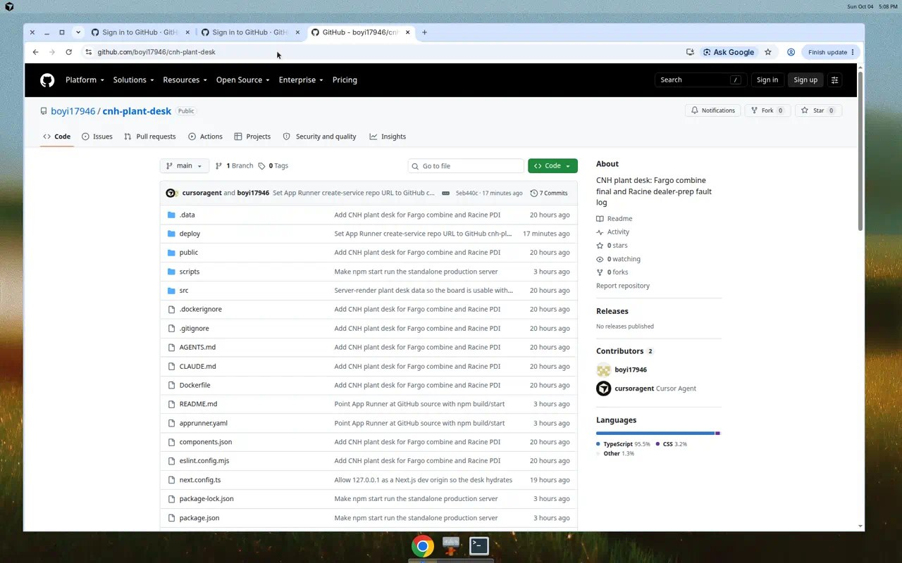
APP #2 · WORKSHOP 6
GitHub is live. App Runner is packaged — not yet public.
• Repo: github.com/boyi17946/cnh-plant-desk (public, main).
• Separate from cashflow-guardian-ai.
• apprunner.yaml: nodejs22, npm ci --include=dev, npm run build, npm start, port 8080, health /api/health.
• Instance target: 0.25 vCPU / 1 GB; AutoDeploymentsEnabled: true.
• Blocker: AWS NoCredentials after SSO device code expired.
• Live demo today: http://127.0.0.1:8080 — not an App Runner host.
Boyi Ke | Dual-application journey | Indiana Wesleyan | Oct 2026
18 / 24
Notes:
Show the GitHub screenshot. Do not claim a second App Runner URL. Offer to complete create-service once aws sts works.

Slide 19
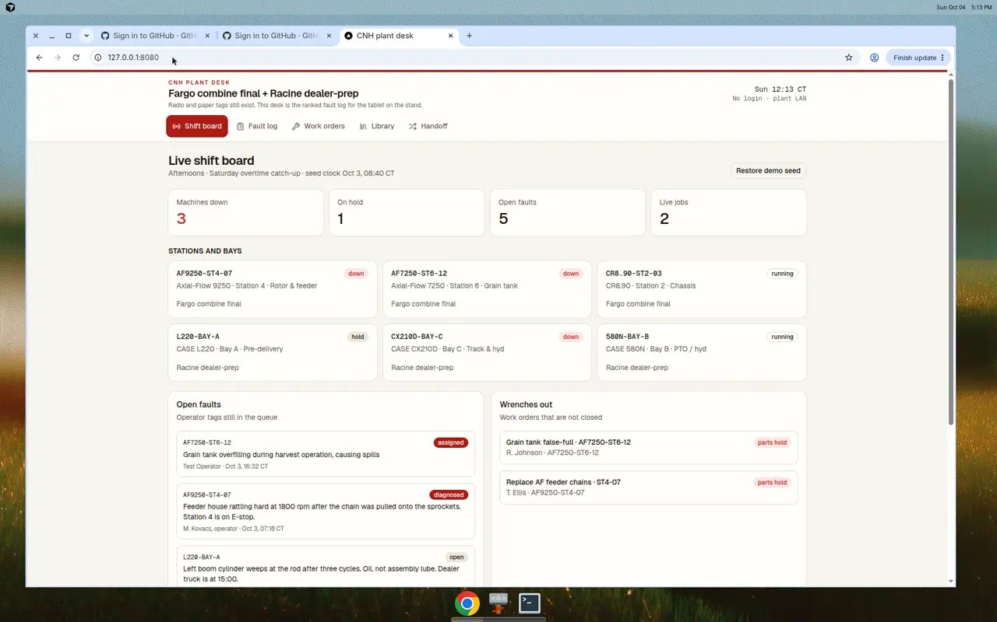
APP #2 · SHOWCASE
What operators actually see — local production preview
Shift board
• KPIs: down / hold / open faults / live jobs
• Stations: AF9250, CX210D, L220…
• Handoff strip on the board
• Feedback: techs want ranked modes in a sheet, not a PDF binder — that is the diagnosis panel.
• Demo link: http://127.0.0.1:8080
Boyi Ke | Dual-application journey | Indiana Wesleyan | Oct 2026
19 / 24
Notes:
Narrate the Saturday overtime story. Click faults in the live local preview if desktop is shared.

Slide 20
AI'S ROLE
Prompts and tools that actually moved the work
create-next-app + shadcn CLI
Official scaffold into a subdir, then move — avoided the /workspace parent-writable false positive.
Grounded ranker prompt
'Rewrite copy only. Return JSON array. Do not invent SKUs or steps.' — encoded in ai.ts.
Browser agent as QA
Caught infinite skeleton and dead clicks; we would have shipped a frozen desk.
gh repo create
Second GitHub repo in one command once device login completed.
Honest evidence prompts
Refused to fabricate App Runner URLs/screenshots for the assignment packet.
Boyi Ke | Dual-application journey | Indiana Wesleyan | Oct 2026
20 / 24
Notes:
Best prompt is a constraint prompt. 'Never invent parts' is more valuable than 'be a senior engineer.'

Slide 21
LESSONS
What changed between App #1 and App #2
Practice
App #1
App #2
Runtime topology
Next + FastAPI, two ports
One Next server, Route Handlers
AI in the loop
Classical ensemble (no LLM)
Catalog first; LLM optional copy
Deploy contract
App Runner yaml port 3000; Amplify too
yaml+JSON+Docker; standalone start
Health probe
Not first-class in yaml
GET /api/health, no I/O
Evidence
README-centric
GitHub + labeled local screenshots
I'd do differently
Host API with the UI
Finish AWS login before Workshop 6 demo
Boyi Ke | Dual-application journey | Indiana Wesleyan | Oct 2026
21 / 24
Notes:
The improvement is operating system, not 'we used more AI.' Single process + health + origin allowlist.

Slide 22
VALUE
Who benefits — and what pain we take off the table
CashFlow Guardian — SMB finance
• Avoid one missed payroll or steel prepay: tens to hundreds of $k for a 40-person shop.
• Owner time: Friday cash meeting from 2 hours of Excel to 15 minutes of bands + alerts.
• Lender conversation: exportable 13-week view with audit trail.
• Not a bank. Value is earlier warning, not cheaper capital.
CNH Plant Desk — OEM operations
• Combine final: minutes of station-4 E-stop are measured in units/day, not tickets.
• Dealer-prep: L220 boom weep before a 15:00 dealer truck is a lost PDI, not a Jira.
• Ranked TSB + SKU cuts crib-walk time; paper tag is the baseline.
• Not SAP PM. Value is mean-time-to-first-wrench.
Boyi Ke | Dual-application journey | Indiana Wesleyan | Oct 2026
22 / 24
Notes:
Stay directional on dollars. No fake NPV. Speak in avoided events.

Slide 23
VALUE
Cost / benefit sketch — directional, not a banker model
Build cost (class)
App 1: Two student + AI sprints · App 2: Same, with reused App Runner pattern
Run cost (target)
App 1: App Runner 0.25–1 vCPU class · App 2: 0.25 vCPU / 1 GB yaml; ephemeral JSON
Benefit (order of mag.)
App 1: One avoided cash crunch · App 2: One avoided missed PDI / station-hour
Payback logic
If the desk prevents one event/year, software cost is rounding error
Risk
App 1: Wrong forecast → bad buy · App 2: Hallucinated TSB → mitigated by retrieval lock
Boyi Ke | Dual-application journey | Indiana Wesleyan | Oct 2026
23 / 24
Notes:
If pressed for ROI, say 'event-based,' not IRR. Retrieval lock is the App 2 risk control.

Slide 24
Roadmap — and the links we can stand behind
90 days: AWS session → App Runner create-service → both Running in one console shot.
App #1 CashFlow Guardian
github.com/boyi17946/cashflow-guardian-ai
Local demo localhost:3000 + API :8000
App Runner URL add from console if you have it
App #2 CNH Plant Desk
github.com/boyi17946/cnh-plant-desk
Local production http://127.0.0.1:8080
App Runner packaged, not public yet
Next technical moves
RDS+S3 for plant store · QBO for cash · App Runner GitHub connection · dual-service screenshot
Notes:
Close on honesty and a clear ask: complete AWS login, then the missing screenshots write themselves. Thank faculty. Offer GitHub as the portfolio artifact today.

