Slide 1

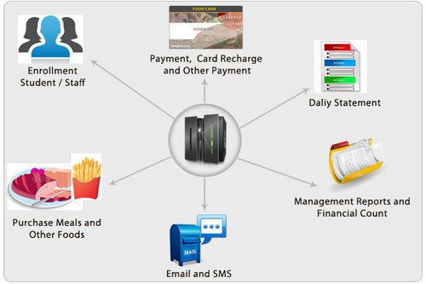
Hajee Mohammad Danesh Science & Technology University, Dinajpur-5200
A project on
AUTOMATED MESS MANAGEMENT SYSTEM
Presented by
Liton Roy (id: 1702120)
Motaleb Hossen (id: 1702129)
Boyiddhanath Roy (id: 1702137)
Dept. of Electronics & Communication Engineering, HSTU
29 November - 2022

Slide 2
Content
Project Overview
Scope of the Project
Current System & its Limitations
Proposed System
Use Case Diagram
Results & Social Impact
Future Scope
Conclusion
Automated Mess Management System
29 November - 2022
2

Slide 3
1. Project overview
Entire mess management and billing calculations are done manually till date. It is very time consuming & increases the chances of performing calculation mistakes. Hence there need a software which make the entire mess management into an automated system.
This system save the records of the mess’s members about their attendance and other things.
This system automatize the mess functionality and provide both the user and the manager a smart platform to interact with each other.
Automated Mess Management System
29 November - 2022
3

Slide 4

2. Scope of the Project
This project focused on the development of an automated mess management system.
Less time consuming
User will get notifications when any update will be occurred in system
It will generate meal rate automatically.
Errorless calculations and easy to perform monthly transactions
Print whole transactions of month which has created automatically
Automated Mess Management System
29 November- 2022
4

Slide 5
3. Current System & it’s Limitation
The existing system to facilitates mess functionalities for the students is the normal pen and paper method.
The current mess management system involves hand-written records that are stored into various papers.
This requires a lot of time & increases the chances of performing calculation mistakes.
It is very difficult to maintain or update all the records and retrieving a certain data is almost impossible
Automated Mess Management System
29 November - 2022
5

Slide 6
4. Proposed System
Consisting of most of the students, one of the most massive task of the mess management is to take care of the dining needs of its students.
To replace the existing system which is much more time consuming, we are developing a web-based application which is user-friendly and its functionality is very good compared to the existing one.
This project is used to provide user friendly daily attendance system that is easy to manage, maintain and query.
It also helps to retrieve the previous transactions details
Our proposal is to develop a paperless system that provide the management a way to facilitate smoother functioning of the mess management system.
Automated Mess Management System
29 November - 2022
6

Slide 7
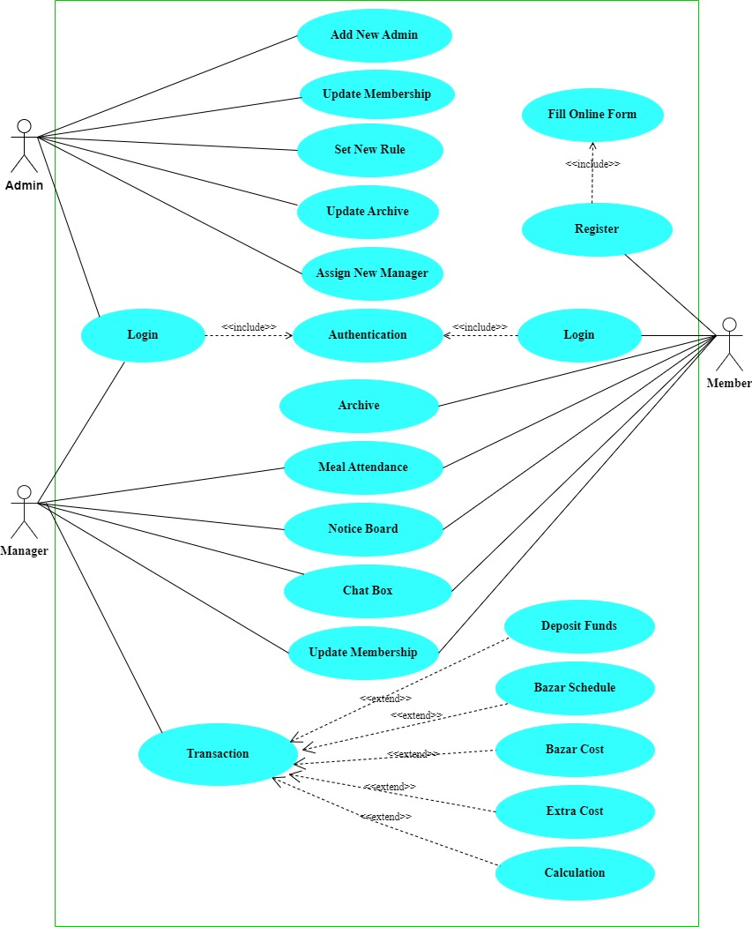
5. Use Case Diagram
29 November - 2022
7

Slide 8
6. Result & Social Impact
After completing the whole process, we get our expected output. The built system fully response according to the input test cases.
It will have a positive impact on the mess proceedings making it more organized.
It decreases the complexity of mess management
It carries out the automatic calculations of all the transactions by clicking a button.
Automated Mess Management System
29 November – 2022
8

Slide 9
7. Future Scope
By working with this project, We have learnt many things and meet with some great person. This project will give us some opportunity to work with this type of similar project.
Add a subsystem which send SMS to the user automatically to publish a notification.
Add online payment system.
Add online voting system
Include functionalities for other mess activities.
Automated Mess Management System
29 November - 2022
9

Slide 10
8. Conclusion
Automated Mess Management System is a user-friendly computer-based system for managing mess facilities. It has been designed to automate, manage and look after the overall processing of records of students residing in a large mess.
As from last few years numbers of colleges/universities are increasing and so a mess where living a large number of students require an automated system which can reduce human effort and make administration easy and in more technological way.
I would recommend that people should try using other methods to solve this problem so that there can be alternative ways in which the problem can be solved without much stress.
Automated Mess Management System
29 November - 2022
10

Slide 11


