Slide 1
Announcements
BST Baseball– April 23rd, Regions Field
UAB OnDemand(rc.uab.edu): an interactive tool for Cheaha
Online RStudio
Graphic User Interface for file management
Need access to Cheaha?
Feedbacks/suggestions for GPC anytime

Slide 2
A Visit to Could Fisher, Jeffreys and Neyman Have Agreed on Testing?
Boyi Guo
Department of Biostatistics
University of Alabama at Birmingham
April 19th 2019

Slide 3
My Goals
Review Conventional Testing Frameworks
Fisher’s Significance Testing
Neyman-Pearson Hypothesis Testing
Introduce Un-conventional Testing Frameworks
Objective Bayesian Testing
Conditional Frequentist Testing
Notes:
Here refered as Jeffreys approach to testing

Slide 4
Outline
History
Motivations & Objectives
Testing Frameworks and Criticisms
Conditional Frequentist Testing
Toy Example
Discussion

Slide 5
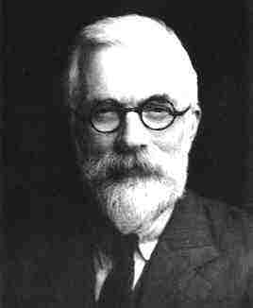
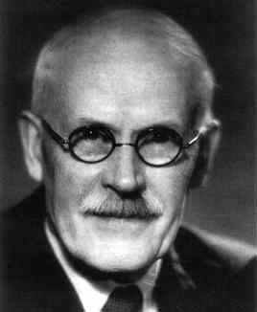
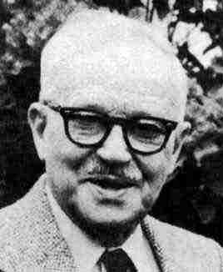
Who Dis?
Ronald Fisher | Harold Jeffreys | Jerzy Neyman
Feb 17, 1890 – Jul 29, 1962 | Apr 22,1891 – Mar 18, 1989 | Apr 16, 1894 – Aug 5, 1981
Fiducial | Bayesian | Frequentist

Slide 6
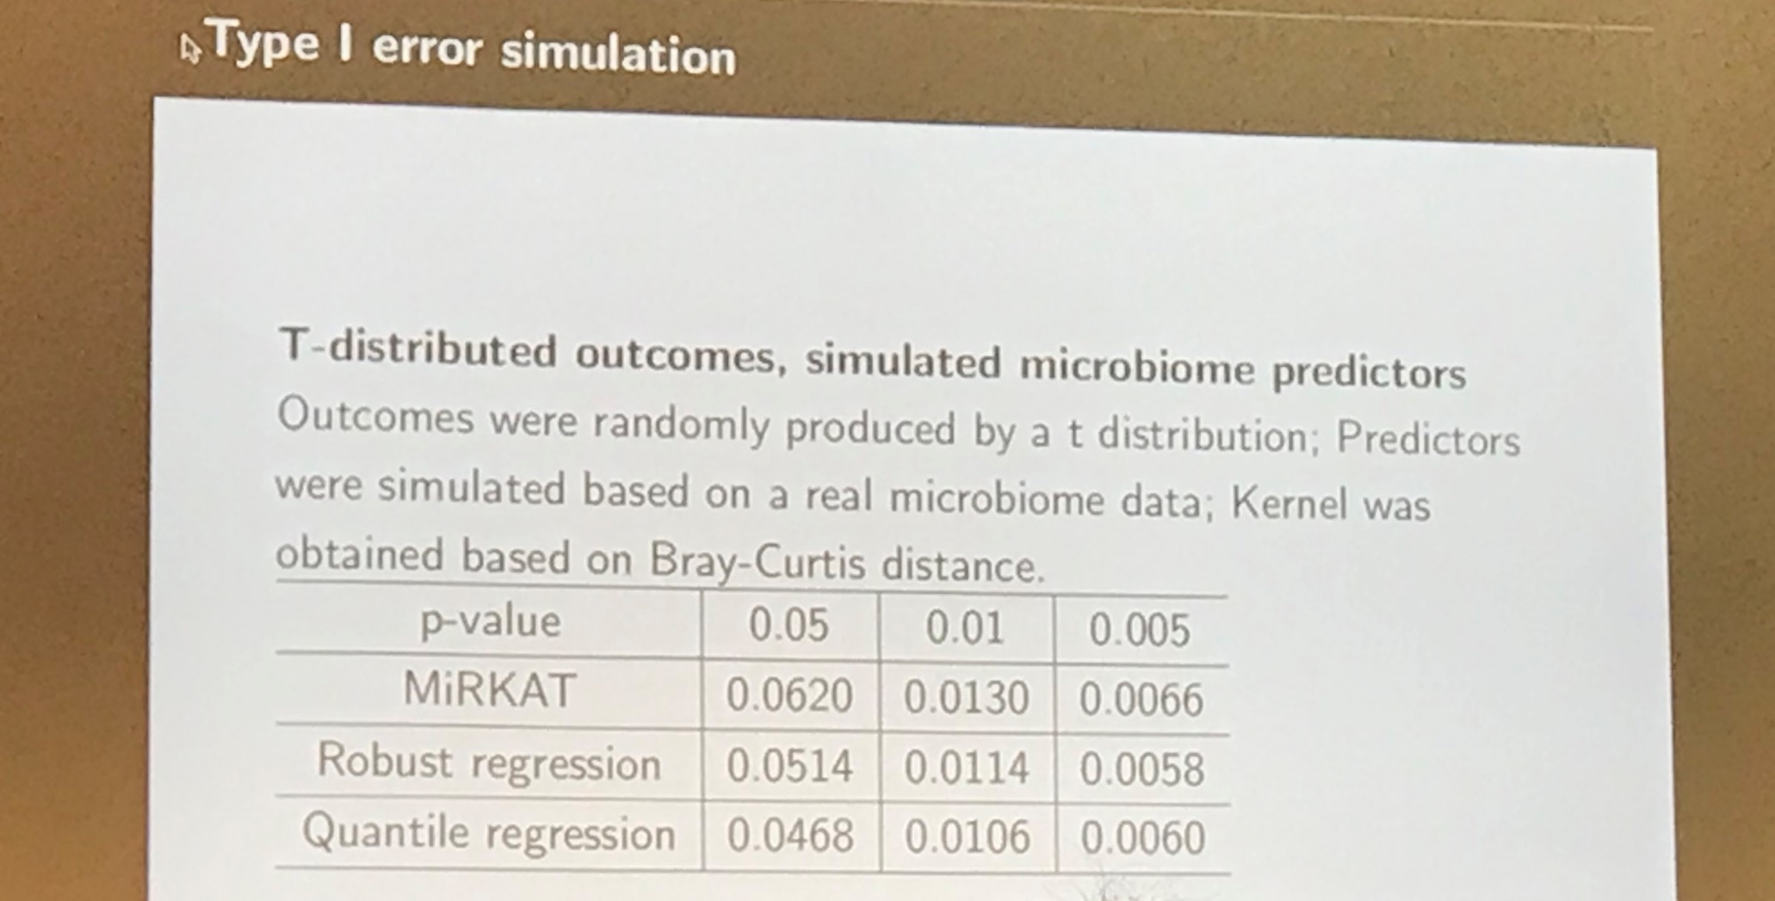
What Is The Problem?

Slide 7
Motivations
Confusion about different schools of testing
P-value VS error probabilities
Different statistics are reported under different paradigms, which leads to wrong interpretation
A belief of the author: “optimal general statistical methodology must be simultaneously interpretable from the differing viewpoints of the major statistical paradigms”

Slide 8
Objectives of the Paper
Propose a novel testing framework that are acceptable to any of the three schools
“Discover the common ground based on a particular synthesis of the views of Fisher, Neyman and Jeffreys.” --- Professor Wesley O. Johnson
Not to address the philosophical disagreement

Slide 9
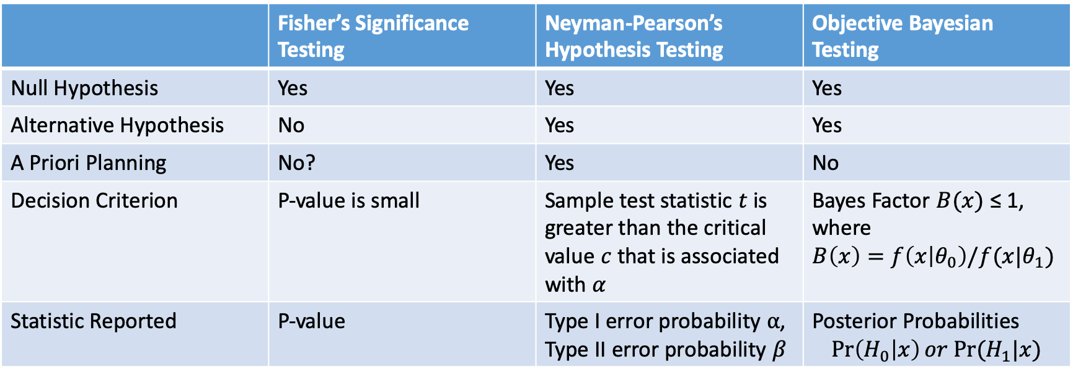
Review of Existing Testing Frameworks
 | Fisher’s Significance Testing | Neyman-Pearson’s Hypothesis Testing | Objective Bayesian Testing
Null Hypothesis | Yes | Yes | Yes
Alternative Hypothesis | No | Yes | Yes
A Priori Planning | No? | Yes | No
Decision Criterion | P-value is small | Sample test statistic $t$ is greater than the critical value $c$ that is associated with $α$ | Bayes Factor $B(x)$ ≤ 1, where $B\left(x\right)=f\left(x | θ_{0}\right)/f(x|θ_{1})$
Statistic Reported | P-value | Type I error probability $α$, Type II error probability $β$ | Posterior Probabilities $$\operatorname{Pr}\left(H_{0} | x\right)or Pr⁡(H_{1}|x)$$

Slide 10
Disagreement & Criticisms
Objective Bayesian Testing
It is Bayesian!
It is Bayesian!

Slide 11
Disagreement & Criticisms
Neyman–Pearson Testing
Error probabilities don’t reflect variation in evidence.
What?!
You need to do power calculation?
Notes:
What is the prior

Slide 12

Disagreement & Criticisms
Fisher’s Significance Test
It is not frequentist!
You make decision based on some tail?
Are you $P$<0.05?
Contemporary Scientists
Notes:
Miss Conception about the meaning of P-value. Hybrid

Slide 13
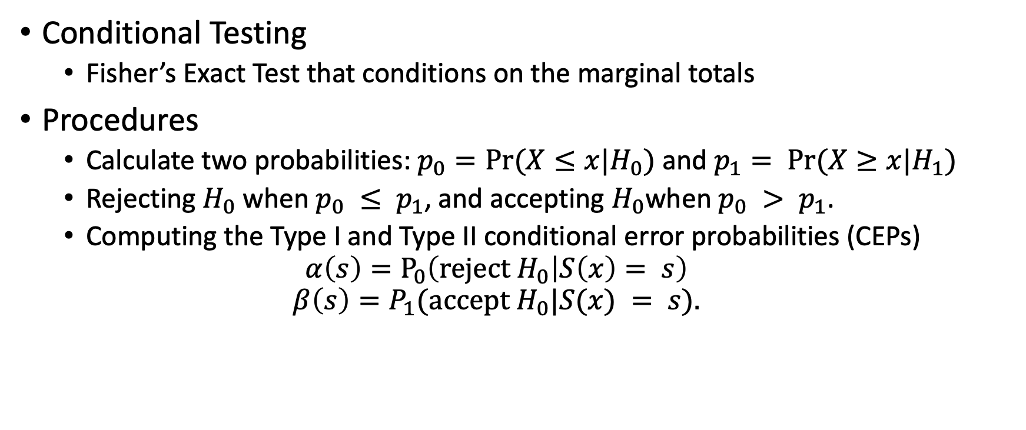
Unification of The Frameworks
Conditional Testing
Fisher’s Exact Test that conditions on the marginal totals
Procedures
Calculate two probabilities: $p_{0}=Pr⁡(X≤x|H_{0})$ and $p_{1}= Pr⁡(X≥x|H_{1})$
Rejecting $H_{0}$ when $p_{0} ≤ p_{1}$, and accepting $H_{0}$when $p_{0} > p_{1}$.
Computing the Type I and Type II conditional error probabilities (CEPs)
$$α\left(s\right)=P_{0}\left(reject H_{0} | S\left(x\right)= s\right)$$
$$β\left(s\right)=P_{1}(accept H_{0}|S(x) = s).$$

Slide 14
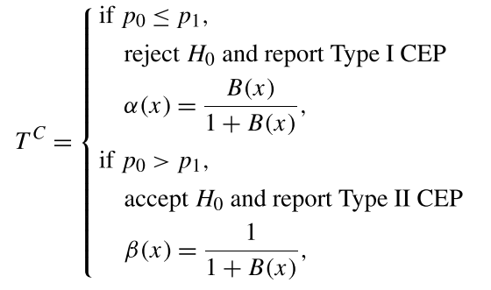
Conditional Frequentist Test

Slide 15
Potential Agreement
Conditional Frequentist
Testing
I am Frequentist!
I use posterior probability!
I use P-value!

Slide 16
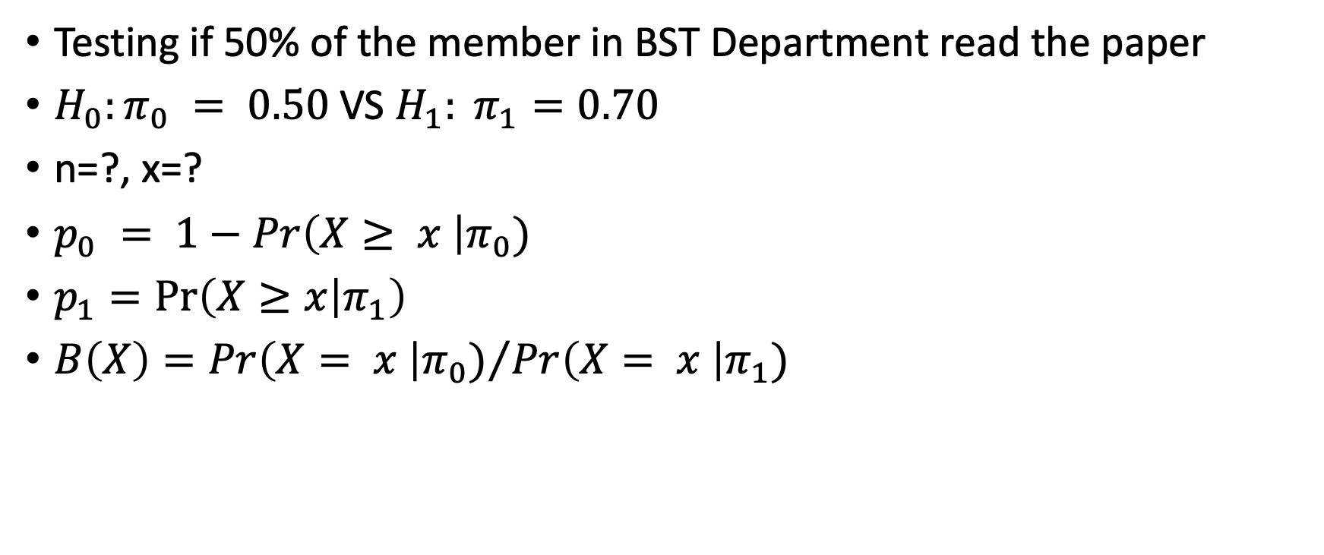
Toy Example
Testing if 50% of the member in BST Department read the paper
$H_{0}:π_{0} = 0.50$ VS $H_{1}: π_{1}=0.70$
n=?, x=?
$p_{0} = 1−Pr\left(X≥ x \right|π_{0})$
$p_{1}=\operatorname{Pr}\left(X≥x | π_{1}\right)$
$B\left(X\right)={Pr\left(X= x \right|π_{0})}/{Pr\left(X= x \right|π_{1})}$

Slide 17

Discussion
How do you feel about the unification?
Do we really need the unification?
What does it mean for practice in public health?
How should we teach testing?
The author’s belief: “optimal general statistical methodology must be simultaneously interpretable from the differing viewpoints of the major statistical paradigms”

Slide 18
Testing Frameworks
“Neyman was extremely clear that one should use pre-experimentally chosen error probabilities if frequentist validity is desired, while Fisher was very careful in distinguishing p-values from error probabilities.”
---Professor Berger

