Slide 1






SAANS during treatment
Using machine learning to investigate sympathetic activation of the autonomic nervous system (SAANS) during the treatment of mild traumatic brain injury, chronic pain, and post-traumatic stress disorder.

Slide 2
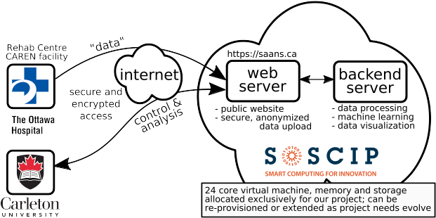
Cloud Infrastructure

Slide 3
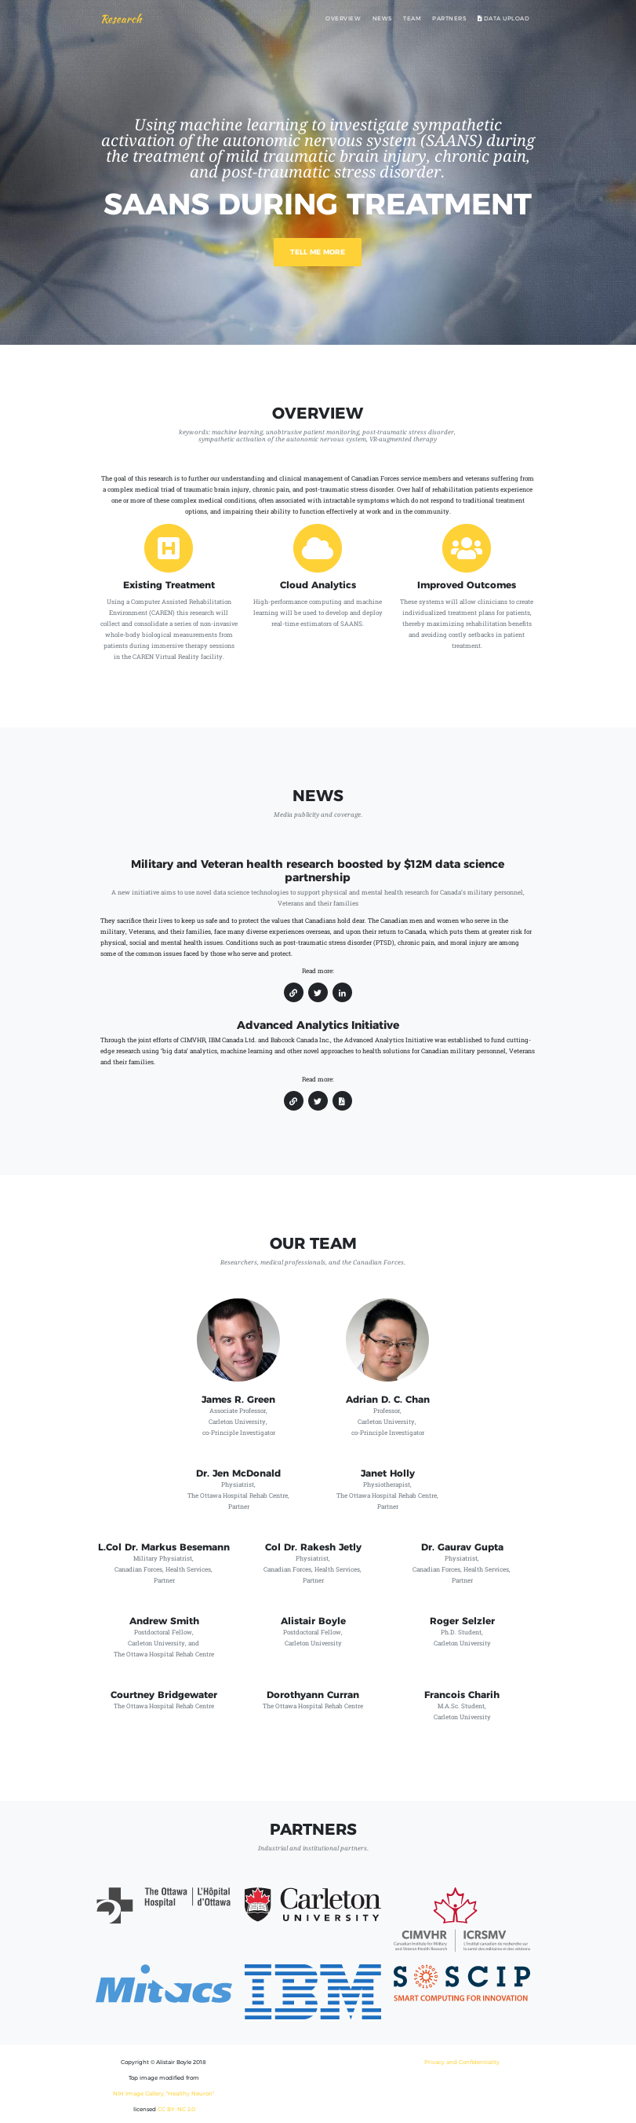
Website: https://saans.ca

Slide 4






1. Data Collection
(Underway)
clinician observations
observed SAANS
“gold standard”
“Machine Learning”
“Deep Neural Network”
patient data
saans.ca
estimated
SAANS
TensorFlow
“the engineers”

Slide 5
2. Training, Validation
(Anticipated)
“Machine Learning”
“Deep Neural Network”
patient
data
estimated
SAANS
=?
TensorFlow
observed SAANS
“gold standard”
“the engineers”

Slide 6
3. Prediction
(Project Goal)
“Machine Learning”
“Deep Neural Network”
clinician
assist
data
estimated
SAANS
TensorFlow
observed SAANS
“gold standard”
patient
- improved treatment outcomes
- “emergency stop”
- online second opinion
- data-based clinician training

Slide 7
Image rights
(not for the presentation)
CC BY-SA 4.0: videoplasty.com
  https://commons.wikimedia.org/wiki/File:Man_Walking_Cartoon_Vector.svg
  https://commons.wikimedia.org/wiki/File:Doctor_Worried_Cartoon.svg
Public domain
  https://svgsilh.com/image/306318.html
Fair Use
  Various logos and trademarks
  EDUCBA TensorFlow tutorial https://cdn.educba.com/academy/wp-content/uploads/2019/02/Deep-Learning.png

