Slide 1

injectso
Modifying and Spying on running processes under Linux and Solaris
Shaun Clowes – shaun@securereality.com.au

Slide 2

Overview – Part 1
A study of InjLib
Introduction to injectso
All about ELF
Program/process modification techniques under Unix

Slide 3
Overview – Part 2
injectso vs InjLib
How injectso works
Intercepting dynamic function calls
Defending against injectso
Future

Slide 4
Introduction to InjLib
Windows System Journal 1994
Jeffrey Richter
Inject a DLL into another process
Injection has no effect on process
DLL can be passed information about the target process

Slide 5

InjLib
InjLib process is trivial
  Entire process complete < 50 lines of code
  Still impressive
Technique very widely used:
  Pwdump (2 and 3)
  GetAdmin
  Fport
  Virtually every ‘Spy’ application
Notes:
Ftport is Foundstone’s app that shows what applications have what ports open

Slide 6
InjLib – Basic Process
Find address of system function used to open libraries
Attach to process
Allocate memory in process
Copy DLL loading function into process
Create thread in process at injected function
Function loads DLL

Slide 7
InjLib – Step 1
Copied function needs to know how to get a DLL loaded
DLLs dynamically loaded with “LoadLibraryA”
Copied function needs to know address of this LoadLibraryA
Copied function cannot rely on normal IAT processing since it is in different process

Slide 8
InjLib – Step 1
‘LoadLibraryA’ is in kernel32.dll
All Windows applications have kernel32.dll mapped
Safe to assume DLL mapped at same address in all processes on a machine

Slide 9
InjLib – Step 1
Load reference to kernel32.dll
  hDll = LoadLibrary ("Kernel32");
Get address of LoadLibraryA
  pLoadLib = GetProcAddress(hDll, “LoadLibraryA”);

Slide 10
InjLib – Step 2
Attach to process (as a debugger)
In code:
  hProc = OpenProcess (PROCESS_ALL_ACCESS, FALSE, dwPid)
Need SE_DEBUG privilege to open processes owned by other users

Slide 11
InjLib – Step 3
Allocate memory in remote process to store
  Copied function
  Arguments to copied function
In code:
  pMem = VirtualAllocEx (hProc, NULL, dwBytesToAlloc, MEM_COMMIT, PAGE_EXECUTE_READWRITE);

Slide 12
InjLib – Step 4
Copy function and arguments into process.
In code:
  WriteProcessMemory (hProc, pAddr, pToCopy, dwAmtToCopy, &dwWritten);
To copy function just copy everything from function address to immediately following function address

Slide 13
InjLib – Step 5
Create a new thread in remote process,
Start it at address of injected function
Pass address of structure in process containing information about location of ‘LoadLibraryA’ and DLL name
In Code:
  hThread = CreateRemoteThread(hProc, NULL, 0, pInjectedFunction, pArgs, 0, NULL);

Slide 14
InjLib – Step 6
Injected function now runs
Call ‘LoadLibraryA’ using function pointer and DLL name arguments

Slide 15
InjLib – Result
InjLib process for injecting a DLL is
  Easy
  Short
  Safe
Notes:
TODO: Check if windows PAX thing will let this happen (the allocated page needs to be marked executable)

Slide 16
InjLib – What next?
Up to application
  Tinker with internal memory structures
  Change window appearance/layout
  Call API routines from inside process
  Use IPC channels in process
  Patch program functions
  Endless possibilities

Slide 17
Introduction to injectso
injectso is like InjLib for Linux and Solaris
Inject shared libraries into remote processes
Provides some support code to help in dynamic function patching/interception
Much more detail later

Slide 18

Modifying Programs/Processes
The ability to modify behavior of programs/processes has obvious security ramifications
  Patching vulnerabilities
    Run time
    Statically
  Subverting applications
    Backdoors
    Viruses

Slide 19
Modifying Programs/Processes under Unix
A few techniques:
  Binary Patching
  Dynamic Loader Environment
  In Core Patching

Slide 20
Breakdown of ELF
Need understanding of internal structure of executables
ELF = Executable and Linkable Format
Originally by Unix System Labs (USL)
Adopted by Tool Interface Standards committee (TIS)
Used in virtually every recent Unix

Slide 21
Breakdown of ELF
Three main types of ELF files
  Relocatable file – object file ready to be linked with others
  Executable
  Shared Object (Library)
Only last two relevant
Concentrate on Executables

Slide 22
ELF ‘Views’
ELF describes two separate ‘views’ of an executable, a linking view and a loading view
Linking view is used at static link time to combine relocatable files
Loading view is used at run time to load and execute program

Slide 23
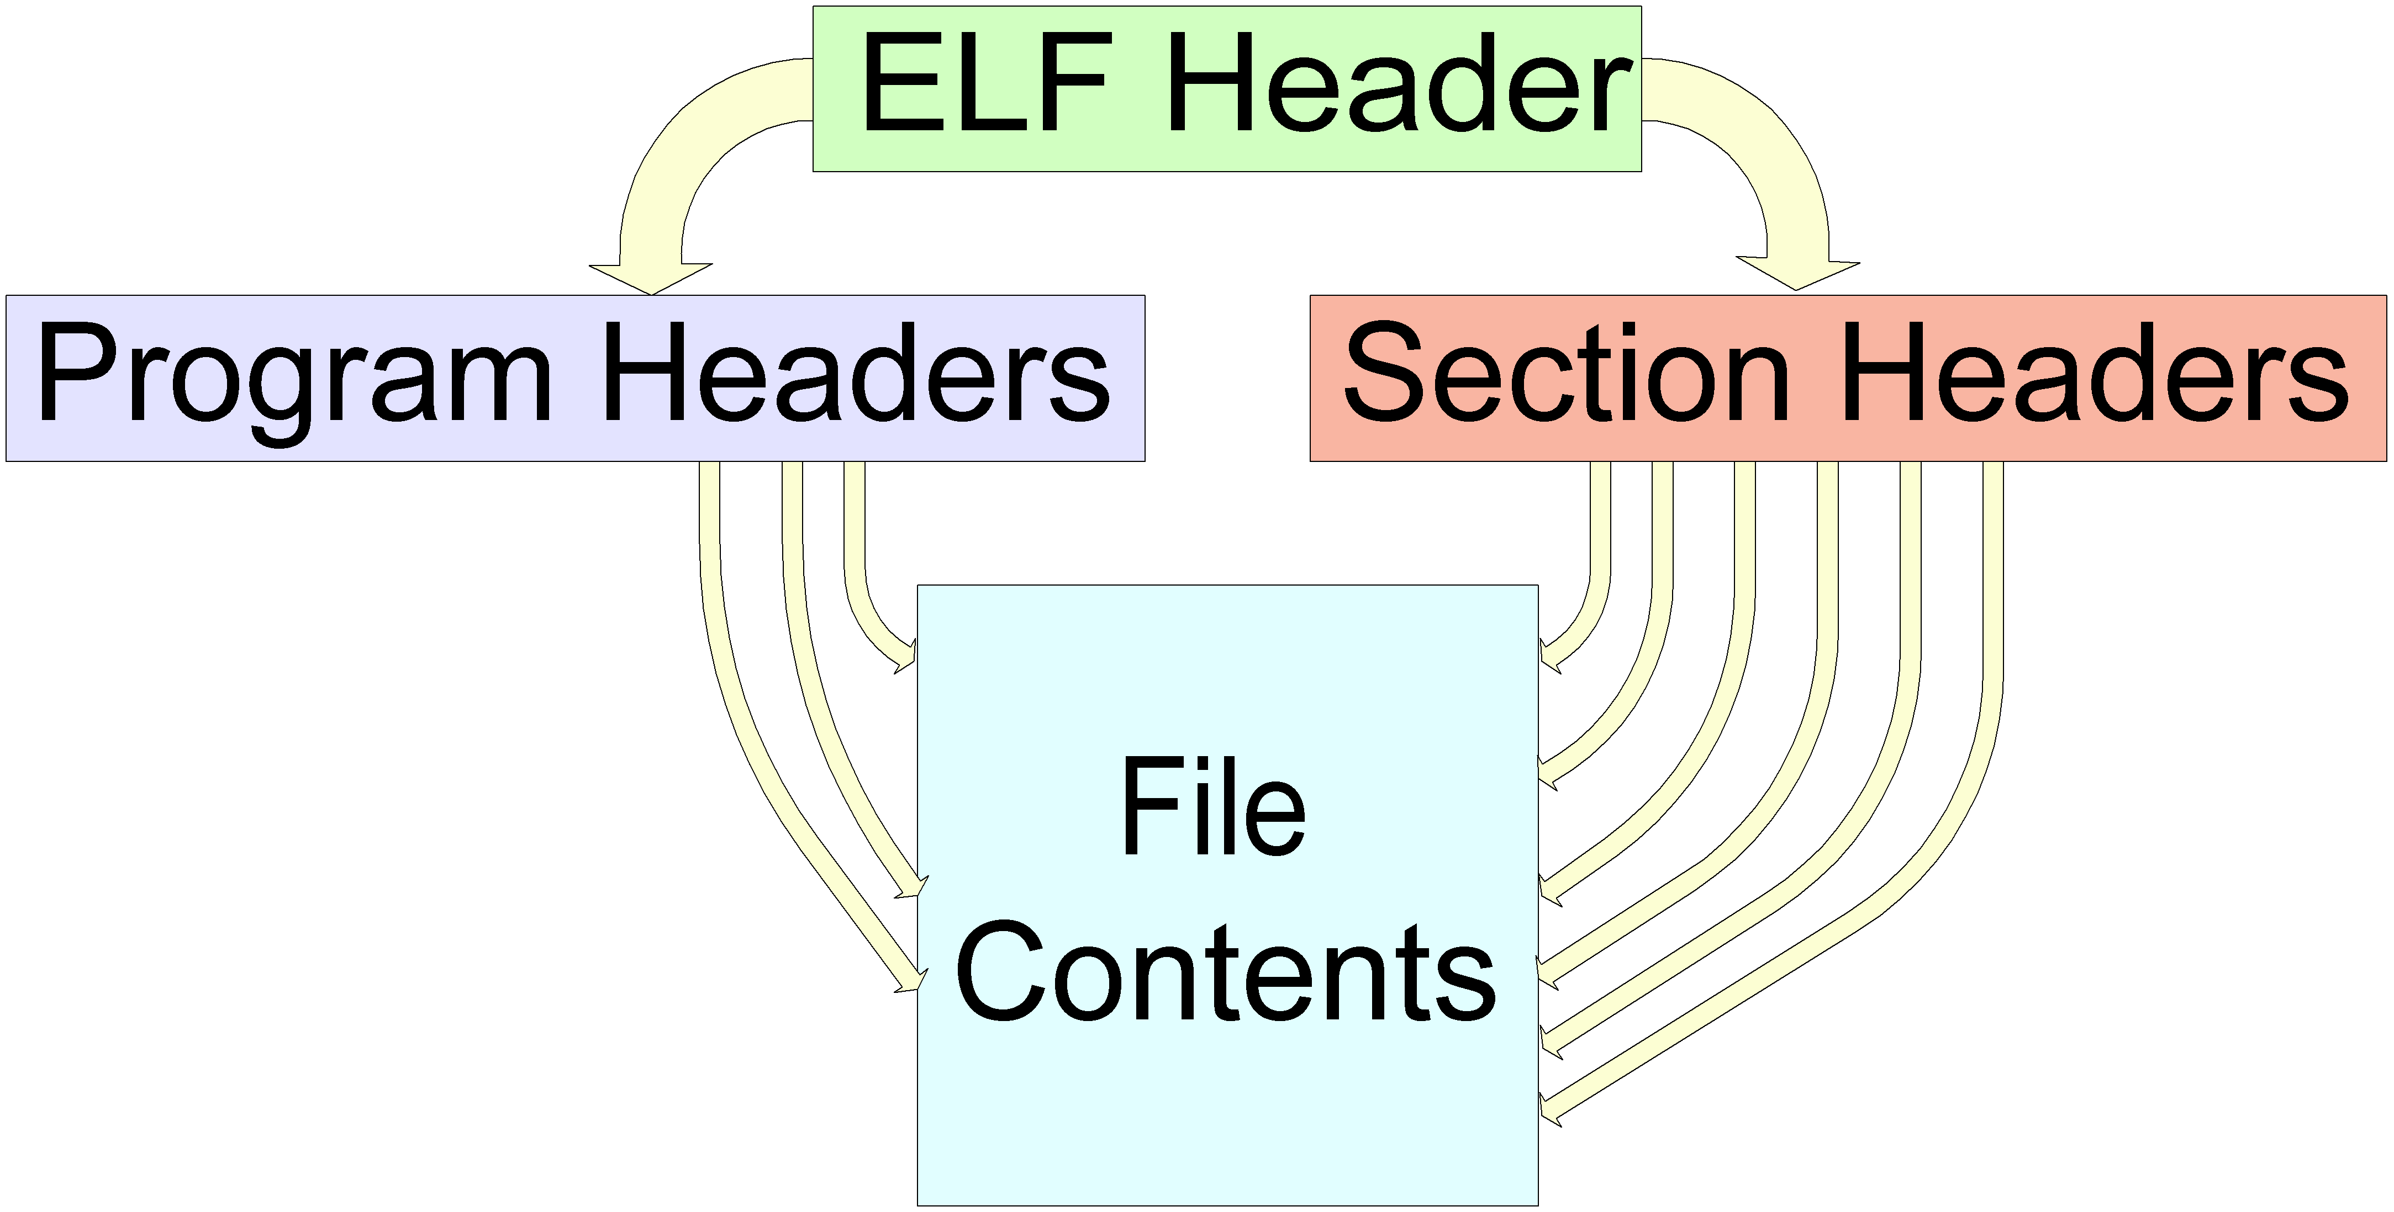
ELF ‘Views’ – Split

Slide 24
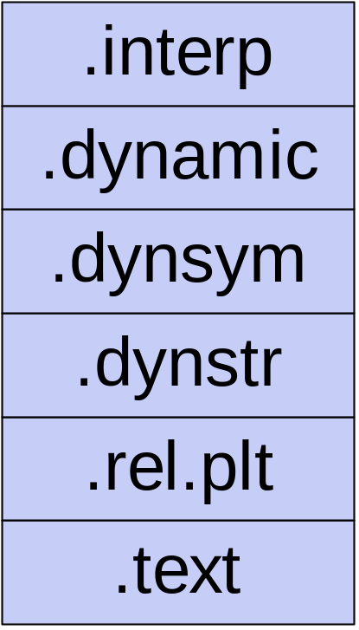
ELF Linking View
Divides executable into many meaningful ‘Sections’
Sections have:
  A name and type
  Requested memory location at run time
  Permissions (writeable/executable)

Slide 25
ELF Linking View – Important Sections
.interp | Requested Dynamic linker
.dynamic | Dynamic linking information
.symtab, .dynsym | Symbols (static/dynamic)
.strtab, .dynstr | String tables
.plt | Procedure linkage table
.rel.<x> | Relocations for section x
.text | Code

Slide 26
ELF Linking View
Not all sections loaded at run time
  Information used for linking
  Debugging information
Difference between link time and run time

Slide 27
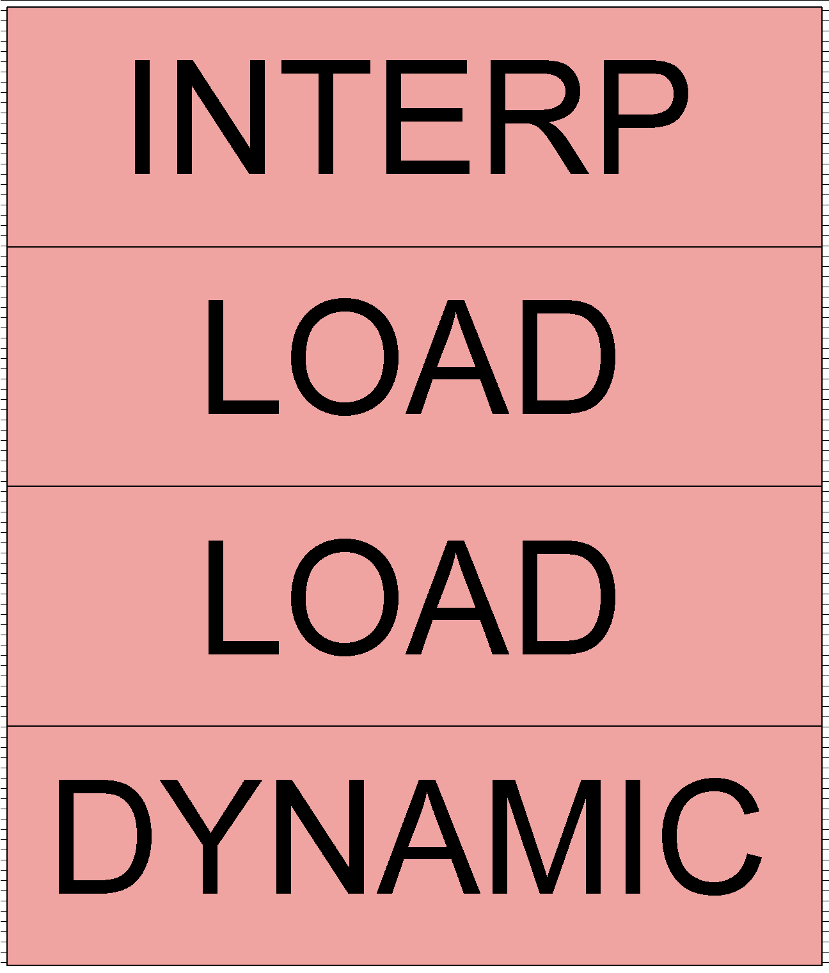

ELF Loading View
Much simpler view, divides executable into ‘Segments’
Only includes data to be loaded into memory at runtime
Segments have:
  A simple type
  Requested memory location at run time
  Permissions (readable/writeable/executable)

Slide 28
ELF Loading View – Segment Types
INTERP | Dynamic linker for this executable
DYNAMIC | Dynamic linking information
LOAD | Segment loaded into memory

Slide 29
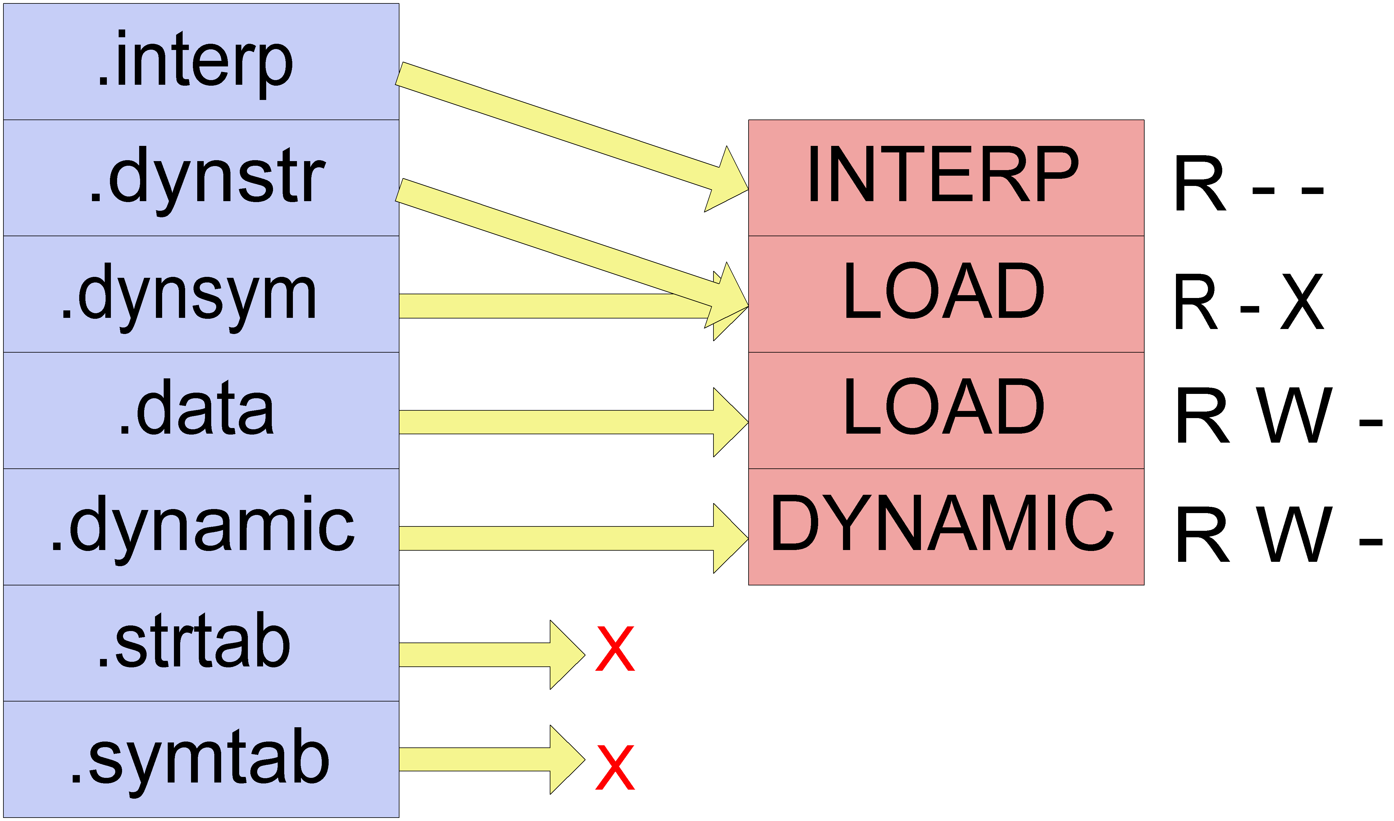
ELF ‘Views’ - Linking to Loading

Slide 30
ELF Loading View
Semantics of section table (Linking View) are irrelevant in Loading View
Section information can be removed from executable

Slide 31
Loading and Executing an ELF Executable
File opened
File descriptor passed to dynamic linker specified in INTERP segment
Linker reads file segments and loads them at requested addresses
Linker finds and processes the dynamic segment

Slide 32
The Dynamic Section/Segment
A table with records containing data critical to dynamic loading/linking
Allows dynamic linker to quickly find out information about the executable
  No need for section table etc
Each record consists of:
  A type (tag)
  Value (or pointer)

Slide 33
Dynamic Segment Record Tags
DT_NEEDED | Name of a required shared library
DT_JMPREL | Address of relocation entries associated with the PLT
DT_DEBUG | Pointer to debugging information from dynamic linker

Slide 34
Loading and Executing an ELF Executable
Map in shared libraries corresponding to DT_NEEDED entries
Add libraries to link map stored in debug struct referenced by DT_DEBUG entry
Perform Global Offset Table (GOT) relocations
Perform Procedure Linkage Table (PLT) relocations (usually lazily)

Slide 35
The Procedure Linkage Table
Stored in the .plt section
Allows executables to call functions that aren’t present at compile time
  Shared library functions
  printf() etc.
Set of function stubs

Slide 36
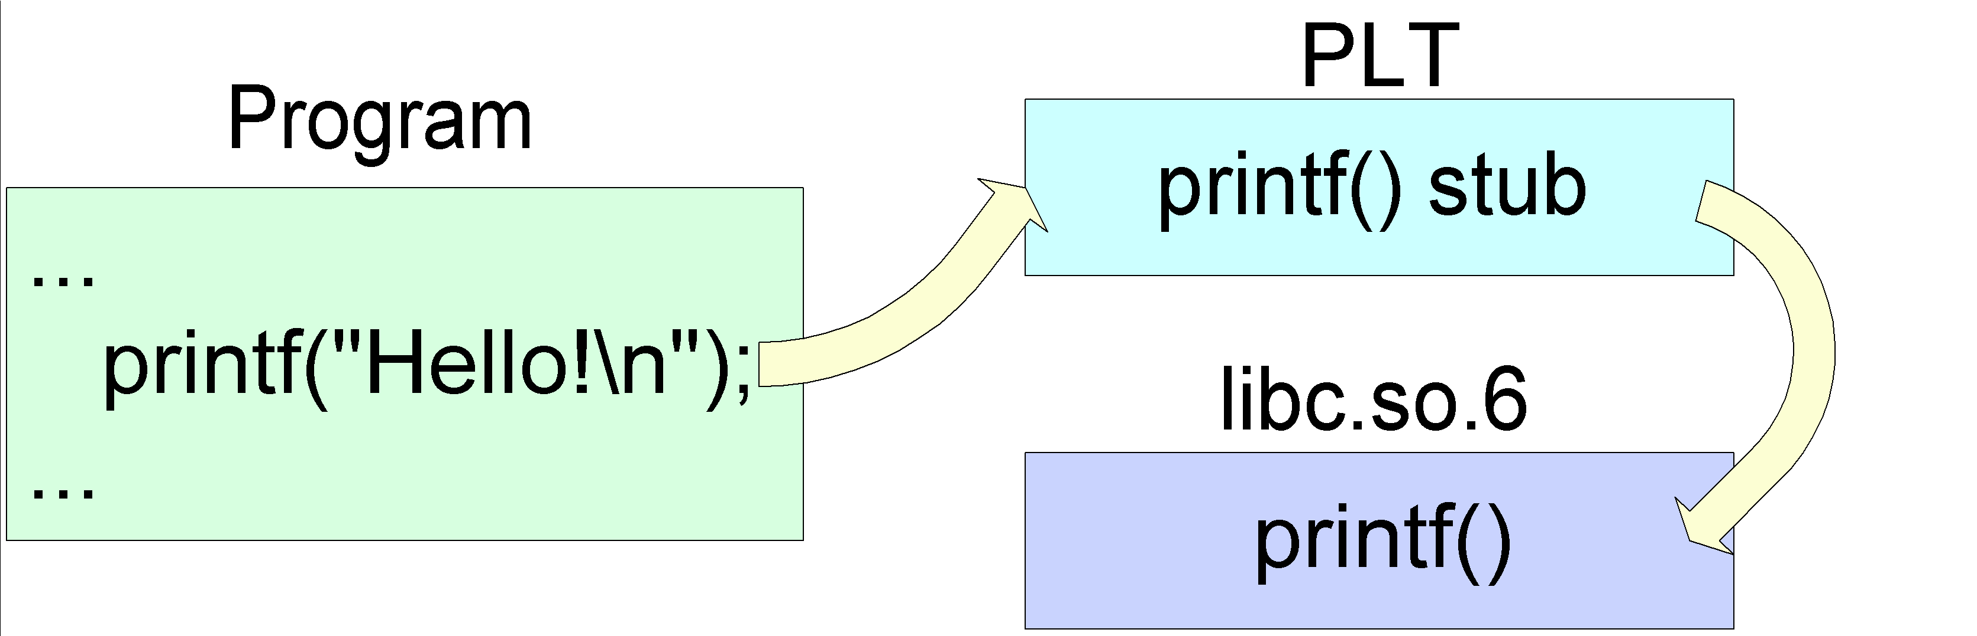
The Procedure Linkage Table

Slide 37
The Procedure Linkage Table
Redirection through PLT to real printf() determined by Dynamic Linker
Usually done ‘Lazily’

Slide 38
Dynamic Symbols/Relocations
In .rel.plt and .dynsym sections
Tell Dynamic Linker what it needs to resolve where (PLT)
More on PLT/Dynamic relocations later

Slide 39
The Global Offset Table
Like PLT but for non function symbols
  ‘stderr’, ‘errno’ etc
Referenced by PLT on IA32
  But NOT Sparc
Both PLT and GOT targeted for attack in format string vulnerabilities

Slide 40
DT_DEBUG Record
Pointer to a structure provided by the Dynamic Linker (at run time)
Normally examined by Debuggers
Shows memory layout of process
  Which object files are loaded
  Base address at which they are loaded
Notes:
TODO: Put in a diagram of the process here (with libraries and base addresses)

Slide 41
Binary Patching
Statically modify code in file
Need to:
  Insert additional code
  Link existing code to added code

Slide 42
Binary Patching – Inserting Code
Code in assembler (sometimes C)
Where to put additional code?
  Overwrite existing unused code
    Hard to identify
  Section padding
    Not much space
    Need section in executable segment (on non IA32 targets)

Slide 43
Binary Patching – Inserting Code
  Add a segment
    Have as much space as needed
  Other methods
    Unix viruses
Our example will add a new segment
  Can reuse existing but unneeded segment entry (e.g PT_PHDR)
  Create our own program headers

Slide 44
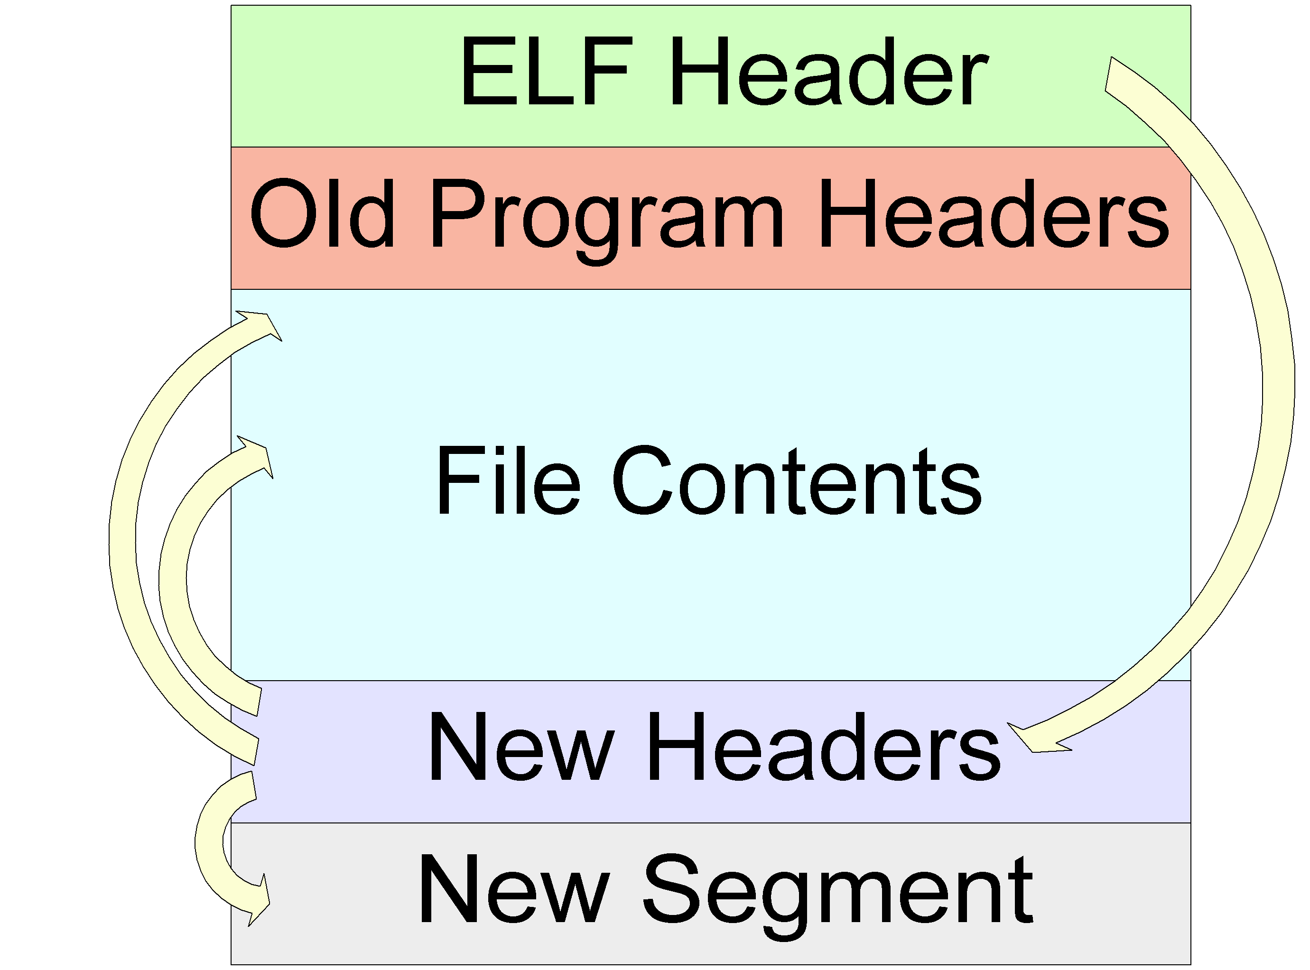
Binary Patching – Adding a Segment

Slide 45
Binary Patching – Patch what?
What to modify?
  Anything!
  Function prologues
    Redirect internal function calls
  General code
    Insert new/remove old code
How to modify old code
  Jump to new code, then jump back

Slide 46
Binary Patching - Demo
Demo

Slide 47
Binary Patching - Advantages
Very flexible
  Can modify almost everything
Permanent
Little performance impact

Slide 48
Binary Patching - Disadvantages
Complex, error prone, time consuming work
  Particularly any asm code/disassembly
Hard to intercept dynamic functions (can’t simply overwrite PLT entries statically)
Program must be restarted
  Bad if it’s a critical service

Slide 49
Binary Patching - Disadvantages
Program executable must be modified
Entire code must usually be relocatable
  Can’t easily import functions
  Direct syscalls

Slide 50
In Core Patching
Modify the in core image of the process while it runs
Can modify the remote process memory using ptrace() or procfs

Slide 51
In Core Patching
As with static patching need to:
  Insert additional code
  Link existing code to new code

Slide 52
In Core Patching
Where to put additional code?
  Need executable memory space
  Overwrite existing unused code
    Hard to identify
  Use segment padding
    Much more significant at run time
    Page padded
  Overwrite Program Headers
    Not needed at execution time
Notes:
Weird that the Program Headers are marked executable

Slide 53
In Core Patching
Linking in additional code:
  Exactly as with file patching

Slide 54
In Core Patching - Demo
Demo

Slide 55
In Core Patching - Advantages
Very flexible
Can modify almost everything
Non permanent
Can be performed on running process

Slide 56
In Core Patching - Disadvantages
Complex, error prone, time consuming work
  Particularly any asm code/disassembly
Can easily kill running program
  Particularly if not stopped at patch time

Slide 57
Dynamic Loader Environment
Dynamic loader resolves at run time all external symbols (dynamic relocations)
  GOT – Data relocations
  PLT – Function relocations
How?

Slide 58
Dynamic Loader Tricks
Reads DT_NEEDED entries in PT_DYNAMIC segment
Loads files and adds them to link map
Then goes on to process relocations

Slide 59
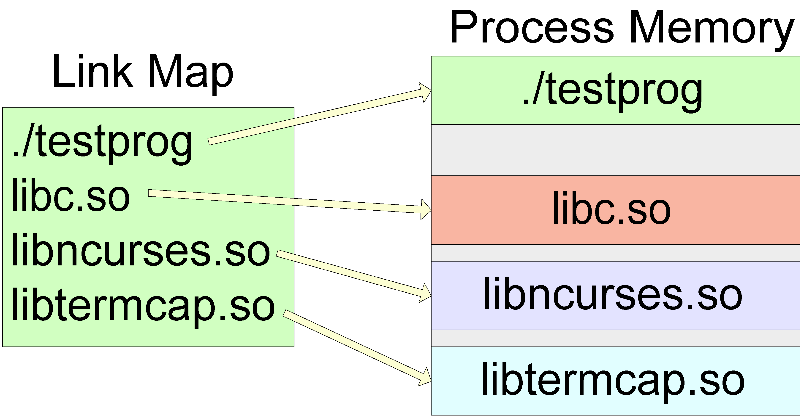
Dynamic Loader Tricks – Process View
Notes:
TODO: I’ve omitted the dynamic linker itself in library process view

Slide 60
Dynamic Linker Tricks - Resolution
When processing relocations dynamic linker looks through map and
  Searches each libraries exported symbols
  Tries to find matching symbol name
  Looks for non ‘weak’ function
First match is the winner

Slide 61
Dynamic Linker – Function Call Interception
Trick is to get your library loaded first
It will be the match (winner) for all its exported symbols
  Can intercept any dynamic function call (libc etc)

Slide 62
Dynamic Linker – Getting in First
Modify DT_NEEDED records
  Overwrite other library entry
    Open it in your library with linker routines
    Substitute library depends on old library
    Requires lazy binding!
  Move DYNAMIC segment and recreate

Slide 63
Dynamic Linker – Getting in First
Use Linker environment
  LD_PRELOAD specifies libraries to be loaded immediately
  Very common technique

Slide 64
Dynamic Linker – Calling Real Function
Intercepting function usually needs to call old function
Dynamic linker provides interface (through libdl.so):
  dlopen – Open a library
  dlsym – Get address of symbol, RTLD_NEXT flag specifies libraries after current one

Slide 65
Dynamic Linker Tricks - Demo
Demo

Slide 66
Dynamic Linker Tricks - Advantages
Easy
  All interception code can be done in C
Simple
Safe
  Provided interception routines are sound
LD_PRELOAD non permanent

Slide 67
Dynamic Linker Tricks - Disadvantages
LD_PRELOAD not permanent
DT_NEEDED approach requires executable modification
  And library in place at all times
Program must be restarted
  Again, bad for a critical service
Notes:
TODO: Maybe add note about only being able to easily intercept dynamic function calls

Slide 68
injectso - End Part 1
Questions?

Slide 69
injectso - Part 2

Slide 70
Re-Overview – Part 2
injectso vs InjLib
How injectso works
Intercepting dynamic function calls
Defending against injectso
Future

Slide 71
injectso Teaser
Since we’re doing all these demos
Quick demo of library injection using injectso
Real demos to follow internal details

Slide 72
injectso – Simple Demo
Demo

Slide 73
injectso Vs InjLib
injectso is basically the same as Injlib, but for Unix (Linux/Solaris)
Much harder on Unix than on windows
  Operating system provides minimal support

Slide 74
injectso Vs Injlib
LoadLibraryA
  Close equivalent under Unix
OpenProcess
  Close equivalent under Unix
VirtualAllocEx
  No Unix equivalent
  No way to modify remote processes’ page protection

Slide 75
injectso Vs Injlib
WriteProcessMemory
  Close equivalent under Unix
CreateRemoteThread
  No Unix Equivalent
  Unix and Threads not best of friends
In summary, the two most important functions for InjLib have no Unix equivalent

Slide 76
injectso – Conceptual Steps
Break down library injection into conceptual steps
  Then find ways to implement them under Unix

Slide 77
injectso – Conceptual Steps
Steps:
  Open process
  Find function in process to load a library
  Get process to call that function to load specified library
  (Bonus Points) Help injected library do something useful

Slide 78
Step 1. Attaching to Process
No problem
InjLib uses OpenProcess to get debugger connection
Almost equivalent functions:
  ptrace() – Linux
  procfs - Solaris

Slide 79
Step 1. Attaching to Process
Abilities gained:
  Read and write to arbitrary process memory
    Page permissions do not apply
  Modify process registers
  Other funky stuff under Solaris (but ptrace() support is nice)

Slide 80
Step 2. Library Open Functions
The function dlopen() can be used to open a dynamic library
  And have it mapped in as normal
In Windows LoadLibraryA is in Kernel32.dll
  Therefore in all programs

Slide 81
Step 2. Library Open Functions
Under Unix dlopen() exists in libdl.so
  Dynamic linker related routines
How to use functions that aren’t loaded?

Slide 82
Step 2. Library Open Functions
Functions in libdl.so are stubs
  Perform error processing (under Linux)
  Real functions are located in
    glibc (Linux)
    ld.so.1 (Solaris)
Makes sense
  Dynamic linker must have access to the functionality to work

Slide 83
Step 2. Library Open Functions
Thus all (dynamically linked) processes have access to dlopen() functionality at all times

Slide 84
Step 2. Locating Library Functions
InjLib:
  Open kernel32.dll
  Find function address
  Assume same in remote process
injectso can do the same using dlopen() and dlsym()
  Does the address assumption hold?

Slide 85
Step 2. Locating Library Functions
No!
  Patches such as PaX, OpenWall etc deliberately randomly map shared libraries
  Location of library in one process not the same in another

Slide 86
Step 2. Locating Library Functions
Duplicate actions of dynamic linker (by reading process memory):
  Loop through link map
  Loop through each objects dynamic symbols
  Find matching symbol
  Determine symbols absolute address (we have the base address)

Slide 87
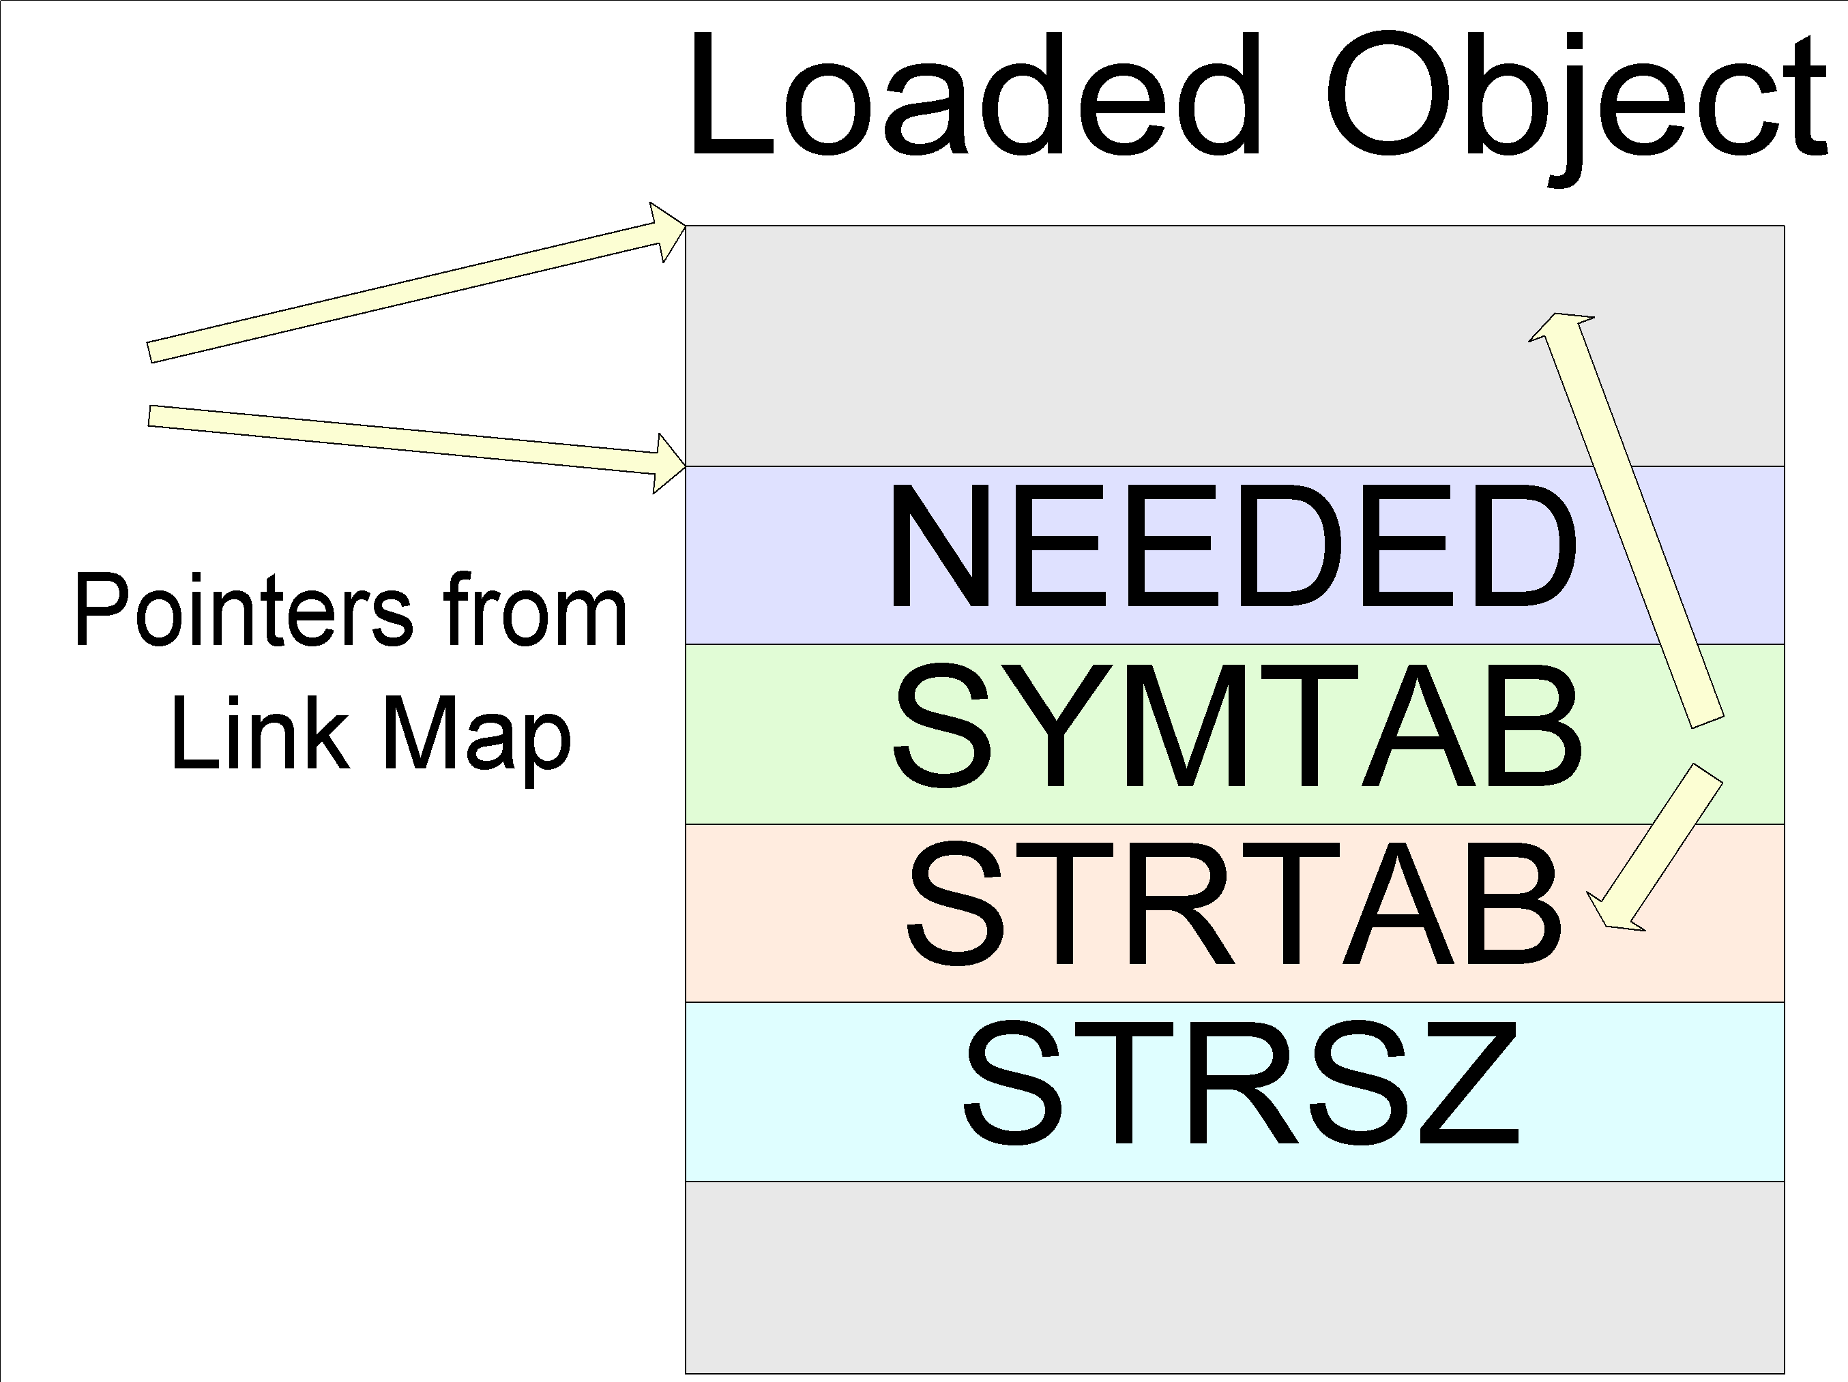
Step 2. Locating Library Functions

Slide 88
Step 3. Calling the Loader Routine
Much harder under Unix
Need to force main process to jump to other code
  Can’t just create a thread and copy function

Slide 89
Step 3. Calling the Loader Routine
Issues:
  Restoring process after
    Syscall interruption
  Constructing arguments to routine
  Actually forcing call to routine

Slide 90
Step 3a. Syscall Interruption
A lot of code spends majority of time in syscalls
  select(), read(), connect(), write() etc.
Redirecting process to other code will break the syscall
  Breaking syscalls is not fun

Slide 91
Step 3a. Syscall Interruption
Syscall arguments stored in registers
  IA32 Linux - %eax, %ebx, %ecx, %edx …
  Sparc Linux - %o1, %o2, %o3, …
  Sparc Solaris - %g1, %o0, %o1, …
When syscall is interrupted the syscall returns an error into:
  IA32 Linux - %eax
  Sparc Linux - %o1
  Sparc Solaris - %g1

Slide 92
Step 3a. Syscall Interruption
Value isn’t errno, I.e EINTR
  Even if it were most code can’t handle it and dies
Need to prevent adverse affects
  Restart syscall
  But the first argument is gone?!

Slide 93
Step 3a. Syscall Interruption
Finding old parameter:
  IA32 Linux – Stored in debugger structure
  Sparc Solaris – Debugger connection doesn’t break syscall, take it before break
  Sparc Linux – Hell!

Slide 94
Step 3a. Syscall Interruption
Save old registers before modifying process
Restore old syscall (and set instruction pointer) in saved registers
When complete restore and start

Slide 95
Step 3b. Calling Function
Need to construct arguments and call function
InjLib copies in a function (and sets it executable)
Doesn’t work on Unix:
  Can’t malloc remote memory
  Can’t set remote memory executable

Slide 96
Step 3b. Calling Function
Obvious solution – Trampolines
  As used in gdb
  Copy code onto process stack to call function
Well and truly broken by PaX, OpenWall etc

Slide 97
Step 3b. Calling Function
injectso steps:
  Copy string arguments onto remote process stack (removed on register restore)
  Set arguments in registers as required
  Set saved PC/EIP to be an invalid page (0x41414140)
  Set PC/EIP to function

Slide 98
Step 3b. Calling Function
  Allow process to execute
  Catch SegFault on return (invalid page)
  Continue processing
No executable code injected at all
  No permissions issues
Notes:
TODO: Other possibilities, write over PLT to create a trampoline

Slide 99
injectso - Success
If done right library is loaded into remote process, care of dynamic linker
  _init() is called as normal
Process continues on as normal

Slide 100
injectso - Demo
Demo

Slide 101
injectso – Issues
Signals
  Signals generated during injection (e.g SIGALRM, SIGCHLD, SIGURG etc)
  Need to be replayed
Dangerous by definition
  Especially with unsafe syscall restart
  But generally reliable with injectso

Slide 102
injectso – What next?
Library can do whatever it wishes
However useful to be able to override dynamic function calls
  Most holes can be fixed this way
  Most processes can be subverted this way

Slide 103
injectso – User Function Call
injectso can call a user specified function after injection
  Provides address of program PT_DYNAMIC segment
Utility object called Intercept.o makes use of this
  Compile it into library
  Easily intercept dynamic functions

Slide 104
Intercept.o – Intercepting Function Calls
User code provides list of functions to override
Intercept.o function intercept_begin() called by injectso
Finds functions in PLT and patches them to refer to replacement versions
Provides pointer to old function to library

Slide 105
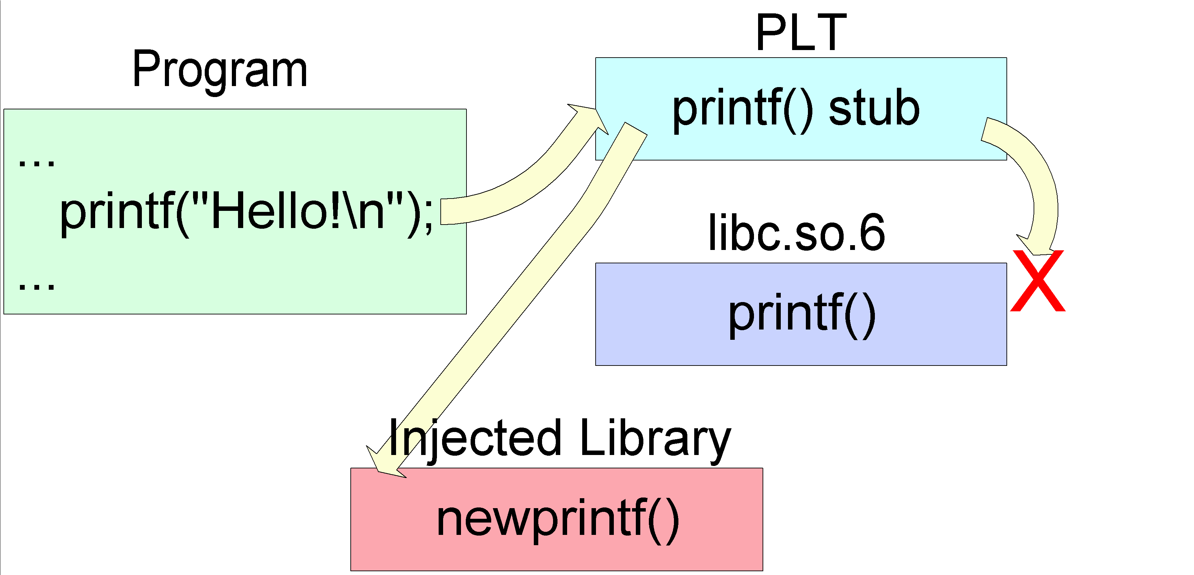
Intercept.o – Intercepting Function Calls

Slide 106
Intercept.o – Intercepting Function Calls
Needs to reapply after every call to original
  Lazy Binding
A little harder on Sparc

Slide 107
injectso – Demo - Interception
Demo

Slide 108
injectso – Protecting Applications
Protect running services
Kill bad input data as it comes in
Intercept input functions and purify

Slide 109
injectso – Demo - Protection
Demo

Slide 110
injectso – Subverting Applications
Backdoor running programs
Pop magic shell on certain input
Log input and output to critical service

Slide 111
injectso – Demo - Subversion
Demo

Slide 112
injectso - Advantages
Simple
Flexible
  Library can do anything it wishes
No modifications to binary
No disk files
  Library may be deleted after injection

Slide 113
injectso – Advantages
Service does not need to be restarted
Code normally in C
Code gets relocations free
Mostly safe

Slide 114
injectso - Disadvantages
Not permanent
Complex to use for non dynamic function interception

Slide 115
Protecting against injectso
injectso is not a new attack
  As demonstrated via three other methods
Modifying processes/binaries only possible after intrusion
Protect machine

Slide 116
injectso – The Future
Modify relocations
  Prevents PLT patching problems for unbound functions
  Need executable space (on Sparc)
    Hard to find with PaX around
    Overwrite library code segment?
Other Platforms
Additional helpers (Prologue interception etc)

Slide 117
Thank you for listening!
Questions?
SecureReality Web Site:
  http://www.securereality.com.au
Email:
  shaun@securereality.com.au

