Slide 1

E2 STUDIO investigation
May 2017
By thai ho

Slide 2
Agenda
Debug configuration
Debugger views

Slide 3
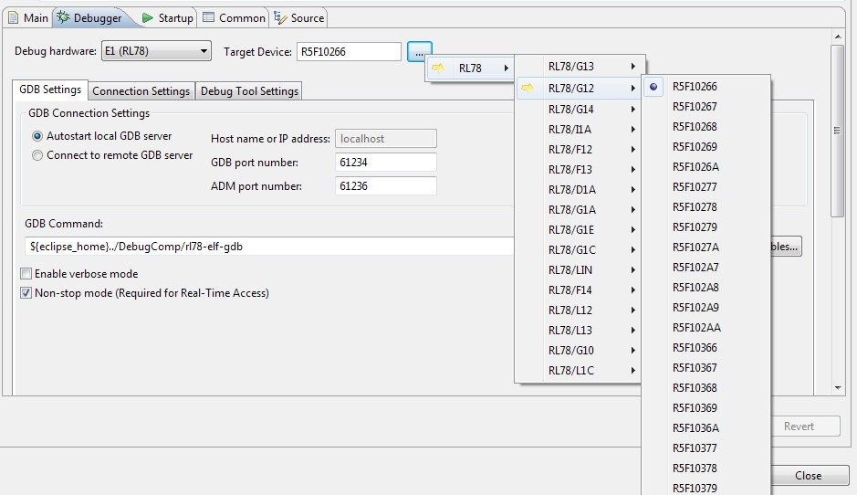
DEBUG CONFIGURATION
Target Selection:
When creating a new project using the Project Generation Wizard a Debug Configuration will be created with the Emulator & Target Device pre-selected
Any additional Debug Configurations will need to have the correct Emulator & Target Device set manually when they are created.
Debug Hardware: Specifies the Emulator & MCU Series combination.
Target Device: Target Device being connected to.

Slide 4
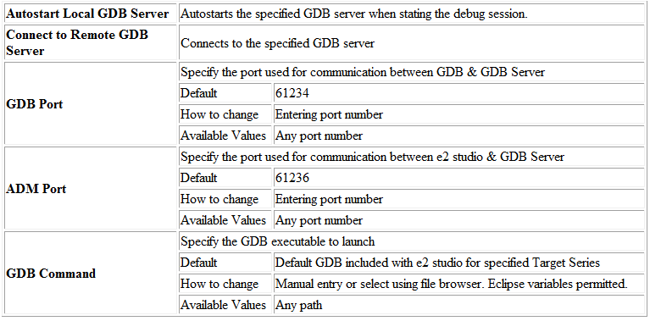
DEBUG CONFIGURATION
GDB Connection Settings:

Slide 5
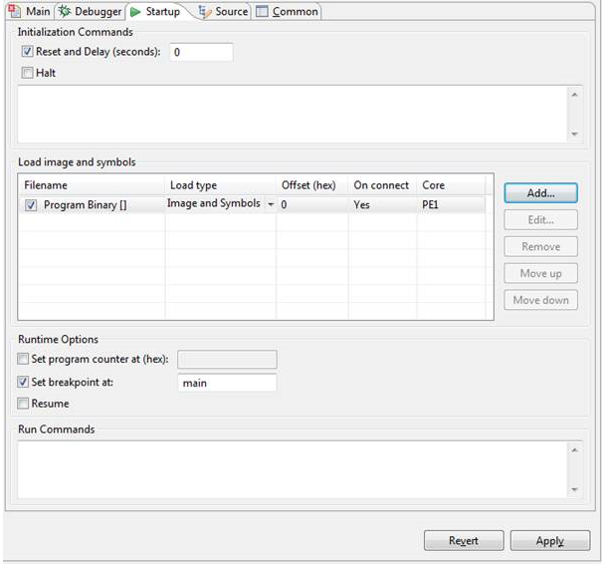
DEBUG CONFIGURATION
Startup Configuration:
The Startup tab of the debug configuration dialog edits the settings which control what to download and the initial behaviour until a connection is established.
The order in which the settings take effect during the reset-download-run cycle are located on the screen in an approximate top to bottom sequence.

Slide 6
DEBUG CONFIGURATION
Startup Configuration:
Initialization Commands
This group of controls determine what happens before your software is downloaded
Reset and Delay (seconds)
Use this option to indicate that for each new connection the target device will be reset. Enter a whole number of zero or more seconds to pause after initiating the reset before proceeding with the download. This is to give the device chance to complete its initialization and be in a state ready to download.
Halt
Select this option to prevent the hardware from attempting to run before any of your software has been downloaded.
Initialization commands text
This text input field allows entry of the reset commands to be used by GDB, typically any memory writes and/or register writes. Each command should be listed on a separate line.

Slide 7
DEBUG CONFIGURATION
Startup Configuration:
Load image and symbols
This group of controls determine which software executables are downloaded by the target device, the order in which they are downloaded and how their content is interpreted and run.
Filename
This column shows the name of the file to download [with its path in square brackets]
Load type
This column contains a drop down editor for each row offering a choice of Image and Symbols, Image only, Symbols only.
Select Image and Symbols when the file contains both executable binary and debug symbols – in other words the output of a debug build. This suits the case where, for example, you wish to repeatedly download a single file and debug it.
Select Image only when the file contains only executable binary information – in other words the output of a release version. This suits the case where, for example, you wish to test the behavior of the software on the target device in a way close to production conditions.
Select Symbols only where you have a symbols file which pertains to software already downloaded to the device which you want to debug and which you do not want to overwrite.

Slide 8
DEBUG CONFIGURATION
Startup Configuration:
Offset (hex)
This column specifies an offset in bytes which will be applied to the load addresses.
On connect
This column contains a yes/no selection indicating when the download should take place. Selecting Yes will cause the file to be downloaded at the first opportunity after the connection is made while selecting No will cause the file to be downloaded on demand from the target device.
Core
Where the target device has multiple cores this column contains a dropdown list populated with the names of the cores of the target device. Where the target device has only a single core then the only option No core is selected by default.
Note that the same Core can be selected on multiple rows, meaning that the selected core is primed to load multiple files.
Note also that the same file can be selected on multiple rows, meaning that the same executable file can be downloaded to different cores.

Slide 9
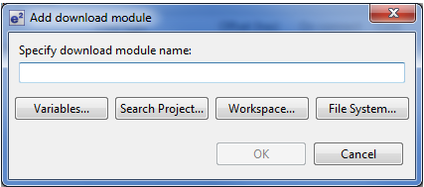
DEBUG CONFIGURATION
Startup Configuration:
Add
Click the Add… button to add a new row to the table.
The dialog which opens permits you to define how your executable file should be located.
Variables…
If your built file is written to a location defined with one or more System properties then use the Variables… button to help you choose the variables which define its location. For example:
${workspace_loc}/../output/myproj.exe

Slide 10
DEBUG CONFIGURATION
Startup Configuration:
Search Project…
Click the Search Project… button to search for executable files found in the workspace below the project selected in the Debug Configurations - Main tab
Workspace…
The Workspace… button works in a similar way to the Search Project… button with scope to choose files from anywhere in the Eclipse workspace, not just the project selected in the main tab.
File System…
The File System… button permits selection of a file located anywhere accessible from your development environment. Click the Open button when you have located the file to be downloaded.
Runtime Options
These options control what happens after the software reaches a state of readiness to run.

Slide 11
DEBUG CONFIGURATION
Startup Configuration:
Set program counter at (hex)
Select this option if you wish to control the starting value of the program counter on a per debug configuration basis. Do not use this option on multicore targets as its effect is indeterminate for other than single core targets.
Set breakpoint at:
The Set breakpoint at text field allows you to specify the name of a function at which execution is to be paused on the first occasion it is called. Subsequent calls will not cause execution to be paused. Note that for a C++ project this will need to be the mangled method name.
Resume
Resume in this contexts means: proceed with execution as soon as possible. Execution becomes possible immediately following the completion of the download of the first file. The selected state is the default state for this checkbox. Clearing the selection causes execution to be paused upon completion of the first download.
Run Commands
In contrast to the initialization commands which are sent to GDB prior to download of the software this text field allows you to enter commands which are sent to GDB after all other startup steps have completed. As with the initialization commands, each run command should be on a separate line.

Slide 12
Agenda
Debug configuration
Debugger views

Slide 13
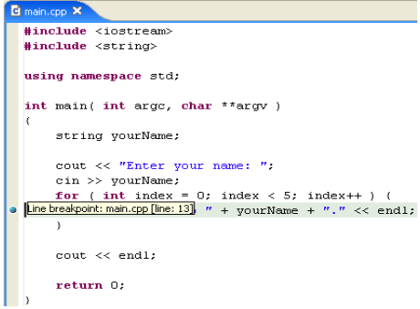
DEBUGger VIEWS
Breakpoints
A breakpoint suspends the execution of a program at the location where the breakpoint is set
When a breakpoint is enabled, it causes the program to suspend whenever it is hit. Enabled breakpoints are indicated with a blue enabled breakpoint circle. Enabled breakpoints that are successfully installed are indicated with a checkmark overlay.
When a breakpoint is disabled, it will not affect the execution of the program. Disabled breakpoints are indicated with a white disabled breakpoint circle.
Note: Execution will also suspend if Stop at main() on startup is enabled on the Launch Configuration dialog. To access the Launch Configuration dialog, from the menu bar choose Run > Debug

Slide 14
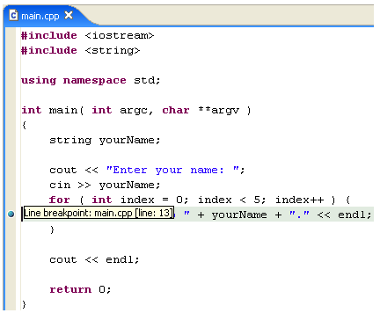
DEBUGger VIEWS
Adding breakpoints
To add a breakpoint point, double click the marker bar located in the left margin of the C/C++ Editor beside the line of code where you want to add a breakpoint.
A dot Icon Breakpoint object is displayed in the marker bar and in the Breakpoints view, along with the name of the associated file.

Slide 15
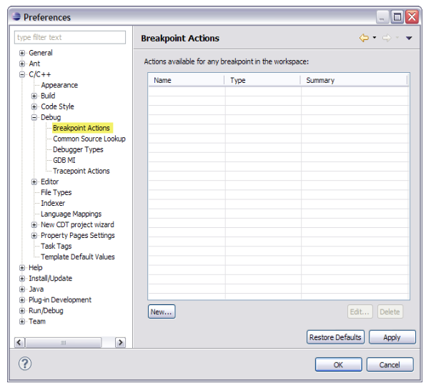
DEBUGger VIEWS
Adding breakpoints actions
To add a new breakpoint action:
Click Window > Preferences.
Expand C/C++ > Debug and click Breakpoint Actions.

Slide 16
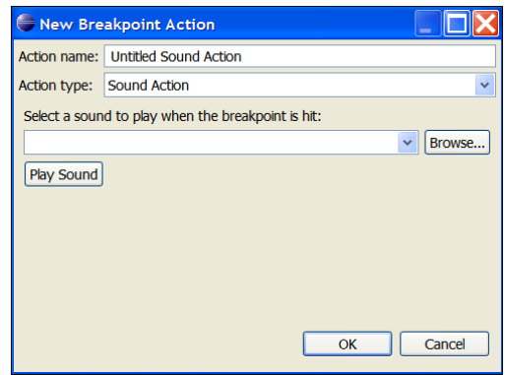
DEBUGger VIEWS
Adding breakpoints actions
3. In the Breakpoint Actions page, click New.

Slide 17
DEBUGger VIEWS
Adding breakpoints actions
4. In the New Breakpoint Action dialog box, type a name for the action in the Action name box.
5. Select an action from the Action type list.
6. Set the action's attributes:
For a sound action, select a sound file.
For a log action, type the message to appear in the Log Action Messages console.
For a resume action, set the Resume after time in seconds.
For an external tool action, click Choose to select a program.
7. Click OK.
The new breakpoint actions appears in the Actions available for any breakpoint in the workspace list

Slide 18
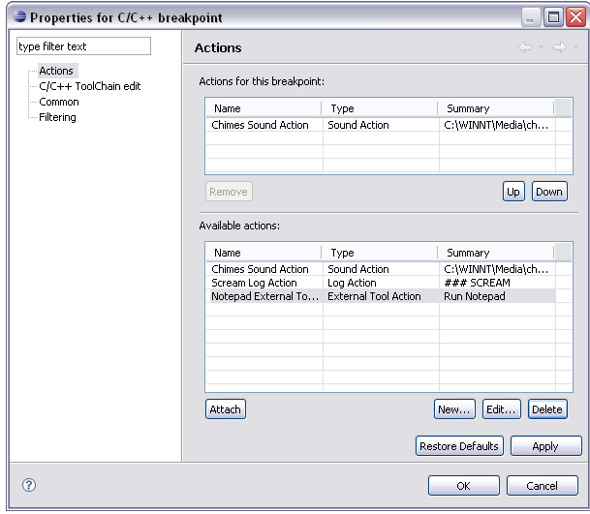
DEBUGger VIEWS
Attaching or removing breakpoint actions
You can attach one or more breakpoint actions to a single breakpoint. For example, when the breakpoint is hit you could both log a message and play a sound.
Actions are executed in the order they appear in the Actions for this breakpoint list
To attach or remove a breakpoint action from a breakpoint:
In the Breakpoints view, right-click the breakpoint, and select Properties.
In the Properties for C/C++ Breakpoint dialog box, click Actions

Slide 19
DEBUGger VIEWS
Attaching or removing breakpoint actions
3. In the Available actions list:
Select an action and click Attach to link it to the breakpoint. Repeat as required.
To add a new breakpoint action, click New.
To edit the selected breakpoint action, click Edit.
To delete the selected action, click Delete. NOTE: Deleting a breakpoint action removes it from the workspace.
4. In the Actions for this breakpoint list you can:
Click Remove to delete the selected action from the list.
Click Up to move the selected action up in the list.
Click Down to move the selected action down in the list.
5. Click OK

Slide 20
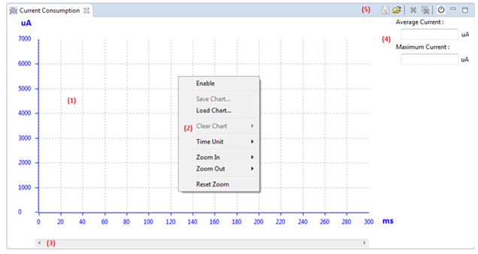
DEBUGger VIEWS
Current consumption view
This below picture shows the default view of Current Consumption plug-in when it is opened:

Slide 21
DEBUGger VIEWS
Current consumption view
Description for Current Consumption view areas:
(1) Chart area
X axis simulates time unit (Default time unit: ms).
Y axis simulates the Current Consumption result (Default consumption unit: uA).
When user right clicks in the chart area, a pop-up menu is shown up as (2) area
(2) Pop-up menu area
(3) Scroll bar is used to scroll X axis of chart. There is no line series at this state then slider of scrollbar doesn’t appear.
(4) Average Current and Maximum Current area shows value of average current and maximum current of consumption data into textboxes.
(5) Toolbar menu area includes menu icons: Save chart to CSV file, Load chart from CSV file, and Clear measured data, Clear all loaded data, Turn Current Consumption On/Off, Minimize and Restore.
“Clear all loaded data” option will be enabled or disabled depending on the loaded data; if there is no loaded data this option will be disabled.

Slide 22
DEBUGger VIEWS
Current consumption view
There are three states of this plug-in depending on program execution status.
Default state
Measuring state
Stop state

Slide 23
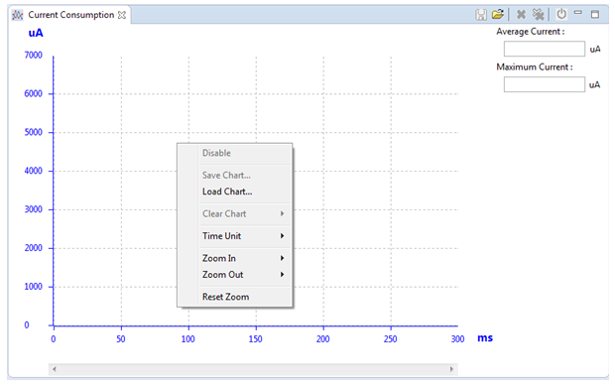
DEBUGger VIEWS
Default state
Current Consumption view becomes to the default state after users start a simulator connection.
In this state, user cannot enable or disable Current Consumption.
The “Enable/Disable” option in Pop-up menu and the Turn Current Consumption On/Off button on Toolbar menu will be disabled after a simulator connection.

Slide 24
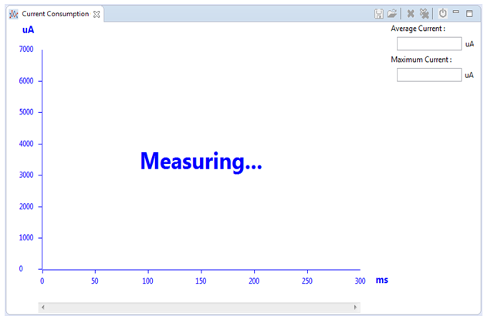
DEBUGger VIEWS
Measuring state
During program execution, the measuring state view of this plug-in will be shown as the picture below:
In this view, the chart area shows “Measuring…” status, pop-up menu cannot be shown when user right-clicks in chart area, other areas are all disabled.
Notice that the measuring state won’t be shown if user already disabled the Current Consumption.

Slide 25
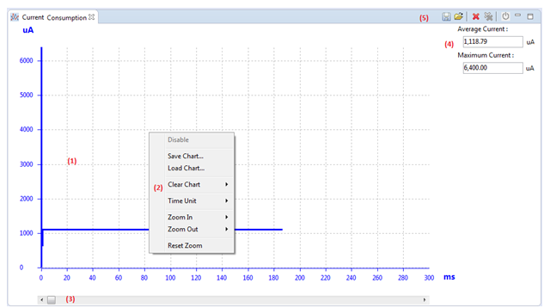
DEBUGger VIEWS
Stop state
When the program execution stops and Current Consumption is already enabled, the view of this plug-in will be shown as this picture:

Slide 26
DEBUGger VIEWS
Stop state
Pop-up menu (2) is shown when user right clicks on chart area, all the options in this pop-up menu is enabled except for “Disable” option.
Scrollbar (3) is enabled; the position of scrollbar is at the minimum X axis.
The area (4) shows the average current and maximum current in the textboxes.
The average current and maximum current show to 2 digits after the decimal point
The Maximum Current gets the maximum Current Consumption in the returned result to show.
The toolbar menu (5) will enable all toolbar icons except icon and .
The chart area (1) will display line series as step series. When user places the mouse in this area, a tooltip showing value of all modules and the Current Consumption value of each peripheral module will be display in the chart area:

Slide 27
DEBUGger VIEWS
Disassembly view
The Disassembly view shows the loaded program as assembler instructions mixed with source code for comparison
Set breakpoints at the start of any assembler instruction
Enable and disable breakpoints and their set their properties
Step through the disassembly instructions of your program
Jump to specific instructions in the program

Slide 28
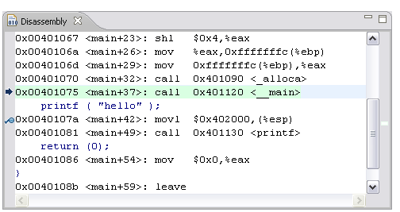
DEBUGger VIEWS
Disassembly view
The currently executing line is indicated by an arrow marker and highlighted in the view

Slide 29
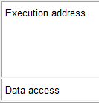
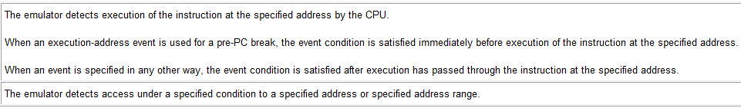
DEBUGger VIEWS
Eventpoints
An event refers to a combination of phenomena that can occur during program execution
Setting up or viewing defined events is possible via the Event Point view
Types of Events

Slide 30

DEBUGger VIEWS
Eventpoints
Event Combination

Slide 31
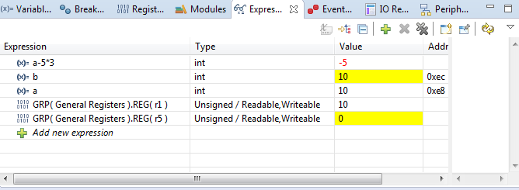
DEBUGger VIEWS
Expressions
Show changes of the variables, expressions, registers… when the project is running (expression name, type, value, address).
You can add, edit or delete an expression.
The changes will be highlighted.
Expression view is linked with real-time chart view.

Slide 32
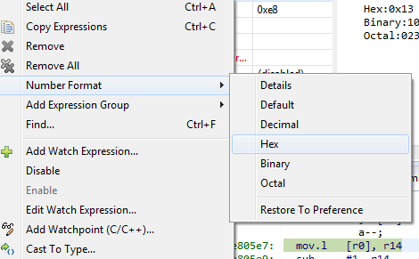
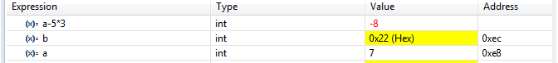
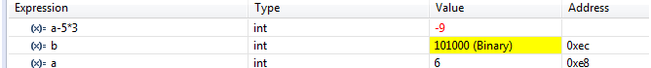
DEBUGger VIEWS
Expressions
Pop-up menu
Real-time Refresh: Allow the expression to update while the target is running (with real-time refresh on, we can record the changes of expression).
Disable Real-time Refresh: Stop updating expression while the target is running.
Number format: See the value of expression in different types.

Slide 33
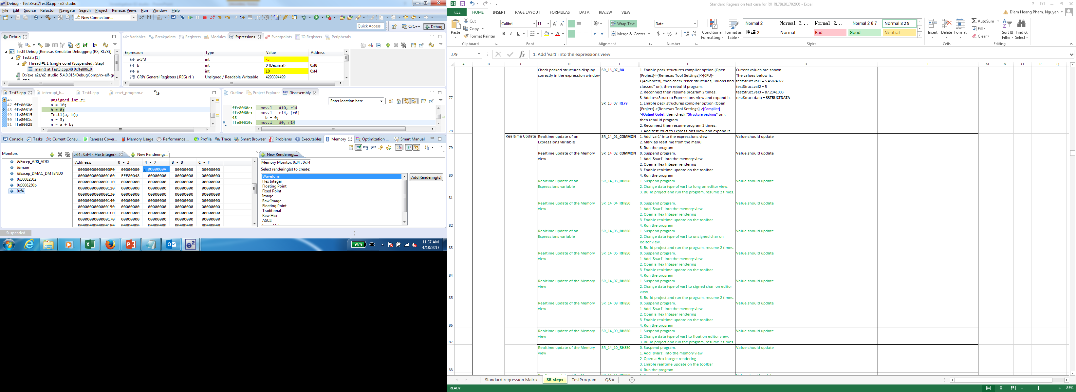
DEBUGger VIEWS
Expressions
We can combine Memory View to see the changes of expression.

