Slide 1
Promotion Report
副研究员I
Huang Boyuan
2018-03-13
助理研究员III
© 2018Ricoh Software Research Center (Beijing) Co., Ltd.
Notes:
Good afternoon everyone, thank you so much for attending my promotion report and it’s very appreciate for giving me second chance. In the conference, I want to apply for promotion from Assistant Researcher III to Deputy Researcher I.

Slide 2
Content
Personal Information
Project involved
Future and Plan
© 2018Ricoh Software Research Center (Beijing) Co., Ltd.
2
Notes:
My report contain 3 parts: they are personal information, project involved ,and the last one is future and plan

Slide 3
Personal Information
Education experience:
2005 ~ 2009 | Beihang University | Bachelor’s degree
2010 ~ 2013 | Beihang University | Master’s degree
Working experience:
2014 ~ 2015 | CAXA | Software Engineer
2015 ~ now | SRCB | Assistant Researcher III
© 2018Ricoh Software Research Center (Beijing) Co., Ltd.
Notes:
I studied in Beihang University from 2005 to 2013.In this university, I get my bachelor’s degree and Master’s degree.
Then I joined CAXA, the largest industry software company in China, as a software engineer.
In 2015, I worked in SRCB as an assistant researcher.

Slide 4
Content
Personal Information
Project involved
Future and Plan
© 2018Ricoh Software Research Center (Beijing) Co., Ltd.
4
Notes:
In the second part, I will give more details of my works in the over 2 years

Slide 5
Project involved
I have been participating all projects of SEB since I joined in SRCB;
Stand out contributions in 4 projects;
Smart Glasses Coordination System
Kinect2 image mapping and composition
Theta Image Transform SDK
BoZ Project
RCP
2015/05
2017/03
2017/07
2017/10
2015/03
2016/08
2017/05
2017/08
2017/12
Drug box
recognition
RCN Sign & Display APP
SOP Secret Monitor
Live Theta
© 2018Ricoh Software Research Center (Beijing) Co., Ltd.
Notes:
I have been participating all projects of SEB since I joined in SRCB, in 2015. In all of my projects, I have made some stand out contributions in 4 of them. They are drug box recognition, kinect2 image mapping and composition, RCN sign & display app, and BoZ project. The rest projects, I did some assist jobs, such as test cases, did feasibility verification. In the coming pages, I will introduce more details about the jobs I have done in the 4 projects.

Slide 6
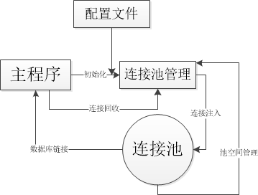
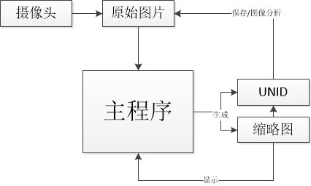
Project involved
Drug box recognition
Major Contributions：
Advanced UI
Multiple Select
Drag images between controls
Database Module
Basic Function
Data Batch import
Connection pool
Data flow Optimize
Temporary file
Memory usage from 1GB ->200MB
© 2018Ricoh Software Research Center (Beijing) Co., Ltd.
Notes:
The first project is Drug box recognition. In this project, my role is a developer. I did 3 major contributions in this project.
The first contribution is Advanced UI. In order to improve the user experience and reduce the complex operation, I come true some advanced UI operation, such as multiple select and Drag images between controls;
The second one is the Database module. With the increase in data, we will import Database to help the data management. So I add database operations in the application , and come true an assist application to help batch data import. However, the frequently data access made the application often be jammed, to solve this problem, I write a connection pool to separated the UI and data I/O.
The last one is a “Data flow Optimize” . In order to do image processing, we use lots of HD image in this application, so the redundancy data flow often trigger Out of Memory Error. I use some temporary file to replace the large size file to flow in the application. The memory usage will reduced from 1GB to 200MB.
I touched this project since I joined TSC, of SRCB. In I would come true all the features according to the specific requirement and fix all the bugs given by testers.

Slide 7

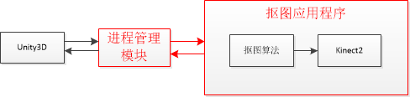
Project involved
Kinect2 image mapping and composition
Major Contributions：
Our algorithm is based on
Kinect2, only support Frameworks4.
Client’s platform only support
limited frameworks 2.
API can’t direct connection
Design a module to solved the unmatched problem between our algorithm and Client’s platform.
© 2018Ricoh Software Research Center (Beijing) Co., Ltd.
Notes:
In this project , my role is a developer. This project is cooperate with Wang xiaoxue. She is in charge of algorithm design. I’m in charge of API design. But our algorithm is based on the Kinect 2, which is only support Frameworks 4.But our client’s platform only support limited frameworks 2.
The same program language, but different version make the API can’t direct connection. So , after analyze the 2 part, I design an inter-task management to make the connection. This method is simple and reliable.

Slide 8
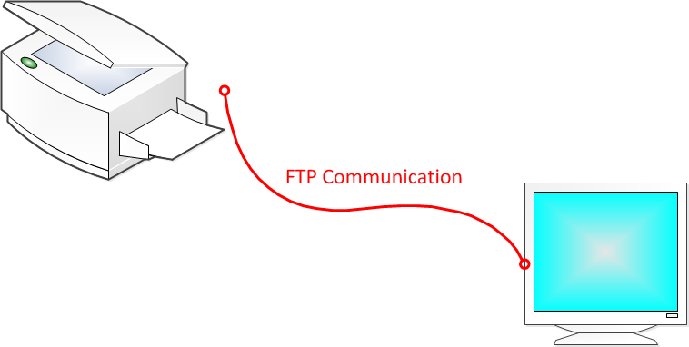
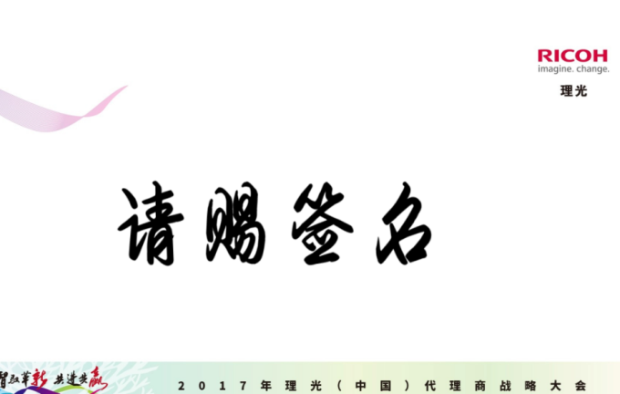

Project involved
RCN Sign & Display APP
Major Contributions：
FTP communication
Designed FTP
communication architecture
PC UI
Design multiple animation module
On site implement
© 2018Ricoh Software Research Center (Beijing) Co., Ltd.
Notes:
RCN Sign & Display APP project is a very typical “limited time”, “unfamiliar development environment ”, “high quality ” project.
Based on the running environment and feature I designed FTP communication architecture, it can simplified the complexity of communication between RICOH MFP and display devices.
In order to make the display more vivified. I added some animation modules in the application.
And the last contributions in this project is I have over come so many difficulties to make sure the DEMO runed smooth and steady on the RCN conference.

Slide 9
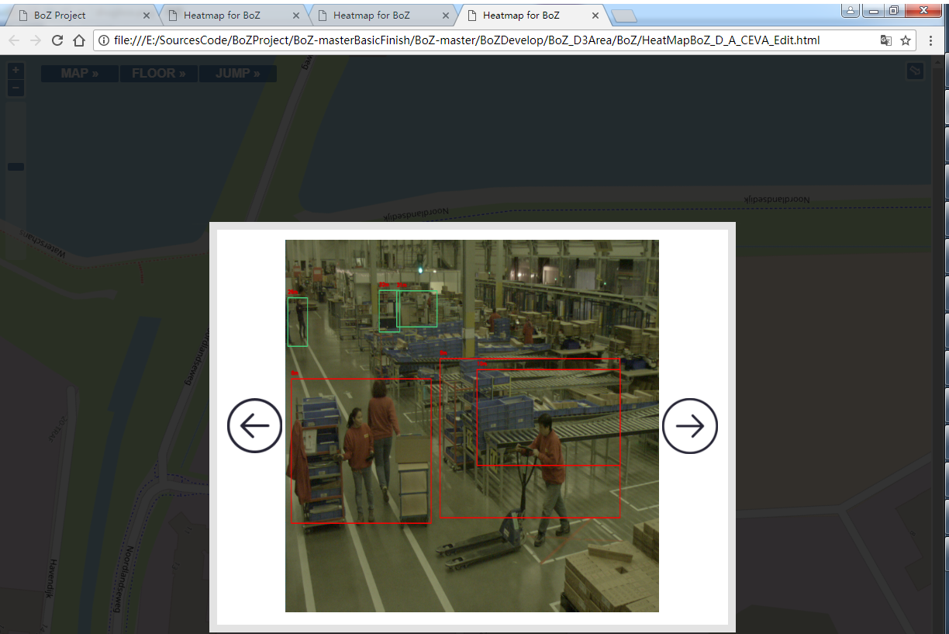
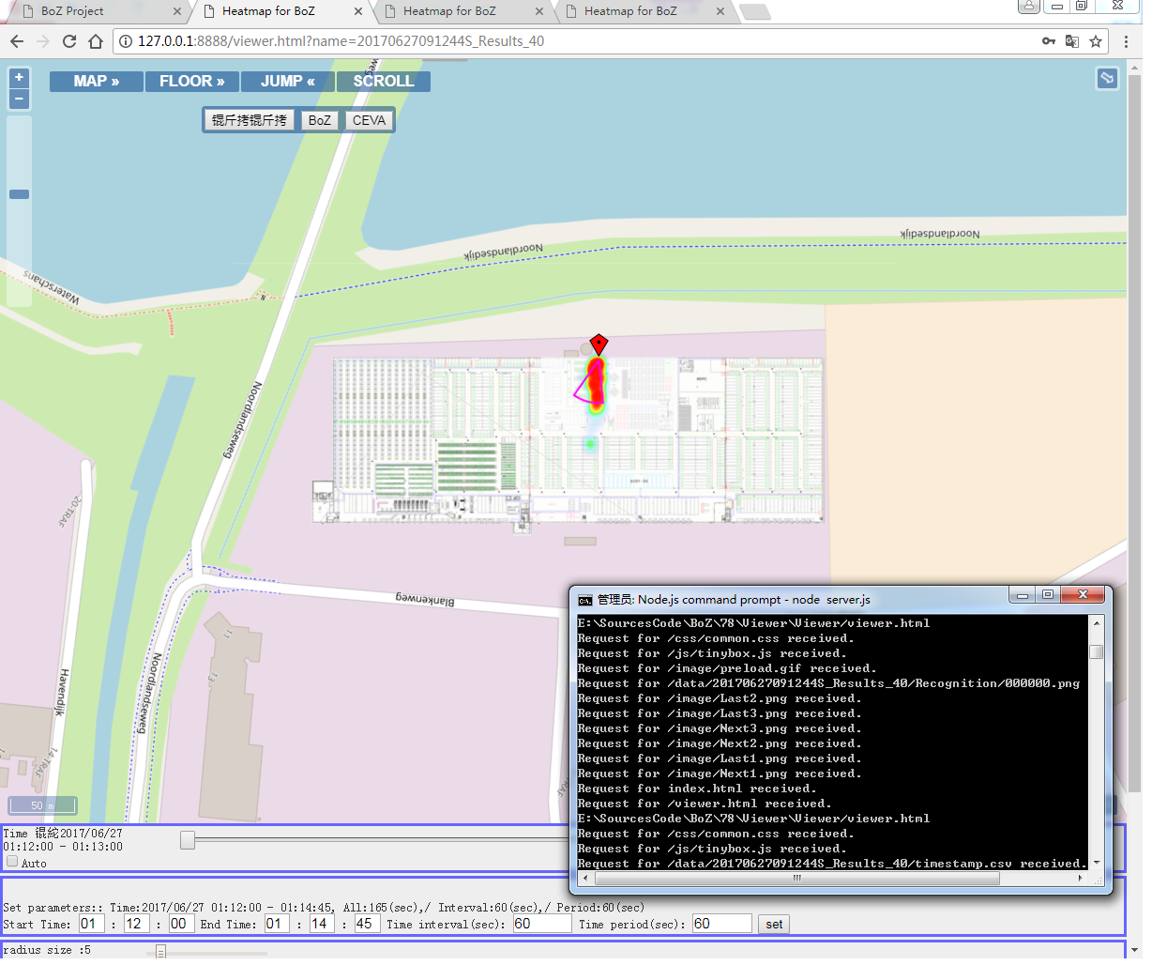
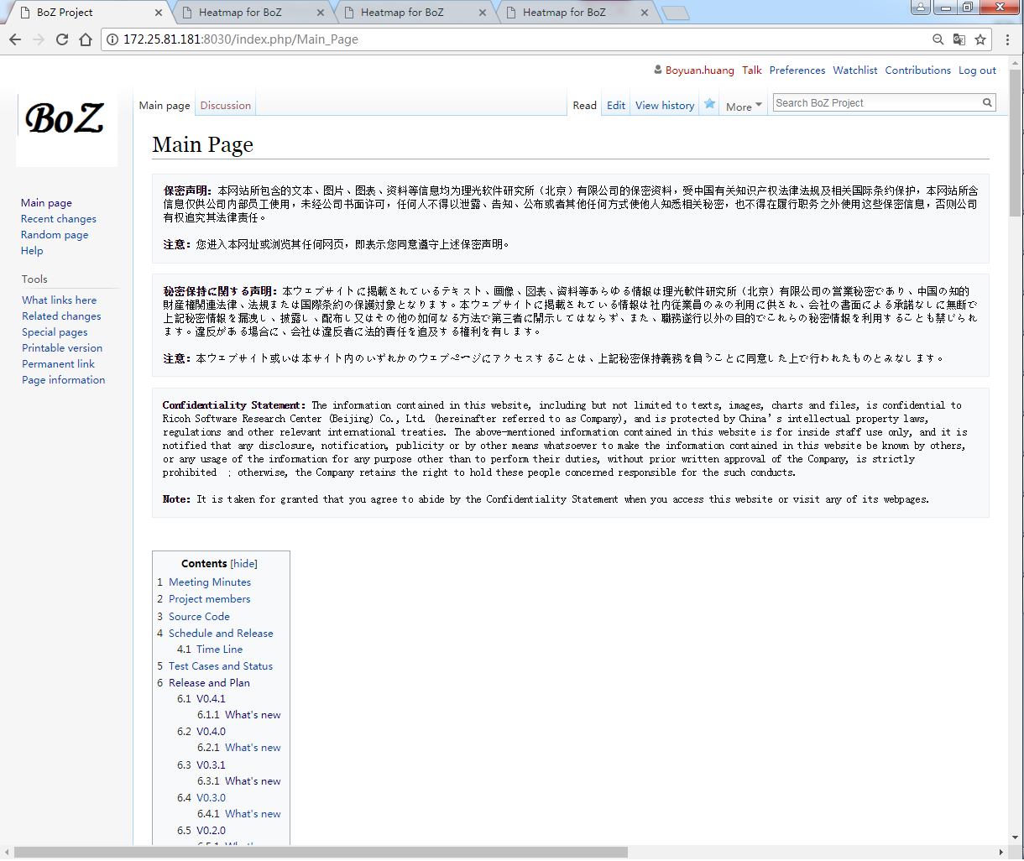
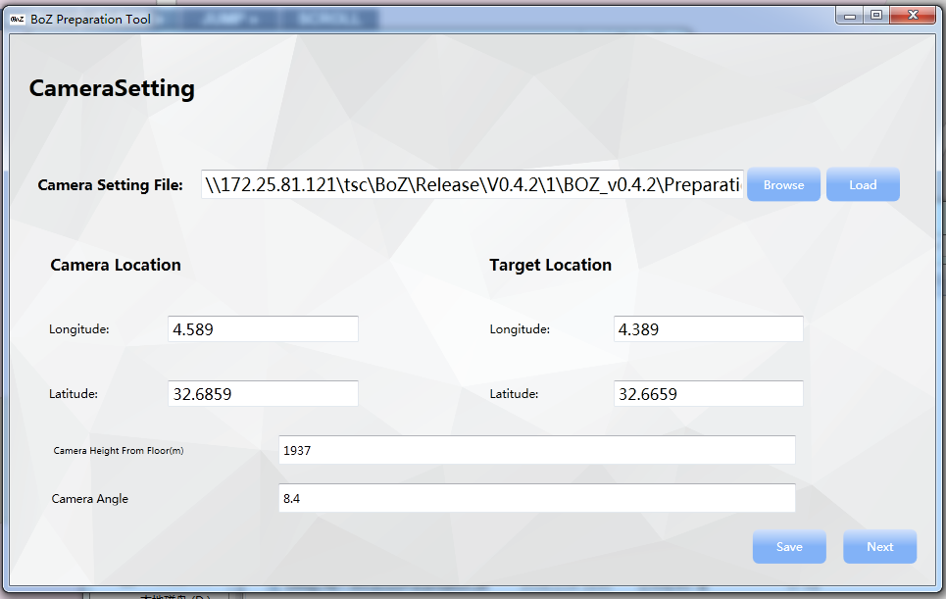
Project involved
BoZ Project
My First PL project
Prototype
Developed a demo based on Japan’s Requirement
Proposal
Communicate with Japan to confirm the requirement.
Write proposal document
Development
Develop Preparation tool
Develop Viewer
Test
Release
Major Contributions：
Write the proposal and manage the project;
Do the communication with Japan;
Develop all the project by myself;
Maintain a Wiki page for any update;
Maintain
Fix bugs
Maintain Wiki pages
© 2018Ricoh Software Research Center (Beijing) Co., Ltd.
Notes:
The last project I want to talk is the BoZ Project. It’s my first time to work as a Project Leader. I have been experienced all the stage of a project would through.
The first stage is a prototype stage. In this stage, I wrote a simple demo based on the Japan’s requirement. After the prototype was confirmed, I communicated with Japan side many times to confirm the requirement and wrote the proposal document on our common view.
Then this project gone to the development stage. According to the proposal document, I chose the technical route to develop the Preparation tool and Viewer. Test the applications based on the test cases and release them. Up to now, those applications have been iterated 6 times.
And the last stage is maintain stage. In this stage ,we fix the bugs and maintain a Wiki page, which is used to make the information exchange more effectively.
In this project , I have done those contributions :……………

Slide 10
Project involved
BoZ Project
My First PL project
Prototype
Developed a demo based on Japan’s Requirement
Proposal
Communicate with Japan to confirm the requirement.
Write proposal document
Development
Develop Preparation tool
Develop Viewer
Test
Release
Comments：
It’s my first time to manage a project as a PL;
I’ve learned how a project was going
and how to communicate with others;
How to manage group members in a project.
Maintain
Fix bugs
Maintain Wiki pages
© 2018Ricoh Software Research Center (Beijing) Co., Ltd.
Notes:
In fact, I have learned lot of from this Project. May be more than all the projects before. It’s my first time to manage a project as a project leader;
In this project, I have to experience a project in a total different way, not just only how to code an application. A project will though many stages from a basic idea to the end. We need to keep in touch with our client to make sure we are on the right way.
And at last, I have learned how to assigning tasks to group members in a project. It’s really get lots practice.

Slide 11
Content
Personal Information
Project involved
Future and Plan
© 2018Ricoh Software Research Center (Beijing) Co., Ltd.
11
Notes:
At the last part , I want to talk about my work plan in the future.

Slide 12
Future and Plan
Expert
Software Engineering
01
Project Management
02
Project Leader
Presentation Skill
03
Programmer
Notes:
In the 2 years, I have been experienced many projects. However, thanks to those projects, I’m not only finished my basic jobs, but also give me lots of practices and overcome kinds difficulties. So, at last, I have learned kinds of skills from them to support me to do more challenging jobs, and just like to climb stairs, I have been grow from a low level programmer to a project leader. It’s so grateful that our company can provide such a nice environment to let everyone get practice and grow up.
But if I want to go further, I need to learn more core competence to support me do more challenging job. I think there are 3 things I need to care. They are software engineering, project management and presentation skill. Software is the basics of all my career, I must always keep an eye on the new technique, new tools, new trend, such as video tech, deep learning, chain block and so on…
Project management ability will support me to do more high level jobs. Management is an art, I will widen my field of vision on it.
And the last one is presentation skill, I think a good presentation will

Slide 13
层进关系图表
Software Engineering
01
Project Management
02
Presentation Skill
03
Notes:
Presentation Skill

Slide 14

Q&A
© 2018Ricoh Software Research Center (Beijing) Co., Ltd.

