Slide 1
EDES 301
PCB Project
Boyuan Zhang
Due 12/16/2025 @ 11:59pm

Slide 2
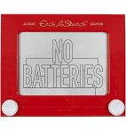
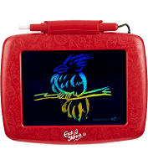
Background Information
Create a PCB for the project 1 DDR game
Hardware:
  7 Segment display
  Two Buzzers
  Eight LEDs (4 Red, 4 Blue)
  Joystick
  PocketBeagle
Replace this slide with your own if you are doing a PCB around your Project #1

Slide 3
System Block Diagram – “Etch-a-Sketch”
5V
3.3V
PocketBeagle
USB Host
VCC
SPI Display
USB
SPI
SPI
VCC
USB
SPI
GPIO
GPIO
GPIO
GND
3.3V
GND
GND
1k
1.8V
Potentiometer
3.3V
GPIO
1k
AIN
GPIO
AGND
GPIO
1.8V
Potentiometer
GPIO
AIN
AGND
GPIO

Slide 4
System Block Diagram
8 LEDs
GPIO headers (P2_2,4,6,8,18,20,22,24)
Pocket beagle
PWM
GPIO headers
ANI
I2C
Buzzers
PWM P2_1, 3
Joystick (2 directions and press)
P1_19 (left right)
P2_17 (press)
Displays
I2C2_SDA (P2_9)
I2C2_SCL (P2_11)

Slide 5
Mechanical Drawing
3.7”
Pocket Beagle
Buzzer
Buzzer
Leds
3.3”
Hex Display
joystick
FRONT
BACK

