Slide 1

GitHub Actions
Notes:
Welcome
Background image: https://unsplash.com/photos/abstract-streaks-of-light-with-a-dark-background-QTPagUbFT1g

Slide 2


Why does GitHub Actions exist?
Notes:
Make developers lives easier, better
Automate boring, repetitive and error-prone tasks
“Every time I…”
Background image: https://unsplash.com/photos/the-sun-is-setting-over-the-sand-dunes-edwB2eeyfyc

Slide 3

Do we think that application devs should be proficient in CI/CD?
Notes:
Lots of potential and power in these tools
All/most devs have task they wish they could automate
Proficiency = confidence
Background image: https://unsplash.com/photos/white-seal-on-soil-giZJHm2m9yY

Slide 4

CI = Continuous Integration
Notes:
Tools and mechanism that make sure the default branch is in a good state
Typically means the code builds, is linted, doesn’t have severe vulnerabilities, and that tests run
Gives developers confidence that they can create feature branches based on main without worrying having to double-check the previous commits to main
Background image: https://unsplash.com/photos/abstract-flowing-green-lines-on-black-background-Jnma4hh2vUs

Slide 5
Making sure main
branch is healthy
CI = Continuous Integration
👉
Notes:
Tools and mechanism that make sure the default branch is in a good state
Typically means the code builds, is linted, doesn’t have severe vulnerabilities, and that tests run
Gives developers confidence that they can create feature branches based on main without worrying having to double-check the previous commits to main
Background image: https://unsplash.com/photos/abstract-flowing-green-lines-on-black-background-Jnma4hh2vUs

Slide 6

CD = Continuous Deployment
Notes:
Builds on the confidence that the main branch is in a good state
Done differently in different companies, but typically means automatic deployments to test and dev
Some automatically deploy to production, most prefer having a manual, human step here
Background image: https://unsplash.com/photos/white-airplane-flying-in-the-sky-during-daytime-iiqpxCg2GD4

Slide 7
CD = Continuous Deployment
“Main branch is healthy”,
we can safely deploy
Notes:
Builds on the confidence that the main branch is in a good state
Done differently in different companies, but typically means automatic deployments to test and dev
Some automatically deploy to production, most prefer having a manual, human step here
Background image: https://unsplash.com/photos/white-airplane-flying-in-the-sky-during-daytime-iiqpxCg2GD4

Slide 8

How different is GH Actions to Azure DevOps and the like?
Notes:
The workshop might as well have been in Azure or Bitbucket, but GitHub is the simplest to start using
The concepts between these vendors are usually identical, the syntax is similar
Most devs seem to prefer GitHub, many are migrating from Azure and Bitbucket to Github
Background image: https://unsplash.com/photos/mt-fuji-n--CMLApjfI

Slide 9

What will I learn in this workshop?
Notes:
Main goal is to build confidence that allows you to tinker with these tools on your own
Best case is to give inspiration for you to solve something you’ve already wished you could automate
Might give you the skills needed to help a colleague in need one day
Background image: https://unsplash.com/photos/mountains-under-white-clouds-at-daytime-pZ-XFIrJMtE

Slide 10

Then how do we do it??
Notes:
Feel free to work in pairs or together
Background: https://unsplash.com/photos/brown-and-white-mountain-under-white-clouds-during-daytime-lLTwa21urpY

Slide 11
https://url.td/gha-ws
(https://github.com/boyum/github-actions-workshop)

Slide 12

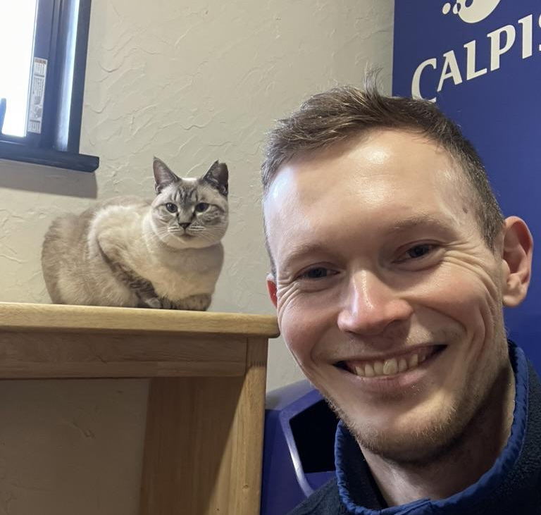

Vegard
Sindre
Sopra Steria
Kraftlauget
https://url.td/gha-ws
Notes:
Background image: https://unsplash.com/photos/pink-skies-kxt_ghfjHBg

