Slide 1

Automated Tail-bound Analysis for Probabilistic Recurrence Relations
Yican Sun, Hongfei Fu, Krishnendu Chatterjee and Amir Kafshdar Goharshady

Slide 2
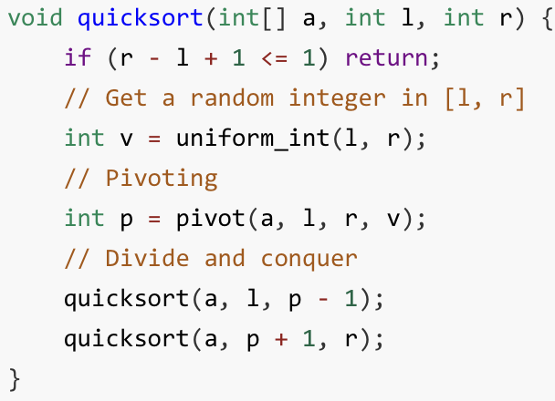
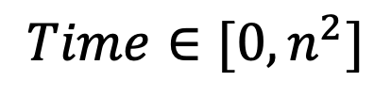
Runtime Analysis of Randomized Algorithms
Randomized Algorithms
Randomized Runtime
Run
$$Time∈[0, n^{2}]$$

Slide 3

Runtime Analysis of Randomized Algorithms
Randomized Algorithms
Randomized Runtime
Run
$$T∈[0, n^{2}]$$
Quantitative
analysis
Notes:
最后加一句： it is a central and fundamental topic in the theory of computation

Slide 4
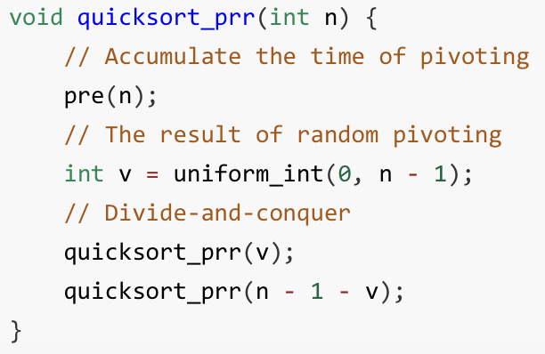
Probabilistic Recurrence Relations (PRRs)
Randomized Algorithms
PRR
Abstract
Notes:
最后加一句： it is a central and fundamental topic in the theory of computation

Slide 5


Automated Tail-bound Analysis on PRRs
PRR
Automated
analysis
Runtime Tail-bound
$$\operatorname{Pr}\left[T≥κ\right]≤ ?$$
Prescribed Time Limit
$$κ=αn⋅ln n$$

Slide 6
Automated Tail-bound Analysis on PRRs
PRR
Automated
analysis
Runtime Tail-bound
$$\operatorname{Pr}\left[T≥κ\right]≤ ?$$
Magnitude
Exponentially-decreasing
Prescribed Time Limit
$$κ=αn⋅ln n$$

Slide 7


Karp’s Method
PRR
Automated
analysis
Runtime Tail-bound
$$\operatorname{Pr}\left[T≥κ\right]≤exp(−α+0.5)$$
Prescribed Time Limit
$$κ=αn⋅ln n$$

Slide 8
Karp’s Method
PRR
Automated
analysis
Runtime Tail-bound
$$\operatorname{Pr}\left[T≥κ\right]≤exp(−α+0.5)$$
Not tight!
Prescribed Time Limit
$$κ=αn⋅ln n$$
Notes:
Actually Karp’s method does not provide tight bounds on all our 12 benchmarks

Slide 9


Karp’s Method vs. Our Method
PRR
Karp’s bound
Automated
analysis
$$\operatorname{Pr}\left[T≥κ\right]≤exp(−α+0.5)$$
Our bound
$$\operatorname{Pr}\left[T≥κ\right]≤exp(\left(4−α\right) ln n)$$
Prescribed Time Limit
$$κ=αn⋅ln n$$
Notes:
We have an extra ln n term.

Slide 10

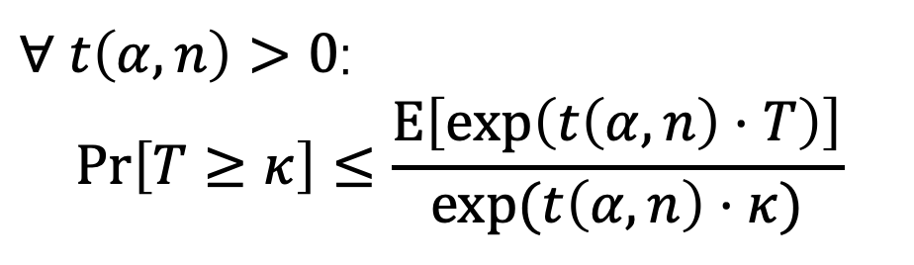
Our Main Theorem
$$\operatorname{Pr}\left[T≥κ\right]≤ ?$$
Exponential form of Markov’s inequality
$∀ t\left(α, n\right)>0$:
$$\operatorname{Pr}\left[T≥κ\right]≤\frac{E\left[\exp\left(t\left(α,n\right)⋅T\right)\right]}{exp⁡(t\left(α,n\right)⋅κ)}$$
Notes:
We have an extra ln n term.

Slide 11
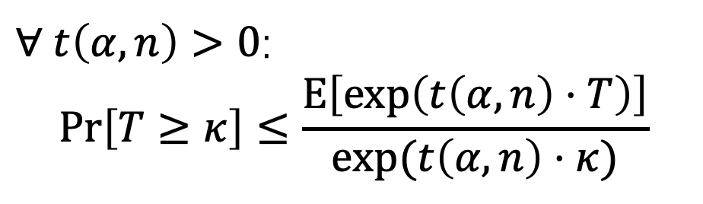
Our Main Theorem: Step 1
$$\operatorname{Pr}\left[T≥κ\right]≤ ?$$
Exponential form of Markov’s inequality
Need further upper bound
$∀ t\left(α, n\right)>0$:
$$\operatorname{Pr}\left[T≥κ\right]≤\frac{E\left[\exp\left(t\left(α,n\right)⋅T\right)\right]}{exp⁡(t\left(α,n\right)⋅κ)}$$
Notes:
We have an extra ln n term.

Slide 12

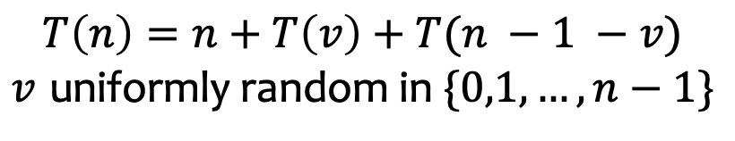
Our Main Theorem: Step 2
$$E\left[\exp\left(t\left(α,n\right)⋅T\right)\right]≤ ?$$
$$T\left(n\right)=n+T\left(v\right)+T(n −1 −v)$$
$v$ uniformly random in $\{0,1,…,n−1\}$
Notes:
We have an extra ln n term.

Slide 13
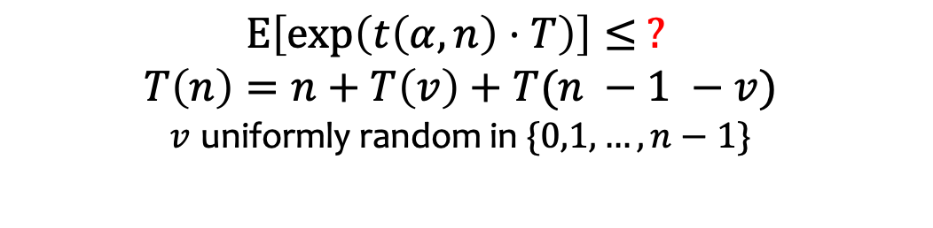
Our Main Theorem: Step 2
$$E\left[\exp\left(t\left(α,n\right)⋅T\right)\right]≤ ?$$
$$T\left(n\right)=n+T\left(v\right)+T(n −1 −v)$$
$v$ uniformly random in $\{0,1,…,n−1\}$
Notes:
We have an extra ln n term.

Slide 14
Our Main Theorem: Step 2
$$E\left[\exp\left(t\left(α,n\right)⋅T\right)\right]≤ ?$$
$$T\left(n\right)=n+T\left(v\right)+T(n −1 −v)$$
$v$ uniformly random in $\{0,1,…,n−1\}$
$$\exp\left(t\left(α,n\right)⋅T(n)\right)=E[exp⁡(t\left(α,n\right)⋅\left(n+T\left(v\right)+T\left(n−1−v\right)\right)]$$
Notes:
We have an extra ln n term.

Slide 15
Our Main Theorem: Step 2
$$E\left[\exp\left(t\left(α,n\right)⋅T\right)\right]≤ ?$$
$$T\left(n\right)=n+T\left(v\right)+T(n −1 −v)$$
$v$ uniformly random in $\{0,1,…,n−1\}$
$$\exp\left(t\left(α,n\right)⋅T(n)\right)=E[exp⁡(t\left(α,n\right)⋅\left(n+T\left(v\right)+T\left(n−1−v\right)\right)]$$
Martingale-based Conditions:
$$\exp\left(t\left(α,n\right)⋅f(α,n)\right)≥E[exp⁡(t\left(α,n\right)⋅\left(n+f\left(α, v\right)+f\left(α,n−1−v\right)\right)]$$
Notes:
We have an extra ln n term.

Slide 16
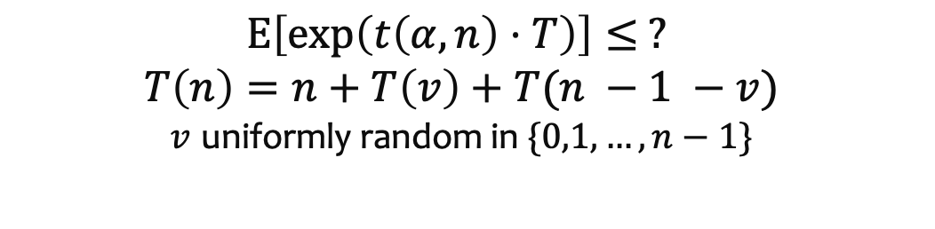
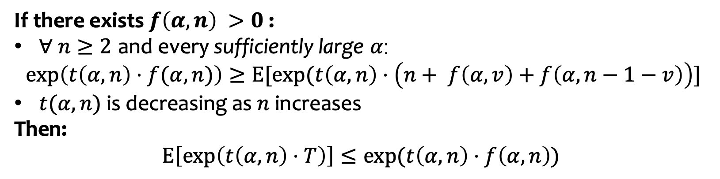
Our Main Theorem: Step 2
$$E\left[\exp\left(t\left(α,n\right)⋅T\right)\right]≤ ?$$
$$T\left(n\right)=n+T\left(v\right)+T(n −1 −v)$$
$v$ uniformly random in $\{0,1,…,n−1\}$
Full Conditions :
If there exists $f\left(α,n\right) >0$ :
$∀ n≥2$ and every sufficiently large $α$:
$$\exp\left(t\left(α,n\right)⋅f(α,n)\right)≥E[exp⁡(t\left(α,n\right)⋅\left(n+ f\left(α, v\right)+f\left(α,n−1−v\right)\right)]$$
$t(α,n)$ is decreasing as $n$ increases
Then:
$$E\left[\exp\left(t\left(α,n\right)⋅T\right)\right]≤exp⁡(t\left(α,n\right)⋅f\left(α,n\right))$$
Notes:
We have an extra ln n term.

Slide 17
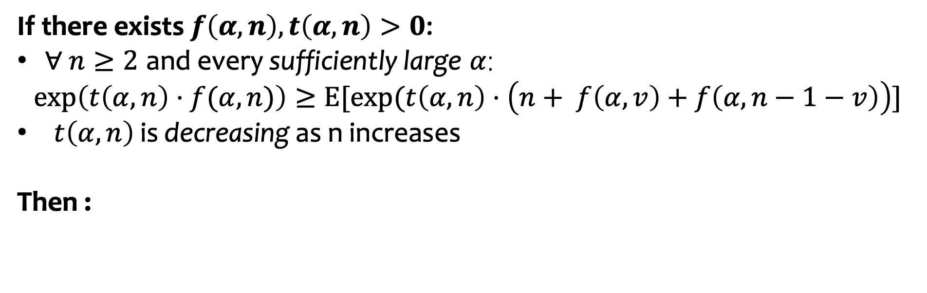
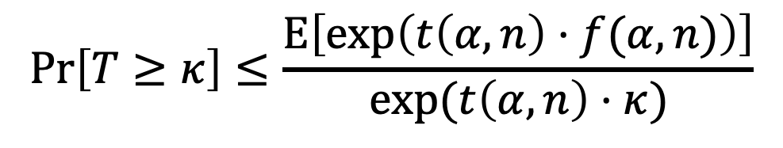
Our Main Theorem: Putting Altogether
If there exists $f\left(α,n\right), t\left(α,n\right)>0$:
$∀ n≥2$ and every sufficiently large $α$:
$$\exp\left(t\left(α,n\right)⋅f(α,n)\right)≥E[exp⁡(t\left(α,n\right)⋅\left(n+ f\left(α, v\right)+f\left(α,n−1−v\right)\right)]$$
$t\left(α,n\right)$ is decreasing as n increases
Then :
$$\operatorname{Pr}\left[T≥κ\right]≤\frac{E\left[\exp\left(t\left(α,n\right)⋅f(α,n)\right)\right]}{exp⁡(t\left(α,n\right)⋅κ)}$$
Notes:
We have an extra ln n term.

Slide 18
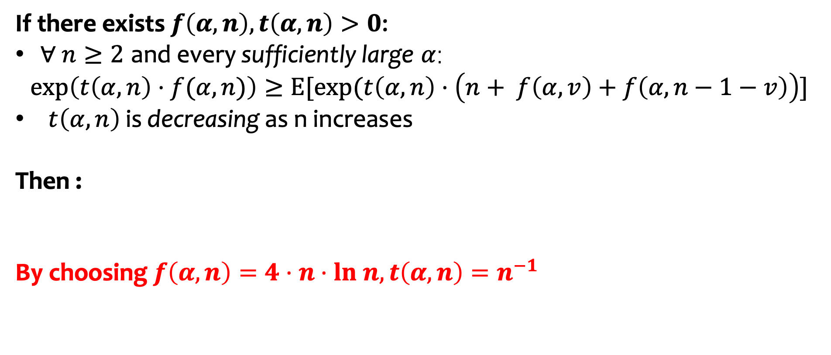

Our Main Theorem: Putting Altogether
If there exists $f\left(α,n\right), t\left(α,n\right)>0$:
$∀ n≥2$ and every sufficiently large $α$:
$$\exp\left(t\left(α,n\right)⋅f(α,n)\right)≥E[exp⁡(t\left(α,n\right)⋅\left(n+ f\left(α, v\right)+f\left(α,n−1−v\right)\right)]$$
$t\left(α,n\right)$ is decreasing as n increases
Then :
By choosing $f\left(α,n\right)=4⋅n⋅ln n, t\left(α,n\right)=n^{−1}$
$$\operatorname{Pr}\left[T≥κ\right]≤\frac{E\left[\exp\left(t\left(α,n\right)⋅f(α,n)\right)\right]}{exp⁡(t\left(α,n\right)⋅κ)}$$
$$\operatorname{Pr}\left[T≥κ\right]≤\exp{(\left(4−α\right)⋅\ln{n})}$$
Notes:
We have an extra ln n term.

Slide 19
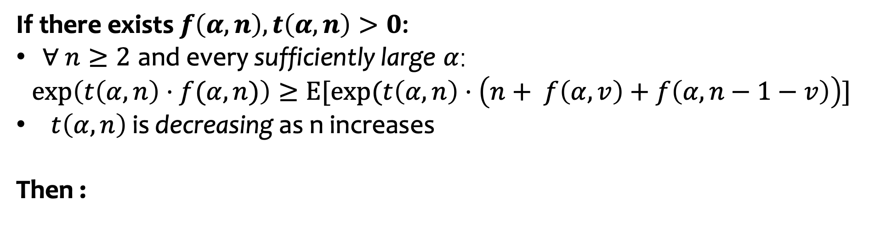

Algorithmic Details
If there exists $f\left(α,n\right), t\left(α,n\right)>0$:
$∀ n≥2$ and every sufficiently large $α$:
$$\exp\left(t\left(α,n\right)⋅f(α,n)\right)≥E[exp⁡(t\left(α,n\right)⋅\left(n+ f\left(α, v\right)+f\left(α,n−1−v\right)\right)]$$
$t\left(α,n\right)$ is decreasing as n increases
Then :
$$\operatorname{Pr}\left[T≥κ\right]≤\frac{E\left[\exp\left(t\left(α,n\right)⋅f(α,n)\right)\right]}{exp⁡(t\left(α,n\right)⋅κ)}$$
How to automatically find $f,t$ ?
Notes:
We have an extra ln n term.

Slide 20
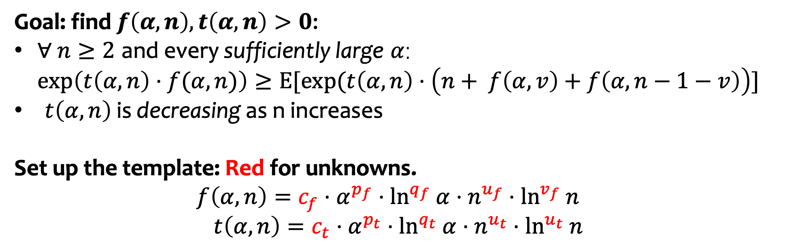
Algorithmic Details
Goal: find $f\left(α,n\right), t\left(α,n\right)>0$:
$∀ n≥2$ and every sufficiently large $α$:
$$\exp\left(t\left(α,n\right)⋅f(α,n)\right)≥E[exp⁡(t\left(α,n\right)⋅\left(n+ f\left(α, v\right)+f\left(α,n−1−v\right)\right)]$$
$t\left(α,n\right)$ is decreasing as n increases
Set up the template: Red for unknowns.
$$f\left(α, n\right)=c_{f}⋅α^{p_{f}}⋅\ln^{q_{f}} α⋅n^{u_{f}}⋅\ln^{v_{f}} n$$
$$t\left(α, n\right)=c_{t}⋅α^{p_{t}}⋅\ln^{q_{t}} α⋅n^{u_{t}}⋅\ln^{u_{t}} n$$
Notes:
We have an extra ln n term.

Slide 21
Algorithmic Details
Goal: find $f\left(α,n\right), t\left(α,n\right)>0$:
$∀ n≥2$ and every sufficiently large $α$:
$$\exp\left(t\left(α,n\right)⋅f(α,n)\right)≥E[exp⁡(t\left(α,n\right)⋅\left(n+ f\left(α, v\right)+f\left(α,n−1−v\right)\right)]$$
$t\left(α,n\right)$ is decreasing as n increases
Set up the template: Red for unknowns.
$$f\left(α, n\right)=c_{f}⋅α^{p_{f}}⋅\ln^{q_{f}} α⋅n^{u_{f}}⋅\ln^{v_{f}} n$$
$$t\left(α, n\right)=c_{t}⋅α^{p_{t}}⋅\ln^{q_{t}} α⋅n^{u_{t}}⋅\ln^{u_{t}} n$$
Enumerate the exponents!
Notes:
We have an extra ln n term.

Slide 22
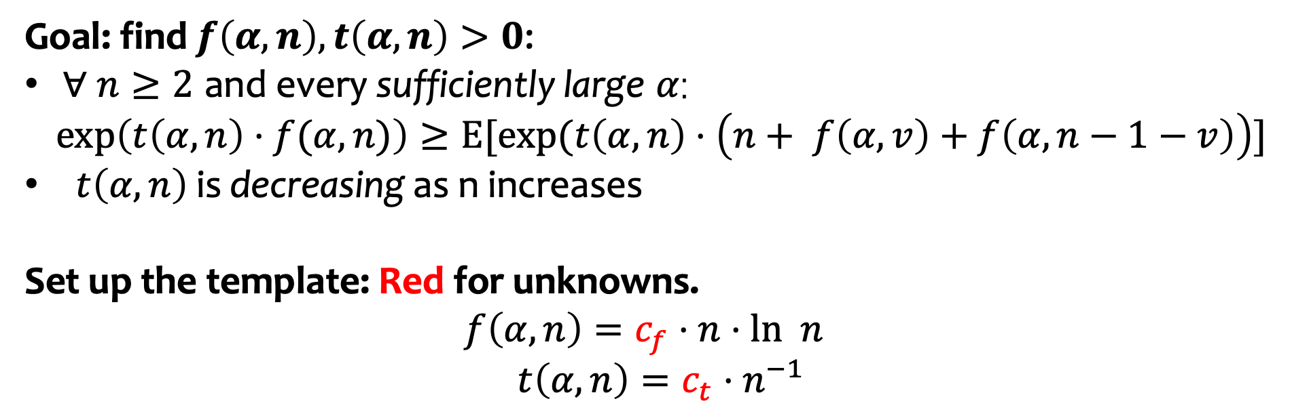
Algorithmic Details
Goal: find $f\left(α,n\right), t\left(α,n\right)>0$:
$∀ n≥2$ and every sufficiently large $α$:
$$\exp\left(t\left(α,n\right)⋅f(α,n)\right)≥E[exp⁡(t\left(α,n\right)⋅\left(n+ f\left(α, v\right)+f\left(α,n−1−v\right)\right)]$$
$t\left(α,n\right)$ is decreasing as n increases
Set up the template: Red for unknowns.
$$f\left(α, n\right)=c_{f}⋅n⋅ln n$$
$$t\left(α, n\right)=c_{t}⋅n^{−1}$$
Notes:
We have an extra ln n term.

Slide 23
Algorithmic Details
Goal: find $f\left(α,n\right), t\left(α,n\right)>0$:
$∀ n≥2$ and every sufficiently large $α$:
$$\exp\left(t\left(α,n\right)⋅f(α,n)\right)≥E[exp⁡(t\left(α,n\right)⋅\left(n+ f\left(α, v\right)+f\left(α,n−1−v\right)\right)]$$
$t\left(α,n\right)$ is decreasing as n increases
Set up the template: Red for unknowns.
$$f\left(α, n\right)=c_{f}⋅n⋅ln n$$
$$t\left(α, n\right)=c_{t}⋅n^{−1}$$
Binary search the coefficient!
Notes:
We have an extra ln n term.

Slide 24
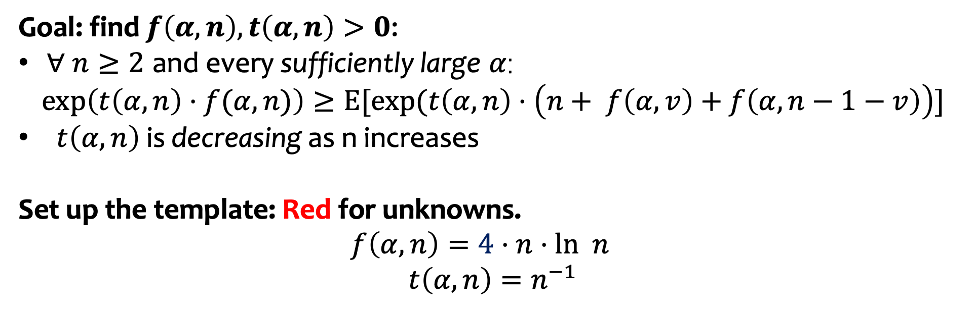
Algorithmic Details
Goal: find $f\left(α,n\right), t\left(α,n\right)>0$:
$∀ n≥2$ and every sufficiently large $α$:
$$\exp\left(t\left(α,n\right)⋅f(α,n)\right)≥E[exp⁡(t\left(α,n\right)⋅\left(n+ f\left(α, v\right)+f\left(α,n−1−v\right)\right)]$$
$t\left(α,n\right)$ is decreasing as n increases
Set up the template: Red for unknowns.
$$f\left(α, n\right)=4⋅n⋅ln n$$
$$t\left(α, n\right)=n^{−1}$$
Verify!
Notes:
We have an extra ln n term.

Slide 25
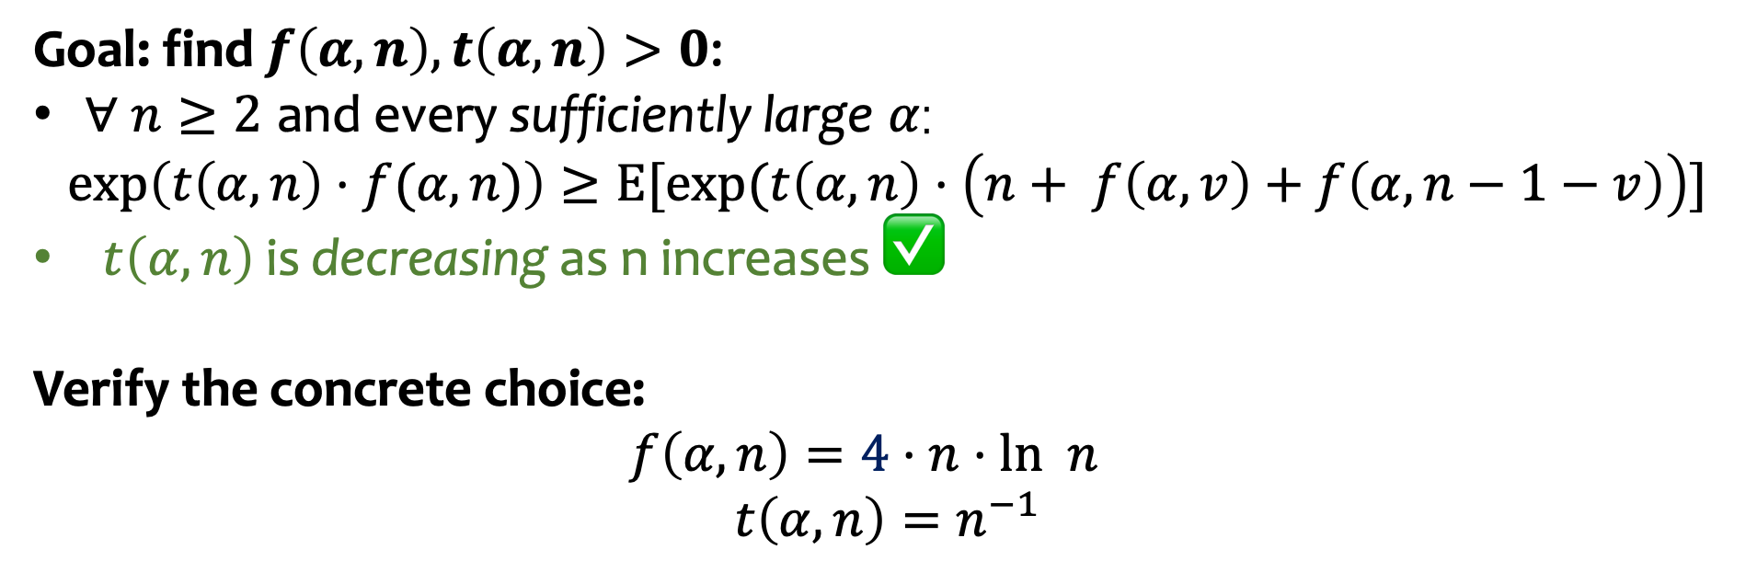
Algorithmic Details
Goal: find $f\left(α,n\right), t\left(α,n\right)>0$:
$∀ n≥2$ and every sufficiently large $α$:
$$\exp\left(t\left(α,n\right)⋅f(α,n)\right)≥E[exp⁡(t\left(α,n\right)⋅\left(n+ f\left(α, v\right)+f\left(α,n−1−v\right)\right)]$$
$t\left(α,n\right)$ is decreasing as n increases ✅
Verify the concrete choice:
$$f\left(α, n\right)=4⋅n⋅ln n$$
$$t\left(α, n\right)=n^{−1}$$
Notes:
We have an extra ln n term.

Slide 26
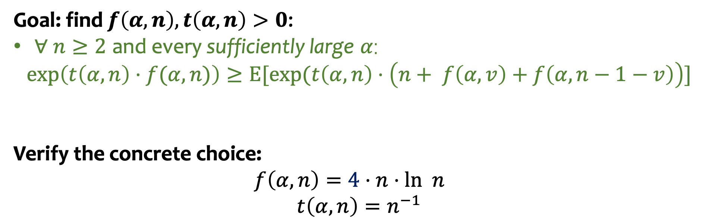
Algorithmic Details
Goal: find $f\left(α,n\right), t\left(α,n\right)>0$:
$∀ n≥2$ and every sufficiently large $α$:
$$\exp\left(t\left(α,n\right)⋅f(α,n)\right)≥E[exp⁡(t\left(α,n\right)⋅\left(n+ f\left(α, v\right)+f\left(α,n−1−v\right)\right)]$$
Verify the concrete choice:
$$f\left(α, n\right)=4⋅n⋅ln n$$
$$t\left(α, n\right)=n^{−1}$$
Notes:
We have an extra ln n term.

Slide 27
Algorithmic Details
Goal: find $f\left(α,n\right), t\left(α,n\right)>0$:
$∀ n≥2$ and every sufficiently large $α$:
$$\exp\left(t\left(α,n\right)⋅f(α,n)\right)≥E[exp⁡(t\left(α,n\right)⋅\left(n+ f\left(α, v\right)+f\left(α,n−1−v\right)\right)]$$
Verify the concrete choice:
$$f\left(α, n\right)=4⋅n⋅ln n$$
$$t\left(α, n\right)=n^{−1}$$
plug in!
Notes:
We have an extra ln n term.

Slide 28
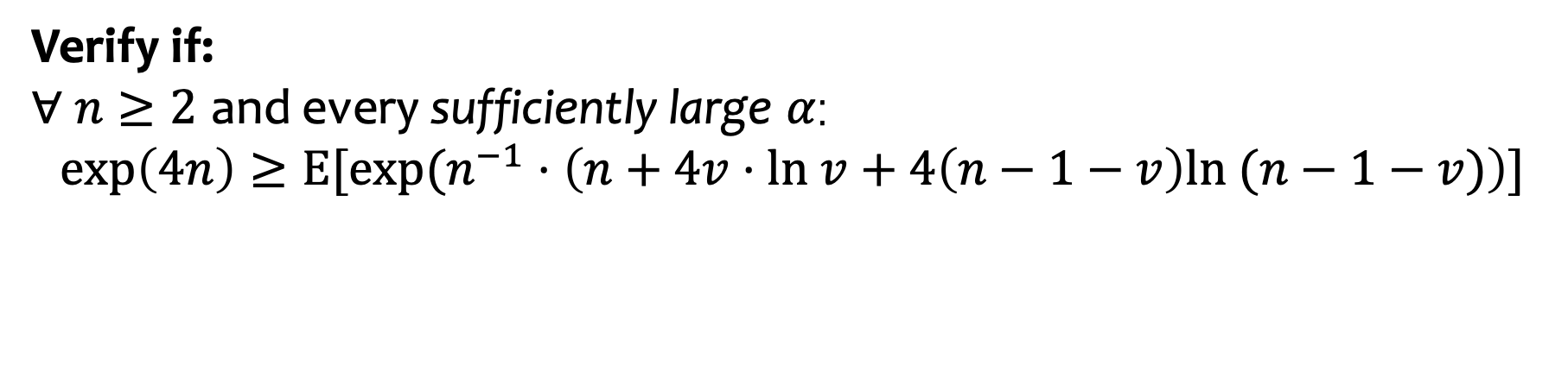
Algorithmic Details
Verify if:
$∀ n≥2$ and every sufficiently large $α$:
$$\exp\left(4n\right)≥E[exp⁡(n^{−1}⋅\left(n+4v⋅ln v+4\left(n−1−v\right)ln (n−1−v)\right)]$$
Very hard conditions!
Notes:
We have an extra ln n term.

Slide 29
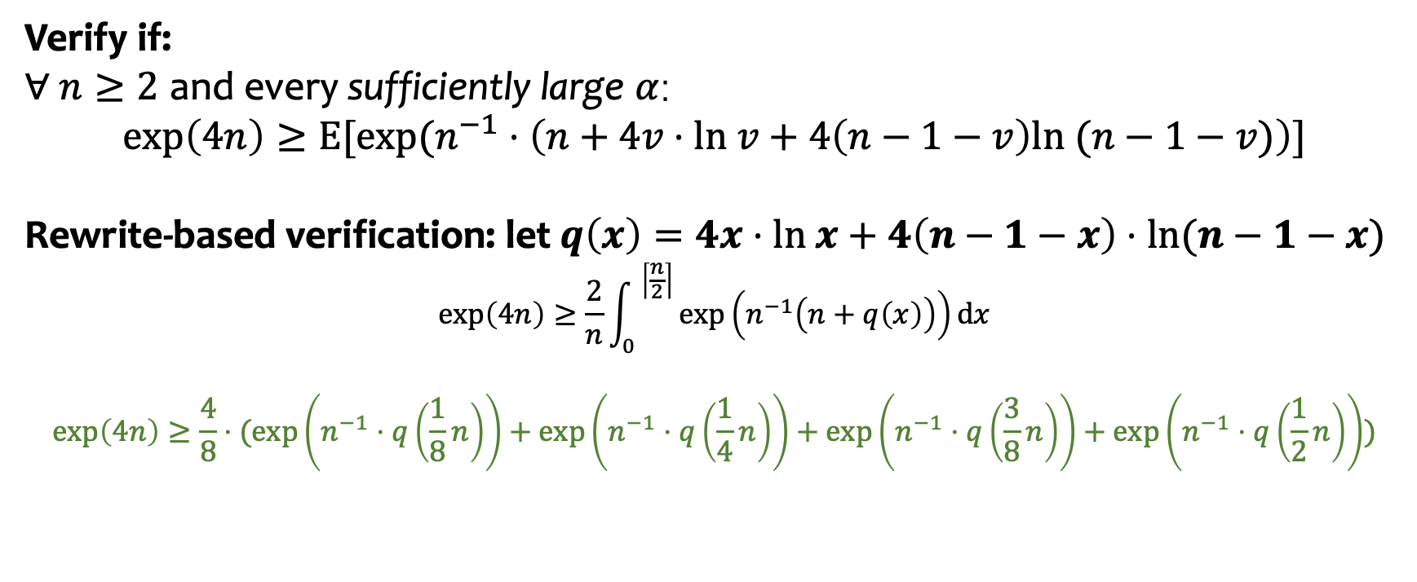
Algorithmic Details
Verify if:
$∀ n≥2$ and every sufficiently large $α$:
$$\exp\left(4n\right)≥E[exp⁡(n^{−1}⋅\left(n+4v⋅ln v+4\left(n−1−v\right)ln (n−1−v)\right)]$$
Rewrite-based verification: let $q\left(x\right)=4x⋅ln x+4\left(n−1−x\right)⋅ln(n−1−x)$
$$\exp\left(4n\right)≥{\frac{2}{n}\int_{0}{ }}^{\left\lceil \frac{n}{2}\right\rceil }\exp\left(n^{−1}\left(n+q\left(x\right)\right)\right)dx$$
$$\exp\left(4n\right)≥\frac{4}{8}⋅(\exp\left(n^{−1}⋅q\left(\frac{1}{8}n\right)\right)+\exp\left(n^{−1}⋅q\left(\frac{1}{4}n\right)\right)+\exp\left(n^{−1}⋅q\left(\frac{3}{8}n\right)\right)+\exp\left(n^{−1}⋅q\left(\frac{1}{2}n\right)\right))$$
✅
Notes:
We have an extra ln n term.

Slide 30
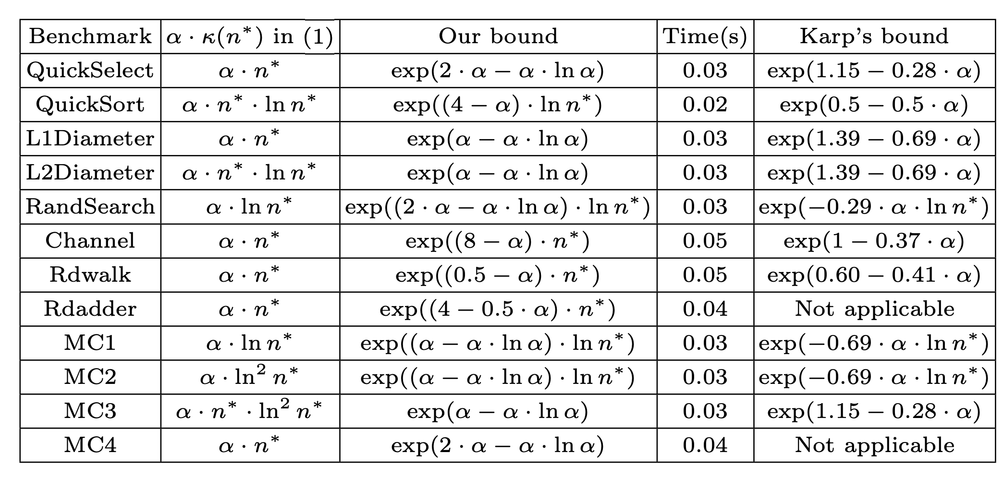
Experimental Details
Notes:
We have an extra ln n term.

Slide 31
Thank you!
Notes:
We have an extra ln n term.

