Slide 1


Proving Functional Program Equivalence via Directed Lemma Synthesis
Yican Sun, Ruyi Ji, Jian Fang, Xuanlin Jiang
Mingshuai Chen, Yingfei Xiong
Notes:
Good afternoon everyone, I am Yican from Peking University. Today, I would like to introduce our recent work on proving program equivalence.

Slide 2

Proving Functional Program Equivalence
Given two functional programs $p_{1},p_{2}$ over the same input $\overline{x}$.
Prove:
$$∀\overline{x}. p_{1}\left(\overline{x}\right)=p_{2}(\overline{x})$$
Notes:
Let me first introduce proving functional program equivalence. We are given two functional programs p1 and p2 over the same input x. Our goal is to prove that p1 and p2 always output the same value.
Proving functional program equivalence is an important problem in program verification.

Slide 3
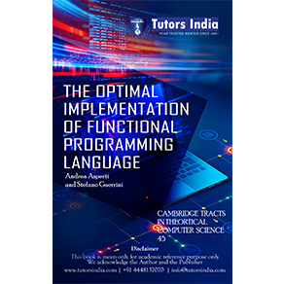

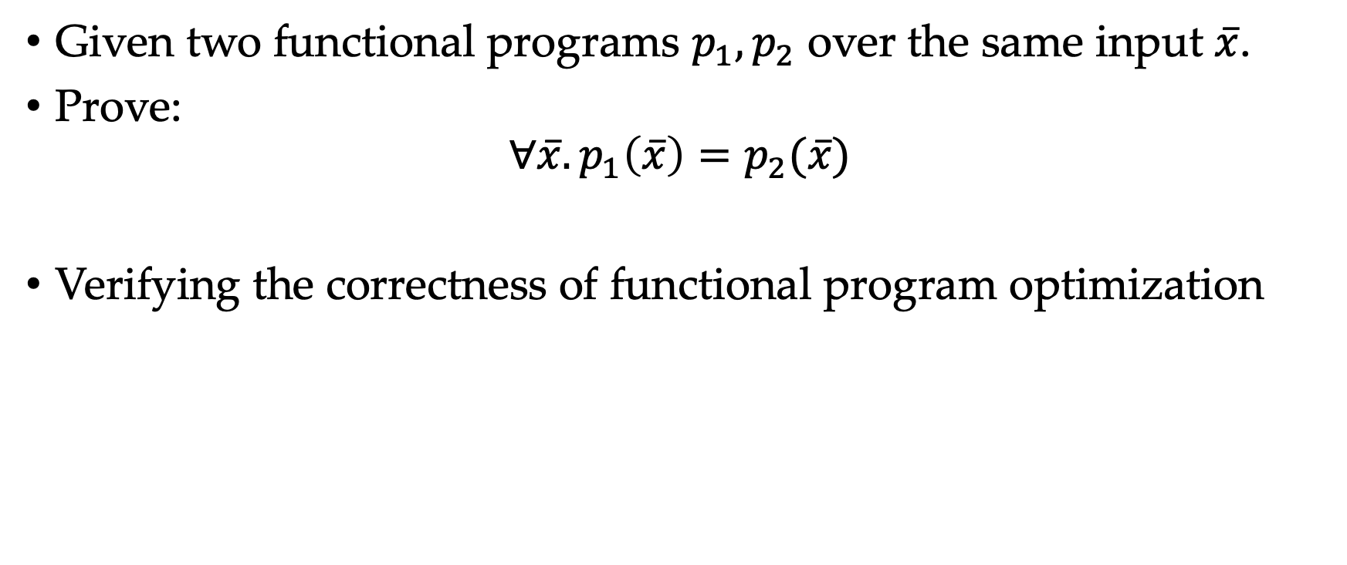
Proving Functional Program Equivalence
Given two functional programs $p_{1},p_{2}$ over the same input $\overline{x}$.
Prove:
$$∀\overline{x}. p_{1}\left(\overline{x}\right)=p_{2}(\overline{x})$$
Verifying the correctness of functional program optimization
Notes:
First, it is the basic way to verify the correctness of the functional program optimization, where we need to prove that the optimized program is equivalent to the original one.

Slide 4

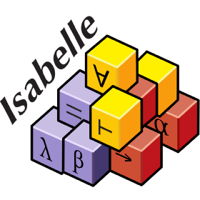
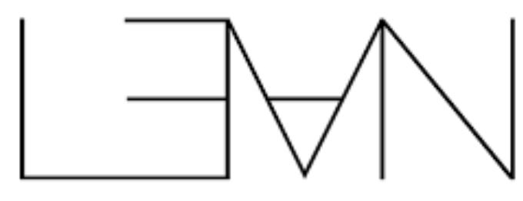
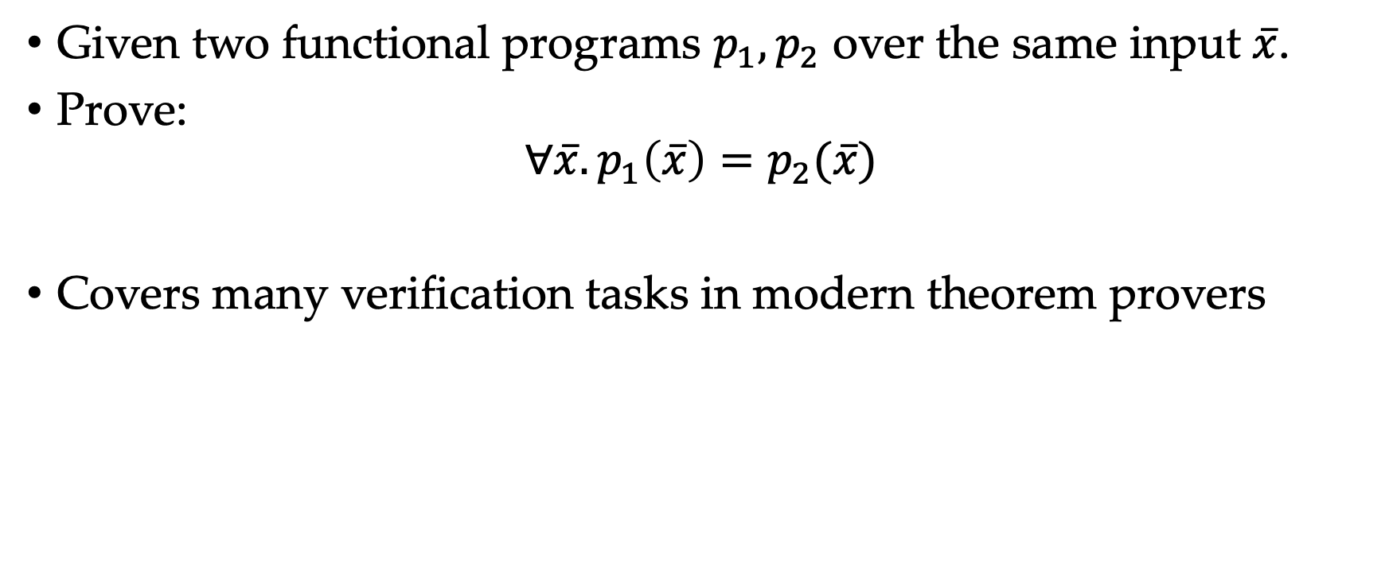
Proving Functional Program Equivalence
Given two functional programs $p_{1},p_{2}$ over the same input $\overline{x}$.
Prove:
$$∀\overline{x}. p_{1}\left(\overline{x}\right)=p_{2}(\overline{x})$$
Covers many verification tasks in modern theorem provers
Notes:
Second, it covers many verification tasks in modern theorem provers, because modern theorem provers often uses functional languages as their core language.

Slide 5
Proving Functional Program Equivalence is Hard
Notes:
Proving functional program equivalence is hard.

Slide 6

Proving Functional Program Equivalence is Hard
Algebraic data type: Inductively-defined composite type
Notes:
The hardness comes from two aspects.
First, we need reason the behavior of algebraic data types. They are inductively-defined composite type. For example, a common algebraic data type List consists of two constructors. The first one is nil, representing an empty list. The second one is cons, it concats a list and a head element into a bigger list.

Slide 7
Proving Functional Program Equivalence is Hard
Algebraic data type: Inductively-defined composite type
Structural Recursion
Notes:
Second, we need to reason structural recursions, they are typical ways to process values with algebraic data type.

Slide 8
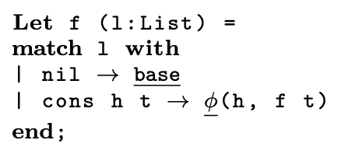
Proving Functional Program Equivalence is Hard
Algebraic data type: Inductively-defined composite type
Structural Recursion
Notes:
For example, the structural recursion over list follows the template below. For a nil list, the template outputs a value base. For a cons list, it first recursively invokes 'f t'. Then it combines `f t` with the head element h using a function phi.

Slide 9
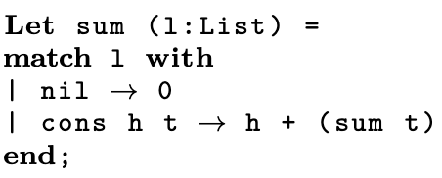
Proving Functional Program Equivalence is Hard
Algebraic data type: Inductively-defined composite type
Structural Recursion
Notes:
For example, consider the sum function that adds up all elements of a input list ell. For an empty list, it simply outputs 0. For a cons list, it adds the head element with the summation over the tail sublist.
Both aspects are non-trivial challenges for automated provers.

Slide 10
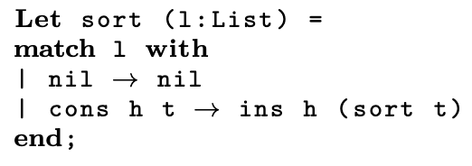
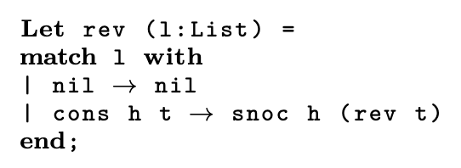
Proving Functional Program Equivalence is Hard
$$∀xs:List. sum \left(rev xs\right)=sum (sort xs)$$
Notes:
To be more concrete, let us see a running example.
The left hand side adds up all elements over the reversed list, that is, rev xs. While the right hand side first applies insertion sort to the input list xs, and then applies the sum function.
All the functions sum, rev and sort are written by a structural recursion.

Slide 11
Proving Functional Program Equivalence is Hard
Algebraic data structure
$$∀xs:List. sum \left(rev xs\right)=sum (sort xs)$$
Notes:
We can see that the example consists of algebraic data structures.

Slide 12
Proving Functional Program Equivalence is Hard
Compositions of structural recursion
$$∀xs:List. sum \left(rev xs\right)=sum (sort xs)$$
Notes:
and compositions of structural recursion.

Slide 13
How to Prove Functional Program Equivalence
Natural approach: Induction
However, induction only on the original proposition may fail
Notes:
So, how to prove functional program equivalence?
Since algebraic data types are inductively-defined. The natural approach is the structural induction!
However, if we only apply induction on the original proposition, we may fail.

Slide 14
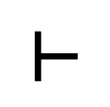
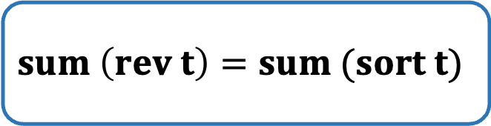


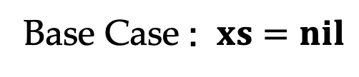
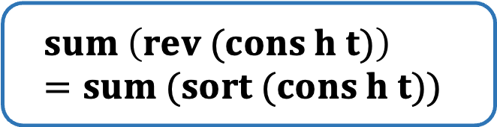
Why Induction May fail
$$∀xs:List. sum \left(rev xs\right)=sum (sort xs)$$
Base Case : $xs=nil$
$$sum \left(rev nil\right)=sum (sort nil)$$
Induction Case : $xs=cons h t$
$$sum \left(rev t\right)=sum (sort t)$$
$$sum \left(rev (cons h t)\right)=sum (sort (cons h t))$$
$$⊢$$
Induction Hypothesis
Notes:
To see why induction may fail, consider our running example.
We make an induction over xs. We need to consider two cases.
In the first base case, we prove the proposition when xs equals nil.
In the second induction case, we represent xs as cons h t, and assume that the proposition have been hold on t. The goal is to prove that the proposition holds for cons h t.

Slide 15
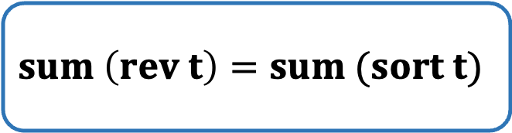
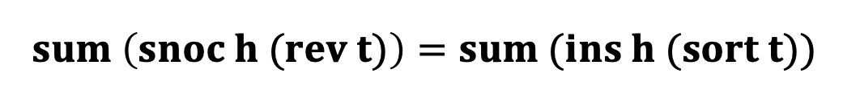
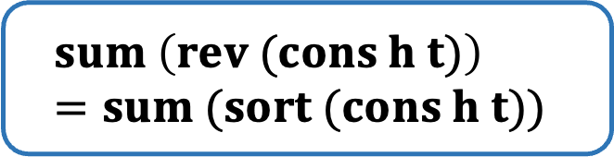
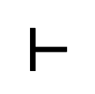
Why Induction May fail
$$sum \left(rev t\right)=sum (sort t)$$
$$sum \left(rev (cons h t)\right)=sum (sort (cons h t))$$
$$⊢$$
Induction Hypothesis
Rewriting the goal
$$sum \left(snoc h (rev t)\right)=sum (ins h (sort t))$$
Notes:
By rewriting the goal, we get the following equation.

Slide 16
Why Induction May fail
$$sum \left(rev t\right)=sum (sort t)$$
$$sum \left(rev (cons h t)\right)=sum (sort (cons h t))$$
$$⊢$$
Induction Hypothesis
Rewriting the goal:
$$sum \left(snoc h (rev t)\right)=sum (ins h (sort t))$$
Induction hypothesis cannot apply 😭
Notes:
We find that neither side of the induction hypothesis appears as a subterm in our goal. Thus, we can not apply the induction hypothesis, making the induction meaningless.

Slide 17
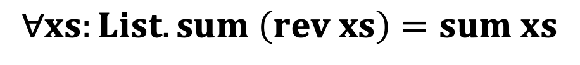
Full Approach: Induction + Lemma
$$∀xs:List. sum \left(rev xs\right)=sum (sort xs)$$
We need to invent the lemma:
$$∀xs:List. sum \left(rev xs\right)=sum xs$$
Notes:
In this case, we need to invent auxiliary lemmas before applying induction.

Slide 18
Full Approach: Induction + Lemma
$$∀xs:List. sum \left(rev xs\right)=sum (sort xs)$$
We need to invent the lemma:
$$∀xs:List. sum \left(rev xs\right)=sum xs$$
Theorem (informal)
The proposition cannot be proved without lemmas!
Notes:
We can even show that the original proposition cannot be proved without lemmas.

Slide 19
Lemma Finding
Lack of systematic study
Previous work: try every lemma based on heuristics:
Enumerate lemmas from small to large
Rank lemmas by text similarity
Predict lemmas by machine learning
Notes:
This makes lemma finding an important module in automated provers. However, there still lacks a systematic study for lemma finding.
Thus, previous works just try every lemma based on some heuristic. For example, enumerate lemmas from small to large, rank lemmas by text similarity, or predict a lemma by machine-learning.

Slide 20
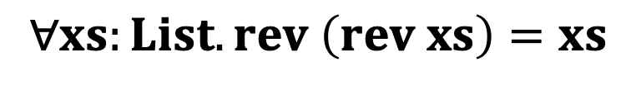
Lemma Finding
Lack of systematic study
Previous work: try every lemma based on heuristics:
Enumerate lemmas from small to large
Rank lemmas by text similarity
Predict lemmas by machine learning
Waste a lot of times trying useless lemmas, e.g.:
Hipspec tries the lemma
$$∀xs:List. sum \left(rev xs\right)=sum (sort xs)$$
$$∀xs:List. rev \left(rev xs\right)=xs$$
Notes:
All these approaches may waste a lot of time trying useless lemmas.
For our running example, the tool HipSpec may try the lemma rev rev xs = xs, which has little help in proving the original proposition.

Slide 21
Directed Lemma Synthesis
Make lemma synthesis systematic
Notes:
Thus, In our work, we propose directed lemma synthesis to make lemma finding systematic.

Slide 22
Directed Lemma Synthesis
Make lemma synthesis systematic
Directed by Induction-friendly forms
(Key conceptual novelty)
Notes:
Our lemma synthesis framework is directed by induction-friendly forms, which is the key conceptual novelty.

Slide 23
Induction-friendly forms
Definition (informal)
Proposition forms where for every proposition in this form, we can apply inductive hypothesis after induction.
Notes:
Briefly speaking, induction-friendly forms are proposition forms where for every proposition in this form, we can apply the induction hypothesis and do generalization to make the proposition `simpler` after induction.

Slide 24
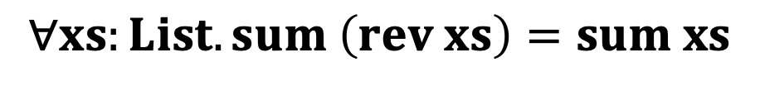
Induction-friendly forms
Definition (informal)
Proposition forms where for every proposition in this form, we can apply inductive hypothesis after induction.
Example: Either side is a single structural recursion
$$∀xs:List. sum \left(rev xs\right)=sum xs$$
Notes:
We give an example of induction-friendly forms. That is: Either side is a single structural recursion without composition.
To see why it is an induction-friendly form, consider the following proposition, which just removes the sort function in the right-hand-side.

Slide 25
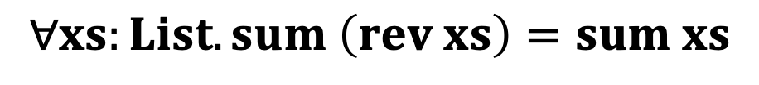
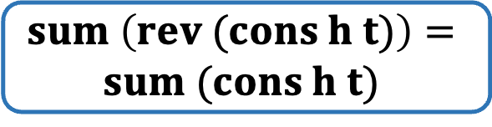
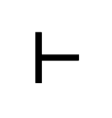
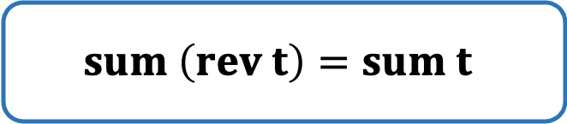
Induction-friendly forms
$$∀xs:List. sum \left(rev xs\right)=sum xs$$
Induction Case : $xs=cons h t$
$$sum \left(rev t\right)=sum t$$
$$⊢$$
$$sum \left(rev (cons h t)\right)=$$
$$sum (cons h t)$$
Induction Hypothesis
Notes:
For the induction case, we need to prove the following.

Slide 26
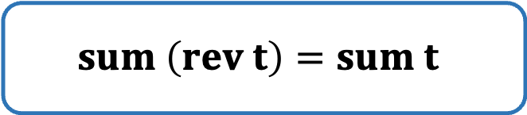

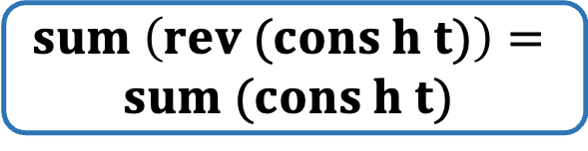
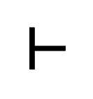
Induction-friendly forms
$$sum \left(rev t\right)=sum t$$
$$⊢$$
$$sum \left(rev (cons h t)\right)=$$
$$sum (cons h t)$$
Induction Hypothesis
Rewriting the goal
$$sum \left(snoc h (rev t)\right)=h+sum t$$
Notes:
We first rewriting the goal

Slide 27


Induction-friendly forms
$$sum \left(rev t\right)=sum t$$
$$⊢$$
$$sum \left(rev (cons h t)\right)=$$
$$sum (cons h t)$$
Induction Hypothesis
Rewriting the goal
$$sum \left(snoc h (rev t)\right)=h+sum t$$
Notes:
, and we find that the right-hand-side of the hypothesis, sum t, appears as a subterm

Slide 28

Induction-friendly forms
$$sum \left(rev t\right)=sum t$$
$$⊢$$
$$sum \left(rev (cons h t)\right)=$$
$$sum (cons h t)$$
Induction Hypothesis
Rewriting the goal
$$sum \left(snoc h (rev t)\right)=h+sum t$$
Apply Inductive Hypothesis
$$sum \left(snoc h (rev t)\right)=h+sum (rev t)$$
Notes:
Thus, we apply the inductive hypothesis

Slide 29
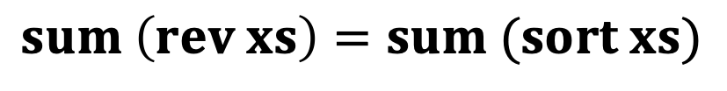
Directed Lemma Synthesis
$$sum \left(rev xs\right)=sum (sort xs)$$
Either side is a single structural recursion
Notes:
We have proposed an induction-friendly form. But our running exmaple does not satisfy this form. We have also already seen that induction over the running example gets stuck.
So, what should we do?

Slide 30
Directed Lemma Synthesis
$$sum \left(rev xs\right)=sum (sort xs)$$
Transform into?
Either side is a single structural recursion
Notes:
A natural approach is to transform the running example into induction-friendly forms.

Slide 31
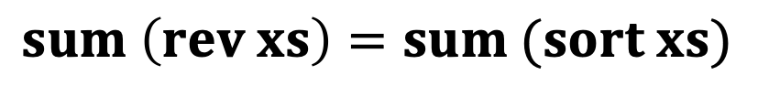


Directed Lemma Synthesis
$$sum \left(rev xs\right)=sum (sort xs)$$
Synthesize structural recursion f
as the “bridge”
$$sum \left(rev xs\right)=f xs$$
$$f xs= sum \left(sort xs\right)$$
fall into
Either side is a single structural recursion
Notes:
The transformation requires us to synthesize a structural recursion f as the bridge, and decompose the original proposition into two subtasks. The first subtask is the lemma we propose, and the second subtask is the transformed proposition after applying the lemma.
We can see that both tasks fall into the induction-friendly form, that's very nice.
Thats what we call directed lemma synthesis. The direction is to transform propositions in bad forms into induction-friendly forms.

Slide 32
Directed Lemma Synthesis
$$sum \left(rev xs\right)=sum (sort xs)$$
Synthesize structural recursion f
as the “bridge”
$$sum \left(rev xs\right)=f xs$$
Notes:
The transformation requires us to synthesize a structural recursion f as the bridge, and decompose the original proposition into two subtasks. The first subtask is the lemma we propose, and the second subtask is the transformed proposition after applying the lemma.
We can see that both tasks fall into the induction-friendly form, that's very nice.
Thats what we call directed lemma synthesis. The direction is to transform propositions in bad forms into induction-friendly forms.

Slide 33
Directed Lemma Synthesis
$$sum \left(rev xs\right)=sum (sort xs)$$
Synthesize structural recursion f
as the “bridge”
$$sum \left(rev xs\right)=f xs$$
$$f xs= sum \left(sort xs\right)$$
Notes:
The transformation requires us to synthesize a structural recursion f as the bridge, and decompose the original proposition into two subtasks. The first subtask is the lemma we propose, and the second subtask is the transformed proposition after applying the lemma.
We can see that both tasks fall into the induction-friendly form, that's very nice.
Thats what we call directed lemma synthesis. The direction is to transform propositions in bad forms into induction-friendly forms.

Slide 34
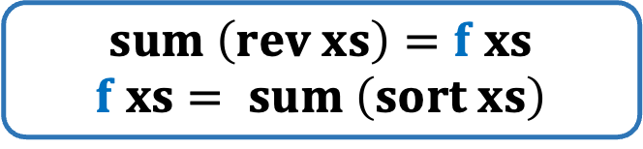
Directed Lemma Synthesis
$$sum \left(rev xs\right)=sum (sort xs)$$
Synthesize structural recursion f
as the “bridge”
$$sum \left(rev xs\right)=f xs$$
$$f xs= sum \left(sort xs\right)$$
fall into
Either side is a single structural recursion
Notes:
But how to synthesize f? Observe that a structural recursion follows a strict template.
Using this template, we just need to synthesize two expressions base and phi.

Slide 35

How to Synthesize $f$ ?
$$sum \left(rev xs\right)=sum (sort xs)$$
Synthesize structural recursion f
as the “bridge”
$$sum \left(rev xs\right)=f xs$$
$$f xs= sum \left(sort xs\right)$$
fall into
Either side is a single structural recursion
Notes:
But how to synthesize f? Observe that a structural recursion follows a strict template.
Using this template, we just need to synthesize two expressions base and phi.

Slide 36
How to Synthesize $f$ ?
$$sum \left(rev xs\right)=sum (sort xs)$$
Synthesize structural recursion f
as the “bridge”
Standard program synthesis!
$$sum \left(rev xs\right)=f xs$$
$$f xs= sum \left(sort xs\right)$$
fall into
Either side is a single structural recursion
Notes:
This is a standard task in program synthesis, and can be done by off-the-shelf synthesizer.

Slide 37
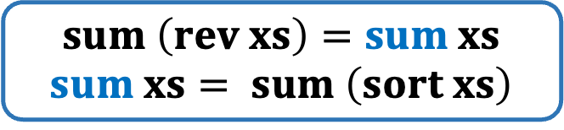
Directed Lemma Synthesis
$$sum \left(rev xs\right)=sum (sort xs)$$
Synthesize structural recursion f
as the “bridge”
$$sum \left(rev xs\right)=sum xs$$
$$sum xs= sum \left(sort xs\right)$$
fall into
Either side is a single structural recursion
Notes:
In our running example, f is the sum function.

Slide 38
Summary: Our Design
Step 1: Identify induction-friendly forms
Either side is a single structural recursion
Notes:
To summarize, our design of lemma synthesis module consists of two steps.
First, we identify induction-friendlu forms.

Slide 39
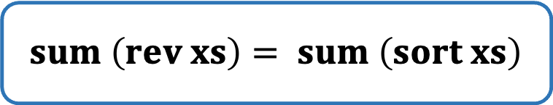
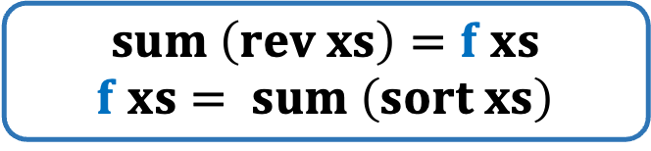
Summary: Our Design
Step 1: Identify induction-friendly forms
Either side is a single structural recursion
Step 2: Propose Lemma Tactics from the form
Synthesize structural recursion f
as the “bridge”
$$sum \left(rev xs\right)= sum \left(sort xs\right)$$
$$sum \left(rev xs\right)=f xs$$
$$f xs= sum \left(sort xs\right)$$
Notes:
Second, we propose lemma tactics to transform a given proposition into these forms.
In our paper, we propose 3 induction-friendly forms and 2 lemma tactics in total.

Slide 40
Summary: Our Design
Step 1: Identify induction-friendly forms
Step 2: Propose Lemma Tactics from the form
Directed
Efficient
Notes:
Our lemma tactics have two desirable properties.
The first property is ’directed’, our lemma tactics ensures that: as long as the tactic is successfully applied, the input proposition can be finally transformed into an induction-friendly forms.
The second property is `efficient`, the application of our lemma tactic reduces to standard program synthesis tasks, which can be efficiently solved by existing solver.

Slide 41
Evaluation
Implement our tool on top of CVC4
Notes:
We have implemented our tool on top of CVC4.

Slide 42
Evaluation
Implement our tool on top of CVC4
Benchmarks:
248 from the equivalence subset of standard benchmarks
CLAM, Isaplanner, TIP
22 extended benchmarks with mixed ADT+LIA theory
Notes:
Our benchmarks consists of two parts.
The first part is the equivalence subset of standard benchmarks in functional program verification.
The second part is the extended benchmarks, mixing the theory of algebraic data types and linear integer arithmetics.

Slide 43
Evaluation
Implement our tool on top of CVC4
Benchmarks:
248 from the equivalence subset of standard benchmarks
CLAM, Isaplanner, TIP
22 extended benchmarks with mixed ADT+LIA theory
Baseline: CVC4+Ind
Directed Lemma Synthesis vs. Enumerative Lemma finding
Notes:
Our baseline is the induction version of CVC4, which uses lemma enumeration.
Thus, our evaluation shows the strength of directed lemma synthesis over enumerative lemma finding.

Slide 44
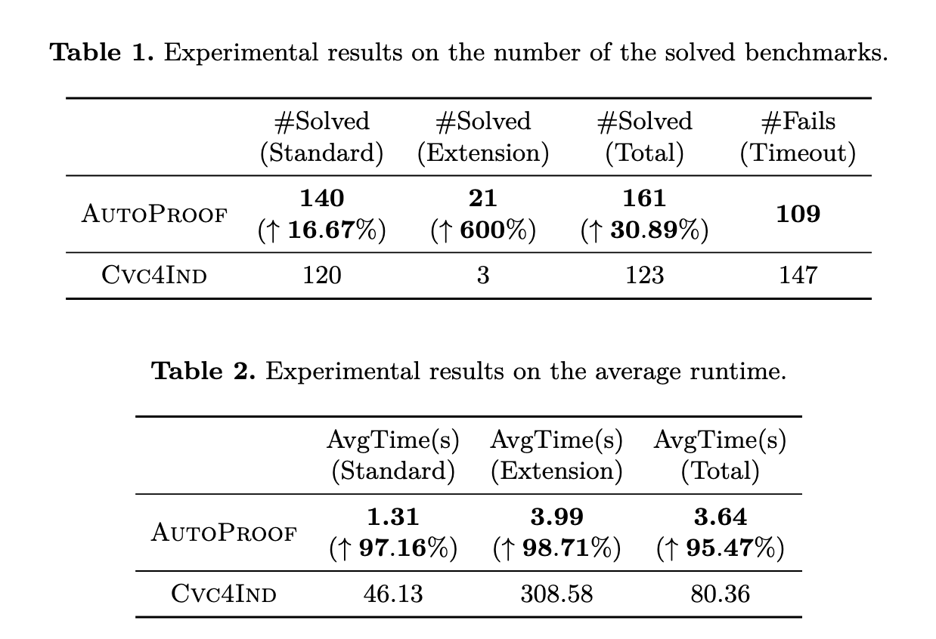
Evaluation Result
Significantly beat CVC4+Ind
Save 95.47% runtime
Solve 30.89% more problems
Notes:
The results shows that our tool significantly beats CVC4 + Induction, saving 95% of time and solving 31% more problems.

Slide 45
Thanks!
Full paper: https://arxiv.org/abs/2405.11535
2 induction-friendly forms + 2 lemma tactics
Proof of the Theorems
Artifact: https://doi.org/10.5281/zenodo.12532389
Notes:
Thank you so much!
Any questions?

Slide 46
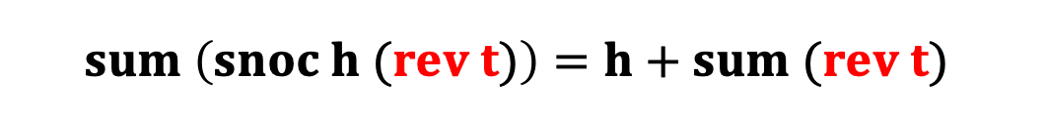
Induction-friendly forms
$$sum \left(rev t\right)=sum t$$
$$⊢$$
$$sum \left(rev (cons h t)\right)=$$
$$sum (cons h t)$$
Induction Hypothesis
Rewriting the goal
$$sum \left(snoc h (rev t)\right)=h+sum t$$
Apply Inductive Hypothesis
$$sum \left(snoc h (rev t)\right)=h+sum (rev t)$$
Notes:
and find that there is a common rev t in both side.

Slide 47

Induction-friendly forms
$$sum \left(rev t\right)=sum t$$
$$⊢$$
$$sum \left(rev (cons h t)\right)=$$
$$sum (cons h t)$$
Induction Hypothesis
Rewriting the goal
$$sum \left(snoc h (rev t)\right)=h+sum t$$
Apply Inductive Hypothesis
$$sum \left(snoc h (rev t)\right)=h+sum (rev t)$$
Generalization
$$sum \left(snoc h r\right)=h+sum r$$
Notes:
thus we can do generalization.

