Slide 1

Synthesis and Verification of Algorithms
Yican Sun
Notes:
Good morning everyone, I am Yican from Peking University. Today, I will talk about synthesis and verification of algorithms.

Slide 2
Algorithm is Important but Hard
Designing algorithms requires human insight
Notes:
Algorithm is important to improve efficiency. But Writing an algorithm is hard. First, Designing algorithms requires human insight.

Slide 3
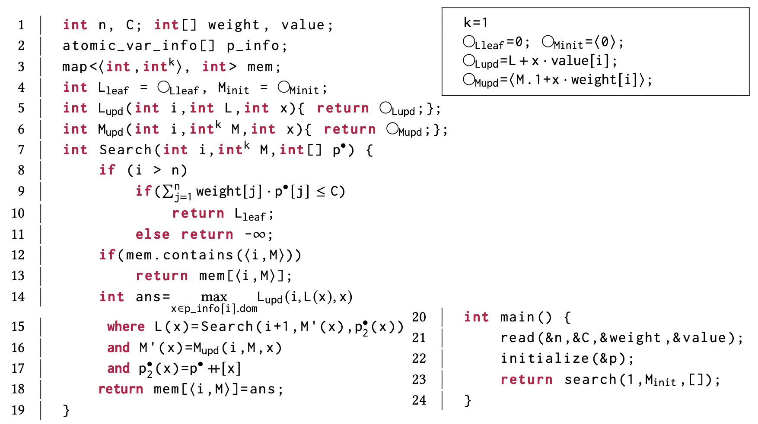
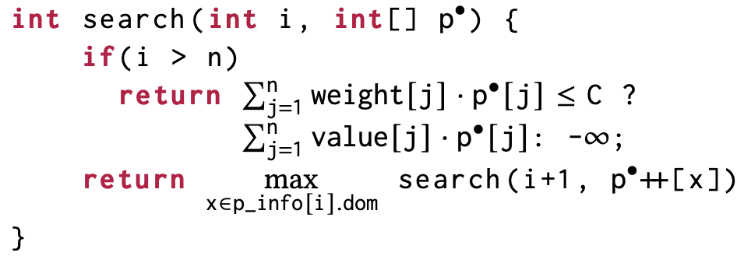
Algorithm is Important but Hard
Designing algorithms requires human insight
e.g.: Knapsack
Enumerative Search: Easy
Dynamic Programming: Hard
Overlapping subproblem
Optimal Substructure
Notes:
For example, for the knapsack problem, writing an enumerative search is easy. But writing a dynamic programming is hard.
It requires people to discover the overlapping subproblem and optimal substructure.

Slide 4
Algorithm is Important but Hard
(2) Implementing algorithms is error-prone
e.g.: Knapsack
Enumerative Search: 5 lines
Dynamic Programming: 20+ lines
Notes:
Second, Implementing algorithms is error-prone due to its higher code-complexity.

Slide 5
Algorithm Synthesis
Formal
Specification
Expected Algorithm
Paradigm
Desired Algorithm
e.g., divide-and-conquer,
dynamic programming, etc.
Notes:
Thus, it is attractive to consider automated synthesis of algorithm.
Specically. At the input side, we are given a formal specification to specify the input-output behavior of the algorithm.
We are also given the expected algorithmic paradigm (such as the divide-and-conquer or dynamic programming).
At the output side, we synthesize an algorithm with the given paradigm and satisfies the specification.

Slide 6
Algorithm Synthesis
Brute-force Reference Program
Synthesize an algorithm
equivalent to the reference program
Formal
Specification
Declarative Specification
e.g., MiniZinc, Weighted programming
Notes:
The specification can be in various forms. It can be a brute-force reference program.
In this case, the goal is to synthesize an algorithm equivalent to the reference.
It can also be a declarative specification written in some language, such as MiniZinc or weight programming.

Slide 7
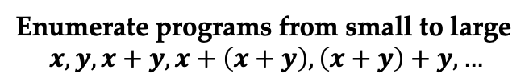
How to Synthesize Algorithms?
State-of-the-art: Inductive Approach
Enumerator
Enumerate programs from small to large
$$x,y,x+y,x+\left(x+y\right),\left(x+y\right)+y,…$$
Fail
Candidate Program
Test
Pass
Notes:
So, how to synthesize algorithms
Modern algorithm synthesizers applies the inductive approach.
It basically searches all programs from small to large, and test the current candidate using randomly-generated inputs.

Slide 8
How to Synthesize Algorithms?
State-of-the-art: Inductive Approach
Successful in D&C (like) algorithm
Widely open for other algorithms
Synthesis result is not guaranteed to be correct
Enumerator
Enumerate programs from small to large
$$x,y,x+y,x+\left(x+y\right),\left(x+y\right)+y,…$$
Fail
Candidate Program
Test
Pass
Notes:
Such approaches have been successfully applied to divide-and-conquer algorithms.
However, there is still a big blank on how to synthesize other kinds of alogrithms.
Futhermore, since the synthesis result is only tested over random inputs. We cannot guarantee its correctness.

Slide 9
Q1: Can We Synthesize More Algorithms?
Q2: How to Verify the Synthesis Result (Practically)?
Notes:
Thus, we propose two quesionts.
First, Can We Synthesize More Algorithms?.
Second, How to Verify the Synthesis Result (Practically)? Since this problem is undedicable in theory.

Slide 10
Q1: Can We Synthesize More Algorithms?
SynMem: Synthesize Dynamic Programming
Notes:
Currently, we have proposed synmem, a method to synthesize dynamic programming.

Slide 11
Q1: Can We Synthesize More Algorithms?
Scalability Challenge:
A dynamic programming implementation is too large for enumeration!
Efficiency Challenge:
How to control the efficiency during synthesis?
SynMem: Synthesize Dynamic Programming
Notes:
There two major challegnes.
First, such an implementation is often too large for enumeration. Second, if we only use enumeration, we cannot guarantee the efficiency of the synthesis result.

Slide 12
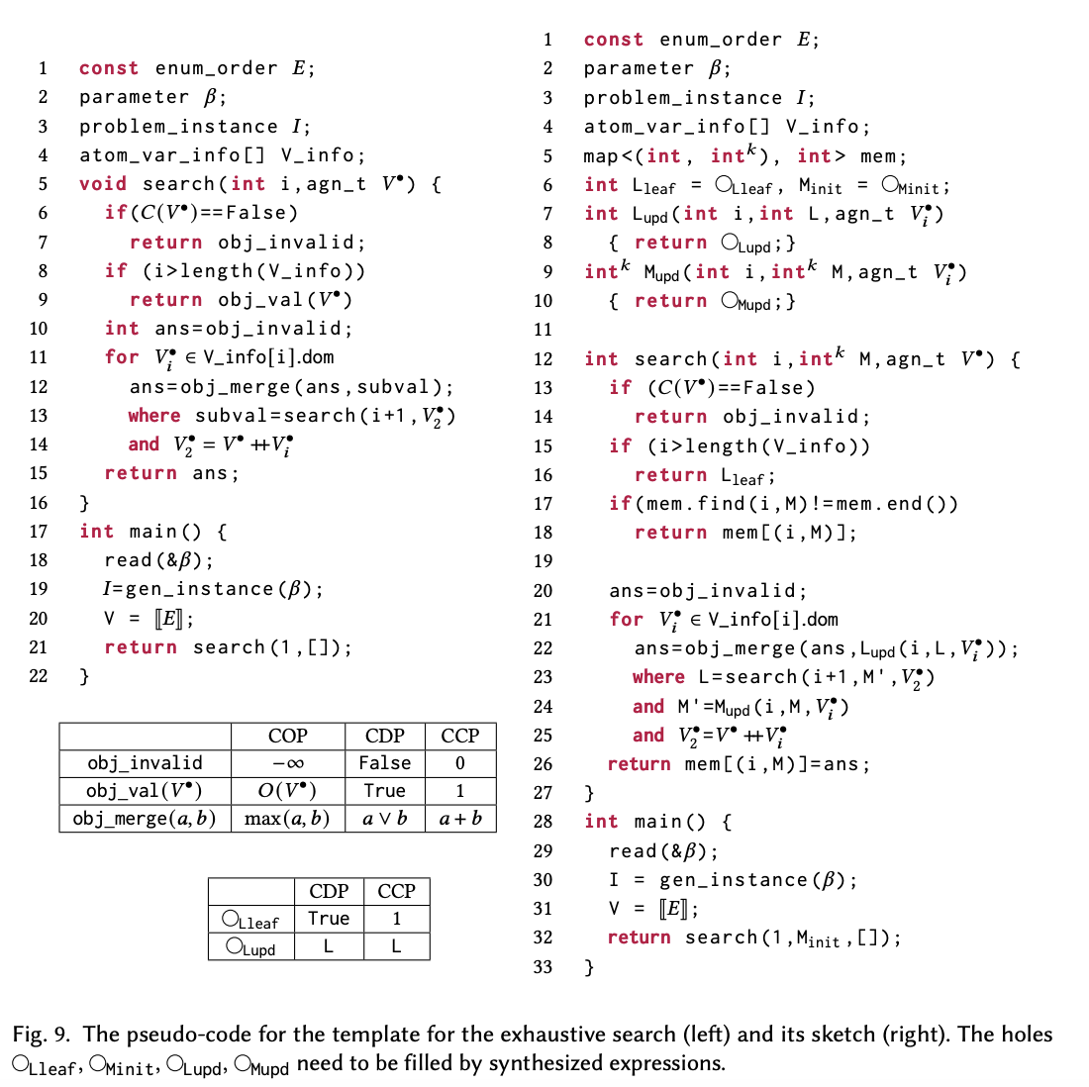
SynMem: Synthesizing Dynamic Programming
Template based on the Rationale of Dynamic Programming
Notes:
Our solution carefully designs a template for dynamic programming.

Slide 13
Why Template Works?
Template based on the Rationale of Dynamic Programming
Scalability Challenge:
Synthesis fragments instead of whole program
Efficiency Challenge:
Controlled by the range of one synthesized
function
Notes:
Using the template, instead of synthesizing the whole program, we can just synthesize unknown parts in the template, which is much smaller. Second, our template can control the efficiency of the synthesis result by an optimization procedure.
In the future, we will consider the synthesis of more types of algorithms.

Slide 14
SynMem: Synthesizing Dynamic Programming
Template based on the Rationale of Dynamic Programming
Overlapping subproblem
Optimal Substructure
Notes:
Furthermore, Our template captures the rationale of dynamic programming, that is, Overlapping subproblem and Optimal Substructure.

Slide 15

Q2: How to Verify the Synthesis Result?
Consider a simplified setting
Brute-force
Reference Program
$$≡$$
Synthesized
Algorithm
Notes:
For the second question, we first consider a simplified setting, where the formal specification is a brute-force reference program. In this case, we need to verify if the synthesis result is equivalent to the refernece program..

Slide 16
Q2: How to Verify the Synthesis Result?
Consider a simplified setting
Brute-force
Reference Program
$$≡$$
Synthesized
Algorithm
Both are Functional
Notes:
We also assume both programs are functional to avoid memory-state reasoning.

Slide 17
Q2: How to Verify the Synthesis Result?
Proving Equivalence Between Functional Programs
Lemma finding is important in this problem
However, existing lemma finding uses heuristic-based enumeration.
Progress
Directed lemma synthesis
Notes:
This reduces to Proving Equivalence Between Functional Programs.
To prove such an equivalence, lemmas play an important role here. However, existing lemma finding approaches uses heuristic-based enumeration
we have revisited lemma finding, and improve it by proposing Directed lemma synthesis to avoid enumerating useless lemmas.

Slide 18
Q2: How to Verify the Synthesis Result?
Proving Equivalence Between Functional Programs
Lemma finding is important in this problem
However, existing lemma finding uses heuristic-based enumeration.
Progress
Directed lemma synthesis
Lemmas are used to transform the goal into induction-friendly forms.
Notes:
This reduces to Proving Equivalence Between Functional Programs.
To prove such an equivalence, lemmas play an important role here. However, existing lemma finding approaches uses heuristic-based enumeration
we have revisited lemma finding, and improve it by proposing Directed lemma synthesis to avoid enumerating useless lemmas.

Slide 19
Q2: How to Verify the Synthesis Result?
Proving Equivalence Between Functional Programs
Lemma finding is important in this problem
However, existing lemma finding uses heuristic-based enumeration.
Progress
Directed lemma synthesis
Lemmas are used to transform the goal into induction-friendly forms.
Lemma Synthesis
Algorithm
Synthesis
Notes:
This reduces to Proving Equivalence Between Functional Programs.
To prove such an equivalence, lemmas play an important role here. However, existing lemma finding approaches uses heuristic-based enumeration
we have revisited lemma finding, and improve it by proposing Directed lemma synthesis to avoid enumerating useless lemmas.

Slide 20
Thanks and Future Work
Further improvement in algorithm synthesis
Consider the general case and verify the result of SynMem
Open-box the synthesizer
Notes:
In the future, we will consider the general case. Ideally, we hope to verify the synthesis result of SynMem.
Our idea is to open-box the synthesizer. The insight is that we may use our prior to the synthesis algorithm to simplify the verification condition.

Slide 21
Q2: How to Verify the Synthesis Result?
Proving Equivalence Between Functional Programs
Progress
Lemma finding is important in this problem
Directed lemma synthesis
Notes:
This reduces to Proving Equivalence Between Functional Programs.
We have revisited the lemma finding module in this problem, and improve this module by Directed lemma synthesis.
We find that lemma synthesis reduces to Algorithm synthesis.

Slide 22
Algorithm Synthesis
LLM Approach
Deductive Approach
Inductive Approach
Notes:
Modern algorithm synthesizers uses applies the inductive approach.

Slide 23
LLM Approach
Memorize “Example” problems
Cannot handle variants
Notes:
Modern algorithm synthesizers uses applies the inductive approach.

Slide 24
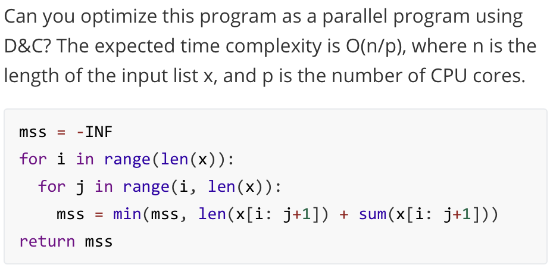
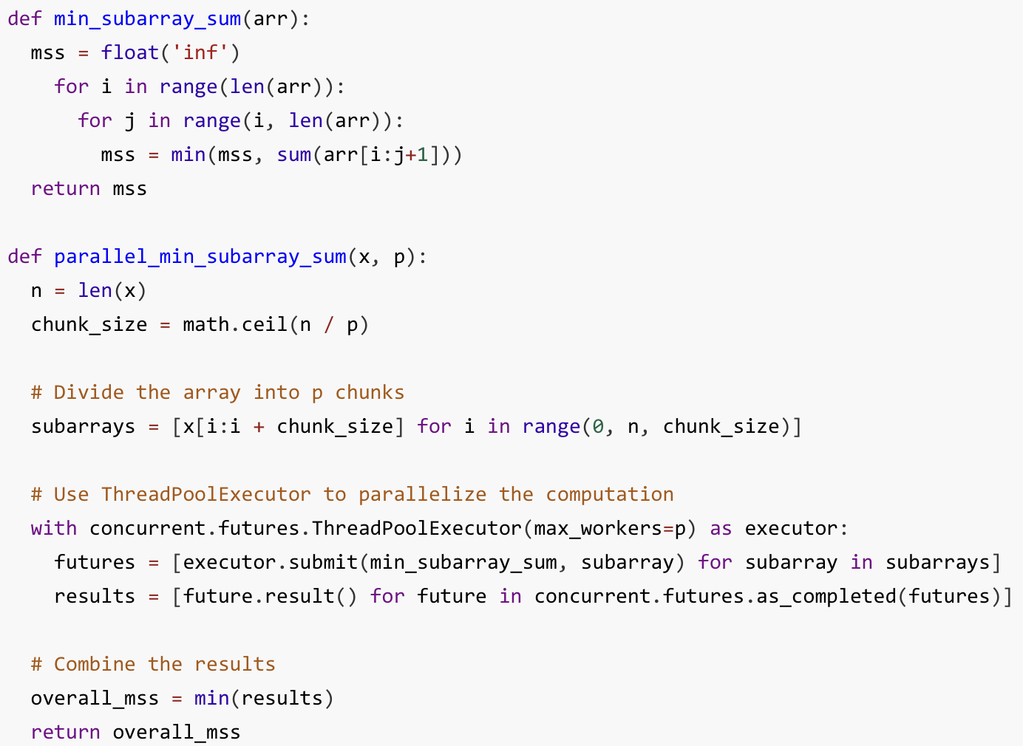
LLM Approach
Notes:
Modern algorithm synthesizers uses applies the inductive approach.

Slide 25
Deductive Approach
Rewriting-based Framework
Semi-automated
Why?
Need to design rewriting rule problem by problem
Notes:
Modern algorithm synthesizers uses applies the inductive approach.

