Slide 1

Improved Hardness of Approximating k-Clique under ETH
Bingkai Lin, Xuandi Ren, Yican Sun, Xiuhan Wang
Nanjing U, UC Berkeley, Peking U, Tsinghua U
November 2023

Slide 2
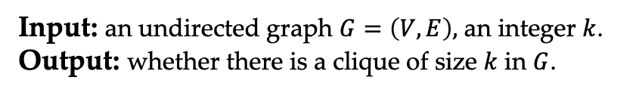
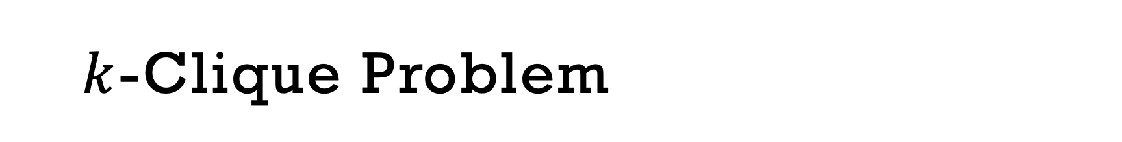
$k$-Clique Problem
Input: an undirected graph $G=\left(V,E\right),$ an integer $k$.
Output: whether there is a clique of size $k$ in $G$.

Slide 3

$k$-Clique Problem
Let $n=|V|$, then $k$-Clique problem is
NP-complete [Karp’72]
does not admit $n^{O(1)}$ time algorithm assuming NP$≠$P
W[1]-complete [Downey-Fellows’95]
does not admit $f\left(k\right)∙n^{O(1)}$ time algorithm assuming W[1]$≠$FPT
Input: an undirected graph $G=\left(V,E\right),$ an integer $k$.
Output: whether there is a clique of size $k$ in $G$.

Slide 4






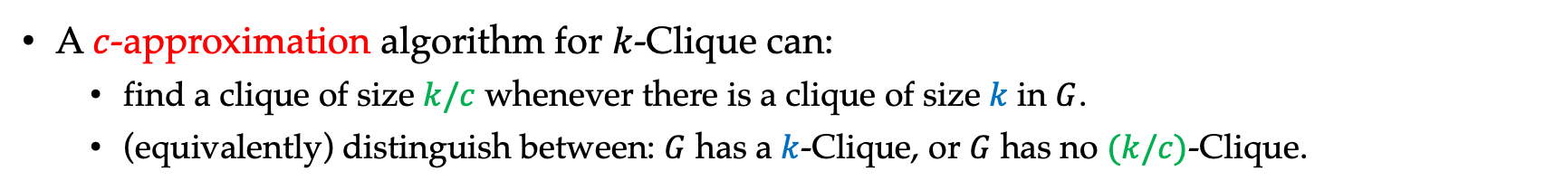

Hardness of Approximating $k$-Clique
A $c$-approximation algorithm for $k$-Clique can:
find a clique of size $k/c$ whenever there is a clique of size $k$ in $G$.
(equivalently) distinguish between: $G$ has a $k$-Clique, or $G$ has no $(k/c)$-Clique.
$$K_{k}$$
$$⊆$$
$$G$$
$$K_{\frac{k^{′}}{c}}$$
or
$$⊈$$
$$G′$$
Notes:
Equivalently or gap version?

Slide 5

Hardness of Approximating $k$-Clique
A $c$-approximation algorithm for $k$-Clique can:
find a clique of size $k/c$ whenever there is a clique of size $k$ in $G$.
(equivalently) distinguish between: $G$ has a $k$-Clique, or $G$ has no $(k/c)$-Clique.
After a long line of work [BGLR93, BS94, FGLSS96, Has96, BGS97, Gol98, FK00, Zuc07]:
$n^{1−ε}$-approximating $k$-Clique is NP-hard
Notes:
Equivalently or gap version?

Slide 6

Hardness of Approximating $k$-Clique
Fine-grained understanding from parameterized complexity
Does $k$-Clique have $f\left(k\right)⋅n^{o(k/c(k))}$ time $c(k)$-approximation algorithm?

Slide 7
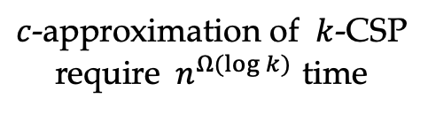
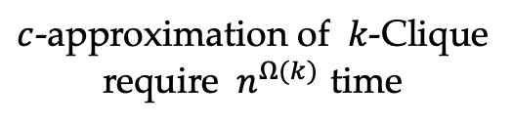
Hardness of Approximating $k$-Clique
Fine-grained understanding from parameterized complexity
Does $k$-Clique have $f\left(k\right)⋅n^{o(k)}$ time constant-approximation algorithm?
Does $k$-Clique have FPT time $c(k)$-approximation algorithm?
Disperser
Does $k$-Clique have $f\left(k\right)⋅n^{o(k/c(k))}$ time $c(k)$-approximation algorithm?
$c$-approximation of $k$-Clique
require $n^{Ω(k)}$ time
$c$-approximation of $k$-CSP
require $n^{Ω(log k)}$ time
Parameterized PCP Theorem!

Slide 8
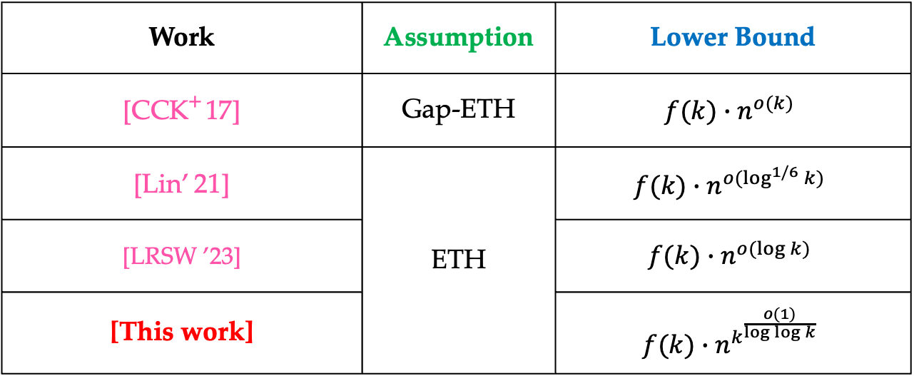
Overview of Previous Results
Does $k$-Clique have $f\left(k\right)⋅n^{o(k)}$ time constant-approximation algorithm?
Work | Assumption | Lower Bound
[CCK⁺ 17] | Gap-ETH | $$f(k)∙n^{o(k)}$$
[Lin’ 21] | ETH | $$f(k)∙n^{o(\log^{1/6}{k})}$$
[LRSW ’23] | W[1]$≠$FPT | $$f(k)∙n^{o(\log{k})}$$
[This work] | ETH | $$f(k)∙n^{k^{\frac{o(1)}{\log{\log{k}}}}}$$

Slide 9
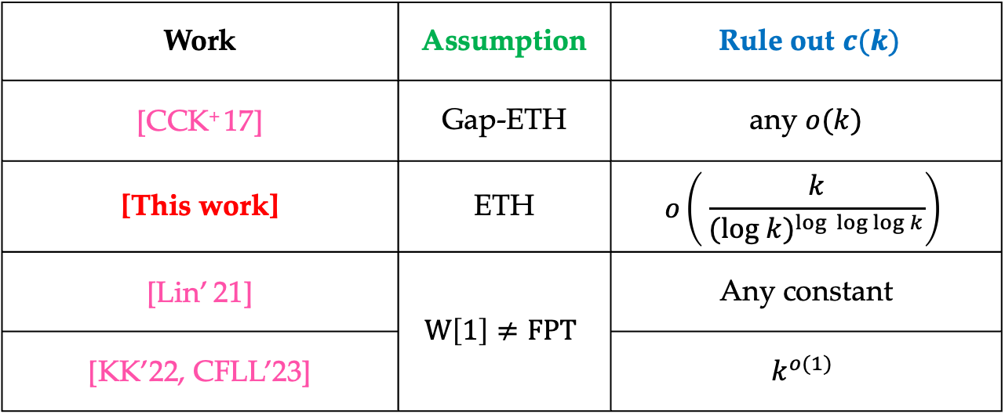
Overview of Previous Results
Does $k$-Clique have FPT time $c(k)$-approximation algorithm?
Work | Assumption | Rule out $c(k)$
[CCK⁺ 17] | Gap-ETH | any $o(k)$
[This work] | ETH | $$o\left( \frac{k}{(log {k)}^{log \log{\log{k}}}}\right)$$
[Lin’ 21] | $$W\left[1\right]≠FPT$$ | Any constant
[KK’22, CFLL’23] | W[1]$≠$FPT | $$k^{o(1)}$$

Slide 10
Hardness of Approximating $k$-Clique
Fine-grained understanding from parameterized complexity
Does $k$-Clique have $f\left(k\right)⋅n^{o(k)}$ time constant-approximation algorithm?
Does $k$-Clique have FPT time $c(k)$-approximation algorithm?
Open problem:
Can we obtain the same bound from ETH, as the one from Gap-ETH?

Slide 11
Our Result
Assuming ETH:
$k$-Clique has no $f\left(k\right)⋅f\left(k\right)∙n^{k^{\frac{o\left(1\right)}{\log{\log{k}}}}}$time constant-approximation algorithm?
Disperser
$k$-Clique has no FPT time $o\left( \frac{k}{(log {k)}^{log \log{\log{k}}}}\right)$-approximation algorithm?

Slide 12
Our Result
Assuming ETH:
$k$-Clique has no $f\left(k\right)⋅f\left(k\right)∙n^{k^{\frac{o\left(1\right)}{\log{\log{k}}}}}$time constant-approximation algorithm?

Slide 13



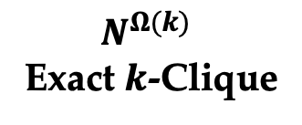













Parameterized Gap-producing Reduction
$N^{Ω(k)}$
Exact $k$-Clique
$${(N^{′})}^{{(k^{′})}^{\frac{Ω(1)}{\log{\log{k^{′}}}}}}$$
$c$-gap $k$-Clique
$2^{Ω(n)}$ SAT
$φ$ is satisfiable
$$K_{k}$$
$$⊆$$
$$G$$
$$K_{k′}$$
$$⊆$$
$$G′$$
$φ$ is unsatisfiable
$$K_{k}$$
$$⊈$$
$$G$$
$$K_{\frac{k^{′}}{c}}$$
$$⊈$$
$$G′$$

Slide 14
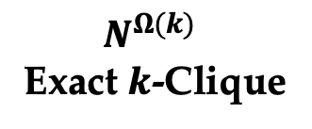

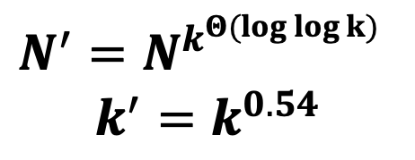


Parameterized Gap-producing Reduction
$N^{Ω(k)}$
Exact $k$-Clique
${(N^{′})}^{{(k^{′})}^{\frac{Ω(1)}{\log{\log{k^{′}}}}}}$
$c$-gap $k$-Clique
$N^{′}=N^{k^{Θ(log log k)}}$
$$k^{′}=k^{0.54}$$
$$K_{k}$$
$$⊆$$
$$G$$
$$K_{k′}$$
$$⊆$$
$$G′$$
$$K_{k}$$
$$⊈$$
$$G$$
$$K_{\frac{k^{′}}{c}}$$
$$⊈$$
$$G′$$

Slide 15
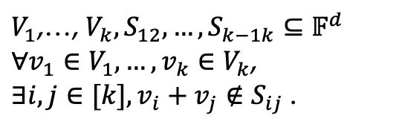
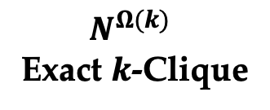

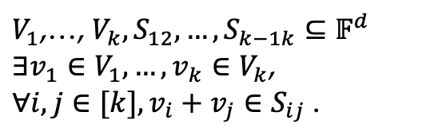




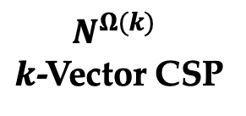

$$d = Θ(log ⁡n)$$
$N^{Ω(k)}$
Exact $k$-Clique
$N^{Ω(k)}$
$k$-Vector CSP
${(N^{′})}^{{(k^{′})}^{\frac{Ω(1)}{\log{\log{k^{′}}}}}}$
$c$-gap $k$-Clique
$V_{1}$,…, $V_{k},S_{12},…,S_{k−1k}⊆𝔽^{d}$
$∃v_{1}∈V_{1},…,v_{k}∈V_{k}$,
$∀i,j∈[k],v_{i}+v_{j}∈S_{ij}$ .
$$K_{k}$$
$$⊆$$
$$G$$
$$K_{k′}$$
$$⊆$$
$$G′$$
$V_{1}$,…, $V_{k},S_{12},…,S_{k−1k}⊆𝔽^{d}$
$∀v_{1}∈V_{1},…,v_{k}∈V_{k}$,
$∃i,j∈[k],v_{i}+v_{j}∉S_{ij}$ .
$$K_{k}$$
$$⊈$$
$$G$$
$$K_{\frac{k^{′}}{c}}$$
$$⊈$$
$$G′$$
R

Slide 16



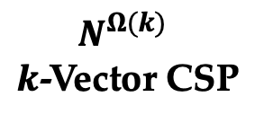

$N^{Ω(k)}$
Exact $k$-Clique
$$d = Θ(log ⁡n)$$
$N^{Ω(k)}$
$k$-Vector CSP
$$K_{k}$$
$$⊆$$
$$G$$
$V_{1}$,…, $V_{k},S_{12},…,S_{k−1k}⊆𝔽^{d}$
$∃v_{1}∈V_{1},…,v_{k}∈V_{k}$,
$∀i,j∈[k],v_{i}+v_{j}∈S_{ij}$ .
$$K_{k}$$
$$⊈$$
$$G$$
$V_{1}$,…, $V_{k},S_{12},…,S_{k−1k}⊆𝔽^{d}$
$∀v_{1}∈V_{1},…,v_{k}∈V_{k}$,
$∃i,j∈[k],v_{i}+v_{j}∉S_{ij}$ .

Slide 17

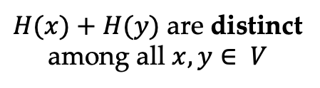


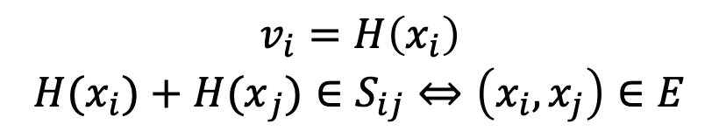

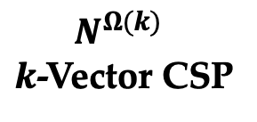
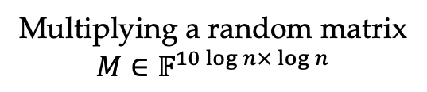
$N^{Ω(k)}$
Exact $k$-Clique
$$d = Θ(log ⁡n)$$
Gadget
$N^{Ω(k)}$
$k$-Vector CSP
$$H:V→𝔽^{10\log{n}}$$
$$K_{k}$$
$$⊆$$
$$G$$
$V_{1}$,…, $V_{k},S_{12},…,S_{k−1k}⊆𝔽^{d}$
$∃v_{1}∈V_{1},…,v_{k}∈V_{k}$,
$∀i,j∈[k],v_{i}+v_{j}∈S_{ij}$ .
$H(x)+H(y)$ are distinct
among all $x, y∈ V$
Construction
Apply
$$K_{k}$$
$$⊈$$
$$G$$
Multiplying a random matrix
$M∈𝔽^{10\log{n×\log{n}}}$
$V_{1}$,…, $V_{k},S_{12},…,S_{k−1k}⊆𝔽^{d}$
$∀v_{1}∈V_{1},…,v_{k}∈V_{k}$,
$∃i,j∈[k],v_{i}+v_{j}∉S_{ij}$ .
$$S_{ij}=\{H\left(x\right)+H\left(y\right): \begin{matrix}x∈P_{i} \\ y∈P_{j} \\ \left(x,y\right)∈E\end{matrix}\}$$
$$V_{i}=\{H\left(x\right):x∈P_{i}\}$$
$$v_{i}=H\left(x_{i}\right)$$
$${H(x}_{i})+{H(x}_{j})∈S_{ij}⇔\left(x_{i},x_{j}\right)∈E$$

Slide 18

$$d = Θ(log ⁡n)$$
$N^{Ω(k)}$
Exact $k$-Clique
$N^{Ω(k)}$
$k$-Vector CSP
${(N^{′})}^{{(k^{′})}^{\frac{Ω(1)}{\log{\log{k^{′}}}}}}$
$c$-gap $k$-Clique
$V_{1}$,…, $V_{k},S_{12},…,S_{k−1k}⊆𝔽^{d}$
$∃v_{1}∈V_{1},…,v_{k}∈V_{k}$,
$∀i,j∈[k],v_{i}+v_{j}∈S_{ij}$ .
$$K_{k}$$
$$⊆$$
$$G$$
$$K_{k′}$$
$$⊆$$
$$G′$$
$V_{1}$,…, $V_{k},S_{12},…,S_{k−1k}⊆𝔽^{d}$
$∀v_{1}∈V_{1},…,v_{k}∈V_{k}$,
$∃i,j∈[k],v_{i}+v_{j}∉S_{ij}$ .
$$K_{k}$$
$$⊈$$
$$G$$
$$K_{\frac{k^{′}}{c}}$$
$$⊈$$
$$G′$$
R

Slide 19

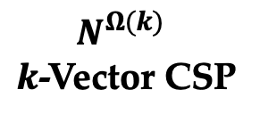
${(N^{′})}^{{(k^{′})}^{\frac{Ω(1)}{\log{\log{k^{′}}}}}}$
$c$-gap $k$-Clique
$$d = Θ(log ⁡n)$$
$N^{Ω(k)}$
$k$-Vector CSP
$V_{1}$,…, $V_{k},S_{12},…,S_{k−1k}⊆𝔽^{d}$
$∃v_{1}∈V_{1},…,v_{k}∈V_{k}$,
$∀i,j∈[k],v_{i}+v_{j}∈S_{ij}$ .
$$K_{k′}$$
$$⊆$$
$$G′$$
$$K_{\frac{k^{′}}{c}}$$
$$⊈$$
$$G′$$
$V_{1}$,…, $V_{k},S_{12},…,S_{k−1k}⊆𝔽^{d}$
$∀v_{1}∈V_{1},…,v_{k}∈V_{k}$,
$∃i,j∈[k],v_{i}+v_{j}∉S_{ij}$ .

Slide 20



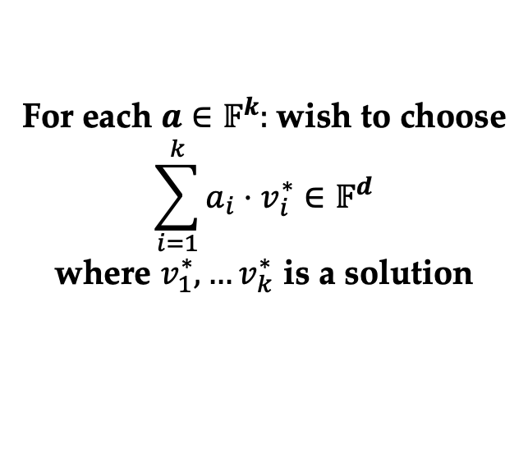


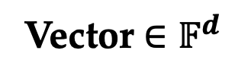



Warmup
Vector $∈𝔽^{d}$
$$d = Θ(log ⁡n)$$
$N^{Ω(k)}$
$k$-Vector CSP
$$…$$
$$𝔽^{d}$$
$V_{1}$,…, $V_{k},S_{12},…,S_{k−1k}⊆𝔽^{d}$
$∃v_{1}∈V_{1},…,v_{k}∈V_{k}$,
$∀i,j∈[k],v_{i}+v_{j}∈S_{ij}$ .
$$…$$
$$…$$
$$…$$
$$…$$
$$…$$
$$…$$
$V_{1}$,…, $V_{k},S_{12},…,S_{k−1k}⊆𝔽^{d}$
$∀v_{1}∈V_{1},…,v_{k}∈V_{k}$,
$∃i,j∈[k],v_{i}+v_{j}∉S_{ij}$ .
$$𝔽^{k}$$
For each $a∈𝔽^{k}:$wish to choose
$$\sum_{i=1}^{k}{a_{i}⋅v_{i}^{∗}}∈𝔽^{d}$$
where $v_{1}^{∗},…v_{k}^{∗}$ is a solution

Slide 21







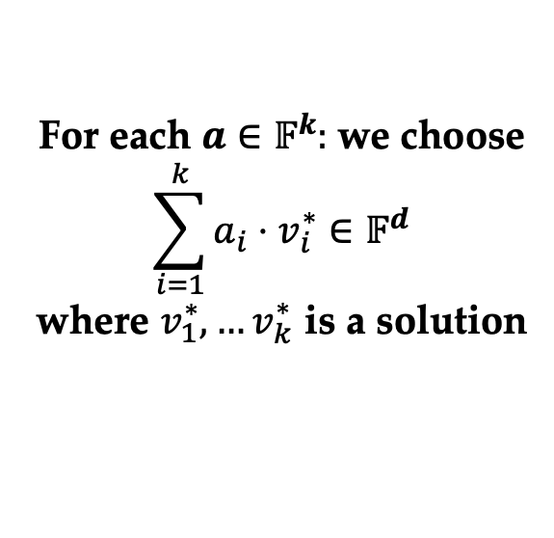
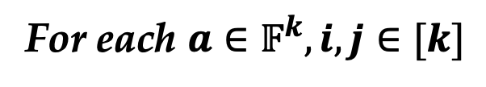







Constraint
Suppose
Goal: verify
For each ${a∈𝔽}^{k}, i,j∈[k]$
For each $a∈𝔽^{k}:$we choose
$$\sum_{i=1}^{k}{a_{i}⋅v_{i}^{∗}}∈𝔽^{d}$$
where $v_{1}^{∗},…v_{k}^{∗}$ is a solution
$V_{1}$,…, $V_{k},S_{12},…,S_{k−1k}⊆𝔽^{d}$
$∃v_{1}∈V_{1},…,v_{k}∈V_{k}$,
$∀i,j∈[k],v_{i}+v_{j}∈S_{ij}$ .
$$−$$
$$∈S_{ij}$$
$$…$$
$$…$$
$$a$$
$$a+e_{i}+e_{j}$$
$$…$$
$$𝔽^{d}$$
$$…$$
$$…$$
$$…$$
$$…$$
$$…$$
$$…$$
$$−$$
$$∈V_{i}$$
$$…$$
$$…$$
$$a$$
$$a+e_{i}$$
$$𝔽^{k}$$

Slide 22
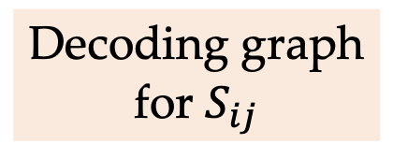

Constraint
Suppose
For each ${a∈𝔽}^{k}, i,j∈[k]$
For each $a∈𝔽^{k}:$we choose
$$\sum_{i=1}^{k}{a_{i}⋅v_{i}^{∗}}∈𝔽^{d}$$
where $v_{1}^{∗},…v_{k}^{∗}$ is a solution
$$−$$
$$∈S_{ij}$$
Decoding graph
for $S_{ij}$
$$…$$
$$…$$
$$a$$
$$a+e_{i}+e_{j}$$
$$…$$
$$𝔽^{d}$$
$$…$$
$$…$$
$$…$$
$$…$$
$$…$$
$$…$$
$$−$$
$$∈V_{i}$$
$$…$$
$$…$$
$$a$$
$$a+e_{i}$$
$$𝔽^{k}$$

Slide 23
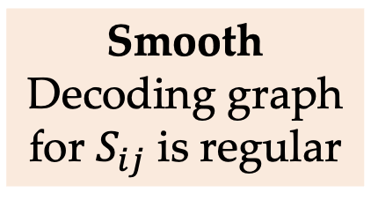
Constraint
Suppose
Smooth
Decoding graph for $S_{ij}$ is regular
For each ${a∈𝔽}^{k}, i,j∈[k]$
For each $a∈𝔽^{k}:$we choose
$$\sum_{i=1}^{k}{a_{i}⋅v_{i}^{∗}}∈𝔽^{d}$$
where $v_{1}^{∗},…v_{k}^{∗}$ is a solution
$$−$$
$$∈S_{ij}$$
$$…$$
$$…$$
$$a$$
$$a+e_{i}+e_{j}$$
$$…$$
$$𝔽^{d}$$
$$…$$
$$…$$
$$…$$
$$…$$
$$…$$
$$…$$
$$−$$
$$∈V_{i}$$
$$…$$
$$…$$
$$a$$
$$a+e_{i}$$
$$𝔽^{k}$$

Slide 24

Suppose
Goal: verify
For each $a∈𝔽^{k}:$we choose
$$\sum_{i=1}^{k}{a_{i}⋅v_{i}^{∗}}∈𝔽^{d}$$
where $v_{1}^{∗},…v_{k}^{∗}$ is a solution
$V_{1}$,…, $V_{k},S_{12},…,S_{k−1k}⊆𝔽^{d}$
$∃v_{1}∈V_{1},…,v_{k}∈V_{k}$,
$∀i,j∈[k],v_{i}+v_{j}∈S_{ij}$ .
$$Clique=𝔽^{k}$$
$$…$$
$$𝔽^{d}$$
$$…$$
$$…$$
$$…$$
$$…$$
$$…$$
$$…$$
$$𝔽^{k}$$

Slide 25


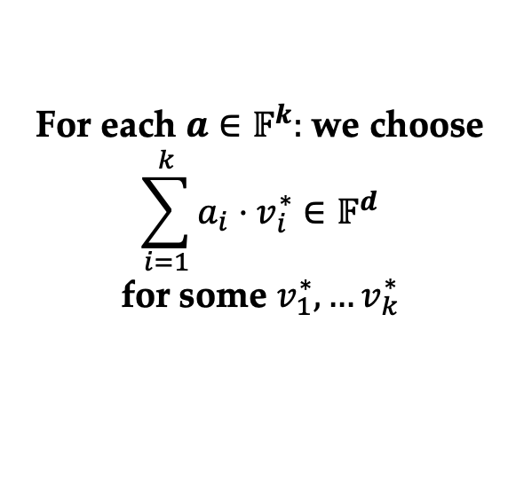

Suppose
Soundness
For each $a∈𝔽^{k}:$we choose
$$\sum_{i=1}^{k}{a_{i}⋅v_{i}^{∗}}∈𝔽^{d}$$
for some $v_{1}^{∗},…v_{k}^{∗}$
$V_{1}$,…, $V_{k},S_{12},…,S_{k−1k}⊆𝔽^{d}$
$∀v_{1}∈V_{1},…,v_{k}∈V_{k}$,
$∃i,j∈[k],v_{i}+v_{j}∉S_{ij}$ .
$$Clique≤\frac{𝔽^{k}}{2}$$
$$…$$
$$𝔽^{d}$$
$$…$$
$$…$$
$$…$$
$$…$$
$$…$$
$$…$$
$$𝔽^{k}$$

Slide 26
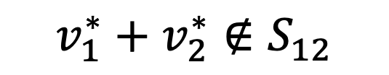
Suppose
Soundness
For each $a∈𝔽^{k}:$we choose
$$\sum_{i=1}^{k}{a_{i}⋅v_{i}^{∗}}∈𝔽^{d}$$
for some $v_{1}^{∗},…v_{k}^{∗}$
$$v_{1}^{∗}+v_{2}^{∗}∉S_{12}$$
$$Clique≤\frac{𝔽^{k}}{2}$$
$$…$$
$$𝔽^{d}$$
$$…$$
$$…$$
$$…$$
$$…$$
$$…$$
$$…$$
$$𝔽^{k}$$

Slide 27





Suppose
Soundness
For each $a∈𝔽^{k}:$we choose
$$\sum_{i=1}^{k}{a_{i}⋅v_{i}^{∗}}∈𝔽^{d}$$
for some $v_{1}^{∗},…v_{k}^{∗}$
Constraint
$$v_{1}^{∗}+v_{2}^{∗}∉S_{12}$$
$$∃{a∈𝔽}^{k}$$
$$−$$
$$∉S_{12}$$
$$…$$
❌
$$…$$
$$a$$
$$a+e_{1}+e_{2}$$
$$…$$
$$𝔽^{d}$$
$$…$$
$$…$$
$$…$$
$$…$$
$$…$$
$$…$$
Pigeonhole!
$$𝔽^{k}$$

Slide 28
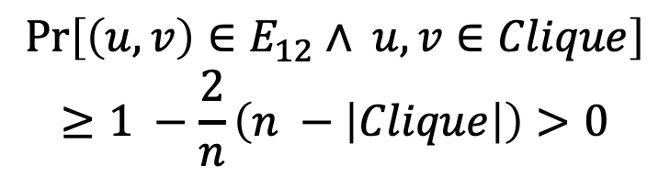
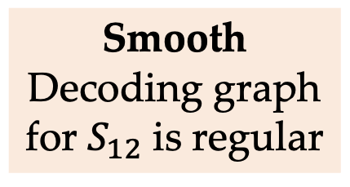
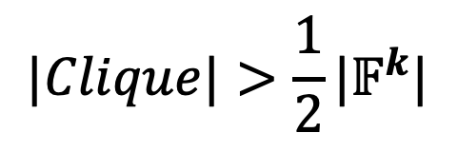
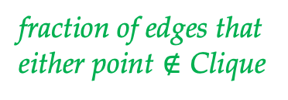


Suppose
Soundness
Smooth
Decoding graph for $S_{12}$ is regular
For each $a∈𝔽^{k}:$we choose
$$\sum_{i=1}^{k}{a_{i}⋅v_{i}^{∗}}∈𝔽^{d}$$
for some $v_{1}^{∗},…v_{k}^{∗}$
$$v_{1}^{∗}+v_{2}^{∗}∉S_{12}$$
Decoding graph for $S_{12}$
$$Pr\left[\left(u,v\right)∈E_{12}∧ u, v∈Clique\right]$$
$$≥1 −\frac{2}{n}\left(n −\left|Clique\right|\right)>0$$
$$…$$
$$𝔽^{d}$$
fraction of edges that either point $∉$ Clique
$$…$$
$$…$$
$$…$$
$$…$$
$$…$$
$$…$$
#Vertices $∉$ Clique
$$|Clique|>\frac{1}{2}|𝔽^{k}|$$
$$𝔽^{k}$$

Slide 29

Suppose
Soundness
For each $a∈𝔽^{k}:$we choose
$$\sum_{i=1}^{k}{a_{i}⋅v_{i}^{∗}}∈𝔽^{d}$$
for some $v_{1}^{∗},…v_{k}^{∗}$
$$v_{1}^{∗}+v_{2}^{∗}∉S_{12}$$
$$Clique≤\frac{𝔽^{k}}{2}!$$
$$…$$
$$𝔽^{d}$$
$$…$$
$$…$$
$$…$$
$$…$$
$$…$$
$$…$$
$$𝔽^{k}$$

Slide 30


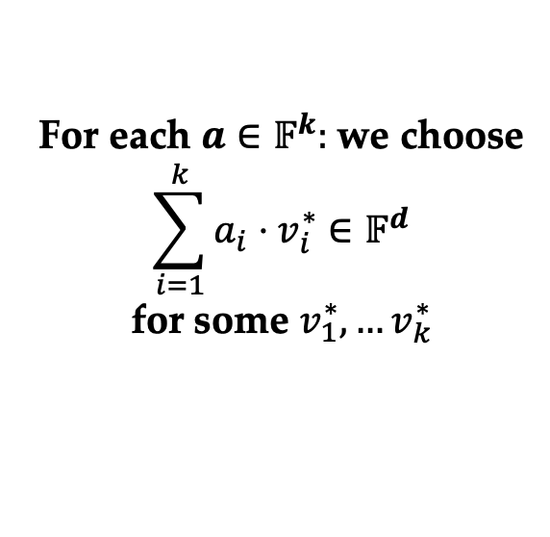





How to check
For each $a∈𝔽^{k}:$we choose
$$\sum_{i=1}^{k}{a_{i}⋅v_{i}^{∗}}∈𝔽^{d}$$
for some $v_{1}^{∗},…v_{k}^{∗}$
For each $a,b∈𝔽^{k}$
( , , ):
+ =
Consistency
$$…$$
$$𝔽^{d}$$
BLR test!
$$…$$
$$…$$
$$…$$
$$…$$
$$…$$
$$…$$
$$a$$
$$b$$
$$a+b$$

Slide 31


How to check
For each $a∈𝔽^{k}:$we choose
$$\sum_{i=1}^{k}{a_{i}⋅v_{i}^{∗}}∈𝔽^{d}$$
for some $v_{1}^{∗},…v_{k}^{∗}$
Clique $≥1−ε⇒$ close to a linear form
$$…$$
$$…$$
$$𝔽^{d}$$
BLR test!
$$…$$
$$…$$
$$…$$
$$…$$
$$…$$
$$…$$
$$a$$
$$b$$
$$a+b$$
Clique $≥1−ε⇒$ Pigeonhole principle!

Slide 32

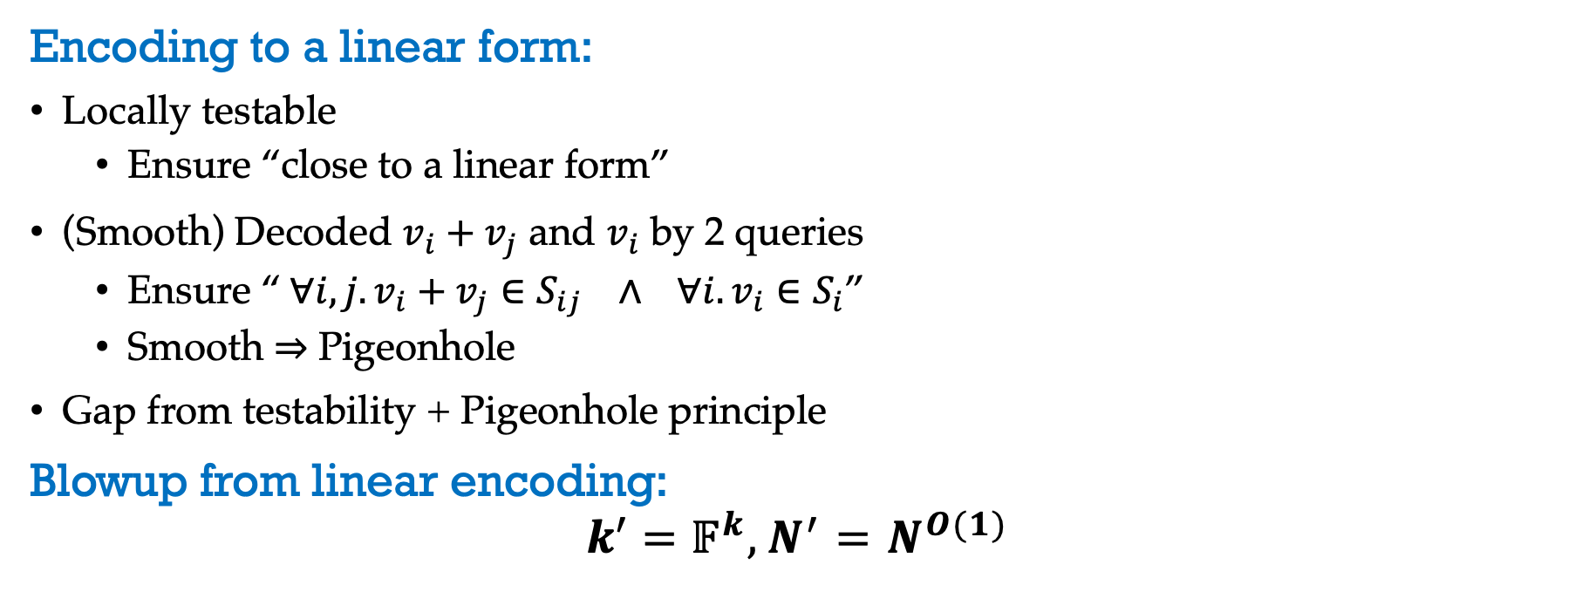
In Summary
Encoding to a linear form:
Locally testable
Ensure “close to a linear form”
(Smooth) Decoded $v_{i}+v_{j}$ and $v_{i}$ by 2 queries
Ensure “$∀i,j. v_{i}+v_{j}∈S_{ij} ∧ ∀i. v_{i}∈S_{i}$”
Smooth $⇒$ Pigeonhole
Gap from testability + Pigeonhole principle
Blowup from linear encoding:
$$k^{′}=𝔽^{k}, N^{′}=N^{O(1)}$$
$$N^{o(log k)}$$

Slide 33
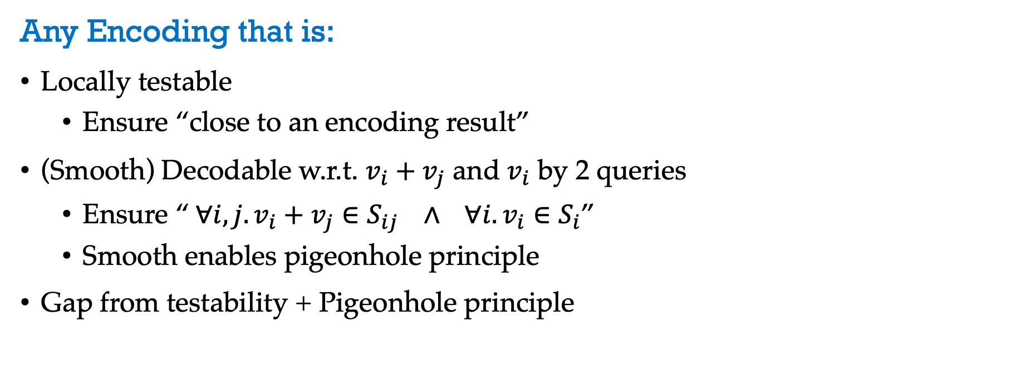
Generalize The Idea
Any Encoding that is:
Locally testable
Ensure “close to an encoding result”
(Smooth) Decodable w.r.t. $v_{i}+v_{j}$ and $v_{i}$ by 2 queries
Ensure “$∀i,j. v_{i}+v_{j}∈S_{ij} ∧ ∀i. v_{i}∈S_{i}$”
Smooth enables pigeonhole principle
Gap from testability + Pigeonhole principle

Slide 34
Polynomial Form

Slide 35
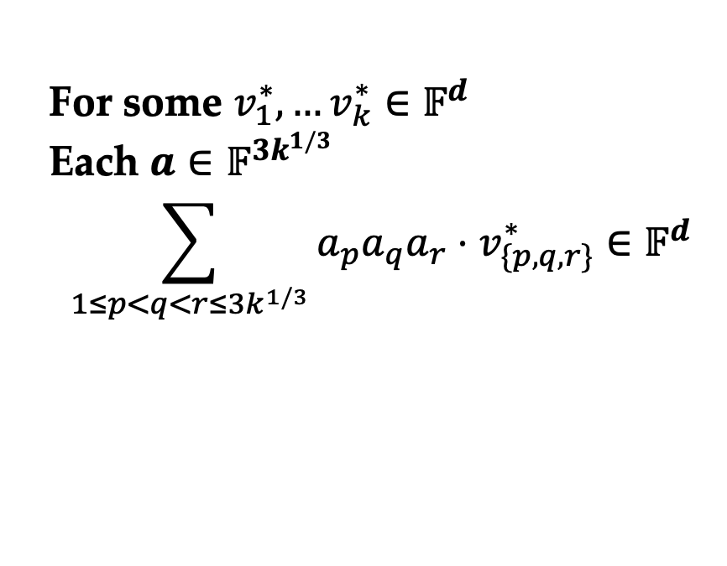
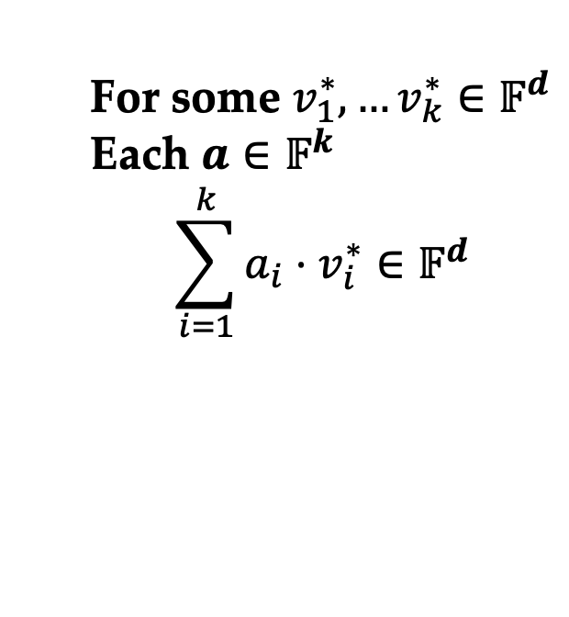

Degree-3 Form
For some $v_{1}^{∗},…v_{k}^{∗}∈𝔽^{d}$
Each $a∈$ $𝔽^{k}$
$$\sum_{i=1}^{k}{a_{i}⋅v_{i}^{∗}}∈𝔽^{d}$$
For some $v_{1}^{∗},…v_{k}^{∗}∈𝔽^{d}$
Each $a∈$ $𝔽^{{3k}^{1/3}}$
$$\sum_{1≤p<q<r≤3k^{1/3}}{a_{p}a_{q}a_{r}⋅v_{\{p,q,r\}}^{∗}}∈𝔽^{d}$$
indentify each $i∈[k]$ by a 3-set $\left\{p,q,r\right\}∈\left({3k^{1/3} \atop 3}\right)$

Slide 36

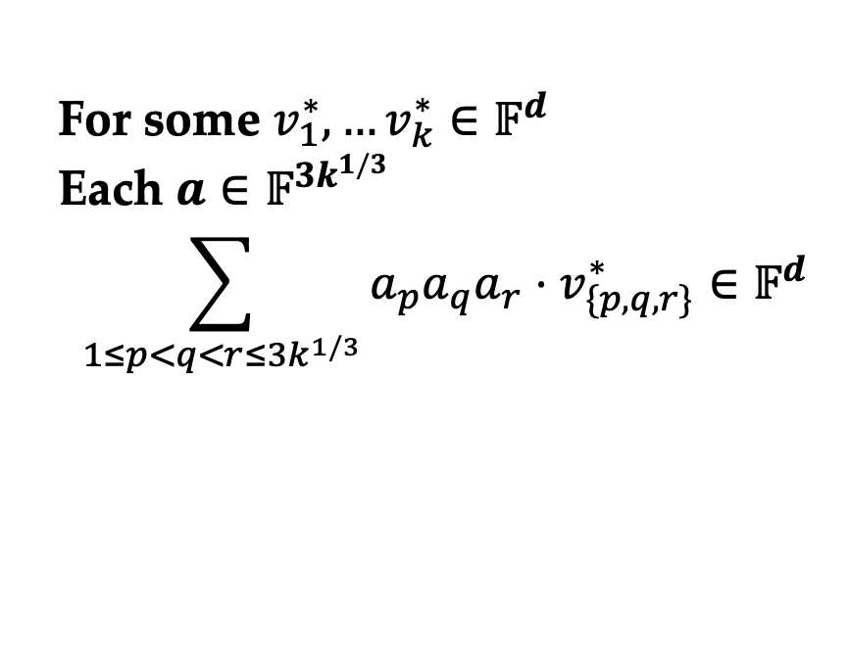
Degree-3 Form
For some $v_{1}^{∗},…v_{k}^{∗}∈𝔽^{d}$
Each $a∈$ $𝔽^{{3k}^{1/3}}$
$$\sum_{1≤p<q<r≤3k^{1/3}}{a_{p}a_{q}a_{r}⋅v_{\{p,q,r\}}^{∗}}∈𝔽^{d}$$
Testable?
✅
Low degree test!
Decodable?
indentify each $i∈[k]$ by a 3-set $\left\{p,q,r\right\}∈\left({3k^{1/3} \atop 3}\right)$

Slide 37
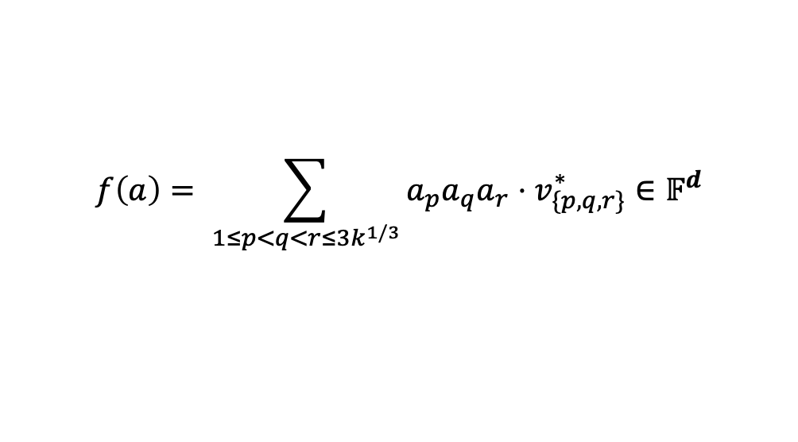
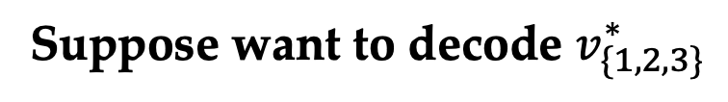
Decoding Degree-3 Polynomials
Suppose want to decode $v_{\{1,2,3\}}^{∗}$
$$f\left(a\right)= \sum_{1≤p<q<r≤3k^{1/3}}{a_{p}a_{q}a_{r}⋅v_{\{p,q,r\}}^{∗}}∈𝔽^{d}$$

Slide 38

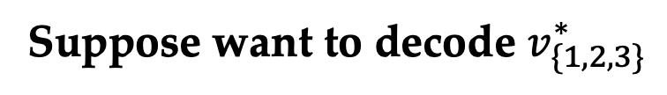

Decoding Degree-3 Polynomials
Suppose want to decode $v_{\{1,2,3\}}^{∗}$
$$⇔$$
Query $e=(1,1,1,0,0,…,0)$
$$f\left(a\right)= \sum_{1≤p<q<r≤3k^{1/3}}{a_{p}a_{q}a_{r}⋅v_{\{p,q,r\}}^{∗}}∈𝔽^{d}$$

Slide 39








Decoding Degree-3 Polynomials
Suppose want to decode $v_{\{1,2,3\}}^{∗}$
$$⇔$$
Query $a_{0}=(1,1,1,0,0,…,0)$
$$f\left(a\right)= \sum_{1≤p<q<r≤3k^{1/3}}{a_{p}a_{q}a_{r}⋅v_{\{p,q,r\}}^{∗}}∈𝔽^{d}$$
$d$ deg-3 univariate polynomials
$$g(i) =f(a_{0}+i⋅e)$$
For each line
$$ℓ_{e}= \{a+ i⋅e:i∈𝔽\}$$
For each 4 distinct points on $ℓ$, we can
decode $g(0)$ by interpolation
4-ary hyperedges!
$$a_{0}= (1,1,1,0,0,…,0)$$

Slide 40





Interpolation by Derivatives
Suppose want to decode $v_{\{1,2,3\}}^{∗}$
$$⇔$$
Query $a_{0}=(1,1,1,0,0,…,0)$
$$f\left(a\right)= \sum_{1≤p<q<r≤3k^{1/3}}{a_{p}a_{q}a_{r}⋅v_{\{p,q,r\}}^{∗}}∈𝔽^{d}$$
$$∇f\left(a\right) ∈{{(𝔽}^{m})}^{d}$$
$d$ deg-3 univariate polynomials
$$g\left(i\right)=f\left(a_{0}+i⋅e\right),$$
$$g^{′}\left(i\right)=⟨∇f(a_{0}+i⋅e), e⟩$$
For each line
$$ℓ_{e}= \{a+ i⋅e:i∈𝔽\}$$
For each 2 distinct points $\left(a_{0}+p⋅e\right)$, $\left(a_{0}+q⋅e\right)$ on $ℓ$, we can decode $g(0)$ by $g(p), g(q), g’(p), g’(q)$
$$a_{0}= (1,1,1,0,0,…,0)$$

Slide 41




Interpolation by Derivatives
For each 2 distinct points $\left(a_{0}+p⋅e\right)$, $\left(a_{0}+q⋅e\right)$ on $ℓ$, we can decode $g(0)$ by $g(p), g(q), g’(p), g’(q)$
$d$ deg-3 univariate polynomials
$$g\left(i\right)=f\left(a_{0}+i⋅e\right), { g}^{′}\left(i\right)=⟨∇f(a_{0}+i⋅e), e⟩$$
For each $j∈ \left[d\right], g_{j}\left(i\right)=c_{0}+c_{1}i+c_{2}i^{2}+c_{3}i^{3}$
$$\left(\begin{aligned}\begin{matrix}g_{j}(p) \\ g_{j}′(p)\end{matrix} \\ \begin{matrix}g_{j}(q) \\ g_{j}′(q)\end{matrix}\end{aligned}\right)=\left(\begin{aligned}\begin{matrix}1 & p \\ 0 & 1\end{matrix} \begin{matrix}p^{2} & p^{3} \\ 2p & 3p^{2}\end{matrix} \\ \begin{matrix}1 & q \\ 0 & 1\end{matrix} \begin{matrix}q^{2} & q^{3} \\ 2q & 3q^{3}\end{matrix}\end{aligned}\right)\left(\begin{aligned}\begin{matrix}c_{0} \\ c_{1}\end{matrix} \\ \begin{matrix}c_{2} \\ c_{3}\end{matrix}\end{aligned}\right)$$
$det⁡= {\left(q−p\right)}^{4}$, invertible!

Slide 42

Blowup by Deg-3 Polynomial
Deg-3: $k^{′}=𝔽^{{3k}^{1/3}}, N^{′}=N^{{3k}^{1/3}}⇒N^{o(\log^{2}k^{′})}$
Deg-5: $k^{′}=𝔽^{{5k}^{1/5}}, N^{′}=N^{{5k}^{2/5}}⇒N^{o(\log^{3}k^{′})}$
Deg-7: $k^{′}=𝔽^{{7k}^{1/7}}, N^{′}=N^{{7k}^{3/5}}⇒N^{o(\log^{4}k^{′})}$
…
Deg - $\frac{log k}{log log k}$: $N^{{k^{′}}^{\frac{o\left(1\right)}{log log k^{′}}}}$

Slide 43

Conclusion and Open Problem
Contributions
A framework to prove hardness of gap $k$-Clique
A good encoding is all you need!
Improved lower bound and inapproximability ratio under ETH
$f(k)⋅n^{k^{Ω(1/\log{\log{k}})}}$ time lower bound for constant approximation
$k^{1−o(1)}$ inapproximability ratio in FPT time
Open problem
Can we get the same hardness as Gap-ETH from ETH?
Thank You!

