Slide 1

Synthesizing Efficient Memoization Algorithms
Yican Sun, Xuanyu Peng, Yingfei Xiong
Notes:
Good afternoon, everyone! I'm Yican from Peking University, I gonna share you with our recent work on synthesizing efficient memoization algorithms to solve combinatorial optimization problems.

Slide 2
Combinatorial Optimization Problems(COPs)
Important category of real-world problems.
Find the best valid solution
valid : satisfies user-provided constraints
best: maximizes an objective function
Notes:
Let me first introduce the combinatorial optimization problems (short as COPs). COP is an important category of real-world problems. In general, it targets to find the best valid solution, where the valid means that the solution must satisfy the user-provided constraints, and the best means that the solution should maximize an objective function

Slide 3





Combinatorial Optimization Problems(COPs)
Find the best valid solution
e.g.: 0-1 Knapsack problem
weight | 1 | 1 | 4 | 3
value | 10 | 15 | 29 | 18
Capacity = 5
Notes:
For example, let’s consider the classic 0-1 knapsack problem, where there are several items, each item has a weight and a value. There is also a knapsack with a capacity. The goal is to choose a subset of items such that the total weight of the selected items does not exceed the capacity, and the total value of the selected items is maximized.

Slide 4
Combinatorial Optimization Problems(COPs)
Find the best valid solution
e.g.: 0-1 Knapsack problem
weight | 1 | 1 | 4 | 3
value | 10 | 15 | 29 | 18
Capacity = 5
total weight = 5
total value = 44
Notes:
Here we present a concrete example. There are four items, whose weight and value is presented below. The capacity of the knapsack is 5. The optimal solution is marked red. We can verify that the total weight of red items is 5, which is no more than the capacity, and the total value is 44, which is the maximum.

Slide 5
How to solve COP?
Exhaustive search
Try every solution and pick the best valid one
Notes:
So, how to solve COPs? Maybe the first idea that comes into our mind is to apply exhaustive search, which just try every solution and pick the best valid one.

Slide 6
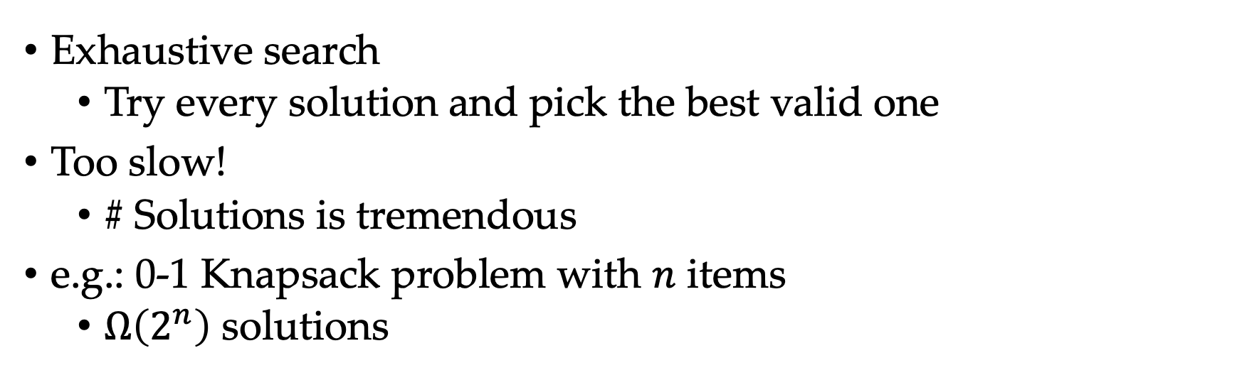
How to solve COP?
Exhaustive search
Try every solution and pick the best valid one
Too slow!
# Solutions is tremendous
e.g.: 0-1 Knapsack problem with $n$ items
$Ω\left(2^{n}\right)$ solutions
Notes:
However, the exhaustive search is too slow! Because the number of solutions Is tremendous. For example, the 0-1 knapsack problem with n items has 2 to the n solutions, which is exponentially large.

Slide 7
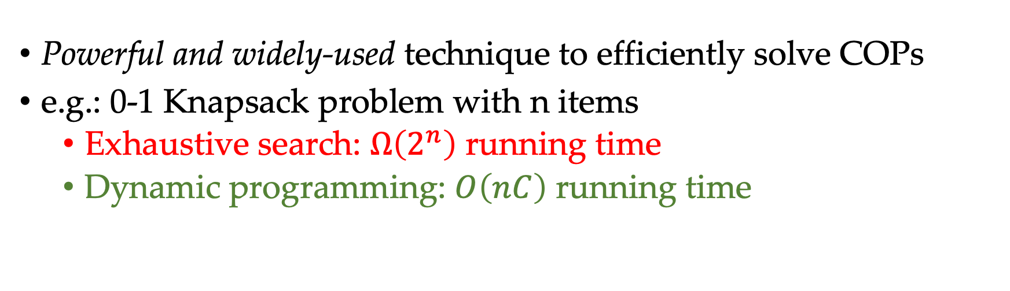
Dynamic Programming (DP)
Powerful and widely-used technique to efficiently solve COPs
e.g.: 0-1 Knapsack problem with n items
Exhaustive search: $Ω\left(2^{n}\right)$ running time
Dynamic programming: $O\left(nC\right)$ running time
Notes:
To efficiently solve COPs, dynamic programming is a powerful and widely-used technique. For 0-1 knapsack problem, its dynamic programming algorithm has the complexity O(nC), which is much more efficient.

Slide 8
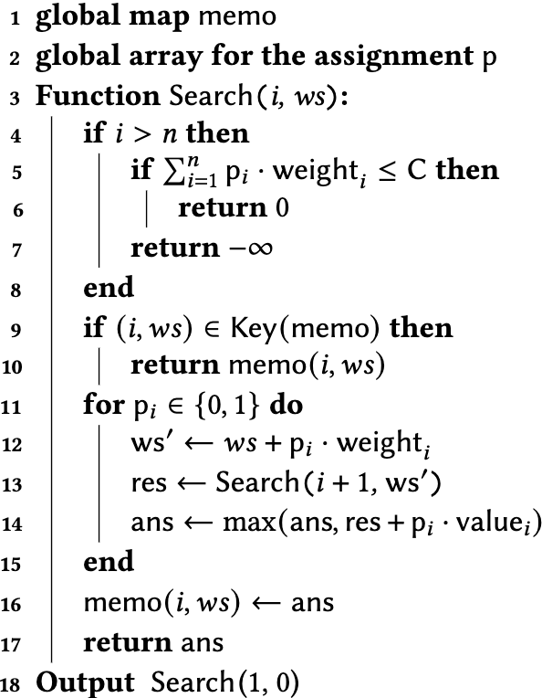
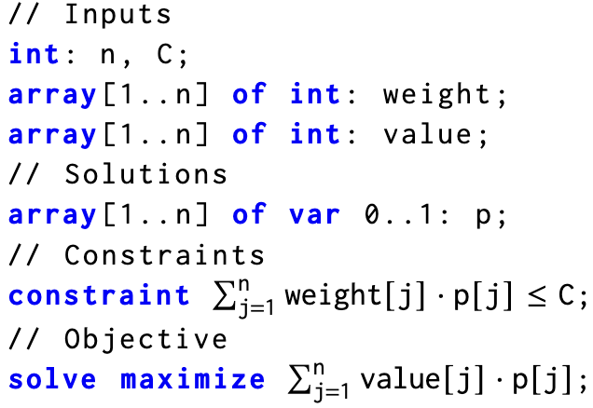
SynMem: Goal
SynMem
Logical Description
of COPs
Dynamic programming
Notes:
Motivated by the importance of combinatorial optimization problems and the dynamic programming algorithm, we propose SynMem, that can automatically synthesize dynamic programming algorithms from logical description of COPs.

Slide 9

Logical Description of COPs
Notes:
At the input side, the logical description of COPs is written in constraint modelling language (e.g., MiniZinc). In detail, the specification is divided into four separate parts.

Slide 10
Logical Description of COPs
weight | 1 | 1 | 4 | 3
value | 10 | 15 | 25 | 18
Capacity = 5
n = 4, C = 5
weight = [1,1,4,3]
value = [10,15,25,18]
Notes:
First, the input part specifies all components to describe a problem instance. In the knapsack problem, we use n to represent the number of items, C to represent the capacity, and use two arrays, weight and value, to represent the weight and value for each item.
In the right side, we show the parameter choice of the previously presented concrete instance.

Slide 11
Logical Description of COPs
Notes:
Second, the solution part consists of all components to describe the solution. In the knapsack problem, we use a array p, where p[i] represents whether to put the item I into the knapsack.

Slide 12
Logical Description of COPs
Notes:
Third, In the constraint part, we impose constraints to the solution. In the knapsack problem, we make sure that the total weight of selected items does not exceed C.

Slide 13
Logical Description of COPs
Notes:
Finally, In the objective function part, we set up a objective function that maximizes the total value of the selected items.

Slide 14
SynMem: Goal
SynMem
Logical Description
of COPs
Memoization
Algorithm
Notes:
At the output side, we produce the top-down approach of dynamic programming, which is also termed as memoization algorithms.

Slide 15
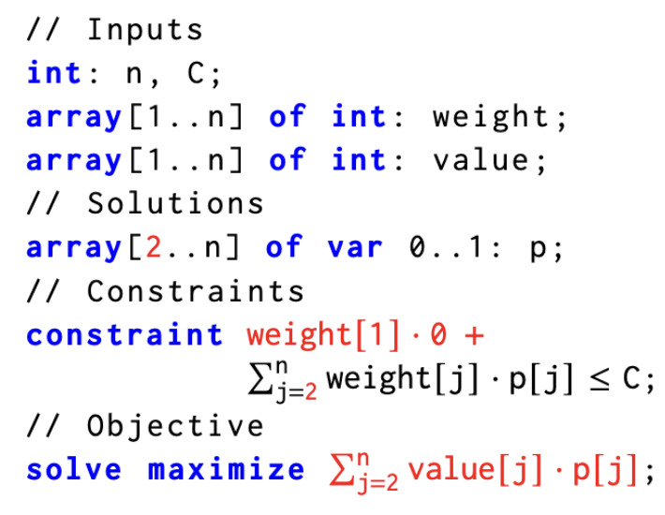
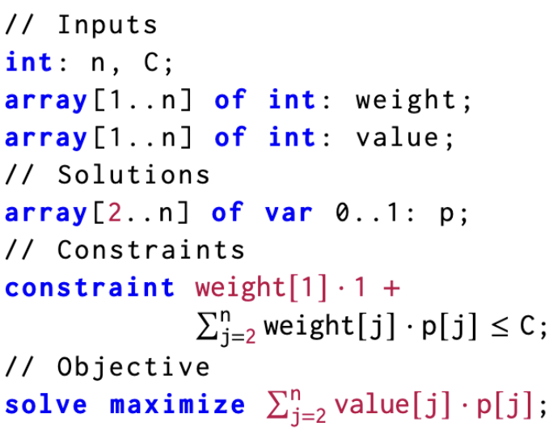
Memoization Algorithm
Notes:
Generally, A memoization algorithm is in a recursive form. It decomposes a problem into several subproblems, and recursively solve these subproblems.

Slide 16
Memoization Algorithm
…
Equivalent!
…
Notes:
The key point that makes memoization algorithms efficient is that, during the recursive solving procedure, there are many pairs of subproblems that are equivalent. For each equivalent class, we only need to solve one subproblem in this class, and the results of other subproblems can be effectively reused.

Slide 17
Challenges
Scalability challenge: Too large to be synthesized
Efficiency challenge: Hard to verify the efficiency
Notes:
However, synthesizing a memoization algorithm is never easy. There are two major challenges. First, memoization algorithms are always too large to be synthesized. Second, it is hard to verify whether a huge synthesized program is efficient.

Slide 18
Our solution
Novel template of memoization algorithms
Memoization Algorithm
=
Exhaustive
Search
+
Local Objective Function + updating function
Memoization Partition Function + updating function
Notes:
Our solution is a novel template of memoization algorithms that solves all these challenges. Below, we dive into more details.

Slide 19







Subproblems from Exhaustive Search
$$p[1]=1$$
$$p[1]=0$$
$$p[2]=0$$
$$p[2]=1$$
$$p[2]=0$$
$$p[2]=1$$
$$⋅⋅⋅$$
Search tree
Notes:
To design a memoization algorithm, we need first define the subproblems. We find that the notion of subproblems can be extracted from the search tree of the exhaustive search. In the search tree, the first layer decides the value of p[1], and the second layer further decides the value of p[2]. If we assign 0 to p[1], then we decide not to put the item 1 into the knapsack. If we assign 1 to p[1], then we decide to put it into the knapsack.
Below, we can see that there is a correspondence between nodes in the search tree and the COP problems.

Slide 20





Subproblems from Exhaustive Search
$$p[1]=1$$
$$p[1]=0$$
$$p[2]=0$$
$$p[2]=1$$
$$p[2]=0$$
$$p[2]=1$$
$$⋅⋅⋅$$
Notes:
At the root node, the subproblem is identical to the original knapsack problem.

Slide 21
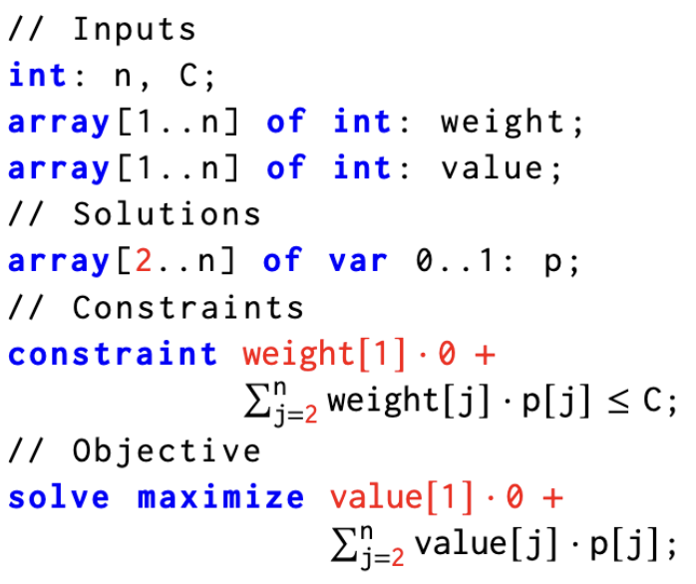




Subproblems from Exhaustive Search
$$p[1]=1$$
$$p[1]=0$$
$$p[2]=0$$
$$p[2]=1$$
$$p[2]=0$$
$$p[2]=1$$
$$⋅⋅⋅$$
Notes:
Now suppose we have decided p[1] to be 0. At this node of the search tree, since the value of p[1] has been determined, the remaining task is to find an assignment to p[2], p[3] to p[n]. In the constraint and objective function part, replace p[1] with its decided value, 0.

Slide 22
Subproblems from Exhaustive Search
$$p[1]=1$$
$$p[1]=0$$
$$p[2]=0$$
$$p[2]=1$$
$$p[2]=0$$
$$p[2]=1$$
$$⋅⋅⋅$$
Notes:
This is exactly the COP that the subtree whose root is the red node tries to solve.

Slide 23
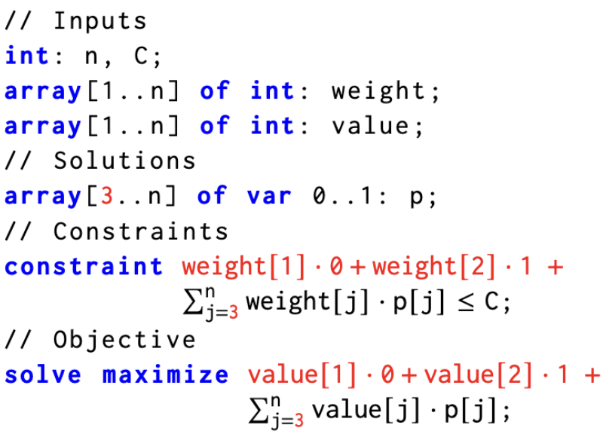





Subproblems from Exhaustive Search
$$p[1]=1$$
$$p[1]=0$$
$$p[2]=0$$
$$p[2]=1$$
$$p[2]=0$$
$$p[2]=1$$
$$⋅⋅⋅$$
Notes:
Suppose we further decided p[2] to be 1, now the remaining task is further changed to decide the value of p[3], p[4] to p[n], and we replace the value of p[2] to be 1 in the constraint and the objective function part.

Slide 24


Subproblems from Exhaustive Search
$$p[1]=0$$
$$p[1]=1$$
Notes:
In general, every node in the search tree corresponds to a subproblem, by enumerating a new variable, a parent subproblem is split into two child subproblems, and the parent subproblems picks a better solution from the two child subproblems.

Slide 25


Subproblems from Exhaustive Search
Cannot reuse!
$$p[1]=0$$
$$p[1]=1$$
Notes:
Unfortunately, these subproblems cannot be reused! Let’s see why.

Slide 26
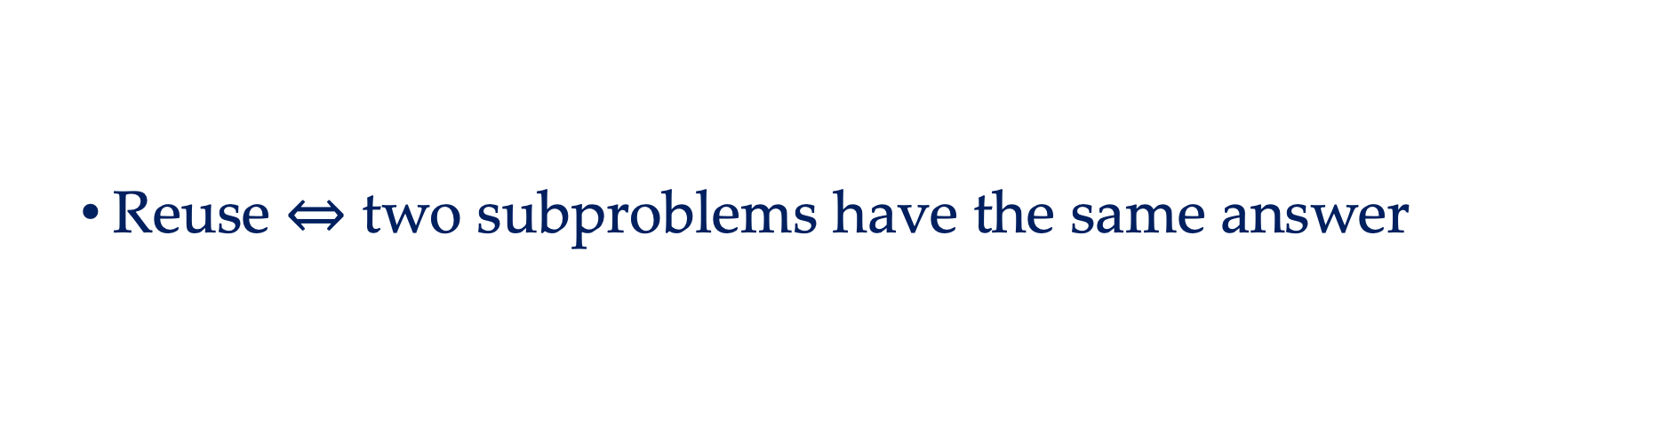
Reusing Conditions
Reuse $⇔$ two subproblems have the same answer
Notes:
To reuse between two subproblems, in principle, we need to make sure that these subproblems have the same answer.

Slide 27
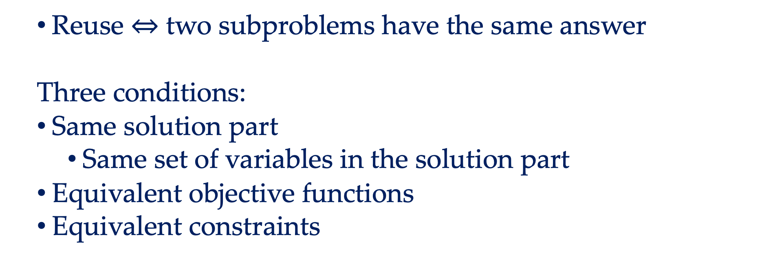
Reusing Conditions
Reuse $⇔$ two subproblems have the same answer
Three conditions:
Same solution part
Same set of variables in the solution part
Equivalent objective functions
Equivalent constraints
Notes:
In this work, we consider three natural conditions of equivalence of subproblems that guarantee the same answer. In detail, two subproblems are equivalent if they share the same solution part, that is, same set of variables in the solution part, and they have equivalent objective function and constraints.

Slide 28






First Reusing Condition
Same solution part ✅
$$p[1]=1$$
$$p[1]=0$$
$$p[2]=0$$
$$p[2]=1$$
$$p[2]=0$$
$$p[2]=1$$
$$⋅⋅⋅$$
Notes:
For the first condition, it can be satisfied by many pairs of subproblems. As long as two subproblems are at the same level of the search tree, this condition can be satisfied.

Slide 29
Reusing Conditions
Same set of variables in the solution part✅
Equivalent objective functions❌
Equivalent constraints
Notes:
However, the second condition is rarely satisfied.

Slide 30
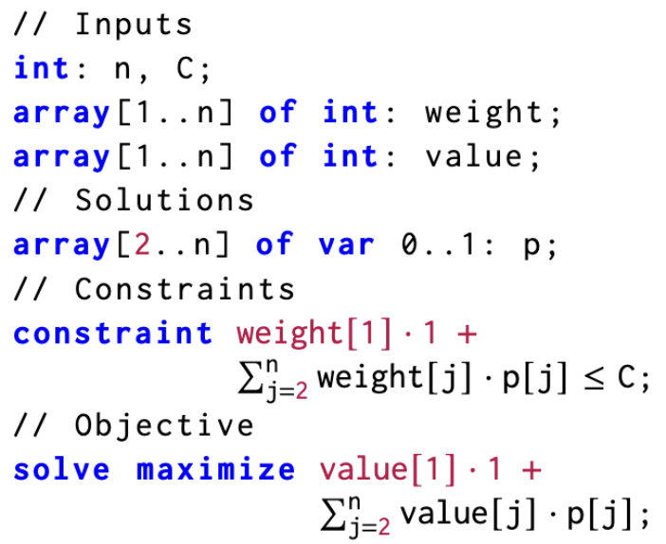



Objective Functions are Usually Different
$$p[1]=0$$
$$p[1]=1$$
$$⋅⋅⋅$$
Notes:
. Let’s consider two sibling subproblems, where they assign different values to p[1] and the other variables are still undetermined.

Slide 31
Objective Functions are Usually Different
$$p[1]=0$$
$$p[1]=1$$
$$⋅⋅⋅$$
Different!
Notes:
We can see that the objective function depends on the value of p[1] and thus is different! In the left side, since we assign 0 to p[1], there is a term value[1] dot zero. However, in the right side, the term becomes value[1] dot one, this makes the two objective functions different. Indeed, different subproblems assign different values to enumerated variables, and thus there is little chance to satisfy the condition on “equivalent objective function”

Slide 32
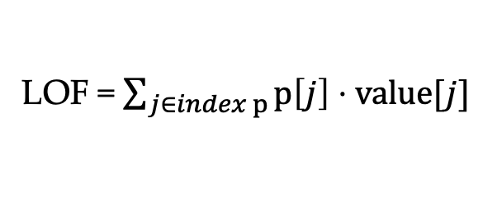
Local Objective Function (LOF)
LOF = $\sum_{j∈index p}{p\left[j\right]⋅value[j]}$
Notes:
To make the objective function independent with the enumerated variables, we introduce the local objective function (short as LOF), and replace the original objective function with the LOF. For knapsack, the LOF is the total value of the to-be-selected items.

Slide 33
Local Objective Function (LOF)
LOF = $\sum_{j∈index p}{p\left[j\right]⋅value[j]}$
preserve the order of solutions
Notes:
We need to ensure that this replacement preserves the order of the solutions for each subproblem and does not affect the answer.

Slide 34

Local Objective Function (LOF)
Same solution part => Equivalent LOF
+ extra updating function
$$p[1]=0$$
$$p[1]=1$$
$$⋅⋅⋅$$
Equivalent!
Notes:
After applying the LOF, the objective function of each subproblem is independent with the enumerated variables, so as long as two subproblems have the same solution part, they share equivalent objective function!
Note that we also need an updating function for LOF to obtain the best solution of the parent subproblem from those of child subproblems.

Slide 35

Equivalent Constraints
$$p[1]=0$$
$$p[1]=1$$
$$⋅⋅⋅$$
Costly to check!
Notes:
Finally, let’s check the equivalent constraint condition. This condition can be generally checked via constraint solvers, but it is too costly!

Slide 36

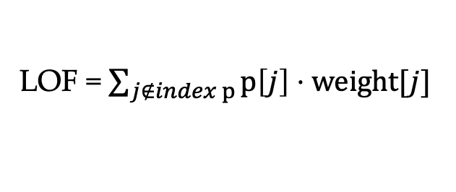
Memoization Partition Function (MPF)
LOF = $\sum_{j∉index p}{p\left[j\right]⋅weight[j]}$
$$weight\left[1\right]⋅0$$
Notes:
Thus, we introduce the memoization partition function (MPF), we need to make sure that two subproblems with same solution part and same MPF share equivalent constraints over solution part. For knapsack, this function is the total weight of selected items.

Slide 37


Memoization Partition Function (MPF)
Same MPF + Same set of solutions => Equivalent constraints
+ extra updating function
$$p[1]=0$$
$$p[1]=1$$
$$⋅⋅⋅$$
Easy to check!
Notes:
After applying MPF, we just need to check whether two subproblem have the same solution part and same MPF, which is easy to check. We also need an updating function to efficiently obtain the MPF of the child subproblem from the parent one.

Slide 38
What is Memoized Search Algorithm?
Memoization
Algorithm
=
Exhaustive
Search
+
Local Objective Function + updating function
Memoization Partition Function + updating function
Notes:
In summary, we have the formula for memoization algorithms below.
Memzoiation algorithms equals exhaustive search plus LOF, MPF and together with their updating functions.

Slide 39
What is Memoized Search Algorithm?
Memoization
Algorithm
=
Exhaustive
Search
+
Local Objective Function + updating function
Memoization Partition Function + updating function
Defines the subproblem
Notes:
where the exhaustive search provides the definition of subproblems.

Slide 40
What is Memoized Search Algorithm?
Memoization
Algorithm
=
Exhaustive
Search
+
Local Objective Function + updating function
Memoization Partition Function + updating function
Enabling efficient reusing
Notes:
and the LOF and MPF makes the subproblems to have more chances to reuse. As long as two subproblems have the same solution part and same MPF value, they are equivalent and thus can be reused.

Slide 41
What is Memoized Search Algorithm?
Memoization
Algorithm
=
Exhaustive
Search
+
Local Objective Function + updating function
Memoization Partition Function + updating function
#Classes = O ( #variables * range of MPF )
Notes:
Thus, the number of equivalent classes of the memoization algorithm is upper bounded by the multiplication of the number of variables and the range of the MPF.
Finally, let’s see why our template solves the two challenges.

Slide 42
What is Memoized Search Algorithm?
Memoization
Algorithm
=
Exhaustive
Search
+
Local Objective Function + updating function
Memoization Partition Function + updating function
#Classes = O ( #variables * range of MPF )
Each of the three parts is a much smaller program!
Notes:
First, Each of the three parts is a much smaller program! Thus can be effectively solved by synthesizers.

Slide 43
What is Memoized Search Algorithm?
Memoization
Algorithm
=
Exhaustive
Search
+
Local Objective Function + updating function
Memoization Partition Function + updating function
#Classes = O ( #variables * range of MPF )
Each of the three parts is a much smaller program!
Better Efficiency $⇔$ Less #Classes $⇔$ smaller range of MPF
Notes:
Second, we can control the efficiency of the memoization algorithm with the range of the MPF. By synthesizing an MPF with the smallest range, we can obtain the most efficient memoization algorithm.

Slide 44
Synthesis of Memoization Algorithm
Memoization
Algorithm
=
Exhaustive
Search
+
Local Objective Function + updating function
Memoization Partition Function + updating function
Generating from templates
Notes:
To implement a program synthesizer, we generate the exhaustive search from templates,

Slide 45
Synthesis of Memoization Algorithm
Memoization
Algorithm
=
Exhaustive
Search
+
Local Objective Function + updating function
Memoization Partition Function + updating function
Mix inductive and deductive methods
Please refer to our paper for details!
Notes:
To synthesize LOF and MPF, we propose a synthesis procedure that mixes the inductive and deductive methods. Due to time limits, please refer to our paper for details.

Slide 46
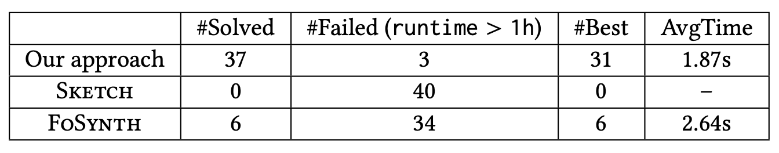
Evaluation & Thanks!
SynMem could be extended to decision and counting problems without any change
Benchmarks: 40 Combinatorial Problems
36 problems from LeetCode: top frequent problems in interview
4 problems from CSP-J
Knapsack, Longest common/increasing subsequence, Fibonacci sequence, shortest path on grids
Notes:
SynMem could be extended to decision and counting problems without any change. We evaluate our approach on 40 real-world combinatorial problems, it can solve 6 times problems more than previous approaches! Thank you!

