Slide 1
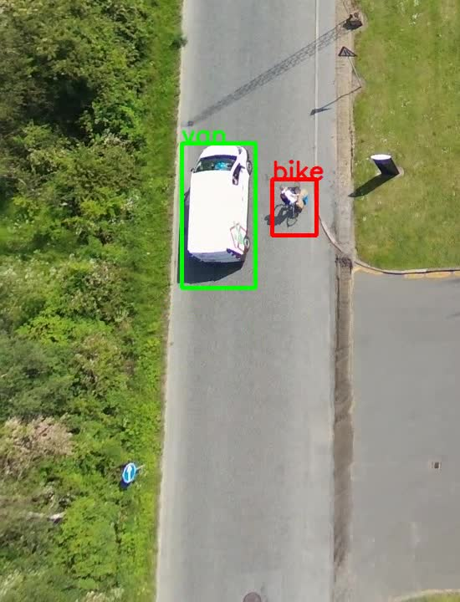
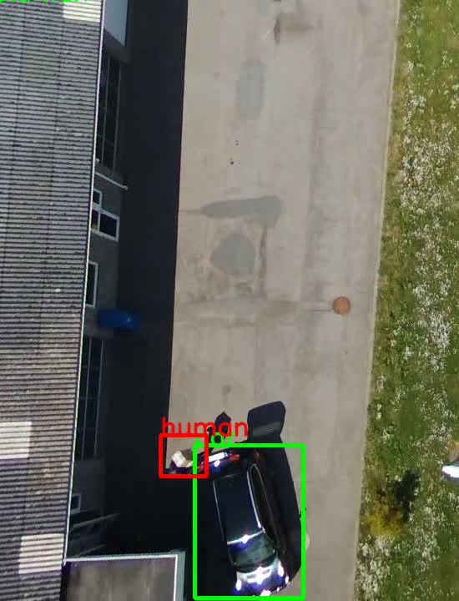
Anomaly Detection using Drones
Anomaly detection is crucial process for surveillance tasks. It requires a security guard in a controlling room looking at multiple screens. So, it is inefficient and error prone.
In this project, I designed AI-based surveillance system to detect anomalies by drones. The solution is based on Variational Autoencoders and learns anomalies in unsupervised manner.
I formulated the anomaly detection problem to be solvable with machine learning methods. In this project, an anomaly is defined as unusual occurrence of objects, and I use variational auto-encoders learn object distributions in images. Objects which are outliers for the distribution are considered as anomaly. Keras and OpenCV are main tools that are used in this project.

