Slide 1
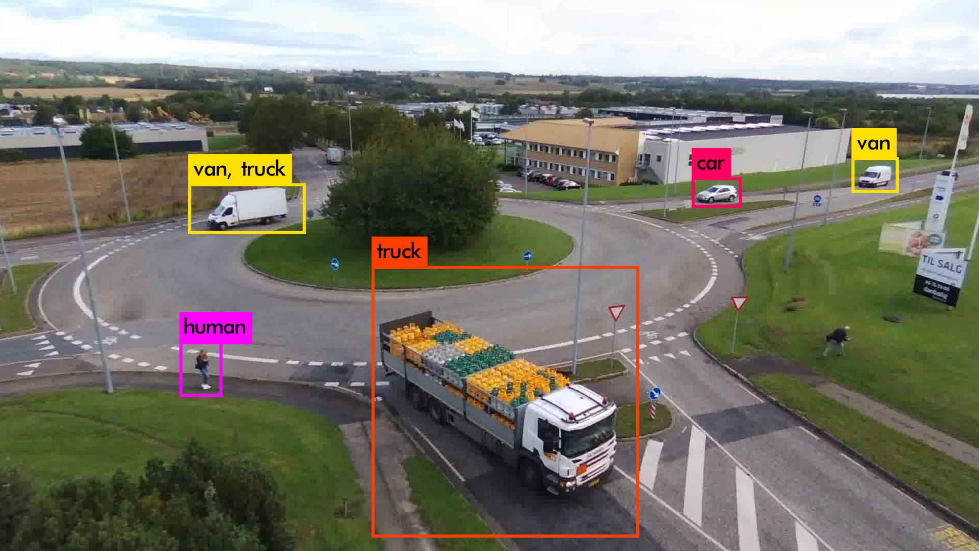
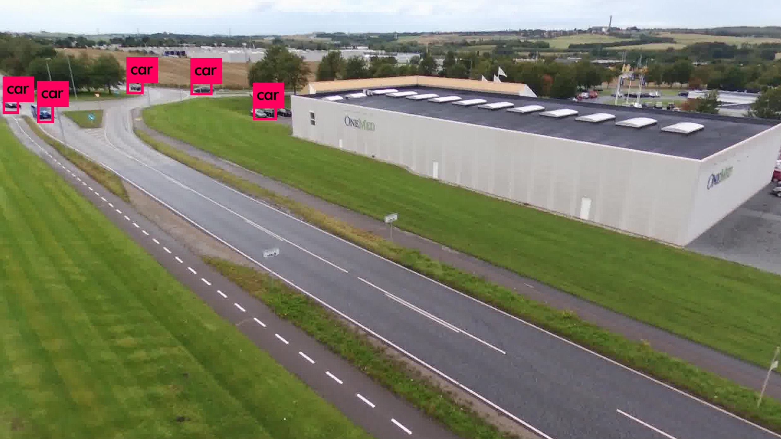
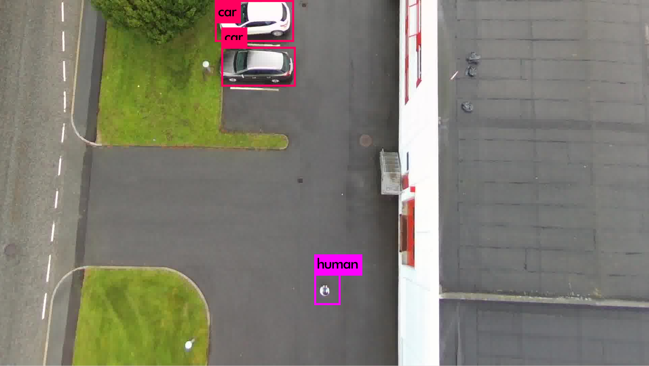
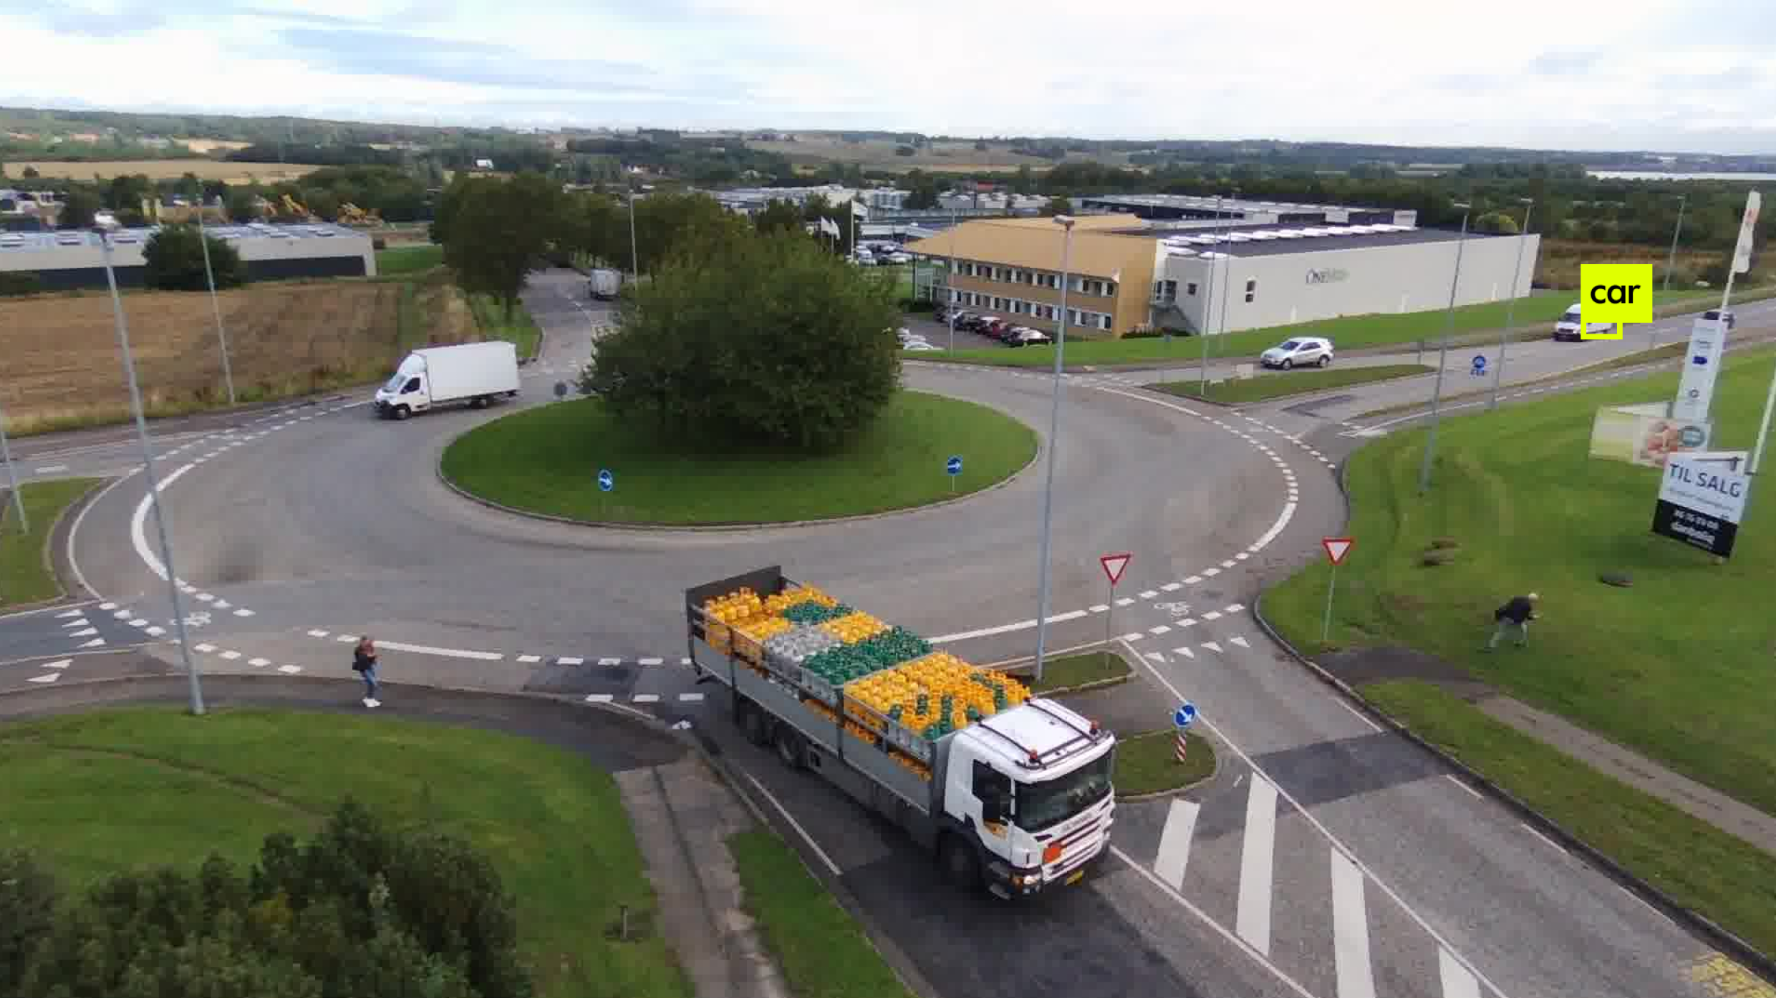
Object Detection (Vehicles and Humans) in Aerial Images
Well-known object detectors (e.g., YOLO, FasterRCNN) trained on natural images (such as COCO, Pascal datasets) perform poorly to detect objects in aerial images because of significant differences between aerial and natural datasets.
In this project, I design and implement new object detector dedicated to aerial object detection, and manage dataset collection process.
(Output of the my designed network: Detection of traffic related objects like vehicles and pedestrians)
(Output of the my designed network: Perspective increases the challenge)
(Output of the my designed network: View angle increases the challenge )
(Output of other available method (YOLOv3): Object detectors trained on natural images performs poorly)

