Slide 1

Binary image classifier

Slide 2
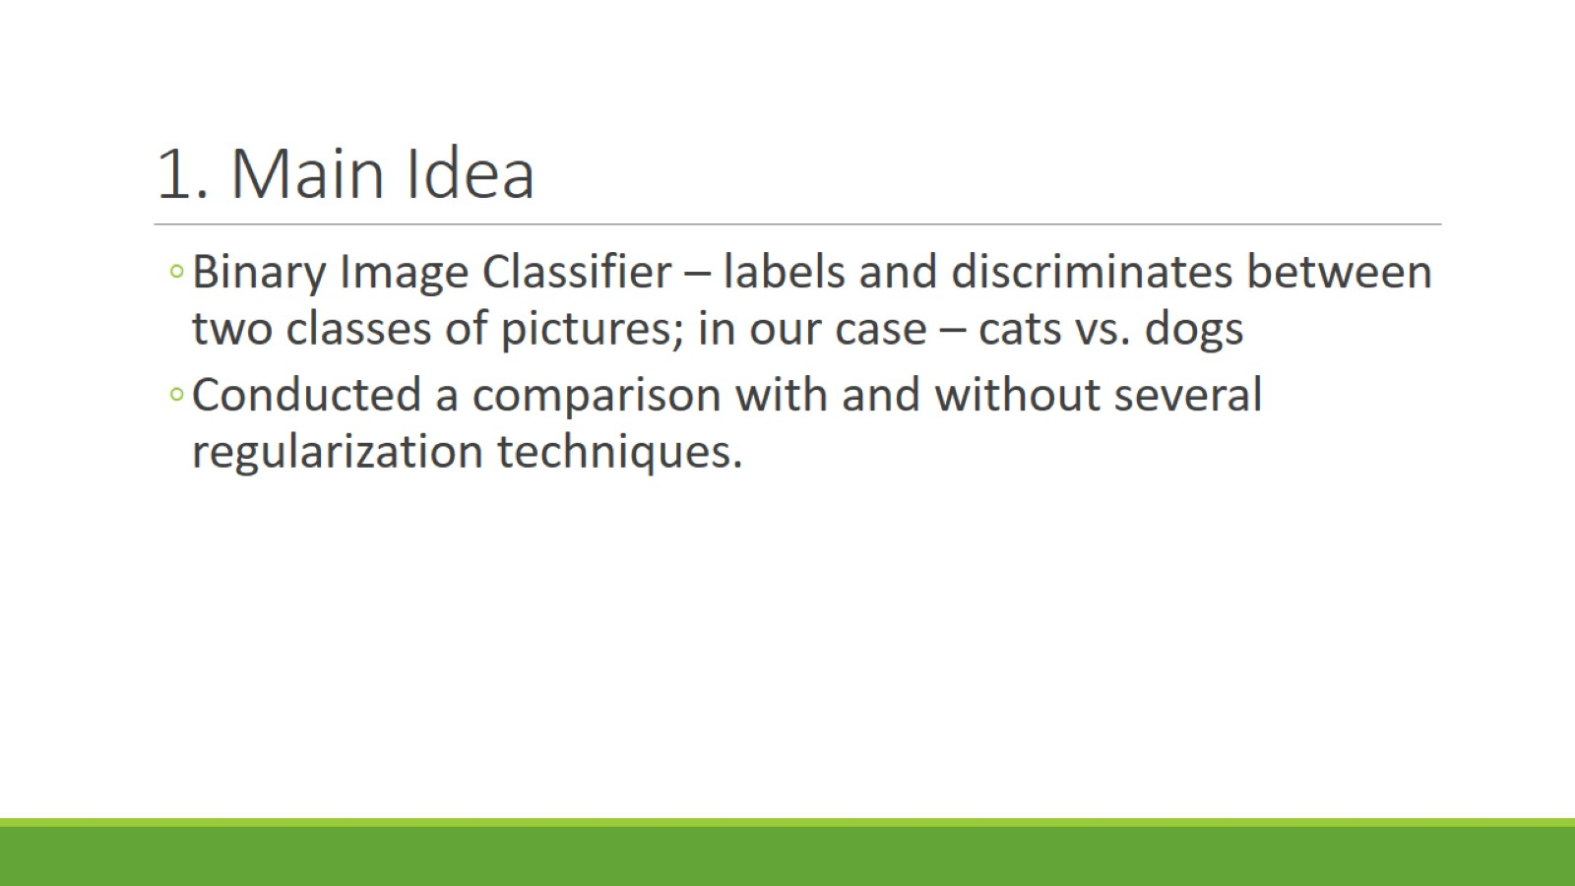
1. Main Idea

Slide 3
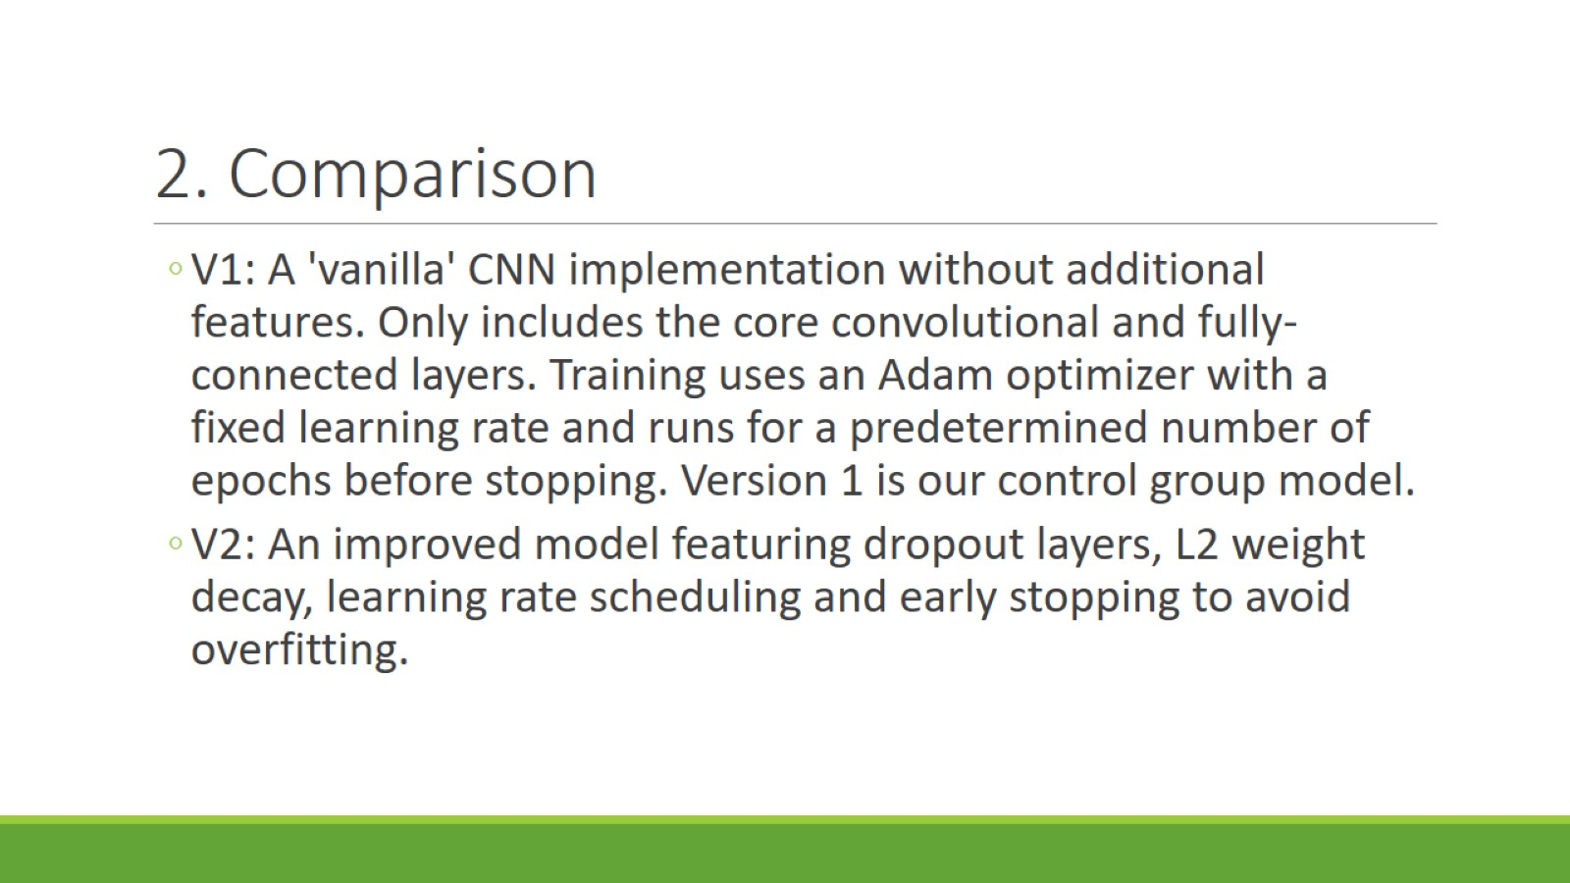
2. Comparison

Slide 4
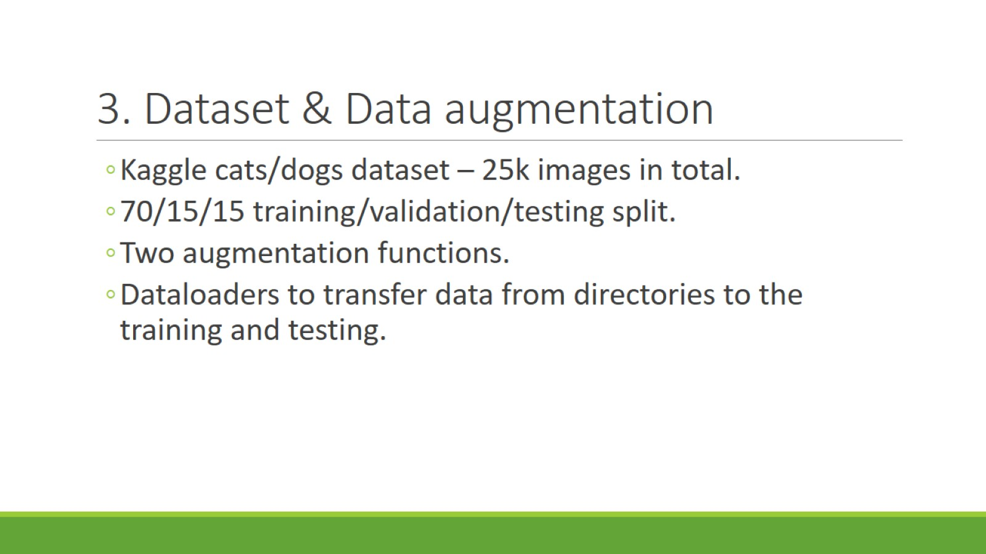
3. Dataset & Data augmentation

Slide 5
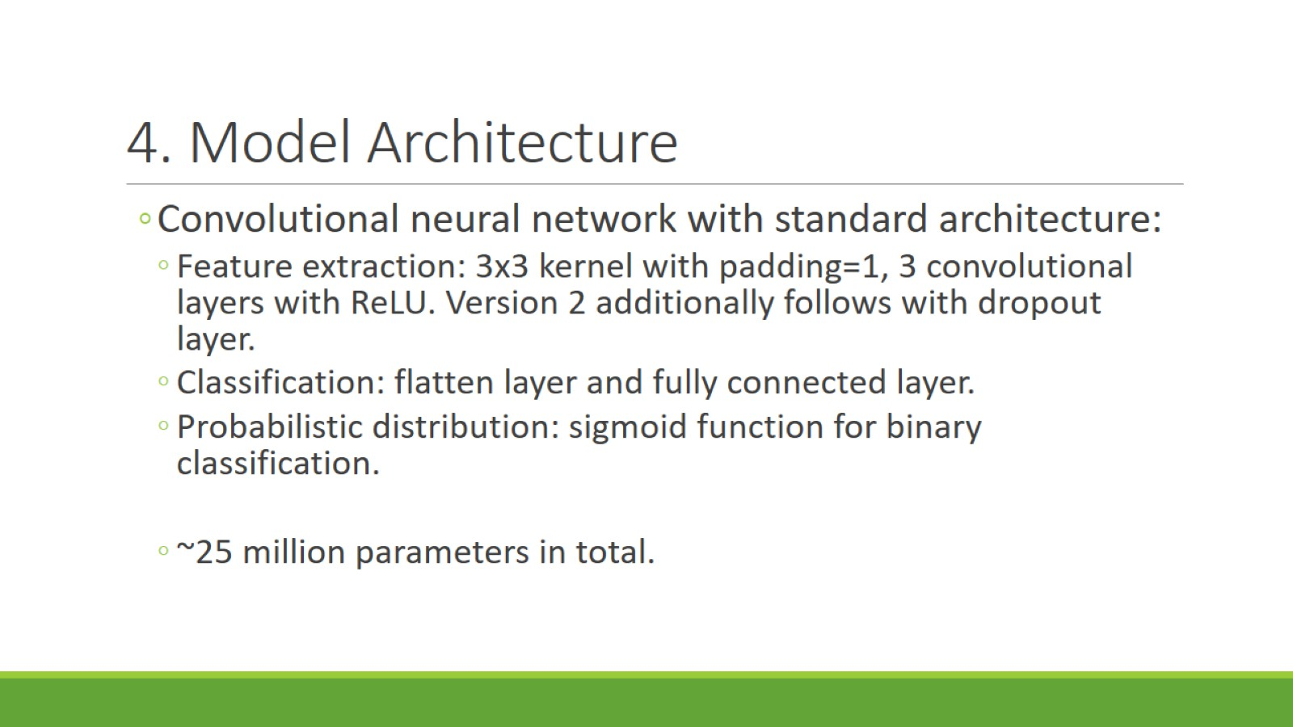
4. Model Architecture

Slide 6
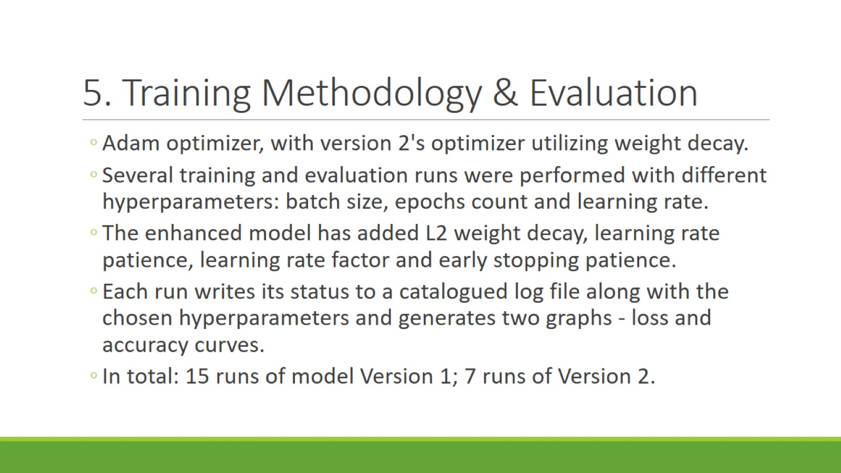
5. Training Methodology & Evaluation

Slide 7
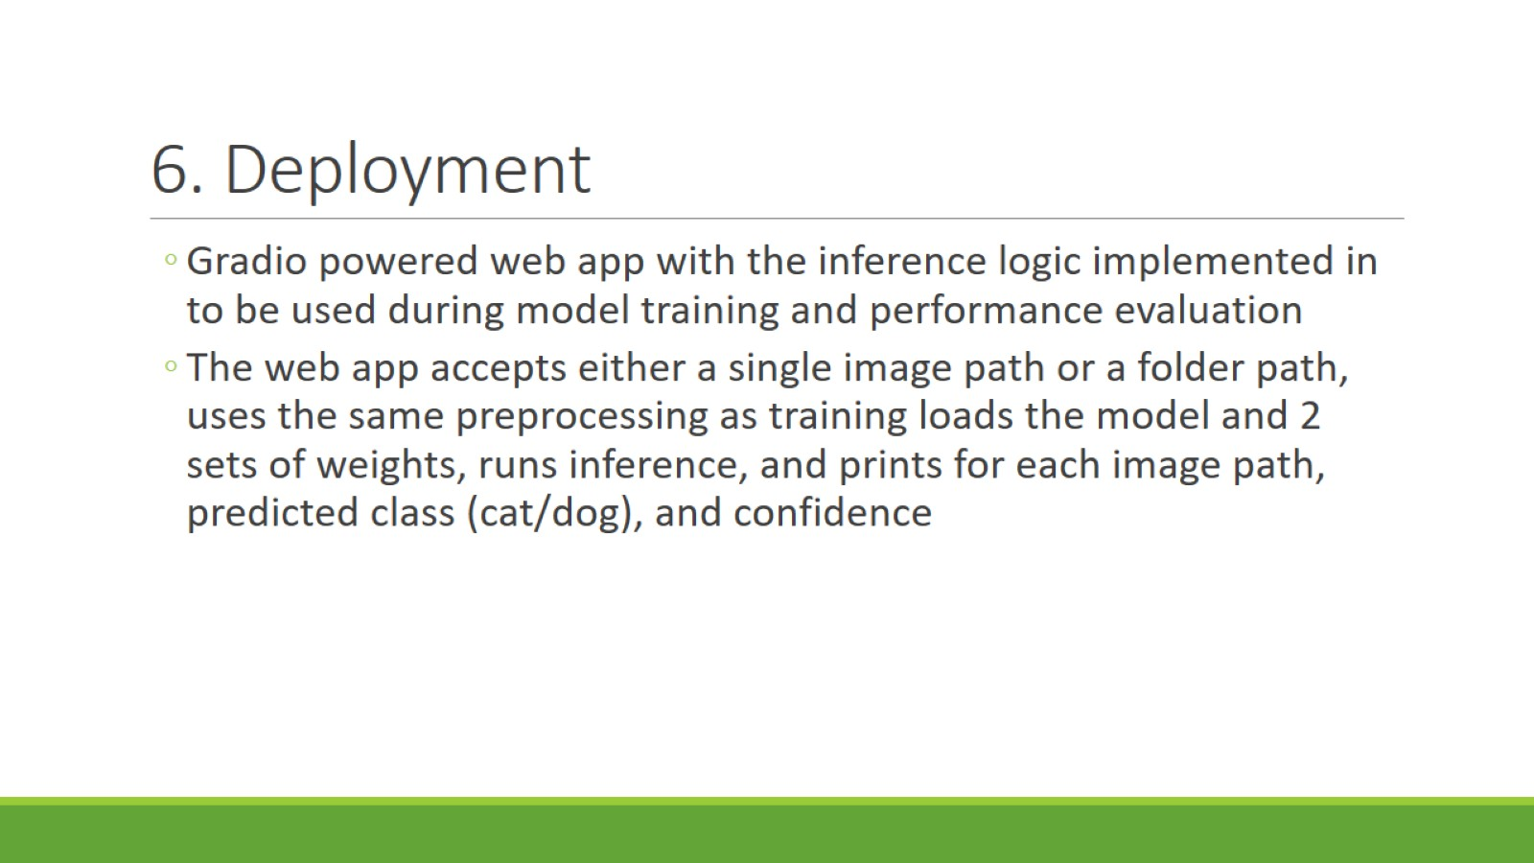
6. Deployment

Slide 8
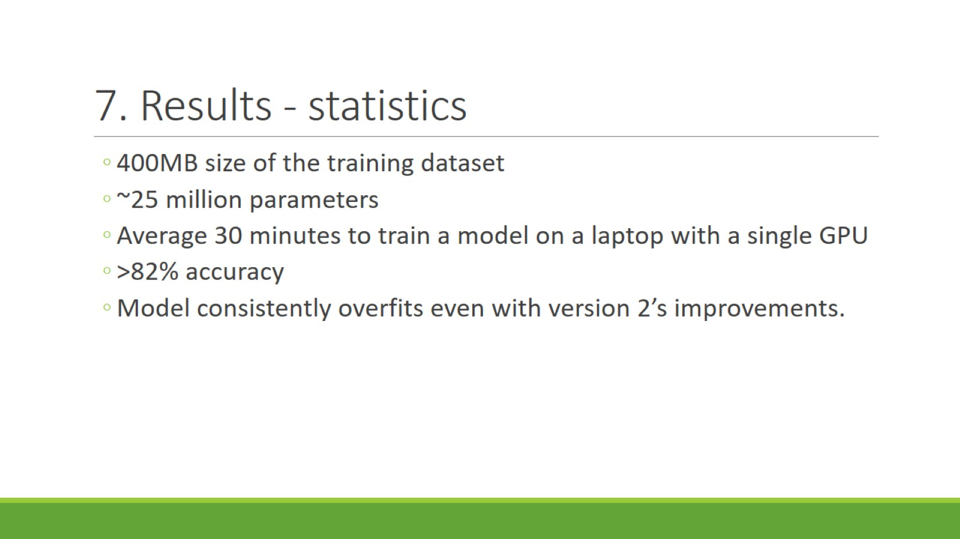
7. Results - statistics

Slide 9
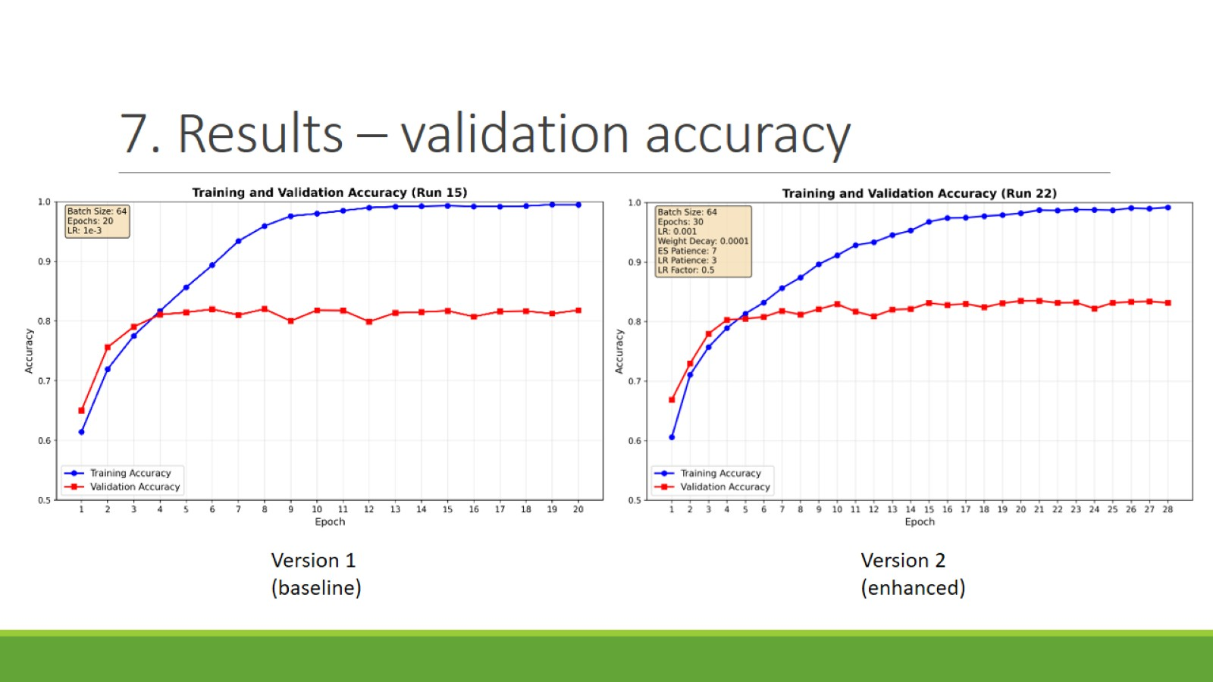
7. Results – validation accuracy

Slide 10
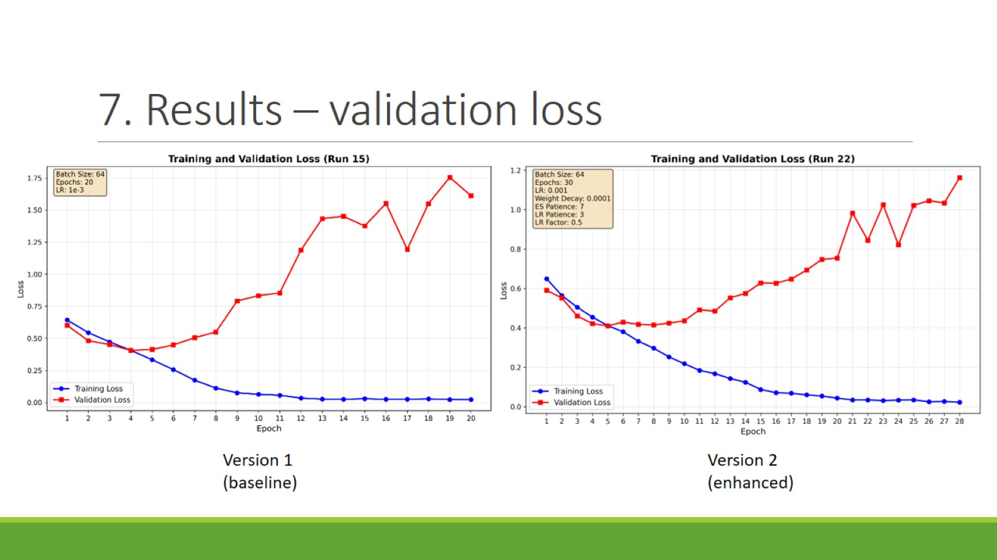
7. Results – validation loss

