Slide 1
Feel The Sound

Slide 2
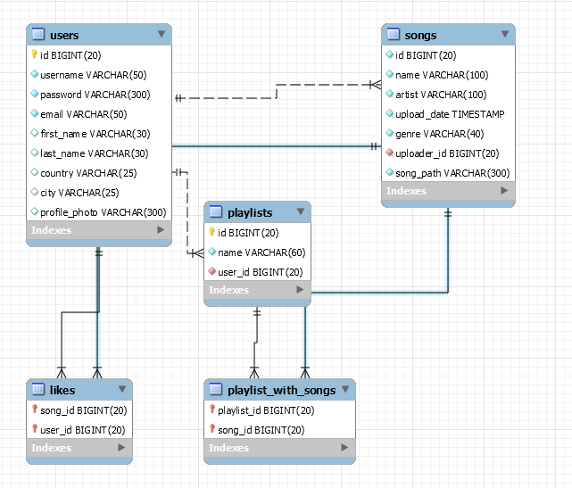

Slide 3
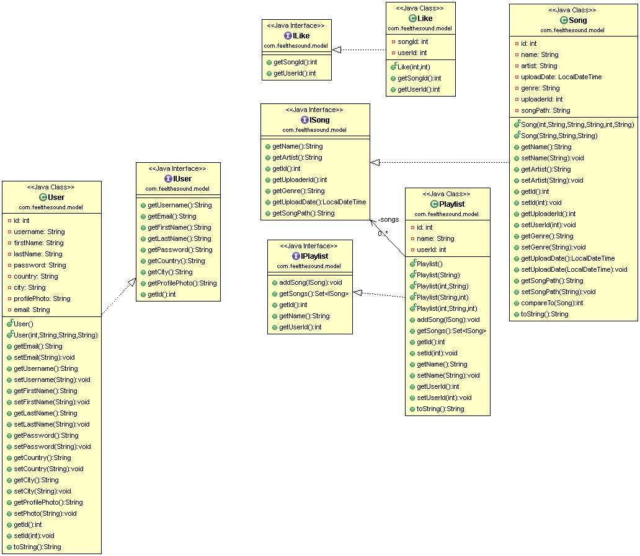

Slide 4


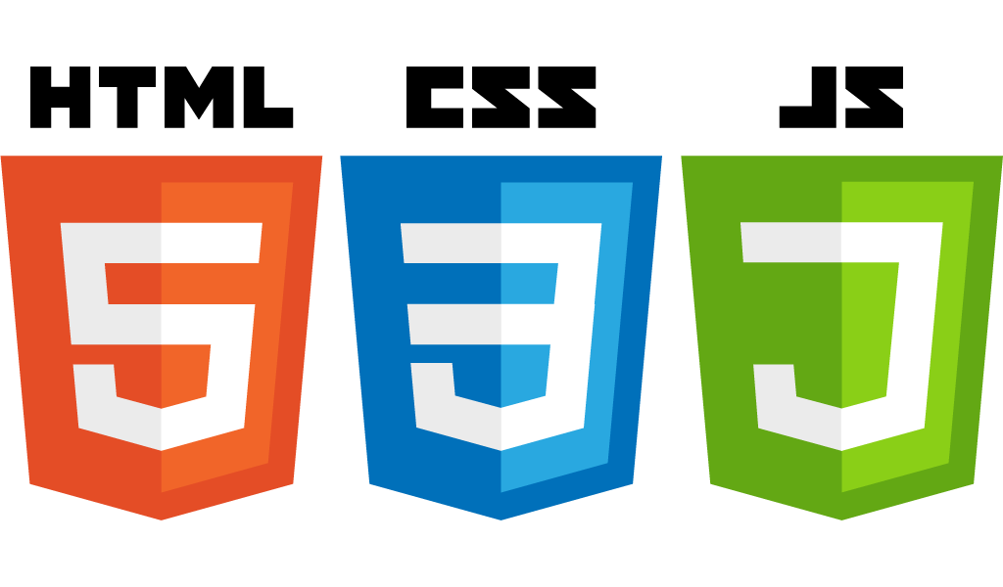

Технологии
Spring MVC
MySQL
JavaScript
Ajax
JSP
JSTL
HTML
CSS

Slide 5
DEMO

