Slide 1
Python Blockchain Project v 1.0 Stanislav Bozhimirov Shumen, BULGARIA
13/06/2024 https://github.com/bozhimirov

Slide 2
Python Blockchain Project
Description:
A demo of a blockchain written in python with local data.json file that stores the blockchain info. Each block has a data, timestamp, previous hash, difficulty, nonce and current hash. After initiation automatically is generated genesis block and a data file is created to store the blocks. After that from the UI users can add data to blockchain. Each block, once created, cannot be deleted from the data file. Each time the project is run the data is added to the already created blockchain. If the data.json file is deleted, after the project is run new blockchain is created with new genesis block.

Slide 3
Used libraries and modules:
Flask
Flask-RESTful
pytest
hashlib
datetime
json
os
ast

Slide 4
App Architecture
Python_Blockchain_Project
active_chain.py
data.json
block.py
requirements.txt
blockchain.py
README.md
project.py
static
test_project.py
css
styles.css
templates
index.html

Slide 5
Python Blockchain Project v1.0
DEMO

Slide 6
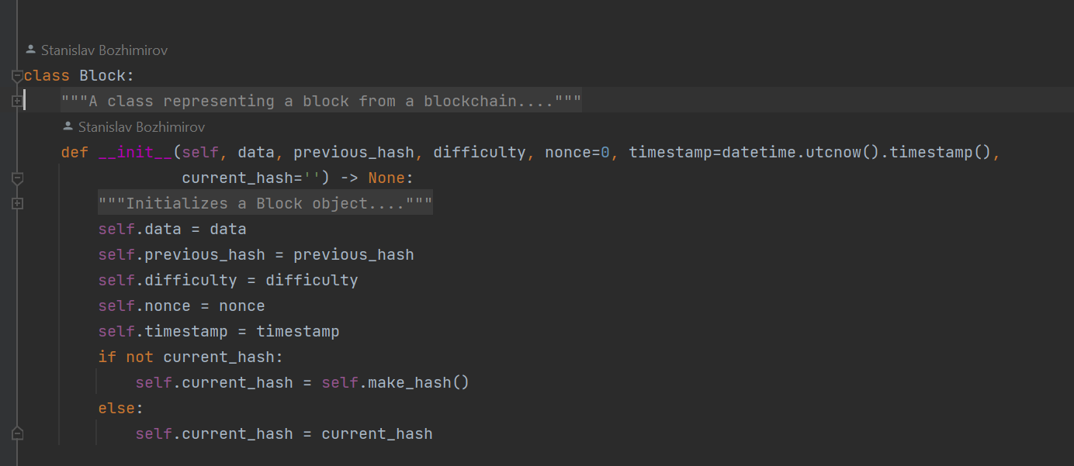

Slide 7
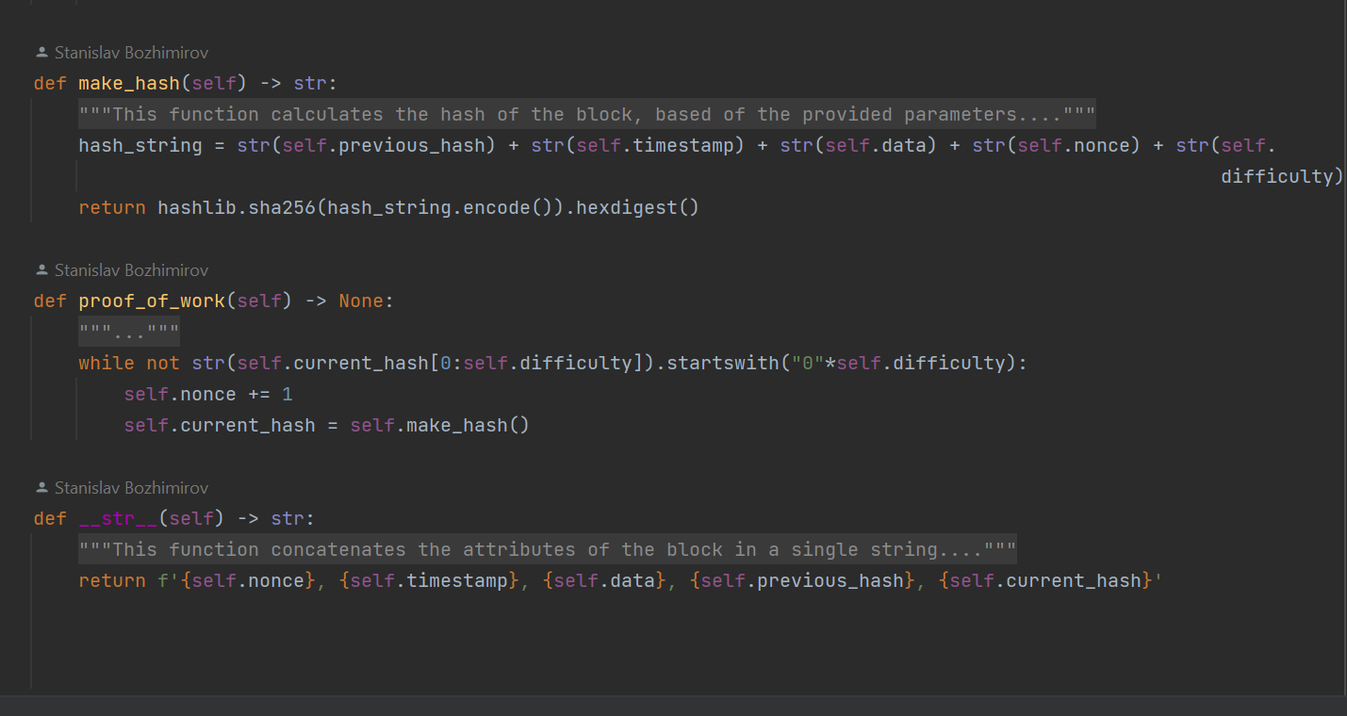

Slide 8
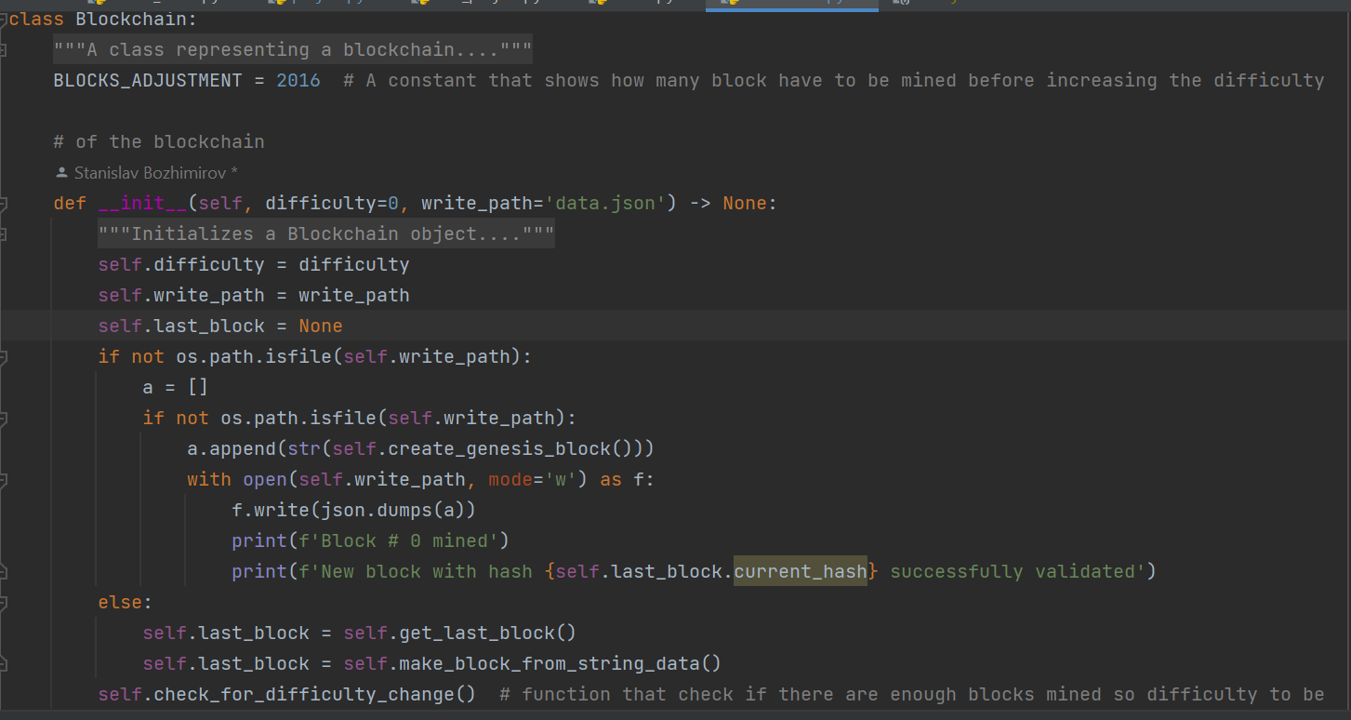

Slide 9
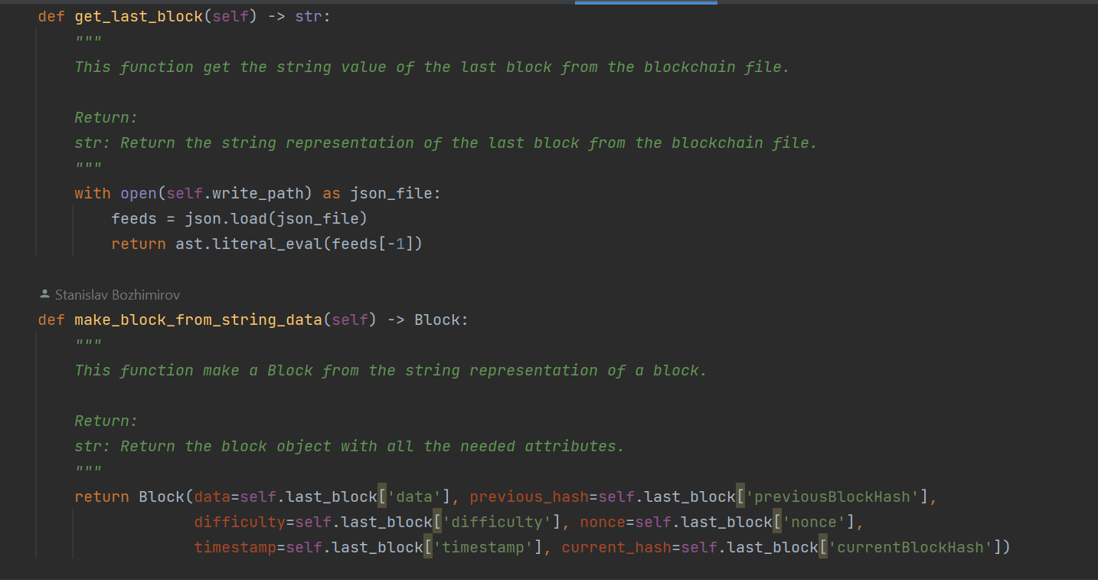

Slide 10
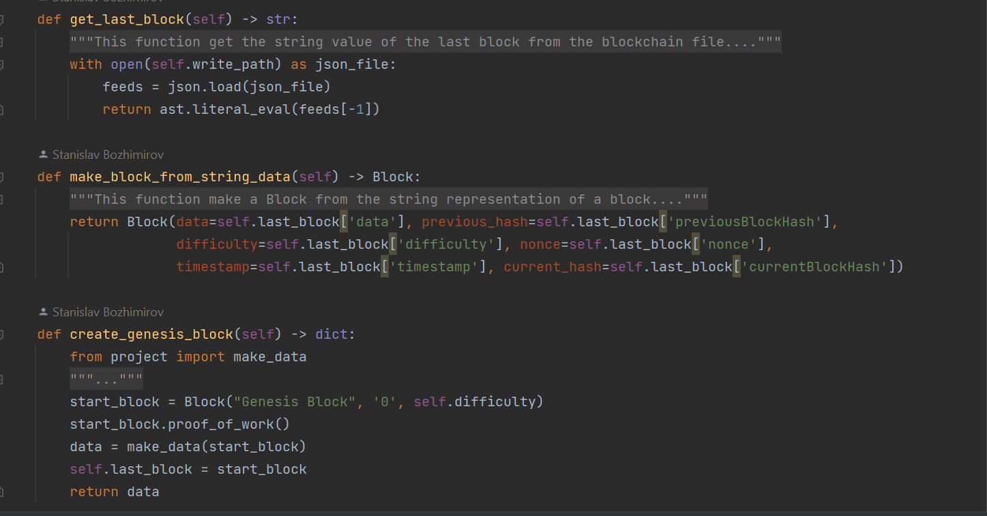

Slide 11
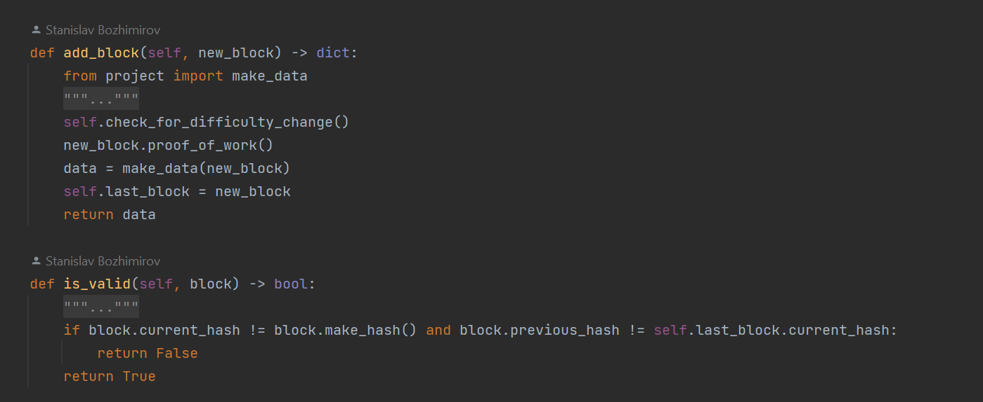

Slide 12
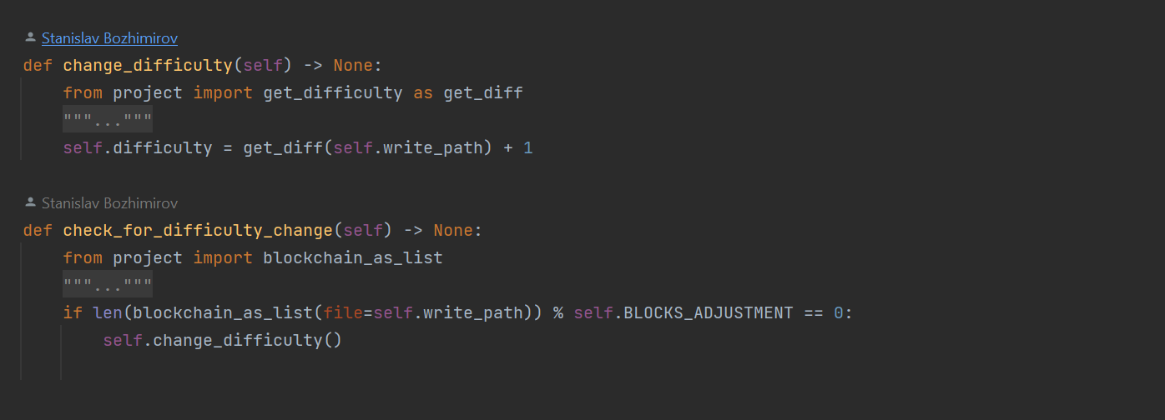

Slide 13
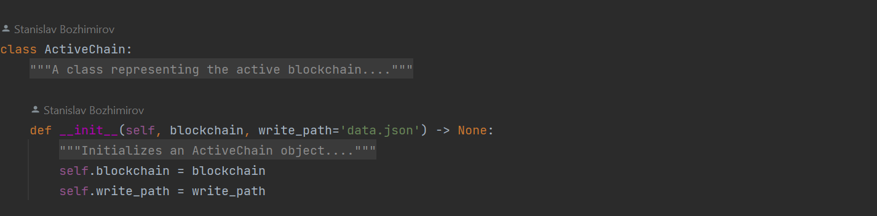
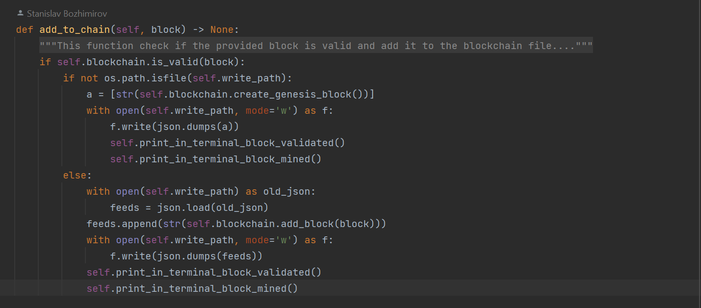

Slide 14
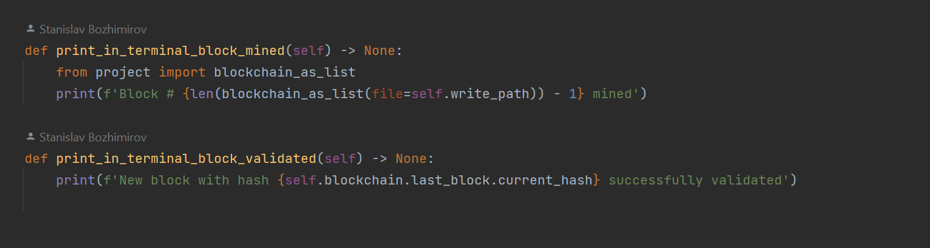

Slide 15
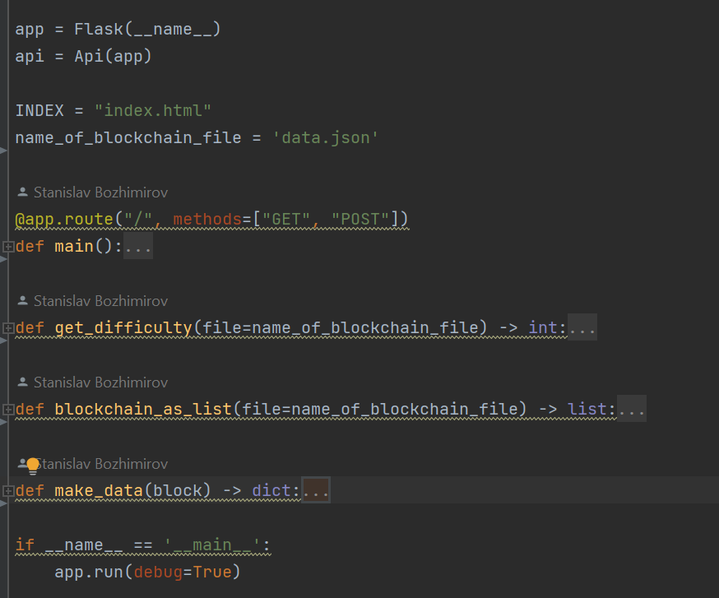

Slide 16
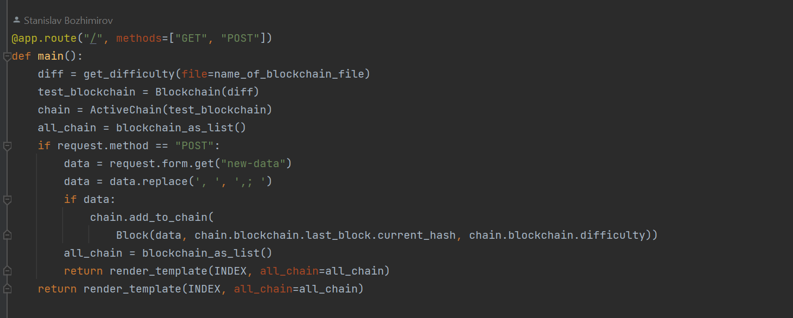

Slide 17
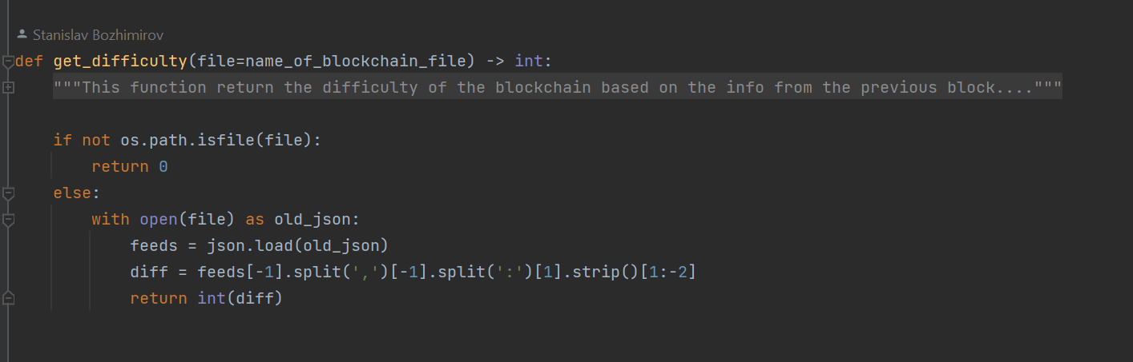
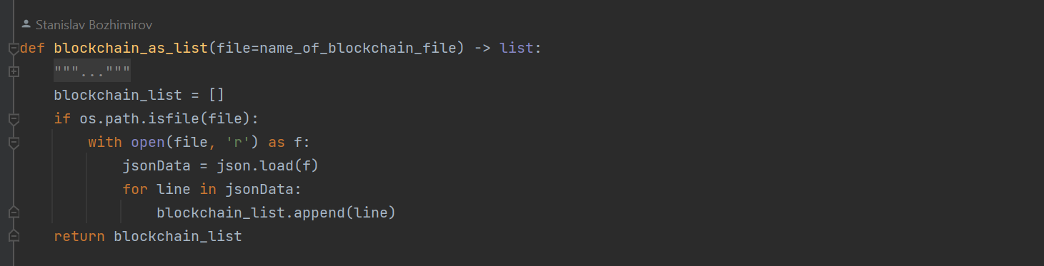

Slide 18
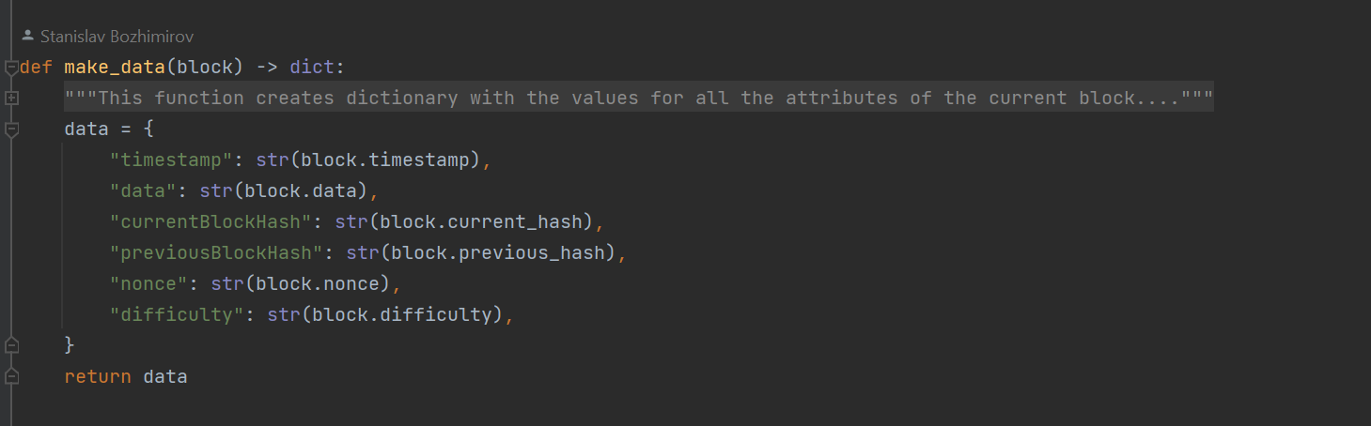

Slide 19
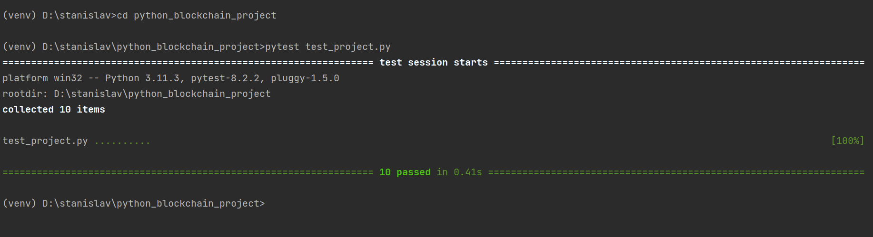
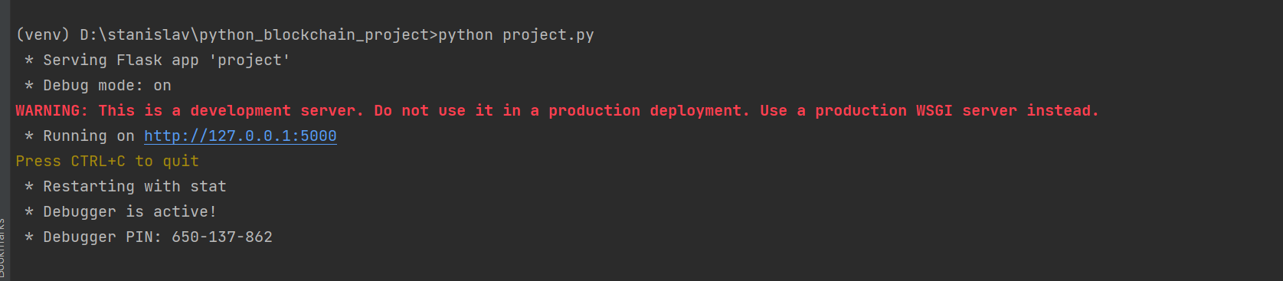

Slide 20
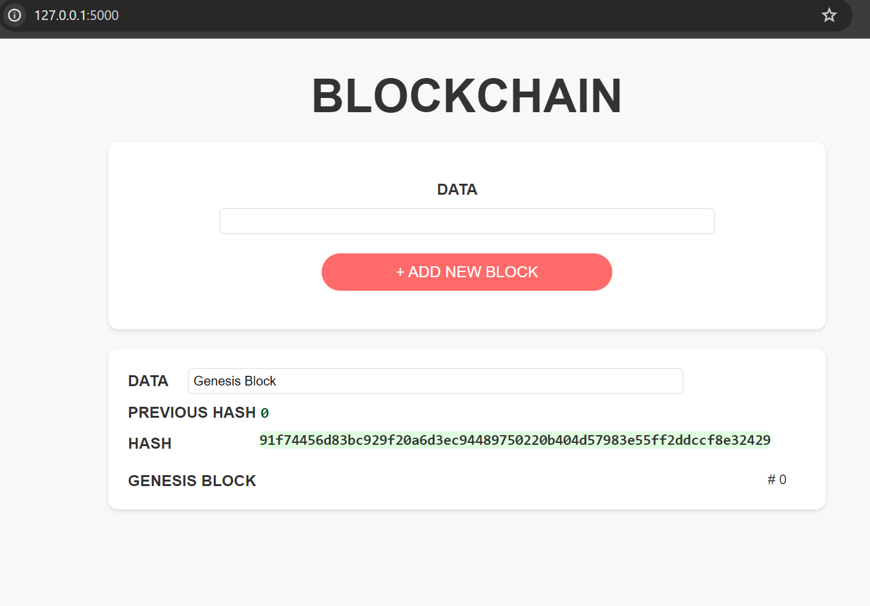

Slide 21
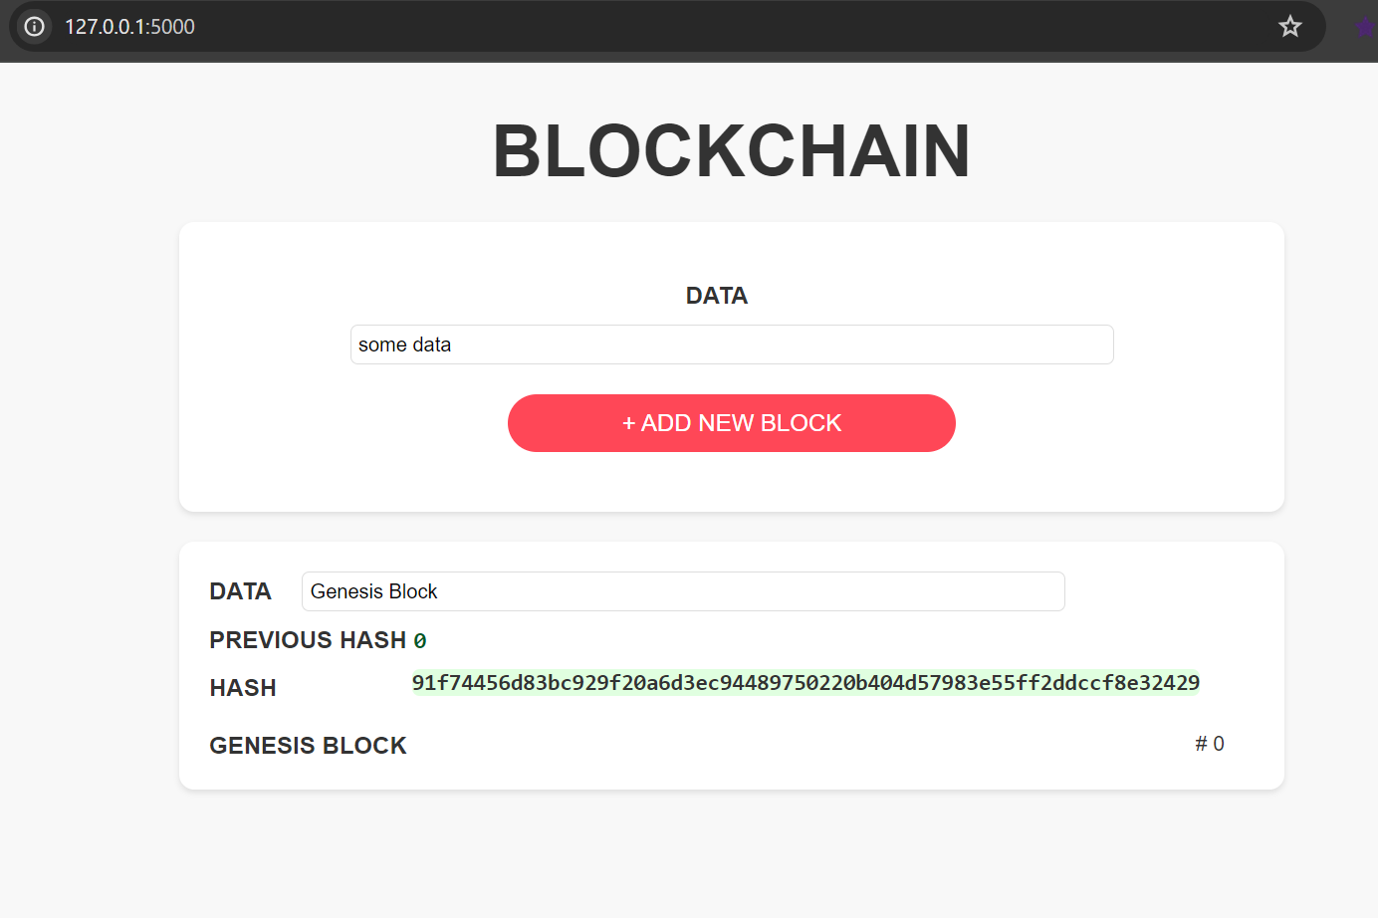
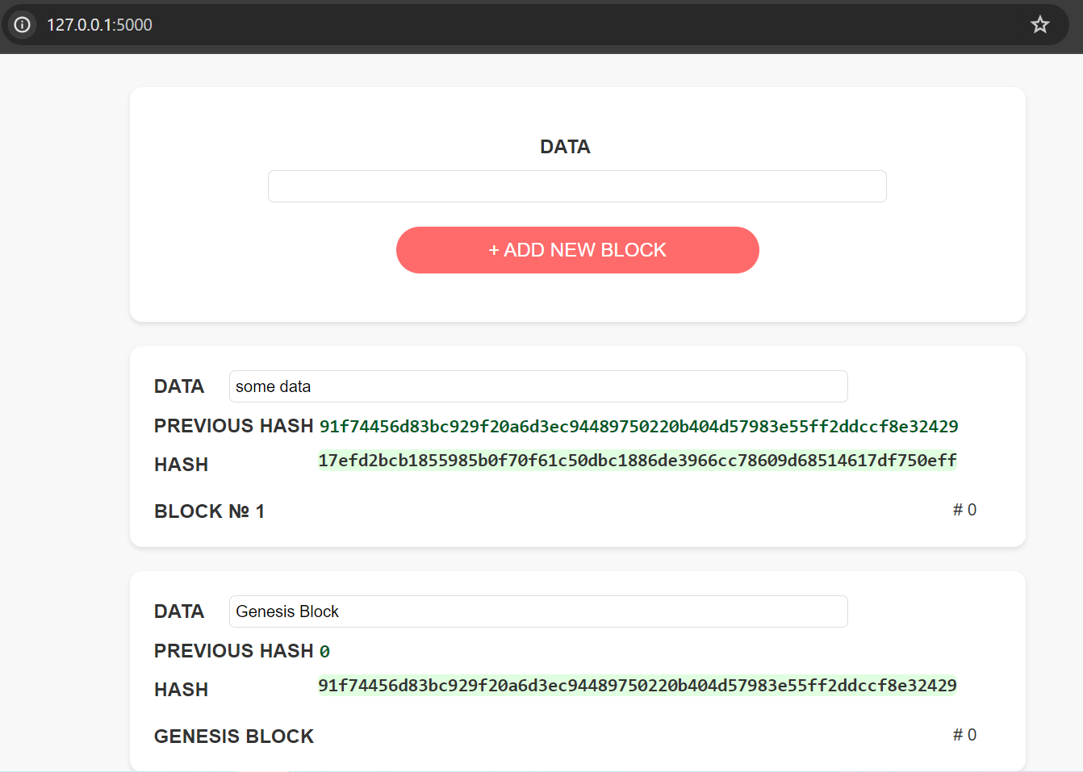

Slide 22
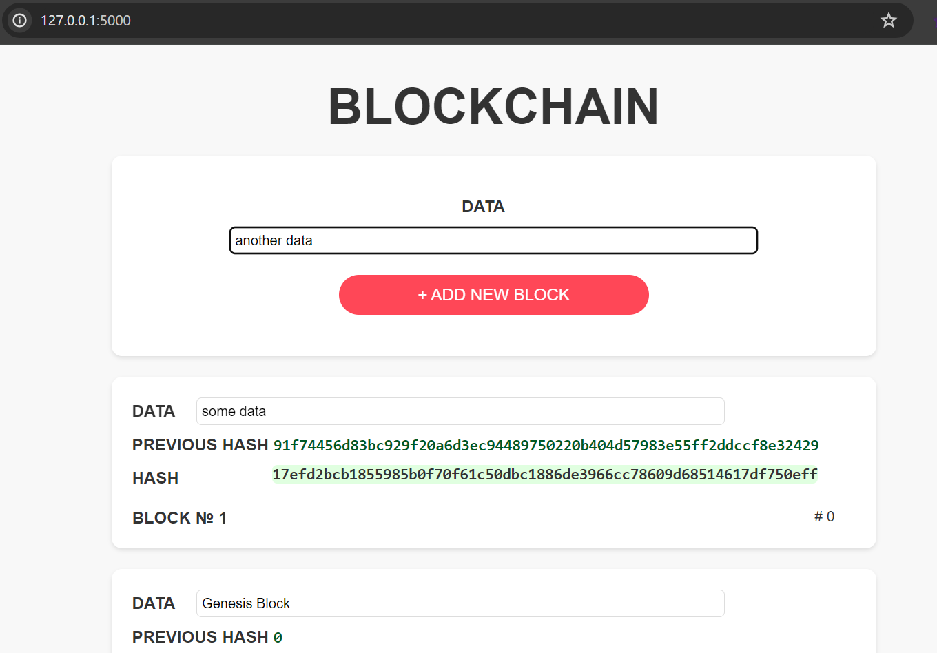
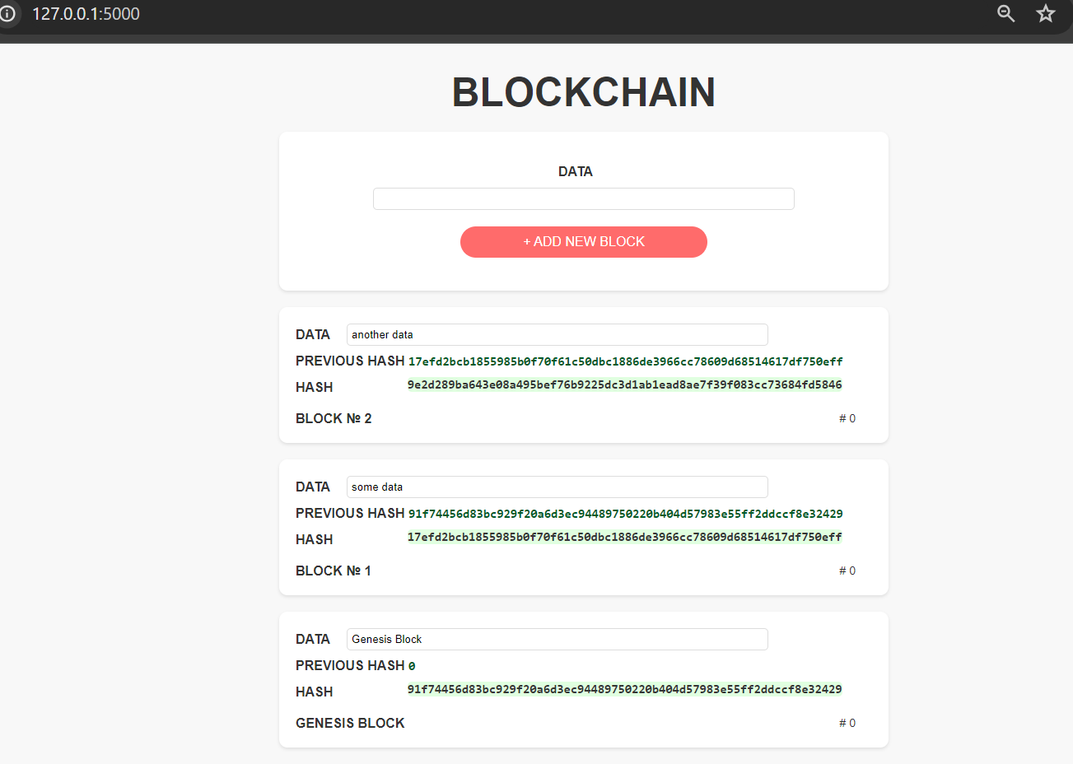

Slide 23
Thank you!
Enjoy!

