Slide 1
Malicious Software
What is the concept of defense: The parrying of a blow. What is its characteristic feature: Awaiting the blow.
—On War, Carl Von Clausewitz
Notes:
Opening quote.

Slide 2
Viruses and Other Malicious Content
computer viruses have got a lot of publicity
one of a family of malicious software
effects usually obvious
have figured in news reports, fiction, movies (often exaggerated)
getting more attention than deserve
are a concern though
Notes:
This chapter examines malicious software (malware), especially viruses and worms, which exploit vulnerabilities in computing systems. These have been given a lot of (often uninformed) comment in the general media. They are however, of serious concern, and are perhaps the most sophisticated types of threats to computer systems. We begin with a survey of various types of malware, with a more detailed look at the nature of viruses and worms. We then turn to distributed denial-of-service attacks.

Slide 3
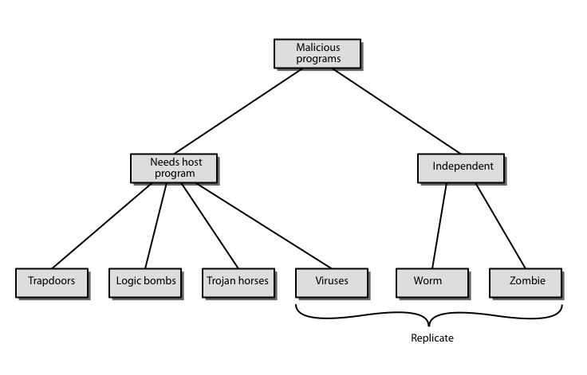
Malicious Software
Notes:
The terminology used for malicious software presents problems because of a lack of universal agreement on all terms and because of overlap. Stallings Table 21.1, and this diagram from 3/e, provide a useful taxonomy. It can be divided into two categories: those that need a host program (being a program fragment eg virus), and those that are independent programs (eg worm); alternatively you can also differentiate between those software threats that do not replicate (are activated by a trigger) and those that do (producing copies of themselves). Will now survey this range of malware.

Slide 4
Backdoor or Trapdoor
secret entry point into a program
allows those who know access bypassing usual security procedures
have been commonly used by developers
a threat when left in production programs allowing exploited by attackers
very hard to block in O/S
requires good s/w development & update
Notes:
A backdoor, or trapdoor, is a secret entry point into a program that allows someone that is aware of it to gain access without going through the usual security access procedures. Have been used legitimately for many years to debug and test programs, but become a threat when left in production programs, allowing intruders to gain unauthorized access. It is difficult to implement operating system controls for backdoors. Security measures must focus on the program development and software update activities.

Slide 5
Logic Bomb
one of oldest types of malicious software
code embedded in legitimate program
activated when specified conditions met
eg presence/absence of some file
particular date/time
particular user
when triggered typically damage system
modify/delete files/disks, halt machine, etc
Notes:
One of the oldest types of program threat, predating viruses and worms, is the logic bomb. The logic bomb is code embedded in some legitimate program that is set to "explode" when certain conditions are met. Examples of conditions that can be used as triggers for a logic bomb are the presence or absence of certain files, a particular day of the week or date, or a particular user running the application. Once triggered, a bomb may alter or delete data or entire files, cause a machine halt, or do some other damage.

Slide 6
Trojan Horse
program with hidden side-effects
which is usually superficially attractive
eg game, s/w upgrade etc
when run performs some additional tasks
allows attacker to indirectly gain access they do not have directly
often used to propagate a virus/worm or install a backdoor
or simply to destroy data
Notes:
A Trojan horse is a useful, or apparently useful, program or command procedure (eg game, utility, s/w upgrade etc) containing hidden code that performs some unwanted or harmful function that an unauthorized user could not accomplish directly. Commonly used to make files readable, propagate a virus or worm or backdoor, or simply to destroy data.

Slide 7
Mobile Code
program/script/macro that runs unchanged
on heterogeneous collection of platforms
on large homogeneous collection (Windows)
transmitted from remote system to local system & then executed on local system
often to inject virus, worm, or Trojan horse
or to perform own exploits
unauthorized data access, root compromise
Notes:
Mobile code refers to programs (e.g., script, macro, or other portable instruction) that can be shipped unchanged to a heterogeneous collection of platforms and execute with identical semantics. The term also applies to situations involving a large homogeneous collection of platforms (e.g., Microsoft Windows). Mobile code is transmitted from a remote system to a local system and then executed on the local system without the user’s explicit instruction. Mobile code often acts as a mechanism for a virus, worm, or Trojan horse to be transmitted to the user’s workstation. In other cases, mobile code takes advantage of vulnerabilities to perform its own exploits, such as unauthorized data access or root compromise. Popular vehicles for mobile code include Java applets, ActiveX, JavaScript, and VBScript. The most common ways of using mobile code for malicious operations on local system are cross-site scripting, interactive and dynamic Web sites, e-mail attachments, and downloads from untrusted sites or of untrusted software.

Slide 8
Multiple-Threat Malware
malware may operate in multiple ways
multipartite virus infects in multiple ways
eg. multiple file types
blended attack uses multiple methods of infection or transmission
to maximize speed of contagion and severity
may include multiple types of malware
eg. Nimda has worm, virus, mobile code
can also use IM & P2P
Notes:
Viruses and other malware may operate in multiple ways.
A multipartite virus infects in multiple ways. Typically, the multipartite virus is capable of infecting multiple types of files, so that virus eradication must deal with all of the possible sites of infection.
A blended attack uses multiple methods of infection or transmission, to maximize the speed of contagion and the severity of the attack. Some writers characterize a blended attack as a package that includes multiple types of malware. An example of a blended attack is the Nimda attack, erroneously referred to as simply a worm. Nimda has worm, virus, and mobile code characteristics. Blended attacks may also spread through other services, such as instant messaging and peer-to-peer file sharing.

Slide 9
Viruses
piece of software that infects programs
modifying them to include a copy of the virus
so it executes secretly when host program is run
specific to operating system and hardware
taking advantage of their details and weaknesses
a typical virus goes through phases of:
dormant
propagation
triggering
execution
Notes:
A virus is a piece of software that can "infect" other programs by modifying them; the modification includes a copy of the virus program, which can then go on to infect other programs. A virus can do anything that other programs do. The difference is that a virus attaches itself to another program and executes secretly when the host program is run. Once a virus is executing, it can perform any function, such as erasing files and programs. Most viruses carry out their work in a manner that is specific to a particular operating system and, in some cases, specific to a particular hardware platform. Thus, they are designed to take advantage of the details and weaknesses of particular systems. During its lifetime, a typical virus goes through the following four phases:
• Dormant phase: The virus is idle. The virus will eventually be activated by some event, such as a date, the presence of another program or file, or the capacity of the disk exceeding some limit. Not all viruses have this stage.
• Propagation phase: The virus places an identical copy of itself into other programs or into certain system areas on the disk. Each infected program will now contain a clone of the virus, which will itself enter a propagation phase.
• Triggering phase: The virus is activated to perform the function for which it was intended. As with the dormant phase, the triggering phase can be caused by a variety of system events, including a count of the number of times that this copy of the virus has made copies of itself.
• Execution phase: The function is performed, which may be harmless, e.g. a message on the screen, or damaging, e.g. the destruction of programs and data files

Slide 10
Virus Structure
components:
infection mechanism - enables replication
trigger - event that makes payload activate
payload - what it does, malicious or benign
prepended / postpended / embedded
when infected program invoked, executes virus code then original program code
can block initial infection (difficult)
or propogation (with access controls)
Notes:
A computer virus has three parts [AYCO06]:
• Infection mechanism:The means by which a virus spreads, enabling it to replicate. The mechanism is also referred to as the infection vector.
• Trigger: event or condition determining when the payload is activated or delivered.
• Payload: What the virus does, besides spreading. The payload may involve damage or may involve benign but noticeable activity.
A virus can be prepended or postpended to an executable program, or it can be embedded in some other fashion. The key to its operation is that the infected program, when invoked, will first execute the virus code and then execute the original code of the program.
Once a virus has gained entry to a system by infecting a single program, it is in a position to infect some or all other executable files on that system when the infected program executes. Thus, viral infection can be completely prevented by preventing the virus from gaining entry in the first place. Unfortunately, prevention is extraordinarily difficult because a virus can be part of any program outside a system. Thus, unless one is content to take an absolutely bare piece of iron and write all one's own system and application programs, one is vulnerable. The lack of access controls on early PCs is a key reason why traditional machine code based viruses spread rapidly on these systems. In contrast, while it is easy enough to write a machine code virus for UNIX systems, they were almost never seen in practice due to the existence of access controls on these systems prevented effective propagation of the virus.

Slide 11
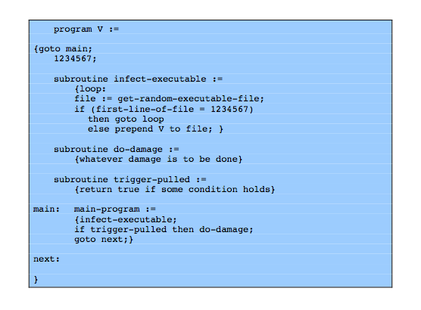
Virus Structure
Notes:
A very general depiction of virus structure is shown in Figure 21.1. In this case, the virus code, V, is prepended to infected programs, and it is assumed that the entry point to the program, when invoked, is the first line of the program. An infected program begins with the virus code and works as follows. The first line of code is a jump to the main virus program. The second line is a special marker that is used by the virus to determine whether or not a potential victim program has already been infected with this virus. When the program is invoked, control is immediately transferred to the main virus program. The virus program first seeks out uninfected executable files and infects them. Next, the virus may perform some action, usually detrimental to the system. This action could be performed every time the program is invoked, or it could be a logic bomb that triggers only under certain conditions. Finally, the virus transfers control to the original program. If the infection phase of the program is reasonably rapid, a user is unlikely to notice any difference between the execution of an infected and uninfected program.

Slide 12
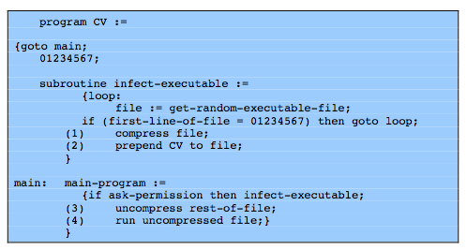
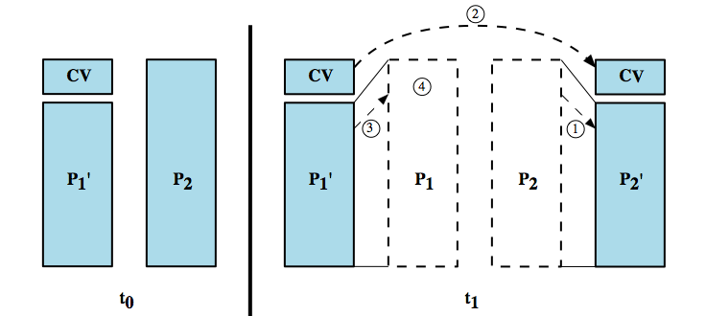
Compression Virus
Notes:
A virus such as the one just described is easily detected because an infected version of a program is longer than the corresponding uninfected one. A way to thwart such a simple means of detecting a virus is to compress the executable file so that both the infected and uninfected versions are of identical length. The code shown from Figure 21.2 shows in general terms the logic required. The key lines in this virus are numbered, and Figure 21.3 illustrates the operation. In this example, the virus does nothing other than propagate. As in the previous example, the virus may include a logic bomb. We assume that program P₁ is infected with the virus CV. When this program is invoked, control passes to its virus, which performs the following steps:
1. For each uninfected file P₂ that is found, the virus first compresses that file to produce , which is shorter than the original program by the size of the virus.
2. A copy of the virus is prepended to the compressed program.
3. The compressed version of the original infected program, , is uncompressed.
4. The uncompressed original program is executed.

Slide 13
Virus Classification
boot sector
file infector
macro virus
encrypted virus
stealth virus
polymorphic virus
metamorphic virus
Notes:
There has been a continuous arms race between virus writers and writers of antivirus software since viruses first appeared. As effective countermeasures have been developed for existing types of viruses, new types have been developed. A virus classification by target includes the following categories:
• Boot sector infector:Infects a master boot record or boot record and spreads when a system is booted from the disk containing the virus.
• File infector: Infects files that operating system or shell consider to be executable.
• Macro virus: Infects files with macro code that is interpreted by an application.
A virus classification by concealment strategy includes the following categories:
• Encrypted virus: the virus creates a random encryption key, stored with the virus, and encrypts the remainder of the virus. When an infected program is invoked, the virus uses the stored random key to decrypt the virus. When the virus replicates, a different random key is selected.
• Stealth virus: A form of virus explicitly designed to hide itself from detection by antivirus software. Thus,the entire virus, not just a payload is hidden.
• Polymorphic virus: A virus that mutates with every infection, making detection by the “signature”of the virus impossible.
• Metamorphic virus: As with a polymorphic virus ,a metamorphic virus mutates with every infection. The difference is that a metamorphic virus rewrites itself completely at each iteration, increasing the difficulty of detection. Metamorphic viruses may change their behavior as well as their appearance.

Slide 14
Macro Virus
became very common in mid-1990s since
platform independent
infect documents
easily spread
exploit macro capability of office apps
executable program embedded in office doc
often a form of Basic
more recent releases include protection
recognized by many anti-virus programs
Notes:
In the mid-1990s, macro viruses became by far the most prevalent type of virus. Macro viruses are particularly threatening for a number of reasons:
1. A macro virus is platform independent. Virtually all of the macro viruses infect Microsoft Word documents. Any hardware platform and operating system that supports Word can be infected.
2. Macro viruses infect documents, not executable portions of code. Most of the information introduced onto a computer system is in the form of a document rather than a program.
3. Macro viruses are easily spread. A very common method is by electronic mail.
Macro viruses take advantage of a feature found in Word and other office applications such as Microsoft Excel, namely the macro. In essence, a macro is an executable program embedded in a word processing document or other type of file. Typically, users employ macros to automate repetitive tasks and thereby save keystrokes. The macro language is usually some form of the Basic programming language. A user might define a sequence of keystrokes in a macro and set it up so that the macro is invoked when a function key or special short combination of keys is input. Successive releases of Word provide increased protection against macro viruses. For example, Microsoft offers an optional Macro Virus Protection tool that detects suspicious Word files and alerts the customer to the potential risk of opening a file with macros. Various antivirus (A/V) product vendors have also developed tools to detect and correct macro viruses. As in other types of viruses, the arms race continues in the field of macro viruses, but they no longer are the predominant virus threat.

Slide 15
E-Mail Viruses
more recent development
e.g. Melissa
exploits MS Word macro in attached doc
if attachment opened, macro activates
sends email to all on users address list
and does local damage
then saw versions triggered reading email
hence much faster propagation
Notes:
A more recent development in malicious software is the e-mail virus. The first rapidly spreading e-mail viruses, such as Melissa, made use of a Microsoft Word macro embedded in an attachment. If the recipient opens the e-mail attachment, the Word macro is activated. Then the e-mail virus sends itself to everyone on the mailing list in the user's e-mail package, and also does local damage.
At the end of 1999, a more powerful version of the e-mail virus appeared. This newer version can be activated merely by opening an e-mail that contains the virus rather than opening an attachment. The virus uses the Visual Basic scripting language supported by the e-mail package.
Thus we see a new generation of malware that arrives via e-mail and uses e-mail software features to replicate itself across the Internet. The virus propagates itself as soon as activated (either by opening an e-mail attachment of by opening the e-mail) to all of the e-mail addresses known to the infected host. As a result, whereas viruses used to take months or years to propagate, they now do so in hours. This makes it very difficult for antivirus software to respond before much damage is done. Ultimately, a greater degree of security must be built into Internet utility and application software on PCs to counter the growing threat.

Slide 16
Virus Countermeasures
prevention - ideal solution but difficult
realistically need:
detection
identification
removal
if detect but can’t identify or remove, must discard and replace infected program
Notes:
The ideal solution to the threat of viruses is prevention: Do not allow a virus to get into the system in the first place. This goal is, in general, impossible to achieve, although prevention can reduce the number of successful viral attacks. The next best approach is to be able to do the following:
• Detection: Once the infection has occurred, determine that it has occurred and locate the virus.
• Identification: Once detection has been achieved, identify the specific virus that has infected a program.
• Removal: Once the specific virus has been identified, remove all traces of the virus from the infected program and restore it to its original state. Remove the virus from all infected systems so that the disease cannot spread further.
If detection succeeds but either identification or removal is not possible, then the alternative is to discard the infected program and reload a clean backup version.

Slide 17
Anti-Virus Evolution
virus & antivirus tech have both evolved
early viruses simple code, easily removed
as become more complex, so must the countermeasures
generations
first - signature scanners
second - heuristics
third - identify actions
fourth - combination packages
Notes:
Advances in virus and antivirus technology go hand in hand. Early viruses were relatively simple code fragments and could be identified and purged with relatively simple antivirus software packages. As the virus arms race has evolved, both viruses and, necessarily, antivirus software have grown more complex and sophisticated. [STEP93] identifies four generations of antivirus software:
A first-generation scanner requires a virus signature to identify a virus. The virus may contain "wildcards" but has essentially the same structure and bit pattern in all copies. Such signature-specific scanners are limited to the detection of known viruses.
A second-generation scanner uses heuristic rules to search for probable virus infection, e.g to look for fragments of code that are often associated with viruses.. Another second-generation approach is integrity checking, using a hash function rather than a simpler checksum.
Third-generation programs are memory-resident programs that identify a virus by its actions rather than structure in an infected program. These have the advantage that it is not necessary to develop signatures / heuristics, but only to identify the small set of actions indicating an infection is attempted and then intervene.
Fourth-generation products are packages consisting of a variety of antivirus techniques used in conjunction. These include scanning and activity trap components. In addition, such a package includes access control capability, which limits the ability of viruses to penetrate a system and then limits the ability of a virus to update files in order to pass on the infection.

Slide 18
Generic Decryption
runs executable files through GD scanner:
CPU emulator to interpret instructions
virus scanner to check known virus signatures
emulation control module to manage process
lets virus decrypt itself in interpreter
periodically scan for virus signatures
issue is long to interpret and scan
tradeoff chance of detection vs time delay
Notes:
More sophisticated antivirus approaches and products continue to appear. In this subsection, we highlight some of the most important.
Generic decryption (GD) technology enables the antivirus program to easily detect even the most complex polymorphic viruses, while maintaining fast scanning speeds. In order to detect encrypted viruses, executable files are run through a GD scanner:
• CPU emulator: A software-based virtual computer that interprets instructions in an executable file rather than executing them on the underlying processor.
• Virus signature scanner: scans target code looking for known virus signatures.
• Emulation control module: Controls the execution of the target code.
At the start of each simulation, the emulator begins interpreting instructions in the target code, one at a time. Thus, if the code includes a decryption routine that decrypts and hence exposes the virus, that code is interpreted. In effect, the virus does the work for the antivirus program by exposing the virus. Periodically, the control module interrupts interpretation to scan the target code for virus signatures. During interpretation, the target code can cause no damage to the actual personal computer environment, because it is being interpreted in a completely controlled environment. The most difficult design issue with a GD scanner is to determine how long to run each interpretation. Typically, virus elements are activated soon after a program begins executing, but this need not be the case. The longer the scanner emulates a particular program, the more likely it is to catch any hidden viruses. However, the antivirus program can take up only a limited amount of time and resources before users complain.

Slide 19
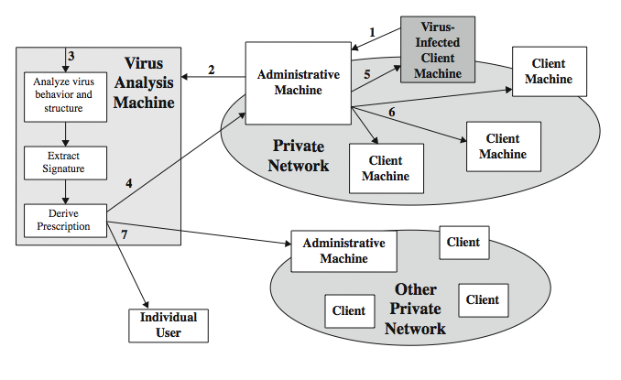
Digital Immune System
Notes:
The digital immune system is a comprehensive approach to virus protection developed by IBM and subsequently refined by Symantec. The objective of this system is to provide rapid response time so that viruses can be stamped out almost as soon as they are introduced. When a new virus enters an organization, the immune system automatically captures it, analyzes it, adds detection and shielding for it, removes it, and passes information about that virus to other systems so that it can be detected before it is allowed to run elsewhere, as Figure 21.4 illustrates:
1. A monitoring program on each PC uses a variety of heuristics to infer that a virus may be present, and forwards a copy to an administrative machine.
2. Admin machine encrypts this and sends it to a central virus analysis machine.
3. This machine creates an environment in which the infected program can be safely run for analysis. The virus analysis machine then produces a prescription for identifying and removing the virus.
4. The resulting prescription is sent back to the administrative machine.
5. The administrative machine forwards the prescription to the infected client.
6. The prescription is also forwarded to other clients in the organization.
7. Subscribers worldwide get regular antivirus updates to protect from new virus
The success of the digital immune system depends on the ability of the virus analysis machine to detect new and innovative virus strains. By constantly analyzing and monitoring the viruses found in the wild, it should be possible to continually update the digital immune software to keep up with the threat.

Slide 20
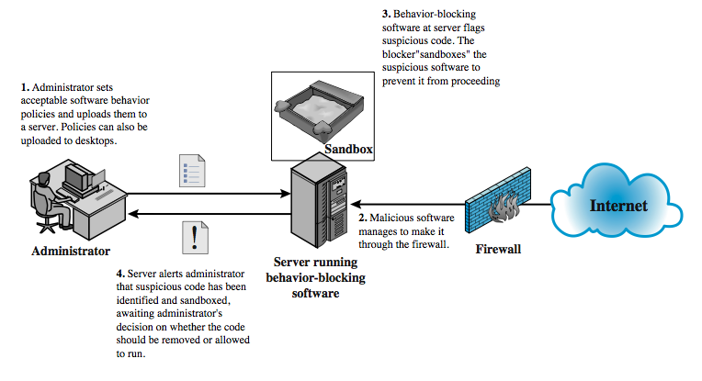
Behavior-Blocking Software
Notes:
Unlike heuristics or fingerprint-based scanners, behavior-blocking software integrates with the operating system of a host computer and monitors program behavior in real-time for malicious actions. The behavior blocking software then blocks potentially malicious actions before they can affect the system. Monitored behaviors can include
• Attempts to open, view, delete, and/or modify files;
• Attempts to format disk drives and other unrecoverable disk operations;
• Modifications to the logic of executable files or macros;
• Modification of critical system settings, such as start-up settings;
• Scripting of e-mail and instant messaging clients to send executable content; and
• Initiation of network communications.
Figure 21.5 illustrates its operation. Behavior-blocking software runs on server and desktop computers and is instructed through policies set by the network administrator to let benign actions take place but to intercede when unauthorized or suspicious actions occur. The module blocks any suspicious software from executing. A blocker isolates the code in a sandbox, which restricts the code's access to various OS resources and applications. The blocker then sends an alert. Because behavior blocker can block suspicious software in real-time, it has an advantage over such established antivirus detection techniques as fingerprinting or heuristics. Behavior blocking alone has limitations. Because the malicious code must run on the target machine before all its behaviors can be identified, it can cause harm before it has been detected and blocked.

Slide 21
Worms
replicating program that propagates over net
using email, remote exec, remote login
has phases like a virus:
dormant, propagation, triggering, execution
propagation phase: searches for other systems, connects to it, copies self to it and runs
may disguise itself as a system process
concept seen in Brunner’s “Shockwave Rider”
implemented by Xerox Palo Alto labs in 1980’s
Notes:
A worm is a program that can replicate itself and send copies from computer to computer across network connections. Upon arrival, the worm may be activated to replicate and propagate again. In addition to propagation, the worm usually performs some unwanted function. Network worm programs use network connections to spread from system to system. Once active within a system, a network worm can behave as a computer virus or bacteria, or it could implant Trojan horse programs or perform any number of disruptive or destructive actions. To replicate itself, a network worm uses some sort of network vehicle such as email, remote execution or remote login capabilities. The new copy of the worm program is then run on the remote system where, in addition to any functions that it performs at that system, it continues to spread in the same fashion. A network worm exhibits the same characteristics as a computer virus: a dormant phase, a propagation phase, a triggering phase, and an execution phase. The propagation phase generally: searches for other systems to infect by examining host tables or similar repositories of remote system addresses; establishes a connection with a remote system; and copies itself to the remote system and cause the copy to be run. The network worm may also attempt to determine whether a system has previously been infected before copying itself to the system. In a multiprogramming system, it may also disguise its presence by naming itself as a system process or using some other name that may not be noticed by a system operator. The concept of a computer worm was introduced in John Brunner’s 1975 SF novel “The Shockwave Rider”. The first known worm implementation was done in Xerox Palo Alto Labs in the early 1980s. It was a nonmalicious search for idle systems to use to run a computationally intensive task. As with viruses, network worms are difficult to counter.

Slide 22
Morris Worm
one of best know worms
released by Robert Morris in 1988
various attacks on UNIX systems
cracking password file to use login/password to logon to other systems
exploiting a bug in the finger protocol
exploiting a bug in sendmail
if succeed have remote shell access
sent bootstrap program to copy worm over
Notes:
Until the current generation of worms, the best known was the worm released onto the Internet by Robert Morris in 1988. The Morris worm was designed to spread on UNIX systems and used a number of different techniques for propagation. When a copy began execution, its first task was to discover other hosts known to this host that would allow entry from this host. The worm performed this task by examining a variety of lists and tables, including system tables that declared which other machines were trusted by this host, users' mail forwarding files, tables by which users gave themselves permission for access to remote accounts, and from a program that reported the status of network connections. For each discovered host, the worm tried a number of methods for gaining access:
It attempted to log on to a remote host as a legitimate user, having cracked the local password file, and assuming that many users use the same password on different systems.
It exploited a bug in the finger protocol
It exploited a trapdoor in the debug option of the remote sendmail process.
If any of these attacks succeeded, the worm achieved communication with the operating system command interpreter. It then sent this interpreter a short bootstrap program, issued a command to execute that program, and then logged off. The bootstrap program then called back the parent program and downloaded the remainder of the worm. The new worm was then executed.

Slide 23
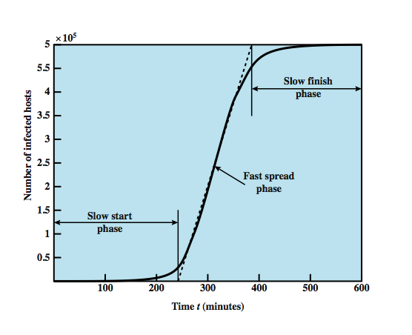
Worm Propagation Model
Notes:
[ZOU05] describes a model for worm propagation based on an analysis of recent worm attacks. The speed of propagation and the total number of hosts infected depend on a number of factors, including the mode of propagation, the vulnerability or vulnerabilities exploited, and the degree of similarity to preceding attacks. For the latter factor, a an attack that is a variation on a recent previous attack may be countered more effectively than a more novel attack. Figure 21.6 shows the dynamics for one, typical, set of parameters. Propagation proceeds through three phases. In the initial phase, the number of hosts increases exponentially. To see that this is so, consider a simplified case in which a worm is launched from a single host and infects two nearby hosts. Each of these hosts infects two more hosts, and so on. This results in exponential growth. After a time, infecting hosts waste some time attacking already-infected hosts, which reduces the rate of infection. During this middle phase, growth is approximately linear, but the rate of infection is rapid. When most vulnerable computers have been infected, the attack enters a slow finish phase as the worm seeks out those remaining hosts that are difficult to identify. Clearly, the objective in countering a worm is to catch the worm in its slow start phase, at a time when few hosts have been infected.

Slide 24
Recent Worm Attacks
Code Red
July 2001 exploiting MS IIS bug
probes random IP address, does DDoS attack
Code Red II variant includes backdoor
SQL Slammer
early 2003, attacks MS SQL Server
Mydoom
mass-mailing e-mail worm that appeared in 2004
installed remote access backdoor in infected systems
Warezov family of worms
scan for e-mail addresses, send in attachment
Notes:
The contemporary era of worm threats began with the release of the Code Red worm in July of 2001, that exploits a security hole in the Microsoft Internet Information Server (IIS) to penetrate and spread. It disables the system file checker in Windows, and probes random IP addresses to spread to other hosts. It then initiates a denial-of-service attack against a government Web site by flooding the site with packets from numerous hosts. The worm then suspends activities and reactivates periodically. In the second wave of attack, Code Red infected nearly 360,000 servers in 14 hours. In addition to the havoc it causes at the targeted server, Code Red can consume enormous amounts of Internet capacity, disrupting service. Code Red II is a variant that targets Microsoft IISs. In addition, this newer worm installs a backdoor allowing a hacker to direct activities of victim computers.
In early 2003, the SQL Slammer worm appeared. This worm exploited a buffer overflow vulnerability in Microsoft SQL server. The Slammer was extremely compact and spread rapidly, infecting 90% of vulnerable hosts within 10 minutes. Late 2003 saw the arrival of the Sobig.f worm, which exploited open proxy servers to turn infected machines into spam engines.
Mydoom is a mass-mailing e-mail worm that appeared in 2004, installing a backdoor in infected computers, thereby enabling hackers to gain remote access to data such as passwords and credit card numbers. Mydoom replicated up to 1000 times/minute and flooded Internet with 100 million infected messages in 36 hours.
Have recently seen the Warezov family of worms, that scan several types of files for e-mail addresses and sends itself as an e-mail attachment. Some can download other malware.

Slide 25
Worm Technology
multiplatform
multi-exploit
ultrafast spreading
polymorphic
metamorphic
transport vehicles
zero-day exploit
Notes:
The state of the art in worm technology includes the following:
• Multiplatform: Newer worms are not limited to Windows machines but can attack a variety of platforms, especially the popular varieties of UNIX.
• Multi-exploit: New worms penetrate systems in a variety of ways, using exploits against Web servers, browsers, e-mail, file sharing, and other network-based applications.
• Ultrafast spreading: One technique to accelerate the spread of a worm is to conduct a prior Internet scan to accumulate Internet addresses of vulnerable machines.
• Polymorphic: To evade detection, skip past filters, and foil real-time analysis, worms adopt the virus polymorphic technique. Each copy of the worm has new code generated on the fly using functionally equivalent instructions and encryption techniques.
• Metamorphic: In addition to changing their appearance, metamorphic worms have a repertoire of behavior patterns that are unleashed at different stages of propagation.
• Transport vehicles: Because worms can rapidly compromise a large number of systems, they are ideal for spreading other distributed attack tools, such as distributed denial of service bots.
• Zero-day exploit: To achieve maximum surprise and distribution, a worm should exploit an unknown vulnerability that is only discovered by the general network community when the worm is launched.

Slide 26
Mobile Phone Worms
first appeared on mobile phones in 2004
target smartphone which can install s/w
they communicate via Bluetooth or MMS
to disable phone, delete data on phone, or send premium-priced messages
CommWarrior, launched in 2005
replicates using Bluetooth to nearby phones
and via MMS using address-book numbers
Notes:
Worms first appeared on mobile phones in 2004. These worms communicate through Bluetooth wireless connections or via the multimedia messaging service (MMS). The target is the smartphone, which is a mobile phone that permits users to install software applications from sources other than the cellular network operator. Mobile phone malware can completely disable the phone, delete data on the phone, or force the device to send costly messages to premium- priced numbers. An example of a mobile phone worm is CommWarrior, which was launched in 2005. This worm replicates by means of Bluetooth to other phones in the receiving area. It also sends itself as an MMS file to numbers in the phone's address book and in automatic replies to incoming text messages and MMS messages. In addition, it copies itself to the removable memory card and inserts itself into the program installation files on the phone.

Slide 27
Worm Countermeasures
overlaps with anti-virus techniques
once worm on system A/V can detect
worms also cause significant net activity
worm defense approaches include:
signature-based worm scan filtering
filter-based worm containment
payload-classification-based worm containment
threshold random walk scan detection
rate limiting and rate halting
Notes:
There is considerable overlap in techniques for dealing with viruses and worms. Once a worm is resident on a machine, antivirus software can be used to detect it. In addition, because worms propagation generates considerable network activity, the monitoring of that activity can lead form the basis of a worm defense. Have classes:
Signature-based worm scan filtering: generates a worm signature, which is then used to prevent worm scans from entering/leaving a network/host.
Filter-based worm containment: focuses on worm content rather than a scan signature. The filter checks a message to determine if it contains worm code.
Payload-classification-based worm containment: examine packets to see if they contain a worm using anomaly detection techniques
Threshold random walk (TRW) scan detection: exploits randomness in picking destinations to connect to as a way of detecting if a scanner is in operation
Rate limiting: limits the rate of scanlike traffic from an infected host.
Rate halting: immediately blocks outgoing traffic when a threshold is exceeded either in outgoing connection rate or diversity of connection attempts. Rate halting can integrate with a signature- or filter-based approach so that once a signature or filter is generated, every blocked host can be unblocked; as with rate limiting, rate halting techniques are not suitable for slow, stealthy worms.

Slide 28
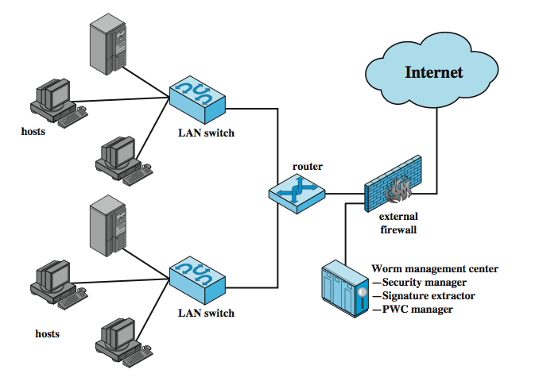
Proactive Worm Containment
Notes:
The Proactive Worm Containment (PWC) scheme is host based software that looks for surges in the rate of frequency of outgoing connection attempts and the diversity of connections to remote hosts. When such a surge is detected, the software immediately blocks its host from further connection attempts. A deployed PWC system consists of a PWC manager and PWC agents in hosts. Figure 21.7 from the text is an example of an architecture that includes PWC, which operates as detailed:
A PWC agent monitors outgoing traffic for scan activity, determined by a surge in UDP / TCP connection attempts to remote hosts. If a surge is detected, the agent: 1) issues an alert to local system; 2) blocks all outgoing connection attempts; 3) transmits the alert to the PWC manager; and 4) starts a relaxation analysis.
B. A PWC manager receives an alert, and propagates the alert to all other agents.
C. The host receives an alert, and must decide whether to ignore the alert. If the time since last incoming packet is sufficiently long so that agent would have detected a worm if infected, then the alert is ignored. Otherwise, the agent assumes that it might be infected and performs the following actions:(1) blocks all outgoing connection attempts from the specific alerting port;and (2) starts a relaxation analysis.
D. Relaxation analysis. An agent monitors outgoing activity for a fixed window of time to see if outgoing connections exceed a threshold. If so, blockage is continued and relaxation analysis is repeated until the outgoing connection rate drops below the threshold, at which time the agent removes the block. If the threshold continues to be exceeded over a sufficient number of relaxation windows, the agent isolates the host and reports to the PWC manager.
Meanwhile, a signature extractor functions as a passive sensor that monitors all traffic and attempts to detect worms by signature analysis.

Slide 29
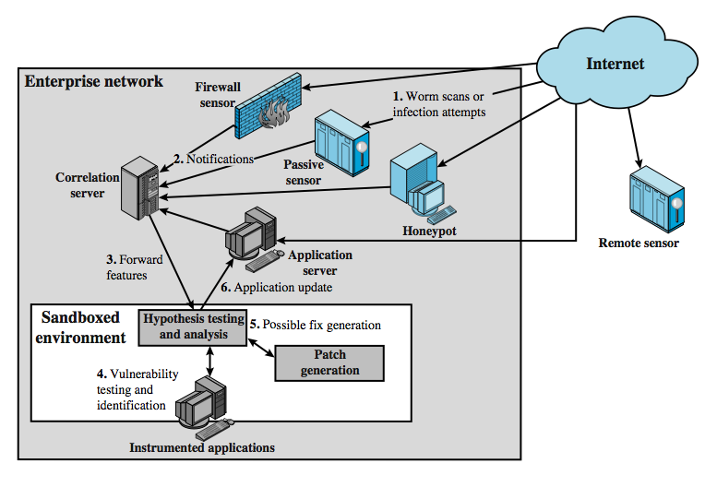
Network Based Worm Defense
Notes:
The key element of a network-based worm defense is worm monitoring software. Two types of monitoring software are needed:
• Ingress monitors: located at the border between the enterprise network and the Internet, in a border router, external firewall, separate passive monitor, or honeypot.
• Egress monitors: located at the egress point of individual LANs on the enterprise network as well as at the external border, in a LAN router or switch, external firewall or honeypot. The two types of monitors can be collocated. It is designed to catch the source of a worm attack by monitoring outgoing traffic for signs of scanning etc.
Worm monitors can act in the manner of intrusion detection systems and generate alerts to a central administrative system. It is also possible to implement a system that attempts to react in real time to a worm attack, so as to counter zero-day exploits effectively. This is similar to the approach taken with the digital immune system (Figure 21.4). Figure 21.8 shows an example of a worm countermeasure architecture that works as :
Sensors deployed at various network locations detect a potential worm.
2. and send alerts to a central server that correlates / analyzes incoming alerts.
3. forwards info to a protected environment, where worm is sandboxed for analysis
4. protected system tests the suspicious software against an appropriately instrumented version of the targeted application to identify the vulnerability.
5. protected system generates one or more software patches and tests these.
6. system sends the patch to the application host to update the targeted application.

Slide 30
Distributed Denial of Service Attacks (DDoS)
Distributed Denial of Service (DDoS) attacks form a significant security threat
making networked systems unavailable
by flooding with useless traffic
using large numbers of “zombies”
growing sophistication of attacks
defense technologies struggling to cope
Notes:
Distributed denial of service (DDoS) attacks present a significant security threat to corporations, and the threat appears to be growing. DDoS attacks make computer systems inaccessible by flooding servers, networks, or even end user systems with useless traffic so that legitimate users can no longer gain access to those resources. In a typical DDoS attack, a large number of compromised (zombie) hosts are amassed to send useless packets. In recent years, the attack methods and tools have become more sophisticated, effective, and more difficult to trace to the real attackers, while defense technologies have been unable to withstand large-scale attacks.

Slide 31
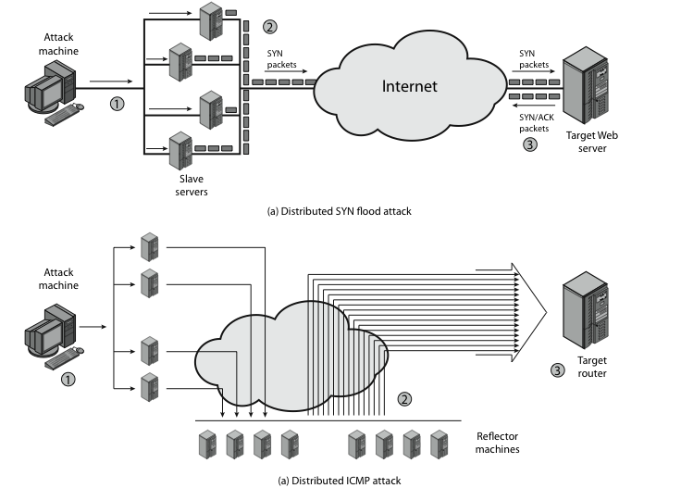
Distributed Denial of Service Attacks (DDoS)
Notes:
A DDoS attack attempts to consume the target’s resources so that it cannot provide service. One way to classify DDoS attacks is in terms of the type of resource that is consumed, either an internal host resource on the target system, or data transmission capacity in the target local network.
Stallings Figure 21.9a shows an example of an internal resource attack - the SYN flood attack. 1. The attacker takes control of multiple hosts over the Internet 2. The slave hosts begin sending TCP/IP SYN (synchronize/initialization) packets, with erroneous return IP address information, to the target 3. For each such packet, the Web server responds with a SYN/ACK (synchronize/acknowledge) packet. The Web server maintains a data structure for each SYN request waiting for a response back and becomes bogged down as more traffic floods in.
Stallings Figure 21.9b illustrates an example of an attack that consumes data transmission resources. 1. The attacker takes control of multiple hosts over the Internet, instructing them to send ICMP ECHO packets with the target’s spoofed IP address to a group of hosts that act as reflectors 2. Nodes at the bounce site receive multiple spoofed requests and respond by sending echo reply packets to the target site. 3. The target’s router is flooded with packets from the bounce site, leaving no data transmission capacity for legitimate traffic.

Slide 32
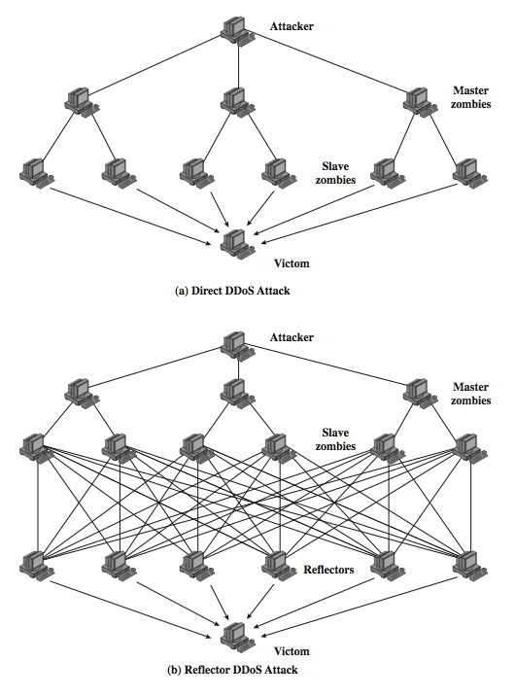
DDoS Flood Types
Notes:
Can also classify DDoS attacks as either direct or reflector DDoS attacks.
In a direct DDoS attack (Figure 21.10a), the attacker is able to implant zombie software on a number of sites distributed throughout the Internet. Often, the DDoS attack involves two levels of zombie machines: master zombies and slave zombies. The hosts of both machines have been infected with malicious code. The attacker coordinates and triggers the master zombies, which in turn coordinate and trigger the slave zombies. The use of two levels of zombies makes it more difficult to trace the attack back to its source and provides for a more resilient network of attackers.
A reflector DDoS attack adds another layer of machines (Figure 21.10b). In this type of attack, the slave zombies construct packets requiring a response that contain the target's IP address as the source IP address in the packet's IP header. These packets are sent to uninfected machines known as reflectors. The uninfected machines respond with packets directed at the target machine. A reflector DDoS attack can easily involve more machines and more traffic than a direct DDoS attack and hence be more damaging. Further, tracing back the attack or filtering out the attack packets is more difficult because the attack comes from widely dispersed uninfected machines.

Slide 33
Constructing an Attack Network
must infect large number of zombies
needs:
software to implement the DDoS attack
an unpatched vulnerability on many systems
scanning strategy to find vulnerable systems
random, hit-list, topological, local subnet
Notes:
The first step in a DDoS attack is for the attacker to infect a number of machines with zombie software that will ultimately be used to carry out the attack. The essential ingredients are:
Software that can carry out the DDoS attack, runnable on a large number of machines, concealed, communicating with attacker or time-triggered, and can launch intended attack toward the target
2. A vulnerability in a large number of systems, that many system admins/users have failed to patch
3. A strategy for locating vulnerable machines, known as scanning, such as:
• Random: probe random IP addresses in the IP address space
• Hit-list: use a long list of potential vulnerable machines
• Topological: use info on infected victim machine to find more hosts
• Local subnet: look for targets in own local network

Slide 34
DDoS Countermeasures
three broad lines of defense:
attack prevention & preemption (before)
attack detection & filtering (during)
attack source traceback & ident (after)
huge range of attack possibilities
hence evolving countermeasures
Notes:
Have three lines of defense against DDoS attacks:
• Attack prevention and preemption (before the attack): to enable victim to endure attack attempts without denying service to legitimate clients
• Attack detection and filtering (during the attack): to attempt to detect attack as it begins and respond immediately, minimizing impact of attack on the target
• Attack source traceback and identification (during and after the attack): to identify source of attack to prevent future attacks.
The challenge in coping with DDoS attacks is the sheer number of ways in which they can operate, hence countermeasures must evolve with the threat.

Slide 35
Summary
have considered:
various malicious programs
trapdoor, logic bomb, trojan horse, zombie
viruses
worms
distributed denial of service attacks
Notes:
Chapter 21 summary.

