Slide 1
Human Factors
important, broad area
consider a few key topics:
security awareness, training, and education
organizational security policy
personnel security
E-mail and Internet use policies
Notes:
The subject of human factors as it relates to computer security is a broad one, and a full discussion is well beyond the scope of this book, however we do touch on a few important topics relating to security awareness, training, and education; organizational security policy; personnel security; E-mail and Internet use policies.

Slide 2
Security Awareness, Training, and Education
prominent topic in various standards
provides benefits in:
improving employee behavior
increasing employee accountability
mitigating liability for employee behavior
complying with regulations and contractual obligations
Notes:
The topic of security awareness, training, and education is mentioned prominently in a number of standards and standards-related documents, including ISO 17799 and NIST SP 800-100. Security awareness, training, and education programs provide benefits in:
• Improving employee behavior - which is critical concern in ensuring the security of computer systems and information assets, as their actions (such as errors and omissions, fraud, and actions by disgruntled employees) account for a more computer-related loss and security compromise than all other sources combined
• Increasing the ability to hold employees accountable for their actions - which can serve as a deterrent to fraud and actions by disgruntled employees. Employees have to be aware of policies and procedures to follow them and not claim ignorance if violate.
• Mitigating liability of the organization for an employee's behavior - since this can bolster an organization's claim that due care has been taken in protecting information.
• Complying with regulations and contractual obligations - which legally mandate this. Companies that have access to information from clients may have specific awareness and training obligations that they must meet for all employees with access to client data, for example.

Slide 3
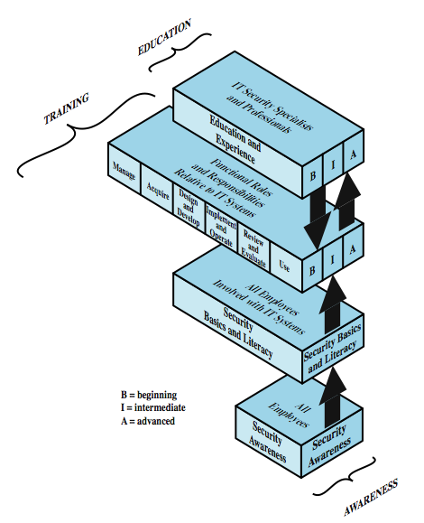
Learning Continuum
Notes:
A number of NIST documents, as well as ISO 17799, recognize that the learning objectives for an employee with respect to security depend on the employee's role. There is a need for a continuum of learning programs that starts with awareness, builds to training, and evolves into education. Figure 14.1 shows a model that outlines the learning needed as an employee assumes different roles and responsibilities with respect to information systems, including equipment and data. Beginning at the bottom of the model, all employees need an awareness of the importance of security and a general understanding of policies, procedures, and restrictions. Training, represented by the two middle layers, is required for individuals who will be using IT systems and data and therefore need more detailed knowledge of IT security threats, vulnerabilities, and safeguards. The top layer applies primarily to individuals who have a specific role centered on IT systems, such as programmers and those involved in maintaining and managing IS assets, and those involved in IS security. NIST SP 800-16 (Information Technology Security Training Requirements: A Role- and Performance-Based Model) summarizes the four layers as follows:
• Security Awareness is explicitly required for all employees
• Security Basics and Literacy category is a transitional stage between Awareness and Training. It provides the foundation for subsequent training by providing a universal baseline of key security terms and concepts.
• Roles and Responsibilities Relative to IT Systems focuses on providing knowledge, skills, and abilities for individuals in their job position
• Education and Experience focuses on developing the ability, vision and skills needed to further IT security and to keep pace with threat and technology changes.

Slide 4
Awareness
seeks to inform and focus an employee's attention on security issues
threats, vulnerabilities, impacts, responsibility
must be tailored to organization’s needs
using a variety of means
events, promo materials, briefings, policy doc
should have an employee security policy document
Notes:
In general, a security awareness program seeks to inform and focus an employee's attention on issues related to security within the organization. The content of an awareness program must be tailored to the needs of the organization and to the target audience, which includes managers, IT professionals, IS users, and employees with little or no interaction with information systems. NIST SP-800-100 (Information Security Handbook: A Guide for Managers) describes the content of awareness programs, in general terms, as follows: “Awareness tools are used to promote information security and inform users of threats and vulnerabilities that impact their division or department and personal work environment by explaining the what but not the how of security, and communicating what is and what is not allowed. Awareness not only communicates information security policies and procedures that need to be followed, but also provides the foundation for any sanctions and disciplinary actions imposed for noncompliance. Awareness is used to explain the rules of behavior for using an agency’s information systems and information and establishes a level of expectation on the acceptable use of the information and information systems.”
An awareness program must continually promote the security message to employees in a variety of ways, such as: events (e.g. security awareness day); promotional materials (e.g. newsletters, posters, memos, videos); briefings (program- or system-specific- or issue-specific); an employee security policy document.
To cement the importance of security awareness, an organization should have a security awareness policy document, provided to all employees, that establishes the need for their participation, time granted, and responsibilities.

Slide 5
Training
teaches what people should do and how they do it to securely perform IS tasks
encompasses a spectrum covering:
general users
good computer security practices
programmers, developers, maintainers
security mindset, secure code development
managers
tradeoffs involving security risks, costs, benefits
executives
risk management goals, measurement, leadership
Notes:
A security training program is designed to teach people the skills to perform their IS-related tasks more securely. Training teaches what people should do and how they should do it. Depending on the role of the user training encompasses a spectrum ranging from basic computer skills to more advanced specialized skills.
For general users, training focuses on good computer security practices, including: protecting the physical area and equipment, protecting passwords / other authentication data or tokens, reporting security violations or incidents
Programmers, developers, and system maintainers are critical to establishing and maintaining computer security, and require more specialized or advanced training. The training objectives for this group include: Develop a security mindset in the developer; Show the developer how to build security into development life cycle, using well-defined checkpoints; Teach the developer how attackers exploit software and how to resist attack; Provide analysts with a toolkit of specific attacks and principles with which to interrogate systems.
Management-level training should teach development managers tradeoffs involving risks, costs, and benefits involving security, understanding the development lifecycle, and using security checkpoints / security evaluation techniques.
Executive-level training must explain the difference between software security and network security and in particular the pervasiveness of software security issues. Executives need to develop an understanding of security risks and costs. Executives need training on the development of risk management goals, means of measurement, and the need to lead by example in the area of security awareness.

Slide 6
Education
most in depth
targeted at security professionals whose jobs require expertise in security
more employee career development
often provided by outside sources
college courses
specialized training programs
Notes:
The most in-depth program is security education. This is targeted at security professionals and those whose jobs require expertise in security. Security education is normally outside the scope of most organization awareness and training programs. It more properly fits into the category of employee career development programs. Quite often, this type of education is provided by outside sources such as college courses or specialized training programs.

Slide 7
Organizational Security Policy
“formal statement of rules by which people given access to organization's technology and information assets must abide”
also used in other contexts
Notes:
RFC 2196 (Site Security Handbook) defines security policy as follows: “A security policy is a formal statement of the rules by which people who are given access to an organization's technology and information assets must abide.”
The term security policy is also used in other contexts. For example, we discuss security policies in Chapter 10 in the context of formal models for confidentiality and integrity. Security policy may refer to specific security rules for specific systems and be focused on technical matters rather than human factors. In this section, we are concerned with security policy in the above sense.

Slide 8
Organizational Security Policy
need written security policy document
to define acceptable behavior, expected practices, and responsibilities
makes clear what is protected and why
articulates security procedures / controls
states responsibility for protection
provides basis to resolve conflicts
must reflect executive security decisions
protect info, comply with law, meet org goals
Notes:
A written security policy document is fundamental to define acceptable behavior, expected practices, and responsibilities. Without written policies, users and administrators are left to decide important security-related issues for themselves. The policy document also provides valuable support for IT staff and lower-level managers in convincing higher-level managers of the need for a particular expenditure or commitment of resources.
A security policy plays four important roles:
1. makes clear what is being protected and why.
2. articulates the security procedures, controls, and standards used in the organization.
3. clearly states the responsibility for that protection.
4. provides basis on which to interpret and resolve any later conflicts that may arise.
To fulfill these roles, the security policy must reflect security decisions made by executive management. Hence, decision makers must:
1. Identify sensitive information and critical systems.
2. Incorporate local / national laws; contractual obligations, relevant ethical standards.
3. Define institutional security goals and objectives.
4. Set a course for accomplishing these goals and objectives
5. Ensure have necessary mechanisms for accomplishing the goals and objectives.

Slide 9
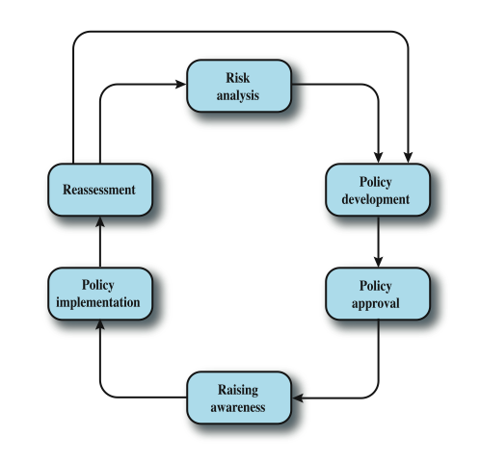
Security Policy Lifecycle
Notes:
These considerations can be realized in the form of a security policy life cycle, as illustrated in Figure 14.2. Briefly, the main steps are:
• Risk analysis: This analysis includes a mission statement, asset evaluation, and threat assessment. Chapter 16 explores this topic.
• Policy development: The security policy consists of specific security procedures, controls, and standards. The development of these elements is discussed in Chapters 16 and 17.
• Policy approval: For the policy to be effective, it needs approval from not only executive management, but also representatives of key organizational departments and groups. Some form of interdepartmental committee should be involved at this stage.
• Raising awareness: This we discuss in Section 14.1.
• Policy implementation: Implementation enforces the application of the security policy, using enforcement procedures and mechanisms spelled out in the policy itself.
• Reassessment: There needs to be an ongoing, or at least periodic, monitoring and assessment of the various elements of the security policy.

Slide 10
Policy Document Responsibility
security policy needs broad support
especially from top management
should be developed by a team including:
site security administrator, IT technical staff, user groups admins, security incident response team, user groups representatives, responsible management, legal counsel
Notes:
The security policy needs broad support within an organization, at all levels and across all functional areas. Essential is the support of top management. Thus a variety of individuals should be involved in formulating policy and generating the security policy document. RFC 2196 suggests the following list of individuals who should be involved in the creation and review of security policy documents:
• site security administrator
• information technology technical staff (e.g., staff from computing center)
• administrators of large user groups within the organization (e.g., business divisions, computer science department within a university, etc.)
• security incident response team
• representatives of the user groups affected by the security policy
• responsible management
• legal counsel (if appropriate)

Slide 11
Document Content
what is the reason for the policy?
who developed the policy?
who approved the policy?
whose authority sustains the policy?
which laws / regulations is it based on?
who will enforce the policy?
how will the policy be enforced?
whom does the policy affect?
what information assets must be protected?
what are users actually required to do?
how should security breaches be reported?
what is the effective date / expiration date of it?
Notes:
The security policy document or documents needs to cover a number of topics, or subject areas, and for each topic provide specific information to the reader. Some general questions that should be address are:
• What is the reason for the policy?
• Who developed the policy?
• Who approved the policy?
• Whose authority sustains the policy?
• Which laws or regulations, if any, are the policy based on?
• Who will enforce the policy?
• How will the policy be enforced?
• Whom does the policy affect?
• What information assets must be protected?
• What are users actually required to do?
• How should security breaches and violations be reported?
• What is the effective date and expiration date of the policy?

Slide 12
Security Policy Topics
principles
organizational reporting structure
physical security
hiring, management, and firing
data protection
communications security
hardware
software
operating systems
Notes:
Security involves a broad range of topics and a multitude of details, including:
• Principles: Including (a) a definition of information security, its overall objectives and scope and the importance of security as an enabling mechanism for information sharing; and (b) a statement of management intent, supporting the goals and principles of information security in line with the business strategy and objectives.
• Organizational reporting structure: give management commitment to information security, lists responsible individuals / offices for implementation and this policy.
• Physical security: Covers physical protection of and access to all IS equipment, including servers, workstations, storage devices, and all other IS-related equipment.
• Hiring, management, and firing: Includes guidelines prior to employment, and to employee termination,
• Data protection: procedures and mechanisms for data protection, classification schemes used by organization, data access controls, when to use encryption, and guidelines to countering industrial espionage
• Communications security: Includes perimeter controls; web usage and content filtering; e-mail usage; and telephone and fax usage.
• Hardware: Purchasing guidelines that specify required, or preferred, security features. These should supplement existing purchasing policies and guidelines.
• Software: Includes: purchasing guidelines; list of authorized products; development standards; quality assurance and testing.
• Operating systems: including access control guidelines and logging requirements.

Slide 13
Security Policy Topics cont.
technical support
privacy
access
accountability
authentication
availability
maintenance
violations reporting
business continuity
supporting information
Notes:
Continuing the list of Security Policy Topics:
• Technical support: Discusses services offered, including help-desk functions.
• Privacy: Defines reasonable expectations of privacy regarding such issues as monitoring of electronic mail, logging of keystrokes, and access to users' files.
• Access: Defines access rights and privileges to protect assets from loss or disclosure by specifying acceptable use guidelines for users, operations staff, and management.
• Accountability: Defines responsibilities of users, operations staff, and management. It should specify an audit capability, and provide incident handling guidelines
• Authentication: Establish trust through an effective password policy, and by setting guidelines for remote location authentication and the use of authentication devices
• Availability: defines expected availability of resources, redundancy and recovery issues, as well as specify operating hours and maintenance downtime periods.
• Maintenance: Describe how both internal and external maintenance people are allowed to handle and access technology. Another issue is outsourcing
• Violations reporting: types of violations, how they’re reported, and to whom
• Business continuity: considerations for maintaining business continuity after various disasters and other causes of interruption.
• Supporting information: contact information for each type of policy violation; guidelines on outside queries about security incidens, information considered confidential or proprietary; and cross-references security procedures and related info.

Slide 14
Resources
ISO 17799
popular international standard
has a comprehensive set of controls
a convenient framework for policy authors
COBIT
business-oriented set of standards
includes IT security and control practices
Standard of Good Practice for Information Security
other orgs, e.g. CERT, CIO
Notes:
ISO 17799 (Code of Practice for Information Security Management). ISO 17799 is an increasingly popular standard, including a comprehensive set of controls comprising best practices in information security, and offers a convenient framework to help security policy writers structure their policies. ISO 17799 certification, provided by various accredited bodies, has been established as a goal for many corporations, government agencies, and other organizations around the world.
COBIT(Control Objectives for Information and Related Technology) is a business-oriented set of standards for guiding management in the use of information technology. It has been developed as a general standard for information technology security and control practices and includes a general framework for management, users, IS audit, and security practitioners. COBIT also has a process focus and a governance flavor. The documents are quite detailed and provide not only a practical basis for defining security requirements but also for implementing them and verifying compliance.
The Standard of Good Practice for Information Security from the Information Security Forum, are designed as an aid to organizations in understanding and applying best practices for information security. Because it addresses security from a business perspective, The Standard appropriately recognizes the intersection between organizational drivers and security drivers. See Appendices 16A and 16B.
In addition to these standards, a number of informal guidelines are widely consulted by organizations in developing their own security policy. Such as those from CERT (www.cert.org), and the Chief Information Officers Council (cio.gov).

Slide 15
Personnel Security
hiring, training, monitoring behavior, and handling departure
employees security violations occur:
unwittingly aiding commission of violation
knowingly violating controls or procedures
threats include:
gaining unauthorized access, altering data, deleting production and back up data, crashing systems, destroying systems, misusing systems , holding data hostage, stealing strategic or customer data for corporate espionage or fraud schemes
Notes:
This section deals with personnel security: hiring, training, monitoring behavior, and handling departure. Employees can be involved in security violations either by unwittingly aiding in the commission of a security violation by failing to follow proper procedures, by forgetting security considerations, or by not realizing that they are creating a vulnerability; or by knowingly violating controls or procedures to cause or aid a security violation.
Threats from internal users include:
• Gaining unauthorized access or enabling others to gain unauthorized access
• Altering data
• Deleting production and back up data
• Crashing systems
• Destroying systems
• Misusing systems for personal gain or to damage the organization
• Holding data hostage
• Stealing strategic or customer data for corporate espionage or fraud schemes

Slide 16
Security in Hiring Process
objective:
“to ensure that employees, contractors and third party users understand their responsibilities, and are suitable for the roles they are considered for, and to reduce the risk of theft, fraud or misuse of facilities”
need appropriate background checks, screening, and employment agreements
Notes:
ISO 17799 lists the following security objective of the hiring process: To ensure that employees, contractors and third party users understand their responsibilities, and are suitable for the roles they are considered for, and to reduce the risk of theft, fraud or misuse of facilities.

Slide 17
Background Checks & Screening
issues:
inflated resumes
reticence of former employers to give good or bad references due to fear of lawsuits
employers do need to make significant effort to do background checks / screening
get detailed employment / education history
reasonable checks on accuracy of details
have experienced staff members interview
for some sensitive positions, additional intensive investigation is warranted
Notes:
From a security viewpoint, hiring presents management with significant challenges. Growing evidence suggests that many people inflate their resumes with unfounded claims. Compounding this problem is the increasing reticence of former employers to give either bad references for incompetent, underperforming, or unethical employees for fear of a lawsuit if their comments become known and an employee fails to get a new job; or alternatively, a favorable reference for an employee who subsequently causes problems at his new job that may invite a lawsuit from the new employer. Despite these obstacles, employers must make a significant effort to do background checks and screening of applicants. Of course, such checks are to assure that the prospective employee is competent to perform the intended job and poses no security risk. Additionally, employers need to be cognizant of the concept of "negligent hiring" that applies in some jurisdictions. In essence, an employer may be held liable for negligent hiring if an employee causes harm to a third part (individual or company) while acting as an employee. General guidelines for checking applicants include:
• Ask for as much detail as possible about employment and educational history. The more detail that is available, the more difficult it is for the applicant to consistently lie.
• Investigate the accuracy of the details to the extent reasonable
• Have experienced staff members to interview candidates & discuss discrepancies
For highly sensitive positions, more intensive investigation is warranted, as noted in the text. For many employees, these steps are excessive. However, you the employer should conduct extra checks of any employee who will be in a position of trust or privileged access—including maintenance and cleaning personnel.

Slide 18
Employment Agreements
employees should agree to and sign the terms and conditions of their employment contract, which should include:
information on their and the organization’s security responsibilities
confidentiality and non-disclosure agreement
agreement to abide by organization's security policy
Notes:
As part of their contractual obligation, employees should agree and sign the terms and conditions of their employment contract, which should state their and the organization’s responsibilities for information security. The agreement should include a confidentiality and non-disclosure agreement spelling out specifically that the organization's information assets are confidential unless classified otherwise and that the employee must protect that confidentiality. The agreement should also reference to organization's security policy and indicate that the employee has reviewed and agrees to abide by the policy.

Slide 19
During Employment
current employee security objectives:
ensure employees, contractors, third party users are aware of info security threats & concerns
know their responsibilities and liabilities
are equipped to support organizational security policy in their work, and reduce human error risks
need security policy and training
security principles:
least privilege
separation of duties
limited reliance on key personnel
Notes:
ISO 17799 lists the following employee security objectives: To ensure that employees, contractors and third party users are aware of information security threats and concerns, their responsibilities and liabilities, and are equipped to support organizational security policy in the course of their normal work, and to reduce the risk of human error. Two essential elements of personnel security during employment are a comprehensive security policy document and an ongoing awareness and training program for all employees. In addition to enforcing the security policy in a fair and consistent manner, certain principles that should be followed for personnel security:
• Least privilege: Give each person the minimum access necessary to do his or her job. This restricted access is both logical (access to accounts, networks, programs) and physical (access to computers, backup tapes, and other peripherals).
• Separation of duties: Carefully separate duties so that people involved in checking for inappropriate use are not also capable of making such inappropriate use. Thus, having all the security functions and audit responsibilities reside in the same person is dangerous.
• Limited reliance on key employees: No one in an organization should be irreplaceable. There should be no single employee with unique knowledge or skills. Organizations cannot help but have key employees. To be secure, organizations should have written policies and plans established for unexpected illness or departure. As with systems, redundancy should be built in to the employee structure.

Slide 20
Termination of Employment
termination security objectives:
ensure employees, contractors, third party users exit organization or change employment in an orderly manner
that the return of all equipment and the removal of all access rights are completed
critical actions:
remove name from authorized access list
inform guards that general access not allowed
remove personal access codes, change lock combinations, reprogram access card systems, etc
recover all assets
Notes:
ISO 17799 lists the following security objective with respect to termination of employment: To ensure that employees, contractors and third party users exit an organization or change employment in an orderly manner, and that the return of all equipment and the removal of all access rights are completed.
The termination process is complex and depends on the nature of the organization, the status of the employee in the organization, and the reason for departure. From a security point of view, the following actions are important:
• Removing the person's name from all lists of authorized access
• Explicitly informing guards that the ex-employee is not allowed into the building without special authorization by named employees
• Removing all personal access codes
• If appropriate, changing lock combinations, reprogramming access card systems, and replacing physical locks
• Recovering all assets including employee ID, disks, documents, and equipment

Slide 21
Email & Internet Use Policies
E-mail & Internet access for employees is common in office and some factories
increasingly have e-mail and Internet use policies in organization's security policy
due to concerns regarding
work time lost
computer / comms resources consumed
risk of importing malware
possibility of harm, harassment, bad conduct
Notes:
E-mail and Internet access for most or all employees is common in office environments and is typically provided for at least some employees in other environments, such as factory. A growing number of companies incorporate specific e-mail and Internet use policies into the organization's security policy document. Widespread use of e-mail and the Internet by employees raises a number of concerns for employers, including: significant employee work time lost, significant computer and communications resources consumed, increased risk of introduction of malicious software, possibility of harm to other organizations or individuals, use for harassment by one employee against another, inappropriate employee online conduct by an may damage the organization’s reputation.

Slide 22
Suggested Policies
business use only
policy scope
content ownership
privacy
standard of conduct
reasonable personal use
unlawful activity prohibited
security policy
company policy
company rights
disciplinary action
Notes:
Some suggested policies on company e-mail and Internet access include:
• Business use only: use for conducting company business use only.
• Policy scope: covers e-mail access & contents; Internet / intranet communications; and records of e-mail, Internet and intranet communications.
• Content ownership: Electronic comms, files, and data remain company property
• Privacy: Employees have no expectation of privacy in use of them
• Standard of conduct: Employees are expected to use good judgment and act courteously and professionally when using them.
• Reasonable personal use: Employees may make reasonable personal use of them provided it does not interfere with the employee's duties, violate company policy, or unduly burden company facilities.
• Unlawful activity prohibited: Employees may not use them for any illegal purpose.
• Security policy: Employees must follow the company's security policy
• Company policy: Employees must follow all other company policies, e.g. prohibit viewing, storing, or distributing pornography; making or distributing harassing or discriminatory communications; and unauthorized disclosure of confidential info.
• Company rights: The company may access, monitor, intercept, block access, inspect, copy, disclose, use, destroy, recover using computer forensics, and/or retain and communications, files or other data covered by this policy.
• Disciplinary action: Violation of this policy may result in immediate termination of employment or other discipline deemed appropriate by the company.

Slide 23
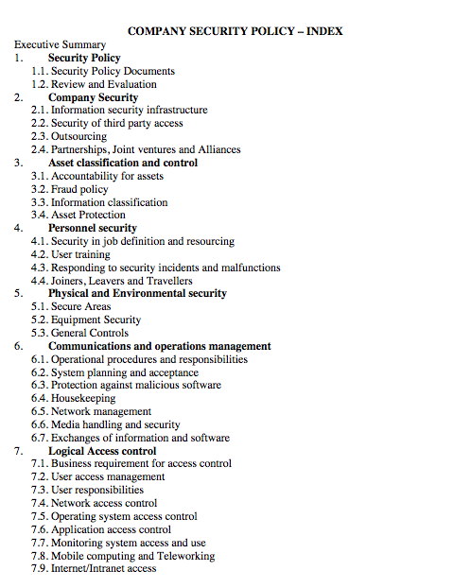
Example Policy
Notes:
To give the reader a feel for how organizations deal with physical security, we provide a real-world example of a security policy document. The company is an EU-based engineering consulting firm that specializes in the provision of planning, design and management services for infrastructure development worldwide. With interests in transportation, water, maritime and property, the company is undertaking commissions in over 70 countries from a network of more than 70 offices.
Figure 14.3 is an excerpt from the table of contents of the company's security standards document. The table of contents indicates the topical scope of the document. As an illustration of the level of detail, Figure 13.3 reproduces part of Section 5 of the document, covering physical and environmental security. The entire document is available at this book's Web site.

Slide 24
Summary
introduced some important topics relating to human factors
security awareness, training & education
organizational security policy
personnel security
E-mail and Internet Use Policies
Notes:
Chapter 14 summary.

