Slide 1
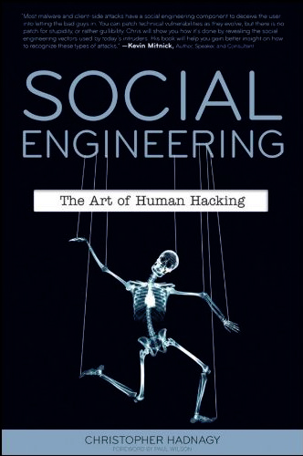
Social Engineering – The Art of Human Hacking
Dr. Fred Mtenzi

Slide 2
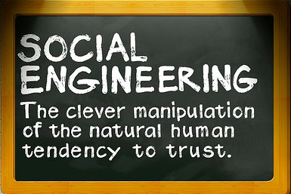
What is Social Engineering?

Slide 3
Better overview of Social Engineering
Social engineering is the art of manipulating people into performing actions or divulging confidential information.
In other words, making people do things or tell you secret information such as passwords and personal details.
Social engineering is a component of many, if not most, types of exploits. Virus writers use social engineering tactics to persuade people to run malware-laden email attachments, phishers use social engineering to convince people to divulge sensitive information, and scareware vendors use social engineering to frighten people into running software that is useless at best and dangerous at worst.

Slide 4
Pretexting
Pretexting is the act of creating and using an invented scenario (the pretext) to engage a target victim in a manner that increases the chances the victim will divulge sensitive information or perform actions that would be unlikely in ordinary circumstances.

Slide 5

Social What ??
Social Engineering!
Trick people in doing something you want (without hacking!)
E.g.: Trick people into reveal their secrets
The most secure systems in the world are still vulnerable!
Its easier than you think!

Slide 6
Many ways of doing it
And many more!
Pretexting Create a scenario and engage a victim, gain their trust and use it to gain information. E.g.: Impersonate a co-worker, ask about...!
Phishing Gain private information by fraud. Typically via e-mail, requesting e.g.: credit card information from the victim.
Diversion theft ”Con” a person to deliver their stuff elsewhere than intended. E.g.: Their secret information to you!
Baiting “Real world Trojan Horse”. Leave some “infested” media for others to find; USB, CD, DVD, MicroSD, etc. When media is inserted into a PC, “auto-runs” can execute some malware.
Quid pro quo (something for something) Call random phone numbers, pretend to be an IT-Supporter, ... Eventually you end up with someone that needs help... Trick them to give you access to their system, so that you might “help” them.
Source:
http://en.wikipedia.org/wiki/Social_engineering_%28security%29

Slide 7
Counter measures
IT-Policies
User education
Physical security
Two-phase (or more) security – defense in depth

Slide 8

The Weakest link
People are the largest vulnerabilities in any network.
Social engineering is based on decision making of human being.

Slide 9
Different types:
Pretexting
Diversion theft
Quid pro quo
Phishing
Baiting
IVR or phone phishing

Slide 10
Pretexting
Created scenario to persuade target to release information
Research
Gathering information in advance about victim
Build the trust
Rely on personal past experience

Slide 11
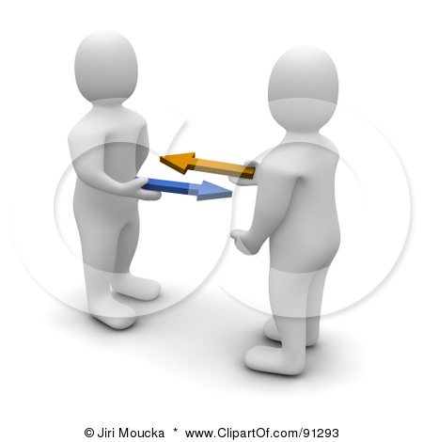
Quid pro quo
From Latin
“what for what”
Indicates exchanges
“Something for
something”
in social engineering
Can exchange a password for a pen
In survay, for instance

Slide 12
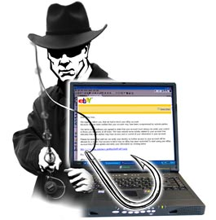
Phishing
Method of fraudulently obtaining private information
E-mail with verification
Link to the fake
web-page which
look like real

Slide 13

Baiting
Leaving some CD/DVD/USB with malicious program where it will be definitely found
Have name like “salary from the last month”
Curious employee will run it to see the context
Access will be given by 3rd parties even without knowing

Slide 14
Summary
We try to secure our system, to find all the vulnerabilities, to mitigate the risks but
THE WEAKEST LINK in ANY system is PERSON
Social engineering is based of human desision making
There are several types pretexting, phishing, vishing, baithing and so on
Collecting information about the victim will bring closer to the success

Slide 15
Conclusion
We should educate people more that they should not easily trust others
Password should be hard enough and hardly guessible
No secret question like “mothers surname or pet name” should be ussed
Check all the time the information which you get, if it is needed to call to the bank, use the phone number you have, not the one which is provided

Slide 16
Background & History (1)
Trojan Horse
Trojan War
Greek mythology
C. 1200-1300 BCE
Iliad & Odyssey of Homer
Virgil’s Aeneid
Greeks sailed to island of Tenedos
Pretended to abandon war
Left giant hollow horse with soldiers inside
Sinon, who convinced Trojans it was offering to Athena
Lacoon & Cassandra warned of danger
Greeks opened gates from inside, slaughtered Trojans, won war

Slide 17

Background & History (2)
Definition: obtaining information or resources using coercion or deceit
Manipulate trust or gullibility of people
Often piece together information
Random order
Multiple victims / enablers
Purposes vary but results often loss of
Intellectual property
Money
Business advantage
Credibility….

Slide 18

Some Notorious Social Engineers
Frank Abagnale, Jr.
See Catch Me If You Can movie
Impersonated pilot, attorney, teacher…
Passed phony checks
Became expert for FBI
Kevin Mitnick
Many exploits
See earlier lecture on History of Computer Crime

Slide 19

Social Engineering Methods
Impersonation
Seduction
Low-Tech Attacks
Network and Voice Methods
Reverse Social Engineering

Slide 20
Impersonation
Criminals wear uniforms, badges, use right terms
Adopt confident air of entitlement
Pretending to be HelpDesk employees
Employees conditioned to cooperate
Technical knowledge reduces questions
Some HelpDesks violate standards by habitually asking for passwords (BAD)
HelpDesk employees can be victims
Criminals pretend to be employees
Often assume identity of high-ranking executives
Sometimes bully HelpDesk staff into violating standard operating procedures

Slide 21

Seduction
Long-term strategy
May study victim to learn background, habits, likes, dislikes, weaknesses
Form bond with victim
Apparent friendship
Exploit good will to ask for favors
May use sexual relationship as lever to develop trust
Foot-in-the-door technique especially useful
Ask for tiny deviation from standards
Gradually increase demands

Slide 22
Low-Tech Attacks
Exploit physical weaknesses in defenses
Often support social engineering
Examples
Dumpster® Diving
Theft
Leveraging Social Settings
Exploiting Curiosity or Naïveté
Bribery
Data Mining & Data Grinding
Piggybacking / Tailgating
Phishing & Pharming
Spim, Spit, & Vishing
Trojan Code and Viruses

Slide 23

Dumpster® Diving
Dumpster® is registered trademark of Dempster Brothers for mobile trash receptacles
Discarded materials are not protected by law unless on private property
Many organizations sloppily throw away confidential info
Papers
Magnetic media
Criminals derive value from
Internal organization charts
Memoranda
Vacation schedules
Use info for industrial espionage and impersonation

Slide 24
Theft
Outright theft of confidential information
Paper
CD-ROMs
USB flash drives and disk drives
Backups
Entire laptop computers
Purses, wallets, briefcases
Trash bags
Information used directly or for impersonation

Slide 25
Leveraging Social Settings
Employees relaxing or traveling may let down guard
Social engineers may deliberately eavesdrop
Company parties
Clubs, trains, coffee shops
Classic errors
Talking about confidential matters
In public amongst themselves
To friendly strangers
Loudly on mobile phones
Letting strangers view computer screens
Leaving portable computers unlocked

Slide 26

Exploiting Curiosity or Naïveté
Criminals (and researchers) have left media lying around
CD-ROMs
USB flash drives
iPod music players
Music CDs
Victims routinely insert media into company computers
Unknowingly load malicious software; e.g.,
Keyloggers – capture keystrokes and send them to criminals
Backdoors – allow criminals to seize control of compromised computer behind firewall

Slide 27
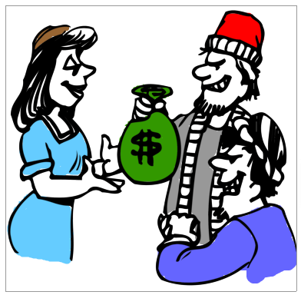
Bribery
Exchange of value in return for violation of policy
Dangerous for social engineer
Obviously wrong
Honest employees (or one with second thoughts) will report attempt to management
May lead to police involvement, arrest
Success depends in part on employee attitude
Disgruntled, unhappy employees better
Contractors
Those about to quit or be fired anyway
Criminal may probe for attitudes using negative comments

Slide 28
Data Mining & Data Grinding
Search engines
Reveal confidential information
Mine information about organizations
Use caches for pages that have been removed
Web history for older versions
Search-engine APIs provide special tools
See references to “Google hacking” using any search engine
Data grinding
Extracting metadata from published docs
Unprotected DOC & HTML files may contain valuable info (e.g., author, e-mail address, ….)

Slide 29
Network and Voice Methods
Piggybacking / Tailgating
Phishing & Pharming
Spim, Spit, & Vishing
Trojan Code and Viruses

Slide 30

Piggybacking / Tailgating
Follow authorized employee into secured location
Using social expectations of victim
What is polite in normal society may be insecure an unwise for security
Preparations
Dress like any other employee
Have excuse ready (“Forgot my card….”)
Defenses
Explicitly forbid piggybacking & explain why
Teach employees using role-playing

Slide 31

Phishing & Pharming
Phishing
Sending e-mail to trick user into providing personal information
Try to copy official correspondence
Paste logos
Often bad grammar, spelling mistakes
Pharming
Fake Websites imitate real sites (banks, stores)
Collect login, financial information

Slide 32


Spim, Spit, & Vishing
Spim
Instant messaging carrying spam
Try to trick victim by sending link to fake Website via IM
Bypass normal Web/e-mail content controls
Spit
Spam over Internet telephony
Limited controls over such spam
Vishing
Voice fishing: spam using phone & e-mail
Trick victim into answering questions about personal information

Slide 33
Trojan Code and Viruses
Discussed above in slide “Exploiting Curiosity or Naïveté”
Attackers insert malware on victim’s computer
Malware silently installed
Collects or transmits confidential information
Provides backdoor code to allow unauthorized access

Slide 34
Reverse Social Engineering
Aka knight-in-shining-armor attack
Social engineer creates a problem
E.g., a denial-of-service attack
Rename or move of critical file
Arranges to seem to be only person who can solve problem
Fixes the problem (easy if attacker caused it)
Gather information during solution
“I need to log on as you.”
Victim may even forget that security policy has been violated
Gains trust for future exploitation

Slide 35
Psychology & Social Psychology of Social Engineering
Psychology of Victim
Social Psychology
Social Engineer Profile

Slide 36
Psychology of Victim
Cognitive biases aid criminals
Choice-supportive bias
Go with the flow
Use what works most of time
Confirmation bias
Remember what fits
See person in janitor outfit as janitor – regardless rules
Exposure effect
What is familiar is comfortable
Gain trust by referring to familiar topics
Anchoring
Focus on one trait at a time
Soothing, friendly demeanor covers intrusive questions

Slide 37
Social Psychology
Schema is picture of reality
Defines normal ways of making judgements and decisions
Many cognitive errors
Fundamental attribution error: assuming that behavior indicates stable, internal attributes
Therefore a pleasant, friendly social engineer cannot possibly be a criminal
Salience: people notice outliers
So social engineers try to blend in
Conformity, compliance & obedience
Social engineers exert (false) authority

Slide 38

Social Engineer Profile
Not as in movies: may be
Outgoing
Confident
Well educated
Blend into environment (clothing, style, speech)
Good actor
Quick reactions to changing circumstances
Dark side
Exploits relationships
Little or no empathy for victims (instrumental)
May be involved in criminal gangs

Slide 39
Dangers & Impact
Consequences
Success Rate
Small Businesses vs Large Organizations

Slide 40
Consequences
Loss of control over internal documents
Advantage to competitors – loss of market share
Stock manipulation – SEC investigations
Bankrupt company
Possible criminal proceedings against officers
Loss of control over customer personally identifiable information (PII)
Legal ramifications including $$$ liability
Embarrassment
Human consequences of identity theft
Difficulty tracking down how crime was committed
Destroy trust among employees

Slide 41

Success Rate
Poor statistical base
Difficult to detect
Difficult to find documentation
Anecdotal evidence from security experts
Social engineering works
Consensus that methods are often used…
… and highly successful
Organizations must prepare to defend themselves against these methods (see below)

Slide 42
Small Businesses vs Large Organizations
Small Businesses
Less prepared & more vulnerable
People know each other
More likely to suspect and challenge strangers
Better communication – may report suspicions quickly to people they know
Smaller workforce to train
Large Businesses
More fragmented: many strangers anyway
Concern about embarrassment if stranger is executive from afar
Bystander effect: let someone else deal with it
Poorer communications: may never have met security officers

Slide 43
Detection
People
Audit Controls
Technology for Detection

Slide 44
People (1)
Train employees to remember details of phone calls they receive when caller asks questions
Gender?
Caller ID?
Noise in background?
Accent?
What questions?
What answers?
Beware questions about names of managers
No employee should ask (let alone give) password

Slide 45
People (2)
Ensure that employees know they will not be punished for enforcing security policies
No legitimate manager would threaten them for NOT violating security rules
Explicitly provide script for responding to threats (“Yes, I’ll be glad to help you – please hold the line.” – and then employee notifies Security Team)
Provide employees with notification procedure
Whom should they call?
What information is most helpful (see previous slide)?

Slide 46
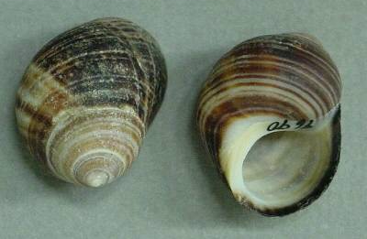
Audit Controls
Real-time audits of log files may detect social engineering attack in progress
But no guarantees
Human manipulation may have no technical exploits until later in crime
Actual exploit may be very fast
Post hoc audits may be useful in reconstructing crime
Trace how criminal used information winkled out of employees

Slide 47
Technology for Detection
Content-blocking technology
E-mail
Web pages
Social Engineering Defense Architecture (SEDA)
Voice-recognition technology
Provides better logging of phone calls

Slide 48
Response
Integrate social engineering attacks into computer security incident response team processes
Collect forensic evidence
In real time if possible
ASAP
Interview human victims
Quickly
Humanely – do not give impression of looking for scapegoats

Slide 49
Defense & Mitigation
Training & Awareness
Technology for Prevention
Physical Security & Encryption

Slide 50
Training & Awareness
Explain social engineering techniques to employees
Real case studies
Demonstrations
Encourage and support challenges
Asking reasons for questions
Asking for employee identification
Checking for authorization for unusual requests
Provide role-playing exercises to reduce reluctance
Provide emergency response contact info

Slide 51
Technology for Prevention
Effective antimalware tools
Block viruses, Trojans
Block dangerous Web sites
Block dangerous phishing spam
Block popups, ActiveX controls
Restrict types of cookies
Use digital certificates to authenticate internal e-mail
Control over software installation
Cleanse documents of hidden metadata
Check Web for unauthorized posting of confidential documents or information

Slide 52
Physical Security & Encryption
Prevent theft of confidential information
Lock filing cabinets
Shred discarded documents
Protect Dumpsters® against divers
Use data encryption
Laptop computers
Peripherals such as USB drives
Virtual private networks for remote access

Slide 53
Pre-Contact Social Engineering model
Stage 1
Victim
identification
Desires
identification
Weakness
identification

Slide 54
Pre-Contact Social Engineering model
Stage 2
Attack type
identification
Attack type Vs.
Victim Desires (Stage 1)
Reward

Slide 55
Pre-Contact Social Engineering model
Stage 1
knowledge
Stage 2
knowledge
Stage 3
Reward Vs. Risk
Risk > reward
Move back
to stage 1
Risk < reward
Proceed to 1st
contact

Slide 56

Questions?

