Slide 1
Eigenvectors and Eigenvalues

Slide 2
Principal Components
The underlying structure of the data
The directions where there is most variance

Slide 3
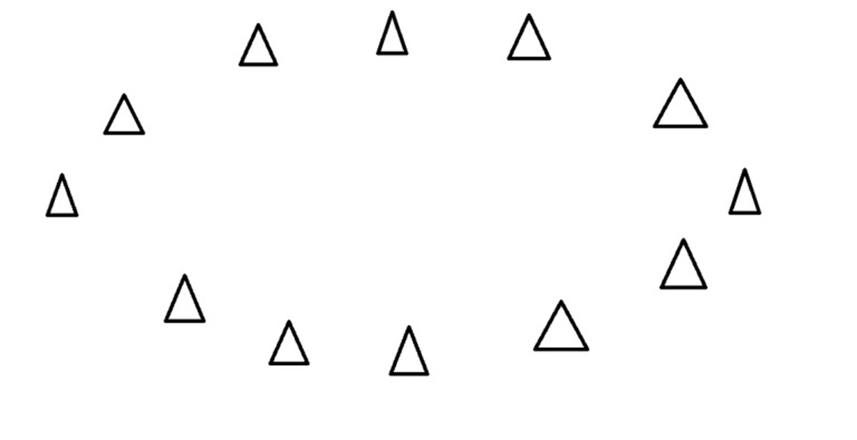
The triangles are points of data. To find the direction find the straight line where the data is most spread out when it is projected onto it

Slide 4
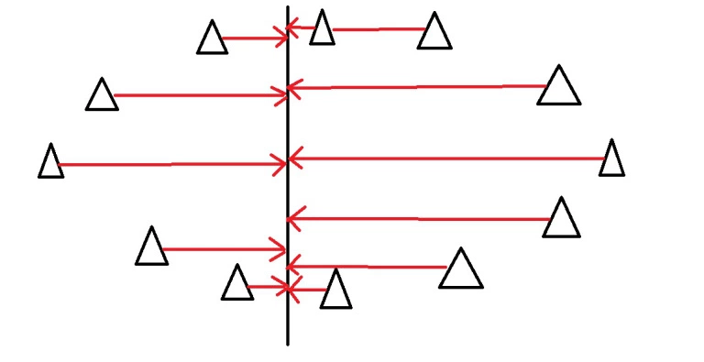
If we choose a vertical line and project the data onto it:
The data isn’t very spread out, so it doesn’t have a lot of variance. This vertical line is probably not a component.

Slide 5
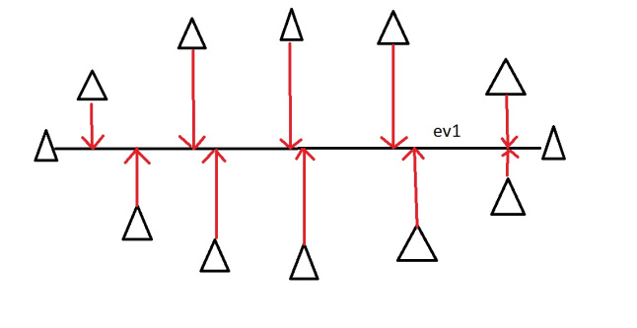
Horizontal line, data is more spread out. More variance.
How do we find the principal component? Maths

Slide 6
Eigenvector and Eigenvalues exist as pairs.
Eigenvector is a direction of a line (vertical, horizontal, 45 degrees etc.)
Eigenvalue is a number telling you how much variance there is in the data in that direction.
The Eigenvector with the highest Eigenvalue is the principal component.

Slide 7
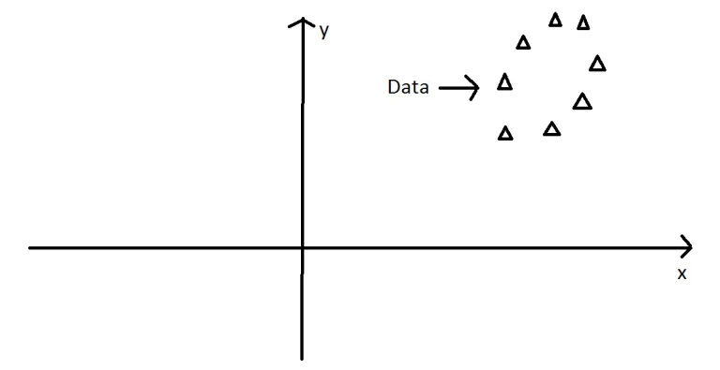
Example: Age and Hrs spent on the internet
Two variables, two dimensions, two eigenvectors and values
The Oval here is the data plotted against the x and y axis (x-age, y-hrs on internet)

Slide 8
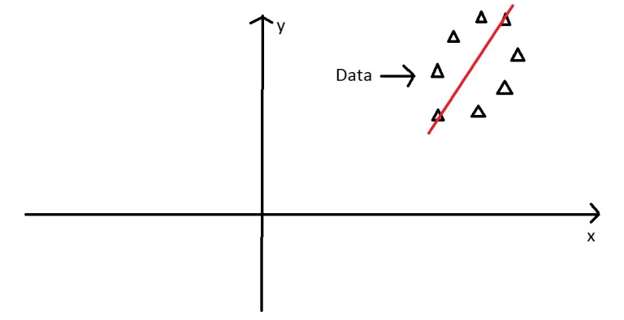
Principal Component is line splitting it lengthways – 1st eigenvector

Slide 9
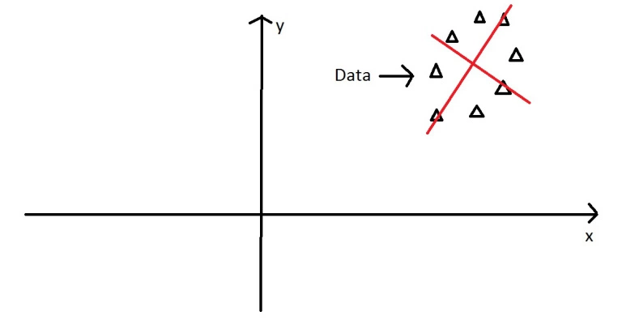
Second is perpendicular to this
The eigenvectors have to be able to span the whole x-y area, in order to do this (most effectively), the two directions need to be orthogonal (i.e. 90 degrees) to one another. This why the x and y axis are orthogonal to each other in the first place. It would be really awkward if the y axis was at 45 degrees to the x axis.

Slide 10
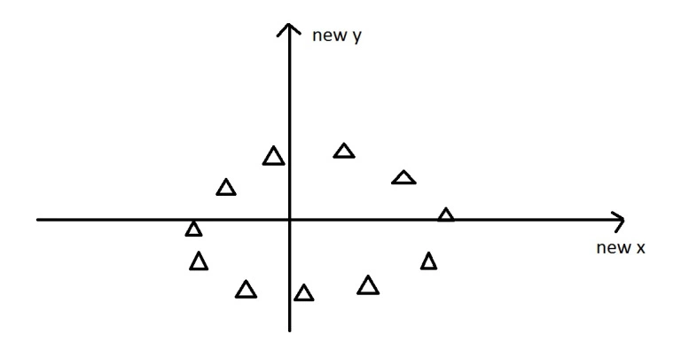
If we now project the data against these eigenvectors as axes
Nothing has been done to the data itself. We’re just looking at it from a different angle.
These axes are much more intuitive to the shape of the data now.
These directions are where there is most variation, and that is where there is more information
But what are these new axes? This is where our knowledge comes into play.

