Slide 1
Electronic Mail Security
Despite the refusal of VADM Poindexter and LtCol North to appear, the Board's access to other sources of information filled much of this gap. The FBI provided documents taken from the files of the National Security Advisor and relevant NSC staff members, including messages from the PROF system between VADM Poindexter and LtCol North. The PROF messages were conversations by computer, written at the time events occurred and presumed by the writers to be protected from disclosure. In this sense, they provide a first-hand, contemporaneous account of events.
—The Tower Commission Report to President Reagan on the Iran-Contra Affair, 1987
Notes:
Opening quote.

Slide 2
Email Security
email is one of the most widely used and regarded network services
currently message contents are not secure
may be inspected either in transit
or by suitably privileged users on destination system
Notes:
In virtually all distributed environments, electronic mail is the most heavily used network-based application. But current email services are roughly like "postcards”, anyone who wants could pick it up and have a look as its in transit or sitting in the recipients mailbox.

Slide 3
Email Security Enhancements
confidentiality
protection from disclosure
authentication
of sender of message
message integrity
protection from modification
non-repudiation of origin
protection from denial by sender
Notes:
With the explosively growing reliance on electronic mail for every conceivable purpose, there grows a demand for authentication and confidentiality services. What we want is something more akin to standard mail (contents protected inside an envelope) if not registered mail (have confidence about the sender of the mail and its contents). That is, the “classic” security services listed are desired.

Slide 4
Pretty Good Privacy (PGP)
widely used de facto secure email
developed by Phil Zimmermann
selected best available crypto algs to use
integrated into a single program
on Unix, PC, Macintosh and other systems
originally free, now also have commercial versions available
Notes:
The Pretty Good Privacy (PGP) secure email program, is a remarkable phenomenon, has grown explosively and is now widely used. Largely the effort of a single person, Phil Zimmermann, who selected the best available crypto algorithms to use & integrated them into a single program, PGP provides a confidentiality and authentication service that can be used for electronic mail and file storage applications. It runs on a wide range of systems, in both free & commercial versions.

Slide 5
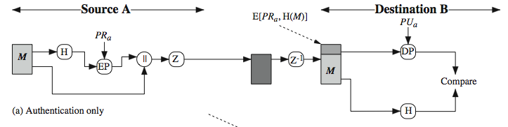
PGP Operation – Authentication
sender creates message
make SHA-1160-bit hash of message
attached RSA signed hash to message
receiver decrypts & recovers hash code
receiver verifies received message hash
Notes:
The actual operation of PGP, as opposed to the management of keys, consists of four services: authentication, confidentiality, compression, and e-mail compatibility. Stallings Figure 18.1a illustrates the digital signature service provided by PGP. This is the digital signature scheme discussed in Chapter 13 and illustrated in Figure 13.2. The sequence is as listed. Note this assumes use of RSA digital signatures, created using the sender's private key, and verified with the sender's public key. Recent PGP versions also support the use of DSS signatures. Signatures can also be detached from a message/file and sent/stored separately. This can be useful to maintain a separate signature log of all messages sent or received; or on an executable program to detect subsequent virus infection, or when more than one party must sign a document.

Slide 6
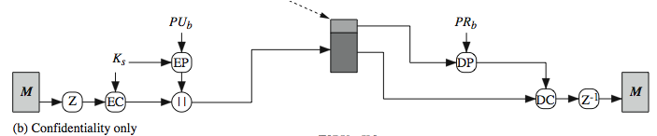
PGP Operation – Confidentiality
sender forms 128-bit random session key
encrypts message with session key
attaches session key encrypted with RSA
receiver decrypts & recovers session key
session key is used to decrypt message
Notes:
Another basic service provided by PGP is confidentiality, provided by encrypting messages to be transmitted or to be stored locally as files, using symmetric encryption algorithms CAST-128, IDEA or 3DES in 64-bit cipher feedback (CFB) mode. The randomly chosen session key used for this is sent encrypted using the recipient’s public RSA key. The steps used in this process are as listed. Stallings Figure 18.1b illustrates the sequence. Recent PGP versions also support the use of ElGamal (a Diffie-Hellman variant) for session-key exchange.

Slide 7
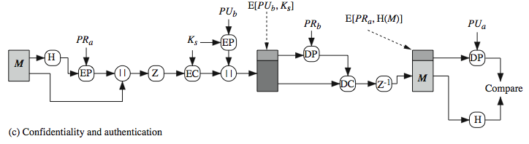
PGP Operation – Confidentiality & Authentication
can use both services on same message
create signature & attach to message
encrypt both message & signature
attach RSA/ElGamal encrypted session key
Notes:
As Stallings Figure 18.1c illustrates, both confidentiality & authentication services may be used for the same message. Firstly a signature is generated for the plaintext message and prepended to it. Then the plaintext message plus signature is encrypted using CAST-128 (or IDEA or 3DES), and the session key is encrypted using RSA (or ElGamal). This sequence is preferable to the opposite: encrypting the message and then generating a signature for the encrypted message. It is generally more convenient to store a signature with a plaintext version of a message. Furthermore, for purposes of third-party verification, if the signature is performed first, a third party need not be concerned with the symmetric key when verifying the signature. In summary, when both services are used, the sender first signs the message with its own private key, then encrypts the message with a session key, and then encrypts the session key with the recipient's public key.

Slide 8
PGP Operation – Compression
by default PGP compresses message after signing but before encrypting
so can store uncompressed message & signature for later verification
& because compression is non deterministic
uses ZIP compression algorithm
Notes:
By default PGP compresses the message after applying the signature but before encryption. This has the benefit of saving space both for e-mail transmission and for file storage. The signature is generated before compression for the reasons shown. The compression algorithm used is ZIP, and is indicated by Z for compression and Z–1 for decompression in Figure 18.1. It is described in Online Appendix O.

Slide 9
PGP Operation – Email Compatibility
when using PGP will have binary data to send (encrypted message etc)
however email was designed only for text
hence PGP must encode raw binary data into printable ASCII characters
uses radix-64 algorithm
maps 3 bytes to 4 printable chars
also appends a CRC
PGP also segments messages if too big
Notes:
When PGP is used, at least part of the block to be transmitted is encrypted, and thus consists of a stream of arbitrary 8-bit octets. However many electronic mail systems only permit the use of ASCII text. To accommodate this restriction, PGP provides the service of converting the raw 8-bit binary stream to a stream of printable ASCII characters. It uses radix-64 conversion, in which each group of three octets of binary data is mapped into four ASCII characters. The use of radix 64 expands a message by 33%. Fortunately, the session key and signature portions of the message are relatively compact, and the plaintext message has been compressed, often by more than enough to compensate for the radix-64 expansion. This format also appends a CRC to detect transmission errors. See Stallings Appendix 18A for a description.
PGP also automatically subdivides a message that is too large for a single email, into segments that are small enough to send.

Slide 10
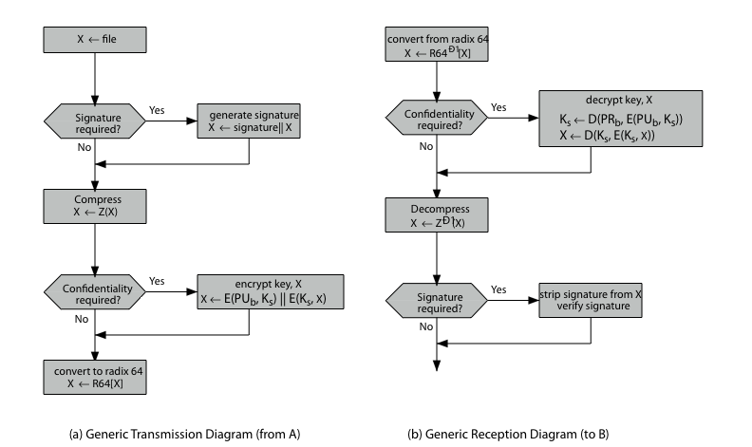
PGP Operation – Summary
Notes:
Stallings Figure 18.2 illustrates the general operation of PGP, and the relationship between the services discussed. On transmission, if it is required, a signature is generated using a hash code of the uncompressed plaintext. Then the plaintext, plus signature if present, is compressed. Next, if confidentiality is required, the block (compressed plaintext or compressed signature plus plaintext) is encrypted and pre-pended with the public-key-encrypted symmetric encryption key. Finally, the entire block is converted to radix-64 format.
On reception, the incoming block is first converted back from radix-64 format to binary. Then, if the message is encrypted, the recipient recovers the session key and decrypts the message. The resulting block is then decompressed. If the message is signed, the recipient recovers the transmitted hash code and compares it to its own calculation of the hash code.

Slide 11
PGP Session Keys
need a session key for each message
of varying sizes: 56-bit DES, 128-bit CAST or IDEA, 168-bit Triple-DES
generated using ANSI X12.17 mode
uses random inputs taken from previous uses and from keystroke timing of user
Notes:
PGP makes use of four types of keys: one-time session symmetric keys, public keys, private keys, and passphrase-based symmetric keys.
Each session key is associated with a single message and is used only for the purpose of encrypting and decrypting that message, using a symmetric encryption algorithm, such as CAST-128 and IDEA with 128-bit keys; or 3DES with a 168-bit key. Random numbers are generated using the ANSI X12.17 generator, with inputs based on keystroke input from the user, where both the keystroke timing and the actual keys struck are used to generate a randomized stream of numbers. Stallings Online Appendix P discusses PGP random number generation techniques in more detail.

Slide 12
PGP Public & Private Keys
since many public/private keys may be in use, need to identify which is actually used to encrypt session key in a message
could send full public-key with every message
but this is inefficient
rather use a key identifier based on key
is least significant 64-bits of the key
will very likely be unique
also use key ID in signatures
Notes:
Since many public/private keys may be in use with PGP, there is a need to identify which key is actually used to encrypt the session key for any specific message. You could just send the full public-key with every message, but this is inefficient. Rather PGP use a key identifier based on the least significant 64-bits of the key, which will very likely be unique. Then only the much shorter key ID would need to be transmitted with any message. A key ID is also required for the PGP digital signature.

Slide 13
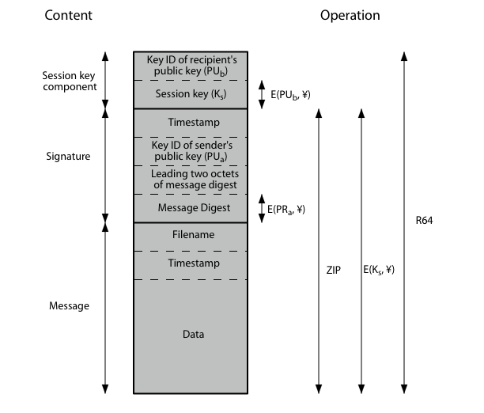
PGP Message Format
Notes:
Stallings Figure 18.3 shows the format of a transmitted PGP message. A message consists of three components: the message component, a signature (optional), and a session key component (optional). The message component includes the actual data to be stored or transmitted, as well as a filename and a timestamp that specifies the time of creation. The signature component includes a timestamp, encrypted SHA-1 message digest, leading two digest octets for verification, and the Key ID of the sender’s public key. The session key component includes the session key and the identifier of the recipient's public key that was used by the sender to encrypt the session key. The entire block is usually encoded with radix-64 encoding.

Slide 14
PGP Key Rings
each PGP user has a pair of keyrings:
public-key ring contains all the public-keys of other PGP users known to this user, indexed by key ID
private-key ring contains the public/private key pair(s) for this user, indexed by key ID & encrypted keyed from a hashed passphrase
security of private keys thus depends on the pass-phrase security
Notes:
Keys & key IDs are critical to the operation of PGP. These keys need to be stored and organized in a systematic way for efficient and effective use by all parties. PGP uses a pair of data structures, one to store the users public/private key pairs - their private-key ring; and one to store the public keys of other known users, their public-key ring. The private keys are kept encrypted using a block cipher, with a key derived by hashing a pass-phrase which the user enters whenever that key needs to be used. As in any system based on passwords, the security of this system depends on the security of the password, which should be not easily guessed but easily remembered.

Slide 15
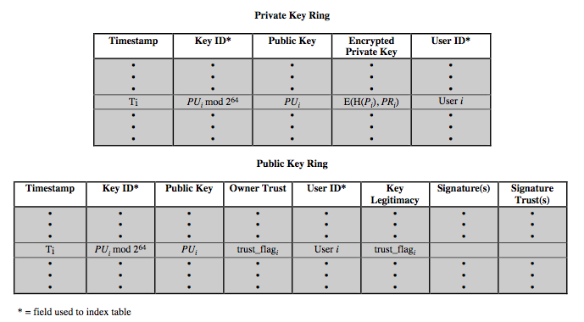
PGP Key Rings
Notes:
Stallings Figure 18.4 shows the general structure of a private-key ring. We can view the ring as a table, in which each row represents one of the public/private key pairs owned by this user. The private-key ring can be indexed by either User ID or Key ID. The actual private key itself encrypted using CAST-128 (or IDEA or 3DES) keyed using a user supplied passphrase.
Figure 18.4 also shows the general structure of a public-key ring. This data structure is used to store public keys of other users that are known to this user. The public-key ring can be indexed by either User ID or Key ID.

Slide 16
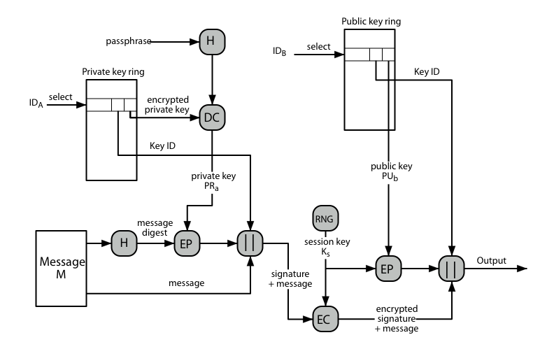
PGP Message Generation
Notes:
Stallings Figure 18.5 illustrates how these key rings are used in message transmission to implement the various PGP crypto services (ignoring compression and radix-64 conversion for simplicity). The sending PGP entity performs the following steps:
1. Signing the message:
a. PGP retrieves the sender's private key from the private-key ring using your_userid as an index. If your_userid was not provided in the command, the first private key on the ring is retrieved.
b. PGP prompts the user for the passphrase to recover the unencrypted private key.
c. The signature component of the message is constructed.
2. Encrypting the message:
a. PGP generates a session key and encrypts the message.
b. PGP retrieves the recipient's public key from the public-key ring using her_userid as an index.
c. The session key component of the message is constructed.

Slide 17
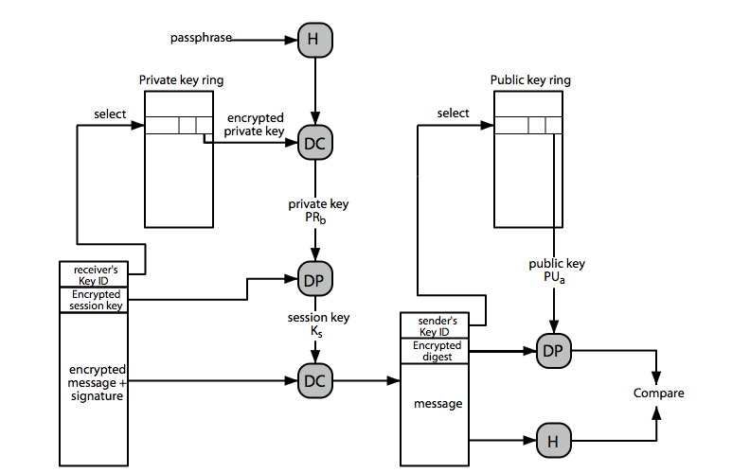
PGP Message Reception
Notes:
Stallings Figure 18.6 then illustrates how these key rings are used in message reception to implement the various PGP crypto services (again ignoring compression and radix-64 conversion for simplicity). The receiving PGP entity performs the following steps:
1. Decrypting the message:
a. PGP retrieves the receiver's private key from the private-key ring, using the Key ID field in the session key component of the message as an index.
b. PGP prompts the user for the passphrase to recover the unencrypted private key.
c. PGP then recovers the session key and decrypts the message.
2. Authenticating the message:
a. PGP retrieves the sender's public key from the public-key ring, using the Key ID field in the signature key component of the message as an index.
b. PGP recovers the transmitted message digest.
c. PGP computes the message digest for the received message and compares it to the transmitted message digest to authenticate.

Slide 18
PGP Key Management
rather than relying on certificate authorities
in PGP every user is own CA
can sign keys for users they know directly
forms a “web of trust”
trust keys have signed
can trust keys others have signed if have a chain of signatures to them
key ring includes trust indicators
users can also revoke their keys
Notes:
The PGP documentation notes that “This whole business of protecting public keys from tampering is the single most difficult problem in practical public key applications”. Its solution is to support a variety of formal and informal environments, in which any user can act as a “CA” to certify another user’s public key, and then act as a “trusted introducer” to other users, thus forming a “web of trust”. PGP provides a convenient means of using trust, associating trust with public keys, and exploiting trust information. The key ring is regularly processed to derive trust indicators for keys in it. Associated with each such entry is a key legitimacy field that indicates the extent to which PGP will trust that this is a valid public key for this user; the higher the level of trust, the stronger is the binding of this user ID to this key. PGP allows a user to revoke their current public key, either because compromise is suspected or simply to avoid the use of the same key for an extended period.

Slide 19
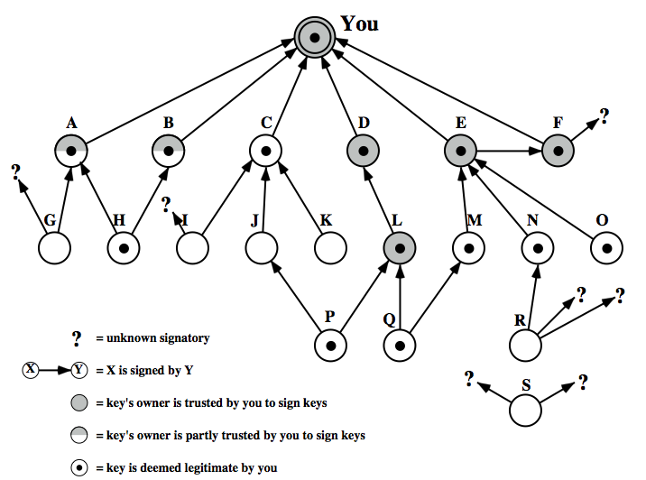
PGP Trust Model Example
Notes:
Stallings Figure 18.7 provides an example of the way in which signature trust and key legitimacy are related. The figure shows the structure of a public-key ring. The user has acquired a number of public keys, some directly from their owners and some from a third party such as a key server. The node labeled "You" refers to the entry in the public-key ring corresponding to this user. This key is legitimate and the OWNERTRUST value is ultimate trust. Each other node in the key ring has an OWNERTRUST value of undefined unless some other value is assigned by the user. In this example, this user has specified that it always trusts the following users to sign other keys: D, E, F, L. This user partially trusts users A and B to sign other keys. So the shading, or lack thereof, of the nodes in Figure 18.7 indicates the level of trust assigned by this user. The tree structure indicates which keys have been signed by which other users. If a key is signed by a user whose key is also in this key ring, the arrow joins the signed key to the signatory. If the key is signed by a user whose key is not present in this key ring, the arrow joins the signed key to a question mark, indicating that the signatory is unknown to this user.

Slide 20
S/MIME (Secure/Multipurpose Internet Mail Extensions)
security enhancement to MIME email
original Internet RFC822 email was text only
MIME provided support for varying content types and multi-part messages
with encoding of binary data to textual form
S/MIME added security enhancements
have S/MIME support in many mail agents
eg MS Outlook, Mozilla, Mac Mail etc
Notes:
S/MIME (Secure/Multipurpose Internet Mail Extension) is a security enhancement to the MIME Internet e-mail format standard, which in turn provided support for varying content types and multi-part messages over the text only support in the original Internet RFC822 (now RFC5322) email standard. See text for discussion of these extensions. MIME is specified in RFCs 2045 through 2049. MIME allows encoding of binary data to textual form for transport over traditional RFC822 email systems. S/MIME support is now included in many modern mail agents.

Slide 21
S/MIME Functions
enveloped data
encrypted content and associated keys
signed data
encoded message + signed digest
clear-signed data
cleartext message + encoded signed digest
signed & enveloped data
nesting of signed & encrypted entities
Notes:
In terms of general functionality, S/MIME is very similar to PGP. Both offer the ability to sign and/or encrypt messages. S/MIME provides the functions shown.

Slide 22
S/MIME Cryptographic Algorithms
digital signatures: DSS & RSA
hash functions: SHA-1 & MD5
session key encryption: ElGamal & RSA
message encryption: AES, Triple-DES, RC2/40 and others
MAC: HMAC with SHA-1
have process to decide which algs to use
Notes:
S/MIME uses a range of cryptographic algorithms, as shown. Support for SHA-1, DSS, RSA and Triple-DES is required, the rest should be provided for backwards compatibility of possible. message authentication code (MAC)
The S/MIME specification includes a discussion of the procedure for deciding which content encryption algorithm to use, based on the capabilities of all parties. To support this decision process, a sending agent may announce its decrypting capabilities in order of preference any message that it sends out. A receiving agent may store that information for future use. If a message is to be sent to multiple recipients and a common encryption algorithm cannot be selected for all, then the sending agent will need to send two messages. However, in that case, it is important to note that the security of the message is made vulnerable by the transmission of one copy with lower security.

Slide 23
S/MIME Messages
S/MIME secures a MIME entity with a signature, encryption, or both
forming a MIME wrapped PKCS object
have a range of content-types:
enveloped data
signed data
clear-signed data
registration request
certificate only message
Notes:
PKCS stands for "Public Key Cryptography Standards”. S/MIME secures a MIME entity with a signature, encryption, or both. A MIME entity may be an entire message or one or more of the subparts of the message. The MIME entity plus some security related data, such as algorithm identifiers and certificates, are processed by S/MIME to produce a PKCS, which refers to a set of public-key cryptography specifications issued by RSA Laboratories. A PKCS object is then treated as message content and wrapped in MIME. A range of S/MIME content-types are specified, as shown. See text for details of how these are used.

Slide 24
S/MIME Certificate Processing
S/MIME uses X.509 v3 certificates
managed using a hybrid of a strict X.509 CA hierarchy & PGP’s web of trust
each client has a list of trusted CA’s certs
and own public/private key pairs & certs
certificates must be signed by trusted CA’s
Notes:
S/MIME uses public-key certificates that conform to version 3 of X.509 (see Chapter 14). The key-management scheme used by S/MIME is in some ways a hybrid between a strict X.509 certification hierarchy and PGP’s web of trust. S/MIME managers and/or users must configure each client with a list of trusted keys and with certificate revocation lists, needed to verify incoming signatures and to encrypt outgoing messages. But certificates are signed by trusted certification authorities.

Slide 25
Certificate Authorities
have several well-known CA’s
Verisign one of most widely used
Verisign issues several types of Digital IDs
increasing levels of checks & hence trust
Class Identity Checks Usage
1 name/email check web browsing/email
2 + enroll/addr check email, subs, s/w validate
3 + ID documents e-banking/service access
Notes:
There are several companies that provide X.509 certification authority (CA) services. Of these, the most widely used is the VeriSign CA service. VeriSign issues X.509 certificates known as Digital IDs. As of early 1998, over 35,000 commercial Web sites were using VeriSign Server Digital IDs, and over a million consumer Digital IDs had been issued to users of Netscape and Microsoft browsers. VeriSign provides three levels, or classes, of security for public-key certificates, with increasing levels of checks & hence trust, as shown above, and with additional details in Stallings Table 18.8. Class 1 and Class 2 requests are processed on line, and in most cases take only a few seconds to approve. For Class 3 Digital IDs, VeriSign requires a higher level of identity assurance. An individual must prove his or her identity by providing notarized credentials or applying in person.

Slide 26
S/MIME Enhanced Security Services
3 proposed enhanced security services:
signed receipts
security labels
secure mailing lists
Notes:
As of this writing, three enhanced security services have been proposed in an Internet draft, and may change or be extended. The three services are:
• Signed receipts: may be requested in a SignedData object to provide proof of delivery to the originator of a message and allows the originator to demonstrate to a third party that the recipient received the message.
• Security labels: may be included in the authenticated attributes of a SignedData object, and is a set of security information regarding the sensitivity of the content that is protected by S/MIME encapsulation. They may be used for access control, indicating which users are permitted access to an object
• Secure mailing lists: When a user sends a message to multiple recipients, a certain amount of per-recipient processing is required, including the use of each recipient's public key. The user can be relieved of this work by employing the services of an S/MIME Mail List Agent (MLA). An MLA can take a single incoming message, perform recipient-specific encryption for each recipient, and forward the message. The originator of a message need only send the message to the MLA, with encryption performed using the MLA's public key.

Slide 27
Domain Keys Identified Mail
a specification for cryptographically signing email messages
so signing domain claims responsibility
recipients / agents can verify signature
proposed Internet Standard RFC 4871
has been widely adopted
Notes:
Domain Keys Identified Mail (DKIM) is a specification for cryptographically signing email messages, permitting a signing domain to claim responsibility for a message in the mail stream. Message recipients (or agents acting in their behalf) can verify the signature by querying the signer's domain directly to retrieve the appropriate public key, and thereby confirm that the message was attested to by a party in possession of the private key for the signing domain. DKIM is a proposed Internet Standard (RFC 4871: DomainKeys Identified Mail (DKIM) Signatures). DKIM has been widely adopted by a range of email providers, including corporations, government agencies, gmail, yahoo, and many Internet Service Providers (ISPs).

Slide 28
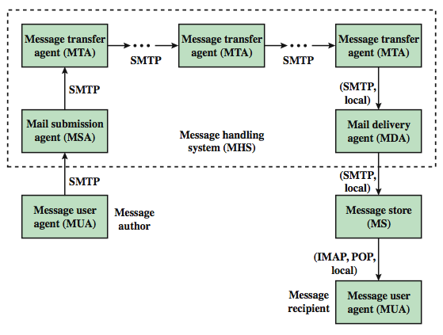
Internet Mail Architecture
Notes:
To understand to operation of DKIM, it is useful to have a basic grasp of the Internet mail architecture, as illustrated in Stallings Figure 18.9. At its most fundamental level, the Internet mail architecture consists of a user world in the form of Message User Agents (MUA), and the transfer world, in the form of the Message Handling Service (MHS), which is composed of Message Transfer Agents (MTA). A MUA is usually housed in the user's computer, and referred to as a client email program, or on a local network email server. The MHS accepts a message from one User and delivers it to one or more other users, creating a virtual MUA-to-MUA exchange environment. The MSA accepts the message submitted by an MUA and enforces the policies of the hosting domain and the requirements of Internet standards. This function may be co-located with the MUA or be a separate functional model. In the latter case, the Simple Mail Transfer Protocol (SMTP) is used between the MUA and the MSA. The MTA relays mail for one application-level hop. Relaying is performed by a sequence of MTAs, until the message reaches a destination MDA. The MDA is responsible for transferring the message from the MHS to the MS. An MS can be located on a remote server or on the same machine as the MUA. Typically, an MUA retrieves messages from a remote server using POP (Post Office Protocol) or IMAP (Internet Message Access Protocol). Also an administrative management domain (ADMD) is an Internet email provider. The Domain Name System (DNS) is a directory lookup service that provides a mapping between the name of a host on the Internet and its numerical address.

Slide 29
Email Threats
see RFC 4684- Analysis of Threats Motivating DomainKeys Identified Mail
describes the problem space in terms of:
range: low end, spammers, fraudsters
capabilities in terms of where submitted, signed, volume, routing naming etc
outside located attackers
Notes:
RFC 4684 (Analysis of Threats Motivating DomainKeys Identified Mail) describes the problem space being addressed by DKIM in terms of the characteristics, capabilities, and location of potential attackers. It characterizes the range of attackers on a spectrum of three levels of threat: low end attackers who simply want to send email that a recipient does not want to receive, often with falsified sender addresses. At the next level are professional senders of bulk spam mail. The most sophisticated and financially motivated senders of messages are those who stand to receive substantial financial benefit, such as from an email-based fraud scheme. The RFC then lists a range of capabilities that an attacker might have in terms of where submitted, signed, volume, routing naming etc (see text). DKIM focuses primarily on attackers located outside of the administrative units of the claimed originator and the recipient.

Slide 30
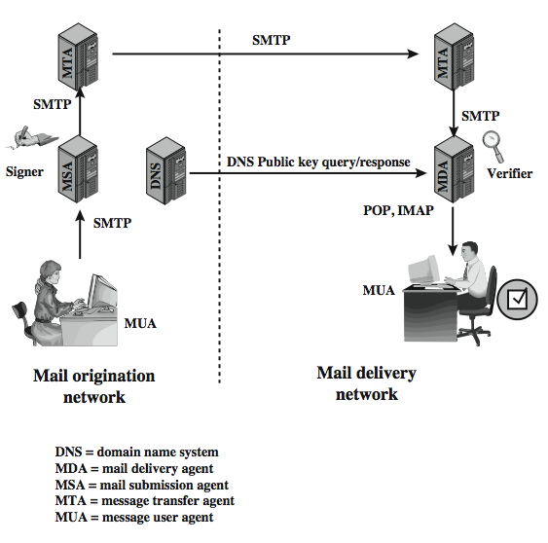
DKIM Strategy
transparent to user
MSA sign
MDA verify
for pragmatic reasons
Notes:
DKIM is designed to provide an email authentication technique transparent to the end user. In essence, a user's email message is signed by a private key of the administrative domain from which the email originates. The signature covers all of the content of the message and some of the RFC 5322 message headers. At the receiving end, the MDA can access the corresponding public key via a DNS and verify the signature, thus authenticating that the message comes from the claimed administrative domain. Thus, mail that originates from somewhere else but claims to come from a given domain will not pass the authentication test and can be rejected. This approach differs from that of S/MIME and PGP, which use the originator's private key to sign the content of the message, for various pragmatic reasons (see text).
Stallings Figure 18.10 shows a simple example of the operation of DKIM. An email message is generated by an email client program. The content of the message, plus selected RFC 5322 headers, is signed by the email provider using the provider's private key. The signer is associated with a domain, which could be a corporate local network, an ISP, or a public email facility such as gmail. The signed message then passes through the Internet via a sequence of MTAs. At the destination, the MDA retrieves the public key for the incoming signature and verifies the signature before passing the message on to the destination email client. The default signing algorithm is RSA with SHA-256. RSA with SHA-1 may also be used.

Slide 31
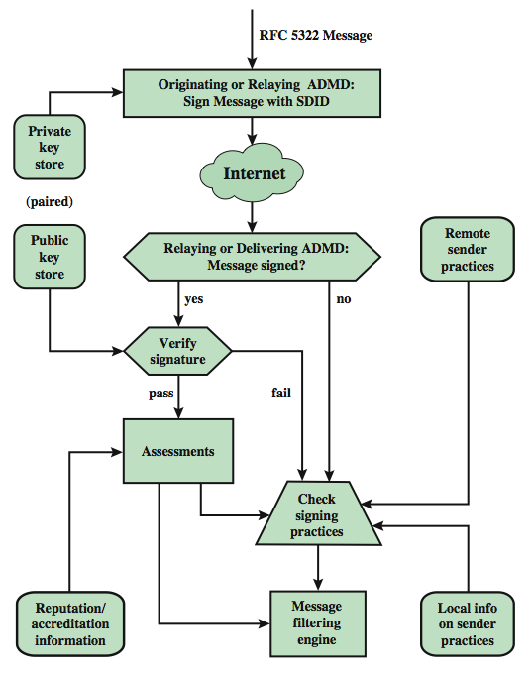
DCIM Functional Flow
Notes:
Stallings Figure 18.11 provides a more detailed look at the elements of DKIM operation. Basic message processing is divided between a signing Administrative Management Domain (ADMD) and a verifying ADMD. Signing is performed by an authorized module within the signing ADMD and uses private information from a Key Store. Verifying is performed by an authorized module within the verifying ADMD. The module verifies the signature or determines whether a particular signature was required. Verifying the signature uses public information from the Key Store. If the signature passes, reputation information is used to assess the signer and that information is passed to the message filtering system. If the signature fails or there is no signature using the author's domain, information about signing practices related to the author can be retrieved remotely and/or locally, and that information is passed to the message filtering system.
The signature is inserted into the RFC 5322 message as an additional header entry, starting with the keyword Dkim-Signature. Before a message is signed, a process known as canonicalization is performed on both the header and body of the RFC 5322 message. Canonicalization is necessary to deal with the possibility of minor changes in the message made en route. The signature includes a number of fields, as listed in the text.

Slide 32
Summary
have considered:
secure email
PGP
S/MIME
domain-keys identified email
Notes:
Chapter 18 summary.

