Slide 1
Cyber Security: The Road Ahead

Slide 2
Agenda
Introduction
The response
The key players
Public-Private Cooperation
International Cooperating
Summary and future work

Slide 3
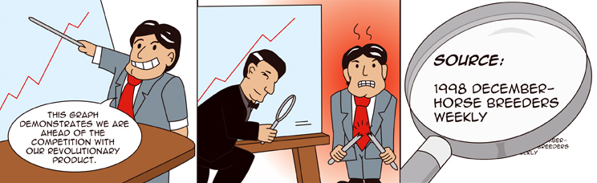
Security Statistics

Slide 4
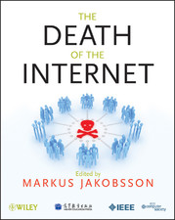
















Security Books you may want to read …

Slide 5
Web War One (WW1)
Cyber war is real
Cyber war happens at the speed of light
Cyber war is global
Cyber war skips the battlefield
Cyber war has begun
Source: Cyberwar: Richard Clarke and Robert Knake, Harper and Collins Publishers, 2010

Slide 6
Web War One (WW1)
“…May you live in interesting time”
Source: Chinese proverb
“We cannot solve our problems with the same thinking we used when we created them”
Source: Albert Einstein

Slide 7
Security 2020
Consumerization – consumer devices will become trendier, cheaper, and more integrated
Decentralization – increase use of cloud computing
Deconcetration – special purpose hardware like iPhone
Decustomerization – get more IT function without any business relationship: free Google, Bing, Social Networking sites etc
Source: Security 2020: Reduce Security Risks this decade, Doug Howard and Kevin Prince: Fowarded by security expert Bruce Schneier, 2010

Slide 8
Vulnerabilities of the Internet
The addressing system that finds out where to go on the internet for a specific address – DNS
The routing among ISPs, a systems known as the Border Gateway Protocol
Almost everything that makes it work is open, unencrypted
Its ability to propagate intentionally malicious traffic designed to attack computers
It is one big network with a decentralised design
Source: Cyberwar: Richard Clarke and Robert Knake, Harper and Collins Publishers, 2010

Slide 9
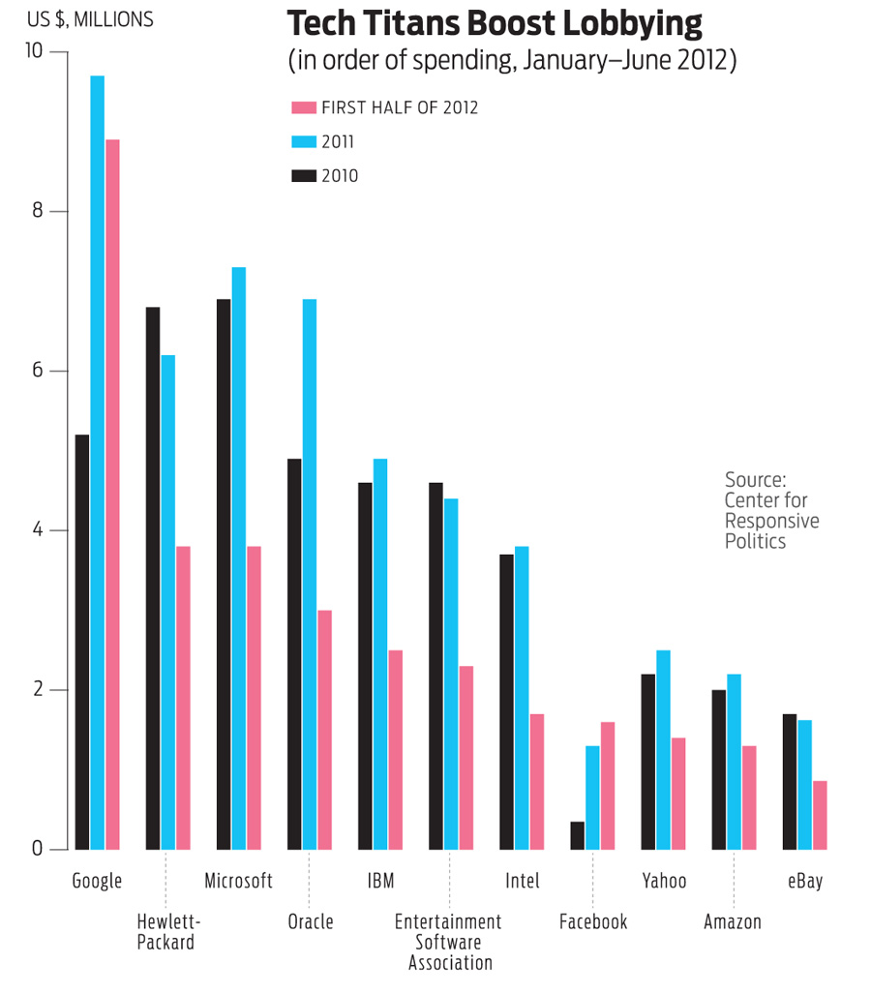

Slide 10
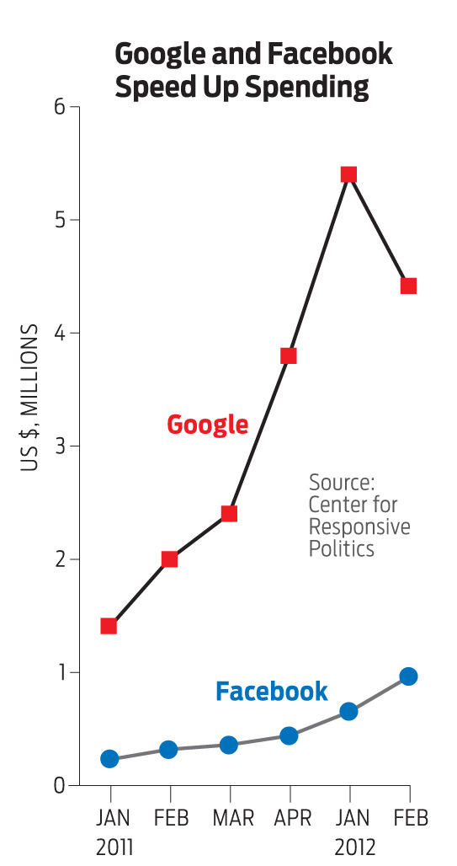

Slide 11
Cyber Security
Cyber security encompasses borderless challenges
Our response have remained overwhelmingly national in scope and this is insufficient
There are enormous gaps in our understanding of Cyber security, as well as in the technical and governance capability to confront it
Democratic governance concerns particularly control, oversight and transparency have been absent from the debate

Slide 12
Cyber Security
Cyberspace is defined by its ubiquitous connectivity. However, that same connectivity opens cyberspace to the greatest risks
As the networks increase in size, reach and function, their growth equally empowers law-abiding and hostile actors
Seemingly localised disruptions can cascade and magnify rapidly, threaten other entities and create systemic risk

Slide 13
Cyberspace
Cyberspace, the 5th space of warfare (after land, sea, air, and space) consists of all of the computer networks in the world and everything they connect and control via cable, fibre-optics or wireless
Cyberspace includes the Internet plus many other networks of computers, including those that are not supposed to be accessible from the internet

Slide 14

Next Generation Mars Science Laboratory rover

Slide 15
The Issues: Cyberspace
Cyber criminals can hack into networks and controls or crash them. Examples of damage range from stealing information to compromising critical systems such as the electric power grid.
Thus a loss of power of just a few days could produce a cascade of economic damage as money runs out and food becomes scarce

Slide 16
The Issues: Cyberspace
Mission critical systems can be exploited or attacked from remote locations
These attacks are possible because of flaws in the design of the internet; flaws in hardware and software; the move to put ever more critical systems online; the lack of effective deterrents; and absence of appropriate defence mechanisms
Threats in cyberspace are as broad and diverse as cyberspace itself

Slide 17
The Issues: Cyberspace
It is increasingly cheap to launch destructive cyber attacks anonymously, but ever more expensive to defend against such attacks
This growing asymmetry is the real game changer
The modern thief can steal more money with a computer than with a gun
Tomorrow’s terrorist may be able to do more damage with a computer keyboard than with a bomb

Slide 18
Cyber crime
Cyber crime is a clear and present danger that has turned into a silent global digital epidemic
Cyber crime encompasses a wide range of offences, including hacking of computers, data and systems, computer related forgery and fraud such as phishing and pharming and copyright offences via dissemination of pirated content

Slide 19
Cyber crime
Current defensive, prevention and protection techniques are providing little defence and are rapidly becoming obsolete
Cyber criminals are leveraging innovation at a pace which many governments, organisations and security vendors can no longer match
Malware authors and cyber criminals now provide skills, capabilities, products and outsource services to other cyber criminals

Slide 20
Cyber crime
The cyberspace offers to criminals anonymity and the ability to allow otherwise un-associated individuals in different parts of the world to network on a transactional basis
Organised cyber criminals are working in swarms (http://www.gartner.com/it/page.jsp?id=1416513)

Slide 21
Why Cyber crime will increase in the future?
The technology of cyber crime has become more accessible
The profile of the internet users is changing
Offenders can now increase the number of attacks exponentially through use of automation and growing bandwidth

Slide 22
Trends in cyber crime demand a much more serious response
Cyber crime attacks and security breaches will increase in frequency, complexity and sophistication, with discovery occurring after the fact, if at all
Most indicators point to future cyber crime attacks becoming more severe, more complex, and more difficult to prevent, detect, and address

Slide 23
Trends in cyber crime demand a much more serious response
Effective deterrents to cyber crime are not known, not available or not accessible to a majority of practitioners, many of whom still underestimate the scope and severity of the problem
Lack of accurate intrusion reporting to regulators and law enforcement is the core reason that issues related to cyber security and cyber crime are not being recognised as the most immediate priority

Slide 24
The strategic challenges
The threats to cyber security are the greatest national and economic security threats countries face. Yet remains least understood and most underestimated threat
The very complexity of the threat deters a full understanding of its implications and hinders a comprehensive debate on the strategic responses needed
Cyber security is a cross-cutting issue that permeates all aspects of life of a modern society and economy. This makes identification and solutions procedures more difficult

Slide 25
The strategic challenges
The ability to misuse, manipulate, or even dominate cyberspace will increasingly attract organised crime
Cyberspace needs to be understood increasingly as the most important theatre of military operations – Cyberwar and Cyber dominance
The omnipresence of cyber issues in modern life will require not only military answers to the threat, but a fully integrated strategy by the entire security sector

Slide 26
The strategic challenges
Cybersecurity cannot be achieved at the nation state alone. It requires partnership, collaboration and cooperation from everyone
If the problems posed by cybersecurity cannot be solved, the implications will be severe. There is a genuine risk that the internet will become dysfunctional or disintegrate into a set of separate intranets

Slide 27
Why we have not acted to solve Cybersecurity problems?
A lack of proper incentives (or liability) for technology and software producers to integrate security elements
An unrealistic expectation that the end-user is able, willing or aware enough to be responsible for security in all guises
Divergent legal systems and laws relating to cyber crime and cyber security in the world
Virtually no consequences/sanctions for cybercriminals due to inherent difficulties in implementing legal procedures within and outside national borders

Slide 28

Why we have not acted to solve Cybersecurity problems?
The inability of some governments to cooperate fully due to national security priorities
The lack of reporting and monitoring of cybercrimes, malware and fraud online
The challenge for developing countries to finance necessary cybersecurity measures; without which the global system remains highly insecure
A lack of trained personnel

Slide 29
Key Players: Government
Must establish Cyber Security Strategy
Encourage international collaboration and work to reduce the “Cyber Abyss” between developed and developing countries
Must provide leadership, legal framework, organisation stability and expertise in cyber security related issues

Slide 30
Key Players: Legislative Bodies
The technical complexity of cyber security in most cases surpasses the knowledge and experience of members of the parliament
Cyber security is cross-cutting issue makes it hard to decide which committee is in charge in the parliament
How to measure performance in cyber security issues is hard, in the absence of best practices from other implementation

Slide 31
Key Players: Legislative Bodies
In most countries cyber security issues are headed by the military or intelligence agencies making transparency hard to achieve
There is no clear definition of what constitutes a cyber attack and therefore, legislative bodies cannot decide when the country is at cyber war. The anonymity of attackers and countries not being willing to be responsible of the actions of their citizens does not help

Slide 32
Key Players: Armed Forces
The military has become completely dependent on cyberspace, any threat in the cyber domain is of fundamental consequence
Use of high tech equipment has rendered the military vulnerable to cyber attacks
The inertia of the military to embrace new technologies – “the military always tends to prepare for the last war”
There are few examples of cyber power in action such as Estonia, Georgia and “Stuxnet” attack on Iran. Others are Duqu, Flame and Shamoun

Slide 33
Key Players: Armed Forces
Stuxnet is weaponised software that target industrial control systems -> cyber war
Cyber defence on large scale requires cooperation between private sector and the military
If cyber replaces kinetic as prime manifestation of prime power the changes in the military will be phenomenal

Slide 34
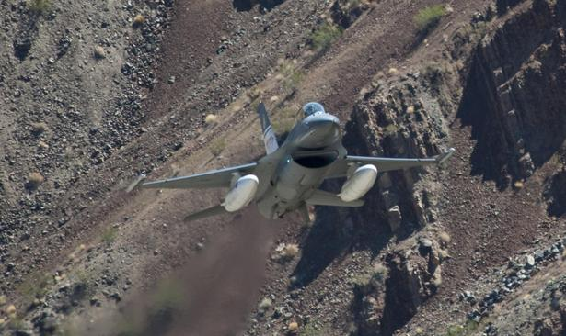
Key Players: Armed Forces
Cyber advances will have a serious impact on the relative military strength of nations and the international balance of power
Cyberspace presents the military with questions for which there are not only no answers, but for which we might not even have understood the questions yet

Slide 35
Key Players: Law Enforcement
Perpetrators and victims are frequently located in different jurisdictions posing acute difficulties for law enforcement investigating and prosecuting online crimes
The speed at which cyber criminals can inflict harm and evade detection puts law enforcement under heavy pressure, making the need for international cooperation more pressing

Slide 36
Key Players: Law Enforcement
Law enforcement lack expertise, responsiveness, techniques and procedures for responding to cybercrimes, insufficient cyber forensics personnel and outdated or nonexistent legal remedies
The response to criminal activity in physical world is hard to replicate in cyberspace

Slide 37
Key Players: Judges and Prosecutors
All judges, investigative judges and prosecutors should have basic knowledge of matters related to cyber crime and electronic evidence
Cyber crime laws are not update, contain loopholes or do not exist at all, penalties for cyber crime are weak; many impediments exist for investigators in forensics search and seizure and in obtaining witness cooperation

Slide 38
Key Players: End User
User must be aware of the risks of cyber crime, as well as the best practices required to protect themselves
The public must become aware that attack on CNI can cause loss of life, threaten public safety, impact national security, cause widespread economic upheaval, or create environmental disasters
Public must be aware of the importance of reporting all electronic intrusions and associated losses to law enforcement

Slide 39

Key Players: Private Sector
The private sector response to cyber security can be characterized as unstructured
There are three responses to market failures of this sort: regulation, taxation and insurance pricing
The relevant insurance question is: how to underwrite the risk? And the answer only can come if the risk-taker is motivated by liability to insure the risk in the first place

Slide 40
Key Players: Private Sector
It is not easy for the government to propose regulatory mandates in a complex technical area like cyber security
Taxing remains a tool by which governments have frequently sought to modify private actor conduct
Can the private sector police itself in cyber security?

Slide 41
Key Players: IT sector
The IT sector is a critical part of any cyber security solution
The quality of software needs to improve
The security attention is moving from OS to the application layer and the lower level such as firmware are poised to be next target of attack
Relying on the end-user to be responsible for the security of her PC or devices is perhaps akin to asking a driver to purchase her own seatbelt or airbag

Slide 42



Key Players: Banks and Financial Services
IT investment in online banking, brokerage and insurance services has focused to increase convenience, improve QoS and reduce cost
These benefits bring new and virulent risks of fraud, theft, extortion, credit quality deterioration as well as systemic risk

Slide 43
Key Players: Banks and Financial Services
Reasons why banks or financial services do not report intrusions or losses include:
Negative publicity
Negative information competitors would use to their advantage
The need to protect individual customer’s privacy
The risk of exposing themselves to costly and time consuming litigation
Fear among IT personnel of reporting incidents due to worries about job security
Lack of trust towards law enforcement, or concern that reporting may lead to increased regulation of the industry or of e-commerce in general

Slide 44
Key Players: Critical National Infrastructure
Every sector of private and public life is a potential target for criminal cyber attacks – for covert probing, intelligence gathering or sabotage operations by foreign powers
The process of protecting CNI requires a high degree of cooperation and information sharing among key players being led by the government

Slide 45

Key Players: WikiLeaks
WikiLeaks has published classified documents in spectacular fashion
This is an internet platform dedicated to the disclosure of private/classified information and open to all
WikiLeaks is a highly commercial enterprise – relationship with Spiegel.online and The New York Times

Slide 46
Key Players: WikiLeaks
WikiLeaks posses more questions:
The right of the public to know vs the right to privacy
How to protect governments from massive leaks through disgruntled personnel?
How to protect at the private level (from Facebook to Smartphone) –confidential, personal and private data?
How to handle the issue in the integrated fashion at the national level?
What international action is needed and appropriate?
If answers are not found urgently, the anarchic reaction to the WikiLeaks drama will transform itself into a permanent and dangerous phenomenon

Slide 47
The response: Public-Private Partnerships
The private sector is reluctant to share sensitive proprietary information with government or its competitors because of risky and less than clear benefits
They fear that sharing information with government may lead to increased regulation
There is a general lack to trust towards law enforcement and private sector fear being caught in investigations and lose production

Slide 48
The response: Public-Private Partnerships
There is a prospect that confidential information shared may be disclosed using acts such as Freedom of Information Act
There is strong sharing culture among private sector without intervention from the government such as white-hate hacker and security research community

Slide 49
Unique attributes to cyber security partnership
Issues of property in the cyber realm, both intellectual and in asset valuation
Traditional PPC operates under established regulatory structures, such structures do not exist in the cyber domain
The time scale involved in cyber development, incident, response and threat indications are shorter than in traditional PPC

Slide 50
Essential capabilities for the cyber security partnership to be successful
Detection: the partnership must define, identify and watch for behaviour concerns
Protection: it must ensure compliance with partnership’s security standards, sanctioning those who fail to comply
Response: which must provide a means to conduct forensic examinations following disruptions, analyse vulnerabilities and effectively attribute attacks to their perpetrators

Slide 51
Essential capabilities for the cyber security partnership to be successful
Inspection and enforcement of standards upon suppliers and ISPs
The ability to watch networks, search for and analyse future threats, and warn all users before and emergence occurs
The ability to respond to attacks, through warnings and technical fixes, as well as to plan for the recovery of crucial systems after an emergence

Slide 52
Essential capabilities for the cyber security partnership to be successful
Necessary protection of privacy and free speech, individual rights and business concerns, cognizant of government needs
Mechanisms for international collaboration on cyber security

Slide 53
The Response: International Cooperation
There are several regional and international cyber security initiatives such as:
Council of Europe’s Convention on Cyber Crime
European Network and Information Security Agency (ENISA)
Protecting cyberspace and the digital infrastructure is a shared responsibility of government, private sector, international organisations and users

Slide 54
Important Cyber Security Questions
How will we define what constitutes a cyber-attack and what kind of retaliation is realistic, effective and appropriate?
Does this mean that we will have to stay one step ahead of the attacker with constantly evolving and innovative software and hardware? Is this realistic?
How can government and/or militaries hope to be quicker, faster and more agile than the cyber enemy?
Are countries already de-facto in the process of abdicating their responsibility for security of citizens and key business sectors to private cyber-security firms? How can the trend be reversed?

Slide 55
Important Cyber Security Questions
There is a clear move to fragment the cyberspace for several reasons such as national boundaries and censorship, language etc. Are we moving into an age of internet protectionism? What will this mean?
What about privacy and identity in an age of heightened cyber security? How will increased focus on cyber security affect the web as we know it today? Will cyber security take precedence over freedom?

Slide 56
Important Cyber Security Questions
What are the peripheral uses of new technology designed specifically for defence purposes? Have we given enough thought to it? What about its potential use for employers, marketing agencies and others to monitor individuals’ behaviour at work and online? Will privacy exist in the future?

Slide 57
Important Cyber Security Questions
If there is a cyber gap between the US and EU and cyber abyss between the OECD and the developing world, how can cyber failed states be prevented and the South’s ability be improved to meet the security, regulatory, and technical challenges of online security?
How can states detect and respond to the emerging threat of cyber war? Clearly, new forms of private public cooperation are needed. But what forms should they take, how transparent should they be, and how can they be best subjected to parliamentary and democratic control?

Slide 58
Important Cyber Security Questions
What is the responsibility of states regarding attacks by groups and individuals operating on their territory?
How can regulation deal with the international nature of the threat? What international approaches and norms are conceivable and needed? Who should take the lead in this issue?
How to shape, in an open debate, national consensus, strategies, and policy in this area?
Is time on our side? Or is technological change outpacing regulatory efforts and the drive for democratic control?

Slide 59
Important Cyber Security Questions
Is cyber war replacing kinetic energy as the core essence of military power? Are we witnessing a second wave of the revolution in military affairs? Is the face of battle to be changed fundamentally? If so, what will be the implications for the armed forces and the security at large? What will be the implications for intelligence services? For law enforcement agencies?

Slide 60
Proposed measures needed for discovering and monitoring cyber threats and risks
Establishing real-time surveillance, monitoring, and early warning capability of attacks, and a capability for sharing critical response information with key stakeholders
Implementing intrusion detection systems using passive sensors to identify when unauthorized users attempt to gain access to networks and IT systems
Strategically addressing identity management, authentication, credential and access management to provide assurance that critical systems are accessed by authorised individuals

Slide 61
Proposed measures needed for discovering and monitoring cyber threats and risks
Developing malicious code detection methods that go beyond simple signature detection for long term detection and analysis
Developing methods for determining the source of malicious behaviour through analysis of network topology and traffic that also work in the presence of IP spoofing
Developing online learning methods for dynamic modelling, for modelling data with skewed class distributions, and feature selection for data with evolving characteristics

Slide 62
Proposed measures needed for countering cyber threats and risks
Achieving a more reliable, resilient and trustworthy digital infrastructure for the future
Developing a cyber security strategy, designed to shape the international environment on issues such as technical standards, acceptable norms, sovereign responsibility and use of force
Carrying out comprehensive assessments of the vulnerabilities of key resources and critical infrastructure, including risk assessments to determine risk posed by particular types of attacks
Developing a comprehensive national plan to deal with these vulnerabilities.

Slide 63
Proposed measures needed for countering cyber threats and risks
Better defining roles, lead-responsibility and accountability of government entities in securing critical national infrastructures, government networks, and IT systems
Making concerted and collaborative research development in cyber and critical infrastructure security a national priority
Establishing working groups charged with conducting annual reviews of research and development initiatives in their sectors, and recommending updates to the priorities based on changes in technology, threats, vulnerabilities, and risk

Slide 64
Proposed measures needed for countering cyber threats and risks
Encouraging the private sector to perform periodic vulnerability assessments of CNI
Conducting performance audits in accordance with generally accepted government auditing standards
Establishing effective coordination and information sharing between public and private sector participants in response to significant cyber incidents

Slide 65
Proposed measures needed to solve the legal challenges
Establishing, reviewing, and modernizing criminal law, procedures for electronic investigations, and policy to ensure the capability exist to prevent, deter, respond to, and prosecute cybercrime
Establishing dedicated cyber crime units, electronic forensics, training, and outreach for all who have a role in organising a unified response to cyber incidents and deterring cybercrime, including the judiciary and the private sector

Slide 66
Proposed measures needed to solve the legal challenges
Establishing, reviewing, and updating legal infrastructures related to data protection, privacy, digital signatures, commercial law, e-government, and encryption in close consultation with experts across government and civil society
Reconciling differing national laws concerning investigation and prosecution of cybercrimes, data protection, preservation, and privacy, and addressing the problem of existing cyber laws of other countries that do not carry enforcement provisions

Slide 67
Proposed measures needed to create a skilled cyber workforce and public awareness to promote cyber security
Overcoming the major challenges in attracting, hiring, training, retaining, and effectively managing cyber security and forensics talent, and introducing more attractive career tracks
Reaching agreement on the scope of educational efforts and projects to ensure that adequate cadre of skilled personnel is developed to protect IT systems and redirecting efforts to build a professional cyber workforce for now and future needs

Slide 68


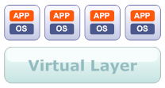


Proposed measures needed to create a skilled cyber workforce and public awareness to promote cyber security
Initiating national public awareness and educational campaign to promote cyber security, to expand support for key education programs, and research and development to ensure the nation’s continued ability to compete in the information age economy

Slide 69

The keys for creating an effective Cyber Security Strategy
Develop a cyber security strategy that clearly articulates strategic objectives, goals and priorities
Establish top-level government responsibility and accountability for leading and overseeing the national cyber security policy
Establish a governance structure for the strategic implementation of cyber security strategy
Publicize and raise awareness about the seriousness of the cyber security problem
Create an accountable, operational cyber security organisation leading the implementation

Slide 70

The keys for creating an effective Cyber Security Strategy
Bolster public private partnerships through an improved value proposition and use of more incentives
Focus much greater attention on addressing the global aspects of cyberspace
Improve law enforcement efforts on addressing malicious activities in cyberspace

Slide 71

The keys for creating an effective Cyber Security Strategy
Place greater emphasis on cyber security research and development, including consideration of how to better coordinate government and private sector efforts
Increase the cadre of cyber security and forensics professionals
Make the government a model for cyber and CNI security, including using its acquisition function to enhance cyber security aspects of products and services

Slide 72

Cyber security
Many security programs are based on reactive measures such as software patching, instead of proactive measures that prevent attacks in the first place
Will the internet be there when you really need it?
We are too dependent on the internet and are underestimating risks for the sake of cost, convenience and efficiency

Slide 73
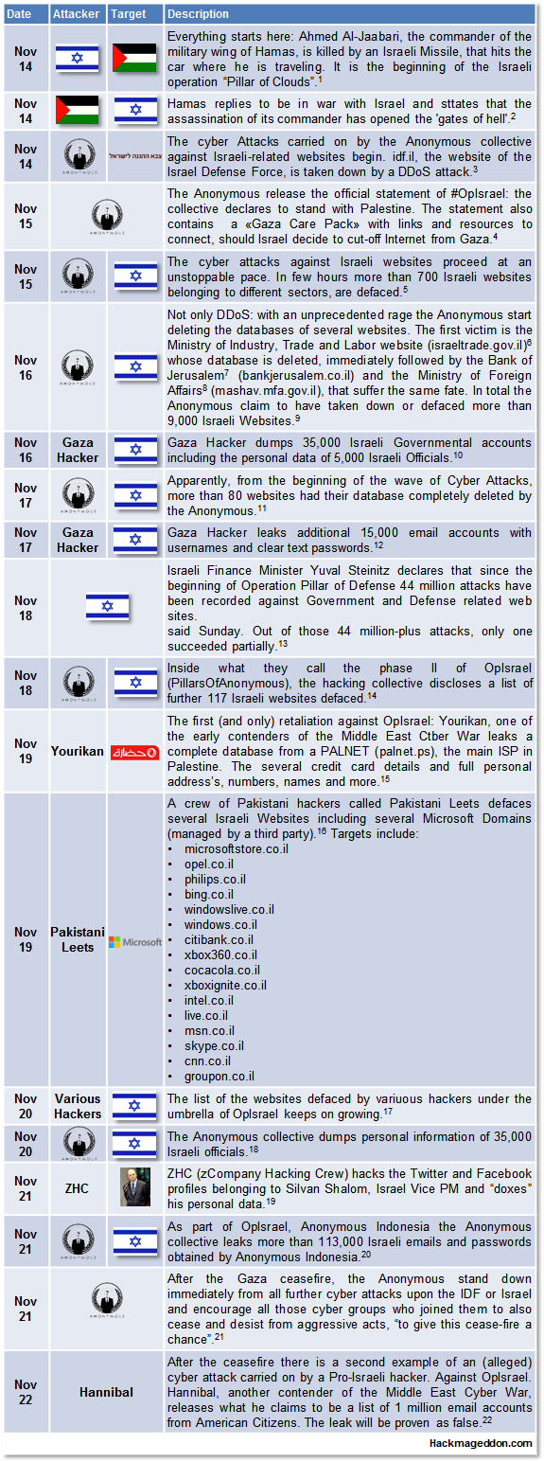
Cyber security

