Slide 1
Steganography

Slide 2
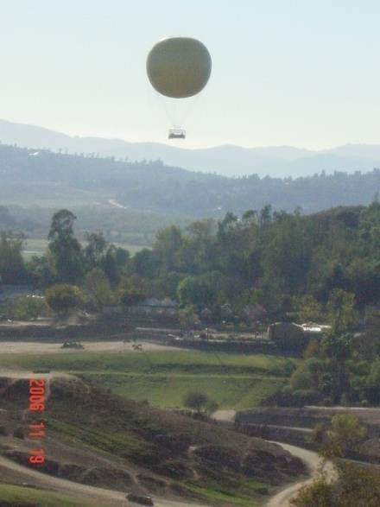
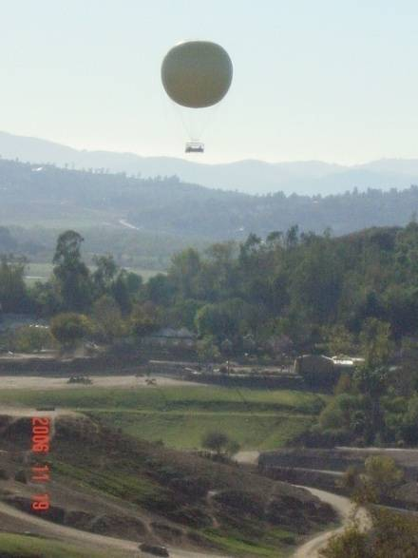
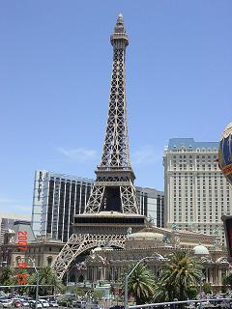
What is Steganography ?
The art and science of hiding information in a cover document such as digital images in a way that conceals the existence of hidden data.
Hidden Image
Cover Image
Stego Image

Slide 3
cryptography
κρυπό ς
γραφία
hidden
writing
A secret manner of writing, … Generally, the art of writing or solving ciphers.
— Oxford English Dictionary

Slide 4
cryptology
κρυπός
λογια
hidden
speaking
1967 D. Kahn, Codebreakers p. xvi, Cryptology is the science that embraces cryptography and cryptanalysis, but the term ‘cryptology’ sometimes loosely designates the entire dual field of both rendering signals secure and extracting information from them.
— Oxford English Dictionary

Slide 5
Steganography
στεγανός
γραφία
covered
writing
The art of secret (hidden) writing

Slide 6
Introduction
Steganography
(covered writing, covert channels)
Protection against detection
(data hiding)
Protection against removal
(document marking)
Watermarking
(all objects are marked
in the same way)
Fingerprinting
(identify all objects, every
object is marked specific)
Source: Richard Popa.

Slide 7
Steganography and encryption
Confidentiality
Encryption
(hide the content of the message, but not the existence of the message)
Steganography
(hide the content of the message and even the existence of the message)
Anybody can see both parties are communicating in secret.
Suspicious.
Ideally nobody can see that both parties are secretly communicating.
Innocent.

Slide 8
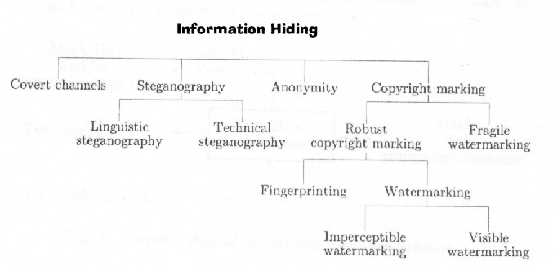
Information Hiding
F. A. P. Petitcolas, R. J. Anderson, M. G. Kuhn, “Information Hiding – A Survey”, Proceedings of the IEEE,
special issue on protection of multimedia content, 87(7):1062-1078, July 1999

Slide 9
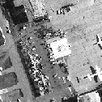



How steganography works
Secret Image
Stego Object
Cover Image
Encoder
Key
Secret Image
Decoder
Communications Channel
Original Cover

Slide 10
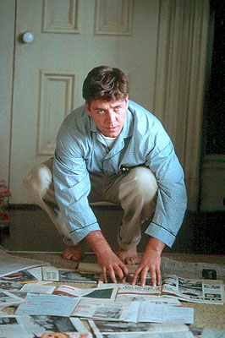
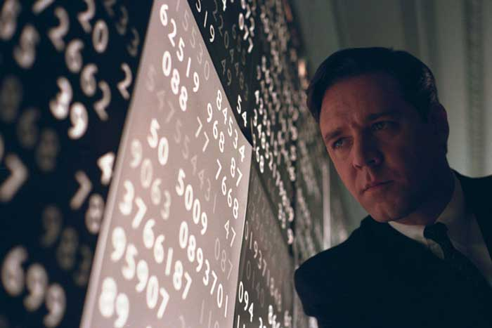
Historical & Modern-Day Examples
Tattoo on a Shaved Head
Invisible Ink: milk, lemon juice, vinegar
Microdot: a photograph the size of a printed period having the clarity of a type-written page.
Null Ciphers: take the n-th letter of each word in a passage in a book, magazine, etc.

Slide 11
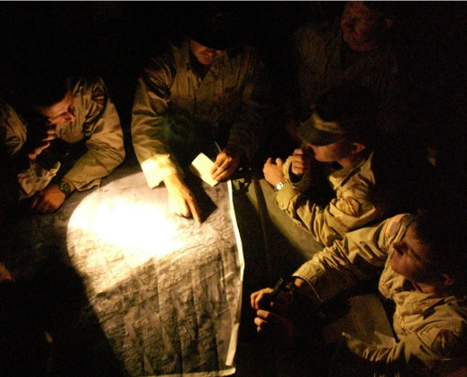
What is Steganography?
Goal: transmit secret message in an unsuspicious document so that the existence of hidden data is undetectable
Capacity is preferably large
Typically dependent on file format
“Covert communications”
Military applications
Message passing by spies
Concealing Criminal Activity

Slide 12
Steganography
Art and science of communicating in a way that hides the existence of a message
signal or pattern imposed on content
persistent under transmission
not encryption
original image/file is intact
not fingerprinting
fingerprinting leaves separate file describing contents

Slide 13
Motivation
Steganography received little attention in computing
Renewed interest because of industry desire to protect copyrighted digital work
audio
images
video
Text
Detect counterfeiter, unauthorized presentation, embed key, embed author ID
Steganography ≠ Copy protection

Slide 14
Null Cipher
Hide message among irrelevant data
Confuse the cryptoanalyst

Slide 15
Null Cipher
Hide message among irrelevant data
Confuse the cryptoanalyst
Big rumble in New Guinea.
The war on
celebrity acts should end soon.
Over four
big ecstatic elephants replicated.

Slide 16
Null Cipher
Hide message among irrelevant data
Confuse the cryptoanalyst
Big rumble in New Guinea.
The war on
celebrity acts should end soon.
Over four
big ecstatic elephants replicated.
Bring two cases of beer.

Slide 17
Hiding text within text
Message sent by a German spy in WWII:
“Apparently neutral’s protest is thoroughly discounted and ignored. Isman hard hit. Blockade issue affects pretext for embargo on by-products, ejecting suets and vegetable oils.”

Slide 18
Hiding text within text
Message sent by a German spy in WWII:
“Apparently neutral’s protest is thoroughly discounted and ignored. Isman hard hit. Blockade issue affects pretext for embargo on by-products, ejecting suets and vegetable oils.”
Pershing sails from NY June I.

Slide 19
Why Image Files?
Digital image data contains a great deal of redundant information (high capacity)
Unlike audio or video, typically no copyright issues to arouse suspicion
However, audio and video files have greater capacity than digital images
Researchers discourage use of clip art, images with text, few color variations, and/or distinct lines

Slide 20
Steganography
Main Techniques Used Today:
Least Significant Bit or noise insertion/replacement
Altering the image or compression algorithms
Modifying properties of the image such as color palette or luminance
Over 800 different embedding software programs available
Check out www.stegoarchive.com for freeware programs and other places on the Web

Slide 21
Possible Uses of Steganography | Drawbacks
Combine explanatory information with an image | Could degrade or render an image useless
Embed corrective audio or image data in case of corrosion | Could counteract and be counterproductive with original image
Private Communications | Doesn’t hide the fact an e-mail was sent
Posting secret communications on Web to avoid transmission | Third parties with steganography detection and cracking tools can view message
Copywrite protection | Steganographic software can’t protect the watermark
Maintaining anonymity | Easier to open free Web-based e-mail

Slide 22
Cryptography & Steganography vs. Watermarking Comparison
Cryptography is about protecting the content of messages (their meaning).
Steganography is about concealing the existence of messages
Watermarking is about establishing identity of information to prevent unauthorized use (Stegocrypt: e-Document Authentication - http://eleceng.dit.ie/blackledge/index.php?uid=516&menu_id=22)
They are imperceptible
They are inseparable from the works they are embedded in
They remain embedded in the work even during transformation
Notes:
While cryptography is about protecting the content of messages (their meaning), steganography is about concealing their very existence. It comes from Greek roots, literally means 'covered writing', and is usually interpreted to mean hiding information in other information. Examples include sending a message to a spy by marking certain letters in a newspaper using invisible ink, and adding sub-perceptible echo at certain places in an audio recording. It is often thought that communications may be secured by encrypting the traffic, but this has rarely been adequate in practice. Æneas the Tactician, and other classical writers, concentrated on methods for hiding messages rather than for enciphering them; and although modern cryptographic techniques started to develop during the Renaissance, we find in 1641 that John Wilkins still preferred hiding over ciphering because it arouses less suspicion. This preference persists in many operational contexts to this day. For example, an encrypted email message between a known drug dealer and somebody not yet under suspicion, or between an employee of a defense contractor and the embassy of a hostile power, has obvious implications. As the purpose of steganography is having a covert communication between two parties whose existence is unknown to a possible attacker, a successful attack consists in detecting the existence of this communication (e.g., using statistical analysis of images with and without hidden information). Watermarking, as opposed to steganography, has the (additional) requirement of robustness against possible attacks. In this context, the term 'robustness' is still not very clear; it mainly depends on the application. Copyright marks do not always need to be hidden, as some systems use visible digital watermarks, but most of the literature has focused on imperceptible (e.g., invisible, inaudible) digital watermarks which have wider applications. Visible digital watermarks are strongly linked to the original paper watermarks which appeared at the end of the XIII century to differentiate paper makers of that time. Modern visible watermarks may be visual patterns (e.g., a company logo or copyright sign) overlaid on digital images. The intent of use is also different: the payload of a watermark can be perceived as an attribute of the cover-signal (e.g., copyright information, license, ownership, etc.). In most cases the information hidden using steganographic techniques is not related at all to the cover. These differences in goal lead to very different hiding techniques.

Slide 23
Steganography Early Examples
In his history of the Persian Wars, Herodotus tells of a messenger who shaved his head and allowed a secret message to be tattooed on his scalp. He waited until his hair grew back. Then he journeyed to where the recipient awaited him and shaved his head again. The message was revealed. It was history’s first use of Steganography.

Slide 24
Steganography Invisible Ink
Ancient Romans used to write between lines using invisible ink based on various natural substances such as fruit juices, urine, and milk. Their experience was not forgotten: even nowadays children play spies and write secret messages that appear only when heated.

Slide 25
Steganography Invisible Ink
During the World War II the Germans developed the microdot. A secret message was photographically reduced to the size of a period, and affixed as the dot for the letter 'i' or other punctuation on a paper containing a written message. Microdots permitted the transmission of large amounts of printed data, including technical drawings, and the fact of the transmission was effectively hidden.

Slide 26
Steganography Principles
Computer Steganography is based on two principles.
The first one is that the files containing digitized images or sound can be altered to a certain extend without loosing their functionality.
The other principle deals with the human inability to distinguish minor changes in image color or sound quality, which is especially easy to make use of in objects that contain redundant information, be it 16-bit sound, 8-bit or even better 24-bit image. The value of the least significant bit of the pixel color won’t result in any perceivable change of that color.

Slide 27
Steganography Process
The data to be concealed is compressed and hidden within another file.
The first step is to find a file which will be used to hide the message (also called a carrier or a container.)
The next step is to embed the message one wants to hide within the carrier using a steganographic technique.
Two different techniques commonly used for embedding are:
Replace the least significant bit of each byte in the [carrier] with a single bit for the hidden message.
Select certain bytes in which to embed the message using a random number generator; resampling the bytes to pixel mapping to preserve color scheme, in the case of an image...; hiding information in the coefficients of the discrete cosine, fractal or wavelet transform of an image; and applying mimic functions that adapt bit pattern to a given statistical distribution."
Notes:
The data to be concealed is compressed and hidden within another file. The hidden message may be placed inside:
the white space of text messages
the dark areas of a photographic image
within the unused portions of a digital file format.
The first item needed for steganography is called a carrier or a container.
This can be a text file, graphic file or sound file which will host the message that is desired to be hidden.
The carrier or container is innocent looking so that it does not arouse the suspicion of anyone viewing it.
The next step is to embed the message one wants to hide within the carrier using a steganographic technique.
Techniques
Replace the least significant bit of each byte in the [carrier] with a single bit for the hidden message.
Selecting certain bytes in which to embed the message using a random number generator; resampling the bytes to pixel mapping to preserve color scheme, in the case of an image...; hiding information in the coefficients of the discrete cosine, fractal or wavelet transform of an image; and applying mimic functions that adapt bit pattern to a given statistical distribution."

Slide 28
Steganography Software
EZStego (Stego Online, Stego Shareware, Romana Machado)
Java based software program which supports only GIF and PICT formats;
Gif-It-Up v1.0 (Lee Nelson)
A stego program for Windows 95 that hides data in GIF files
Hide and Seek (Colin Maroney)
can hide any data into GIF images;
JPEG-JSTEG (Derek Upham)
can hide data inside a JPEG file
MP3Stego (Fabien A.P. Petitcolas, Computer Laboratory, University of Cambridge)
can hide data inside MP3 sound files;
Steganos (Demcom, Frankfurt, Germany)
encrypts files and then hides them within BMP, DIB, VOC, WAV, ASCII and HTML files.
Reference:http://www.antichildporn.org/steganog.html

Slide 29
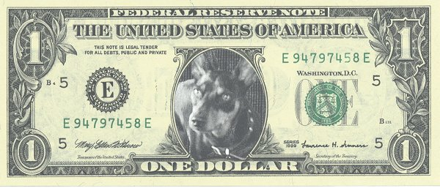
Watermarking Basics
Watermarking is the practice of hiding a message about an image, audio clip, or other work of media within the work itself.
Watermark is hidden from the user in normal use
Watermark becomes visible as a result of a special viewing process

Slide 30
Watermarking Examples
Sending a message to a spy by marking certain letters in a newspaper using invisible ink
Adding sub-perceptible echo at certain places in an audio recording.
Embedding a picture of President Andrew Jackson into the paper during paper making process.
Notes:
The main driving force is concern over protecting copyright; as audio, video and other works become available in digital form, it may be that the ease with which perfect copies can be made will lead to large-scale unauthorized copying which will undermine the music, film, book and software publishing industries. There has therefore been significant recent research into ‘watermarking’ (hidden copyright messages) and ‘fingerprinting’ (hidden serial numbers or a set of characteristics that tend to distinguish an object from other similar objects); the idea is that the latter can be used to detect copyright violators and the former to prosecute them

Slide 31
Watermarking Examples
“In 1981, photographic reprints of confidential British
Cabinet Documents were being printed in newspapers.
Rumor has it that to determine the source of the leak,
Margaret Thatcher arranged to distribute uniquely identifiable
copies of the documents to each of the ministers. Each copy had
a different word spacing that was used to encode the identity of
the recipient.”
- Digital Watermarking, Cox
Notes:
A digital watermark is a digital signal or pattern inserted into a digital image. Since this signal or pattern is present in each unaltered copy of the original image, the digital watermark may also serve as a digital signature for the copies. A given watermark may be unique to each copy (e.g., to identify the intended recipient), or be common to multiple copies (e.g., to identify the document source). In either case, the watermarking of the document involves the transformation of the original into another form. This distinguishes digital watermarking from digital fingerprinting where the original file remains intact, but another file is created that "describes" the original file's content. As a simple example, the checksum field for a disk sector would be a fingerprint of the preceding block of data. Similarly, hash algorithms produce fingerprint files.
Digital watermarking is also to be contrasted with public-key encryption, which also transform original files into another form. It is a common practice nowadays to encrypt digital
documents so that they become un-viewable without the decryption
key. Unlike encryption, however, digital watermarking leaves the original image or (or file) basically intact and recognizable. In addition, digital watermarks, as signatures, may not be validated without special software. Further, decrypted documents are free of any residual effects of encryption, whereas digital watermarks are designed to be persistent in viewing, printing, or subsequent re-transmission or dissemination.

Slide 32
Watermarking vs. Steganography
Goal of steganography
Intruder cannot detect a message
Primarily 1:1 communication
Goal of watermarking
Intruder cannot remove or replace the message
Primarily 1:many communication

Slide 33
Mathematics Behind Digital Images
Each image is saved as a MxN matrix
Each element in the matrix corresponds to a pixel location in the image
Grayscale Image - matrix values are 8-bit integers {0,1,2,…,255}
Color Images – matrix values are triples (R, G, B) where R,G,B are
8-bit integers {0,1,2,…,255}

Slide 34
Least Significant Bit Embedding in Images
Assume grayscale, 8 bit pixel values
Simplest method: embed one bit of message at each pixel location in spatial domain in LSB
Strengths: usually visually imperceptible
Weaknesses: easily destroyed or overwritten, will lose message if image is compressed

Slide 35
Bit plane embedding
Encrypting before embedding can be better
Variations on bit plane embedding
Can place bits randomly instead of sequentially
Can randomly add or subtract one to change the bit to match the payload bit with the changed image bit (LSB matching)
LSB replacement: can be reliably detected using a statistical test called the chi-square test
LSB matching is much more difficult to detect
For covert communications, LSB embedding in spatial domain is not the top choice

Slide 36
What is Steganalysis ?
The art and science of detecting hidden data, determining the length of the message, and extracting the data.
Why is it important?
Prevent Terrorist Attacks
Catch people engaging in illegal activities
Discourage Piracy

Slide 37
Steganalysis Basics
Steganalysis is the art of discovering and rendering useless such covert messages.
Steganalysis involves analysis of the carrier file
Simpler steganographic techniques produce some discernible change in the file size, statistics or both.
These changes can manifest themselves in color variations, loss of resolution and other distortions that are visible to the human eye.
This form of detection requires that you know what the original carrier image or file should look like.

Slide 38
Types of Steganalysis
Targeted Steganalysis
Relys on knowing the method used to hide the data & using known distinguishing statistics to detect stego images
Sometimes steganalysts reverse engineer steganographic methods
Blind Steganalysis
Most beneficial to forensics because it’s not based on knowing the algorithm
Most difficult because the type of images and method of hiding data are enormous and continuously changing.
The current trend is to develop a neural network using training images and multiple statistical features.

Slide 39
Steganalysis of LSB Embedding
In a “typical” natural scene, the number of even gray values is not the same as the number of odd values
If you embed a 0-1 message string into the least significant bits (LSBs) of an image, then (since it is uniformly distributed), there will be approximately the same number of even and odd values
Statistical “attack” to detect this anomaly, using chi-square statistic

Slide 40
Steganalysis
A recent study (Purdue, 10/18/07) shows that Steganography is being used more frequently, particularly in child pornography and identity theft trafficking
Evidence of Steganography tools on convicted criminals’ computers as tools leave behind “footprints”
Easier to identify this than to find embedded data

Slide 41
Examples of Steganalysis
If you have the Original Image, you can compare their underlying matrix values
Look at bit planes
Fridrich et al developed a method of approximating the original image from the unknown for JPEG images

Slide 42
Hiding information digitally
Requirements
The quality of the marked object must not noticeably degrade upon the addition of the mark.
Marks should be undetectable without some secret knowledge (typically, a key)
The marks should survive transformations which don’t degrade the perceived quality of the work
If multiple marks are present, they should not interfere with each other.

Slide 43
Robustness and fragility
Fragile
Hidden information destroyed as soon as object is modified.
Protocols tend to be easy to implement.
Useful in proving objects have not been manipulated and changed e.g. evidence in a court of law.
Robust
It should be infeasible to remove the hidden data without degrading the perceived quality of the data.
Protocols are more complex.
One single protocol may not withstand all object manipulations.
Useful in copyright watermarking.

Slide 44
Digital Millennium Copyright Act
General Highlights
It is a crime to circumvent anti-piracy measures built into commercial software
Outlaws manufacturing, sale, or distribution of code-cracking devices used to illegally copy software
Permits cracking copyright protection devices to conduct encryption research, assess product interoperability, and test computer security systems
You can read about it & view the full document at http://www.gseis.ucla.edu/iclp/dmca1.htm

Slide 45
Discussion
What advantages does steganography have over cryptography? Vice versa?
How could a hidden message in an image get corrupted?
If you suspected a message of having a hidden meaning, what algorithm could you use to see if you are right?

