Slide 1
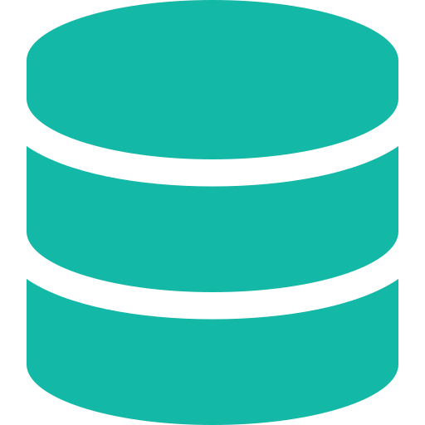
Internal Database
Observability Platform
Unified Monitoring for RDBMS · NoSQL · Infrastructure
Real-time Monitoring
Smart Alerting
500+ Instances
Open Source
Maintained by DBA Team • Secure • Scalable • Offline Ready

Slide 2






The Challenge
What we faced before this platform
Fragmented Monitoring
No Application Visibility
Slow Incident Detection
Each database managed independently with no centralized visibility across systems.
No correlation between DB performance and application tiers (SIT / UAT).
Issues discovered after user complaints — hours of downtime and slow MTTR.
No Infrastructure View
Low DBA Productivity
No Standardized Process
Servers, VMs, disks, and network devices had zero observability coverage.
DBAs spent hours on manual checks instead of proactive optimization.
Every team monitored differently — no shared dashboards or runbooks.

Slide 3



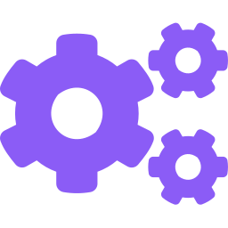


Our Solution
A centralized observability platform — one place to monitor everything
Fleet Visibility
Performance Insights
Smart Alerting
Single-pane-of-glass for all DBs & infra
Deep metrics for faster troubleshooting
Context-aware alerts by app & tier
Auto Discovery
Scalable Architecture
Offline Ready
CSV-driven dynamic target generation
Supports 500+ database instances
No internet dependency required

Slide 4
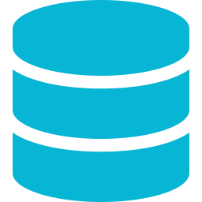





Platform Architecture
End-to-end data flow from source to insight
MySQL/PostgreSQL/Oracle/MSSQL
Data Sources
MongoDB/Cassandra/Redis/ES
RDBMS · NoSQL · Servers
Servers/VMs/Containers
Exporters Layer
Metrics Collection
Grafana
Dashboards & Visualization
Prometheus
Processing & Alert Rules
Alertmanager
Email Notifications (SMTP)
VictoriaMetrics
Long-term Time Series DB

Slide 5
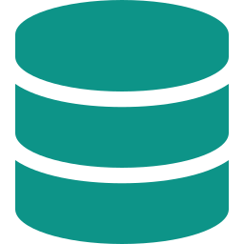

Dashboard Portfolio
Real-time insights across all layers
Fleet Overview
Database Monitoring
Infrastructure
Total systems & availability %
Query performance & execution time
CPU / Memory utilization
Active alerts & down instances
Session & blocking analysis
Disk usage & I/O throughput
Multi-environment summary
Capacity tracking & growth
Network traffic & errors
Top consumers at a glance
Replication & cluster health
Container & VM metrics

Slide 6



Intelligent Alerting
Context-aware alerts with full operational context via Alertmanager
[CRITICAL][CORE-BANKING][SIT]
High Resource Usage on db-oracle-01
CPU: 94% | Memory: 87% | Duration: 12min
Centralized via Alertmanager
Email (SMTP) notifications
Application:
CORE-BANKING
Tier:
SIT
Severity:
CRITICAL
Instance:
db-oracle-01
Routed by app + tier + severity
Channel:
Email / SMTP
Auto-resolution on recovery

Slide 7
Deployment & Auto Discovery
Simple, reproducible, CSV-driven setup
01
Run Deployment Script
500+
3
sudo ./deploy_all.sh
Database Instances
DB Types Supported
02
Manage Inventory (CSV)
inventory/targets.csv
1
0
03
Generate Configurations
Deploy Command
Internet Required
python scripts/generate_targets.py
04
Output: Prometheus Configs
config/targets/

Slide 8





Business Value
Impact delivered to the organization
Faster Detection
Reduced Downtime
DBA Productivity
Real-time alerts cut mean-time-to-detect from hours to minutes across all environments.
Proactive monitoring catches issues before they impact business operations and users.
DBAs shift from reactive firefighting to strategic optimization and planning.
Standardized Monitoring
Operational Visibility
Zero License Cost
Unified tooling and dashboards across all teams, apps, and environments.
Full-stack observability linking database metrics to application performance.
100% open-source: Prometheus, VictoriaMetrics, Grafana, Alertmanager.

Slide 9


Roadmap
Where we're headed next
Phase 1
Now — Done
Phase 2
Next 3 Months
Phase 3
Future
Fleet dashboard live
AI anomaly detection
Auto remediation
DB monitoring active
Root cause analysis
Multi-channel alerts
Email alerting ready
Custom thresholds
Predictive scaling
Auto-discovery via CSV
Log integration
Self-healing workflows

Slide 10
Secure • Scalable • Reliable • Open Source
Built for the DBA Team.
Built for the Business.
Prometheus
VictoriaMetrics
Grafana
Alertmanager
Maintained by DBA Team

