Slide 1

Introduction to Code Generation
Comp 412
COMP 412
FALL 2010
Copyright 2010, Keith D. Cooper & Linda Torczon, all rights reserved.
Students enrolled in Comp 412 at Rice University have explicit permission to make copies of these materials for their personal use.
Faculty from other educational institutions may use these materials for nonprofit educational purposes, provided this copyright notice is preserved.

Slide 2
Structure of a Compiler
A compiler is a lot of fast stuff followed by some hard problems
  The hard stuff is mostly in code generation and optimization
  For multicores, we need to manage parallelism & sharing
  For unicore performance, allocation & scheduling are critical
O(n)
O(n)
O(n log n) to Exponential
Scanner
words
Parser
IR
Analysis
&
Optimization
IR
Instruction
Selection
asm
Instruction
Scheduling
asm
Register
Allocation
asm
∞
regs
∞
regs
k
regs
Either fast or
NP-Complete
NP-Complete
NP-Complete
Comp 412, Fall 2010

Slide 3
Structure of a Compiler
For the rest of 412, we assume the following model
Selection is fairly simple (problem of the 1980s)
Allocation & scheduling are complex
Operation placement is not yet critical (unified register set)
What about the IR ?
Low-level, RISC-like IR such as ILOC
Has “enough” registers
ILOC was designed for this stuff
IR
Analysis
&
Optimization
IR
Instruction
Selection
asm
Instruction
Scheduling
asm
Register
Allocation
asm
∞
regs
∞
regs
∞
regs
∞
regs
k
regs
Branches, compares, & labels
Memory tags
Hierarchy of loads & stores
Provision for multiple ops/cycle
Parallelism either comes from the application, or is derived with techniques that are beyond the level of this course.
Comp 412, Fall 2010

Slide 4
Definitions
Instruction selection
Mapping IR into assembly code
Assumes a fixed storage mapping & code shape
Combining operations, using address modes
Instruction scheduling
Reordering operations to hide latencies
Assumes a fixed program (set of operations)
Changes demand for registers
Register allocation
Deciding which values will reside in registers
Changes the storage mapping, may add false sharing
Concerns about placement of data & memory operations
These 3 problems are tightly coupled.
Comp 412, Fall 2010

Slide 5
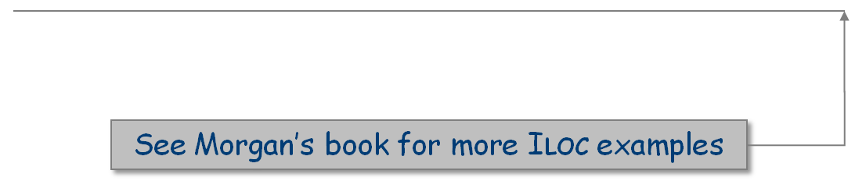
Code Shape (Chapter 7)
Definition
All those nebulous properties of the code that effect performance
Includes code, approach for different constructs, cost, storage requirements & mapping, & choice of operations
Code shape is the end product of many decisions (big & small)
Impact
Code shape influences algorithm choice & results
Code shape can encode important facts, or hide them
Rule of thumb: expose as much derived information as possible
Example: explicit branch targets in ILOC simplify analysis
Example: hierarchy of memory operations in ILOC (EaC, p 237)
Comp 412, Fall 2010

Slide 6
Code Shape
My favorite example
What if x is 2 and z is 3?
What if y+z is evaluated earlier?
The “best” shape for x+y+z depends on contextual knowledge
  There may be several conflicting options
x + y + z
x + y → t1
t1+ z → t2
x + z → t1
t1+ y → t2
y + z → t1
t1+ z → t2
+
+
+
+
+
+
y
+
z
x
x
y
z
x
y
x
z
y
z
Addition is commutative & associative for integers
Comp 412, Fall 2010

Slide 7
Code Shape
Another example -- the case statement
Implement it as cascaded if-then-else statements
  Cost depends on where your case actually occurs
  O(number of cases)
Implement it as a binary search
  Need a dense set of conditions to search
  Uniform (log n) cost
Implement it as a jump table
  Lookup address in a table & jump to it
  Uniform (constant) cost
Compiler must choose best implementation strategy
No amount of massaging or transforming will convert one into another
Performance depends on order of cases!
Comp 412, Fall 2010

Slide 8
Code Shape
Why worry about code shape? Can’t we just trust the
optimizer and the back end?
Optimizer and back end approximate the answers to many hard problems
The compiler’s individual passes must run quickly
It often pays to encode useful information into the IR
  Shape of an expression or a control structure
  A value kept in a register rather than in memory
Deriving such information may be expensive, when possible
Recording it explicitly in the IR is often easier and cheaper
Comp 412, Fall 2010

Slide 9
Generating Code for Expressions
expr(node) {
int result, t1, t2;
switch (type(node)) {
case ×,÷,+,− :
t1← expr(left child(node));
t2← expr(right child(node));
result ← NextRegister();
emit (op(node), t1, t2, result);
break;
case IDENTIFIER:
t1← base(node);
t2← offset(node);
result ← NextRegister();
emit (loadAO, t1, t2, result);
break;
case NUMBER:
result ← NextRegister();
emit (loadI, val(node), none, result);
break;
}
return result;
}
The Concept
Assume an AST as input & ILOC
as output
Use a postorder treewalk evaluator
(visitor pattern in OOD)
  Visits & evaluates children
  Emits code for the op itself
  Returns register with result
Bury complexity of addressing
names in routines that it calls
  base(), offset(), & val()
Works for simple expressions
Easily extended to other operators
Does not handle control flow
Comp 412, Fall 2010
Notes:
Base( an IDENTIFIER node ) looks up the node’s symbol in the table, finds its base address, and gets that address in a register.
It can, in a decent implementation, know that &_procname.static_ is already in a register and avoid the load.
Offset( an IDENTIFIER node ) looks up the node’s symbol in the table, places its offset in a register, & returns that register.
Val( a NUMBER node ) gets that number into a register & returns it.

Slide 10
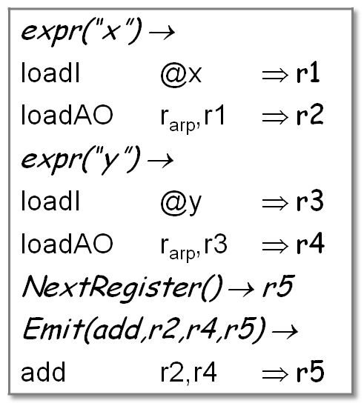
Generating Code for Expressions
expr(node) {
int result, t1, t2;
switch (type(node)) {
case ×,÷,+,− :
t1← expr(left child(node));
t2← expr(right child(node));
result ← NextRegister();
emit (op(node), t1, t2, result);
break;
case IDENTIFIER:
t1← base(node);
t2← offset(node);
result ← NextRegister();
emit (loadAO, t1, t2, result);
break;
case NUMBER:
result ← NextRegister();
emit (loadI, val(node), none, result);
break;
}
return result;
}
Example:
Produces:
+
x
y
Comp 412, Fall 2010

Slide 11
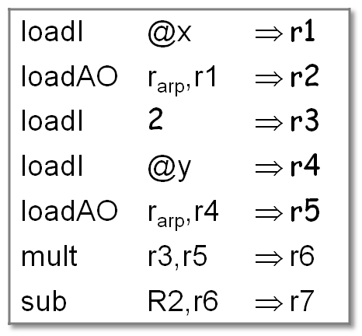
Generating Code for Expressions
expr(node) {
int result, t1, t2;
switch (type(node)) {
case ×,÷,+,− :
t1← expr(left child(node));
t2← expr(right child(node));
result ← NextRegister();
emit (op(node), t1, t2, result);
break;
case IDENTIFIER:
t1← base(node);
t2← offset(node);
result ← NextRegister();
emit (loadAO, t1, t2, result);
break;
case NUMBER:
result ← NextRegister();
emit (loadI, val(node), none, result);
break;
}
return result;
}
Example:
Produces:
−
x
×
2
y
Comp 412, Fall 2010

Slide 12
Extending the Simple Treewalk Algorithm
More complex cases for IDENTIFIER
What about values that reside in registers?
  Modify the IDENTIFIER case
  Already in a register ⇒ return the register name
  Not in a register ⇒ load it as before, but record the fact
  Choose names to avoid creating false dependences
What about parameter values?
  Many linkages pass the first several values in registers
  Call-by-value ⇒ just a local variable with a negative offset
  Call-by-reference ⇒ negative offset, extra indirection
What about function calls in expressions?
  Generate the calling sequence & load the return value
  Severely limits compiler’s ability to reorder operations
Comp 412, Fall 2010

Slide 13
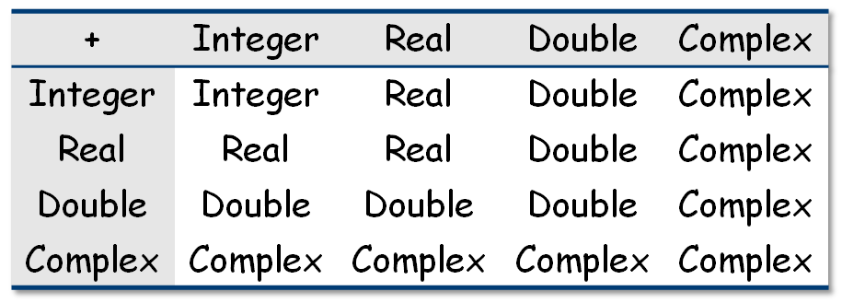
Extending the Simple Treewalk Algorithm
Adding other operators
Evaluate the operands, then perform the operation
Complex operations may turn into library calls
Handle assignment as an operator
Mixed-type expressions
Insert conversions as needed from conversion table
Most languages have symmetric & rational conversion tables
  Original PL/I had asymmetric tables for BCD & binary integers
Typical Table for Addition
Comp 412, Fall 2010

Slide 14
Extending the Simple Treewalk Algorithm
What about evaluation order?
Can use commutativity & associativity to improve code
This problem is truly hard
Commuting operands at a single operation is much easier
1st operand must be preserved while 2nd is evaluated
Takes an extra register for 2nd operand
Should evaluate more demanding operand expression first
(Ershov in the 1950’s, Sethi in the 1970’s)
Taken to its logical conclusion, this creates Sethi-Ullman scheme for register allocation [See Bibliography in EaC]
Local rather than global
Comp 412, Fall 2010

Slide 15
Generating Code in the Parser
Need to generate an initial IR form
Chapter 4 talks about ASTs & ILOC
Might generate an AST, use it for some high-level, near-source work such as type checking and optimization, then traverse it and emit a lower-level IR similar to ILOC for further optimization and code generation
The Big Picture
Recursive treewalk performs its work in a bottom-up order
  Actions on non-leaves occur after actions on children
Can encode same basic structure into ad-hoc SDT scheme
  Identifiers load themselves & stack virtual register name
  Operators emit appropriate code & stack resulting VR name
  Assignment requires evaluation to an lvalue or an rvalue
Comp 412, Fall 2010

Slide 16
Ad-hoc SDT versus a Recursive Treewalk
expr(node) {
int result, t1, t2;
switch (type(node)) {
case ×,÷,+,− :
t1← expr(left child(node));
t2← expr(right child(node));
result ← NextRegister();
emit (op(node), t1, t2, result);
break;
case IDENTIFIER:
t1← base(node);
t2← offset(node);
result ← NextRegister();
emit (loadAO, t1, t2, result);
break;
case NUMBER:
result ← NextRegister();
emit (loadI, val(node), none, result);
break;
}
return result;
}
Goal : Expr { $$ = $1; } ;
Expr: Expr PLUS Term
{ t = NextRegister();
emit(add,$1,$3,t); $$ = t; }
| Expr MINUS Term {…}
| Term { $$ = $1; } ;
Term: Term TIMES Factor
{ t = NextRegister();
emit(mult,$1,$3,t); $$ = t; };
| Term DIVIDES Factor {…}
| Factor { $$ = $1; };
Factor: NUMBER
{ t = NextRegister();
emit(loadI,val($1),none, t );
$$ = t; }
| ID
{ t1 = base($1);
t2 = offset($1);
t = NextRegister();
emit(loadAO,t1,t2,t);
$$ = t; }
Comp 412, Fall 2010
Some details omitted for space; see Chapter 4.

Slide 17
Handling Assignment (just another operator)
lhs ← rhs
Strategy
Evaluate rhs to a value (an rvalue)
Evaluate lhs to a location (an lvalue)
  lvalue is a register ⇒ move rhs
  lvalue is an address ⇒ store rhs
If rvalue & lvalue have different types
  Evaluate rvalue to its “natural” type
  Convert that value to the type of *lvalue
Unambiguous scalars go into registers
Ambiguous scalars or aggregates go into memory
Comp 412, Fall 2010
Keeping ambiguous values in memory lets the hardware sort out the addresses.

Slide 18
Handling Assignment
What if the compiler cannot determine the type of the rhs?
Issue is a property of the language & the specific program
For type-safety, compiler must insert a run-time check
  Some languages & implementations ignore safety (bad idea)
Add a tag field to the data items to hold type information
  Explicitly check tags at runtime
Code for assignment becomes more complex
evaluate rhs
if type(lhs) ≠ rhs.tag
then
convert rhs to type(lhs) or
signal a run-time error
lhs ← rhs
Choice between conversion & a runtime exception depends on details of language & type system
Much more complex than static checking, plus costs occur at runtime rather than compile time
Comp 412, Fall 2010

Slide 19
Handling Assignment
Compile-time type-checking
Goal is to eliminate the need for both tags & runtime checks
Determine, at compile time, the type of each subexpression
Use runtime check only if compiler cannot determine types
Optimization strategy
If compiler knows the type, move the check to compile-time
Unless tags are needed for garbage collection, eliminate them
If check is needed, try to overlap it with other computation
Can design the language so all checks are static
Comp 412, Fall 2010

Slide 20
Handling Assignment with Reference Counts
Reference counting is an incremental strategy for implicit storage deallocation (alternative to batch collectors)
Simple idea
  Associate a count with each heap allocated object
  Increment count when pointer is duplicated
  Decrement count when pointer is destroyed
  Free when count goes to zero
Advantages
  Smaller collections amortized over all pointer assignments
    Useful in real-time applications, user interfaces
  Counts will be in cache, ILP may reduce expense
Disadvantages
  Freeing root node of a graph implies a lot of work & disruption
    Can adopt a protocol to bound the work done at each point
  Cyclic structures pose a problem
Comp 412, Fall 2010

Slide 21
Handling Assignment with Reference Counts
Implementing reference counts
Must adjust the count on each pointer assignment
Extra code on every counted (e.g., pointer) assignment
Code for assignment becomes
This adds 1 +, 1 -, 2 loads, & 2 stores
With extra functional units & large caches, the overhead may become either cheap or free …
evaluate rhs
lhs→count - -
lhs ← addr(rhs)
rhs→count + +
if (rhs→count = 0)
free rhs
Likely hits in the L1 cache
Comp 412, Fall 2010

Slide 22
Evaluating Expressions
What is left for next class?
Boolean & relational values
  Need to extend the grammar
  Need to represent the value, explicitly or implicitly
Loading values that are more complex than scalars
  Array elements, structure elements, characters in a string
Comp 412, Fall 2010

Slide 23
Extra Slides Start Here
Comp 412, Fall 2010

Slide 24
The Big Picture
How hard are these problems?
Instruction selection
Can make locally optimal choices, with automated tool
Global optimality is (undoubtedly) NP-Complete
Instruction scheduling
Single basic block ⇒ heuristics work quickly
General problem, with control flow ⇒ NP-Complete
Register allocation
Single basic block, no spilling, & 1 register size ⇒ linear time
Whole procedure is NP-Complete
Comp 412, Fall 2010

Slide 25
The Big Picture
Conventional wisdom says that we lose little
by solving these problems independently
Instruction selection
Use some form of pattern matching
Assume enough registers or target “important” values
Instruction scheduling
Within a block, list scheduling is “close” to optimal
Across blocks, build framework to apply list scheduling
Register allocation
Start from virtual registers & map “enough” into k
Optimal for
> 85% of blocks
This slide is full of
“fuzzy” terms
Comp 412, Fall 2010

Slide 26
The Big Picture
What are today’s hard issues issues?
Instruction selection
Making actual use of the tools
Impact of choices on power and on functional unit placement
Instruction scheduling
Modulo scheduling loops with control flow
Schemes for scheduling long latency memory operations
Finding enough ILP to keep functional units (& cores) busy
Register allocation
Cost of allocation, particularly for JITs
Better spilling (space & speed)?
Meaning of optimality in SSA-based allocation
Comp 412, Fall 2010

