Slide 1

Instruction Scheduling, III
Software Pipelining
Comp 412
COMP 412
FALL 2010
Warning: This lecture is the second most complicated one in Comp 412, after LR(1) Table Construction
Copyright 2010, Keith D. Cooper & Linda Torczon, all rights reserved.
Students enrolled in Comp 412 at Rice University have explicit permission to make copies of these materials for their personal use.
Faculty from other educational institutions may use these materials for nonprofit educational purposes, provided this copyright notice is preserved.

Slide 2
Background
List scheduling
  Basic greedy heuristic used by most compilers
  Forward & backward versions
  Recommend Schielke’s RBF (5 forward, 5 backward, randomized)
Extended basic block scheduling
  May need compensation code on early exits
  Reasonable benefits for minimal extra work
Superblock scheduling
  Clone to eliminate join points, then schedule as EBBs
Trace scheduling
  Use profile data to find & schedule hot paths
  Stop trace at backward branch (loop-closing branch)
Comp 412, Fall 2010
Theme: apply the list scheduling algorithm to ever larger contexts.

Slide 3
Loop Scheduling
Software Pipelining
Another regional technique, focused on loops
Another way to apply the basic list-scheduling discipline
Reduce loop-initiation interval
  Execute different parts of several iterations concurrently
  Increase utilization of hardware functional units
  Decrease total execution time for the loop
Resulting code mimics a hardware “pipeline”
  Operations proceed through the pipeline
  Several operations (iterations in this case) in progress at once
The Gain
Iteration with unused cycles from dependences & latency
  Fills the unused issue slots
  Reduces total running time by ratio of schedule lengths
The number of cycles between start of 2 successive iterations
Comp 412, Fall 2010

Slide 4
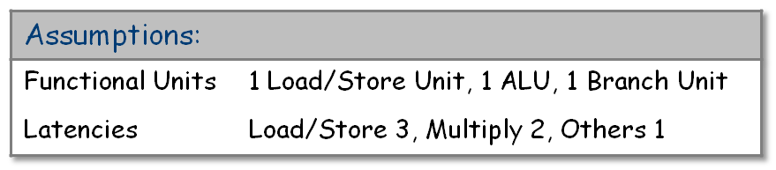
The Concept
c is in a register, as we would want …
Consider a simple sum reduction loop
Loop body contains a load (3 cycles) and two adds (1 cycle each)
Load latency dominates cost of the loop
r_{c} ← 0
r_{@a} ← @a
r₁ ← n x 4
r_{ub} ← r₁ + r_{@a}
if r_{@a} > r_{ub} goto Exit
Loop: r_{a} ← MEM(r_{@a})
r_{c} ← r_{c} + r_{a}
r_{@a} ← r_{@a} + 4
if r_{@a} ≤ r_{ub} goto Loop
Exit: c ← r_{c}
c = 0
for i = 1 to n
c = c + a[i]
Source code
LLIR code
Comp 412, Fall 2010

Slide 5
The Concept
A typical execution of the loop would be:
One iteration in progress at a time
Assume separate fetch, integer, and branch units
Code keeps one functional unit busy
Inefficient use of resources
Software pipelining tries to remedy this inefficiency by mimicking a hardware pipeline’s behavior
With delays, requires 6 cycles per iteration, or n x 6 cycles for the loop
  Local scheduler can reduce that to n x 5 by moving the address update up 1 slot
r_{a} ← MEM(r_{@a})
r_{c} ← r_{c} + r_{a}
r_{@a} ← r_{@a} + 4
if r_{@a} ≤ r_{ub} goto Loop
r_{a} ← MEM(r_{@a})
r_{c} ← r_{c} + r_{a}
r_{@a} ← r_{@a} + 4
if r_{@a} ≤ r_{ub} goto Loop
r_{a} ← MEM(r_{@a})
r_{c} ← r_{c} + r_{a}
r_{@a} ← r_{@a} + 4
if r_{@a} ≤ r_{ub} goto Loop
r_{a} ← MEM(r_{@a})
r_{c} ← r_{c} + r_{a} •••
stall
stall
stall
stall
Remember: 3 units (load/store, ALU, branch)
At 5 cycles, that’s 4 ops in 15 issue slots.
Comp 412, Fall 2010

Slide 6
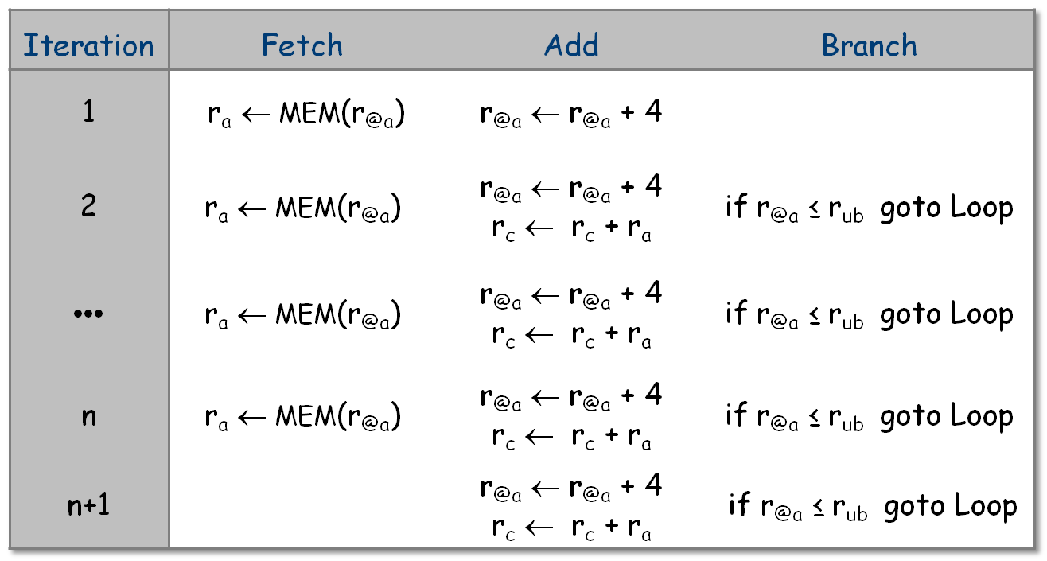
The Concept
An OOO hardware pipeline would execute the loop as
Comp 412, Fall 2010

Slide 7
The Concept
An OOO hardware pipeline would execute the loop as
The loop’s steady state behavior
Comp 412, Fall 2010

Slide 8
The Concept
An OOO hardware pipeline would execute the loop as
The loop’s prologue
The loop’s epilogue
Comp 412, Fall 2010

Slide 9
Implementing the Concept
To schedule an execution that achieves the same result
Build a prologue to fill the pipeline
Generate the steady state portion, or kernel
Build an epilogue to empty the pipeline
r_{a} ← MEM(r_{@a}) | r_{@a} ← r_{@a} + 4 if r_{@a} ≤ r_{ub} goto Loop
r_{a} ← MEM(r_{@a}) | r_{@a} ← r_{@a} + 4 r_{c} ← r_{c} + r_{a} | if r_{@a} ≤ r_{ub} goto Loop
r_{@a} ← r_{@a} + 4 r_{c} ← r_{c} + r_{a}
Comp 412, Fall 2010

Slide 10
Implementing the Concept
Prologue
r_{a} ← MEM(r_{@a}) | r_{@a} ← r_{@a} + 4 if r_{@a} > r_{ub} goto Exit
r_{a} ← MEM(r_{@a}) | r_{@a} ← r_{@a} + 4 r_{c} ← r_{c} + r_{a} | if r_{@a} ≤ r_{ub} goto Loop
Kernel
r_{@a} ← r_{@a} + 4 r_{c} ← r_{c} + r_{a}
Epilogue
Key question:
How long does the kernel need to be?
General schema for the loop
Comp 412, Fall 2010

Slide 11
Implementing the Concept
1
Prologue
r_{a} ← MEM(r_{@a}) | r_{@a} ← r_{@a} + 4 if r_{@a} > r_{ub} goto Exit
3
1
1
1
r_{a} ← MEM(r_{@a}) | r_{@a} ← r_{@a} + 4 r_{c} ← r_{c} + r_{a} | if r_{@a} ≤ r_{ub} goto Loop
Kernel
3
1
1
Epilogue
r_{@a} ← r_{@a} + 4 r_{c} ← r_{c} + r_{a}
The actual schedule must respect both the data dependences and the operation latencies.
General schema for the loop
Comp 412, Fall 2010

Slide 12
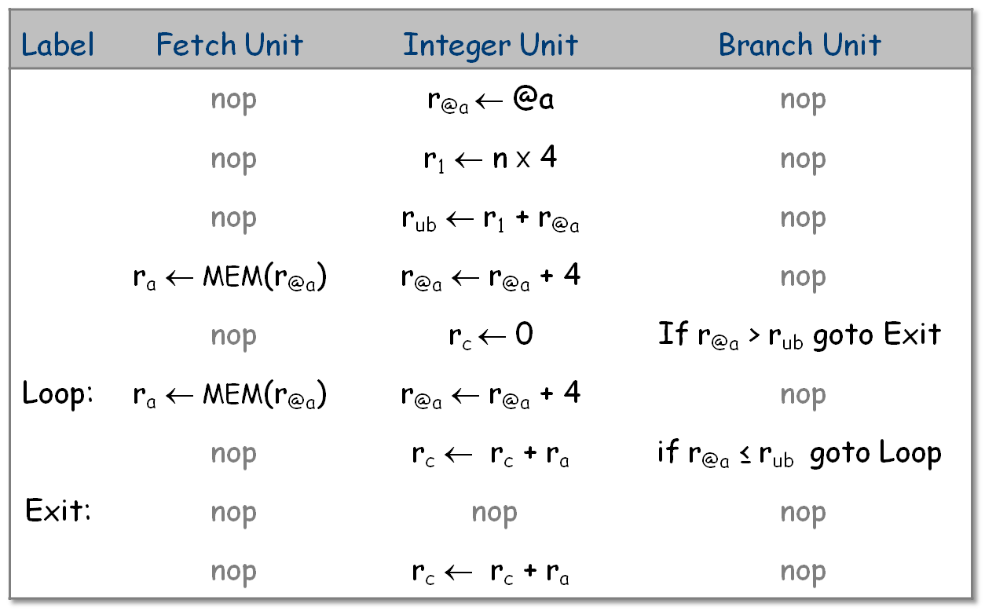
Implementing the Concept
Scheduling the code in this schema produces:
Comp 412, Fall 2010

Slide 13

Implementing the Concept
Scheduling the code in this schema produces:
This schedule initiates a new iteration every 2 cycles.
  We say it has an initiation interval (ii) of 2 cycles
  The original loop had an initiation interval of 5 cycles
Thus, this schedule takes n x 2 cycles, plus the prologue
(2 cycles) and epilogue (2 cycles) code. (2n+4 < 5n, ∀ n > 1)
Comp 412, Fall 2010

Slide 14
Implementing the Concept
Scheduling the code in this schema produces:
Other operations may be scheduled into the holes in the epilogue
Comp 412, Fall 2010

Slide 15
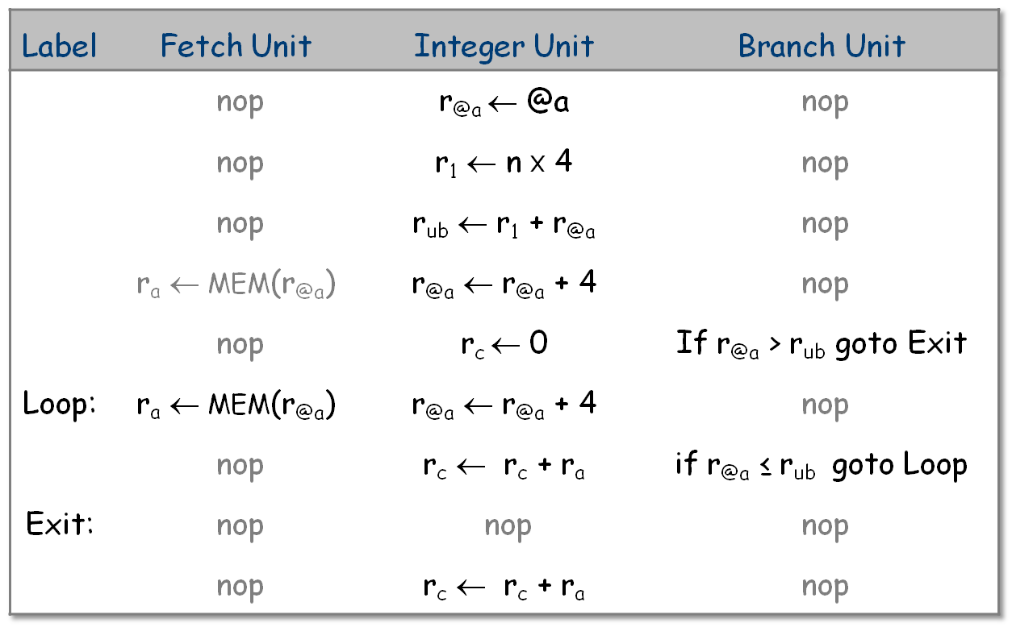
Implementing the Concept
How do we generate this schedule?
Prologue
ii = 2
Body
Epilogue
Comp 412, Fall 2010
The key, of course, is generating the loop body

Slide 16
The Algorithm
Choose an initiation interval, ii
  Compute lower bounds on ii
  Shorter ii means faster overall execution
Generate a loop body that takes ii cycles
  Try to schedule into ii cycles, using modulo scheduler
  If it fails, bump ii by one and try again
Generate the needed prologue & epilogue code
  For prologue, work backward from upward exposed uses in the schedulued loop body
  For epilogue, work forward from downward exposed definitions in the scheduled loop body
Comp 412, Fall 2010
Algorithm due to Monica Lam, PLDI 1988

Slide 17
The Algorithm
Choose an initiation interval, ii
  Compute lower bounds on ii
  Shorter ii means faster overall execution
Generate a loop body that takes ii cycles
  Try to schedule into ii cycles, using modulo scheduler
  If it fails, bump ii by one and try again
Generate the needed prologue & epilogue code
  For prologue, work backward from upward exposed uses in the schedulued loop body
  For epilogue, work forward from downward exposed definitions in the scheduled loop body
Comp 412, Fall 2010

Slide 18
The Algorithm
Lam proposed two lower bounds on ii
Resource constraint
  ii must be large enough to issue every operation
  If N_{u} is number of functional units of type u and I_{u} is the number of operations of type u, then ⎡I_{u} / N_{u}⎤ gives the number of cycles required to issue all of the operations of type u
  max_{u} ( ⎡I_{u} / N_{u}⎤ ) gives the minimum number of cycles required for the loop to issue all of its operations
  ii must be at least as large as max_{u} ( ⎡I_{u} / N_{u}⎤ )
So, max_{u} ( ⎡I_{u} / N_{u}⎤ ) serves as one lower bound on ii
Comp 412, Fall 2010

Slide 19
The Algorithm
Lam proposed two lower bounds on ii
Recurrence constraint
  A recurrence is a loop-based computation whose value is used in a later iteration of the loop.
  ii must be large enough to cover the latency around the longest recurrence in the loop
  If the loop computes a recurrence r over k_{r} iterations and the delay on r is d_{r}, then each iteration must include at least
    ⎡d_{r} / k_{r}⎤ cycles for r to cover its total latency
  Taken over all recurrences, max_{r} ( ⎡ d_{r} / k_{r} ⎤ ) gives the minimum number of cycles required for the loop to complete all of its recurrences
  ii must be at least as large as max_{r} ( ⎡ d_{r} / k_{r} ⎤ )
So, max_{r} ( ⎡ d_{r} / k_{r} ⎤ ) serves as a second lower bound on ii
Comp 412, Fall 2010

Slide 20
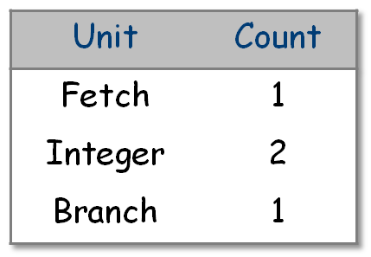
The Algorithm
Estimate ii based on lower bounds
Take max of resource constraint and slope constraint
Other constraints are possible (e.g., register demand )
Take largest lower bound as initial value for ii
For the example loop
Recurrences on r_{@a} & r_{c}
Note that the load latency did not play into lower bound on ii because it is not involved in the recurrence
(That will become clear when we look at the dependence graph…)
r_{c} ← 0
r_{@a} ← @a
r₁ ← n x 4
r_{ub} ← r₁ + r_{@a}
if r_{@a} > r_{ub} goto Exit
Loop: r_{a} ← MEM(r_{@a})
r_{c} ← r_{c} + r_{a}
r_{@a} ← r_{@a} + 4
if r_{@a} ≤ r_{ub} goto Loop
Exit: c ← r_{c}
⇒ ii = 2
⇒ ii = 1
So, ii = max(2,1) = 2
Comp 412, Fall 2010

Slide 21
The Algorithm
Choose an initiation interval, ii
  Compute lower bounds on ii
  Shorter ii means faster overall execution
Generate a loop body that takes ii cycles
  Try to schedule into ii cycles, using modulo scheduler
  If it fails, bump ii by one and try again
Generate the needed prologue & epilogue code
  For prologue, work backward from upward exposed uses in the schedulued loop body
  For epilogue, work forward from downward exposed definitions in the scheduled loop body
Comp 412, Fall 2010

Slide 22
The Example
1
2
3
r_{c} ← 0
r_{@a} ← @a
r₁ ← n x 4
r_{ub} ← r₁ + r_{@a}
if r_{@a} > r_{ub} goto Exit
Loop: r_{a} ← MEM(r_{@a})
r_{c} ← r_{c} + r_{a}
r_{@a} ← r_{@a} + 4
if r_{@a} ≤ r_{ub} goto Loop
Exit: c ← r_{c}
4
5
6
8
7
9
The Code
Its Dependence Graph
Focus on the loop body
Comp 412, Fall 2010
Op 6 is not involved in a cycle
*

Slide 23
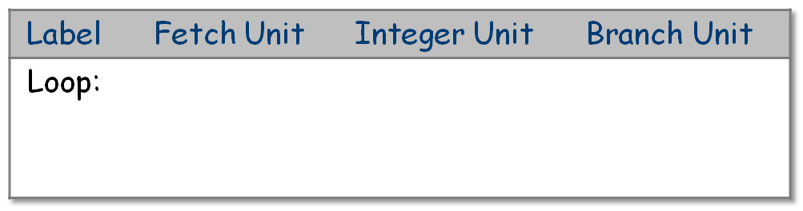
The Example
Focus on the loop body
6
8
7
9
ii = 2
Template for the Modulo Schedule
Comp 412, Fall 2010
*

Slide 24
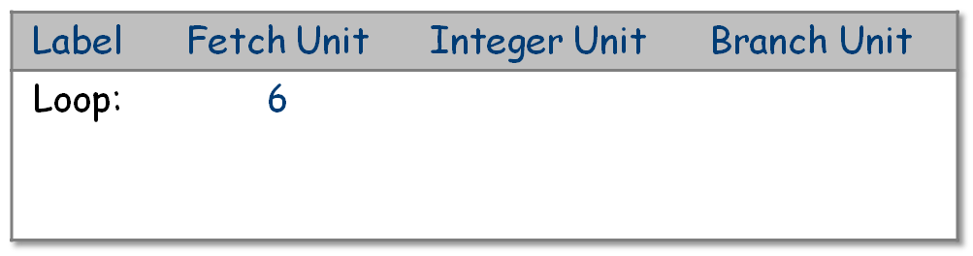
The Example
Focus on the loop body
Schedule 6 on the fetch unit
6
8
3
1
7
9
Simulated
clock
Comp 412, Fall 2010
*

Slide 25
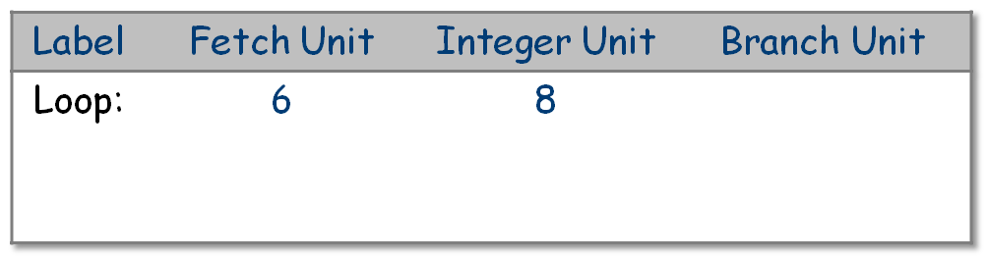
The Example
Focus on the loop body
Schedule 6 on the fetch unit
Schedule 8 on the integer unit
6
8
3
1
7
9
Simulated
clock
Comp 412, Fall 2010
*

Slide 26
The Example
Focus on the loop body
Schedule 6 on the fetch unit
Schedule 8 on the integer unit
Advance the scheduler’s clock
6
8
3
1
7
9
Simulated
clock
Comp 412, Fall 2010
*

Slide 27
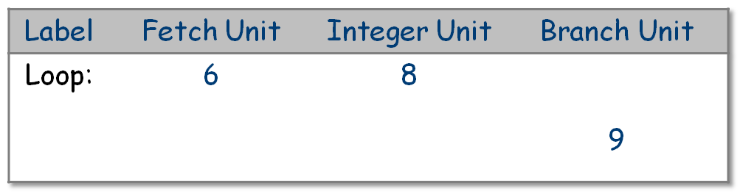
The Example
Focus on the loop body
Schedule 6 on the fetch unit
Schedule 8 on the integer unit
Advance the scheduler’s clock
Schedule 9 on the branch unit
6
8
3
1
7
9
Simulated
clock
Comp 412, Fall 2010
*

Slide 28
The Example
Focus on the loop body
Schedule 6 on the fetch unit
Schedule 8 on the integer unit
Advance the scheduler’s clock
Schedule 9 on the branch unit
Advance the clock (modulo ii)
6
8
3
1
7
9
Simulated
clock
Comp 412, Fall 2010
*

Slide 29
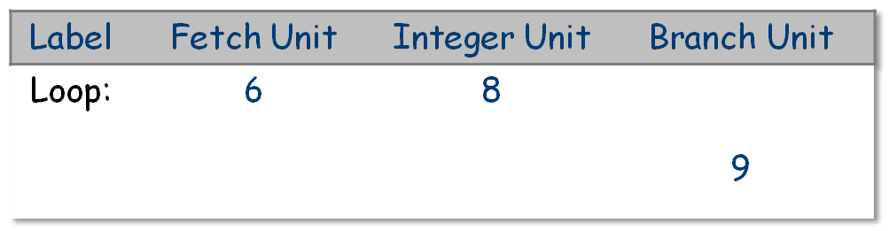
The Example
Focus on the loop body
•••
Advance the scheduler’s clock
Schedule 9 on the branch unit
Advance the clock (modulo ii)
Advance the clock again
6
8
3
1
7
9
Simulated
clock
Comp 412, Fall 2010
*

Slide 30
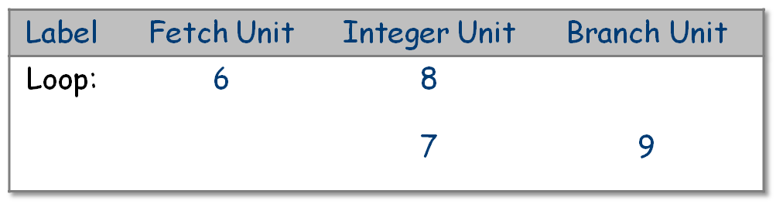
The Example
Focus on the loop body
•••
Schedule 9 on the branch unit
Advance the clock (modulo ii)
Advance the clock again
Schedule 7 on the integer unit
6
8
3
1
7
9
Simulated
clock
Comp 412, Fall 2010
*

Slide 31
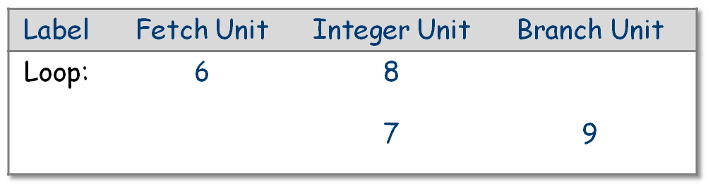
The Example
Focus on the loop body
•••
Advance the clock (modulo ii)
Advance the clock again
Schedule 7 on the integer unit
No unscheduled ops remain in loop body
6
8
3
1
7
9
Simulated
clock
The final schedule for the loop’s body
Comp 412, Fall 2010
*

Slide 32
The Algorithm
Choose an initiation interval, ii
  Compute lower bounds on ii
  Shorter ii means faster overall execution
Generate a loop body that takes ii cycles
  Try to schedule into ii cycles, using modulo scheduler
  If it fails, bump ii by one and try again
Generate the needed prologue & epilogue code
  For prologue, work backward from upward exposed uses in the schedulued loop body
  For epilogue, work forward from downward exposed definitions in the scheduled loop body
Comp 412, Fall 2010

Slide 33
The Example
Given the schedule for the loop kernel, generate the prologue and the epilogue. Can use forward and backward scheduling from the kernel…
6
8
7
9
Comp 412, Fall 2010

Slide 34
The Example
Given the schedule for the loop kernel, generate the prologue and the epilogue. Can use forward and backward scheduling from the kernel…
Need sources for 6, 7, 8, & 9
6
8
7
9
Comp 412, Fall 2010

Slide 35
The Example
Given the schedule for the loop kernel, generate the prologue and the epilogue. Can use forward and backward scheduling from the kernel…
Need sources for 6, 7, 8, & 9
Need sink for 6
6
8
7
9
No sink for 8 since 9 (conditional branch) does not occur in the epilogue …
Comp 412, Fall 2010
*

Slide 36

The Example: Final Schedule
Comp 412, Fall 2010

Slide 37
The Example: Final Schedule
What about the empty slots?
→ Fill them (if needed) in some other way (e.g., fuse loop with another loop that is memory bound?)
Comp 412, Fall 2010

Slide 38
But, Wasn’t This Example Too Simple?
Control flow in the loop causes problems
Lam suggests Hierarchical Reduction
  Schedule control-flow region separately
  Treat it as a superinstruction
  This strategy works, but may not produce satisfactory code
B₁
r₁ < r₂
Difference in path lengths makes the schedule unbalanced
If B₁,B₃,B₄ is the hot path, length of B₂ hurts execution
Overhead on the other path is lower (%)
Does it use predication? Branches?
  Code shape determines (partially) impact
B₂
op₁
op₂
op₃
op₄
B₃
op₅
B₄
Comp 412, Fall 2010

Slide 39
Wienskoski’s Plan
Control flow in the loop causes problems
Wienskoski used cloning to attack the problem
Extended the idea of fall-through branch optimization from the IBM PL.8 compiler
Comp 412, Fall 2010

Slide 40
Fall-through Branch Optimization
while
Some branches have inter-iteration locality
Taken this time makes taken next more likely
Clone to make FT case more likely
This version has FT for same condition, switches loops for change in expr
Hopkins suggests that it paid off in PL.8
Predication eliminates it completely
while ( … ) {
if ( expr )
then block 1
else block 2
}
if
(FT)
b₁
b₂
expr is FT case
Not expr is FT case
while
while
if
if
(FT)
(FT)
b₁
b₂
b₂
b₁
Comp 412, Fall 2010

Slide 41
Control Flow Inside Loops
Wienskoski’s Plan
Build superblocks, with distinct backward branches
Want to pipeline the separate paths
  (B₂,B_{3,}B₄,B₆), (B₂,B_{3,}B₅,B₆), (B₂,B₇)
B₁
B₁
B₂
B₂
B₃
B₇
B₃
B₇
B₄
B₅
B₄
B₅
B₆
B₆
B₆
Comp 412, Fall 2010

Slide 42
Control Flow Inside Loops
So, we clone even more aggressively
B₁
B₂
B₁
B₃
B₂
path
locality
B₇
B₃
B₇
B₄
B₅
B₆
B₆
B₂
B₄
B₅
B₆
B₆
B₂
B₂
B₃
B₃
Exit
Dashed line is unpredicted path
Dotted line is path to exit
Comp 412, Fall 2010

Slide 43
Control Flow Inside Loops
B₁
Cloning creates three distinct loops that can be pipelined
Dashed lines are transitions between pipelined loops
Insert compensation code, if needed, into those seven edges (split the edge)
Doubled the code size, before pipelining
Created the possibility for tight pipelined loops, if paths have locality
B₂
B₃
B₇
B₄
B₅
B₆
B₆
B₂
B₂
B₂
B₃
B₃
Exit
Comp 412, Fall 2010

Slide 44
Control Flow Inside Loops
Wienskoski used cloning to attack the problem
Extended the idea of fall-through branch optimization from the IBM PL.8 compiler
Worked well on paper; our MSCP compiler did not generate enough ILP to demonstrate its effectiveness
With extensive cloning, code size was a concern
Handling control-flow in pipelined loops is a problem where further research may pay off
(Wienskoski also proposed a register-pressure constraint to be used in conjunction with the resource constraint and the slope constraint)
STOP
Comp 412, Fall 2010

Slide 45
New Material for EaC 2e
Example from EaC 2e, § 12.5
Slides not yet complete
Comp 412, Fall 2010

Slide 46
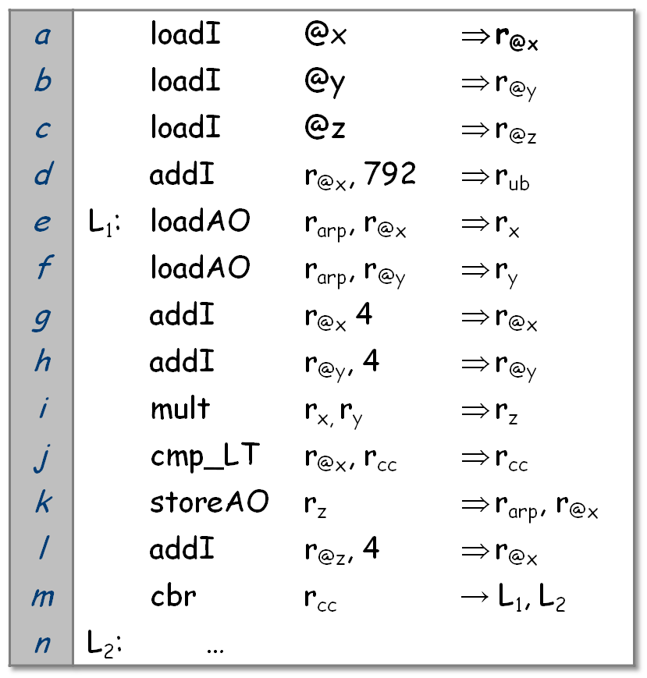
Loop Scheduling Example
Loop Scheduling Example from § 12.5 of EaC 2e (See Fig. 12.11)
a
b
c
d
g
h
l
j
e
f
l
i
m
k
Loop Body
Comp 412, Fall 2010
Dependence Graph

Slide 47
Antidependences in the Example Code
Antidependences restrict code placement
A→B implies B must execute before A
a
b
c
d
g
h
l
j
e
f
l
i
m
k
Loop Body
Comp 412, Fall 2010

Slide 48
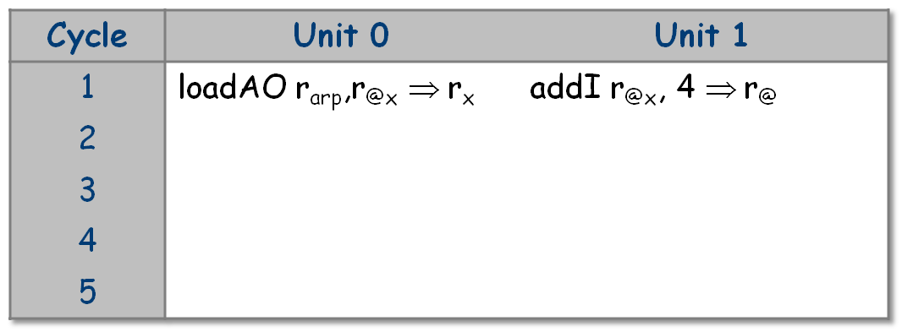
Initially, operations e & f are ready.
Break the tie in favor of original order (prefer r_{x})
Scheduling e satisfies antidependence to g with delay 0
Schedule it immediately (tweak to algorithm for delay 0)
Comp 412, Fall 2010

Slide 49
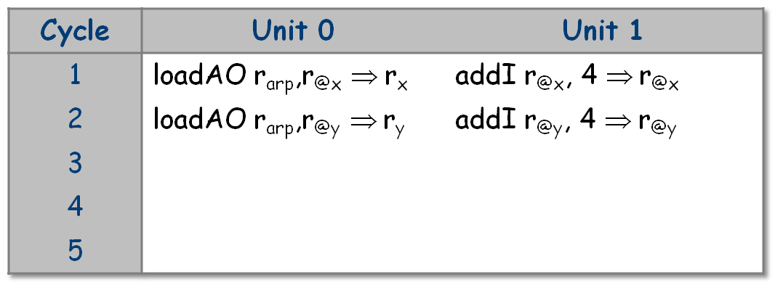
Now, f and j are ready.
Break the tie in favor of long latency op & schedule f
Scheduling f satisfies antidependence to h with delay 0
Schedule h immediately
Comp 412, Fall 2010

Slide 50
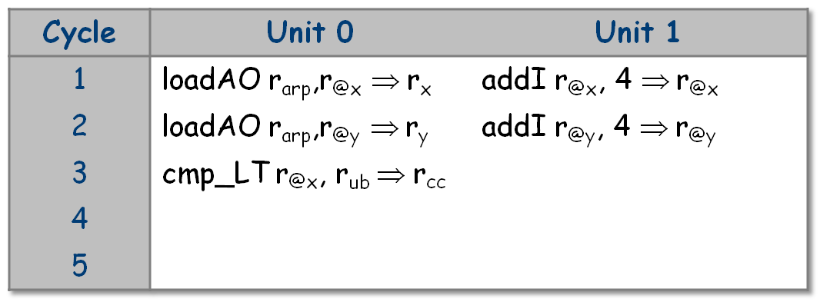
The only ready operation is j, so schedule it in cycle 3
That action makes operation m ready in cycle 4, but it cannot be scheduled until cycle 5 because of its block-ending constraint.
Comp 412, Fall 2010

Slide 51
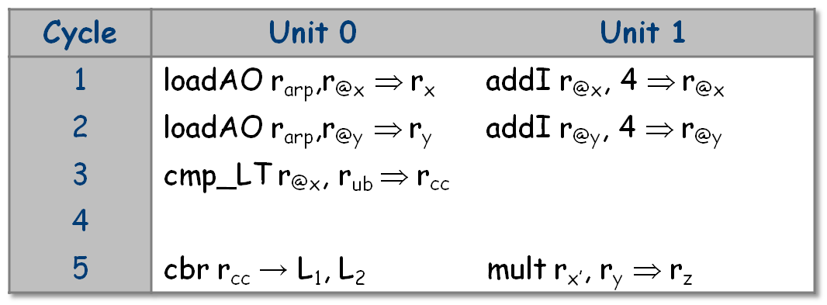
cbr is constrained so that S(cbr) + delay(cbr) = ii + 1
Both m and i are ready in cycle 5; we place them both.
Comp 412, Fall 2010

Slide 52
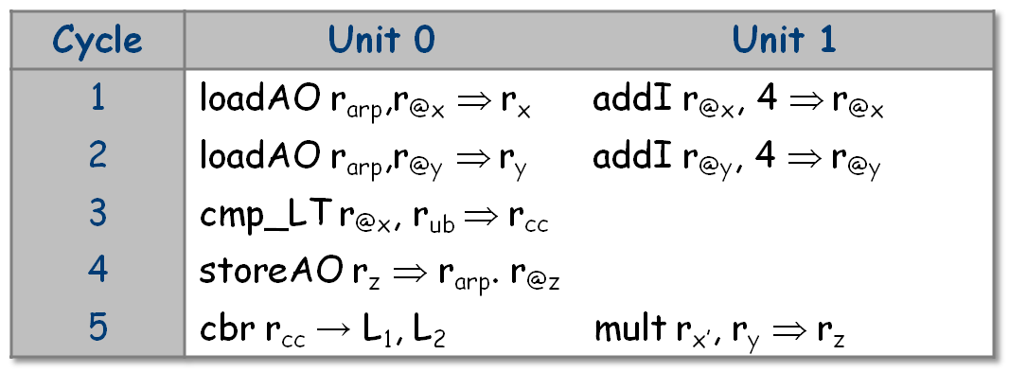
We bump along for several cycles looking for an issue slot on Unit 0 where we can schedule the storeAO in k.
Finally, in cycle 4, we can schedule operation k, the store
That frees operation l from the antidependence and we schedule it immediately into cycle 4.
Comp 412, Fall 2010

Slide 53
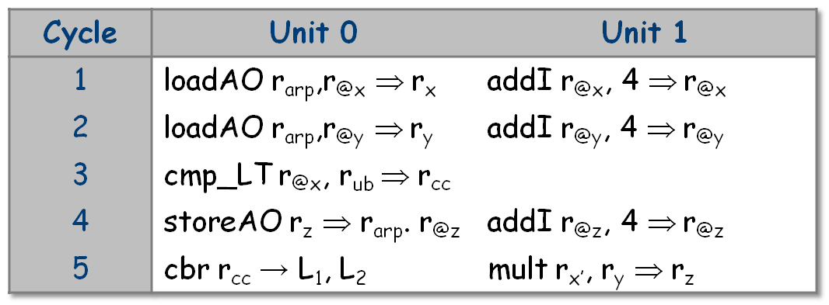
The algorithm runs for two more cycles, until the store comes off the active list. It has no uses, so it adds nothing to the ready list.
At this point, both Ready and Active are empty, so the algorithm halts.
Comp 412, Fall 2010

