Slide 1

Parsing Wrap Up
Comp 412
COMP 412
FALL 2010
Copyright 2010, Keith D. Cooper & Linda Torczon, all rights reserved.
Students enrolled in Comp 412 at Rice University have explicit permission to make copies of these materials for their personal use.
Faculty from other educational institutions may use these materials for nonprofit educational purposes, provided this copyright notice is preserved.

Slide 2
LR(k ) versus LL(k )
Finding the next step in a derivation
LR(k) ⇒ Each reduction in the parse is detectable with
the complete left context,
the reducible phrase, itself, and
the k terminal symbols to its right
LL(k) ⇒ Parser must select the expansion based on
The complete left context
The next k terminals
Thus, LR(k) examines more context
The question is, do languages fall in the gap between LR(k) and LL(k)?
generalizations of LR(1) and LL(1) to longer lookaheads
Comp 412, Fall 2010

Slide 3
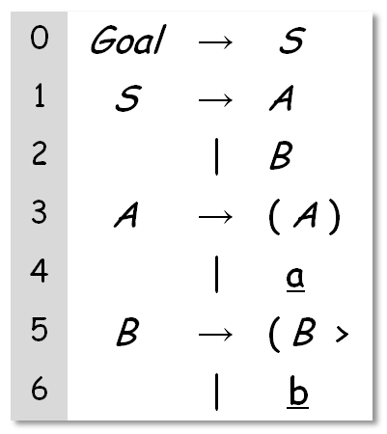
LR(1) versus LL(1)
Example due to Bill Waite, UC Boulder
The following LR(1) grammar has no LL(1) counterpart
The Canonical Collection has 18 sets of LR(1) Items
  It is not a simple grammar
  It is, however, LR(1)
It requires an arbitrary lookahead to choose between A & B
An LR(1) parser can carry the left context (the ‘(‘ s) until it sees a or b
The table construction will handle it
In contrast, an LL(1) parser cannot decide whether to expand Goal by A or B
  No amount of massaging the grammar will resolve this problem
More precisely, the language described by this LR(1) grammar cannot be described with an LL(1) grammar. In fact, the language has no LL(k) grammar, for finite k.
Comp 412, Fall 2010

Slide 4
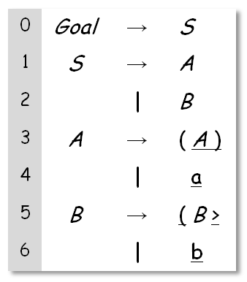
Building LR(1) Tables for Waite’s Language
The Canonical Collection of Sets of LR(1) Items
cc₀ | [Goal→•S, EOF], [S→•A, EOF], [S→•B, EOF] [A→•( A ), EOF], [A→•a, EOF], [B→•( B >, EOF], [B→•b, EOF],
cc₁ | [Goal→S •, EOF]
cc₂ | [S→A•,EOF]
cc₃ | [S→B•,EOF]
cc₄ | [A→ (• A ), )], [A→ (•A ), EOF], [A→•a, )], [B→• (B >, >], [B→ (• B >, EOF], [B→•b, >]
cc₅ | [A→a•, EOF]
cc₆ | [B→b•, EOF]
cc₇ | [A→ ( A • ), EOF]
cc₈ | [B→ ( B • >, EOF]
cc₄ is goto(cc₀, ( )
Comp 412, Fall 2010

Slide 5
Building LR(1) Tables for Waite’s Language
And, the rest of it …
cc₉ | [A→ ( • A ), )], [A→ (•A ), )], [A→•a, )], [B→• (B >, >], [B→ ( • B >, >], [B→•b, >]
cc₁₀ | [A→a•, )]
cc₁₁ | [B→b•, >]
cc₁₂ | [A→( A )•, EOF]
cc₁₃ | [B→ ( B >•, EOF]
cc₁₄ | [A→ (A •), )]
cc₁₅ | [B→ (B • >, >]
cc₁₆ | [A→ (A )•, )]
cc₁₇ | [B→ (B >•, >]
Comp 412, Fall 2010

Slide 6
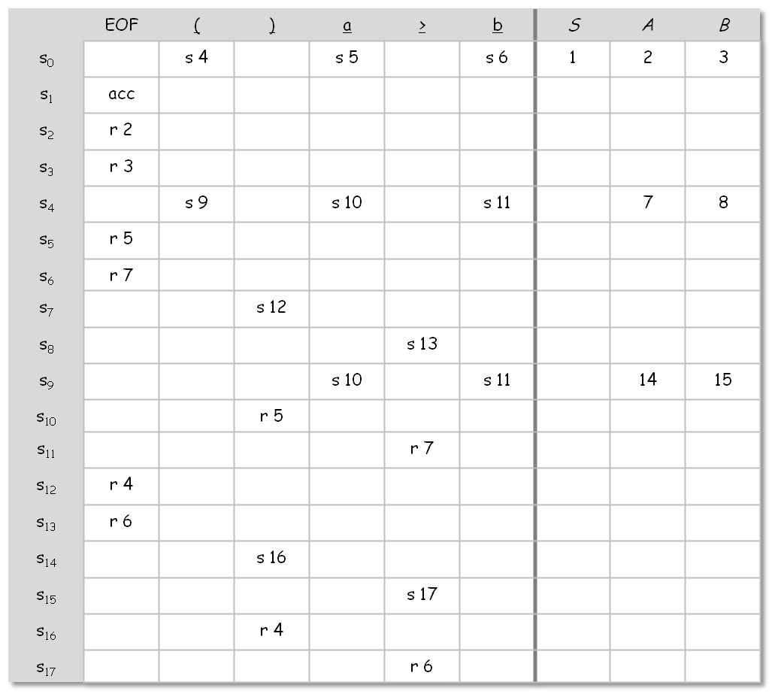
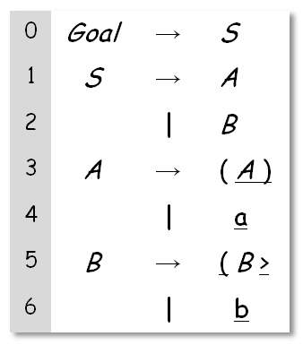
Building LR(1) Tables for Waite’s Language
Notice how sparse the table is.
- Goto has 7 of 54
- Action has 23 of
108
Notice rows & columns that might be combined.
Notice |CC| > |P|
Comp 412, Fall 2010

Slide 7
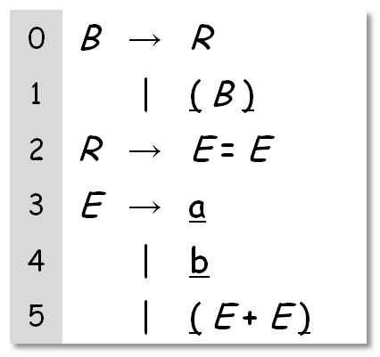
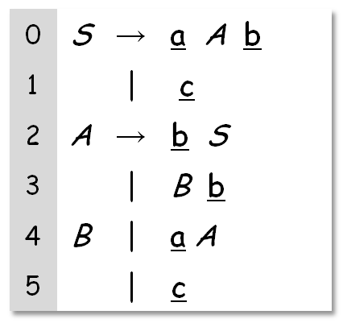
LR(k ) versus LL(k )
Other Non-LL Grammars
Example from D.E Knuth, “Top-Down Syntactic Analysis,” Acta Informatica, 1:2 (1971), pages 79-110
Example from Lewis, Rosenkrantz, & Stearns book, “Compiler Design Theory,” (1976), Figure 13.1
This grammar is actually LR(0)
Comp 412, Fall 2010

Slide 8
LR(k ) versus LL(k )
Finding the next step in a derivation
LR(k) ⇒ Each reduction in the parse is detectable with
the complete left context,
the reducible phrase, itself, and
the k terminal symbols to its right
LL(k) ⇒ Parser must select the expansion based on
The complete left context
The next k terminals
Thus, LR(k) examines more context
“… in practice, programming languages do not actually seem to fall in the gap between LL(1) languages and deterministic languages” J.J. Horning, “LR Grammars and Analysers”, in Compiler Construction, An Advanced Course, Springer-Verlag, 1976
generalizations of LR(1) and LL(1) to longer lookaheads
Comp 412, Fall 2010

Slide 9
Left Recursion versus Right Recursion
*
Right recursion
  Required for termination in top-down parsers
  Uses (on average) more stack space
  Naïve right recursion produces right-associativity
Left recursion
  Works fine in bottom-up parsers
  Limits required stack space
  Naïve left recursion produces left-associativity
Rule of thumb
  Left recursion for bottom-up parsers
  Right recursion for top-down parsers
*
w
*
x
z
y
w * ( x * ( y * z ) )
*
*
*
z
y
w
x
( (w * x ) * y ) * z
Comp 412, Fall 2010

Slide 10
Associativity
What difference does it make?
Can change answers in floating-point arithmetic
Can change opportunities for optimization
Consider x+y+z
  What if y+z occurs elsewhere? Or x+y? or x+z?
The compiler may want to change the “shape” of expressions
What if x = 2 & z = 17 ? Neither left nor right exposes 19.
Best shape is function of surrounding context
+
+
+
+
z
x
+
x
y
z
x
y
y
z
Ideal operator
Left association
Right association
Comp 412, Fall 2010

Slide 11
Error Detection and Recovery
Error Detection
Recursive descent
  Parser takes the last else clause in a routine
  Compiler writer can code almost any arbitrary action
Table-driven LL(1)
  In state s_{i} facing word x, entry is an error
  Report the error, valid entries in row for s_{i} encode possibilities
Table-driven LR(1)
  In state s_{i} facing word x, entry is an error
  Report the error, shift states in row encode possibilities
  Can precompute better messages from LR(1) items
Comp 412, Fall 2010

Slide 12
Error Detection and Recovery
Error Recovery
Table-driven LL(1)
  Treat as missing token, e.g. ‘)‘, ⇒ expand by desired symbol
  Treat as extra token, e.g., ‘x - + y’, ⇒ pop stack and move ahead
Table-driven LR(1)
  Treat as missing token, e.g. ‘)’, ⇒ shift the token
  Treat as extra token, e.g., ‘x - + y’, ⇒ don’t shift the token
Can pre-compute sets of states with appropriate entries…
Comp 412, Fall 2010

Slide 13
Error Detection and Recovery
One common strategy is “hard token” recovery
Skip ahead in input until we find some “hard” token, e.g. ‘;’
  ‘;’ separates statements, makes a logical break in the parse
  Resynchronize state, stack, and input to point after hard token
    LL(1): pop stack until we find a row with entry for ‘;’
    LR(1): pop stack until we find a state with a reduction on ‘;’
  Does not correct the input, rather it allows parse to proceed
NT ← pop()
repeat until Table[NT,’;’] ≠ error
NT ← pop()
token ← NextToken()
repeat until token = ‘;’
token ← NextToken()
repeat until token = ‘;’
shift token
shift s_{e}
token ← NextToken()
reduce by error production
// pops all that state off stack
Resynchronizing an LL(1) parser
Resynchronizing an LR(1) parser
Comp 412, Fall 2010

Slide 14
Shrinking the ACTION and GOTO Tables
Three options:
Combine terminals such as number & identifier, + & -, * & /
  Directly removes a column, may remove a row
  For expression grammar, 198 (vs. 384) table entries
Combine rows or columns
  Implement identical rows once & remap states
  Requires extra indirection on each lookup
  Use separate mapping for ACTION & for GOTO
Use another construction algorithm
  Both LALR(1) and SLR(1) produce smaller tables
    LALR(1) represents each state with its “core” items
    SLR(1) uses LR(0) items and the FOLLOW set
  Implementations are readily available
left-recursive expression grammar with precedence, see §3.7.2 in EAC
classic space-time tradeoff
Fewer grammars,
same languages
Comp 412, Fall 2010

Slide 15
Hierarchy of Context-Free Languages
Context-free languages
LR(k) ≡ LR(1)
Deterministic languages (LR(k))
LL(k) languages
Simple precedence
languages
LL(1) languages
Operator precedence
languages
The inclusion hierarchy for context-free languages
Comp 412, Fall 2010

Slide 16
Hierarchy of Context-Free Grammars
Context-free grammars
Floyd-Evans
Parsable
Unambiguous
CFGs
Operator
Precedence
LR(k)
LR(1)
LL(k)
Operator precedence includes some ambiguous grammars
Note sub-categories of LR(1)
LL(1) is a subset of SLR(1)
LALR(1)
SLR(1)
LL(1)
LR(0)
The inclusion hierarchy for
context-free grammars
Comp 412, Fall 2010

Slide 17
Summary
Advantages
Fast
Good locality
Simplicity
Good error detection
Fast
Deterministic langs.
Automatable
Left associativity
Disadvantages
Hand-coded
High maintenance
Right associativity
Large working sets
Poor error messages
Large table sizes
Top-down
Recursive
descent,
LL(1)
LR(1)
Comp 412, Fall 2010

Slide 18
Lab 2 Overview: An LL(1) Parser Generator
You will build a program to generate LL(1) parse tables
Input is a modified form of Backus-Naur Form (MBNF)
Output is a parse table and some auxiliary data structures
  Both a pretty (human-readable) version and the C declarations
You will write:
  A hand-coded scanner for MBNF
  A hand-coded, recursive descent parser for MBNF
  A table generator (First, Follow, First⁺ sets)
Interim deadlines to keep you on track
  Want you to make progress at a steady rate
Documents will be online by Monday, October 4, 2010
Skeleton parser ready in about a week, with its own docs
Comp 412, Fall 2010

Slide 19
Beyond Syntax
There is a level of correctness that is deeper than grammar
fie(a,b,c,d)
int a, b, c, d;
{ … }
fee() {
int f[3],g[0],
h, i, j, k;
char *p;
fie(h,i,“ab”,j, k);
k = f * i + j;
h = g[17];
printf(“<%s,%s>.\n”,
p,q);
p = 10;
}
What is wrong with this C program?
(let me count the ways …)
Comp 412, Fall 2010

Slide 20
Beyond Syntax
To generate code, we need to understand its meaning !
There is a level of correctness that is deeper than grammar
fie(a,b,c,d)
int a, b, c, d;
{ … }
fee() {
int f[3],g[0],
h, i, j, k;
char *p;
fie(h,i,“ab”,j, k);
k = f * i + j;
h = g[17];
printf(“<%s,%s>.\n”,
p,q);
p = 10;
}
What is wrong with this C program?
(let me count the ways …)
declared g[0], used g[17]
wrong number of args to fie()
“ab” is not an int
wrong dimension on use of f
undeclared variable q
10 is not a character string
All of these are “deeper than syntax”
Comp 412, Fall 2010

Slide 21
Beyond Syntax
To generate code, the compiler needs to answer many questions
Is “x” a scalar, an array, or a function? Is “x” declared?
Are there names that are not declared? Declared but not used?
Which declaration of “x” does each use reference?
Is the expression “x * y + z” type-consistent?
In “a[i,j,k]”, does a have three dimensions?
Where can “z” be stored? (register, local, global, heap, static)
In “f ← 15”, how should 15 be represented?
How many arguments does “fie()” take? What about “printf ()” ?
Does “*p” reference the result of a “malloc()” ?
Do “p” & “q” refer to the same memory location?
Is “x” defined before it is used?
These cannot be expressed in a CFG
Comp 412, Fall 2010

