Slide 1

Context-sensitive Analysis or
Semantic Elaboration
Comp 412
COMP 412
FALL 2010
Copyright 2010, Keith D. Cooper & Linda Torczon, all rights reserved.
Students enrolled in Comp 412 at Rice University have explicit permission to make copies of these materials for their personal use.
Faculty from other educational institutions may use these materials for nonprofit educational purposes, provided this copyright notice is preserved.

Slide 2
Beyond Syntax
There is a level of correctness that is deeper than grammar
To generate code, we need to understand its meaning !
fie(a,b,c,d) {
int a, b, c, d;
…
}
fee() {
int f[3],g[0], h, i, j, k;
char *p;
fie(h,i,“ab”,j, k);
k = f * i + j;
h = g[17];
printf(“<%s,%s>.\n”,p,q);
p = 10;
}
What is wrong with this program?
(let me count the ways …)
number of args to fie()
declared g[0], used g[17]
“ab” is not an int
wrong dimension on use of f
undeclared variable q
10 is not a character string
All of these are
“deeper than syntax”
Comp 412, Fall 2010

Slide 3
Beyond Syntax
To generate code, the compiler needs to answer many questions
Is “x” a scalar, an array, or a function? Is “x” declared?
Are there names that are not declared? Declared but not used?
Which declaration of “x” does a given use reference?
Is the expression “x * y + z” type-consistent?
In “a[i,j,k]”, does a have three dimensions?
Where can “z” be stored? (register, local, global, heap, static)
In “f ← 15”, how should 15 be represented?
How many arguments does “fie()” take? What about “printf ()” ?
Does “*p” reference the result of a “malloc()” ?
Do “p” & “q” refer to the same memory location?
Is “x” defined before it is used?
These are beyond the expressive power of a CFG
Comp 412, Fall 2010

Slide 4
Beyond Syntax
These questions are part of context-sensitive analysis
Answers depend on values, not parts of speech
Questions & answers involve non-local information
Answers may involve computation
How can we answer these questions?
Use formal methods
  Context-sensitive grammars?
  Attribute grammars? (attributed grammars?)
Use ad-hoc techniques
  Symbol tables
  Ad-hoc code (action routines)
In parsing, formalisms won.
In context-sensitive analysis, ad-hoc techniques dominate practice.
Comp 412, Fall 2010

Slide 5
Beyond Syntax
Telling the story
We will study the formalism — an attribute grammar
  Clarify many issues in a succinct and immediate way
  Separate analysis problems from their implementations
We will see that the problems with attribute grammars motivate actual, ad-hoc practice
  Non-local computation
  Need for centralized information
Some folks still argue for attribute grammars
  Knowledge is power
  Information is immunization
We will cover attribute grammars, then move on to ad-hoc ideas
Comp 412, Fall 2010

Slide 6
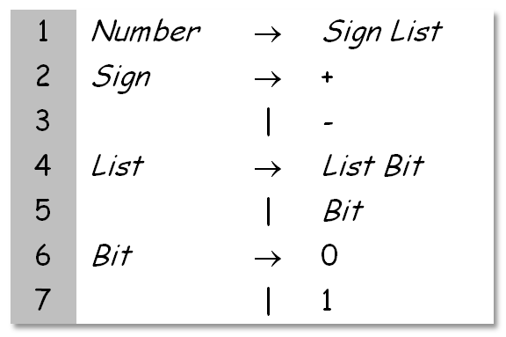
Attribute Grammars
What is an attribute grammar?
A context-free grammar augmented with a set of rules
Each symbol in the derivation (or parse tree) has a set of named values, or attributes
The rules specify how to compute a value for each attribute
  Attribution rules are functional; they uniquely define the value
Example grammar
This grammar describes signed binary numbers
We would like to augment it with rules that compute the decimal value of each valid input string
Comp 412, Fall 2010

Slide 7
Examples
Number → Sign List
→ Sign Bit
→ Sign 1
→ – 1
For “–1”
For “–101”
Number → Sign List
→ Sign List Bit
→ Sign List 1
→ Sign List Bit 1
→ Sign List 0 1
→ Sign Bit 0 1
→ Sign 1 0 1
→ – 101
Number
Sign
List
Number
–
List
Bit
List
Bit
1
Sign
List
Bit
0
–
Bit
1
1
We will use these two examples throughout the lecture
Comp 412, Fall 2010

Slide 8
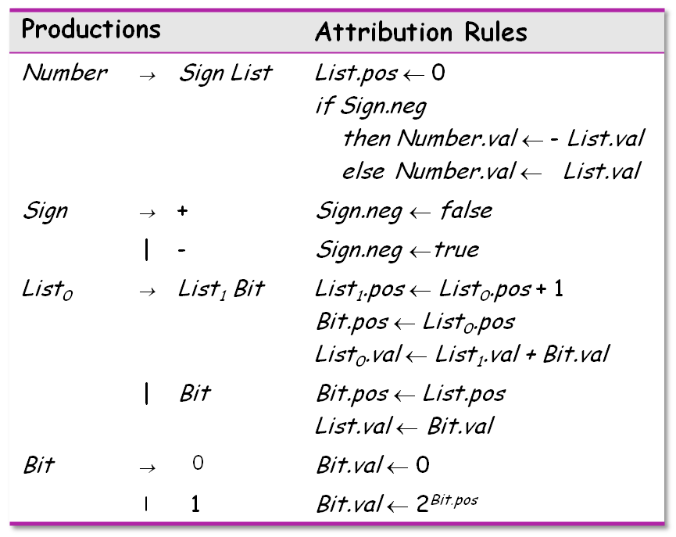
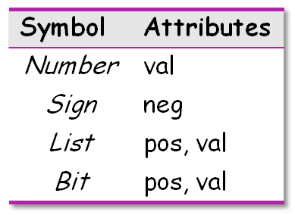
Attribute Grammars
Add rules to compute the decimal value of a signed binary number
Comp 412, Fall 2010

Slide 9
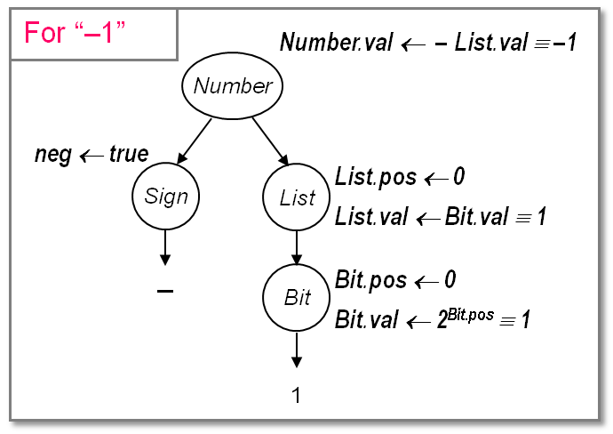
Back to the Examples
Rules + parse tree imply an attribute dependence graph
One possible evaluation order:
  List.pos
  Sign.neg
  Bit.pos
  Bit.val
  List.val
  Number.val
Other orders are possible
Knuth suggested a data-flow model for evaluation
Independent attributes first
Others in order as input values become available
Evaluation order must be consistent with the attribute dependence graph
Comp 412, Fall 2010

Slide 10
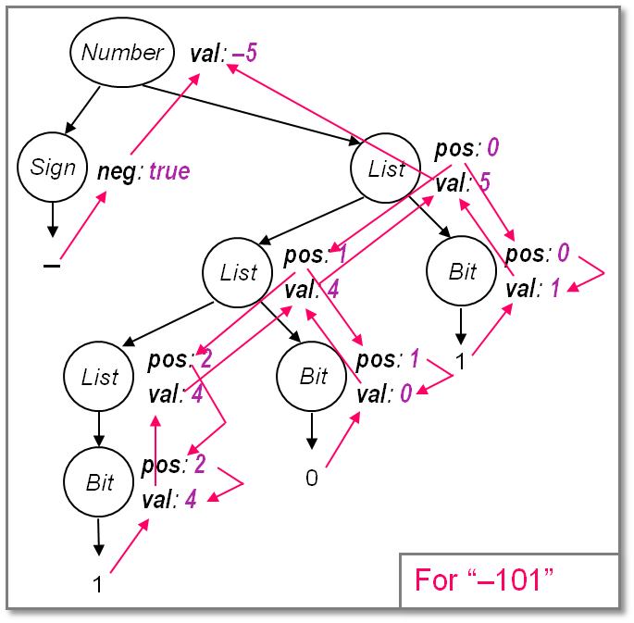
Back to the Examples
This is the complete attribute dependence graph for “–101”.
It shows the flow of all attribute values in the example.
Some flow downward
→ inherited attributes
Some flow upward
→ synthesized attributes
A rule may use attributes in the parent, children, or siblings of a node
Comp 412, Fall 2010

Slide 11
The Rules of the Game
Attributes associated with nodes in parse tree
Rules are value assignments associated with productions
Attribute is defined once, using local information
Label identical terms in production for uniqueness
Rules & parse tree define an attribute dependence graph
  Graph must be non-circular
This produces a high-level, functional specification
Synthesized attribute
  Depends on values from children
Inherited attribute
  Depends on values from siblings & parent
N.B.: AG is a specification for the computation, not an algorithm
Comp 412, Fall 2010
Notes:
AG is a specification for the computation, in the same way that a CFG is a specification for a parser.

Slide 12
Using Attribute Grammars
Attribute grammars can specify context-sensitive actions
Take values from syntax
Perform computations with values
Insert tests, logic, …
We want to use both kinds of attributes
Synthesized Attributes
Use values from children
& from constants
S-attributed grammars
Evaluate in a single
bottom-up pass
Good match to LR parsing
Inherited Attributes
Use values from parent,
constants, & siblings
Directly express context
Can rewrite to avoid them
Thought to be more natural
Not easily done at parse time
Comp 412, Fall 2010

Slide 13
Evaluation Methods
Dynamic, dependence-based methods
Build the parse tree
Build the dependence graph
Topological sort the dependence graph
Define attributes in topological order
Rule-based methods (treewalk)
Analyze rules at compiler-generation time
Determine a fixed (static) ordering
Evaluate nodes in that order
Oblivious methods (passes, dataflow)
Ignore rules & parse tree
Pick a convenient order (at design time) & use it
Comp 412, Fall 2010

Slide 14
Back to the Example
Number
Syntax Tree
Sign
List
–
List
Bit
List
Bit
1
Bit
0
1
For “–101”
Comp 412, Fall 2010

Slide 15
Back to the Example
Number
val: –5
Attributed Syntax Tree
Sign
List
pos: 0
val: 5
neg: true
–
List
pos: 1
val: 4
Bit
pos: 0
val: 1
pos: 2
val: 4
pos: 1
val: 0
List
Bit
1
Bit
pos: 2
val: 4
0
1
For “–101”
Comp 412, Fall 2010

Slide 16
Back to the Example
Number
val: –5
Inherited Attributes
Sign
List
pos: 0
val: 5
neg: true
–
List
pos: 1
val: 4
Bit
pos: 0
val: 1
pos: 2
val: 4
pos: 1
val: 0
List
Bit
1
Bit
pos: 2
val: 4
0
1
For “–101”
Comp 412, Fall 2010

Slide 17
Back to the Example
Number
val: –5
Synthesized attributes
Sign
List
pos: 0
val: 5
neg: true
–
List
pos: 1
val: 4
Bit
pos: 0
val: 1
pos: 2
val: 4
pos: 1
val: 0
List
Bit
1
Bit
pos: 2
val: 4
0
1
For “–101”
Val draws from children & the same node.
Comp 412, Fall 2010

Slide 18
Back to the Example
Number
val: –5
More Synthesized attributes
Sign
List
pos: 0
val: 5
neg: true
–
List
pos: 1
val: 4
Bit
pos: 0
val: 1
pos: 2
val: 4
pos: 1
val: 0
List
Bit
1
Bit
pos: 2
val: 4
0
1
For “–101”
Comp 412, Fall 2010

Slide 19
Back to the Example
Number
val: –5
If we show the computation ...
Sign
List
pos: 0
val: 5
neg: true
& then peel away the parse tree ...
–
List
pos: 1
val: 4
Bit
pos: 0
val: 1
pos: 2
val: 4
pos: 1
val: 0
List
Bit
1
Bit
pos: 2
val: 4
0
1
For “–101”
Comp 412, Fall 2010

Slide 20
Back to the Example
All that is left is the attribute dependence graph.
This succinctly represents the flow of values in the problem instance.
The dynamic methods sort this graph to find independent values, then work along graph edges.
The rule-based methods try to discover “good” orders by analyzing the rules.
The oblivious methods ignore the structure of this graph.
val: –5
pos: 0
val: 5
neg: true
–
pos: 1
val: 4
pos: 0
val: 1
pos: 2
val: 4
pos: 1
val: 0
1
pos: 2
val: 4
0
1
For “–101”
The dependence graph must be acyclic
Comp 412, Fall 2010

Slide 21
Circularity
We can only evaluate acyclic instances
General circularity testing problem is inherently exponential!
We can prove that some grammars can only generate instances with acyclic dependence graphs
  Largest such class is “strongly non-circular” grammars (SNC )
  SNC grammars can be tested in polynomial time
  Failing the SNC test is not conclusive
Many evaluation methods discover circularity dynamically
⇒ Bad property for a compiler to have
Comp 412, Fall 2010
SNC comes from Kennedy & Warren, POPL 1976

Slide 22
A Circular Attribute Grammar
Productions |  |  | Attribution Rules
Number | → | List | List.a ← 0
List₀ | → | List₁ Bit | List₁.a ← List₀.a + 1 List₀.b ← List₁.b List₁.c ← List₁.b + Bit.val
 | | | Bit | List₀.b ← List₀.a + List₀.c + Bit.val
Bit | → | 0 | Bit.val ← 0
 | | | 1 | Bit.val ← 1
Remember, the circularity is in the attribution rules, not the underlying CFG
Comp 412, Fall 2010
Notes:
In the interest of time, skip over the example. It is in the published notes.

Slide 23
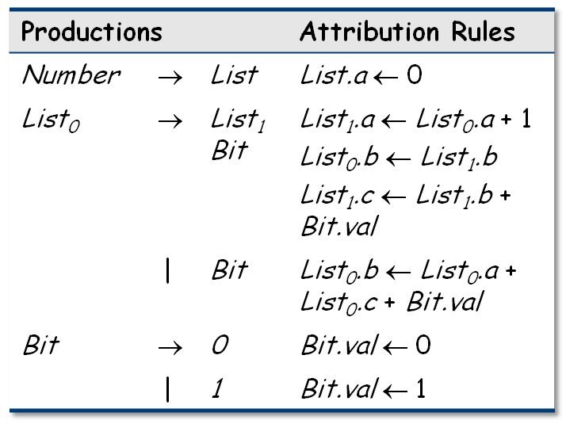
Circular Grammar Example
Number
a: 0
b:
c:
Sign
a:
b:
c:
List
–
a:
b:
c:
List
Bit
val:
List
Bit
1
val:
Bit
0
val:
1
For “–101”
Comp 412, Fall 2010

Slide 24
Circular Grammar Example
Number
a: 0
b:
c:
Sign
a:
b:
c:
List
–
a:
b:
c:
List
Bit
val:
List
Bit
1
val:
Bit
0
val:
1
For “–101”
Comp 412, Fall 2010

Slide 25

Circular Grammar Example
Number
a: 0
b:
c:
Sign
a:
b:
c:
List
–
a:
b:
c:
List
Bit
val:
List
Bit
1
val:
Bit
0
val:
1
Comp 412, Fall 2010

Slide 26

Circular Grammar Example
Number
a: 0
b:
c:
Sign
a:
b:
c:
List
–
a:
b:
c:
List
Bit
val:
List
Bit
1
val:
Bit
0
val:
1
Comp 412, Fall 2010

Slide 27
Circular Grammar Example
Number
a: 0
b:
c:
Sign
a:
b:
c:
List
–
a:
b:
c:
List
Bit
val:
List
Bit
1
val:
Bit
0
val:
1
Here is the circularity …
Comp 412, Fall 2010

Slide 28
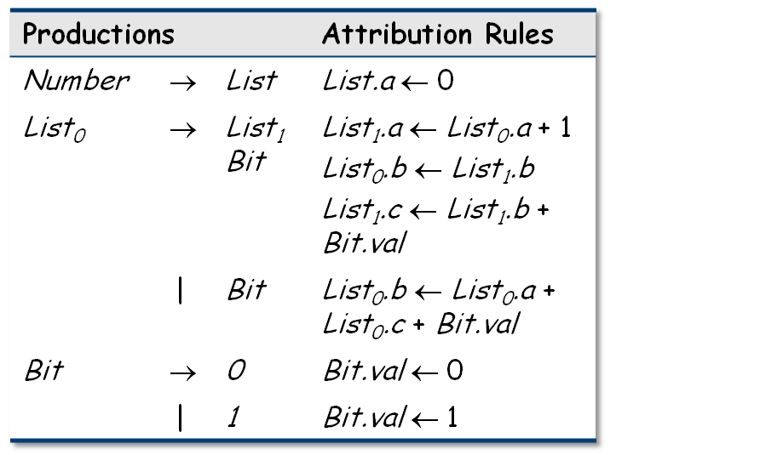
Circular Grammar Example
Number
a: 0
b:
c:
Sign
a:
b:
c:
List
–
a:
b:
c:
List
Bit
val:
List
Bit
1
val:
Bit
0
val:
1
Here is the circularity …
Comp 412, Fall 2010

Slide 29
Circularity — The Point
Circular grammars have indeterminate values
  Algorithmic evaluators will fail
Noncircular grammars evaluate to a unique set of values
Circular grammar might give rise to noncircular instance
  Probably shouldn’t bet the compiler on it …
Should (undoubtedly) use provably noncircular grammars
Remember, we are studying AGs to gain insight
We should avoid circular, indeterminate computations
If we stick to provably noncircular schemes, evaluation should be easier
Comp 412, Fall 2010

Slide 30
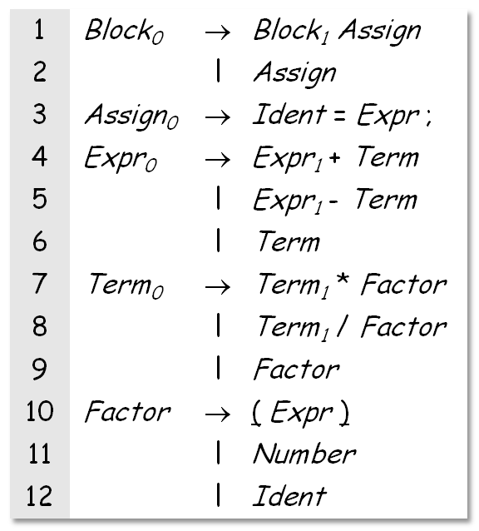
An Extended Attribute Grammar Example
Grammar for a basic block (§ 4.3.3)
Let’s estimate cycle counts
Each operation has a COST
Add them, bottom up
Assume a load per value
Assume no reuse
Simple problem for an AG
Hey, that is a practical application!
Comp 412, Fall 2010

Slide 31
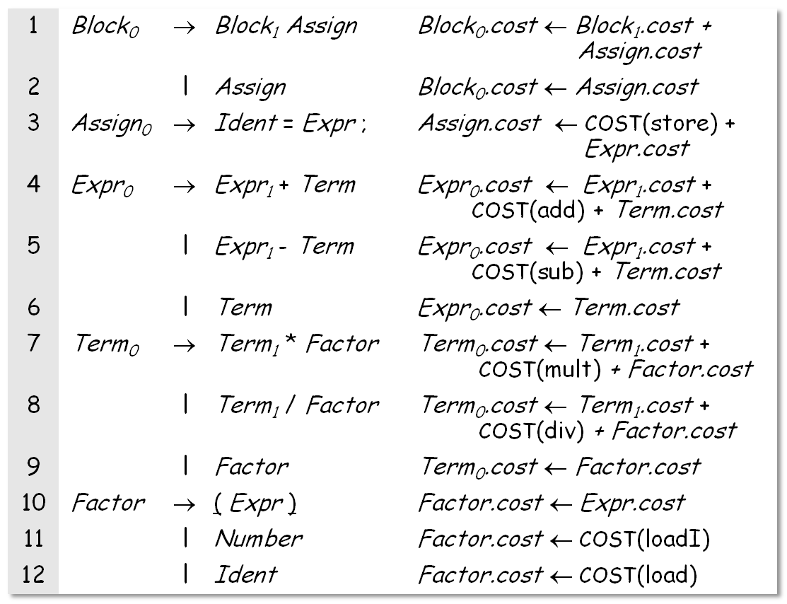
An Extended Example (continued)
These are all synthesized attributes !
Values flow from rhs to lhs in prod’ns
Comp 412, Fall 2010

Slide 32
An Extended Example (continued)
Properties of the example grammar
All attributes are synthesized ⇒ S-attributed grammar
Rules can be evaluated bottom-up in a single pass
  Good fit to bottom-up, shift/reduce parser
Easily understood solution
Seems to fit the problem well
What about an improvement?
Values are loaded only once per block (not at each use)
Need to track which values have been already loaded
Comp 412, Fall 2010

Slide 33
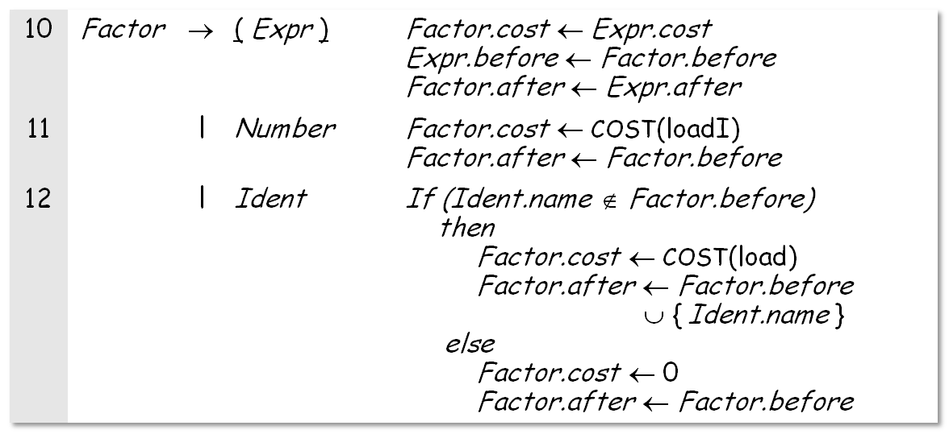
A Better Execution Model
Adding load tracking
Need sets Before and After for each production
Must be initialized, updated, and passed around the tree
This version is much more complex
Comp 412, Fall 2010

Slide 34
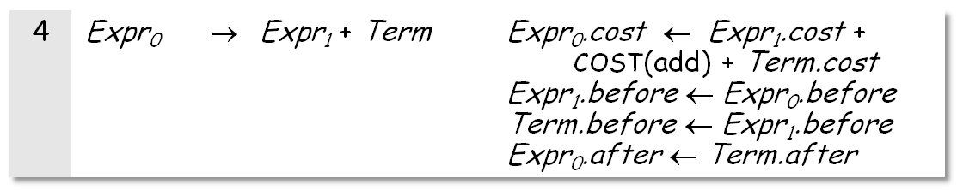
A Better Execution Model
Load tracking adds complexity
But, most of it is in the “copy rules”
Every production needs rules to copy Before & After
A sample production
These copy rules multiply rapidly
Each creates an instance of the set
Lots of work, lots of space, lots of rules to write
Comp 412, Fall 2010

Slide 35
An Even Better Model
What about accounting for finite register sets?
Before & After must be of limited size
Adds complexity to Factor→Identifier
Requires more complex initialization
Jump from tracking loads to tracking registers is small
Copy rules are already in place
Some local code to perform the allocation
Comp 412, Fall 2010

Slide 36
And Its Extensions
Tracking loads
Introduced Before and After sets to record loads
Added ≥ 2 copy rules per production
  Serialized evaluation into execution order
Made the whole attribute grammar large & cumbersome
Finite register set
Complicated one production (Factor → Identifier)
Needed a little fancier initialization
Changes were quite limited
Why is one change hard and the other easy?
Comp 412, Fall 2010

Slide 37
The Moral of the Story
Non-local computation needed lots of supporting rules
Complex local computation was relatively easy
The Problems
Copy rules increase cognitive overhead
Copy rules increase space requirements
  Need copies of attributes
  Can use pointers, for even more cognitive overhead
Result is an attributed tree (somewhat subtle points)
  Must build the parse tree
  Either search tree for answers or copy them to the root
A good rule of thumb is that the compiler touches all the space it allocates, usually multiple times
Comp 412, Fall 2010

