Slide 1

Context-sensitive Analysis, Part II
From AGs to ad-hoc methods
Comp 412
COMP 412
FALL 2010
Copyright 2010, Keith D. Cooper & Linda Torczon, all rights reserved.
Students enrolled in Comp 412 at Rice University have explicit permission to make copies of these materials for their personal use.
Faculty from other educational institutions may use these materials for nonprofit educational purposes, provided this copyright notice is preserved.

Slide 2
Discussion
Dates for the Midterm
Dates for the Lab
October 2010
Sunday | Monday | Tuesday | Wednesday | Thursday | Friday | Saturday
3 | 4 | 5 | 6 | 7 | 8 | 9
10 | 11 | 12 | 13 | 14 | 15 | 16
17 | 18 | 19 | 20 | 21 | 22 | 23
34 | 25 | 26 | 27 | 28 | 29 | 30
31 | 1 | 2 | 3 | 4 | 5 | 6
You are here
Scanner & Parser due
Lab 2 due
(Table gen.)
Comp 412, Fall 2010

Slide 3
The Moral of the Story
Non-local computation needed lots of supporting rules
Complex local computation was relatively easy
The Problems
Copy rules increase cognitive overhead
Copy rules increase space requirements
  Need copies of attributes
  Can use pointers, for even more cognitive overhead
Result is an attributed tree (somewhat subtle points)
  Must build the parse tree
  Either search tree for answers or copy them to the root
A good rule of thumb is that the compiler touches all the space it allocates, usually multiple times
Comp 412, Fall 2010

Slide 4
Addressing the Problem
If you gave the problem of estimating cycle counts to a competent junior or senior CS major, …
Introduce a central repository for facts
Table of names
  Field in table for loaded/not loaded state
Avoids all the copy rules, allocation & storage headaches
All inter-assignment attribute flow is through table
  Clean, efficient implementation
  Good techniques for implementing the table (hashing, § B.3)
  When it is done, information is in the table !
  Cures most of the problems
Unfortunately, this design violates the functional paradigm of an AG.
Do we care?
Comp 412, Fall 2010

Slide 5
The Realist’s Alternative
Ad-hoc syntax-directed translation
Build on bottom-up, shift-reduce parser
Associate a snippet of code with each production
At each reduction, the corresponding snippet runs
Allowing arbitrary code provides complete flexibility
  Includes ability to do tasteless & bad things
To make this work
Need names for attributes of each symbol on lhs & rhs
  Typically, one attribute passed through parser + arbitrary code (structures, globals, statics, …)
  Yacc introduced $$, $1, $2, … $n, left to right
Need an evaluation scheme
  Fits nicely into LR(1) parsing algorithm
Similar ideas work for top-down parsers…
Comp 412, Fall 2010

Slide 6
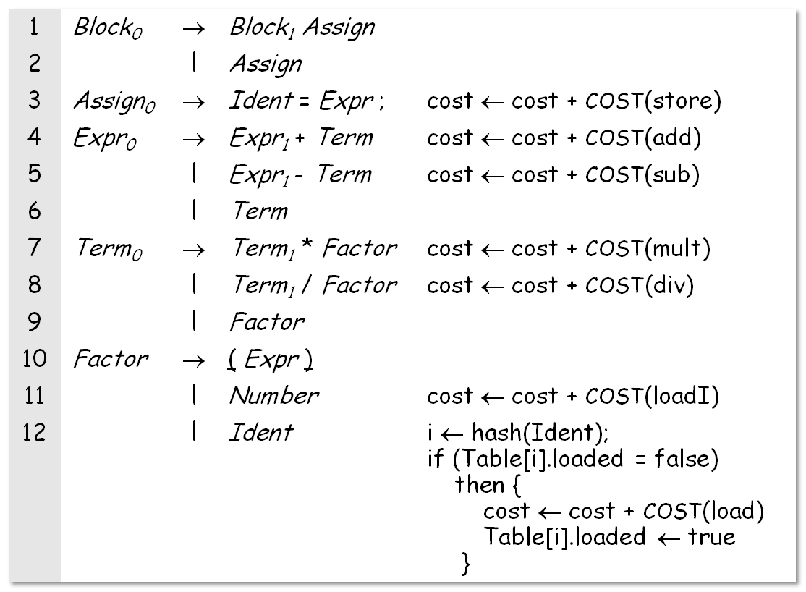
Reworking the Example (with load tracking)
This looks cleaner & simpler than the AG sol’n !
One missing detail: initializing cost
Comp 412, Fall 2010

Slide 7
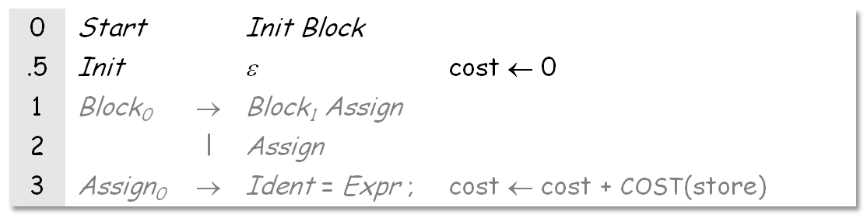
Reworking the Example (with load tracking)
and so on as shown on previous slide…
Before parser can reach Block, it must reduce Init
Reduction by Init sets cost to zero
We split the production to create a reduction in the middle — for the sole purpose of hanging an action there. This trick has many uses.
Comp 412, Fall 2010

Slide 8
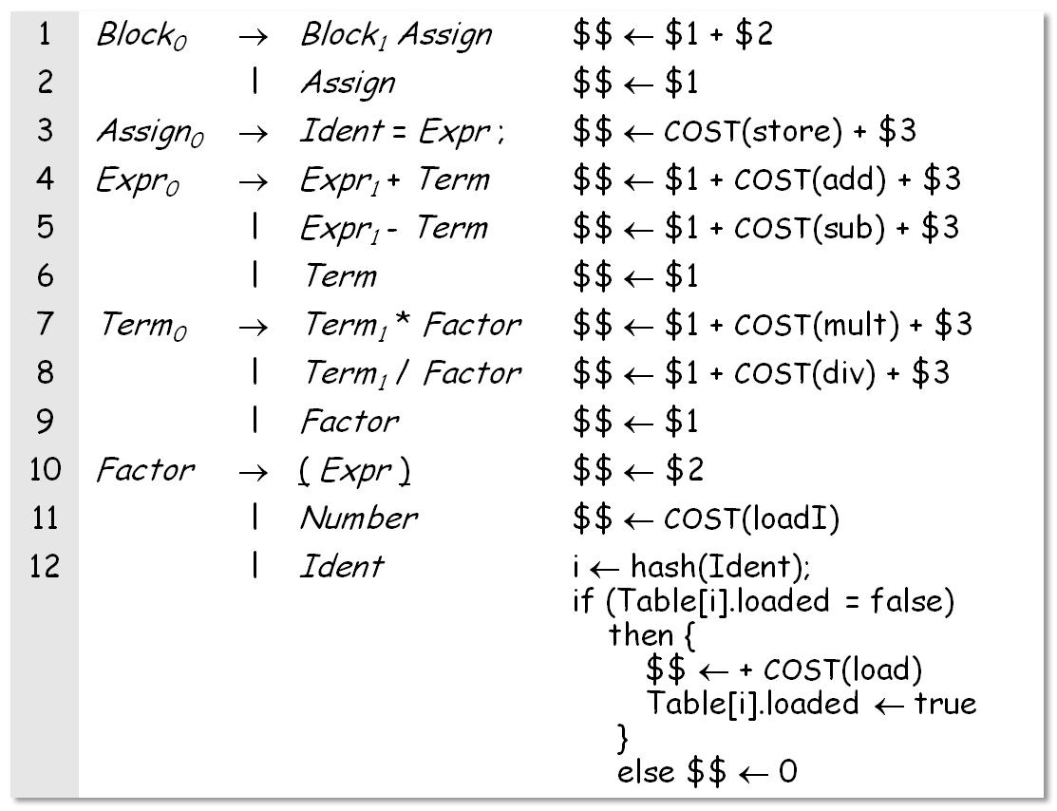
Reworking the Example (with load tracking)
This version passes the values through attributes. It avoids the need to initialize “cost”
Comp 412, Fall 2010

Slide 9
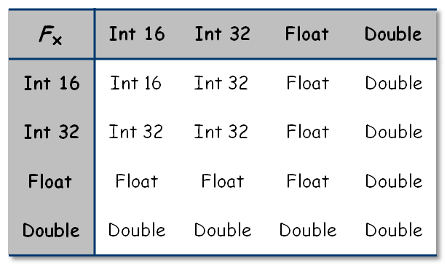
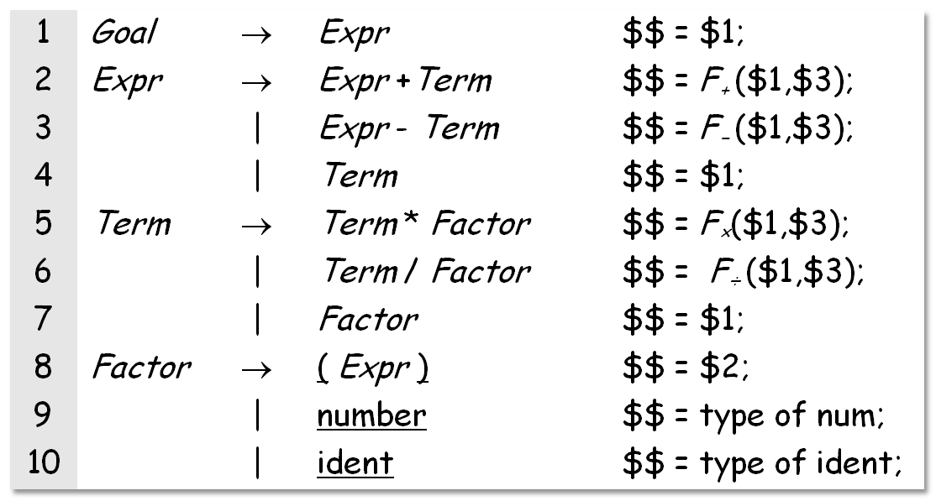
Example — Assigning Types in
Expression Nodes
Assume typing functions or tables
F₊, F₋, F×, and F÷
Comp 412, Fall 2010

Slide 10
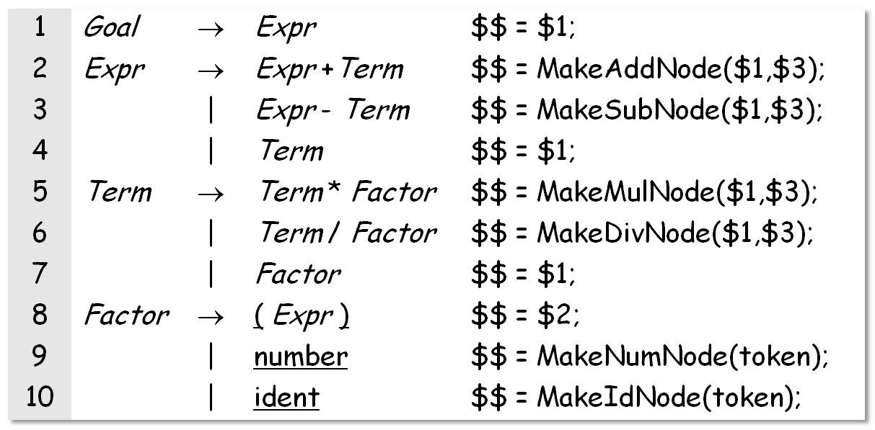
Example — Building an Abstract Syntax Tree
Assume constructors for each node
Assume stack holds pointers to nodes
Assume yacc syntax
Comp 412, Fall 2010

Slide 11
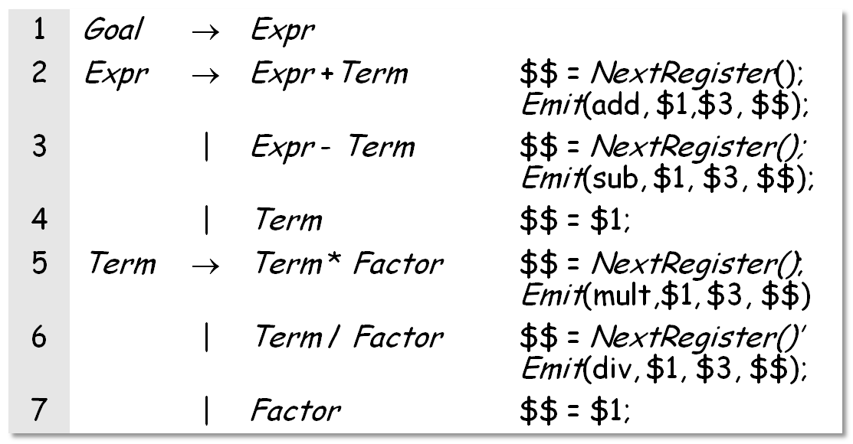
Example — Emitting ILOC
Assume NextRegister() returns a virtual register name
Assume Emit() can format assembly code
Comp 412, Fall 2010

Slide 12
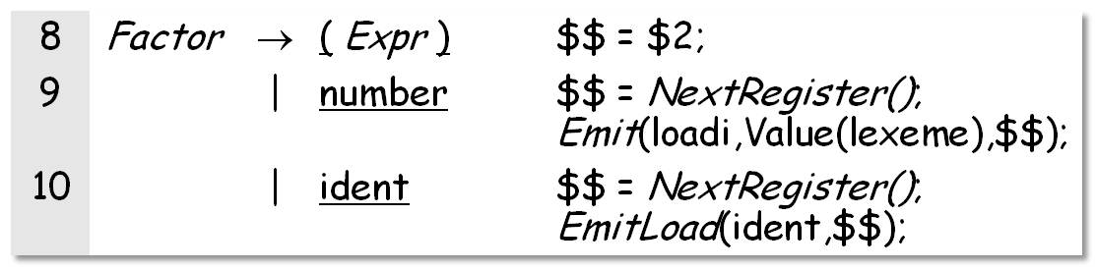
Example — Emitting ILOC
Assume NextRegister() returns a virtual register name
Assume Emit() can format assembly code
Assume EmitLoad() handles addressability & gets a value into a register
Comp 412, Fall 2010

Slide 13
Reality
Most parsers are based on this ad-hoc style of context-sensitive analysis
Advantages
Addresses the shortcomings of the AG paradigm
Efficient, flexible
Disadvantages
Must write the code with little assistance
Programmer deals directly with the details
Most parser generators support a yacc-like notation
Comp 412, Fall 2010

Slide 14
Typical Uses
Building a symbol table
  Enter declaration information as processed
  At end of declaration syntax, do some post processing
  Use table to check errors as parsing progresses
Simple error checking/type checking
  Define before use → lookup on reference
  Dimension, type, ... → check as encountered
  Type conformability of expression → bottom-up walk
  Procedure interfaces are harder
    Build a representation for parameter list & types
    Create list of sites to check
    Check offline, or handle the cases for arbitrary orderings
assumes table is global
Comp 412, Fall 2010

Slide 15
Is This Really “Ad-hoc” ?
Relationship between practice and attribute grammars
Similarities
Both rules & actions associated with productions
Application order determined by tools, not author
(Somewhat) abstract names for symbols
Differences
Actions applied as a unit; not true for AG rules
Anything goes in ad-hoc actions; AG rules are functional
AG rules are higher level than ad-hoc actions
Comp 412, Fall 2010

Slide 16
Limitations
Forced to evaluate in a given order: postorder
  Left to right only
  Bottom up only
Implications
  Declarations before uses
  Context information cannot be passed down
    How do you know what rule you are called from within?
    Example: cannot pass bit position from right down
  Could you use globals?
    Requires initialization & some re-thinking of the solution
  Can we rewrite it in a form that is better for the ad-hoc sol’n
Comp 412, Fall 2010

Slide 17
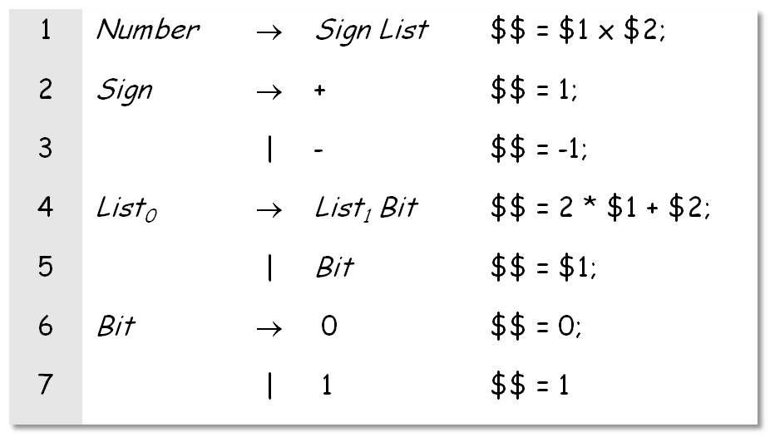
Limitations
Can often rewrite the problem to fit S-attributed model
The key step
Of course, you can rewrite the AG in this same S-attributed style
Comp 412, Fall 2010

Slide 18
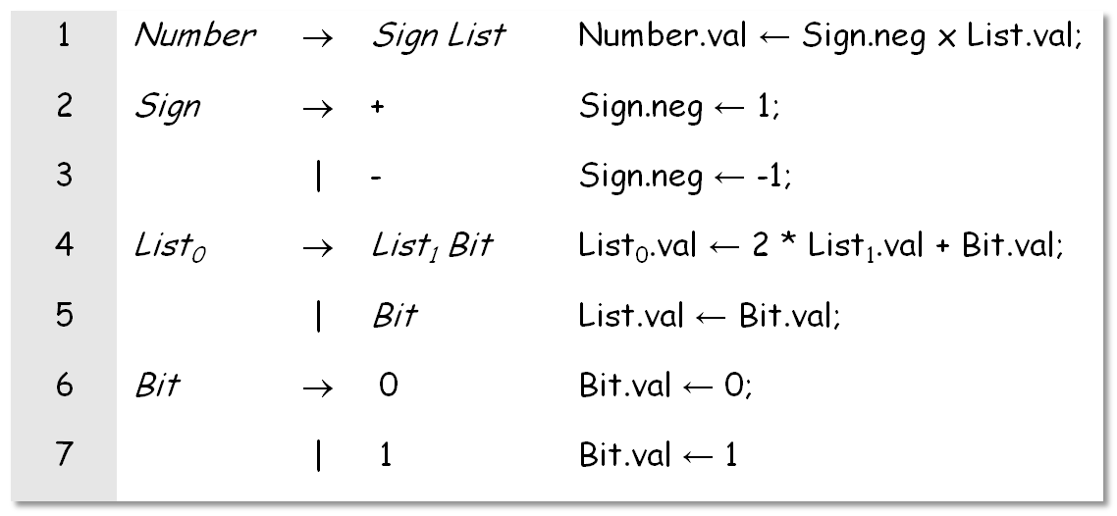
Limitations
Of course, the same scheme works in an attribute grammar
We picked the original attribution rules to highlight features of attribute grammars, rather than to show you the most efficient way to compute the answer!
Comp 412, Fall 2010

Slide 19
Making Ad-hoc SDT Work
How do we fit this into an LR(1) parser?
stack.push(INVALID);
stack.push(s₀); // initial state
token = scanner.next_token();
loop forever {
s = stack.top();
if ( ACTION[s,token] == “reduce A→β” ) then {
stack.popnum(2*|β|); // pop 2*|β| symbols
s = stack.top();
stack.push(A); // push A
stack.push(GOTO[s,A]); // push next state
}
else if ( ACTION[s,token] == “shift s_{i}” ) then {
stack.push(token); stack.push(s_{i});
token ← scanner.next_token();
}
else if ( ACTION[s,token] == “accept”
& token == EOF )
then break;
else throw a syntax error;
}
report success;
From an earlier lecture
Comp 412, Fall 2010

Slide 20
Augmented LR(1) Skeleton Parser
stack.push(INVALID);
stack.push(NULL);
stack.push(s₀); // initial state
token = scanner.next_token();
loop forever {
s = stack.top();
if ( ACTION[s,token] == “reduce A→β” ) then {
/* insert case statement here */
stack.popnum(3*|β|); // pop 3*|β| symbols
s = stack.top();
stack.push(A); // push A
stack.push(GOTO[s,A]); // push next state
}
else if ( ACTION[s,token] == “shift s_{i}” ) then {
stack.push(token); stack.push(s_{i});
token ← scanner.next_token();
}
else if ( ACTION[s,token] == “accept”
& token == EOF )
then break;
else throw a syntax error;
}
report success;
To add yacc-like actions
Stack 3 items per symbol rather than 2 (3rd is $$)
Add case statement to the reduction processing section
  Case switches on production number
  Each case clause holds the code snippet for that production
  Substitute appropriate names for $$, $1, $2, …
Slight increase in parse time
50% increase in stack space
Comp 412, Fall 2010

Slide 21
Making Ad-hoc SDT Work
How do we fit this into an LR(1) parser?
Need a place to store the attributes
  Stash them in the stack, along with state and symbol
  Push three items each time, pop 3 x |β| symbols
Need a naming scheme to access them
  $n translates into stack location (top - 3n)
Need to sequence rule applications
  On every reduce action, perform the action rule
  Add a giant case statement to the parser
Adds a rule evaluation to each reduction
  Usually the code snippets are relatively cheap
Use macros
Comp 412, Fall 2010

Slide 22
Making Ad-hoc SDT Work
What about a rule that must work in mid-production?
Can transform the grammar
  Split it into two parts at the point where rule must go
  Apply the rule on reduction to the appropriate part
Can also handle reductions on shift actions
  Add a production to create a reduction
    Was: fee → fum
    Make it: fee → fie → fum
    and tie the action to this new reduction
Together, these let us apply rule at any point in the parse
STOP
Comp 412, Fall 2010

Slide 23
Alternative Strategy
What if you need to perform actions that do not fit well into the Ad-hoc Syntax-Directed Translation framework?
Build the abstract syntax tree using SDT
Perform the actions during one or more treewalks
  In an OOL, think of this problem as a classic application of the visitor pattern
  Perform arbitrary computation in treewalk order
  Make multiple passes if necessary
Again, a competent junior or senior CS major would derive this solution after a couple of minutes of thought.
Comp 412, Fall 2010

Slide 24
Summary: Strategies for C-S Analysis
Attribute Grammars
  Pros: Formal, powerful, can deal with propagation strategies
  Cons: Too many copy rules, no global tables, works on parse tree
Postorder Code Execution
  Pros: Simple and functional, can be specified in grammar (Yacc) but does not require parse tree
  Cons: Rigid evaluation order, no context inheritance
Generalized Tree Walk
  Pros: Full power and generality, operates on abstract syntax tree (using Visitor pattern)
  Cons: Requires specific code for each tree node type, more complicated
Comp 412, Fall 2010

Slide 25
Alternative Strategy
Use SDT to build an abstract syntax tree & do complex work
in a tree walk
Use tree walk routines
Use “visitor” design pattern to add functionality
TreeNodeVisitor
VisitAssignment(AssignmentNode)
VisitVariableRef(VariableRefNode)
TypeCheckVisitor
AnalysisVisitor
VisitAssignment(AssignmentNode)
VisitAssignment(AssignmentNode)
VisitVariableRef(VariableRefNode)
VisitVariableRef(VariableRefNode)
Comp 412, Fall 2010

Slide 26
Visitor Treewalk I
Code parallels the tree’s structure:
Separates treewalk code from node handling code
Facilitates change in processing without change to tree structure
TreeNode
Accept(NodeVisitor)
AssignmentNode
VariableRefNode
Accept(NodeVisitor v)
Accept(NodeVisitor v)
v.VisitAssignment(this)
v.VisitVariableRef(this)
Comp 412, Fall 2010

Slide 27
Visitor Treewalk II
VisitAssignment(aNodePtr)
// preprocess assignment
(aNodePtr->rhs)->Accept(this);
// postprocess rhs info;
(aNodePtr->lhs)->Accept(this);
// postprocess assignment;
Refers to current visitor!
To start the process:
AnalysisVisitor a; treeRoot->Accept(a);
Comp 412, Fall 2010

