Slide 1

Code Optimization, Part III
Global Methods
Comp 412
COMP 412
FALL 2010
Copyright 2010, Keith D. Cooper & Linda Torczon, all rights reserved.
Students enrolled in Comp 412 at Rice University have explicit permission to make copies of these materials for their personal use.
Faculty from other educational institutions may use these materials for nonprofit educational purposes, provided this copyright notice is preserved.

Slide 2
The Story So Far …
Introduced scope of optimization
Local — a single basic block
Regional — a subset of the blocks in a procedure
Global — an entire procedure
Whole Program — multiple procedures
Some example optimizations
Local Value Numbering
Superlocal Value Numbering
Loop Unrolling
Data-analysis & an application
Procedure Placement
Intraprocedural
Interprocedural
Comp 412, Fall 2010

Slide 3
Finding Uninitialized Variables
A Global Technique
We can use global data-flow analysis to find variables that might be used before they are ever defined
A variable v is live at point p iff ∃ a path in the CFG
from p to a use of v along which v is not redefined.
Any variable that is live in the entry block of a procedure may be used before it is defined
Represents a potential logic error in the code
Compiler should discover and report this condition
We are looking at this issue because it gives us an opportunity to introduce the computation of liveness
Compiler builds a CFG and computes LIVEOUT(n) ∀ node n
LIVEOUT is a classic problem in data-flow analysis
Comp 412, Fall 2010
Data-flow analysis is a form of compile-time reasoning about the runtime flow of values.

Slide 4
Live Variables
Data-flow problems are expressed with a set of simultaneous equations over sets associated with nodes in a graph
LIVEOUT(n_{f} ) = ∅
LIVEOUT(n) = ∪_{m ∈ succ(n)} (UEVAR(m) ∪ (LIVEOUT(m) ∩ VARKILL(m)))
Where
UEVAR(n) is the set of names used before being defined in the block that corresponds to node n in the CFG
VARKILL(n) is the set of names defined in the block that corresponds to node n in the CFG
These equations annotate each CFG node n with a LIVEOUT set
Comp 412, Fall 2010

Slide 5
Live Variables
To compute live information for a procedure
Build the CFG
Compute UEVAR and VARKILL sets
Use an iterative fixed-point solver to compute LiveOut sets
N ← number of blocks
for i = 0 to N-1
LIVEOUT(i) ← ∅
changed ← true
while(changed)
changed ← false
for i ← 0 to N-1
recompute LIVEOUT(i)
if LIVEOUT(i) changed
then changed ← true
Iterative fixed-point solver
LIVEOUT ⊆ 2^{Names}
UEVAR, VARKILL are constants
Equation is monotone increasing
Finite sets + monotone equations ⇒ algorithm must halt
Theory of data-flow analysis assures us that this equation has a unique fixed point solution
Comp 412, Fall 2010
In EaC1e, see § 9.2.1; in EaC2e, see § 8.6.1

Slide 6
Live Variables
A couple more points
Can use LIVEOUT sets to find uninitialized variables
  x ∈ LIVEOUT(n₀ ) means x is uninitialized at some use
Can use LIVEOUT sets to eliminate unnecessary stores
  Build LIVE at each operation
  x ∉ Live at a store means that the value is never reloaded
The LIVEOUT equations have a unique fixed-point solution
  The algorithm finds a fixed-point solution; since the fixed-point solution is unique, it finds the correct solution
Order of computation determines speed of convergence
  Choose an order that reaches fixed point quickly
Comp 412, Fall 2010

Slide 7
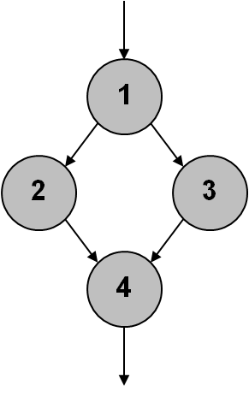
Data-Flow Analysis
The order of computation affects speed of convergence
Live is a backward data-flow problem
  Sets for node n are computed from sets at n’s CFG successors
LIVEOUT(1) is computed from LIVEOUT(2) and LIVEOUT(3), which depend on LIVEOUT(4)
Solver should visit 2 & 3 before 1
Solver should visit 4 before 2 & 3
Update as many “sources” as possible before visiting a given node
General idea is to let a change in the LiveOut set flow as far in the CFG as it can in a single “pass” of the while loop
Example CFG
Comp 412, Fall 2010

Slide 8
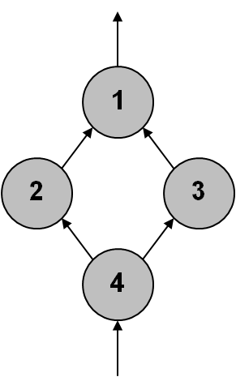
Data-Flow Analysis
Code optimization is intimately tied to graph theory
LIVEOUT is computed, conceptually, on the reverse CFG
Order for solver is defined by the reverse CFG
Propagation Order for Backward Problem
Want to visit 4, then {2,3}, then 1
PostOrder of RCFG would be 1, {2, 3}, 4
Desired order is reverse of postorder
  RPO(i) = |N | + 1 - PO(i)
Reverse PostOrder would be 4, {3, 2}, 1
  We don’t care about order of 2 & 3
Reverse CFG
Forward problem ⇒ RPO on the CFG
Backward problem ⇒ RPO on the reverse CFG
RPO on RFG is not reverse preorder on CFG
Comp 412, Fall 2010

Slide 9
Recap of Live Variables
Define the problem
A variable v is live at point p iff ∃ a path in the CFG
from p to a use of v along which v is not redefined.
Solve the equations for LIVEOUT
LIVEOUT(n_{f} ) = ∅
LIVEOUT(n) = ∪_{m ∈ succ(n)} (UEVAR(m) ∪ (LIVEOUT(m) ∩ VARKILL(m)))
Use an iterative fixed-point solver
Theory guarantees unique solution to this problem
Choose an order that produces efficient solution
Use the sets to identify uninitialized variables, or to eliminate useless stores, or to find live ranges, or to …
EaC1e has material on Live in § 9.2
Chapter 9 of EaC contains more examples of data-flow problems
Comp 412, Fall 2010

