Slide 1

LR(1) Parsers
Comp 412
COMP 412
FALL 2010
Copyright 2010, Keith D. Cooper & Linda Torczon, all rights reserved.
Students enrolled in Comp 412 at Rice University have explicit permission to make copies of these materials for their personal use.
Faculty from other educational institutions may use these materials for nonprofit educational purposes, provided this copyright notice is preserved.
Notes:
This lecture builds the LR(1) tables for the left-recursive version of the SheepNoise grammar.
It is about as simple as an example can be. EaC 1e shows the example for the right-recursive
SheepNoise grammar, along with the ambiguous if-then-else grammar. EaC 2e shows the
Construction for the parenthesis grammar and the ambiguous if-then-else grammar. The next
Lecture shows the construction for Bill Waite’s example of a non-LL(1) grammar.
Thus, the student has access to a fair number of worked examples.

Slide 2
Building LR(1) Tables
How do we build the parse tables for an LR(1) grammar?
Use the grammar to build a model of the Control DFA
Encode actions & transitions into the ACTION & GOTO tables
If construction succeeds, the grammar is LR(1)
  “Succeeds” means defines each table entry uniquely
The Big Picture
Model the state of the parser with “LR(1) items”
Use two functions goto( s, X ) and closure( s )
  goto() is analogous to move() in the subset construction
  closure() adds information to round out a state
Build up the states and transition functions of the DFA
Use this information to fill in the ACTION and GOTO tables
s is a state
X is T or NT
fixed-point algorithm, like subset construction
Comp 412, Fall 2010

Slide 3
LR(1) Items
We represent a valid configuration of an LR(1) parser with a data structure called an LR(1) item
An LR(1) item is a pair [P, δ], where
  P is a production A→β with a • at some position in the rhs
  δ is a lookahead string of length ≤ 1 (word or EOF )
The • in an item indicates the position of the top of the stack
[A→•βγ,a] means that the input seen so far is consistent with the use of A →βγ immediately after the symbol on top of the stack
[A →β•γ,a] means that the input sees so far is consistent with the use of A →βγ at this point in the parse, and that the parser has already recognized β (that is, β is on top of the stack).
[A →βγ•,a] means that the parser has seen βγ, and that a lookahead symbol of a is consistent with reducing to A.
“possibility”
“partially complete”
“complete”
Comp 412, Fall 2010

Slide 4
LR(1) Items
The production A→β, where β = B₁B₂B₃ with lookahead a,
can give rise to 4 items
  [A→•B₁B₂B₃,a], [A→B₁•B₂B₃,a], [A→B₁B₂•B₃,a], & [A→B₁B₂B₃•,a]
The set of LR(1) items for a grammar is finite
What’s the point of all these lookahead symbols?
Carry them along to help choose the correct reduction
Lookaheads are bookkeeping, unless item has • at right end
  Has no direct use in [A→β•γ,a]
  In [A→β•,a], a lookahead of a implies a reduction by A →β
  For a parser state modeled with items { [A→β•,a],[B→γ•δ,b] },
  lookahead of a ⇒ reduce to A; lookahead in FIRST(δ) ⇒ shift
Limited right context is enough to pick the actions
Comp 412, Fall 2010

Slide 5
LR(1) Table Construction
For convenience, we will require that the grammar have an obvious & unique goal symbol — one that does not appear on the rhs of any production.
High-level overview
Build the canonical collection of sets of LR(1) Items, I
  Start with an appropriate initial state, s₀
    [S’ →•S,EOF], along with any equivalent items
    Derive equivalent items as closure( s₀ )
  Repeatedly compute, for each s_{k}, and each symbol X, goto(s_{k},X)
    If the set is not already in the collection, add it
    Record all the transitions created by goto( )
  This eventually reaches a fixed point
Fill in the table from the collection of sets of LR(1) items
Let’s build the tables for the SheepNoise grammar
The states of the canonical collection are precisely the states of the Control DFA
The construction traces the DFA’s transitions
0 | Goal | → | SheepNoise
1 | SheepNoise | → | SheepNoise baa
2 |  | | | baa
Left recursive version
Comp 412, Fall 2010
*

Slide 6
Computing Closures
Closure(s) adds all the items implied by the items already in s
Item [A→β•C δ,a] in s implies [C →•τ,x] for each production
with C on the lhs, and each x ∈ FIRST(δa)
Since βC δ is valid, any way to derive βC δ is valid, too
The algorithm
Closure( s )
while ( s is still changing )
∀ items [A → β •C δ,a] ∈ s
∀ productions C → τ ∈ P
∀ x ∈ FIRST(δa) // δ might be ε
if [C → • τ,x] ∉ s
then s ← s ∪ { [C → • τ,x] }
Classic fixed-point method
Halts because s ⊂ ITEMS
Worklist version is faster
Closure “fills out” a state
Lookaheads are generated here
Comp 412, Fall 2010

Slide 7
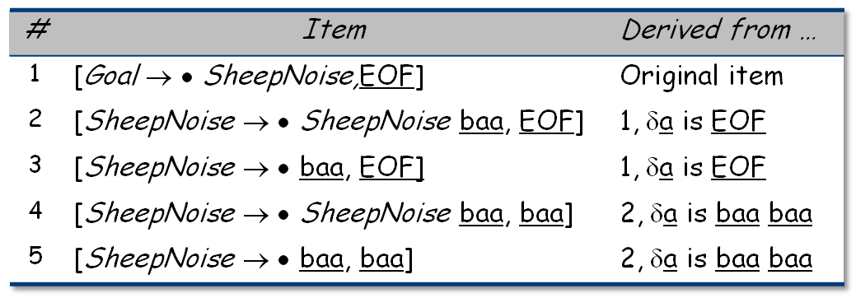
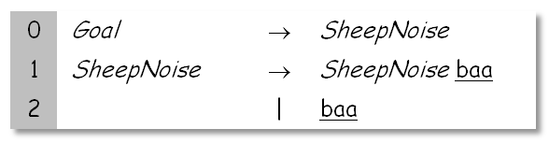
Example From SheepNoise
Initial step builds the item [Goal→•SheepNoise,EOF]
and takes its closure( )
Closure( [Goal→•SheepNoise,EOF] )
So, S₀ is
  { [Goal→ • SheepNoise,EOF], [SheepNoise→ • SheepNoise baa,EOF],
  [SheepNoise→• baa,EOF], [SheepNoise→ • SheepNoise baa,baa],
  [SheepNoise→ • baa,baa] }
This is the left-recursive SheepNoise grammar; EaC 1e shows the right-recursive version.
Comp 412, Fall 2010

Slide 8
Computing Gotos
Goto(s,x) computes the state that the parser would reach
if it recognized an x while in state s
Goto( { [A→β•X δ,a] }, X ) produces [A→βX •δ,a] (obviously)
It finds all such items & uses closure() to fill out the state
The algorithm
Goto( s, X )
new ←Ø
∀ items [A→β•X δ,a] ∈ s
new ← new ∪ { [A→βX •δ,a] }
return closure(new)
Not a fixed-point method!
Straightforward computation
Uses closure ( )
Goto() moves us forward
Comp 412, Fall 2010

Slide 9
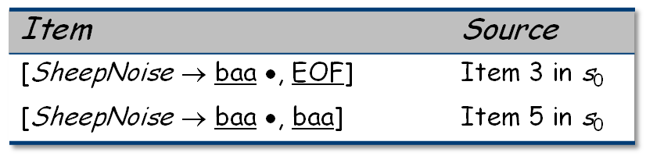
Example from SheepNoise
S₀ is { [Goal→ • SheepNoise,EOF], [SheepNoise→ • SheepNoise baa,EOF],
  [SheepNoise→ • baa,EOF], [SheepNoise→ • SheepNoise baa,baa],
  [SheepNoise→ • baa,baa] }
Goto( S₀ , baa )
Loop produces
Closure adds nothing since • is at end of rhs in each item
In the construction, this produces s₂
  { [SheepNoise→baa •, {EOF,baa}] }
New, but obvious, notation for two distinct items
[SheepNoise→baa •, EOF] & [SheepNoise→baa •, baa]
0 | Goal | → | SheepNoise
1 | SheepNoise | → | SheepNoise baa
2 |  | | | baa
Comp 412, Fall 2010

Slide 10
Building the Canonical Collection
Start from s₀ = closure( [S’→•S,EOF ] )
Repeatedly construct new states, until all are found
The algorithm
s₀ ← closure ( [S’→ S,EOF] )
S ← { s₀ }
k ← 1
while ( S is still changing )
∀ s_{j} ∈ S and ∀ x ∈ ( T ∪ NT )
t ← goto(s_{j},x)
if t ∉ S then
name t as s_{k}
S ← S ∪ { s_{k} }
record s_{j} → s_{k} on x
k ← k + 1
else
t is s_{m} ∈ S
record s_{j} → s_{m} on x
Fixed-point computation
Loop adds to S
S ⊆ 2^{ITEMS}, so S is finite
Worklist version is faster
Comp 412, Fall 2010

Slide 11
Example from SheepNoise
Starts with S₀
S₀ : { [Goal→ • SheepNoise, EOF], [SheepNoise→ • SheepNoise baa, EOF],
  [SheepNoise→ • baa, EOF], [SheepNoise→ • SheepNoise baa, baa],
  [SheepNoise→ • baa, baa] }
Iteration 1 computes
S₁ = Goto(S₀ , SheepNoise) =
{ [Goal→ SheepNoise •, EOF], [SheepNoise→ SheepNoise • baa, EOF],
  [SheepNoise→ SheepNoise • baa, baa] }
S₂ = Goto(S₀ , baa) = { [SheepNoise→ baa •, EOF], [SheepNoise→ baa •, baa] }
Nothing more to compute, since • is at the end of every item in S₃ .
Iteration 2 computes
S₃ = Goto(S₁ , baa) = { [SheepNoise→ SheepNoise baa •, EOF],
  [SheepNoise→ SheepNoise baa •, baa] }
0 | Goal | → | SheepNoise
1 | SheepNoise | → | SheepNoise baa
2 |  | | | baa
Comp 412, Fall 2010

Slide 12
Example from SheepNoise
S₀ : { [Goal→ • SheepNoise, EOF], [SheepNoise→ • SheepNoise baa, EOF],
  [SheepNoise→ • baa, EOF], [SheepNoise→ • SheepNoise baa, baa],
  [SheepNoise→ • baa, baa] }
S₁ = Goto(S₀ , SheepNoise) =
{ [Goal→ SheepNoise •, EOF], [SheepNoise→ SheepNoise • baa, EOF],
  [SheepNoise→ SheepNoise • baa, baa] }
S₂ = Goto(S₀ , baa) = { [SheepNoise→ baa •, EOF], [SheepNoise→ baa •, baa] }
S₃ = Goto(S₁ , baa) = { [SheepNoise→ SheepNoise baa •, EOF],
  [SheepNoise→ SheepNoise baa •, baa] }
Comp 412, Fall 2010

Slide 13
Filling in the ACTION and GOTO Tables
The algorithm
Many items generate no table entry
  Closure( ) instantiates FIRST(X) directly for [A→β • X δ, a]
x is the state number
∀ set S_{x} ∈ S
∀ item i ∈ S_{x}
if i is [A→β • aδ,b] and goto(S_{x},a) = S_{k} , a ∈ T
then ACTION[x,a] ← “shift k”
else if i is [S’→S •,EOF]
then ACTION[x ,EOF] ← “accept”
else if i is [A→β •,a]
then ACTION[x,a] ← “reduce A→β”
∀ n ∈ NT
if goto(S_{x} ,n) = S_{k}
then GOTO[x,n] ← k
• before T ⇒ shift
have Goal ⇒ accept
• at end ⇒ reduce
Comp 412, Fall 2010

Slide 14
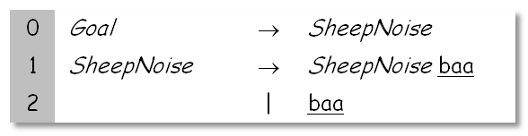
Example from SheepNoise
S₀ : { [Goal→ • SheepNoise, EOF], [SheepNoise→ • SheepNoise baa, EOF],
  [SheepNoise→ • baa, EOF], [SheepNoise→ • SheepNoise baa, baa],
  [SheepNoise→ • baa, baa] }
S₁ = Goto(S₀ , SheepNoise) =
{ [Goal→ SheepNoise •, EOF], [SheepNoise→ SheepNoise • baa, EOF],
  [SheepNoise→ SheepNoise • baa, baa] }
S₂ = Goto(S₀ , baa) = { [SheepNoise→ baa •, EOF], [SheepNoise→ baa •, baa] }
S₃ = Goto(S₁ , baa) = { [SheepNoise→ SheepNoise baa •, EOF],
  [SheepNoise→ SheepNoise baa •, baa] }
• before T ⇒ shift k
so, ACTION[s₀,baa] is “shift S₂” (clause 1)
(items define same entry)
Comp 412, Fall 2010
Notes:
These next slides take the items in the order specified by the algorithm.
They look at the sets in the canonical collection in order, s₀, s₁,s₂, s₃.
They look at the terminals in order, baa then EOF.
This slide is state 0, baa. State 0, EOF generates no entry.

Slide 15
Example from SheepNoise
S₀ : { [Goal→ • SheepNoise, EOF], [SheepNoise→ • SheepNoise baa, EOF],
  [SheepNoise→ • baa, EOF], [SheepNoise→ • SheepNoise baa, baa],
  [SheepNoise→ • baa, baa] }
S₁ = Goto(S₀ , SheepNoise) =
{ [Goal→ SheepNoise •, EOF], [SheepNoise→ SheepNoise • baa, EOF],
  [SheepNoise→ SheepNoise • baa, baa] }
S₂ = Goto(S₀ , baa) = { [SheepNoise→ baa •, EOF], [SheepNoise→ baa •, baa] }
S₃ = Goto(S₁ , baa) = { [SheepNoise→ SheepNoise baa •, EOF],
  [SheepNoise→ SheepNoise baa •, baa] }
so, ACTION[S₁,baa] is “shift S₃” (clause 1)
Comp 412, Fall 2010
Notes:
State 1, baa generates shift s₃

Slide 16
Example from SheepNoise
S₀ : { [Goal→ • SheepNoise, EOF], [SheepNoise→ • SheepNoise baa, EOF],
  [SheepNoise→ • baa, EOF], [SheepNoise→ • SheepNoise baa, baa],
  [SheepNoise→ • baa, baa] }
S₁ = Goto(S₀ , SheepNoise) =
{ [Goal→ SheepNoise •, EOF], [SheepNoise→ SheepNoise • baa, EOF],
  [SheepNoise→ SheepNoise • baa, baa] }
S₂ = Goto(S₀ , baa) = { [SheepNoise→ baa •, EOF], [SheepNoise→ baa •, baa] }
S₃ = Goto(S₁ , baa) = { [SheepNoise→ SheepNoise baa •, EOF],
  [SheepNoise→ SheepNoise baa •, baa] }
so, ACTION[S₁,EOF] is “accept ” (clause 2)
Comp 412, Fall 2010
Notes:
State 1, EOF generates accept.

Slide 17
Example from SheepNoise
S₀ : { [Goal→ • SheepNoise, EOF], [SheepNoise→ • SheepNoise baa, EOF],
  [SheepNoise→ • baa, EOF], [SheepNoise→ • SheepNoise baa, baa],
  [SheepNoise→ • baa, baa] }
S₁ = Goto(S₀ , SheepNoise) =
{ [Goal→ SheepNoise •, EOF], [SheepNoise→ SheepNoise • baa, EOF],
  [SheepNoise→ SheepNoise • baa, baa] }
S₂ = Goto(S₀ , baa) = { [SheepNoise→ baa •, EOF], [SheepNoise→ baa •, baa] }
S₃ = Goto(S₁ , baa) = { [SheepNoise→ SheepNoise baa •, EOF],
  [SheepNoise→ SheepNoise baa •, baa] }
so, ACTION[S₂,EOF] is “reduce 2” (clause 3)
ACTION[S₂,baa] is “reduce 2 ” (clause 3)
Comp 412, Fall 2010
Notes:
State 2, both symbols generate reduce by production 2, SheepNoise → baa

Slide 18
Example from SheepNoise
S₀ : { [Goal→ • SheepNoise, EOF], [SheepNoise→ • SheepNoise baa, EOF],
  [SheepNoise→ • baa, EOF], [SheepNoise→ • SheepNoise baa, baa],
  [SheepNoise→ • baa, baa] }
S₁ = Goto(S₀ , SheepNoise) =
{ [Goal→ SheepNoise •, EOF], [SheepNoise→ SheepNoise • baa, EOF],
  [SheepNoise→ SheepNoise • baa, baa] }
S₂ = Goto(S₀ , baa) = { [SheepNoise→ baa •, EOF], [SheepNoise→ baa •, baa] }
S₃ = Goto(S₁ , baa) = { [SheepNoise→ SheepNoise baa •, EOF],
  [SheepNoise→ SheepNoise baa •, baa] }
ACTION[S₃,EOF] is “reduce 1” (clause 3)
ACTION[S₃,baa] is “reduce 1 ”, as well
Comp 412, Fall 2010

Slide 19
Example from SheepNoise
The GOTO Table records Goto transitions on NTs
s₀ : { [Goal→ • SheepNoise, EOF], [SheepNoise→ • SheepNoise baa, EOF],
  [SheepNoise→ • baa, EOF], [SheepNoise→ • SheepNoise baa, baa],
  [SheepNoise→ • baa, baa] }
s₁ = Goto(S₀ , SheepNoise) =
{ [Goal→ SheepNoise •, EOF], [SheepNoise→ SheepNoise • baa, EOF],
  [SheepNoise→ SheepNoise • baa, baa] }
s₂ = Goto(S₀ , baa) = { [SheepNoise→ baa •, EOF], [SheepNoise→ baa •, baa] }
s₃ = Goto(S₁ , baa) = { [SheepNoise→ SheepNoise baa •, EOF],
  [SheepNoise→ SheepNoise baa •, baa] }
Puts s₁ in GOTO[s₀,SheepNoise]
Based on T, not NT and written into the ACTION table
Only 1 transition in the entire GOTO table
Remember, we recorded these so we don’t need to recompute them.
Comp 412, Fall 2010

Slide 20
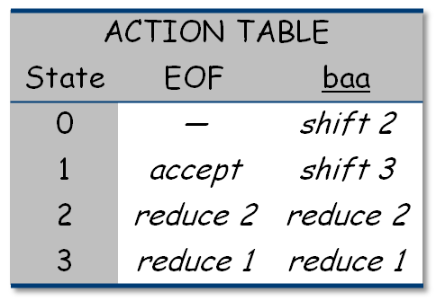
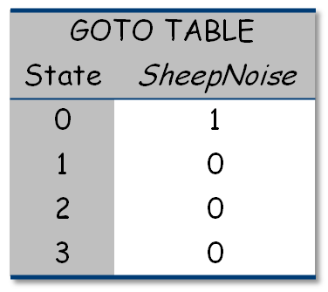
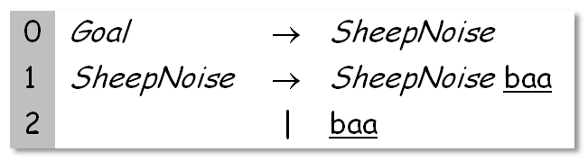
ACTION & GOTO Tables
Here are the tables for the augmented
left-recursive SheepNoise grammar
The tables
The grammar
Remember, this is the left-recursive SheepNoise; EaC shows the right-recursive version.
Comp 412, Fall 2010

Slide 21
What can go wrong?
What if set s contains [A→β•aγ,b] and [B→β•,a] ?
First item generates “shift”, second generates “reduce”
Both define ACTION[s,a] — cannot do both actions
This is a fundamental ambiguity, called a shift/reduce error
Modify the grammar to eliminate it (if-then-else)
Shifting will often resolve it correctly
What is set s contains [A→γ•, a] and [B→γ•, a] ?
Each generates “reduce”, but with a different production
Both define ACTION[s,a] — cannot do both reductions
This is a fundamental ambiguity, called a reduce/reduce conflict
Modify the grammar to eliminate it (PL/I’s overloading of (...))
In either case, the grammar is not LR(1)
Comp 412, Fall 2010

Slide 22
Shrinking the Tables
Three options:
Combine terminals such as number & identifier, + & -, * & /
  Directly removes a column, may remove a row
  For expression grammar, 198 (vs. 384) table entries
Combine rows or columns
  Implement identical rows once & remap states
  Requires extra indirection on each lookup
  Use separate mapping for ACTION & for GOTO
Use another construction algorithm
  Both LALR(1) and SLR(1) produce smaller tables
  Implementations are readily available
left-recursive expression grammar with precedence, see §3.7.2 in EAC
classic space-time tradeoff
Is handle recognizing DFA minimal?
Comp 412, Fall 2010

Slide 23
LR(k ) versus LL(k )
Finding Reductions
LR(k) ⇒ Each reduction in the parse is detectable with
the complete left context,
the reducible phrase, itself, and
the k terminal symbols to its right
LL(k) ⇒ Parser must select the reduction based on
The complete left context
The next k terminals
Thus, LR(k) examines more context
“… in practice, programming languages do not actually seem to fall in the gap between LL(1) languages and deterministic languages” J.J. Horning, “LR Grammars and Analysers”, in Compiler Construction, An Advanced Course, Springer-Verlag, 1976
generalizations of LR(1) and LL(1) to longer lookaheads
Comp 412, Fall 2010

Slide 24
Summary
Advantages
Fast
Good locality
Simplicity
Good error detection
Fast
Deterministic langs.
Automatable
Left associativity
Disadvantages
Hand-coded
High maintenance
Right associativity
Large working sets
Poor error messages
Large table sizes
Top-down
Recursive
descent,
LL(1)
LR(1)
Comp 412, Fall 2010

