Slide 1

Local Instruction Scheduling
— A Primer for Lab 3 —
Comp 412
COMP 412
FALL 2010
Copyright 2010, Keith D. Cooper & Linda Torczon, all rights reserved.
Students enrolled in Comp 412 at Rice University have explicit permission to make copies of these materials for their personal use.
Faculty from other educational institutions may use these materials for nonprofit educational purposes, provided this copyright notice is preserved.

Slide 2
What Makes Code Run Fast?
Many operations have non-zero latencies
Modern machines can issue several operations per cycle
Execution time is order-dependent (and has been since the 60’s)
Operation Cycles
load 3
store 3
loadI 1
add 1
mult 2
fadd 1
fmult 2
shift 1
branch 0 to 8
Loads & stores may or may not block on issue
  Non-blocking ⇒ fill those issue slots
Branch costs vary with path taken
Branches typically have delay slots
  Fill slots with unrelated operations
  Percolates branch upward
Scheduler should hide the latencies
Lab 3 will build a local scheduler
Assumed latencies for example on next slide.
Comp 412, Fall 2010

Slide 3
Example
w ← w * 2 * x * y * z
Simple schedule
Schedule loads early
2 registers, 20 cycles
3 registers, 13 cycles
Reordering operations for speed is called instruction scheduling
Comp 412, Fall 2010

Slide 4

ALU Characteristics
This data is surprisingly hard to measure accurately
Value-dependent behavior
Context-dependent behavior
Compiler behavior
  Have seen gcc underallocate &
  inflate operation costs with
  memory references (spills)
  Have seen commercial compiler
  generate 3 extra ops per divide
  raising effective cost by 3
Difficult to reconcile measured
reality with the data in the
Manuals (e.g. integer divide
on Nehalem)
Intel E5530 operation latencies
Instruction | Cost
64 bit integer subtract | 1
64 bit integer multiply | 3
64 bit integer divide | 41
Double precision add | 3
Double precision subtract | 3
Double precision multiply | 5
Double precision divide | 22
Single precision add | 3
Single precision subtract | 3
Single precision multiply | 4
Single precision divide | 14
Comp 412, Fall 2010
Xeon E5530 uses the Nehalem microarchitecture, as does I7

Slide 5
Instruction Scheduling (Engineer’s View)
The Problem
  Given a code fragment for some target machine and the
  latencies for each individual operation, reorder the operations
  to minimize execution time
The Concept
The Task
Produce correct code
Minimize wasted cycles
Avoid spilling registers
Operate efficiently
Machine description
slow
code
Scheduler
fast
code
Comp 412, Fall 2010

Slide 6
Instruction Scheduling (The Abstract View)
To capture properties of the code, build a precedence graph G
Nodes n ∈ G are operations with type(n) and delay(n)
An edge e = (n₁,n₂) ∈ G if & only if n₂ uses the result of n₁
a
b
c
d
e
f
g
h
i
The Code
The Precedence Graph
Comp 412, Fall 2010

Slide 7
Instruction Scheduling (Definitions)
A correct schedule S maps each n ∈ N into a non-negative integer representing its cycle number, and
1. S(n) ≥ 0, for all n ∈ N, obviously
2. If (n₁,n₂) ∈ E, S(n₁ ) + delay(n₁ ) ≤ S(n₂ )
3. For each type t, there are no more operations of type t in any cycle than the target machine can issue
The length of a schedule S, denoted L(S), is
L(S) = max_{n ∈ N} (S(n) + delay(n))
The goal is to find the shortest possible correct schedule.
S is time-optimal if L(S) ≤ L(S₁ ), for all other schedules S₁
A schedule might also be optimal in terms of registers, power, or space….
Comp 412, Fall 2010

Slide 8
Instruction Scheduling (What’s so difficult?)
Critical Points
All operands must be available
Multiple operations can be ready
Moving operations can lengthen register lifetimes
Placing uses near definitions can shorten register lifetimes
Operands can have multiple predecessors
Together, these issues make scheduling hard (NP-Complete)
Local scheduling is the simple case
Restricted to straight-line code
Consistent and predictable latencies
Comp 412, Fall 2010

Slide 9
Instruction Scheduling: The Big Picture
1. Build a precedence graph, P
2. Compute a priority function over the nodes in P
3. Use list scheduling to construct a schedule, 1 cycle at a time
  a. Use a queue of operations that are ready
  b. At each cycle
    I. Choose the highest priority ready operation & schedule it
    II. Update the ready queue
Local list scheduling
The dominant algorithm for thirty years
A greedy, heuristic, local technique
Editorial: My one complaint about the literature on scheduling is that it does not provide us with an analogy that gives us leverage on the problem in the way that coloring does with allocation.
List scheduling is just an algorithm. It doesn’t provide us with any intuitions about the problem.
Comp 412, Fall 2010
*

Slide 10
Local List Scheduling
Cycle ← 1
Ready ← leaves of P
Active ← Ø
while (Ready ∪ Active ≠ Ø)
if (Ready ≠ Ø) then
remove an op from Ready
S(op) ← Cycle
Active ¬ Active ∪ op
Cycle ← Cycle + 1
for each op ∈ Active
if (S(op) + delay(op) ≤ Cycle) then
remove op from Active
for each successor s of op in P
if (s is ready) then
Ready ← Ready ∪ s
Removal in priority order
op has completed execution
If successor’s operands are “ready”, add it to Ready
Comp 412, Fall 2010

Slide 11
Scheduling Example
Build the precedence graph
a
b
c
d
e
f
g
h
i
The Code
The Precedence Graph
Comp 412, Fall 2010

Slide 12
Scheduling Example
Build the precedence graph
Determine priorities: longest latency-weighted path
a
13
12
b
c
10
10
d
e
9
8
f
g
7
5
h
3
i
The Code
The Precedence Graph
Comp 412, Fall 2010

Slide 13
Scheduling Example
Build the precedence graph
Determine priorities: longest latency-weighted path
Perform list scheduling
Used a new register name
1) a:
l
o
ad
A
I
r
0,
@w
⇒
r
1
a
13
2) c:
l
o
ad
A
I
r
0,
@
x
⇒
r
2
3) e:
l
o
ad
A
I
r
0,
@
y
⇒
r
3
12
b
c
4) b:
a
d
d
r
1,
r
1
⇒
r
1
10
10
5) d:
m
ul
t
r
1,
r
2
⇒
r
1
d
e
9
8
6) g:
l
o
ad
A
I
r
0,
@z
⇒
r
2
g
7) f:
m
ul
t
r
1,
r
3
⇒
r
1
7
f
5
9) h:
m
ul
t
r
1,
r
2
⇒
r
1
h
11) i:
s
t
o
r
e
A
I
r
1
⇒
r
0,
@w
3
i
The Code
The Precedence Graph
Comp 412, Fall 2010

Slide 14
Improving the Efficiency of Scheduling
Cycle ← 1
Ready ← leaves of P
Active ← Ø
while (Ready ∪ Active ≠ Ø)
if (Ready ≠ Ø) then
remove an op from Ready
S(op) ← Cycle
Active ¬ Active ∪ op
Cycle ← Cycle + 1
for each op ∈ Active
if (S(op) + delay(op) ≤ Cycle) then
remove op from Active
for each successor s of op in P
if (s is ready) then
Ready ← Ready ∪ s
Updating the Ready queue is the most expensive part of this algorithm
Can create a separate queue for each cycle
  Add op to queue for cycle when it will complete
  Naïve implementation needs too many queues
Can use fewer queues
  Number of queues bounded by maximum operation latency
  Use them in a cyclic (or modulo) fashion
Detailed algorithm is given at the end of this set of slides (go look on your own time)
Comp 412, Fall 2010

Slide 15
More List Scheduling
List scheduling breaks down into two distinct classes
Variations on list scheduling
Prioritize critical path(s)
Schedule last use as soon as possible
Depth first in precedence graph (minimize registers)
Breadth first in precedence graph (minimize interlocks)
Prefer operation with most successors
Forward list scheduling
Start with available operations
Work forward in time
Ready ⇒ all operands available
Backward list scheduling
Start with no successors
Work backward in time
Ready ⇒ latency covers uses
Comp 412, Fall 2010

Slide 16
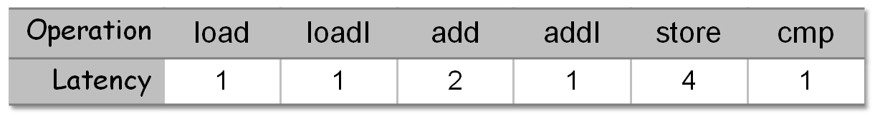
Local Scheduling
Forward and backward can produce different results
Latency to the cbr
8
8
8
8
8
loadI₁
lshift
loadI₂
loadI₃
loadI₄
7
7
7
7
6
add₁
add₂
add₃
add₄
addI
Subscript to identify
2
5
5
5
5
5
cmp
store₁
store₂
store₃
store₄
store₅
1
cbr
Block from SPEC benchmark “go”
Comp 412, Fall 2010

Slide 17
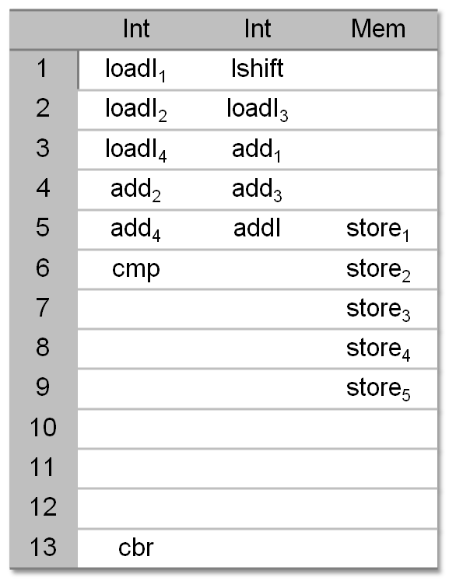
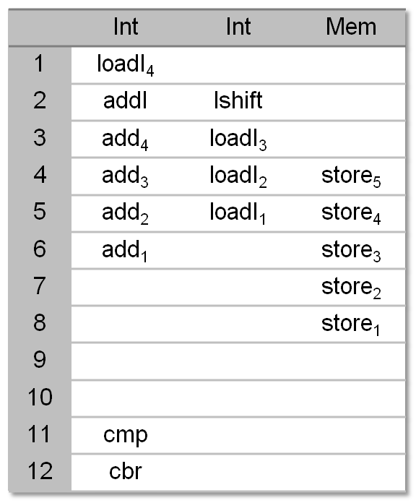
Local Scheduling
F
o
r
w
a
r
d
S
c
h
e
d
u
l
e
B
a
c
k
w
a
r
d
S
c
h
e
d
u
l
e
Comp 412, Fall 2010
Using “latency to root” as the priority function

Slide 18
My Favorite List Scheduling Variant
Schielke’s RBF Algorithm
Recognize that forward & backward both have their place
Recognize that tie-breaking matters & that, while we can rationalize various tie-breakers, we do not understand them
  Part of approximating the solution to an NP-complete problem
The Algorithm
Run forward scheduler 5 times, breaking ties randomly
Run backward scheduler 5 time, breaking ties randomly
Keep the best schedule
RBF means “randomized backward & forward”
The implementation must be scrupulous about randomizing all choices.
Comp 412, Fall 2010

Slide 19
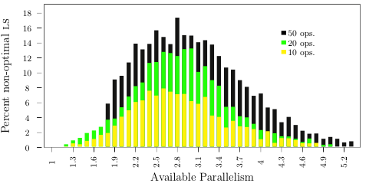
How Good is List Scheduling? Schielke’s Study
Non-optimal list schedules (%) versus available parallelism
  1 functional unit, randomly generated blocks of 10, 20, 50 ops
85,000 randomly generated blocks
RBF found optimal schedules for > 80%
Peak difficulty (for RBF) is around 2.8
Tie-breaking matters because it affects the choice when queue has > 1 element
Comp 412, Fall 2010
3 compute months of work

Slide 20
Lab 3
Implement two schedulers for basic blocks in ILOC
One must be list scheduling with specified priority
Other can be a second priority, or a different algorithm
Same ILOC subset as in lab 1 (plus NOP)
Different execution model
  Two asymmetric functional units
  Latencies different from lab 1
  Simulator different from lab 1
I will post a lab handout later today.
Some of these specifics may change.
I will update the posted lecture notes to match the actual assignment.
Comp 412, Fall 2010

Slide 21
Lab 3 — Specific questions
1. Are we in over our heads? No. The hard part of this lab should be trying to get good code. The programming is not bad; you can reuse some stuff from lab 1. You have all the specifications & tools you need. Jump in and start programming.
2. How many registers can we use? Assume that you have as many registers as you need. If the simulator runs out, we’ll get more. Rename registers to avoid false dependences & conflicts.
3. What about a store followed by a load? If you can show that the two operations must refer to different memory locations, the scheduler can overlap their execution. Otherwise, the store must complete before the load issues.
4. What about test files? We will put some test files online on OwlNet. We will test your lab on files you do not see. We have had problems (in the past) with people optimizing their labs for the test data. (Not that you would do that!)
Comp 412, Fall 2010

Slide 22
Lab 3 - Hints
Begin by renaming registers to eliminate false dependencies
Pay attention to loads and stores
  When can they be reordered?
Understand the simulator
Inserting NOPs may be necessary to get correct code
Tiebreakers can make a difference
Comp 412, Fall 2010

Slide 23
Detailed Scheduling Algorithm I
Idea: Keep a collection of worklists W[c], one per cycle
  We need MaxC = max delay + 1 such worklists
  Precedence graph is (N,E)
Code:
for each n ∈ N do begin count[n] := 0; earliest[n] = 0 end
for each (n1,n2) ∈ E do begin
count[n2] := count[n2] + 1;
successors[n1] := successors[n1] ∪ {n2};
end
for i := 0 to MaxC – 1 do W[i] := ∅;
Wcount := 0;
for each n ∈ N do
if count[n] = 0 then begin
W[0] := W[0] ∪ {n}; Wcount := Wcount + 1;
end
c := 0; // c is the cycle number
cW := 0;// cW is the number of the worklist for cycle c
instr[c] := ∅;
Comp 412, Fall 2010

Slide 24
Detailed Scheduling Algorithm II
while Wcount > 0 do begin
while W[cW] = ∅ do begin
c := c + 1; instr[c] := ∅; cW := mod(cW+1,MaxC);
end
nextc := mod(c+1,MaxC);
while W[cW] ≠ ∅ do begin
select and remove an arbitrary instruction x from W[cW];
if ∃ free issue units of type(x) on cycle c then begin
instr[c] := instr[c] ∪ {x}; Wcount := Wcount - 1;
for each y ∈ successors[x] do begin
count[y] := count[y] – 1;
earliest[y] := max(earliest[y], c+delay(x));
if count[y] = 0 then begin
loc := mod(earliest[y],MaxC);
W[loc] := W[loc] ∪ {y}; Wcount := Wcount + 1;
end
end
else W[nextc] := W[nextc] ∪ {x};
end
end
Priority
Comp 412, Fall 2010

