Slide 1

The Procedure Abstraction
Comp 412
COMP 412
FALL 2010
Chapters 6 and 7 of EaC explore techniques that compilers use to implement various language features.
Copyright 2010, Keith D. Cooper & Linda Torczon, all rights reserved.
Students enrolled in Comp 412 at Rice University have explicit permission to make copies of these materials for their personal use.
Faculty from other educational institutions may use these materials for nonprofit educational purposes, provided this copyright notice is preserved.

Slide 2
Where are we?
Well understood
Engineering
Source
Code
Front
End
IR
IR
Back
End
Machine
code
Optimizer
Errors
The latter half of a compiler contains more open problems,
more challenges, and more gray areas than the front half
This is “compilation,” as opposed to “parsing” or “translation”
Implementing promised behavior
  Defining and preserving the meaning of the program
Managing target machine resources
  Registers, memory, issue slots, locality, power, …
  These issues determine the quality of the compiled code
Comp 412, Fall 2010

Slide 3
Conceptual Overview
The compiler must provide, for each programming language construct, an implementation (or at least a strategy).
Those constructs fall into two major categories
Individual statements
Procedures
We will look at procedures first, since they provide the surrounding context needed to implement statements
Object-oriented languages add some peculiar twists
We will treat OOL features in a separate lecture or two
In EaC, Chapter 6 covers implementation of procedures & Chapter 7 covers statements.
Comp 412, Fall 2010

Slide 4
Conceptual Overview
Procedures provide the fundamental abstractions that make programming practical & large software systems possible
Information hiding
Distinct and separable name spaces
Uniform interfaces
Hardware does little to support these abstractions
Part of the compiler’s job is to implement them
  Compiler makes good on lies that we tell programmers
Part of the compiler’s job is to make it efficient
  Role of code optimization
Comp 412, Fall 2010

Slide 5
Practical Overview
The compiler must decide almost everything
Location for each value (named and unnamed)
Method for computing each result
  For example, how should it compute y ^{x} or a case statement?
Compile-time versus runtime behavior
How to locate objects & values created & manipulated by code that the compiler cannot see? (other files, libraries)
  Dynamic loading and linking add more complications
All of these issues come to the forefront when we consider the implementation of procedures
Pay close attention to compile-time versus runtime
  Confuses students more than any other issue
Comp 412, Fall 2010

Slide 6
The Procedure Abstraction
The compiler must deal with interface between compile time and run time (static versus dynamic)
Most of the tricky issues arise in implementing “procedures”
Issues
Compile-time versus run-time behavior
Assign storage for everything & map names to addresses
Generate code to address any value
  Compiler knows where some of them are
  Compiler cannot know where others are
Interfaces with other programs, other languages, & the OS
Efficiency of implementation
Comp 412, Fall 2010

Slide 7
The Procedure & Its Three Abstractions
The compiler produces code for each procedure
The individual code bodies must fit together to form a working program
Compiled Code
Procedure
Comp 412, Fall 2010

Slide 8
The Procedure & Its Three Abstractions
Each procedure inherits a set of names
Variables, values, procedures, objects, locations, …
Clean slate for new names, “scoping” can hide other names
Naming Environment
Compiled Code
Procedure
“Naming” includes the ability to find and access objects in memory
Comp 412, Fall 2010

Slide 9
The Procedure & Its Three Abstractions
Control History
Each procedure inherits a control history
Chain of calls that led to its invocation
Mechanism to return control to caller
Naming Environment
Compiled Code
Procedure
Some notion of parameterization
(ties back to naming)
Comp 412, Fall 2010

Slide 10
The Procedure & Its Three Abstractions
Control History
Each procedure has access to external interfaces
Access by name, with parameters (may include dynamic link & load)
Protection for both sides of the interface
Naming Environment
System Services
(allocation, communication, I/O, control, naming, …)
Compiled Code
APIs
Procedure
Comp 412, Fall 2010

Slide 11
The Procedure: Three Abstractions
Control Abstraction
  Well defined entries & exits
  Mechanism to return control to caller
  Some notion of parameterization (usually)
Clean Name Space
  Clean slate for writing locally visible names
  Local names may obscure identical, non-local names
  Local names cannot be seen outside
External Interface
  Access is by procedure name & parameters
  Clear protection for both caller & callee
  Invoked procedure can ignore calling context
Procedures permit a critical separation of concerns
Comp 412, Fall 2010

Slide 12
The Procedure (Realist’s View)
Procedures are the key to building large systems
Requires system-wide compact
  Conventions on memory layout, protection, resource allocation calling sequences, & error handling
  Must involve architecture (ISA), OS, & compiler
Provides shared access to system-wide facilities
  Storage management, flow of control, interrupts
  Interface to input/output devices, protection facilities, timers, synchronization flags, counters, …
Establishes a private context
  Create private storage for each procedure invocation
  Encapsulate information about control flow & data abstractions
Comp 412, Fall 2010

Slide 13
The Procedure (Realist’s View)
Procedures allow us to use separate compilation
Separate compilation allows us to build non-trivial programs
Keeps compile times reasonable
Lets multiple programmers collaborate
Requires independent procedures
Without separate compilation, we would not build large systems
The procedure linkage convention
Ensures that each procedure inherits a valid run-time environment and that the callers environment is restored on return
  The compiler must generate code to ensure this happens according to conventions established by the system
Comp 412, Fall 2010

Slide 14
The Procedure (More Abstract View)
A procedure is an abstract structure constructed via software
Underlying hardware directly supports little of the abstraction—it understands bits, bytes, integers, reals, & addresses, but not:
Entries and exits
Interfaces
Call and return mechanisms
  Typical machine supports the transfer of control (call and return) but not the rest of the calling sequence (e.g., preserving context)
Name space
Nested scopes
All these are established by carefully-crafted mechanisms provided by compiler, run-time system, linker, loader, and OS;
The compiler’s job is to make good on the lies told by the programming language design!
Comp 412, Fall 2010

Slide 15
Run Time versus Compile Time
These concepts are often confusing to the newcomer
Linkages (and code for procedure body) execute at run time
Code for the linkage is emitted at compile time
The linkage is designed long before either of these
This issue (compile time versus run time) confuses students more than any other issue in Comp 412
We will emphasize the distinction between them
Comp 412, Fall 2010

Slide 16
The Procedure as a Control Abstraction
Procedures have well-defined control-flow
The Algol-60 procedure call
Invoked at a call site, with some set of actual parameters
Control returns to call site, immediately after invocation
Most languages allow recursion
int p(a,b,c)
int a, b, c;
{
int d;
d = q(c,b);
...
}
int q(x,y)
int x,y;
{
if ( … )
x = q(x-1,y);
return x + y;
}
…
s = p(10,t,u);
…
Comp 412, Fall 2010

Slide 17
The Procedure as a Control Abstraction
Implementing procedures with this behavior
Requires code to save and restore a “return address”
Must map actual parameters to formal parameters (c→x, b→y)
Must create storage for local variables (&, maybe, parameters)
  p needs space for d (&, maybe, a, b, & c)
  where does this space go in recursive invocations?
Compiler emits code that causes all this to happen at run time
int p(a,b,c)
int a, b, c;
{
int d;
d = q(c,b);
...
}
int q(x,y)
int x,y;
{
if ( … )
x = q(x-1,y);
return x + y;
}
…
s = p(10,t,u);
…
Comp 412, Fall 2010

Slide 18
The Procedure as a Control Abstraction
Implementing procedures with this behavior
Must preserve p’s state while q executes
  recursion causes the real problem here
Strategy: Create unique location for each procedure activation
  In simple situations, can use a “stack” of memory blocks to hold local storage and return addresses (closures ⇒ heap allocate)
Compiler emits code that causes all this to happen at run time
int p(a,b,c)
int a, b, c;
{
int d;
d = q(c,b);
...
}
int q(x,y)
int x,y;
{
if ( … )
x = q(x-1,y);
return x + y;
}
…
s = p(10,t,u);
…
Comp 412, Fall 2010

Slide 19
The Procedure as a Control Abstraction
In essence, the procedure linkage wraps around the unique
code of each procedure to give it a uniform interface
Similar to building a brick wall rather than a rock wall
Compiled Code
Compiled Code
Compiled Code
Compiled Code
Compiled Code
Compiled Code
Compiled Code
Compiled Code
Compiled Code
Compiled Code
Compiled Code
Compiled Code
Compiled Code
Compiled Code
Compiled Code
Compiled Code
Compiled Code
Compiled Code
Compiled Code
Compiled Code
Compiled Code
Compiled Code
Compiled Code
Compiled Code
STOP
Comp 412, Fall 2010

Slide 20
The Procedure Abstraction:
Part II
Comp 412
COMP 412
FALL 2010
Copyright 2010, Keith D. Cooper & Linda Torczon, all rights reserved.
Students enrolled in Comp 412 at Rice University have explicit permission to make copies of these materials for their personal use.
Faculty from other educational institutions may use these materials for nonprofit educational purposes, provided this copyright notice is preserved.

Slide 21
Review
From last lecture
The Procedure serves as
A control abstraction
A naming abstraction
An external interface
We covered the control abstraction last lecture.
Today, we will focus on naming.
Access to system services, libraries, code from others …
Comp 412, Fall 2010

Slide 22
The Procedure as a Name Space
Each procedure creates its own name space
Any name (almost) can be declared locally
Local names obscure identical non-local names
Local names cannot be seen outside the procedure
  Nested procedures are “inside” by definition
We call this set of rules & conventions “lexical scoping”
Examples
C has global, static, local, and block scopes (Fortran-like)
  Blocks can be nested, procedures cannot
Scheme has global, procedure-wide, and nested scopes (let)
  Procedure scope (typically) contains formal parameters
The Java twist: allow fully qualified names to reach around scope rules
Comp 412, Fall 2010

Slide 23
The Procedure as a Name Space
Why introduce lexical scoping?
Provides a compile-time mechanism for binding “free” variables
Simplifies rules for naming & resolves conflicts
Lets the programmer introduce “local” names with impunity
How can the compiler keep track of all those names?
The Problem
At point p, which declaration of x is current?
At run-time, where is x found?
As parser goes in & out of scopes, how does it delete x?
The Answer
The compiler must model the name space
Lexically scoped symbol tables (see § 5.7 in EaC 1e)
Comp 412, Fall 2010

Slide 24
Do People Use This Stuff ?
C macro from the MSCP compiler
#define fix_inequality(oper, new_opcode) \
if (value0 < value1) \
{ \
Unsigned_Int temp = value0; \
value0 = value1; \
value1 = temp; \
opcode_name = new_opcode; \
temp = oper->arguments[0]; \
oper->arguments[0] = oper->arguments[1]; \
oper->arguments[1] = temp; \
oper->opcode = new_opcode; \
}
Even in C, a language not known for abstraction, people use scopes to hide details!
Declares a new name “temp”
Comp 412, Fall 2010

Slide 25
Do People Use This Stuff ?
Of course, it might have been more clear written as:
#define swap_values( val0, val1 ) \
{ \
Unsigned_Int tem = val0; \
val0 = val1; \
val1 = temp; \
}
#define fix_inequality(oper, new_opcode) \
if (value0 < value1) \
{ \
swap_values( val0, val1 ); \
opcode_name = new_opcode; \
temp = oper->arguments[0]; \
oper->arguments[0] = oper->arguments[1]; \
oper->arguments[1] = temp; \
oper->opcode = new_opcode; \
}
Even in C, we can build abstractions that are useful and tasteful.
Comp 412, Fall 2010

Slide 26
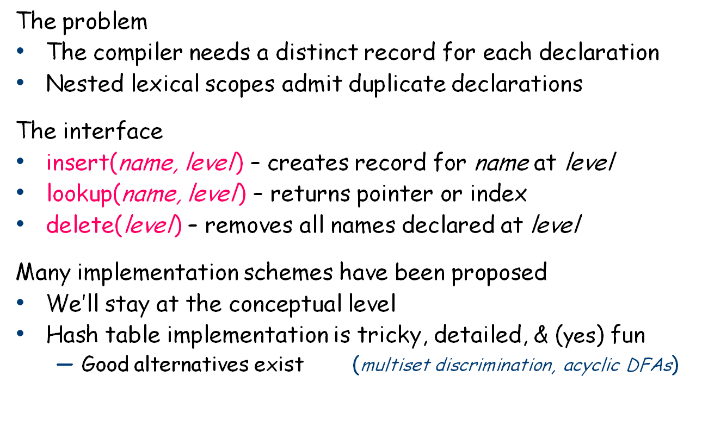
Lexically-scoped Symbol Tables
§ 5.7 in EaC 1e
Symbol tables are compile-time structures that the compiler uses to resolve references to names.
We’ll see the corresponding run-time structures that are used to establish addressability later.
Comp 412, Fall 2010

Slide 27
Example
procedure p {
int a, b, c
procedure q {
int v, b, x, w
procedure r {
int x, y, z
….
}
procedure s {
int x, a, v
…
}
… r … s
}
… q …
}
B0: {
int a, b, c
B1: {
int v, b, x, w
B2: {
int x, y, z
….
}
B3: {
int x, a, v
…
}
… r … s
}
… q …
}
Comp 412, Fall 2010

Slide 28
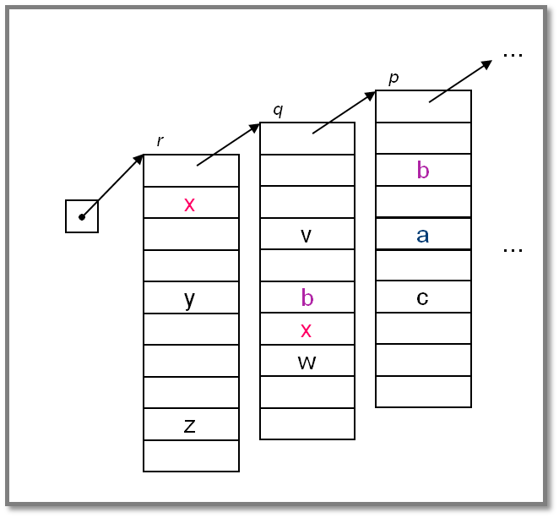
Lexically-scoped Symbol Tables
High-level idea
Create a new table for each scope
Chain them together for lookup
“Sheaf of tables” implementation
insert() may need to create table
it always inserts at current level
lookup() walks chain of tables &
returns first occurrence of name
delete() throws away level p table
if it is top table in the chain
If the compiler must preserve the table (for, say, the debugger ), this idea is actually practical.
Individual tables are hash tables.
Comp 412, Fall 2010
This high-level idea can be implemented as shown, or it can be implemented in more space-efficient (albeit complex) ways.

Slide 29
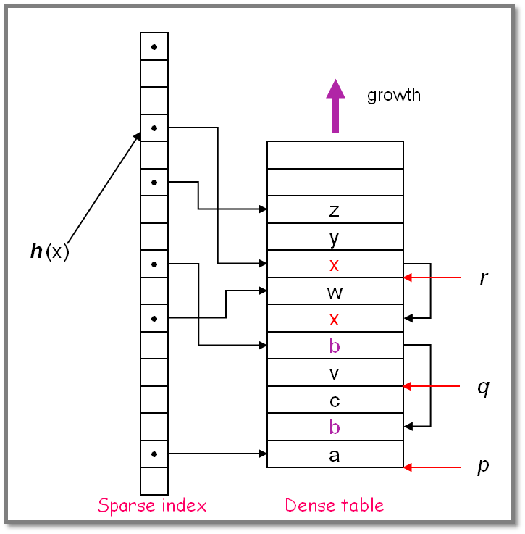
Implementing Lexically Scoped Symbol Tables
Threaded stack organization
Implementation
insert () puts new entry at the head of the list for the name
lookup () goes direct to location
delete () processes each element in level being deleted to remove from head of list
use sparse index for speed
use dense table to limit space
Advantage
lookup is fast
Disadvantage
delete takes time proportional to number of declared variables in level
Comp 412, Fall 2010
Parser (or treewalk) encounters names by scope, so each scope forms a block at stack top.

Slide 30
The Procedure as an External Interface
Naming plays a critical role in our ability to use procedure calls as a general interface
OS needs a way to start the program’s execution
Programmer needs a way to indicate where it begins
  The procedure “main” in most languages
When user invokes “grep” at a command line
  OS finds the executable
  OS creates a process and arranges for it to run “grep”
    Conceptually, it does a fork() and an exec() of the executable “grep”
  “grep” is code from the compiler, linked with run-time system
    Starts the run-time environment & calls “main”
    After main, it shuts down run-time environment & returns
When “grep” needs system services
  It makes a system call, such as fopen()
UNIX/Linux specific discussion
Comp 412, Fall 2010

Slide 31
Where Do All These Variables Go?
Automatic & Local
Keep them in the procedure activation record or in a register
Automatic ⇒ lifetime matches procedure’s lifetime
Static
Procedure scope ⇒ storage area affixed with procedure name
  &_p.x
File scope ⇒ storage area affixed with file name
Lifetime is entire execution
Global
One or more named global data areas
One per variable, or per file, or per program, …
Lifetime is entire execution
Comp 412, Fall 2010

Slide 32
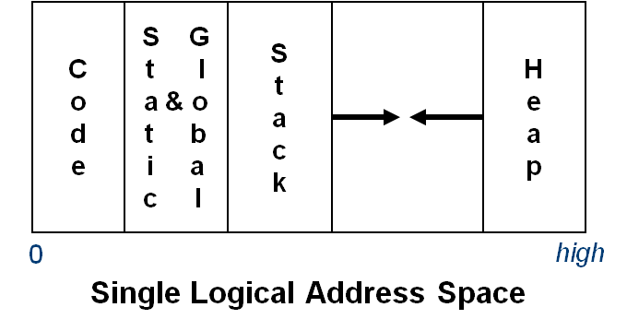
Placing Run-time Data Structures
Classic Organization
Better utilization if stack & heap grow toward each other
Very old result (Knuth)
Code & data separate or interleaved
Uses address space, not allocated memory
Code, static, & global data have known size
  Use symbolic labels in the code
Heap & stack both grow & shrink over time
This is a virtual address space
Comp 412, Fall 2010

Slide 33
How Does This Really Work?
The Big Picture
virtual address spaces
Compiler’s view
C
o
d
e
S G
t l
a & o
t b
i a
c l
S
t
a
c
k
H
e
a
p
C
o
d
e
S G
t l
a & o
t b
i a
c l
S
t
a
c
k
H
e
a
p
C
o
d
e
S G
t l
a & o
t b
i a
c l
S
t
a
c
k
H
e
a
p
C
o
d
e
S G
t l
a & o
t b
i a
c l
S
t
a
c
k
H
e
a
p
...
OS’ view
...
0
high
1980 Hardware view
Physical address space_
Comp 412, Fall 2010
On many modern processors, L1 cache uses physical addresses
Higher level caches typically use virtual addresses

Slide 34
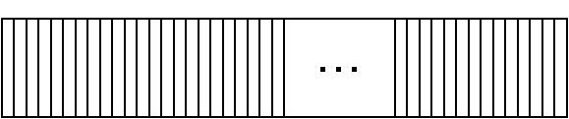
How Does This Really Work?
Most systems now include L3 caches. L4 is on its way.
Of course, the “Hardware view” is no longer that simple
Main
Memory
...
0
high
Caches can use physical or virtual addresses
Caches can be inclusive or exclusive
Caches can be shared
L2 Cache
L1 Caches
Code
Data
Code
Data
Functional unit
Functional unit
Functional unit
Functional unit
Processor Cores
Functional unit
Functional unit
Functional unit
Functional unit
Comp 412, Fall 2010
Cache structure matters for performance, not correctness
Notes:
And this picture does not show the TLBs — core private or shared among cores — in multiple levels.

Slide 35
Where Do Local Variables Live?
A Simplistic model
Allocate a data area for each distinct scope
One data area per “sheaf” in scoped table
What about recursion?
Need a data area per invocation (or activation) of a scope
We call this the scope’s activation record
The compiler can also store control information there !
More complex scheme
One activation record (AR) per procedure instance
All the procedure’s scopes share a single AR (may share space)
Static relationship between scopes in single procedure
Used this way, “static” means knowable at compile time (and, therefore, fixed).
Comp 412, Fall 2010

Slide 36
Translating Local Names
How does the compiler represent a specific instance of x ?
Name is translated into a static coordinate
  < level,offset > pair
  “level” is lexical nesting level of the procedure
  “offset” is unique within that scope
Subsequent code will use the static coordinate to generate addresses and references
“level” is a function of the table in which x is found
  Stored in the entry for each x
“offset” must be assigned and stored in the symbol table
  Assigned at compile time
  Known at compile time
  Used to generate code that executes at run-time
Comp 412, Fall 2010

Slide 37
Storage for Blocks within a Single Procedure
B0: {
int a, b, c
B1: {
int v, b, x, w
B2: {
int x, y, z
…
}
B3: {
int x, a, v
…
}
…
}
…
}
Fixed length data can always be at a constant offset from the beginning of a procedure
  In our example, the a declared at level 0 will always be the first data element, stored at byte 0 in the fixed-length data area
  The x declared at level 1 will always be the sixth data item, stored at byte 20 in the fixed data area
  The x declared at level 2 will always be the eighth data item, stored at byte 28 in the fixed data area
  But what about the a declared in the second block at level 2?
Comp 412, Fall 2010

Slide 38
Variable-length Data
B0: { int a, b
…
assign value to a
…
B1: { int v(a), b, x
…
B2: { int x, y(8)
…
}
}
}
Arrays
If size is fixed at compile time, store in fixed-length data area
If size is variable, store descriptor in fixed length area, with pointer to variable length area
Variable-length data area is assigned at the end of the fixed length area for the block in which it is allocated (including all contained blocks)
a
b
v
b
x
x
y(8)
v(a)
Includes data for all fixed length objects in all blocks
Variable-length data
Comp 412, Fall 2010

Slide 39
Activation Record Basics
Space for parameters to the current routine
parameters
Saved register contents
register
save area
If function, space for return value
return value
Address to resume caller
return address
addressability
Help with non-local access
ARP
caller’s ARP
To restore caller’s AR on a
return
local
variables
Space for local values & variables (including spills)
One AR for each invocation of a procedure
Comp 412, Fall 2010
ARP ≈ Activation Record Pointer

Slide 40
Activation Record Details
How does the compiler find the variables?
They are at known offsets from the AR pointer
The static coordinate leads to a “loadAI” operation
  Level specifies an ARP, offset is the constant
Variable-length data
If AR can be extended, put it above local variables
Leave a pointer at a known offset from ARP
Otherwise, put variable-length data on the heap
Initializing local variables
Must generate explicit code to store the values
Among the procedure’s first actions
Comp 412, Fall 2010

Slide 41
Activation Record Details
Where do activation records live?
If lifetime of AR matches lifetime of invocation, AND
If code normally executes a “return”
Keep ARs on a stack
If a procedure can outlive its caller, OR
If it can return an object that can reference its execution state
ARs must be kept in the heap
If a procedure makes no calls
AR can be allocated statically
Efficiency prefers static, stack, then heap
C
o
d
e
S G
t l
a & o
t b
i a
c l
S
t
a
c
k
H
e
a
p
Yes! That stack
STOP
Comp 412, Fall 2010

Slide 42
Unused Slides
Comp 412, Fall 2010

Slide 43
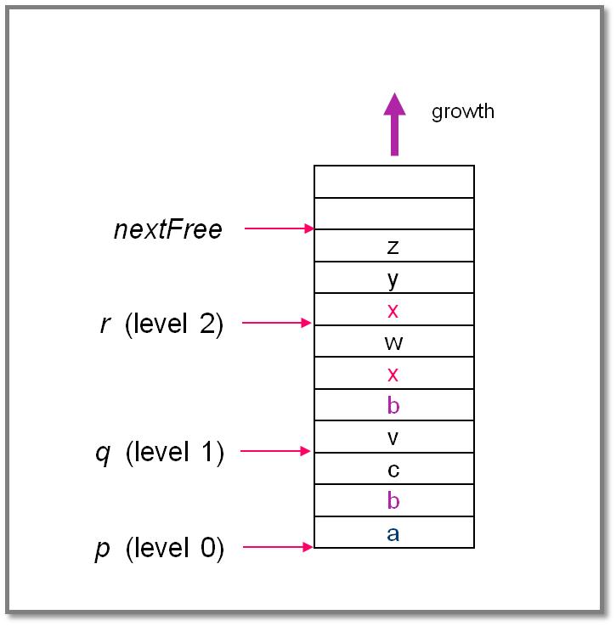
Implementing Lexically Scoped Symbol Tables
Stack organization
Implementation
insert () creates new level pointer if needed and inserts at nextFree
lookup () searches linearly from nextFree–1 forward
delete () sets nextFree to the equal the start location of the level deleted.
Advantage
Uses much less space
Disadvantage
Lookups can be expensive
Comp 412, Fall 2010

