Slide 1

The Procedure Abstraction:
Part II
Comp 412
COMP 412
FALL 2010
Copyright 2010, Keith D. Cooper & Linda Torczon, all rights reserved.
Students enrolled in Comp 412 at Rice University have explicit permission to make copies of these materials for their personal use.
Faculty from other educational institutions may use these materials for nonprofit educational purposes, provided this copyright notice is preserved.

Slide 2
Review
From last lecture
The Procedure serves as
A control abstraction
A naming abstraction
An external interface
We covered the control abstraction last lecture.
Today, we will focus on naming.
Access to system services, libraries, code from others …
Comp 412, Fall 2010

Slide 3
The Procedure as a Name Space
Each procedure creates its own name space
Any name (almost) can be declared locally
Local names obscure identical non-local names
Local names cannot be seen outside the procedure
  Nested procedures are “inside” by definition
We call this set of rules & conventions “lexical scoping”
Examples
C has global, static, local, and block scopes (Fortran-like)
  Blocks can be nested, procedures cannot
Scheme has global, procedure-wide, and nested scopes (let)
  Procedure scope (typically) contains formal parameters
The Java twist: allow fully qualified names to reach around scope rules
Comp 412, Fall 2010

Slide 4
The Procedure as a Name Space
Why introduce lexical scoping?
Provides a compile-time mechanism for binding “free” variables
Simplifies rules for naming & resolves conflicts
Lets the programmer introduce “local” names with impunity
How can the compiler keep track of all those names?
The Problem
At point p, which declaration of x is current?
At run-time, where is x found?
As parser goes in & out of scopes, how does it delete x?
The Answer
The compiler must model the name space
Lexically scoped symbol tables (see § 5.7 in EaC 1e)
Comp 412, Fall 2010

Slide 5
Do People Use This Stuff ?
C macro from the MSCP compiler
#define fix_inequality(oper, new_opcode) \
if (value0 < value1) \
{ \
Unsigned_Int temp = value0; \
value0 = value1; \
value1 = temp; \
opcode_name = new_opcode; \
temp = oper->arguments[0]; \
oper->arguments[0] = oper->arguments[1]; \
oper->arguments[1] = temp; \
oper->opcode = new_opcode; \
}
Even in C, a language not known for abstraction, people use scopes to hide details!
Declares a new name “temp”
Comp 412, Fall 2010

Slide 6
Do People Use This Stuff ?
Of course, it might have been more clear written as:
#define swap_values( val0, val1 ) \
{ \
Unsigned_Int tem = val0; \
val0 = val1; \
val1 = temp; \
}
#define fix_inequality(oper, new_opcode) \
if (value0 < value1) \
{ \
swap_values( val0, val1 ); \
opcode_name = new_opcode; \
temp = oper->arguments[0]; \
oper->arguments[0] = oper->arguments[1]; \
oper->arguments[1] = temp; \
oper->opcode = new_opcode; \
}
Even in C, we can build abstractions that are useful and tasteful.
Comp 412, Fall 2010

Slide 7
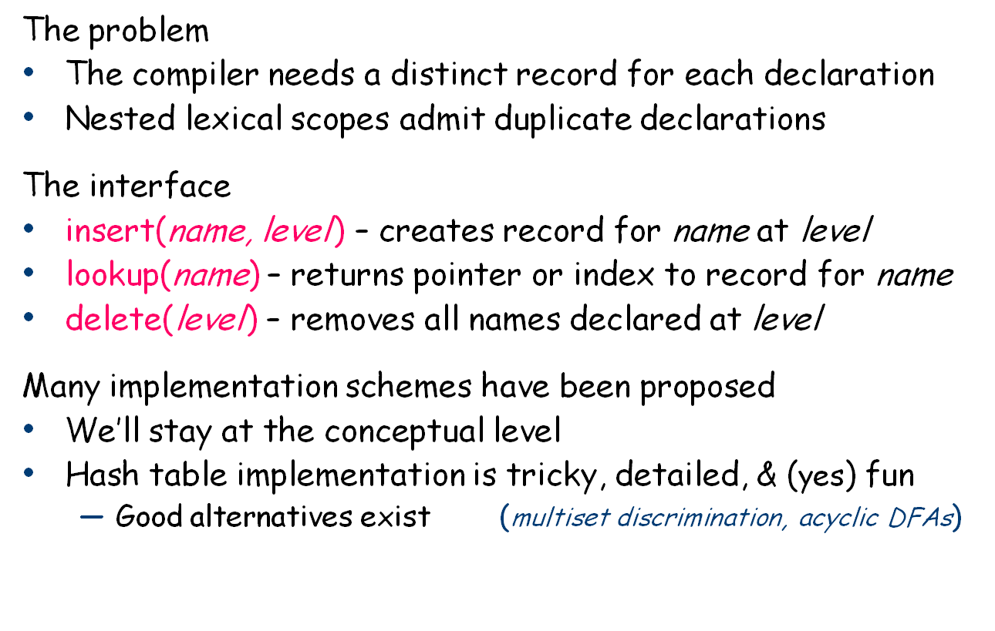
Lexically-scoped Symbol Tables
§ 5.7 in EaC 1e
Symbol tables are compile-time structures that the compiler uses to resolve references to names.
We’ll see the corresponding run-time structures that are used to establish addressability later.
Comp 412, Fall 2010

Slide 8
Example
procedure p {
int a, b, c
procedure q {
int v, b, x, w
procedure r {
int x, y, z
….
}
procedure s {
int x, a, v
…
}
… r … s
}
… q …
}
B0: {
int a, b, c
B1: {
int v, b, x, w
B2: {
int x, y, z
….
}
B3: {
int x, a, v
…
}
…
}
…
}
Comp 412, Fall 2010

Slide 9
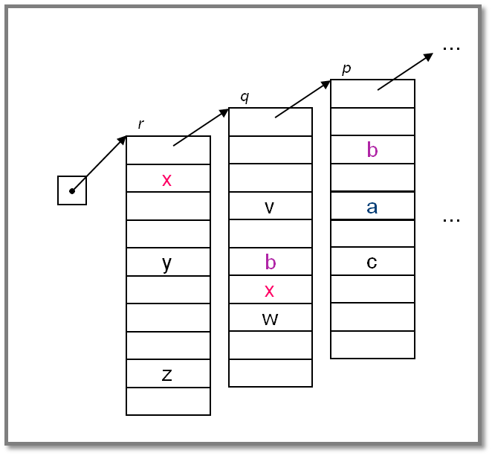
Lexically-scoped Symbol Tables
High-level idea
Create a new table for each scope
Chain them together for lookup
“Sheaf of tables” implementation
insert() may need to create table
it always inserts at current level
lookup() walks chain of tables &
returns first occurrence of name
delete() throws away level p table
if it is top table in the chain
If the compiler must preserve the table (for, say, the debugger ), this idea is actually practical.
Individual tables are hash tables.
Comp 412, Fall 2010
This high-level idea can be implemented as shown, or it can be implemented in more space-efficient (albeit complex) ways.

Slide 10
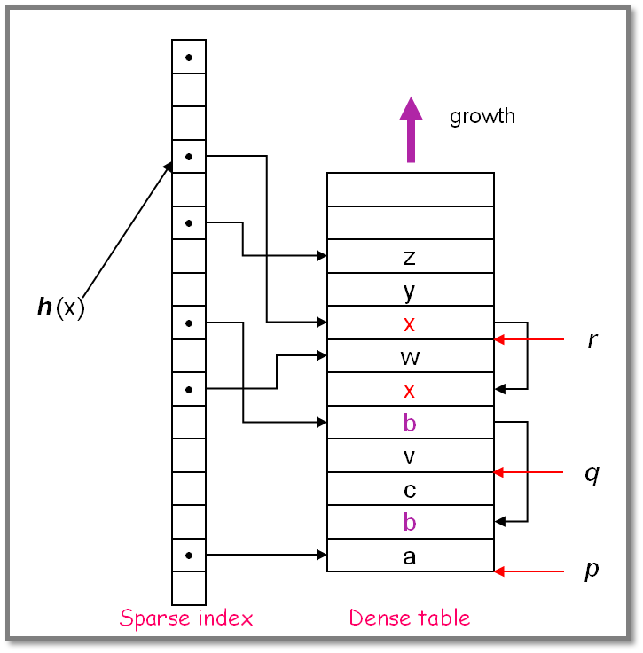
Implementing Lexically Scoped Symbol Tables
Threaded stack organization
Implementation
insert () puts new entry at the head of the list for the name
lookup () goes direct to location
delete () processes each element in level being deleted to remove from head of list
use sparse index for speed
use dense table to limit space
Advantage
lookup is fast
Disadvantage
delete takes time proportional to number of declared variables in level
Comp 412, Fall 2010
Parser (or treewalk) encounters names by scope, so each scope forms a block at stack top.

Slide 11
The Procedure as an External Interface
Naming plays a critical role in our ability to use procedure calls as a general interface
OS needs a way to start the program’s execution
Programmer needs a way to indicate where it begins
  The procedure “main” in most languages
When user invokes “grep” at a command line
  OS finds the executable
  OS creates a process and arranges for it to run “grep”
    Conceptually, it does a fork() and an exec() of the executable “grep”
  “grep” is code from the compiler, linked with run-time system
    Starts the run-time environment & calls “main”
    After main, it shuts down run-time environment & returns
When “grep” needs system services
  It makes a system call, such as fopen()
UNIX/Linux specific discussion
Stopped Here
See next lecture
Comp 412, Fall 2010

Slide 12
Where Do All These Variables Go?
Automatic & Local
Keep them in the procedure activation record or in a register
Automatic ⇒ lifetime matches procedure’s lifetime
Static
Procedure scope ⇒ storage area affixed with procedure name
  &_p.x
File scope ⇒ storage area affixed with file name
Lifetime is entire execution
Global
One or more named global data areas
One per variable, or per file, or per program, …
Lifetime is entire execution
Comp 412, Fall 2010

Slide 13
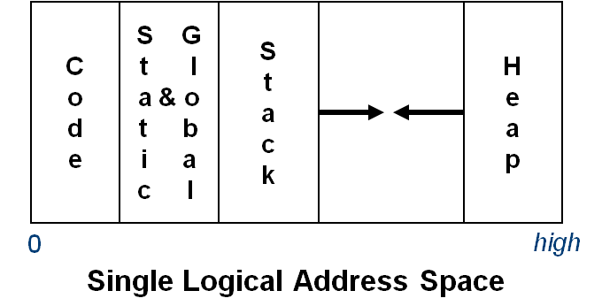
Placing Run-time Data Structures
Classic Organization
Better utilization if stack & heap grow toward each other
Very old result (Knuth)
Code & data separate or interleaved
Uses address space, not allocated memory
Code, static, & global data have known size
  Use symbolic labels in the code
Heap & stack both grow & shrink over time
This is a virtual address space
Comp 412, Fall 2010

Slide 14
How Does This Really Work?
The Big Picture
virtual address spaces
Compiler’s view
C
o
d
e
S G
t l
a & o
t b
i a
c l
S
t
a
c
k
H
e
a
p
C
o
d
e
S G
t l
a & o
t b
i a
c l
S
t
a
c
k
H
e
a
p
C
o
d
e
S G
t l
a & o
t b
i a
c l
S
t
a
c
k
H
e
a
p
C
o
d
e
S G
t l
a & o
t b
i a
c l
S
t
a
c
k
H
e
a
p
...
OS’ view
...
0
high
1980 Hardware view
Physical address space_
Comp 412, Fall 2010
On many modern processors, L1 cache uses physical addresses
Higher level caches typically use virtual addresses

Slide 15
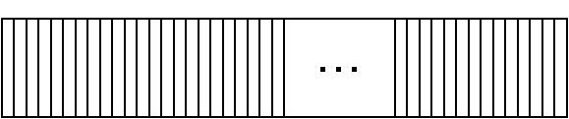
How Does This Really Work?
Most systems now include L3 caches. L4 is on its way.
Of course, the “Hardware view” is no longer that simple
Main
Memory
...
0
high
Caches can use physical or virtual addresses
Caches can be inclusive or exclusive
Caches can be shared
L2 Cache
L1 Caches
Code
Data
Code
Data
Functional unit
Functional unit
Functional unit
Functional unit
Processor Cores
Functional unit
Functional unit
Functional unit
Functional unit
Comp 412, Fall 2010
Cache structure matters for performance, not correctness

Slide 16
Where Do Local Variables Live?
A Simplistic model
Allocate a data area for each distinct scope
One data area per “sheaf” in scoped table
What about recursion?
Need a data area per invocation (or activation) of a scope
We call this the scope’s activation record
The compiler can also store control information there !
More complex scheme
One activation record (AR) per procedure instance
All the procedure’s scopes share a single AR (may share space)
Static relationship between scopes in single procedure
Used this way, “static” means knowable at compile time (and, therefore, fixed).
Comp 412, Fall 2010

Slide 17
Translating Local Names
How does the compiler represent a specific instance of x ?
Name is translated into a static coordinate
  < level,offset > pair
  “level” is lexical nesting level of the procedure
  “offset” is unique within that scope
Subsequent code will use the static coordinate to generate addresses and references
“level” is a function of the table in which x is found
  Stored in the entry for each x
“offset” must be assigned and stored in the symbol table
  Assigned at compile time
  Known at compile time
  Used to generate code that executes at run-time
Comp 412, Fall 2010

Slide 18
Storage for Blocks within a Single Procedure
B0: {
int a, b, c
B1: {
int v, b, x, w
B2: {
int x, y, z
…
}
B3: {
int x, a, v
…
}
…
}
…
}
Fixed length data can always be at a constant offset from the beginning of a procedure
  In our example, the a declared at level 0 will always be the first data element, stored at byte 0 in the fixed-length data area
  The x declared at level 1 will always be the sixth data item, stored at byte 20 in the fixed data area
  The x declared at level 2 will always be the eighth data item, stored at byte 28 in the fixed data area
  But what about the a declared in the second block at level 2?
Comp 412, Fall 2010

Slide 19
Variable-length Data
B0: { int a, b
…
assign value to a
…
B1: { int v(a), b, x
…
B2: { int x, y(8)
…
}
}
}
Arrays
If size is fixed at compile time, store in fixed-length data area
If size is variable, store descriptor in fixed length area, with pointer to variable length area
Variable-length data area is assigned at the end of the fixed length area for the block in which it is allocated (including all contained blocks)
a
b
v
b
x
x
y(8)
v(a)
Includes data for all fixed length objects in all blocks
Variable-length data
Comp 412, Fall 2010

Slide 20
Activation Record Basics
Space for parameters to the current routine
parameters
Saved register contents
register
save area
If function, space for return value
return value
Address to resume caller
return address
addressability
Help with non-local access
ARP
caller’s ARP
To restore caller’s AR on a
return
local
variables
Space for local values & variables (including spills)
One AR for each invocation of a procedure
Comp 412, Fall 2010
ARP ≈ Activation Record Pointer

Slide 21
Activation Record Details
How does the compiler find the variables?
They are at known offsets from the AR pointer
The static coordinate leads to a “loadAI” operation
  Level specifies an ARP, offset is the constant
Variable-length data
If AR can be extended, put it above local variables
Leave a pointer at a known offset from ARP
Otherwise, put variable-length data on the heap
Initializing local variables
Must generate explicit code to store the values
Among the procedure’s first actions
Comp 412, Fall 2010

Slide 22
Activation Record Details
Where do activation records live?
If lifetime of AR matches lifetime of invocation, AND
If code normally executes a “return”
Keep ARs on a stack
If a procedure can outlive its caller, OR
If it can return an object that can reference its execution state
ARs must be kept in the heap
If a procedure makes no calls
AR can be allocated statically
Efficiency prefers static, stack, then heap
C
o
d
e
S G
t l
a & o
t b
i a
c l
S
t
a
c
k
H
e
a
p
Yes! That stack
STOP
Comp 412, Fall 2010

Slide 23
Unused Slides
Comp 412, Fall 2010

Slide 24
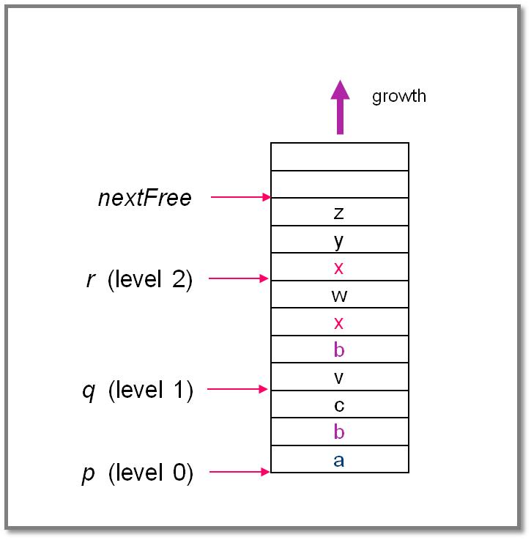
Implementing Lexically Scoped Symbol Tables
Stack organization
Implementation
insert () creates new level pointer if needed and inserts at nextFree
lookup () searches linearly from nextFree–1 forward
delete () sets nextFree to the equal the start location of the level deleted.
Advantage
Uses much less space
Disadvantage
Lookups can be expensive
Comp 412, Fall 2010

