Slide 1

Top-down Parsing
Recursive Descent & LL(1)
Comp 412
COMP 412
FALL 2010
The lecture is self consistent, but the order of the three productions for Factor in the expression grammar is different than in 2e
Copyright 2010, Keith D. Cooper & Linda Torczon, all rights reserved.
Students enrolled in Comp 412 at Rice University have explicit permission to make copies of these materials for their personal use.
Faculty from other educational institutions may use these materials for nonprofit educational purposes, provided this copyright notice is preserved.

Slide 2
Roadmap (Where are we?)
We set out to study parsing
Specifying syntax
  Context-free grammars  
Top-down parsers
  Algorithm & its problem with left recursion 
  Ambiguity 
  Left-recursion removal 
Predictive top-down parsing
  The LL(1) condition 
  Simple recursive descent parsers today
  First and Follow sets today
  Table-driven LL(1) parsers today
Comp 412, Fall 2010

Slide 3
Predictive Parsing
Basic idea
Given A → α | β, the parser should be able to choose between α & β
FIRST sets
  For some rhs α∈G, define FIRST(α) as the set of tokens that appear as the first symbol in some string that derives from α
  That is, x ∈ FIRST(α) iff α ⇒* x γ, for some γ
The LL(1) Property
If A → α and A → β both appear in the grammar, we would like
FIRST(α) ∩ FIRST(β) = ∅
This would allow the parser to make a correct choice with a lookahead of exactly one symbol !
This is almost correct
See the next slide
Comp 412, Fall 2010

Slide 4
Predictive Parsing
What about ε-productions?
They complicate the definition of LL(1)
If A → α and A → β and ε ∈ FIRST(α), then we need to ensure that FIRST(β) is disjoint from FOLLOW(A), too, where
FOLLOW(A) = the set of terminal symbols that can immediately follow A in a sentential form
Define FIRST⁺(A→α) as
FIRST(α) ∪ FOLLOW(A), if ε ∈ FIRST(α)
FIRST(α), otherwise
Then, a grammar is LL(1) iff A → α and A → β implies
FIRST⁺(A→α) ∩ FIRST⁺(A→β) = ∅
The intuition is straightforward. If A expands with 2 right hand sides, those rhs’ must have distinct first symbols.
We only need FIRST⁺ sets because of ε-productions.
Comp 412, Fall 2010

Slide 5
What If My Grammar Is Not LL(1) ?
Can we transform a non-LL(1) grammar into an LL(1) gramar?
In general, the answer is no
In some cases, however, the answer is yes
Assume a grammar G with productions A → α β₁ and A → α β₂
If α derives anything other than ε, then
FIRST⁺(A → α β₁) ∩ FIRST⁺(A → α β₂) ≠ ∅
And the grammar is not LL(1)
If we pull the common prefix, α, into a separate production, we may make the grammar LL(1).
A → α A’, A’ → β₁ and A’ → β₂
Now, if FIRST⁺(A’ → β₁) ∩ FIRST⁺(A’ → β₂) = ∅, G may be LL(1)
Comp 412, Fall 2010

Slide 6
What If My Grammar Is Not LL(1) ?
Left Factoring
This transformation makes some grammars into LL(1) grammars
There are languages for which no LL(1) grammar exists
For each nonterminal A
find the longest prefix α common to 2 or more alternatives for A
if α ≠ ε then
replace all of the productions
A → α β₁ | α β₂ | α β₃ | … | α β_{n} | γ
with
A → α A’ | γ
A’ → β₁ | β₂ | β₃ | … | β_{n}
Repeat until no nonterminal has alternative rhs’ with a common prefix
Comp 412, Fall 2010

Slide 7
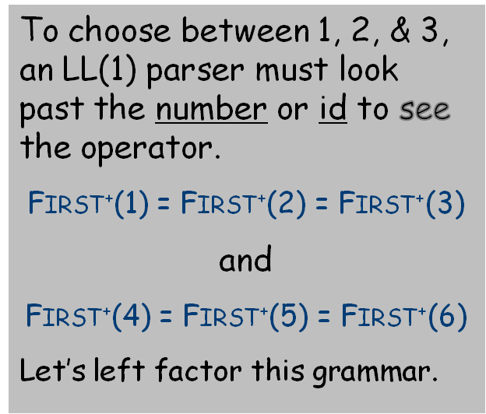
Left Factoring Example
Consider a simple right-recursive expression grammar
0 | Goal | → | Expr
1 | Expr | → | Term + Expr
2 |  | | | Term - Expr
3 |  | | | Term
4 | Term | → | Factor * Term
5 |  | | | Factor / Term
6 |  | | | Factor
7 | Factor | → | number
8 |  | | | id
Comp 412, Fall 2010

Slide 8
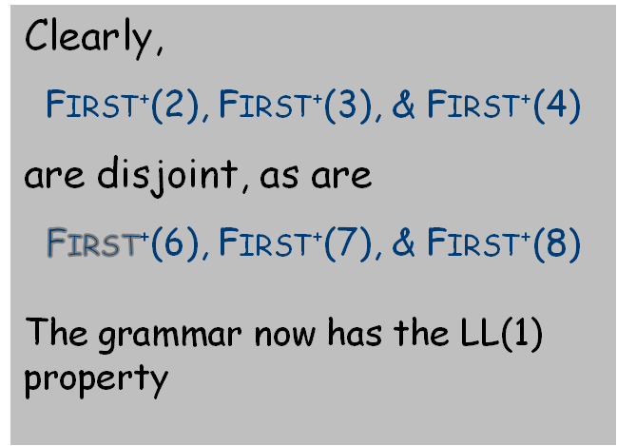
Left Factoring Example
After Left Factoring, we have
0 | Goal | → | Expr
1 | Expr | → | Term Expr’
2 | Expr’ | → | + Expr
3 |  | | | - Expr
4 |  | | | ε
5 | Term | → | Factor Term’
6 | Term’ | → | * Term
7 |  | | | / Term
8 |  | | | ε
9 | Factor | → | number
10 |  | | | id
This transformation makes some grammars into LL(1) grammars.
There are languages for which no LL(1) grammar exists.
Comp 412, Fall 2010

Slide 9
FIRST and FOLLOW Sets
FIRST(α)
  For some α ∈ (T ∪ NT )*, define FIRST(α) as the set of tokens that appear as the first symbol in some string that derives from α
  That is, x ∈ FIRST(α) iff α ⇒* x γ, for some γ
FOLLOW(A)
  For some A ∈ NT, define FOLLOW(A) as the set of symbols that can occur immediately after A in a valid sentential form
  FOLLOW(S) = {EOF}, where S is the start symbol
To build FOLLOW sets, we need FIRST sets …
Comp 412, Fall 2010

Slide 10
Computing FIRST Sets
for each x ∈ T, FIRST(x) ← { x }
for each A ∈ NT, FIRST(A) ← Ø
while (FIRST sets are still changing) do
for each p ∈ P, of the form A→β do
if β is B₁B₂…B_{k} then begin;
rhs ← FIRST(B₁) – { ε }
for i ← 1 to k–1 by 1 while ε ∈ FIRST(B_{i}) do
rhs ← rhs ∪ ( FIRST(B_{i+1}) – { ε } )
end // for loop
end // if-then
if i = k and ε ∈ FIRST(B_{k} )
then rhs ← rhs ∪ { ε }
FIRST(A) ← FIRST(A) ∪ rhs
end // for loop
end // while loop
Outer loop is monotone
increasing for FIRST
sets
| T ∪ NT ∪ ε | is
bounded, so it terminates
Inner loop is bounded
by the length of the
productions in the
grammar
For SheepNoise:
  FIRST(Goal) = { baa }
  FIRST(SN ) = { baa }
  FIRST(baa) = { baa }
Comp 412, Fall 2010
Notes:
NT**2 x L set operations

Slide 11
Computing FIRST Sets
for each x ∈ T, FIRST(x) ← { x }
for each A ∈ NT, FIRST(A) ← Ø
while (FIRST sets are still changing) do
for each p ∈ P, of the form A→β do
if β is B₁B₂…B_{k} then begin;
rhs ← FIRST(B₁) – { ε }
for i ← 1 to k–1 by 1 while ε ∈ FIRST(B_{i}) do
rhs ← rhs ∪ ( FIRST(B_{i+1}) – { ε } )
end // for loop
end // if-then
if i = k and ε ∈ FIRST(B_{k} )
then rhs ← rhs ∪ { ε }
FIRST(A) ← FIRST(A) ∪ rhs
end // for loop
end // while loop
Outer loop is monotone
increasing for FIRST
sets
| T ∪ NT ∪ ε | is
bounded, so it terminates
Inner loop is bounded
by the length of the
productions in the
grammar
For SN → baa
For SheepNoise:
  FIRST(Goal) = { baa }
  FIRST(SN ) = { baa }
  FIRST(baa) = { baa }
Comp 412, Fall 2010

Slide 12
Computing FIRST Sets
for each x ∈ T, FIRST(x) ← { x }
for each A ∈ NT, FIRST(A) ← Ø
while (FIRST sets are still changing) do
for each p ∈ P, of the form A→β do
if β is B₁B₂…B_{k} then begin;
rhs ← FIRST(B₁) – { ε }
for i ← 1 to k–1 by 1 while ε ∈ FIRST(B_{i}) do
rhs ← rhs ∪ ( FIRST(B_{i+1}) – { ε } )
end // for loop
end // if-then
if i = k and ε ∈ FIRST(B_{k} )
then rhs ← rhs ∪ { ε }
FIRST(A) ← FIRST(A) ∪ rhs
end // for loop
end // while loop
Outer loop is monotone
increasing for FIRST
sets
| T ∪ NT ∪ ε | is
bounded, so it terminates
Inner loop is bounded
by the length of the
productions in the
grammar
For Goal → SN
For SheepNoise:
  FIRST(Goal) = { baa }
  FIRST(SN ) = { baa }
  FIRST(baa) = { baa }
Comp 412, Fall 2010

Slide 13
Computing FOLLOW Sets
for each A ∈ NT, FOLLOW(A) ← Ø
FOLLOW(S) ← {EOF }
while (FOLLOW sets are still changing)
for each p ∈ P, of the form A→B₁B₂ … B_{k}
TRAILER ← FOLLOW(A)
for i ← k down to 1
if B_{i} ∈ NT then // domain check
FOLLOW(B_{i}) ← FOLLOW(B_{i}) ∪ TRAILER
if ε ∈ FIRST(B_{i} ) // add right context
then TRAILER ← TRAILER ∪ ( FIRST(B_{i}) – { ε } )
else TRAILER ← FIRST(B_{i}) // no ε => no right context
else TRAILER ← {B_{i} } // B_{i} ∈ T => only 1 symbol
Comp 412, Fall 2010

Slide 14
Classic Expression Grammar
0 | Goal | → | Expr
1 | Expr | → | Term Expr’
2 | Expr’ | → | + Term Expr’
3 |  | | | - Term Expr’
4 |  | | | ε
5 | Term | → | Factor Term’
6 | Term’ | → | * Factor Term’
7 |  | | | / Factor Term’
8 |  | | | ε
9 | Factor | → | number
10 |  | | | id
11 |  | | | ( Expr )
Symbol | FIRST | FOLLOW
num | num | Ø
id | id | Ø
+ | + | Ø
- | - | Ø
* | * | Ø
/ | / | Ø
( | ( | Ø
) | ) | Ø
eof | eof | Ø
ε | ε | Ø
Goal | (,id,num | eof
Expr | (,id,num | ), eof
Expr’ | +, -, ε | ), eof
Term | (,id,num | +, -, ), eof
Term’ | *, /, ε | +,-, ), eof
Factor | (,id,num | +,-,*,/,),eof
FIRST⁺(A→β ) is identical to FIRST(β ) except for productiond 4 and 8
FIRST⁺(Expr’→ ε) is {ε,), eof}
FIRST⁺(Term’→ ε) is {ε,+,-, ), eof}
Comp 412, Fall 2010

Slide 15
Classic Expression Grammar
0 | Goal | → | Expr
1 | Expr | → | Term Expr’
2 | Expr’ | → | + Term Expr’
3 |  | | | - Term Expr’
4 |  | | | ε
5 | Term | → | Factor Term’
6 | Term’ | → | * Factor Term’
7 |  | | | / Factor Term’
8 |  | | | ε
9 | Factor | → | number
10 |  | | | id
11 |  | | | ( Expr )
Prod’n | FIRST+
0 | (,id,num
1 | (,id,num
2 | +
3 | -
4 | ε,), eof
5 | (,id,num
6 | *
7 | /
8 | ε,+,-, ), eof
9 | number
10 | id
11 | (
Comp 412, Fall 2010

Slide 16
Building Top-down Parsers for LL(1) Grammars
Given an LL(1) grammar, and its FIRST & FOLLOW sets …
Emit a routine for each non-terminal
  Nest of if-then-else statements to check alternate rhs’s
  Each returns true on success and throws an error on false
  Simple, working (perhaps ugly) code
This automatically constructs a recursive-descent parser
Improving matters
Nest of if-then-else statements may be slow
  Good case statement implementation would be better
What about a table to encode the options?
  Interpret the table with a skeleton, as we did in scanning
I don’t know of a system that does this …
Comp 412, Fall 2010

Slide 17
Building Top-down Parsers
Strategy
Encode knowledge in a table
Use a standard “skeleton” parser to
interpret the table
Example
The non-terminal Factor has 3 expansions
  ( Expr ) or Identifier or Number
Table might look like:
0 | Goal | → | Expr
1 | Expr | → | Term Expr’
2 | Expr’ | → | + Term Expr’
3 |  | | | - Term Expr’
4 |  | | | ε
5 | Term | → | Factor Term’
6 | Term’ | → | * Factor Term’
7 |  | | | / Factor Term’
8 |  | | | ε
9 | Factor | → | number
10 |  | | | id
11 |  | | | ( Expr )
Terminal Symbols
 | + | - | * | / | Id. | Num. | ( | ) | EOF
Factor | — | — | — | — | 10 | 9 | 11 | — | —
Non-
terminal
Symbols
Expand Factor by rule 9 with input “number”
Cannot expand Factor into an operator ⇒ error
Comp 412, Fall 2010

Slide 18
Building Top-down Parsers
Building the complete table
Need a row for every NT & a column for every T
Comp 412, Fall 2010

Slide 19
LL(1) Expression Parsing Table
 | + | – | * | / | Id | Num | ( | ) | EOF
Goal | — | — | — | — | 0 | 0 | 0 | — | —
Expr | — | — | — | — | 1 | 1 | 1 | — | —
Expr’ | 2 | 3 | — | — | — | — | — | 4 | 4
Term | — | — | — | — | 5 | 5 | 5 | — | —
Term’ | 8 | 8 | 6 | 7 | — | — | — | 8 | 8
Factor | — | — | — | — | 10 | 9 | 11 | — | —
Row we built earlier
Table differs from 2e because order of productions in Factor differs.
Comp 412, Fall 2010

Slide 20
Building Top-down Parsers
Building the complete table
Need a row for every NT & a column for every T
Need an interpreter for the table (skeleton parser)
Comp 412, Fall 2010

Slide 21
LL(1) Skeleton Parser
word ← NextWord() // Initial conditions, including
push EOF onto Stack // a stack to track local goals
push the start symbol, S, onto Stack
TOS ← top of Stack
loop forever
if TOS = EOF and word = EOF then
break & report success // exit on success
else if TOS is a terminal then
if TOS matches word then
pop Stack // recognized TOS
word ← NextWord()
else report error looking for TOS // error exit
else // TOS is a non-terminal
if TABLE[TOS,word] is A→ B₁B₂…B_{k} then
pop Stack // get rid of A
push B_{k}, B_{k-1}, …, B₁ // in that order
else break & report error expanding TOS
TOS ← top of Stack
Comp 412, Fall 2010

Slide 22
Building Top-down Parsers
Building the complete table
Need a row for every NT & a column for every T
Need a table-driven interpreter for the table
Need an algorithm to build the table
Filling in TABLE[X,y], X ∈ NT, y ∈ T
  entry is the rule X→ β, if y ∈ FIRST⁺(X→ β)
  entry is error if rule 1 does not define
If any entry has more than one rule, G is not LL(1)
We call this algorithm the LL(1) table construction algorithm
Comp 412, Fall 2010

Slide 23
Grammar and Sets for the LL(1) Construction
0 | Goal | → | Expr
1 | Expr | → | Term Expr’
2 | Expr’ | → | + Term Expr’
3 |  | | | - Term Expr’
4 |  | | | ε
5 | Term | → | Factor Term’
6 | Term’ | → | * Factor Term’
7 |  | | | / Factor Term’
8 |  | | | ε
9 | Factor | → | number
10 |  | | | id
11 |  | | | ( Expr )
Prod’n | FIRST+
0 | (,id,num
1 | (,id,num
2 | +
3 | -
4 | ε,), eof
5 | (,id,num
6 | *
7 | /
8 | ε,+,-, ), eof
9 | number
10 | id
11 | (
Right-recursive variant of the classic expression grammar
Augmented FIRST sets for the grammar
Comp 412, Fall 2010

