Slide 1

Instruction Selection II:
Tree-pattern Matching
Comp 412
COMP 412
FALL 2010
Copyright 2010, Keith D. Cooper & Linda Torczon, all rights reserved.
Students enrolled in Comp 412 at Rice University have explicit permission to make copies of these materials for their personal use.
Faculty from other educational institutions may use these materials for nonprofit educational purposes, provided this copyright notice is preserved.

Slide 2
The Concept
Many compilers use tree-structured IRs
Abstract syntax trees generated in the parser
Trees or DAGs for expressions
These systems might well use trees to represent target ISA
Consider the ILOC add operations
If we can match these “pattern trees” against IR trees, …
+
+
Operation trees or pattern trees
r_{i}
r_{j}
r_{i}
c_{j}
add r_{i},r_{j} ⇒ r_{k}
addI r_{i},c_{j} ⇒ r_{k}
Comp 412, Fall 2010

Slide 3
The Concept
Use a low-level AST that exposes enough detail
Low-level AST for w ← x - 2 * y
GETS
Simplification: we will restrict our discussion to signed integers.
Expanding to handle multiple other types is straightforward.
+
-
VAL
ARP
NUM
4
REF
*
REF
NUM
2
REF
w: at ARP+4
x: at ARP-26
Y: at @G+12
+
+
VAL
ARP
NUM
-26
LAB
@G
NUM
12
Comp 412, Fall 2010

Slide 4
The Concept
Use a low-level AST that exposes enough detail
Low-level AST for w ← x - 2 * y
GETS
ARP: r_{arp}
NUM: constant
LAB: ASM label
+
-
VAL
ARP
NUM
4
REF
*
NUM is a constant that fits in a loadI
LAB is a constant that does not.
REF
NUM
2
REF
w: at ARP+4
x: at ARP-26
Y: at @G+12
+
+
VAL
ARP
NUM
-26
LAB
@G
NUM
12
Comp 412, Fall 2010

Slide 5
Notation
To describe these trees, we need a concise notation
+
+(r_{i},c_{j})
r_{i}
c_{j}
Linear prefix form
+
+(r_{i},r_{j})
r_{i}
r_{j}
Comp 412, Fall 2010

Slide 6
Notation
To manipulate these trees, we need a concise notation
+
+
+(r_{i},c_{j})
+(c_{j},r_{i})
r_{i}
c_{j}
c_{j}
r_{i}
Pattern for commutative variant of +(r_{i},c_{j})
+
+(r_{i},r_{j})
r_{i}
r_{j}
With each tree pattern, we associate a code template and a cost
Template shows how to implement the subtree
Cost is used to drive process to low-cost code sequences
Comp 412, Fall 2010

Slide 7
Notation
The same notation can describe our low-level AST
GETS
-(REF(REF(+(VAL₂,NUM₂))),
*(NUM₃, REF(+(LAB₁,NUM₃))))
+
-
*(NUM₃, REF(+(LAB₁,NUM₄)))
VAL
ARP
NUM
4
REF
*
+(VAL₁,NUM₁)
REF
NUM
2
REF
REF(REF(+(VAL₂,NUM₂)))
+
+
VAL
ARP
NUM
-26
LAB
@G
NUM
12
GETS(+(VAL₁,NUM₁), -(REF(REF(+(VAL₂,NUM₂))), *(NUM₃,REF(+(LAB₁,NUM₄)))))
Comp 412, Fall 2010
Subscripts added to create unique names

Slide 8
Tree-pattern matching
Goal is to “tile” the AST with operation trees
A tiling is collection of <node,op > pairs
  Node is a node in the AST
  op is a pattern tree
  <node, op > means that op could implement the subtree at node
A tiling ‘implements” an AST if it covers every node in the AST and the overlap between any two trees is limited to a single node
  <node, op > ∈ tiling means that the root of node is also covered by a leaf in another pattern tree in the tiling, unless node is the root of the entire tree
  Where two pattern trees overlap, they must be compatible; that is, they expect the value in the same location
Comp 412, Fall 2010

Slide 9
A Tiling of Our Example Tree
Tile 6
Each tile corresponds to a sequence of operations
Emitting those operations in an appropriate order implements the tree.
GETS
Tile 5
+
-
Tile 1
Tile 2
Tile 4
VAL
ARP
NUM
4
REF
*
Tile 3
REF
NUM
2
REF
+
+
VAL
ARP
NUM
-26
LAB
@G
NUM
12
Comp 412, Fall 2010
Tile numbers correspond to a postorder traversal of the AST.
Notes:
Tiling that might be produced in a postorder walk.
Tile boundaries are taken from actual tree patterns given later in the talk.
At this point, however, they are simply examples.

Slide 10
Generating Code from the Tiled Tree
Postorder treewalk, with node-dependent visitation order
  Right child of GETS before its left child
  Might impose “most demanding subtree first” rule … (Sethi )
Emit code sequence for tiles, in traversal order
Tie boundaries together with names
  Tile 6 uses registers produced by tiles 1 & 5
  Tile 6 emits “store r_{tile 5} ⇒ r_{tile 1}”
  Can incorporate a “real” allocator
  or increment a NextRegister counter
Tile 6
GETS
+
Tile 5
Tile 1
-
Comp 412, Fall 2010

Slide 11
So, What’s Hard About This?
Finding the matches to tile the tree
Compiler writer specifies mapping from AST to operations
Provide a set of rewrite rules
  Rewrite rules describe the AST
Encode tree syntax, in linear form
Associate a code template with each rule
Give the cost of each template
The compiler writer produces the mapping.
Tools turn the mapping into a working instruction selector.
Comp 412, Fall 2010

Slide 12
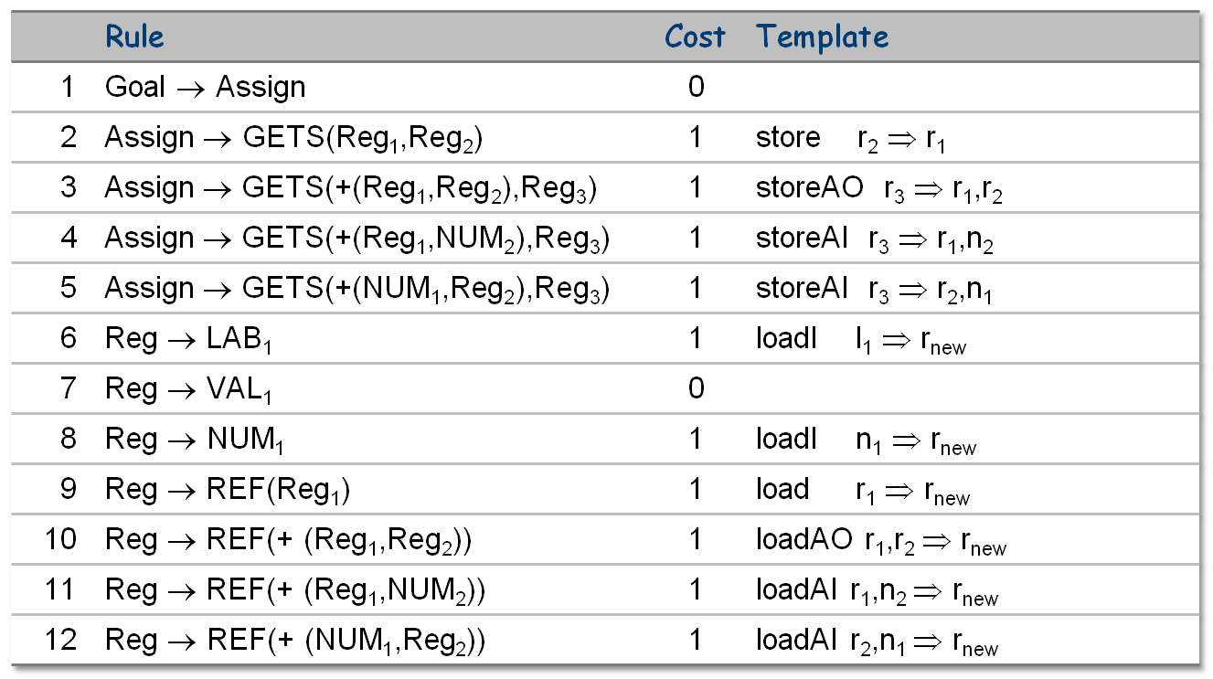
Rewrite rules: Low-Level Integer AST into ILOC
Comp 412, Fall 2010
From Figure 11.5 in EaC

Slide 13
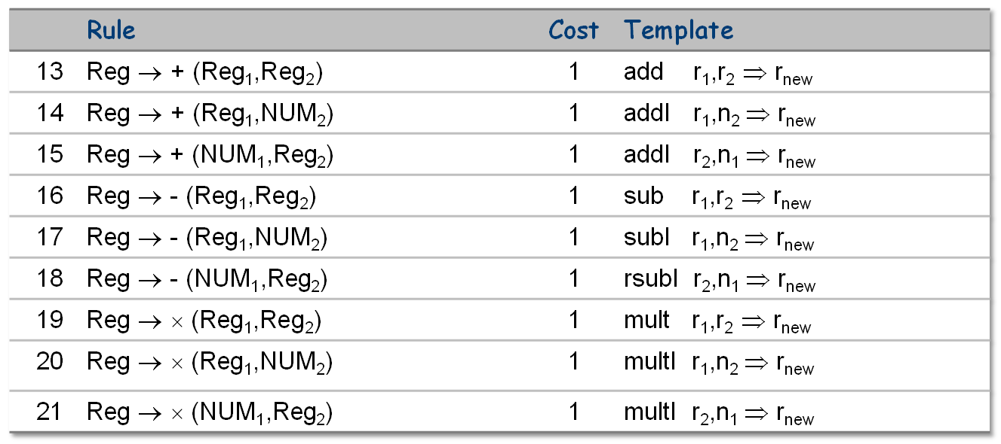
Rewrite rules: LL Integer AST into ILOC (part II)
Commutative pair
A real set of rules would cover more than signed integers …
Comp 412, Fall 2010

Slide 14
So, What’s Hard About This?
Need an algorithm to match AST subtrees with the rules
Consider tile 3 in our example
Tile 3
REF
+
LAB
@G
NUM
12
Comp 412, Fall 2010

Slide 15
So, What’s Hard About This?
Need an algorithm to AST subtrees with the rules
Consider tile 3 in our example
What rules match tile 3?
REF
+
LAB
@G
NUM
12
Comp 412, Fall 2010

Slide 16
So, What’s Hard About This?
Need an algorithm to match AST subtrees with the rules
Consider tile 3 in our example
What rules match tile 3?
6: Reg → LAB₁ tiles the lower left node
REF
+
6
LAB
@G
NUM
12
Comp 412, Fall 2010

Slide 17
So, What’s Hard About This?
Need an algorithm to AST subtrees with the rules
Consider tile 3 in our example
What rules match tile 3?
6: Reg → LAB₁ tiles the lower left node
8: Reg → NUM₁ tiles the bottom right node
REF
+
6
8
LAB
@G
NUM
12
Comp 412, Fall 2010

Slide 18
So, What’s Hard About This?
Need an algorithm to AST subtrees with the rules
Consider tile 3 in our example
What rules match tile 3?
6: Reg → LAB₁ tiles the lower left node
8: Reg → NUM₁ tiles the bottom right node
13: Reg → + (Reg₁,Reg₂) tiles the + node
REF
13
+
6
8
LAB
@G
NUM
12
Comp 412, Fall 2010

Slide 19
So, What’s Hard About This?
Need an algorithm to AST subtrees with the rules
Consider tile 3 in our example
9
What rules match tile 3?
6: Reg → LAB₁ tiles the lower left node
8: Reg → NUM₁ tiles the bottom right node
13: Reg → + (Reg₁,Reg₂) tiles the + node
9: Reg → REF(Reg₁) tiles the REF
REF
13
+
6
8
LAB
@G
NUM
12
Comp 412, Fall 2010

Slide 20
So, What’s Hard About This?
Need an algorithm to AST subtrees with the rules
Consider tile 3 in our example
9
What rules match tile 3?
6: Reg → LAB₁ tiles the lower left node
8: Reg → NUM₁ tiles the bottom right node
13: Reg → + (Reg₁,Reg₂) tiles the + node
9: Reg → REF(Reg₁) tiles the REF
REF
13
+
6
8
LAB
@G
NUM
12
We denote this match as <6,8,13,9>
Of course, it implies <8,6,13,9>
Both have a cost of 4
Comp 412, Fall 2010

Slide 21
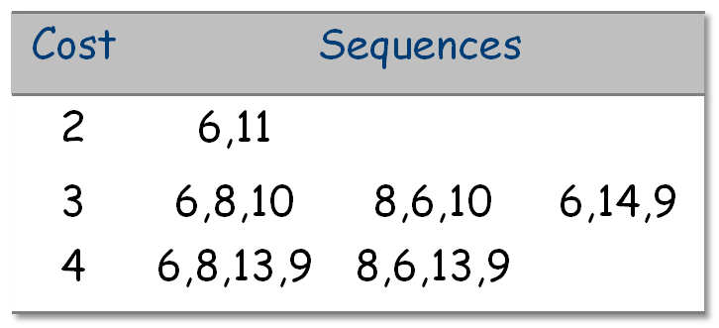
Finding matches
Many Sequences Match Our Subtree
REF
+
LAB
@G
NUM
12
In general, we want the low cost sequence
We have assumed uniform unit costs
We favor shorter (lower-cost) sequences
Accurate costs produce better code
Comp 412, Fall 2010

Slide 22
Finding matches
Many Sequences Match Our Subtree
REF
+
LAB
@G
NUM
12
Notice that the difference between LAB and NUM prevents matches such as <8,12> and <8,15,9>.
The distinction reflects the difference between a number that will fit in the immediate field of an addI and one that will fit in a loadI
Comp 412, Fall 2010

Slide 23
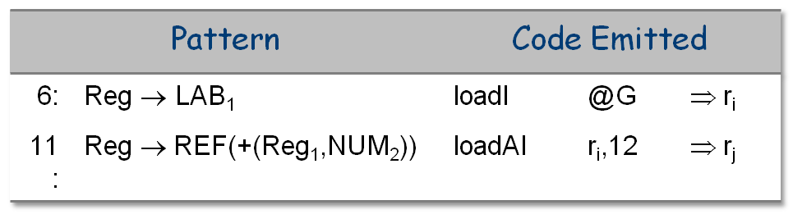
Finding matches
Expanding the Low Cost Match
11
REF
+
6
LAB
@G
NUM
12
Inter-tile connection made with a common name
Comp 412, Fall 2010

Slide 24
Tiling the Tree
We still need an algorithm …
Assume each rule implements one operator
  This is a big assumption because it eliminates rules like 11
Reg → REF(+ (Reg₁,NUM₂)) (corresponds to loadAI)
  A solution: break into two rules
  Reg → REF(T₁) cost: 1
  T₁ → + (Reg₁,NUM₂) cost: 0
Assume operator takes 0, 1, or 2 operands
This assumption allows us to phrase the pattern matching problem as a simple treewalk
  Multiple operations per rule means the algorithm must look at combinations of nodes
  Significant algorithmic complications …
Now, …
Comp 412, Fall 2010

Slide 25
Tiling the Tree
Assume only one storage class for the moment.
Tile(n)
Label(n) ← Ø
if n has two children then
Tile (left child of n)
Tile (right child of n)
for each rule r that implements n
if (left(r) ∈ Label(left(n)) and
(right(r) ∈ Label(right(n))
then Label(n) ← Label(n) ∪ { r }
else if n has one child
Tile(left child of n)
for each rule r that implements n
if (left(r) ∈ Label(child(n))
then Label(n) ← Label(n) ∪ { r }
else /* n is a leaf */
Label(n) ← {all rules that implement n }
Match binary nodes against binary rules
Match unary nodes against unary rules
Handle leaves with lookup in rule table
Comp 412, Fall 2010
Notes:
Tile( node ) labels node with all of the rules that can cover the subtree rooted at node.

Slide 26
Tiling the Tree
Tile(n)
Label(n) ← Ø
if n has two children then
Tile (left child of n)
Tile (right child of n)
for each rule r that implements n
if (left(r) ∈ Label(left(n)) and
(right(r) ∈ Label(right(n))
then Label(n) ← Label(n) ∪ { r }
else if n has one child
Tile(left child of n)
for each rule r that implements n
if (left(r) ∈ Label(child(n))
then Label(n) ← Label(n) ∪ { r }
else /* n is a leaf */
Label(n) ← {all rules that implement n }
Use same notation to navigate through the rules (pattern trees) and the AST
left and right have obvious meanings on AST
left and right have similar meanings on the rhs of a rule — interpreted as if on the underlying pattern tree
Comp 412, Fall 2010

Slide 27
Tiling the Tree
Tile(n)
Label(n) ← Ø
if n has two children then
Tile (left child of n)
Tile (right child of n)
for each rule r that implements n
if (left(r) ∈ Label(left(n)) and
(right(r) ∈ Label(right(n))
then Label(n) ← Label(n) ∪ { r }
else if n has one child
Tile(left child of n)
for each rule r that implements n
if (left(r) ∈ Label(child(n))
then Label(n) ← Label(n) ∪ { r }
else /* n is a leaf */
Label(n) ← {all rules that implement n }
These loops
Find all matches in rule set
Label node n with that set
Can keep lowest cost match at each point
Lead to a notion of local optimality — lowest cost at each point
Spend most of the time in the algorithm
Comp 412, Fall 2010

Slide 28
Tiling the Tree
Tile(n)
Label(n) ← Ø
if n has two children then
Tile (left child of n)
Tile (right child of n)
for each rule r that implements n
if (left(r) ∈ Label(left(n)) and
(right(r) ∈ Label(right(n))
then Label(n) ← Label(n) ∪ { r }
else if n has one child
Tile(left child of n)
for each rule r that implements n
if (left(r) ∈ Label(child(n))
then Label(n) ← Label(n) ∪ { r }
else /* n is a leaf */
Label(n) ← {all rules that implement n }
Oversimplifications
Only handles 1 storage class
Must track low cost sequence in each class
Must choose lowest cost for subtree, across all classes
The extensions to handle these complications are pretty straightforward.
Comp 412, Fall 2010

Slide 29
Tiling the Tree
Tile(n)
Label(n) ← Ø
if n has two children then
Tile (left child of n)
Tile (right child of n)
for each rule r that implements n
if (left(r) ∈ Label(left(n)) and
(right(r) ∈ Label(right(n))
then Label(n) ← Label(n) ∪ { r }
else if n has one child
Tile(left child of n)
for each rule r that implements n
if (left(r) ∈ Label(child(n))
then Label(n) ← Label(n) ∪ { r }
else /* n is a leaf */
Label(n) ← {all rules that implement n }
Can turn matching code (inner loop) into a table lookup
Table can get huge and sparse
|op trees| x |l.s.| x |l.s.|
200 x 1000 x 1000
leads to 200,000,000 entries
Fortunately, they are quite sparse & have reasonable encodings (e.g., Chase’s work)
Here, l.s. means “label sets”
Comp 412, Fall 2010

Slide 30
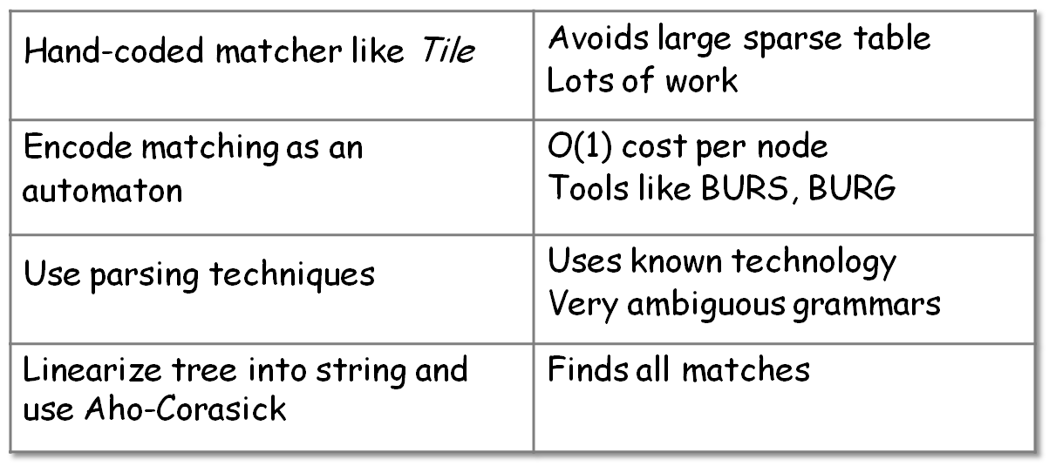
The Big Picture
Tree patterns represent AST and ASM
Can use matching algorithms to find low-cost tiling of AST
Can turn a tiling into code using templates for matched rules
Techniques (& tools) exist to do this efficiently
Comp 412, Fall 2010

Slide 31
One Last Word
What about a tree such as +(2,+(g,4)) ?
Can we catch the opportunity for constant folding?
  Idea goes back to the first “code shape” lecture
  +(2,4) does not occur in the tree, but we’d like to convert
  this tree to +(6,g)
Idea 1:
  Let the optimizer catch this opportunity
  General solution
  “Single point of control” from COMP 210
Idea 2:
  Use a larger pattern set
  Look for all ternary adds with two constants
  Increases size of pattern set, size of table
  Does not increase compile-time cost of table-driven matching
Comp 412, Fall 2010

Slide 32
Extra Slides Start Here
Comp 412, Fall 2010

Slide 33
Other Sequences for Tile 3
11
6,11
6: Reg → LAB₁
11: Reg → REF( + (Reg₁,NUM₂))
REF
Two operator rule
+
6
LAB
@G
NUM
12
Comp 412, Fall 2010

Slide 34
Other Sequences for Tile 3
12
What about 8,12?
8: Reg → NUM₁
12: Reg → REF( + (NUM₁,Reg₂))
It doesn’t match because of the type mismatch between NUM and LAB.
REF
Two operator rule
+
8
LAB
@G
NUM
12
Comp 412, Fall 2010

Slide 35
Other Sequences for Tile 3
10
6,8,10
6: Reg → LAB₁
8: Reg → NUM₁
11: Reg → REF( + (Reg₁,Reg₂))
REF
+
Two operator rule
6
8
LAB
@G
NUM
12
8,6,10 looks the same
Comp 412, Fall 2010

Slide 36
Other Sequences for Tile 3
9
6,14,9
6: Reg → LAB₁
14: Reg → + (Reg₁,NUM₂)
9: Reg → REF(Reg₁)
REF
All single operator rules
14
+
6
LAB
@G
NUM
12
Comp 412, Fall 2010

Slide 37
Other Sequences for Tile 3
9
What about 8,15,9?
8: Reg → NUM₁
15: Reg → + (NUM₁,Reg₂)
9: Reg → REF(Reg₁)
Again, the type mismatch between NUM in rule 15 and LAB in the tree prevents this match, even though it might work if LAB is small enough to fit in the immediate field of the loadAI operations.
REF
All single operator rules
15
+
8
LAB
@G
NUM
12
Comp 412, Fall 2010

Slide 38
Other Sequences for Tile 3
9
6,8,13,9
6: Reg → LAB₁
8: Reg → NUM₁
13: Reg → + (Reg₁,Reg₂)
9: Reg → REF(Reg₁)
REF
All single operator rules
13
+
6
8
LAB
@G
NUM
12
8,6,13,9 looks the same
Comp 412, Fall 2010

Slide 39
Tiling the Tree (Alternative Version)
Tile(n)
Label(n) ← Ø
if n has two children then
Tile (left child of n)
Tile (right child of n)
for each rule r that implements n
if (left(r) ∈ Label(left(n)) and
(right(r) ∈ Label(right(n))
then Label(n) ← Label(n) ∪ { lhs(r) }
else if n has one child
Tile(child of n)
for each rule r that implements n
if (left(r) ∈ Label(child(n))
then Label(n) ← Label(n) ∪ {lhs(r) }
else /* n is a leaf */
Label(n) ← {all left hand sides of rules
that implement n }
Notes
Labels on nodes are sets of nonterminals
Each nonterminal annotated with cheapest cost to produce (and possibly the rules to get there)
At end, entire low-cost tiling can be reconstructed
LHS of a rule is its label …
Comp 412, Fall 2010

