Slide 1
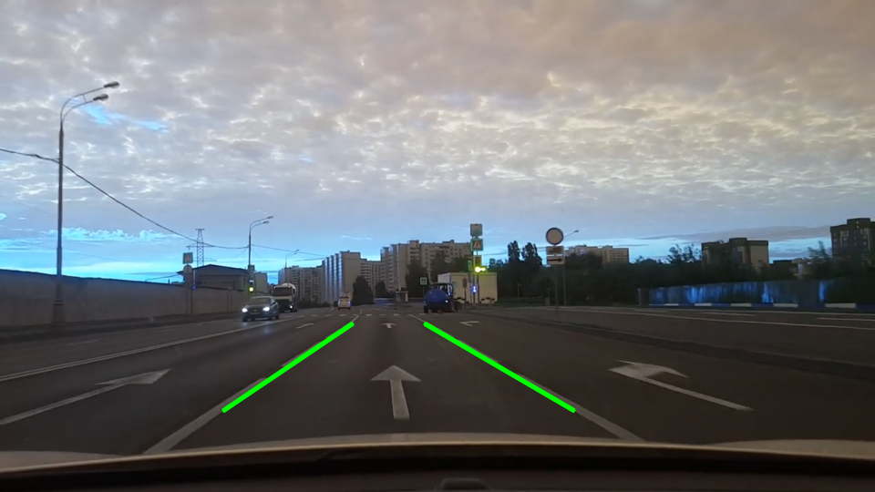
Motivation
Accurate lane line detectipn
Avoiding misidentification caused by road surface marking, cars and other noises.

Slide 2
Introduction
Modern approach – DL
We will use old but gold – Standard Hough Lines Transform (SHT) or even better - Probabilistic Hough transform (PHT)
Difference between SHT and PHT? - link

Slide 3
Description of realization.
Apply Contrast Limited Adaptive Histogram Equalization (CLAHE) to improve the image quality.
Apply Canny filter to detect the edges.
Masked the edges by polygons, which represented of “interested area”
Apply Hough Transform for detect the lines
Using special conditions keep only lines which represented lane.

Slide 4
Demo
For separate image
For video (real time calc)

Slide 5
Result and conclusion
Result still is not precise for noise elements as crosswalk etc.
Line is not stable during detection of “road break line”
Sometimes filter based on total lines number is “too productive”

