Slide 1

Ben's Senior Project!
It's done!

Slide 2
Register-Based Architectures
1
2
3
4

Slide 3
Register-Based Architectures
1
2
3
4
15
7

Slide 4
Register-Based Architectures
1
1
2
3
4
15
22
7
15 + 7

Slide 5
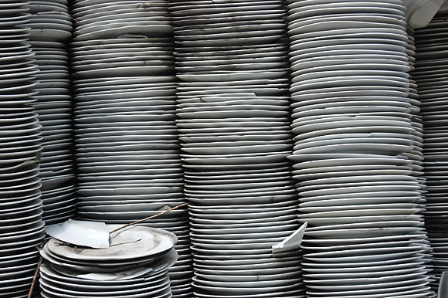
Stack-Based Architectures
Top
Bottom

Slide 6
Stack-Based Architectures
15
Top
15
Top
Bottom
Bottom

Slide 7
Stack-Based Architectures
15
Top
15
Top
Bottom
Bottom

Slide 8
Stack-Based Architectures
4
Top
4
Top
15
15
Top
19
Push 4
Add
Bottom
Bottom
Bottom

Slide 9
Stack-Based Architectures
Top
1
Top
1
1
DUP
2
2
Bottom
3
Bottom
3
Top
2
Top
1
1
OVER
2
2
Bottom
3
Bottom
3

Slide 10
Stack-Based Architectures
Top
Top
1
2
SWAP
2
1
Bottom
3
Bottom
3
Top
Top
1
2
ROT
2
3
Bottom
3
Bottom
1

Slide 11
Designing a Processor
32-bit, stack-based processor
Up to 4 GB of RAM
.025 GHz vs. 3.0-4.0 GHz

Slide 12
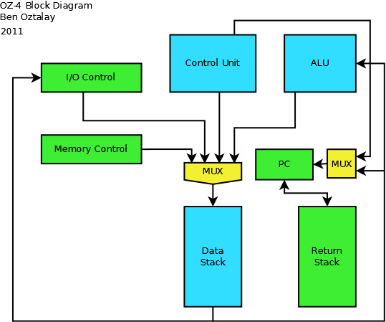
Designing a Processor

Slide 13
How I Did It
Reconfigurable Hardware
VHDL
  VHSIC Hardware Description Language
    Very-High-Speed Integrated Circuit

Slide 14
Comparison of Architectures
Test Program | OZ-3 (Register) | OZ-4 (Stack)
Count to 100 | 102 cycles | 202 cycles
Prime Numbers | 3.0 ms | 3.8 ms
Fibonacci | 153 cycles | 151 cycles
Math Expressions | 19 cycles | 19 cycles
(((5+3)6) + 24) - ((33-6)2)
= ?
(7 + (2*4))

Slide 15
Math Expressions on a Stack
Push 5
Push 3
Push 3
Top
Top
5
Top
3
3
Bottom
Bottom
Bottom
5
5
Add
Push 6
Multiply
Top
8
Top
3
Top
6
48
Bottom
Bottom
5
Bottom
8
Push 24
Add
Top
3
Top
((5 + 3)6 + 24)
24
72
Bottom
5
Bottom
48

