Slide 1
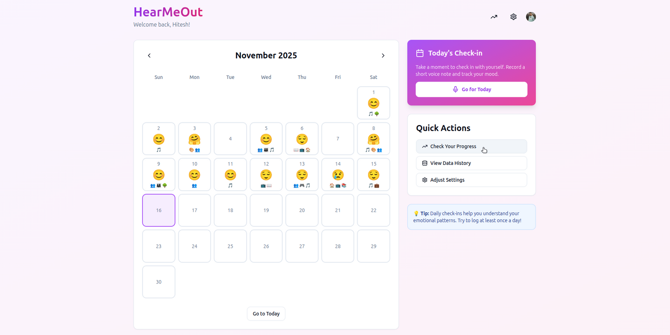
HearMeOut: Speech-Based Mood Journaling Interface
Hi-Fi Prototype Design
CS 435 - Human Computer Interaction
TEAM - 6
Anukriti Bhargava (24510026)
Bhavik Patel (22110047)
Hitesh Kumar (22110098)
Pranav Patil (22110199)

Slide 2
Problem & Motivation
Why this project?
Student mental health issues are rising, but many hesitate to seek help due to stigma, fear of judgment, and limited access to counselors.
Traditional assessments (self-reports, clinical interviews) miss gradual emotional decline.
Goal:
Build a non-clinical, daily-use, speech-based mood tracking tool that feels natural, private, and unintimidating.

Slide 3
Conceptual Model
Primary Metaphor: Daily Mood Journaling
NOT a “Mental Health Screening” → A gentle Journaling Companion.
Replaces Clinical Labels with Emojis and Reflections.
Reduces Stigma and creates a Low-Pressure emotional check-in ritual.
Language Choices:
“Record today’s mood” (not “Complete Assessment”)
“Mood Journal” (not “Depression Screening Tool”)
“Feeling patterns” (not “Symptom Severity”)
“Suggested Emojis” (not “AI Diagnosis”)
Mental Model:
AI acts as an Assistant, not an Authority.
It suggests moods based on Speech, but the user always chooses the final emotion.
Transparent confidence scores maintain trust without making the AI feel diagnostic.

Slide 4
Design Space: The 6 W’s
Who: Students who avoid Clinical Tools or care deeply about Privacy.
What: Emotion recognition from Voice + Calendar-based Mood Tracking + Pattern Visualization.
When: Daily evening check-ins, Optional and Flexible.
Where: Private environments (dorms, rooms, quiet spaces).
Why: Self-awareness, Pattern Recognition, Early signals of Distress.
How: Speak → AI analyzes → User Picks Emoji → Calendar + Analytics Update.

Slide 5
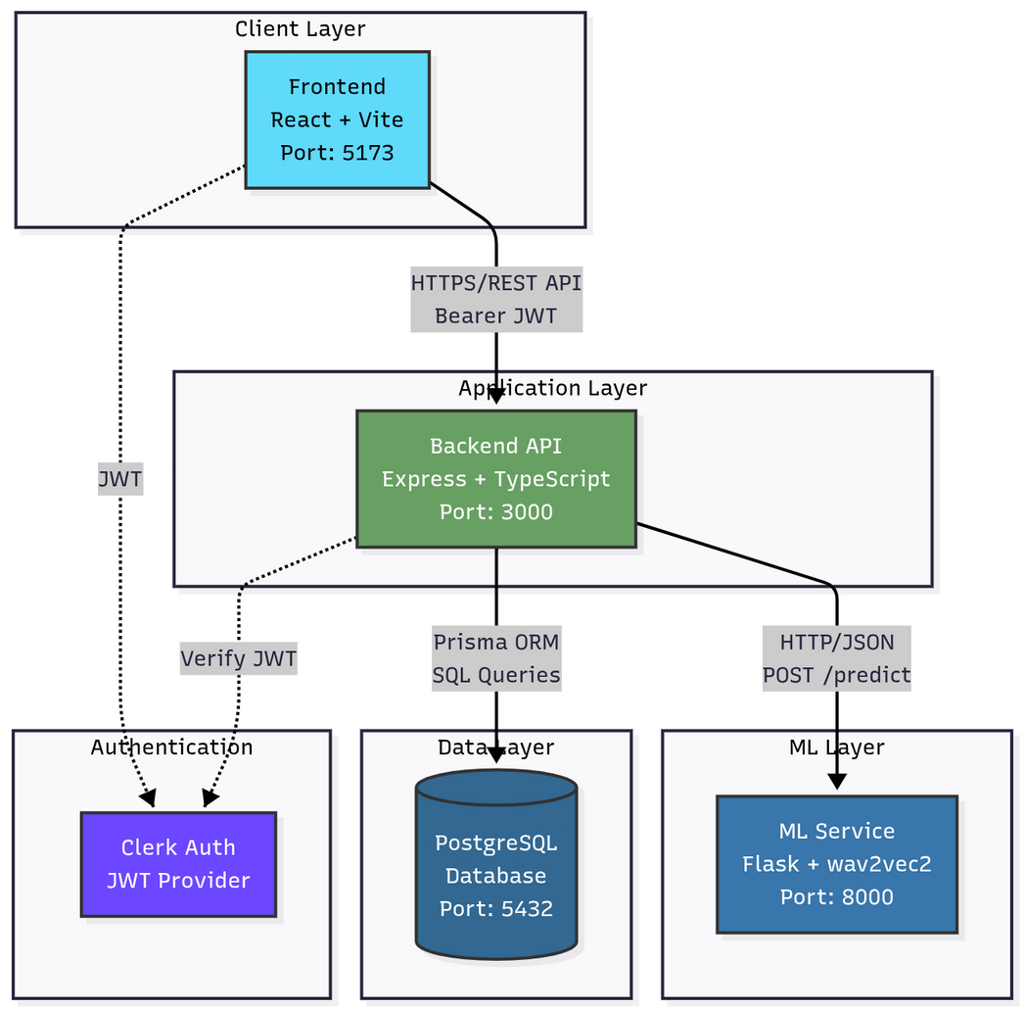
System Architecture

Slide 6
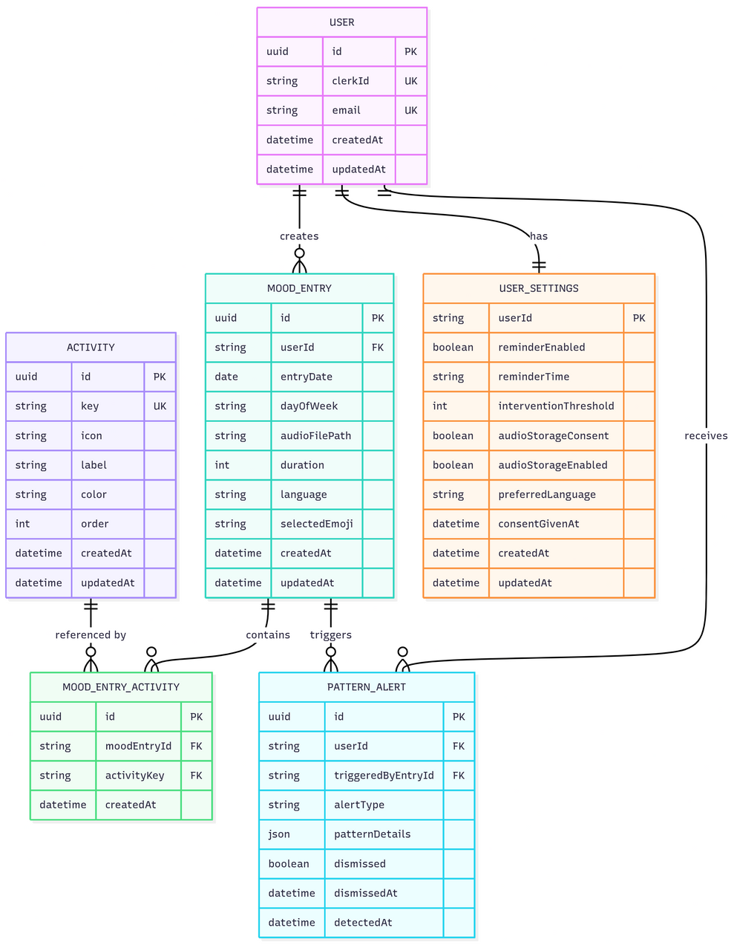
Database Schema

Slide 7
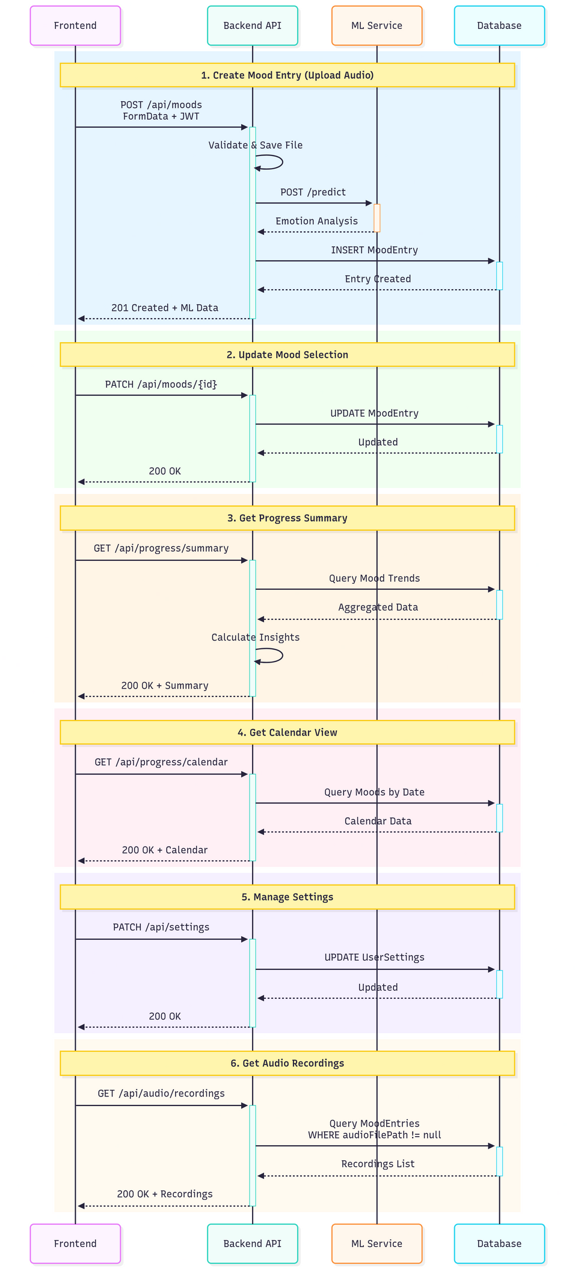
API Flow

Slide 8
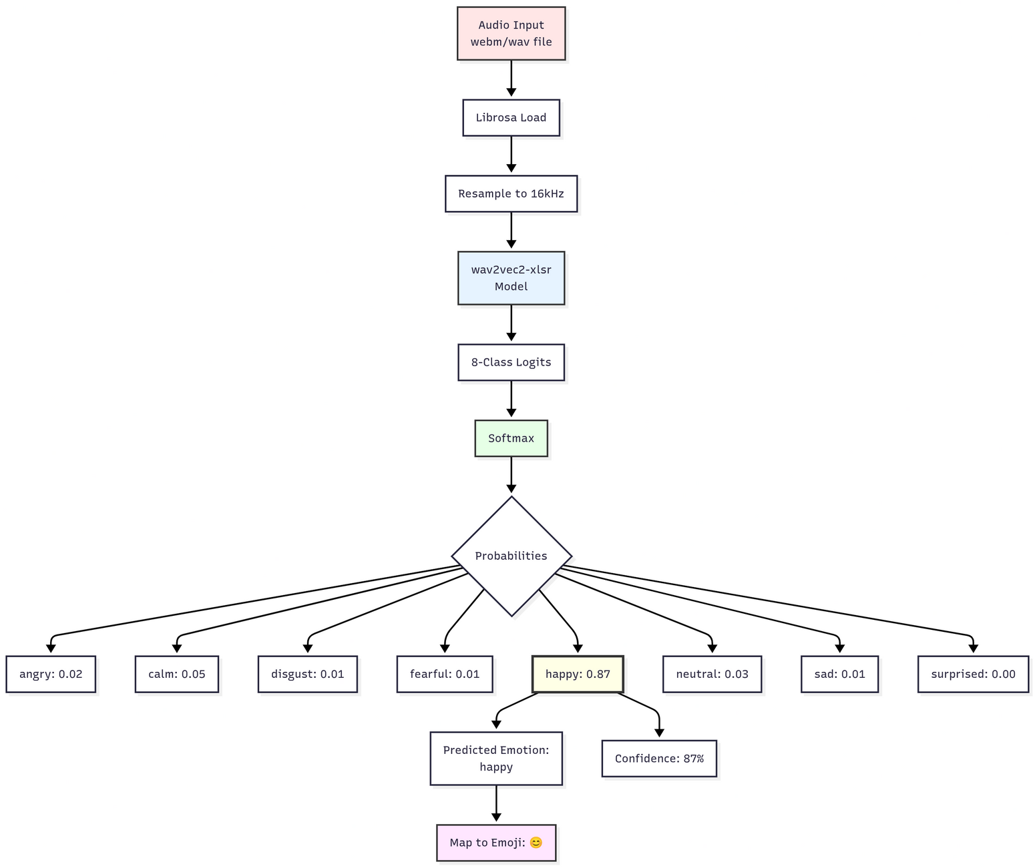
ML Service Flow
Complete flow from Audio Input to Emoji Suggestion:
Not hand-crafted features (like spectrograms, MFCCs, Pitch, Jitter, Shimmer, Zero Cross Rate, LPCC, etc.).
Learned representations optimized during pre-training.
Link: https://huggingface.co/ehcalabres/wav2vec2-lg-xlsr-en-speech-emotion-recognition

Slide 9
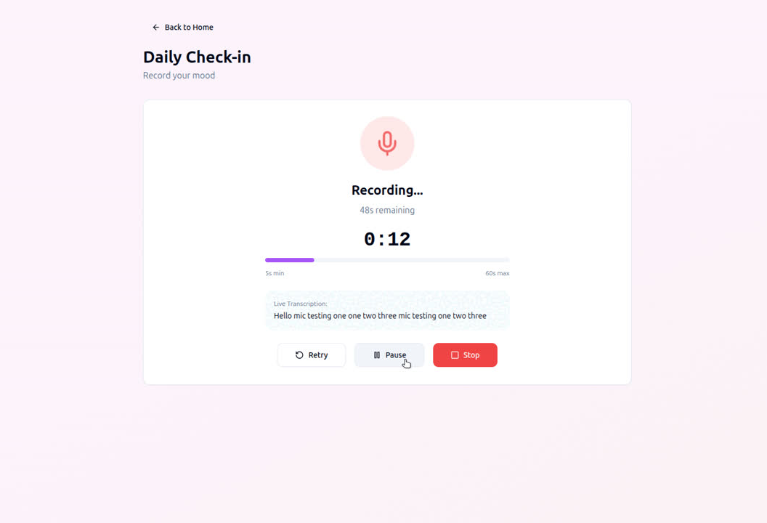
Demonstration

Slide 10
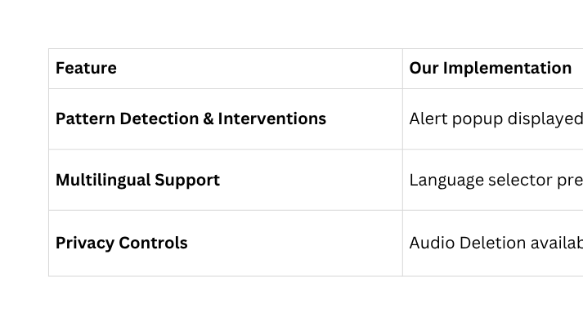
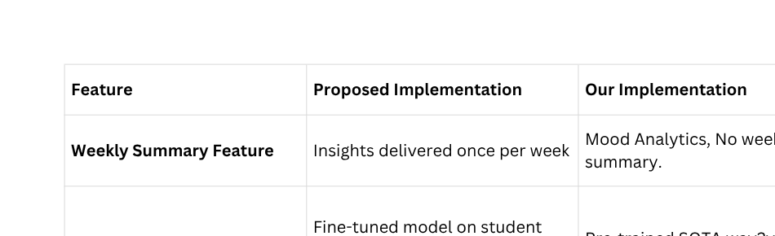
Compromises in Prototyping
Horizontal Compromises (UI Present, Backend Simplified)
Vertical Compromises

Slide 11
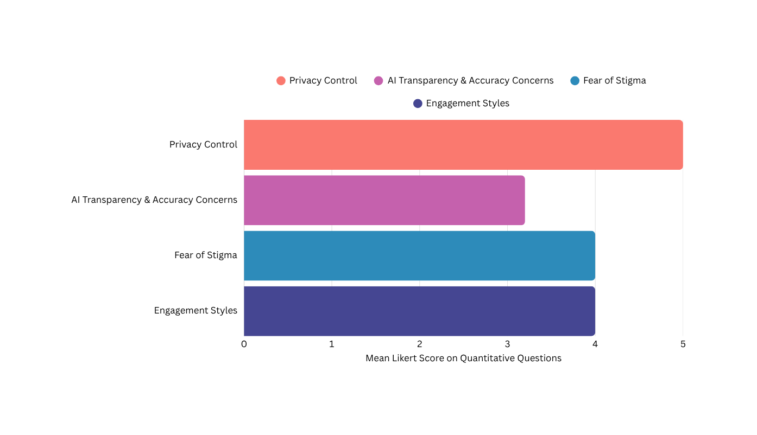

User Evaluation
System Usability Scale (SUS); Mean score: 85
Basic Demographics
Regarding Privacy & Data Control
Quantitive analysis
AI Transparency & Accuracy
Concerns
Mixed Methods Approach (n=5)
Thematic
analysis
Fear of Stigma & Tone Sensitivity
Visual Feedback built Confidence in the App
Calendar Interface Was Intuitive
Personalization & Engagement
Styles
AI Suggestions Were Helpful But Not 100% Trusted
Privacy Messaging & Clear Specialised Features were Reassuring
Privacy Messaging & Clear Specialised Features were Reassuring
Additional Usability & Missing
Elements

Slide 12
Conclusion
Built a working speech-based mood monitoring system.
Validated journaling metaphor as low-stigma and effective.
Real ML integration revealed trust and explainability gaps.
Identified challenges in long-term engagement.

