Slide 1

CS 331
Computer Networks
Smart Guard IOT-Based
Environmental Monitoring System
Presentated by:
Aryan Sahu
Bhavik Patel
Hitesh Kumar
Jinil Patel

Slide 2


Introduction
Smart Guard is an IoT-based environmental monitoring system designed for classrooms and labs.
It collects real-time data on parameters like:
Temperature, Humidity and Light Intensity.
Uses ESP32 microcontrollers connected to sensors to capture environmental data.
Data is transmitted to a central server via HTTP and visualized on a React-based dashboard.
Enables live monitoring, historical analysis, and alert notifications when conditions cross predefined thresholds.
Designed to be modular, scalable, and easy to maintain, supporting multiple rooms and sensor types.

Slide 3
Objectives
Main Goal: Build a scalable, real-time IoT system for monitoring environment conditions in classroom and labs.
Specific Objectives:
🌡️ Sensor Data Collection: Use DHT22 (temp + humidity), BH1750 (light)
🔗 Data Transmission: Send sensor readings to server via HTTP
🗃️ Database Storage: Store readings in PostgreSQL for querying and analysis
💻 Frontend Dashboard: Visualize data using React + Chart.js
🚨 Alert Notifications: Trigger email alerts on threshold breaches
🧩 Modular Design: Easy to add new sensors or locations

Slide 4


System Architecture
4-Layered Architecture
🔌
Hardware Layer
ESP32 Microcontroller + Sensors (DHT22, BH1750)
Backend Layer
Node.js Server – Handles data reception, preprocessing, and storage with database
Database Layer
PostgreSQL – Stores time-series sensor data
Frontend Layer
React Dashboard – Visualizes real-time and historical data
🌐
📊

Slide 5
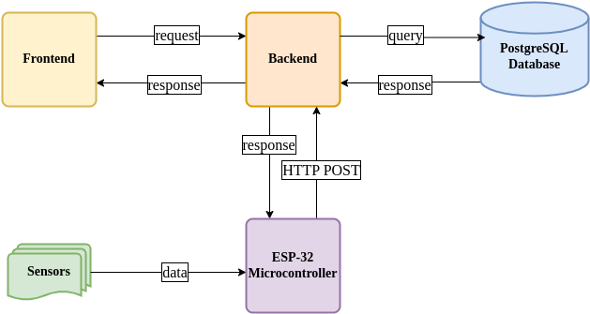
System Architecture
Data Format: JSON

Slide 6


🖼️ UI Features
Room-based filtering
Live graphs
Date-range selection
Alert Visualization
🧩 Designed for intuitive use and scalability.
Frontend
⚙️ Key Technologies
React.js – SPA for real-time interactivity
Chart.js – Visualize sensor data using responsive graphs
Context API – Global state management across components
Axios – API calls to backend
⚙️ Built with:
React.js, Vite.js, Typescript

Slide 7

🛠️ Key Responsibilities:
Receive sensor data via HTTP requests
Validate & preprocess data
Store it in PostgreSQL
Expose REST APIs for frontend
Backend
📡 Email Alert Integration:
Uses Nodemailer
Sends emails when sensor thresholds are breached
⚙️ Built with:
Node.js, Express.js, TypeScript

Slide 8

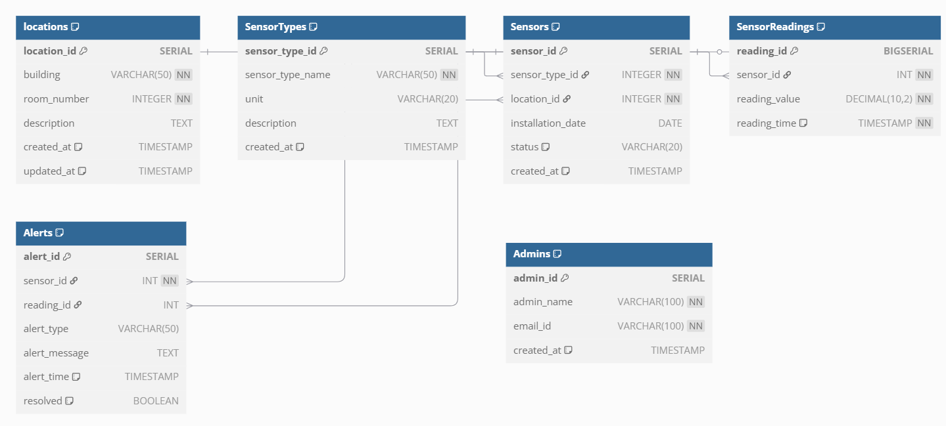
⚡ Optimized for:
Time-series data
Fast querying for historical trends
Scalable storage
PostgreSQL
Database

Slide 9
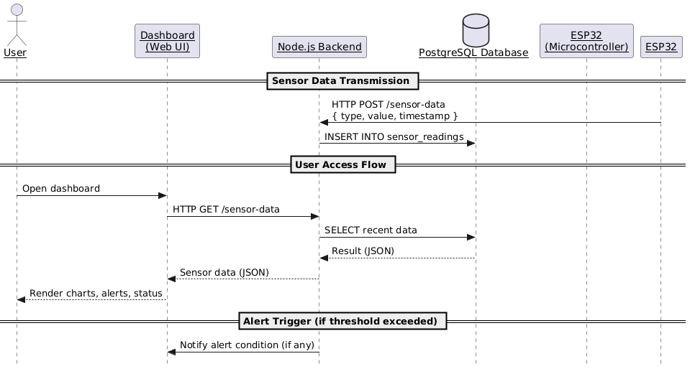
Data Flow

Slide 10
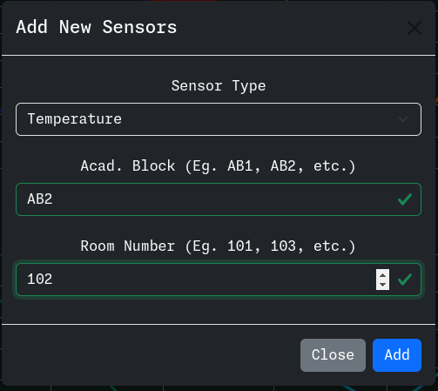
Objectives Achieved
Sensor Management:

Slide 11
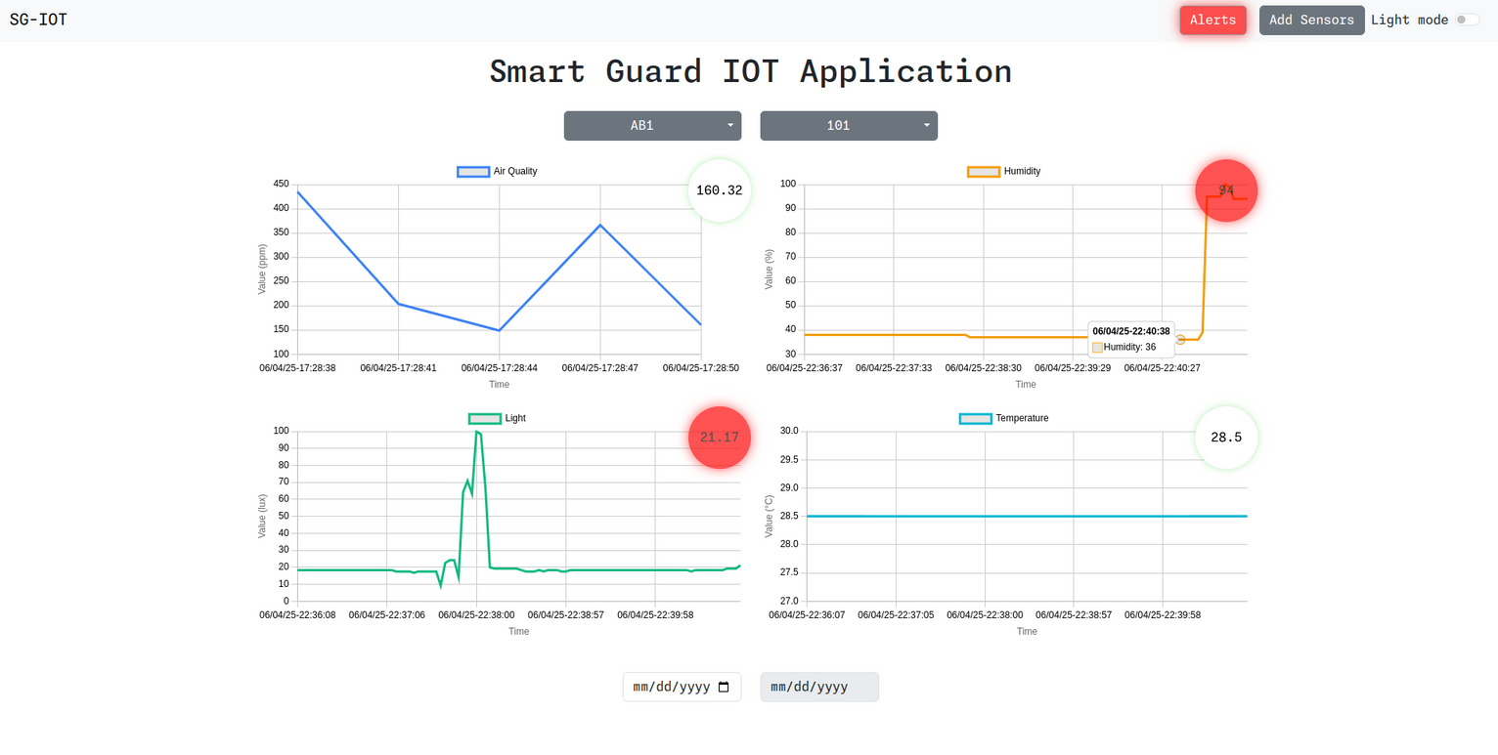
Objectives Achieved
Room-based Real-Time Data Access:

Slide 12
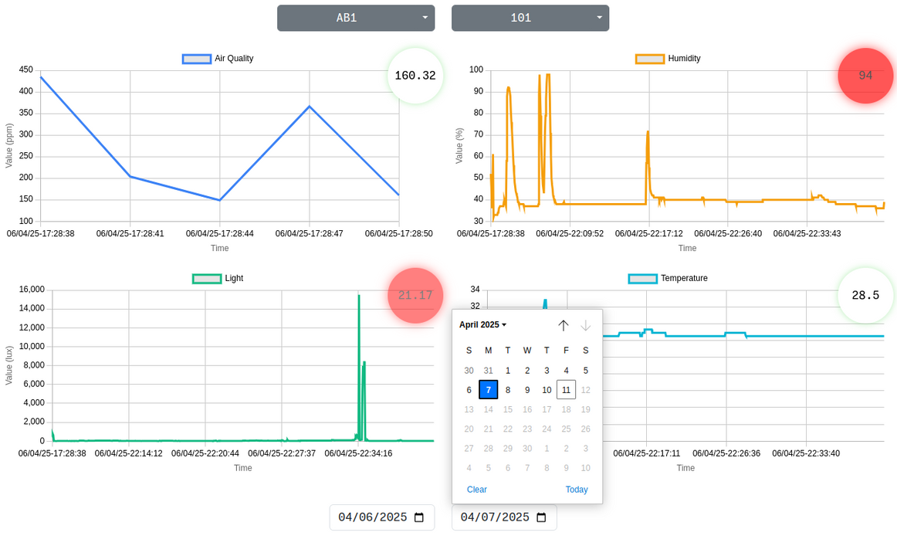
Objectives Achieved
Past Data Visualization:

Slide 13
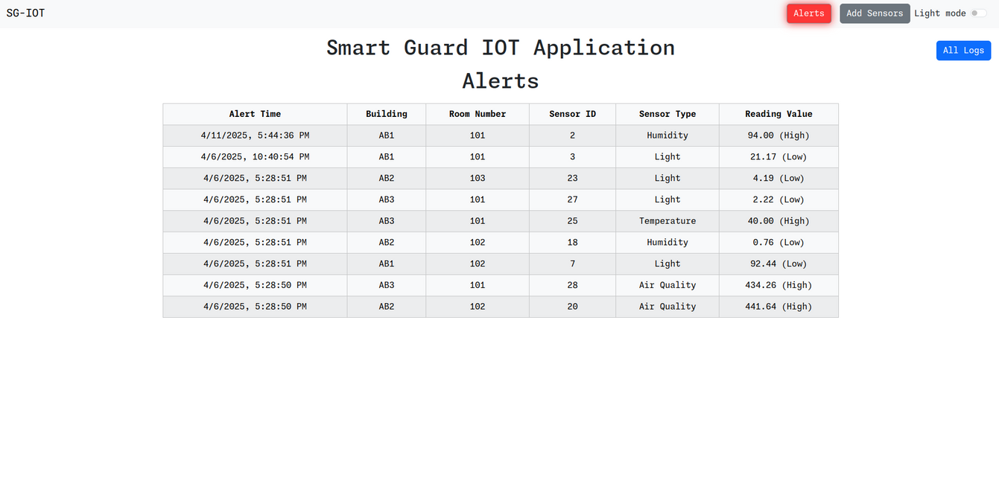
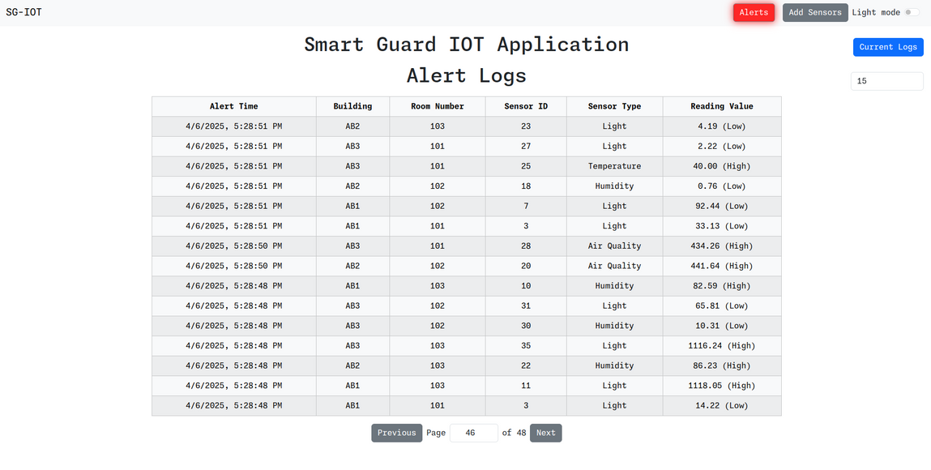
Objectives Achieved
Alert Log Viewer:

Slide 14
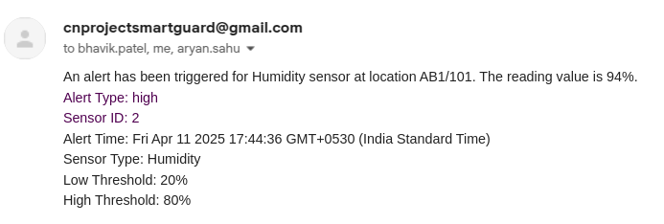
Objectives Achieved
Email Alert System:

Slide 15
Let’s Demonstrate

Slide 16
Thank you

