Slide 1

E-closing: modernizing the mortgage loan climax
With Blockchain
bindu priya

Slide 2
Contents
Problem Statement
As-Is State
Pain points
Proposed solution
Conclusion

Slide 3
Problem statement
Existing Mortgage closing process is one of the major pain points for borrower, lender and other stakeholders included in the process because of the complexity involved in the documentation process.
The direct interaction with customer is required for the loan closing process, which is the last step in a customer’s largest and most complex transaction. Getting all the stakeholders at one place and completing the process is time consuming and involves cost.

Slide 4
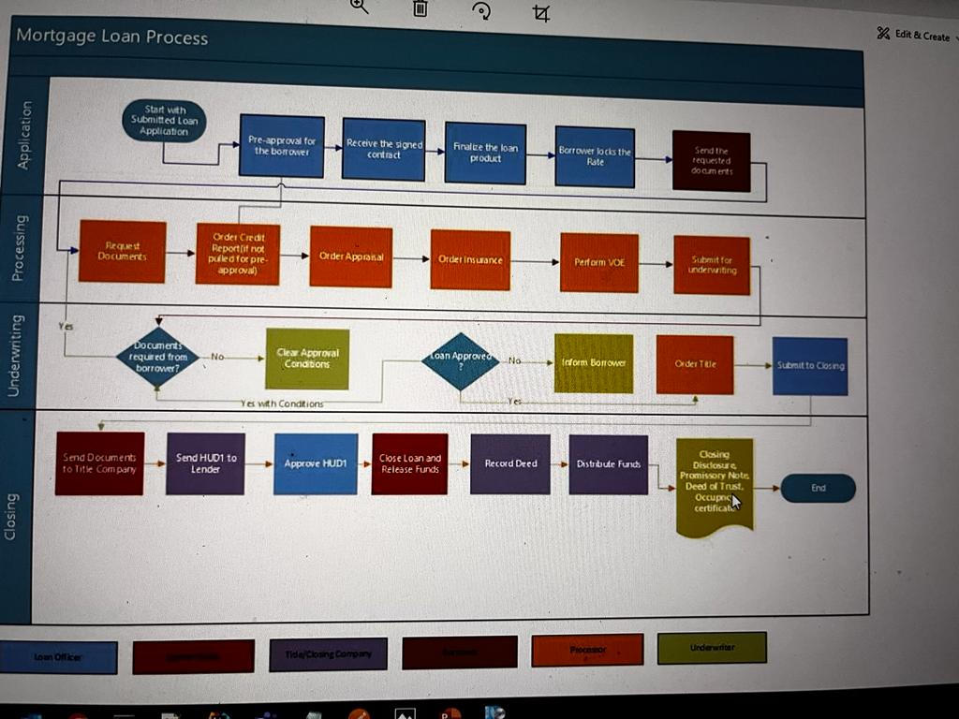
Current MORTGAGE LOAN Processing state

Slide 5

Pain points
Confusion
Manual
Time Pressure
Delay
Cost
Stress

Slide 6
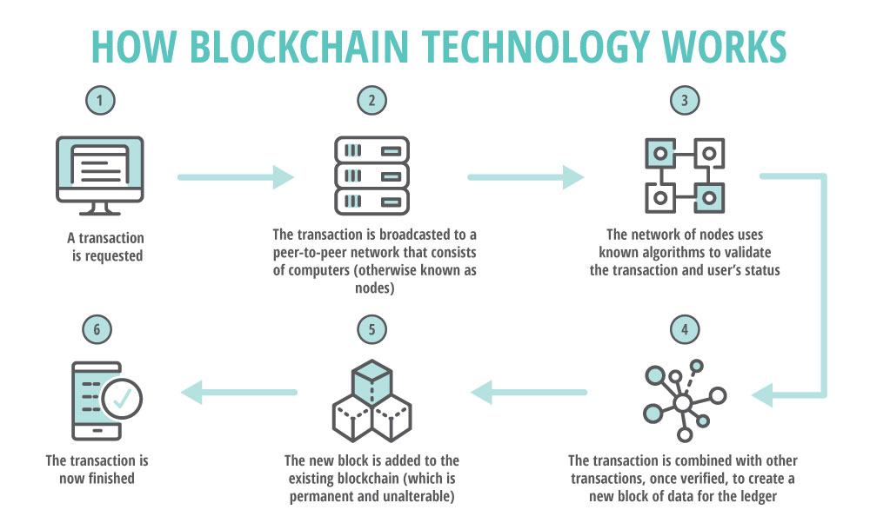
Proposed solution - bLOCKCHAIN
Blockchain is positioning to become a viable technology to address these issues.
While blockchain technology is just beyond the cutting edge for most lenders, so too, was eClosing just a couple of years ago. But now as the blockchain is widely adopted across different domains, this looks most promising solution for this use case.

Slide 7
Proposed Solution
Customer registers through the digital signature while opening the account
Customer digitally signs the closing disclosure document and sends it to the lender.
The digital signature is stored in the chain.
Smart contract will validate the signature and initiate the fund transfer.
Escrow agent, distract attorney, and registrars have read access to the document to verify customer consent.

Slide 8
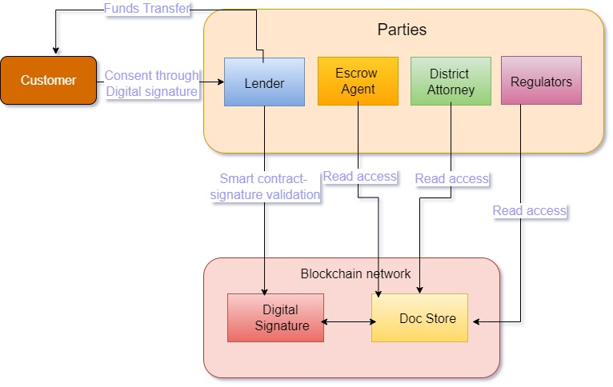
Proposed solution

Slide 9
advantages
Blockchain based eClosing
Transparency
No physical Intervention
Real time view
Faster funds transfer

Slide 10
accelerators
Know your loan status
Your mortgage app

Slide 11
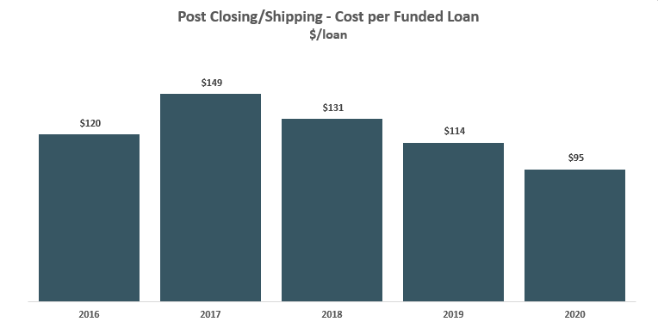
Appendix

Slide 12

Thank You

