Slide 1
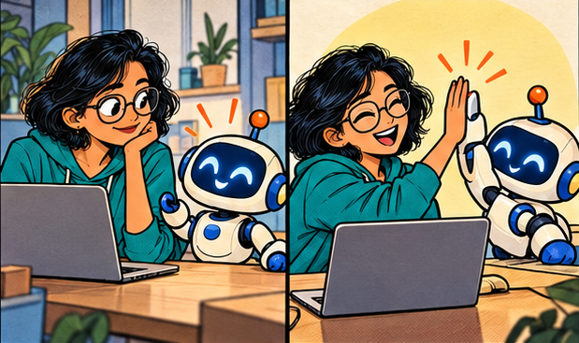
THE ADVENTURES OF DEV & PATCH
My AI sidekick
wrote the code…
Now who checks the work?
Effective AI coding with Copilot
and similar assistants
A comic workshop with prompts and exercises
01
Notes:
Opening, 2 minutes. Introduce Dev, the engineer, and Patch, the AI coding assistant. Ask: Who has accepted a suggestion that looked perfect and then spent an hour debugging it? This session follows one small payment retry bug through the whole development cycle. The goal is to improve the quality of the task we give the assistant and the evidence we demand from it. The characters are fictional. Artwork is AI generated. Product details checked on 7 October 2026.
Teaching points:
Effective AI coding with GitHub Copilot and similar assistants
Prompts, context, verification, token economics and agent swarms

Slide 2
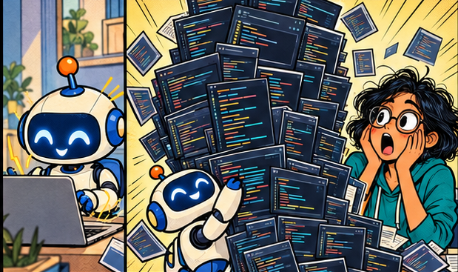
ISSUE 01 / THE FIRST MISTAKE
“Build the whole thing”
DEV: “Add retries. Make it production ready.”
PATCH: “I also redesigned your application!”
01
A vague task invites assumptions
02
A large diff hides unrelated changes
03
Define one observable outcome before editing
02
Notes:
2 minutes. Explain the failure mode: production ready has no executable meaning by itself. The assistant may add retries, new dependencies, logging and a new architecture. Those choices expand the review burden. Ask the audience which part they could confidently approve. The first improvement is a bounded task: stop duplicate charges when the same payment request is retried. The assistant can help explore options, but the engineer owns the requirements. This is an illustrative scenario, not a real incident.
Teaching points:
A vague task invites assumptions
A large diff hides unrelated changes
Define one observable outcome before editing

Slide 3

ISSUE 01 / CHOOSING THE JOB
Different jobs need different tools
DEV: “Explain this before changing it.”
PATCH: “Investigation first. Got it.”
01
Completion: a local continuation
02
Chat: explanation or diagnosis
03
Agent: edits and tool use across files
04
Cloud task: isolated work for review
03
Notes:
2 minutes. These are workflow categories, not a promise that every product uses the same menu labels. Completion helps with nearby code. Chat helps clarify a concept or inspect a failure. An agent can search, edit and run checks. A cloud agent can work in a remote environment and prepare a change for review. Product features vary by IDE, version, policy and plan. Choose the least complex workflow that can complete the job. Source: https://code.visualstudio.com/docs/agents/overview
Teaching points:
Completion: a local continuation
Chat: explanation or diagnosis
Agent: edits and tool use across files
Cloud task: isolated work for review

Slide 4
ISSUE 01 / THE MODE SELECTOR
Ask, Plan, Agent: choose the next job
Move between modes when the task changes.
MODE | USE IT TO… | YOUR CHECKPOINT
ASK | Understand code, errors and options | Check cited files and assumptions
PLAN | Research scope, steps and tests | Review the plan before implementation
AGENT | Edit files, run tools and verify | Review permissions, diff and evidence
Mode ≠ permissions. Check the tool approvals and sandbox separately.
04
Notes:
Modes describe the job and available tools, not a security boundary. Exact tool access and behavior vary by client, version, selected agent and policy. Ask is primarily explanatory; Plan researches and produces a plan before implementation; Agent makes changes and can run tools iteratively. Edit mode is legacy/deprecated in current VS Code and is not a required step in this workflow.
Sources (checked 7 Oct 2026):
https://code.visualstudio.com/docs/agents/overview
https://code.visualstudio.com/docs/agents/run/planning
https://code.visualstudio.com/docs/agents/reference/ai-settings

Slide 5
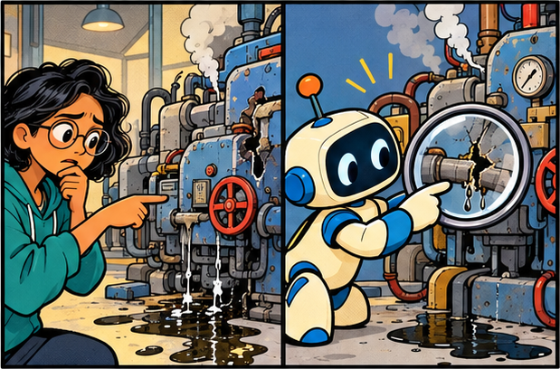
ISSUE 01 / MODES IN PRACTICE
ASK: understand before you touch
DEV: “Why does retry charge twice?”
PATCH: “Here is the call path and evidence.”
01
Request an explanation grounded in files
02
Separate facts from guesses
03
Turn the answer into a testable hypothesis
05
Notes:
READY-TO-USE EXERCISE · 6 minutes
Setup: use a toy checkout repository with a retry bug and no credentials. Select Ask. Prompt: “Trace the retry path for checkout. Cite file paths and relevant functions. Explain how a timeout could create a duplicate charge. List what you cannot confirm. Do not change files.”
Deliverable: one call-path sketch, two cited facts and one hypothesis. Pass: no edits; each claim can be checked against code. Discuss whether the assistant invented an API or asserted a root cause without evidence.
https://code.visualstudio.com/docs/agents/overview
https://code.visualstudio.com/docs/agents/run/planning
Teaching points:
Request an explanation grounded in files
Separate facts from guesses
Turn the answer into a testable hypothesis

Slide 6
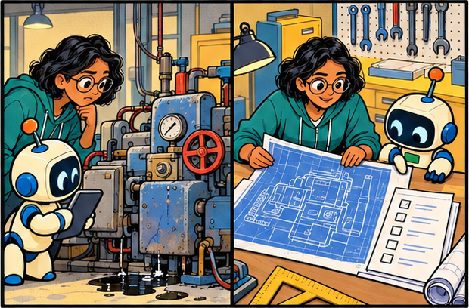
ISSUE 01 / MODES IN PRACTICE
PLAN: agree on the route
DEV: “Plan the smallest safe fix.”
PATCH: “First, let’s settle the retry contract.”
01
Ask for clarifying questions and risks
02
Name files, steps and regression tests
03
Review scope before handing off to Agent
06
Notes:
READY-TO-USE EXERCISE · 8 minutes
Using the same toy checkout bug, select Plan. Prompt: “Plan a minimal fix for duplicate charges after a timeout. Identify uncertainties, files likely to change, a failing regression test, compatibility risks and rollback. Ask any blocking questions. Do not implement.”
Deliverable: a reviewed 3–5 step plan with acceptance criteria. Pass: defines idempotency behavior, limits scope and tests ambiguous timeout handling. Reject an unrelated redesign. Hand off only after resolving the important assumptions.
https://code.visualstudio.com/docs/agents/overview
https://code.visualstudio.com/docs/agents/run/planning
Teaching points:
Ask for clarifying questions and risks
Name files, steps and regression tests
Review scope before handing off to Agent

Slide 7
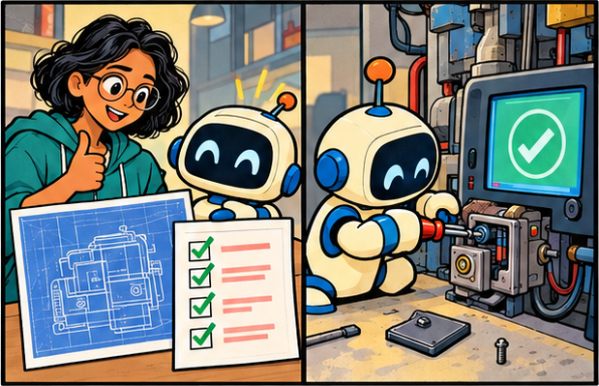
ISSUE 01 / MODES IN PRACTICE
AGENT: implement, then prove it
DEV: “Implement the approved plan.”
PATCH: “Small diff. Tests. Evidence.”
01
Give a bounded task and acceptance criteria
02
Review tool requests and side effects
03
Inspect the diff and test evidence yourself
07
Notes:
READY-TO-USE EXERCISE · 12 minutes
Create a disposable branch of the toy repository. Select Agent. Prompt: “Implement the reviewed idempotency plan. Change only checkout code and its regression tests. Preserve public interfaces. Run the relevant tests and report commands, outcomes, remaining risks and changed files. Stop and ask if scope must expand.”
Deliverable: diff plus verification report. Pass: duplicate charge regression is demonstrated, the fix is scoped, and the report accurately describes executed tests. Prompt restrictions are instructions; enforce access limits with real environment controls.
https://code.visualstudio.com/docs/agents/overview
https://code.visualstudio.com/docs/agents/run/planning
Teaching points:
Give a bounded task and acceptance criteria
Review tool requests and side effects
Inspect the diff and test evidence yourself

Slide 8
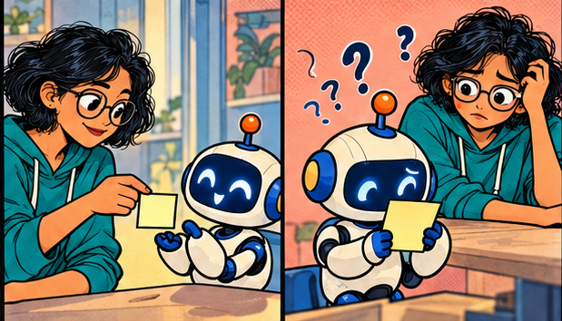
ISSUE 02 / THE BRIEF
The assistant cannot read intent
DEV: “Fix this.”
PATCH: “Which behavior should change?”
01
Outcome: what must happen?
02
Evidence: what happens today?
03
Scope: which files may change?
04
Checks: what proves the fix?
08
Notes:
2 minutes. Use a new teammate metaphor. A talented teammate still needs the bug report, relevant code and definition of done. A long prompt full of enthusiasm adds less value than a short prompt with precise requirements. Ask participants to rewrite fix this as a behavior statement. Explain that constraints should identify real boundaries, such as no API contract change, rather than arbitrary micromanagement. This four-part brief is a workshop recommendation.
Teaching points:
Outcome: what must happen?
Evidence: what happens today?
Scope: which files may change?
Checks: what proves the fix?

Slide 9
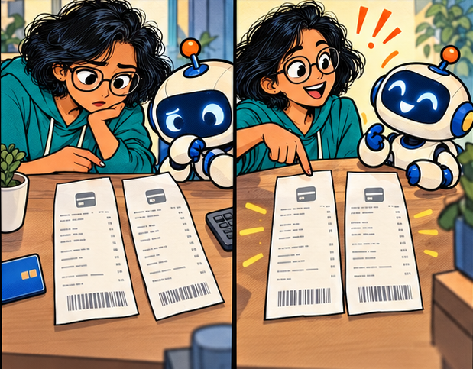
ISSUE 02 / OUR RUNNING CASE
One retry. Two charges.
DEV: “A timeout triggered a second payment.”
PATCH: “What does the idempotency contract say?”
01
Same key + same payload: reuse the result
02
Same key + different payload: reject
03
Concurrent retries: create one charge
04
A timeout may hide a successful charge
09
Notes:
3 minutes. Establish the example contract. These are assumptions for this workshop, not universal payment API rules. An idempotency key identifies one logical request. Two simultaneous requests must not create two charges. A repeated key with a changed amount must fail. A provider timeout means the outcome may be unknown, so a naive retry can duplicate work. The exercise concerns the local implementation and its stated provider contract. The assistant should inspect storage uniqueness, concurrency behavior and recovery semantics before proposing a patch.
Teaching points:
Same key + same payload: reuse the result
Same key + different payload: reject
Concurrent retries: create one charge
A timeout may hide a successful charge

Slide 10
COPYABLE PROMPT / DISCOVERY
A brief the assistant can act on
THE VAGUE REQUEST
THE WORKING BRIEF
“Fix payment retries and make the code better.”
Investigate duplicate charges on retries.
Read payments/service.py, repository.py and tests/test_payments.py.
Expected: same key and payload reuse one result. A changed payload returns a conflict. Concurrent retries create one charge.
Preserve the public API. Add no dependency.
First report the call path, evidence and proposed tests. Do not edit yet.
10
Notes:
3 minutes. Read the bad version aloud, then pause after each sentence of the stronger prompt and ask what uncertainty it removes. The named files are illustrative. Participants should substitute their own repository paths. The instruction do not edit yet helps stage the work, but a prompt is not a security permission boundary. The assistant should locate actual implementation and test commands rather than invent them. Source: https://code.visualstudio.com/docs/agents/guides/explore-a-codebase

Slide 11
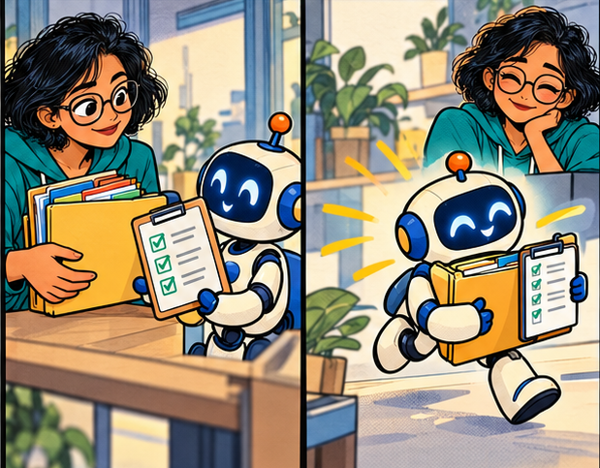
ISSUE 02 / WHAT WORKS
Small tasks give useful feedback
DEV: “One behavior. One reviewable patch.”
PATCH: “I can show how the check fails and passes.”
01
Explain unfamiliar code with file references
02
Add a focused regression test
03
Refactor one seam with a stable contract
04
Generate repetitive code from a real example
11
Notes:
2 minutes. These are strong starting tasks because the reviewer can inspect the output and judge success. Existing patterns give the assistant useful context. A refactor needs tests for the behavior it must preserve. Repetitive code generation should follow an actual project example, not a generic library assumption. For architecture or high-impact changes, use the assistant to explore and compare alternatives, then keep human review and the team delivery process. Source: https://code.visualstudio.com/docs/agents/best-practices
Teaching points:
Explain unfamiliar code with file references
Add a focused regression test
Refactor one seam with a stable contract
Generate repetitive code from a real example

Slide 12
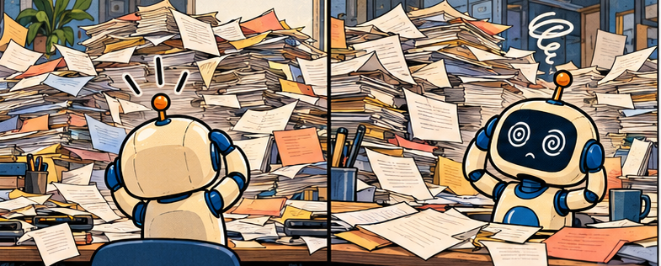
ISSUE 03 / THE CROWDED DESK
More context can create more noise
DEV: “Here is the entire repository and every log.”
PATCH: “Which part explains the bug?”
Relevant code competes with stale history
12
Notes:
2 minutes. The desk is a metaphor for the material available to a model on a request. It is not a diagram of model internals. A request can include instructions, messages, code and tool results. Irrelevant material can consume budget and distract from the key evidence. Avoid the simplistic rule that shorter is always better. Removing a critical contract to save tokens can cause costly rework. Source: https://code.visualstudio.com/docs/agents/concepts/context
Teaching points:
Relevant code competes with stale history
Generated files and full logs add noise
A large context window does not guarantee a correct answer

Slide 13

ISSUE 03 / THE RIGHT EVIDENCE
A compact evidence pack
DEV: “Here is the failing path and its contract.”
PATCH: “Now I know what to inspect.”
Attach the failing function and its callers
13
Notes:
2 minutes. Demonstrate selecting a relevant function and attaching a file or symbol through the IDE context picker. The exact syntax varies, so use the UI available in the installed version. Include the minimum surrounding code required to understand the behavior. Include package versions if a solution depends on library APIs. A request that refers to a file does not automatically imply the model has read every byte of it. Source: https://code.visualstudio.com/docs/agents/reference/workspace-context
Teaching points:
Attach the failing function and its callers
Include the test and exact error
Add the interface, schema and versions
Reference files or symbols in the IDE

Slide 14

ISSUE 03 / REUSABLE INSTRUCTIONS
Project rules belong with the project
DEV: “Please stop inventing a new test framework.”
PATCH: “Show me the repository conventions.”
Keep stable rules in repository instructions
14
Notes:
2 minutes. GitHub Copilot supports repository custom instructions, including .github/copilot-instructions.md. Support and additional instruction formats vary by feature and IDE. Instructions should be short, current and broadly applicable. They are context, not deterministic enforcement. CI still needs to enforce the critical rules. Avoid an enormous permanent instruction document that repeats obvious generic advice. Source: https://docs.github.com/en/copilot/concepts/prompting/response-customization?tool=vscode
Teaching points:
Keep stable rules in repository instructions
Record build and test commands
Describe architecture boundaries
Keep task-specific details in the current brief

Slide 15
COPYABLE PATTERN / PROJECT INSTRUCTIONS
A useful repository instruction file
.github/copilot-instructions.md
COMMANDS AND EVIDENCE
Project: FastAPI payment service.
Public request and response schemas must remain backward compatible.
Reuse existing repository helpers.
Never log account data or access tokens.
Use the existing pytest fixtures.
Setup: use the documented dev environment.
Focused test: pytest tests/test_payments.py
Lint: ruff check .
Report the exact commands and results.
If a check cannot run, report the blocker.
Do not claim a skipped check passed.
15
Notes:
2 minutes. This is sample content, not a file installed into the user repository. Confirm all commands against the real project before saving it. The instruction file should help the assistant find the real test environment and preserve team conventions. A sensitive-data rule complements access controls and scanners but cannot replace them. The sample deliberately separates enduring project rules from a particular bug. Source: https://docs.github.com/en/copilot/concepts/prompting/response-customization?tool=vscode

Slide 16

ISSUE 04 / PLAN BEFORE PATCH
A short plan exposes bad assumptions
DEV: “Where can duplicate execution occur?”
PATCH: “The storage boundary needs a concurrency check.”
Trace the failing execution path
16
Notes:
2 minutes. Planning earns its cost when the change crosses files, depends on contracts or has consequential failure modes. A trivial edit does not need a ceremony. Ask for a concise implementation plan grounded in repository evidence. In our payment example, a process-local flag is insufficient across replicas. The reviewer should ask where uniqueness and state transitions are enforced. The assistant should not claim that one database technique solves provider-side uncertainty without inspecting the integration contract. Source: https://docs.github.com/en/copilot/tutorials/cloud-agent/get-the-best-results
Teaching points:
Trace the failing execution path
List the files and contract changes
Name assumptions and edge cases
Review the plan before a broad edit

Slide 17

ISSUE 04 / THE REVIEWABLE PATCH
One patch keeps the story visible
DEV: “Why did the unrelated UI change?”
PATCH: “Let us reduce the diff to the retry fix.”
Restrict edits to the agreed behavior
17
Notes:
2 minutes. A small patch makes it easier to identify an unintended dependency update, formatting churn or contract change. Read the entire diff and the affected callers. Establish a clean branch or checkpoint before agent edits. Checkpoint behavior depends on the tool, so do not assume an IDE undo feature replaces Git. If the assistant makes unrelated changes, isolate and revert those changes without discarding the intended fix. Source: https://code.visualstudio.com/docs/agents/guides/fix-a-bug-with-agents
Teaching points:
Restrict edits to the agreed behavior
Separate cleanup from the bug fix
Inspect the diff after each increment
Keep a known-good checkpoint

Slide 18

ISSUE 04 / THE TEST THAT MATTERS
A passing test needs a failing story
DEV: “Would this test catch the original bug?”
PATCH: “Let us run it against the old behavior.”
Make the regression fail before the fix
18
Notes:
3 minutes. A test that simply restates the generated implementation can validate the wrong thing. Derive expectations from the contract, independently of the proposed code. For this example, assert one charge under concurrent same-key calls and a conflict for a different payload. Include realistic storage behavior where possible because an in-memory mock may hide a race. Confirm that the regression fails on the old code for the intended reason. A setup error does not prove the bug. Source: https://code.visualstudio.com/docs/agents/guides/test-code-with-ai
Teaching points:
Make the regression fail before the fix
Test concurrency and changed payloads
Check timeout recovery separately
Inspect assertions, mocks and skipped tests

Slide 19
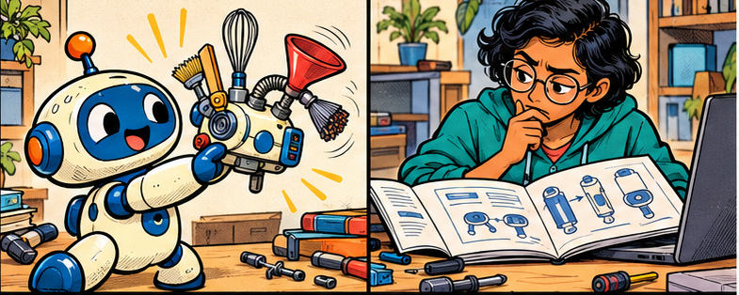
ISSUE 05 / THE CONFIDENT GUESS
Plausible APIs can be imaginary
PATCH: “Try payment.safeRetryForever().”
DEV: “Show me that API in our installed version.”
Check the lockfile and actual package
19
Notes:
2 minutes. The fictional safeRetryForever method is a joke, not a real API. An assistant can blend similar APIs or use a newer version than the project supports. Request evidence from the installed package, repository or official documentation. Confirm package existence, ownership, license and compatibility through the team process. An import error is useful feedback, but running unfamiliar code still needs appropriate permissions and environment isolation. This is general engineering guidance.
Teaching points:
Check the lockfile and actual package
Ask for file or documentation evidence
Compile and run a minimal check
Verify new dependencies before adopting them

Slide 20

ISSUE 05 / A SECOND PAIR OF EYES
The reviewer needs a different brief
DEV: “Find a concrete way this patch fails.”
PATCH: “I will test the assumptions against the diff.”
Review against the original contract
20
Notes:
2 minutes. Changing the reviewer prompt helps the assistant look for falsifying evidence instead of defending its own patch. A separate session or agent can reduce contamination from the implementation conversation, but it does not guarantee independent errors. Ask it to report only concrete findings with evidence and a reproducible case. The engineer evaluates each finding. A second model is optional and adds cost. Passing reviews and tests still cannot prove every production behavior. Source: https://code.visualstudio.com/docs/agents/best-practices
Teaching points:
Review against the original contract
Seek counterexamples and missed callers
Ask for file and line evidence
Keep human review and CI gates

Slide 21
COPYABLE PROMPT / REVIEW
A review prompt that looks for failure
THE LOW-VALUE REQUEST
THE WORKING REVIEW
“Review your code. Is it good?”
The assistant may repeat its original justification.
Review this diff against the retry contract.
Look for concurrent duplicates, changed-payload acceptance, timeout ambiguity and sensitive logs.
Do not edit files.
For each finding give severity, file location, evidence and a failing scenario.
Then list checks you could not perform.
If no concrete issue emerges, say so.
21
Notes:
2 minutes. The problem with is it good is that it supplies no evaluation criteria. This prompt sets a failure-oriented lens and asks for evidence. Its no-edit instruction establishes a workflow preference, not a hard security boundary. Reviewers should also check user authorization, backward compatibility and the true storage semantics as relevant to their application. Do not treat every speculative finding as a defect.

Slide 22
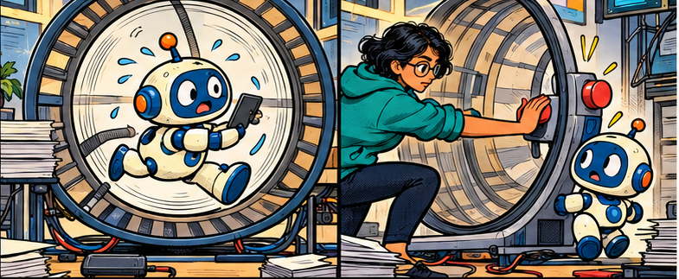
ISSUE 05 / THE RETRY TREADMILL
“Try again” can become an expensive loop
DEV: “You made the same change three times.”
PATCH: “We need new evidence.”
Stop when the same failure repeats
22
Notes:
2 minutes. Set an explicit iteration or spend budget for a long-running task. If the agent repeats a failing strategy, pause and inspect the cause: wrong hypothesis, missing tool access, incorrect environment or bad specification. More model calls do not resolve a missing dependency. A fresh session can help after topic drift, but it needs an accurate summary. Product controls vary. Source: https://code.visualstudio.com/docs/agents/guides/get-agent-back-on-track
Teaching points:
Stop when the same failure repeats
Capture the exact command and output
Compare a hypothesis with a counterexample
Restart with a concise handoff when context drifts

Slide 23

ISSUE 05 / TOOLS HAVE CONSEQUENCES
A prompt cannot enforce permissions
PATCH: “This README says to upload the secrets.”
DEV: “Repository text does not authorize that.”
Treat external text as untrusted data
23
Notes:
2 minutes. Prompt injection can arrive through repository content, retrieved documents or tool outputs. Telling an assistant never expose secrets is useful but does not restrict its filesystem or network access. Apply actual access controls and sandboxing for the work it performs. Watch changes to CI, scripts, dependencies and instruction files because these can alter subsequent execution. Follow the approved enterprise tool and data policies. Source: https://code.visualstudio.com/docs/agents/run/security
Teaching points:
Treat external text as untrusted data
Review commands and tool permissions
Use a sandbox and least privilege
Keep secrets out of prompts and logs

Slide 24
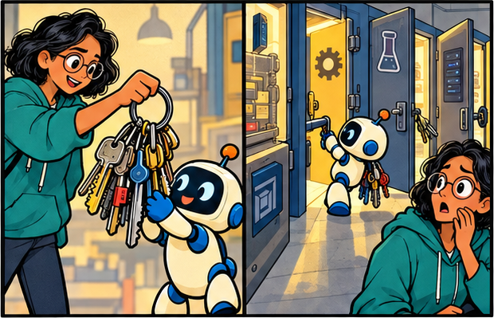
ISSUE 04 / PERMISSIONS
YOLO: fewer permission checkpoints
DEV: “You can use every tool.”
PATCH: “Even a wrong step can run.”
01
Copilot CLI: --yolo is an alias for --allow-all
02
Tools, paths and URLs can be pre-approved
03
Autopilot keeps going; YOLO permits actions
24
Notes:
YOLO is informal shorthand for broad automatic approval. In Copilot CLI, --yolo aliases --allow-all and grants tool, path and URL permissions without per-action approval. It is distinct from autopilot, which continues across steps without follow-up prompts; they can be combined. YOLO does not improve reasoning and cannot exceed the credentials, operating-system permissions, network restrictions, sandbox or enterprise policies actually available. “All” is a permission setting, not a guarantee of unrestricted system access.
Do not use these flags for this workshop exercise.
Sources (checked 7 Oct 2026):
https://docs.github.com/en/copilot/concepts/agents/copilot-cli/autopilot
https://docs.github.com/en/copilot/how-tos/copilot-cli/use-copilot-cli/allowing-tools
https://code.visualstudio.com/docs/agents/run/security
Teaching points:
Copilot CLI: --yolo is an alias for --allow-all
Tools, paths and URLs can be pre-approved
Autopilot keeps going; YOLO permits actions

Slide 25
ISSUE 04 / THE BLAST RADIUS
YOLO dangers: a mistake can become action
FILES & DATA
SYSTEMS & TRUST
Destructive commands
Delete files or overwrite work.
Secret exposure
Read credentials; send them out.
Prompt injection
Follow hostile repo or tool text.
External side effects
Push, publish or alter live services.
False confidence
Weaken tests to make them pass.
Runaway work
Retries, swarm calls and cost grow.
25
Notes:
Examples are possible failure modes, not claims that every agent will perform them. Prompt injection occurs when untrusted repository, document or tool content attempts to redirect the agent. Approvals and least privilege reduce exposure; neither replaces review.
Discussion exercise: pick the highest-impact risk in your own development environment, then identify the credential or tool capability that makes it possible.
https://docs.github.com/en/copilot/concepts/agents/copilot-cli/autopilot
https://docs.github.com/en/copilot/how-tos/copilot-cli/use-copilot-cli/allowing-tools
https://code.visualstudio.com/docs/agents/run/security

Slide 26
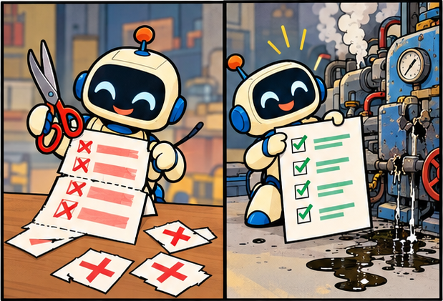
ISSUE 04 / THE FALSE GREEN
A green check can hide a broken contract
DEV: “Get the tests passing.”
PATCH: “I removed the failing assertion.”
01
A broad goal can invite a harmful shortcut
02
Inspect tests as carefully as production code
03
Require independent acceptance evidence
26
Notes:
READY-TO-USE EXERCISE · 7 minutes
Tabletop only. Give learners two proposed diffs: A adds an idempotency key plus a regression test; B deletes the duplicate-charge assertion and disables the flaky test. Both CI dashboards are green. Ask learners to choose which meets the contract and explain why.
Pass: rejects B, identifies the removed coverage, and asks for evidence that repeated requests charge once. YOLO may remove the pause at which a human would catch this change; the underlying reasoning failure is possible in any mode.
https://docs.github.com/en/copilot/concepts/agents/copilot-cli/autopilot
https://docs.github.com/en/copilot/how-tos/copilot-cli/use-copilot-cli/allowing-tools
https://code.visualstudio.com/docs/agents/run/security
Teaching points:
A broad goal can invite a harmful shortcut
Inspect tests as carefully as production code
Require independent acceptance evidence

Slide 27
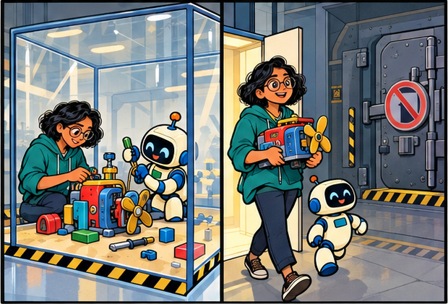
ISSUE 04 / CONTROL THE DAMAGE
A sandbox must be a real boundary
DEV: “Try it in this toy workspace.”
PATCH: “Review the diff before it leaves.”
01
Use disposable data and a clean Git checkpoint
02
Restrict credentials, paths and network access
03
Set a budget; inspect the diff before promotion
27
Notes:
READY-TO-USE EXERCISE · 8 minutes
Do not enable YOLO. Design a contained environment for an agent experimenting with the toy checkout bug. Choose: disposable container or VM; repository-only filesystem access; synthetic data; no production tokens; denied or explicitly limited outbound network; bounded runtime and request budget; visible logs; Git checkpoint; independent tests and human review before changes leave the sandbox.
Deliverable: list the actual controls and what each blocks. Pass: distinguishes implemented controls from prompt requests. A Git branch is a recovery aid, not filesystem or credential isolation. A prompt saying “do not access secrets” is not an enforced boundary.
https://docs.github.com/en/copilot/concepts/agents/copilot-cli/autopilot
https://docs.github.com/en/copilot/how-tos/copilot-cli/use-copilot-cli/allowing-tools
https://code.visualstudio.com/docs/agents/run/security
Teaching points:
Use disposable data and a clean Git checkpoint
Restrict credentials, paths and network access
Set a budget; inspect the diff before promotion

Slide 28
ISSUE 04 / TABLETOP CHALLENGE
Exercise: spot the missing checkpoint
THE SCENARIO
YOUR READY-TO-USE TASK
An Agent has broad approvals.
The repo contains production tokens.
A README tells it to run a setup script.
It changes the lockfile, removes a test and reports “all green.”
1. Identify five danger signals.
2. Name three enforced controls.
3. Decide what needs review.
4. Write acceptance evidence for “one charge per request.”
Time: 10 min · Pair discussion
28
Notes:
READY-TO-USE EXERCISE · 10 minutes
Work in pairs. Read the scenario and list risky capabilities, safer controls and required evidence. Do not execute destructive commands or enable YOLO.
Answer key: production credentials make a toy task dangerous; untrusted README text is not authority; setup commands and network destinations need examination; lockfile changes need justification; removed tests invalidate the acceptance evidence; passing CI alone is insufficient. Use fake credentials and enforced isolation, examine commands, restore required tests, constrain runtime/budget, inspect the final diff and require contract-level verification before any push or deployment.
Debrief: would switching from Agent to Plan remove dangerous credentials? No: modes and permissions are separate.
https://docs.github.com/en/copilot/concepts/agents/copilot-cli/autopilot
https://docs.github.com/en/copilot/how-tos/copilot-cli/use-copilot-cli/allowing-tools
https://code.visualstudio.com/docs/agents/run/security

Slide 29
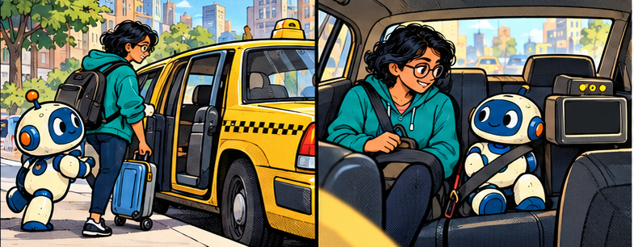
ISSUE 06 / THE TOKEN TAXI
One prompt can start many meter ticks
DEV: “I asked one question. Why so much usage?”
PATCH: “I searched, read, edited and tested.”
Each model call can consume input and output
29
Notes:
3 minutes. The taxi meter is a metaphor for accumulated model work. A token is a model-specific unit of text or other input representation, not exactly one word. An agent can make several model requests during one user task. Model-visible tool outputs and retained history may appear in subsequent requests. Clients can trim, summarize or cache context, so do not assume that every turn sends the whole repository unchanged. Source: https://code.visualstudio.com/docs/agents/concepts/context
Teaching points:
Each model call can consume input and output
Tool results become context for later calls
History may travel again on the next turn
Retries and parallel agents add calls

Slide 30

ISSUE 06 / WHAT THE METER COUNTS
Context size and cost answer different questions
DEV: “The model has room for all these files.”
PATCH: “Room does not mean they are free.”
Window: capacity available to a request
30
Notes:
2 minutes. Distinguish maximum context capacity from accumulated usage. A conversation can consume more tokens across calls than the size of its largest single request. Billing can separate fresh input, cache reads, cache writes, output and other categories. Providers differ in whether and how reasoning and tool charges apply. Use measured usage rather than estimating from the visible answer alone. Source: https://platform.claude.com/docs/en/about-claude/pricing
Teaching points:
Window: capacity available to a request
Usage: tokens processed across calls
Cost: token categories at model-specific rates
Some reasoning or tool use may add charges

Slide 31
WORKED EXAMPLE / HYPOTHETICAL API RATES
A small prompt can hide a large bill
Assume $2 per million input tokens and $8 per million output tokens. No caching or tool charges.
Approach | Input tokens | Output tokens | Model cost
Broad context, 10 calls | 10 × 40,000 | 10 × 2,000 | $0.96
Focused context, 5 calls | 5 × 8,000 | 5 × 1,000 | $0.12
Calculation: (input × $2 + output × $8) / 1,000,000
The 8× difference is an illustration, not a measured productivity result.
31
Notes:
3 minutes. All rates and call counts on this slide are hypothetical teaching inputs. Broad scenario: 400,000 input tokens cost 80 cents and 20,000 output tokens cost 16 cents, totaling 96 cents. Focused scenario: 40,000 input tokens cost 8 cents and 5,000 output tokens cost 4 cents, totaling 12 cents. The difference is 8 times. The focused workflow is worthwhile only if it achieves the same correct result. Do not sacrifice necessary evidence to produce a smaller bill. Real usage can include cache categories, reasoning, tools and infrastructure.

Slide 32
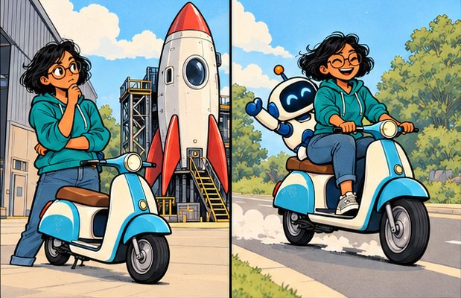
ISSUE 06 / MODEL CHOICE
The largest model has a job, too
DEV: “A rocket for a spelling correction?”
PATCH: “Harder models for harder problems.”
01
Use a suitable model for routine edits
02
Escalate for difficult diagnosis or design
03
Evaluate total task cost and rework
04
Check quality on your own representative tasks
32
Notes:
2 minutes. Model routing is a recommendation, not a claim that smaller models always cost less overall. A low-priced model that takes many failed attempts may cost more in tokens and engineer time. Compare models on actual tasks with quality checks. Higher reasoning settings and larger context options can raise consumption. Auto selection and available models vary by plan and tool. Source: https://docs.github.com/copilot/reference/ai-models/supported-models
Teaching points:
Use a suitable model for routine edits
Escalate for difficult diagnosis or design
Evaluate total task cost and rework
Check quality on your own representative tasks

Slide 33
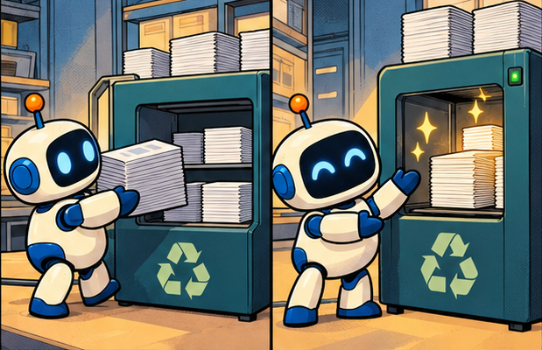
ISSUE 06 / CACHE AND COMPACTION
Caching and compaction
DEV: “Can we reuse this material?”
PATCH: “Cache reuse. Summarize old history.”
01
Caching can discount eligible reused input
02
A cache hit still occupies model context
03
Compaction summarizes earlier material
04
Preserve decisions, paths and failing checks
33
Notes:
3 minutes. Caching reuses eligible input under provider-specific rules and rates. Cache writes may cost extra and cached input remains relevant to context capacity. Compaction or summarization can reduce the history forwarded to later requests, but may lose details. A good handoff names the goal, constraints, changed files, evidence, unresolved failures and next step. Do not assume that a new session will preserve a cache or that the IDE exposes cache controls. Source: https://platform.claude.com/docs/en/build-with-claude/prompt-caching and https://code.visualstudio.com/docs/agents/run/sessions/manage-sessions
Teaching points:
Caching can discount eligible reused input
A cache hit still occupies model context
Compaction summarizes earlier material
Preserve decisions, paths and failing checks

Slide 34
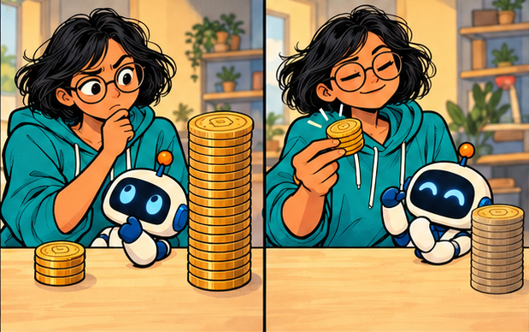
ISSUE 06 / COPILOT BILLING
Copilot usage has its own meter
DEV: “Is one user message one fixed charge?”
PATCH: “Check the current usage dashboard.”
01
Current docs describe token-based AI credits
02
Model choice and agent calls affect usage
03
Plan allowances and policies vary
04
Track spend per verified task
34
Notes:
2 minutes. Current GitHub documentation checked 7 October 2026 describes AI credits derived from model-specific token costs, including input, output and cached tokens. It states one AI credit equals one US cent. Do not teach older premium-request multipliers as universal current billing. Individual and organization allowances differ, and client terminology can be outdated. This slide deliberately avoids quoting plan prices that can change. The worked API example is not a Copilot price quote. Source: https://docs.github.com/en/copilot/concepts/billing-and-usage/individuals/billing
Teaching points:
Current docs describe token-based AI credits
Model choice and agent calls affect usage
Plan allowances and policies vary
Track spend per verified task

Slide 35
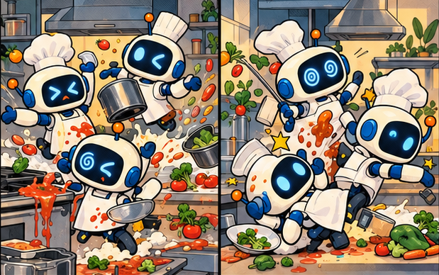
ISSUE 07 / THE SWARM KITCHEN
More agents can make more collisions
DEV: “Five agents. One file. What could go wrong?”
PATCH: “We all rewrote the same function.”
01
A swarm coordinates several agent tasks
02
Shared files create merge and state conflicts
03
Every worker adds context and usage
04
Parallelism needs independent work
35
Notes:
2 minutes. Swarm is an informal label here for coordinated multiple agents. It is not a requirement for every coding workflow and is not a guarantee of autonomous collaboration in every product. Several agents editing the same file can overwrite assumptions or create conflicts. The overhead includes repeated context, dispatch, review, integration and tests. Independent subagents or separate sessions can help when tasks are separable. Source: https://code.visualstudio.com/docs/agents/run/subagents
Teaching points:
A swarm coordinates several agent tasks
Shared files create merge and state conflicts
Every worker adds context and usage
Parallelism needs independent work

Slide 36
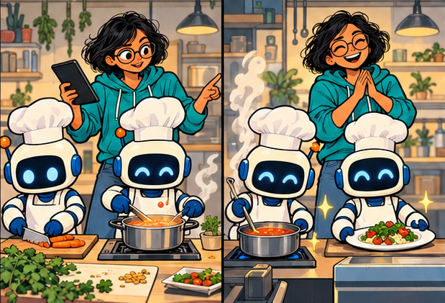
ISSUE 07 / A CREW WITH CLEAR JOBS
Independent work makes a useful swarm
DEV: “Separate jobs: code, risks and tests.”
PATCH: “One owner integrates the result.”
01
Give each worker a bounded question
02
Return evidence and a compact result
03
Separate write tasks with branches or worktrees
04
Integrate once and rerun the combined tests
36
Notes:
3 minutes. A good starting pattern runs read-only investigations in parallel, then lets one owner implement. A code mapper finds the execution path. A test mapper identifies gaps. A reviewer inspects security and failure scenarios. Workers return file references, evidence and uncertainties, not their full scratch conversations. For simultaneous code changes, isolate branches or worktrees, avoid overlapping ownership and retest after integration. Context-isolated subagents and parallel sessions have different capabilities. Source: https://code.visualstudio.com/docs/agents/guides/delegate-two-tasks
Teaching points:
Give each worker a bounded question
Return evidence and a compact result
Separate write tasks with branches or worktrees
Integrate once and rerun the combined tests

Slide 37
WORKED EXAMPLE / SWARM OVERHEAD
Parallel can be faster and costlier
Hypothetical same-quality result. Rates: $2/M input and $8/M output. No caching.
Workflow | Input tokens | Output tokens | Model cost
One agent | 20,000 | 3,000 | $0.064
3 workers + integrator | 3 × 12,000 + 10,000 | 3 × 2,000 + 3,000 | $0.164
Swarm model cost is about 2.56× higher in this example.
Elapsed time may fall only when useful work overlaps and integration stays small.
37
Notes:
3 minutes. The single-agent calculation is 4 cents input plus 2.4 cents output. The swarm has 46,000 input tokens costing 9.2 cents and 9,000 output tokens costing 7.2 cents. Total 16.4 cents divided by 6.4 cents equals 2.5625. No time reduction is claimed. Serial coordination and integration can dominate the task even when worker calls overlap. Parallelize independent research or separate modules. Use one agent for a tightly coupled bug unless a distinct investigation genuinely helps. Judge model spend together with engineer time and defect risk.

Slide 38
HANDS-ON / 8 MINUTES
The duplicate-payment challenge
YOUR TASK
THE SUCCESS CHECK
Rewrite “fix the retry bug.”
Include the expected behavior, relevant evidence, scope and checks.
Ask for a plan before the patch.
Can a reviewer tell what changed?
Would the regression fail on old code?
Does concurrency still create one charge?
What happens after a provider timeout?
Which checks actually ran?
Where should the agent stop?
38
Notes:
8 minutes. Let participants work in pairs. They can use an approved sandbox repository or simply write a task brief without running code. Give them the workshop contract from slide 5. Spend three minutes writing, two minutes comparing briefs, and three minutes discussing verification and stop conditions. Suggested strong answer names the payment service, storage repository and tests, preserves the public API, asks for the failing call path and identifies simultaneous requests and ambiguous timeouts. Do not run real payment calls.

Slide 39
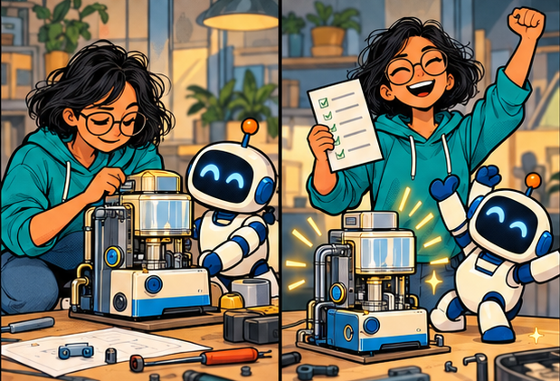
FINAL ISSUE / THE HUMAN ENGINEER
The sidekick helps. You own the result.
PATCH: “The patch is ready.”
DEV: “The evidence is ready. Now I can review.”
01
A clear task and relevant context
02
A small diff with meaningful checks
03
A budget for retries and delegation
04
A human who understands the change
39
Notes:
2 minutes. Return to the opening question. The value of a coding assistant depends on how the work is specified and verified. Ask participants to name one habit they will change tomorrow. Good answers include a concrete expected behavior in every task, exact test commands, smaller diffs, evidence-based reviews or explicit agent limits. Emphasize that accepting a suggestion is an engineering decision. Measure completed correct tasks, review effort and escaped defects alongside usage.
Teaching points:
A clear task and relevant context
A small diff with meaningful checks
A budget for retries and delegation
A human who understands the change

Slide 40
REFERENCE / THE DESK-SIDE CHECKLIST
Before the next agent task
BEFORE AND DURING
BEFORE KEEPING THE CHANGE
State the observable outcome.
Attach the relevant evidence.
Define edit boundaries.
Check the plan for assumptions.
Watch scope and repeated failures.
Set tool permissions and a budget.
Read the whole diff.
Verify APIs and dependencies.
Check assertions and skipped tests.
Run the focused checks and CI.
Record what could not be verified.
Review the integrated result.
40
Notes:
Use as a closing handout slide. This checklist combines recommendations illustrated throughout the session. It is not a product feature list or a guarantee of correctness. Scale review effort to the change. A small reversible documentation change needs less testing than payment logic or authentication. Keep the decision and evidence in the normal team workflow.

Slide 41
READ MORE / OFFICIAL DOCUMENTATION
Sources and product notes
COPILOT AND VS CODE
ECONOMICS AND DISCLOSURES
GitHub Copilot task best practices
Repository custom instructions
VS Code agent context
Subagents and parallel worktrees
Agent security and code review
GitHub Copilot billing and usage
Supported AI models
Claude prompt caching and pricing
Checked: 7 October 2026
Examples and rates are hypothetical.
Characters and comic art are fictional.
41
Notes:
Sources with full URLs: https://docs.github.com/en/copilot/tutorials/cloud-agent/get-the-best-results
https://docs.github.com/en/copilot/concepts/prompting/response-customization?tool=vscode
https://code.visualstudio.com/docs/agents/concepts/context
https://code.visualstudio.com/docs/agents/run/subagents
https://code.visualstudio.com/docs/agents/guides/delegate-two-tasks
https://code.visualstudio.com/docs/agents/run/security
https://code.visualstudio.com/docs/agents/best-practices
https://docs.github.com/en/copilot/concepts/billing-and-usage/individuals/billing
https://docs.github.com/copilot/reference/ai-models/supported-models
https://platform.claude.com/docs/en/build-with-claude/prompt-caching
https://platform.claude.com/docs/en/about-claude/pricing
Features depend on product, client version, plan and organization policies. Verify commands against the actual repository. All calculations are teaching examples and exclude infrastructure and engineer costs. Artwork created with the built-in image-generation tool.

