Slide 1
Bachelor Project Scripting Objects for the Web
Hasso-Plattner-Institut Potsdam
Software Architecture Group
Prof. Dr. Robert Hirschfeld
BP2010H1: Stephan Eckardt, Anton Gulenko, Marcus Hoffmann, Hauke Klement, Robert Strobl, Lauritz Thamsen, Lars Wassermann, Sebastian Woinar
http://www.hpi.uni-potsdam.de/swa/
2011/18/01

Slide 2
SqueakyJS
Comparison between Squeak and JavaScript
SqueakyJS class model
Method name exceptions
Inheritance and access to super methods
Metaprogramming
Block closures and non-local return
Access to super methods

Slide 3
Comparison between Squeak and JS
Squeak | JavaScript
Class driven, class methods | Class free
Single inheritance from superclass | Prototype inheritance
Access superclass by using super | Apply can call functions in another context
Block closures with non-local return | No non-local return

Slide 4
SqueakyJS class model
// class example
Class('Person', {
instanceVariables: ['name'],
instanceMethods: {
setName: function(aName) {
this.name = aName;
},
getName: function() {
return this.name;
},
makeNoise: function() {
return this.getName() + " says: ";
}
},
});
// create an instance
aPerson = Person._newInstance();

Slide 5
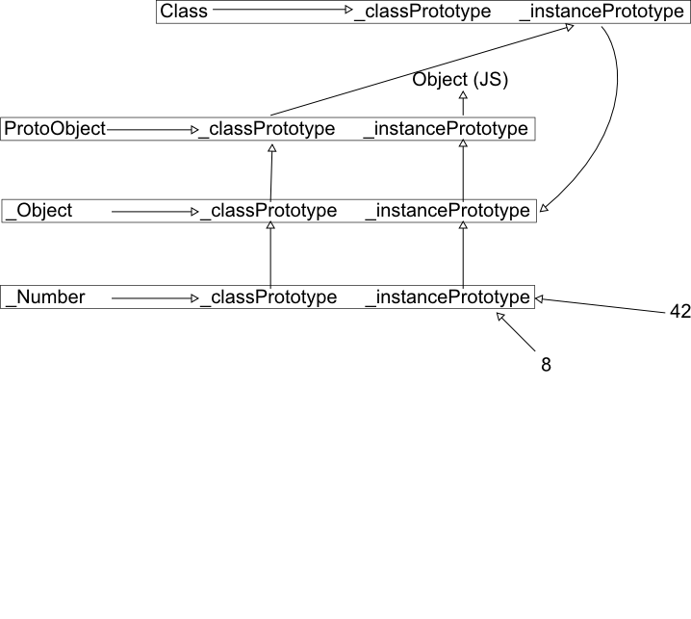
SqueakyJS class model

Slide 6
Method name exceptions (1)
Exact mapping from Squeak to JS methods not possible
-> we need to escape methods
Goal: avoid name conflicts!!

Slide 7
Method name exceptions (2)
Issue:
special characters can not be used as method names in JavaScript (e.g. +,*)
Solution:
provide dictionary for compiler, convert to _plus, _times – leading underscore assures, that there is no conflict with a possible plus or times Squeak method

Slide 8
Method name exceptions (3)
Issue:
accessor and variables have different namespaces in Squeak, but only one namespace in JavaScript
Solution:
all instance variables have a leading $ which is not a valid character in Squeak -> conflicts avoided

Slide 9
Method name exceptions (4)
Issue:
getters and setters only differ in trailing colon
e.g. foobar, foobar: -> colon not valid in JavaScript
Solution:
setters have trailing underscores (foobar_)

Slide 10
Method name exceptions (5)
Issue:
multiple method parameters in Squeak
Squeak:
OrderedCollection>>at: anInteger put: anObject
Solution:
concatenation of selector parts
JavaScript:
at_put_(anInteger, anObject)

Slide 11
Method name exceptions (6)
Issue:
reserved keywords in JavaScript, (new, class)
Solution:
escape method names with leading underscore (_new, _class)

Slide 12
Inheritance and access to super methods
Class('Pirate', {
// inherits from Person
superclass: Person,
instanceMethods: {
makeNoise: function() {
return this._super.makeNoise() + this._class().noise();
}
},
classMethods: {
noise: function() {
return 'Arrrrrr!!!';
}
}
});
aPirate = Pirate._newInstance();

Slide 13
Metaprogramming
Pirate._addClassMethods({
printFoobar: function() {
alert(“foobar”);
}
});
// prints foobar
aPirate._class().printFoobar();

Slide 14
Block closures and non-local return
Pirate>>evaluateBlock: aBlock
aBlock value.
Pirate>>noise
self evaluateBlock: [ :a | [ :b | ^ a + b] ]
^ 'Arrrrrr!!!'
// JAVASCRIPT
aPirate._addClassMethods({
evaluateBlock: function(aBlock) {
aBlock.value(3).value(4);
},
// overwrite noise method
noise: function() {
aBlock = block(function(a) {
return block(function(b) {
nonLocalReturn(a+b);
});
});
this.evaluateBlock(aBlock);
return 'Arrrrrr!!!';
});

Slide 15
Access to super methods (1)
Optimal: super as global object
super.foobar(a, b);
Issue:
this not bound to object!
Next idea: super as global function
super().foobar(a, b);
Issue:
could get callers context (this), but can‘t provide method slot for this context

Slide 16
Access to super methods (2)
Current solution: super as instance‘s slot
this._super.foobar(a, b);
Benefit: comfortable use for programmer
Issue:
methods have to be copied into the _super slots on class creation -> no prototypical inheritance
Alternative: super as function with method parameter
this._super(‘foobar') (a, b);
Benefit: use of prototypical inheritance
Issue: uncomfortable for the JavaScript programmer

Slide 17
Access to super methods (3)
What would you prefer?
Comfortability
vs.
Implementation

