Slide 1
PROVENANCE at a glance
Provenance ≈ logbook:
capturing all the steps involved in the derivation of a result such as collection of data, creation and sharing of Koopovereenkomst,
could be used to keep track of the execution that led to that particular Koopovereenkomst, so as to validate it.
it helps users (makelaars, kopers, verkopers, notarissen, adviseurs and geldverstrekkers) to make trust judgments. So, it is crucial in decision process!

Slide 2
Expressing provenance in ZV
Domain neutral metadata such as:
1. PROV-O
the author, the date and time of creation etc..
(Explained in the PROV Ontology: https://www.w3.org/TR/2013/REC-prov-o-20130430/)
2. GDPRov (extended PROV-O)
activieties regarding data collection, third party sharing, consent agreements etc..
(Explained in the GDPR Provenance Ontology: https://w3id.org/GDPRov#)

Slide 3
PROV-O: Basic Classes
responsible for the actions affecting entities
the resources whose provenance we want to describe
prov:Agent
:Alice
prov:Entity
:Koopovereenkomst
prov:Agent
:Bob
prov:Activity
:makenVanKoopovereenkomst
describes how entities are created and how they change
See: https://www.w3.org/TR/2013/REC-prov-o-20130430/#Entity

Slide 4
PROV-O: Basic Classes
prov:Entity:
- the resources whose provenance we want to describe. E.g.: “Koopovereenkomst”, “Leveringsakte”, “Lening” maar ook “Handtekening”, “Consent” etc.
prov:Activity:
- describes how entities are created and how they change. E.g.: ”maken van koopovereenkomst”, “vragen om handtekening”, “zetten van handtekening” etc.
prov:Agent:
- responsible for the actions affecting entities. E.g.: “makelaar in de rol van maker van koopovereenkomst”, “koper”, “verkoper”, ”ODS-Provider” etc.

Slide 5
PROV-O: Basic Properties
attribution is the ascribing of an entity to an agent.
(in most cases equivalent to SKOS-LEX Agent.
[https://github.com/bp4mc2/bp4mc2-zvg/blob/master/docs/roles-and-classes.md])
prov:wasAttributedTo
:Chang Cho
An activity association is an assignment of responsibility to an agent for an activity, indicating that the agent had a role in the activity. It further allows for a plan to be specified, which is the plan intended by the agent to achieve some goals in the context of this activity.
(in most cases equivalent to SKOS-LEX Actor.
[https://github.com/bp4mc2/bp4mc2-zvg/blob/master/docs/roles-and-classes.md])
:Koopovereenkomst
:Bob
prov:wasGeneratedBy
prov:wasAssociatedWith
:makenVanKoopovereenkomst
Generation is the completion of production of a new entity by an activity. This entity did not exist before generation and becomes available for usage after this generation.
2021-05-08
prov:startedAtTime
2021-05-08
prov:endedAtTime

Slide 6
PROV-O: Basics Properties
Properties:
- connections describing how entities, agents, and activities interact.

Slide 7
ZV possible approach
Starting point terms SIMPLE
The basics for the rest of the ontology
3 classes + 9 properties
Expanded terms ADVANCED
Extension of the starting point terms
7 classes + 18 properties
Qualifying relationships COMPLEX
Elaborate of the 14 Starting and expanded relationships
GDPR Provenance Ontology EXTENDED
> 100 Classes and > 40 properties
Agent
Entity
Activity

Slide 8
PROV-O: Simple
<?xml version="1.0" encoding="UTF-8"?> <rdf:RDF xml:lang="en" xmlns:rdf="http://www.w3.org/1999/02/22-rdf-syntax-ns#" xmlns:rdfs="http://www.w3.org/2000/01/rdf-schema#" xmlns:prov="http://www.w3.org/ns/prov#"> <prov:Activity rdf:about="Activiteit:makenVanKoopovereenkomst_ex1"> <prov:startedAtTime>2021-05-08T10:20:15</prov:startedAtTime> <prov:endedAtTime>2021-05-09T10:18:54</prov:endedAtTime> <prov:generated rdf:resource="http://mak.zorgeloosvastgoed.nl/id/koopovereenkomst/123e4567-e89b-12d3-a456-426614174000"/> <prov:wasAssociatedWith rdf:resource="ex:Bob_Makelaar"/> </prov:Activity> <prov:Entity rdf:about="http://mak.zorgeloosvastgoed.nl/id/koopovereenkomst/123e4567-e89b-12d3-a456-426614174000"> <prov:generatedAtTime>2021-05-09T10:20:15</prov:generatedAtTime> <prov:wasAttributedTo rdf:resource="https://changchozv.inrupt.net/profile/card#me"/> <prov:wasGeneratedBy rdf:resource="Activiteit:makenVanKoopovereenkomst_ex1"/> </prov:Entity> </rdf:RDF>
[related to ZV-Koopovereenkomst example: https://github.com/bp4mc2/bp4mc2-zvg/blob/master/informatiemodel/voorbeeld/voorbeeld.rdf]

Slide 9
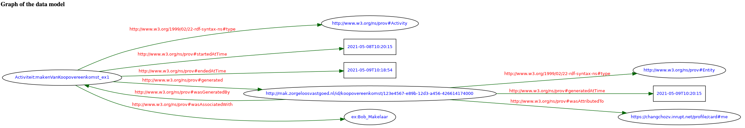
PROV-O: Simple
[related to ZV-Koopovereenkomst example: https://github.com/bp4mc2/bp4mc2-zvg/blob/master/informatiemodel/voorbeeld/voorbeeld.rdf]

Slide 10
PROV-O: Complex
<?xml version="1.0" encoding="UTF-8"?> <rdf:RDF xml:lang="en" xmlns:rdf="http://www.w3.org/1999/02/22-rdf-syntax-ns#" xmlns:rdfs="http://www.w3.org/2000/01/rdf-schema#" xmlns:prov="http://www.w3.org/ns/prov#"> <prov:Activity rdf:about="Activiteit:makenVanKoopovereenkomst_ex1"> <prov:startedAtTime>2021-05-08T10:20:15</prov:startedAtTime> <prov:endedAtTime>2021-05-09T10:18:54</prov:endedAtTime> <prov:generated rdf:resource="http://mak.zorgeloosvastgoed.nl/id/koopovereenkomst/123e4567-e89b-12d3-a456-426614174000"/> <prov:wasAssociatedWith rdf:resource="ex:Bob_Makelaar"/> <prov:qualifiedAssociation rdf:resource="ex:Bob_Makelaar_Uitgebreide_info"/> <prov:qualifiedAssociation rdf:resource="ex:Alice_Makelaar_Uitgebreide_info"/> </prov:Activity> <prov:Entity rdf:about="http://mak.zorgeloosvastgoed.nl/id/koopovereenkomst/123e4567-e89b-12d3-a456-426614174000"> <prov:generatedAtTime>2021-05-09T10:20:15</prov:generatedAtTime> <prov:wasAttributedTo rdf:resource="https://changchozv.inrupt.net/profile/card#me"/> <prov:wasGeneratedBy rdf:resource="Activiteit:makenVanKoopovereenkomst_ex1"/> </prov:Entity> <!-- An activity association is an assignment of responsibility to an agent for an activity, indicating that the agent had a role in the activity. --> <prov:Association rdf:about="ex:Bob_Makelaar_Uitgebreide_info"> <prov:agent rdf:resource="ex:Bob_Makelaar"/> <prov:hadRole>Makelaar verantwoordelijk voor het opstellen Koopovereenkomst</prov:hadRole> <prov:atLocation>Amsterdam</prov:atLocation> </prov:Association> <!-- An activity association is an assignment of responsibility to an agent for an activity, indicating that the agent had a role in the activity. --> <prov:Association rdf:about="ex:Alice_Makelaar_Uitgebreide_info"> <prov:agent rdf:resource="ex:Alice_Makelaar"/> <prov:hadRole>Assistent-Makelaar</prov:hadRole> <prov:atLocation>Naarden</prov:atLocation> </prov:Association> </rdf:RDF>
[related to ZV-Koopovereenkomst example: https://github.com/bp4mc2/bp4mc2-zvg/blob/master/informatiemodel/voorbeeld/voorbeeld.rdf]

Slide 11
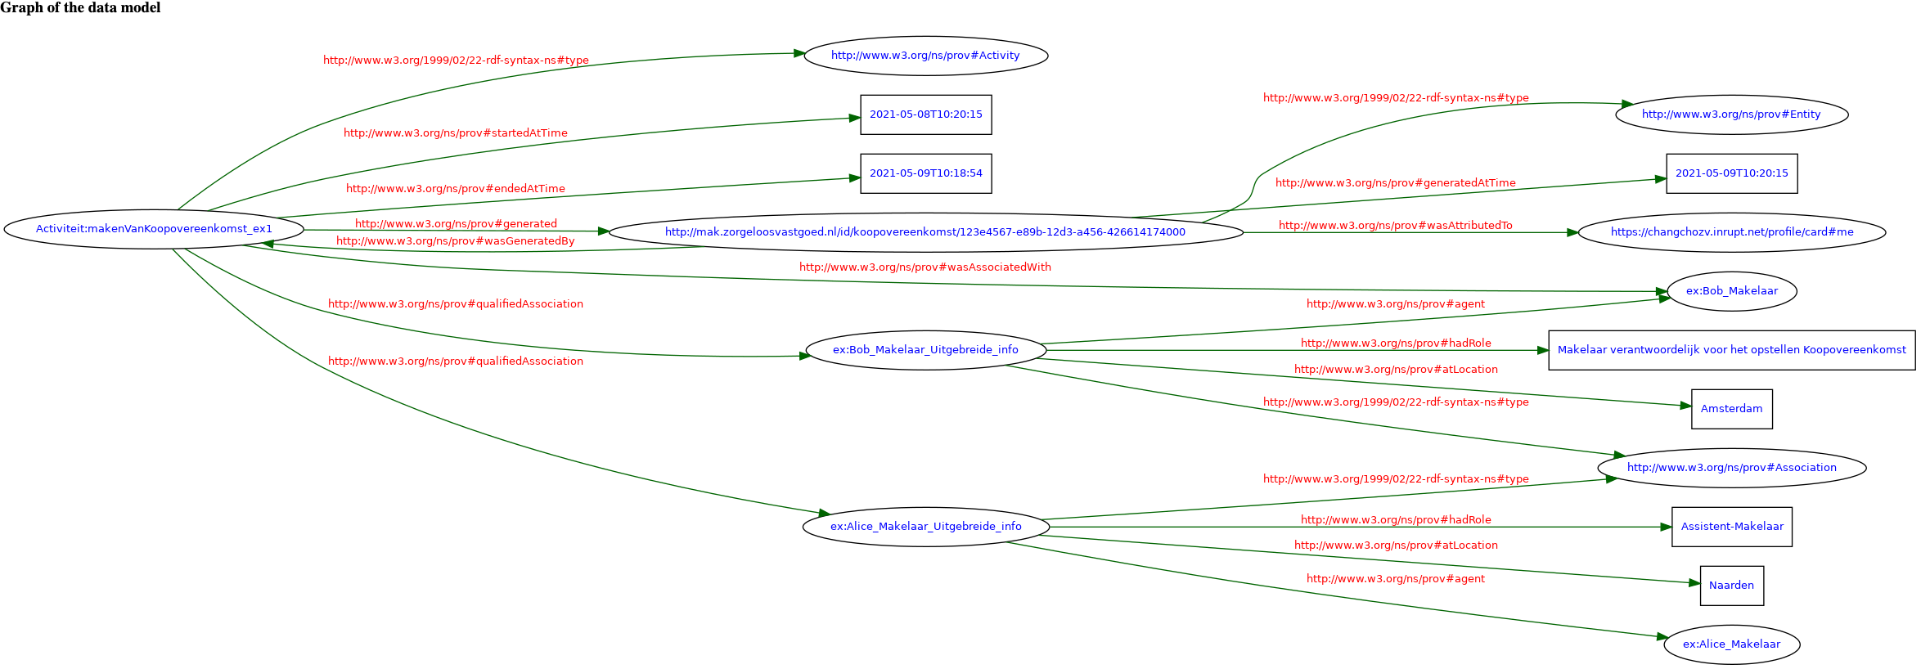
PROV-O: Complex
[related to ZV-Koopovereenkomst example: https://github.com/bp4mc2/bp4mc2-zvg/blob/master/informatiemodel/voorbeeld/voorbeeld.rdf]

Slide 12
GdPROV: Extended
Consent – phase 2
[related to ZV-Koopovereenkomst example: https://github.com/bp4mc2/bp4mc2-zvg/blob/master/informatiemodel/voorbeeld/voorbeeld.rdf]

Slide 13
GdPROV: Extended
Consent – phase 2
[related to ZV-Koopovereenkomst example: https://github.com/bp4mc2/bp4mc2-zvg/blob/master/informatiemodel/voorbeeld/voorbeeld.rdf]

