Slide 1

SPRING 2022 CS 394R REINFORCEMENT LEARNING
Quantum Reinforcement Learning
May 6th, 2022
Presenters: JORDI RAMOS, BENJAMIN PACHEV
The University of Texas at Austin

Slide 2
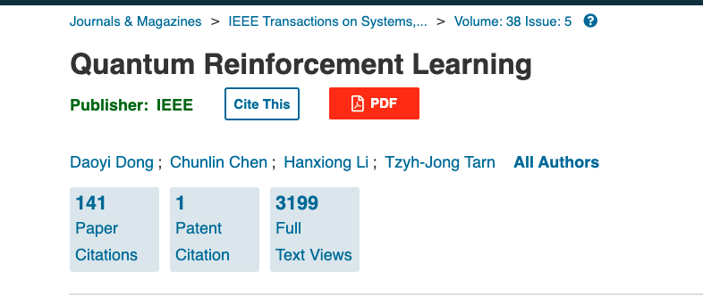
We wanted to replicate
Notes:
we were in interested in quantum reinforcement learning

Slide 3
Bold Claims
“From the following analysis, it is obvious that QRL shows much better performance than other methods when the searching space becomes very large.” (pg 7)
“QRL explores more than TD algorithm at the beginning of learning phase, but it learns much faster and guarantees a better balancing between exploration and exploitation” (pg 9)

Slide 4
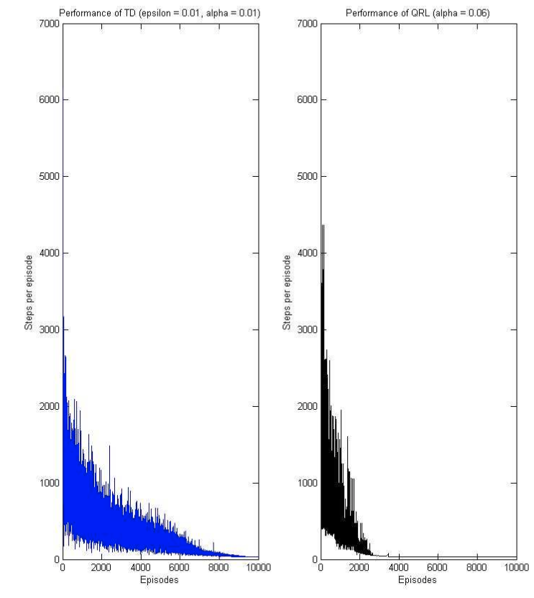
QRL
Figures from (Dong. et al 2008)
QRL is based on TD(0) and uses Grover updates to modify the action probabilities.

Slide 5
Our Journey
Initially, we wanted to extend the results of the paper to new problems and were very excited.
However, the more we dug into the paper, the more we realized that crucial implementation details were missing.
We spent a lot of effort trying to fill in these details with our best guesses.
The better we understood the algorithm, the more questions we had about its feasibility and practicality.

Slide 6
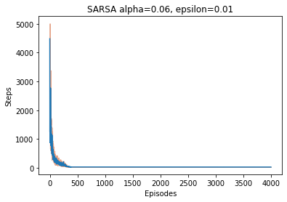
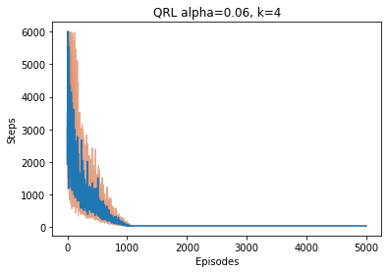
What we Found

Slide 7
Lessons Learned
Not all results are replicable
Citation counts can be misleading
It is important to review papers carefully

Slide 8

Thank you!

