Slide 1
Go Doers
Sergio Avila
Brian Padilla
Carlos Daccarett
Edwin Perea
Juan Taruc

Slide 2
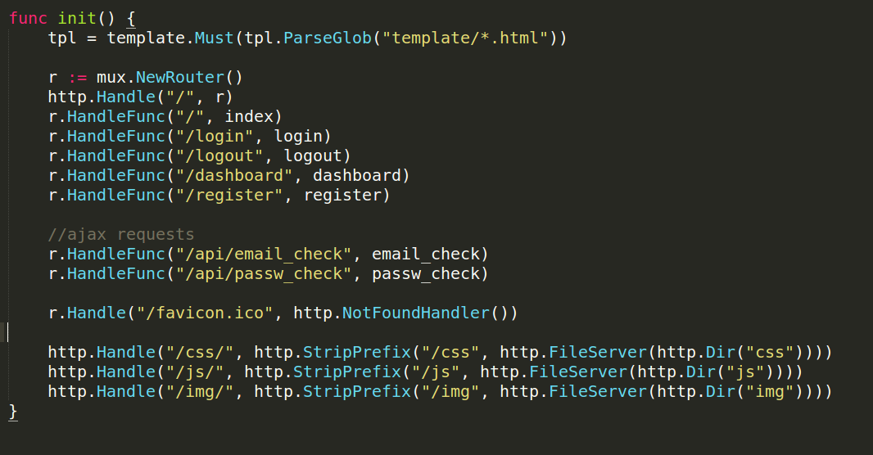
Serves all pages/resources

Slide 3
ParseGlob - creates a new Template and parses the template definitions from the files identified by the pattern, which must match at least one file. The returned template will have the name and contents of the first file matched by the pattern.
Must – checks the validity of the content; whether html tags are properly formed, curly brackets matches, etc. Like a compiler that checks for syntax errors?
Gorilla mux – is used for URL routing. Why? support pretty URLs with variable parameters(might be useful when passing model ids to url) and because it is compatible with the built in http.Handler which only accepts 2 params(response, request), looks more easier.
- line 22 we created a new Router, this is the object that will route our requests to the right handler function.
NotFoundHandler - returns a simple request handler that replies to each request with a “404 page not found” reply.
FileServer - returns a handler that serves HTTP requests with the contents of the declared path.
StripPrefix – serve a directory on folder “/xxx” under an alternate URL
path (/xxx/), use StripPrefix to modify the request URL's path before the FileServer sees it
Handle – accepts interface?
HandleFunc – accepts a handler function?

Slide 4
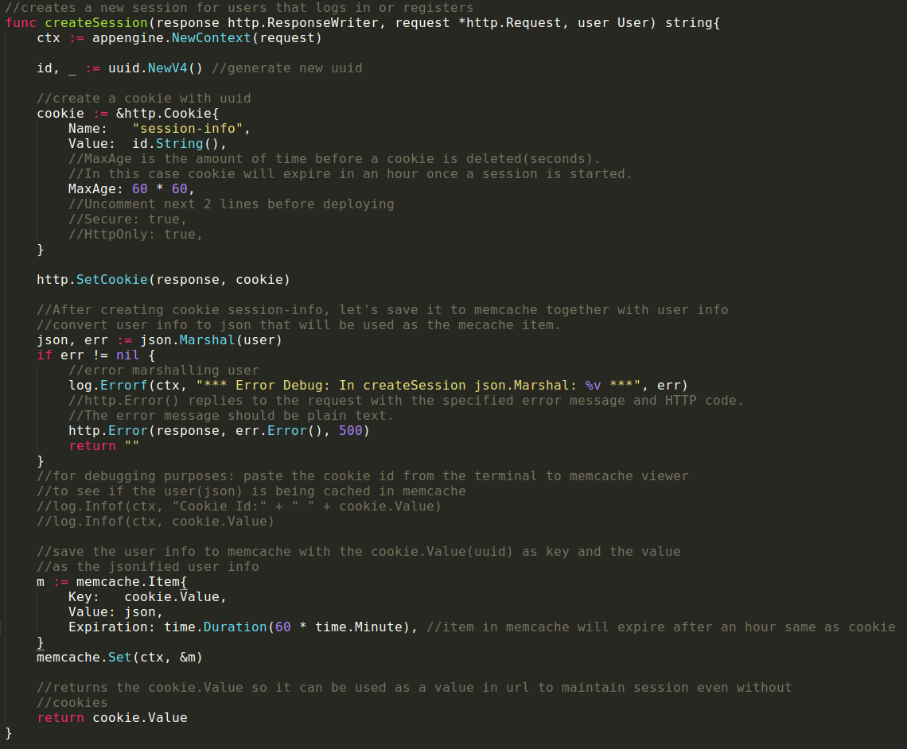
Creating Session

Slide 5
CreateSession function – creates new session for the user with a new uuid each time. It stores the session data(cookie.Value, user info) to datastore memcache to keep the session even without a cookie. The cookie value(uuid) is being passed in the url to make sure that we can reference the value in memcache even without a cookie to maintain the session. Not a good practice though because we are passing confidential id to url but for extra credit purposes we intentionally did it that way. The cookie and memcache item will both expire after an hour after a session is created.
Code:
Context - context defines the Context type, which carries deadlines, cancelation signals, and other request-scoped values. Incoming requests to a server should create a Context, and outgoing calls to servers should accept a Context.
Memcache set - Set writes the given item, unconditionally. Compared to memcache add.

Slide 6
Visually Showing State is maintained
Login → close browser → go back to site → still logged in. Why? Id in cookie is used to get session data in memcache
Login → delete cookie → still logged in. Why? Id in url is used to get session data in memcache
Disable cookies → login → go to home → still logged in. Why? Value in url is used to get session in memcache
Problems: Passing session id to url(unsecure), did that for presentation purposes.
Implemented solution: session in memcache will expire in 1 hour.
Still a lot of time to get user session.
Advise: ALWAYS LOGOUT.

