Slide 1
To Do List in GO
Sergio Avila
Brian Padilla
Carlos Daccarett
Edwin Perea
Juan Taruc

Slide 2
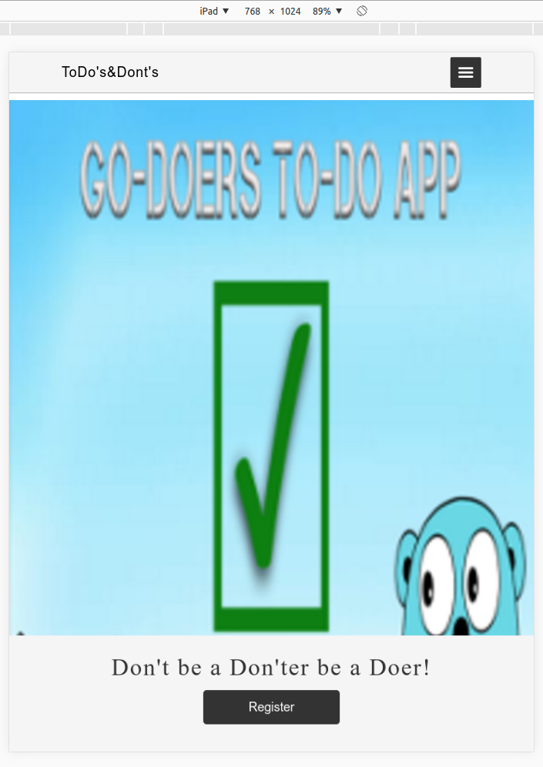
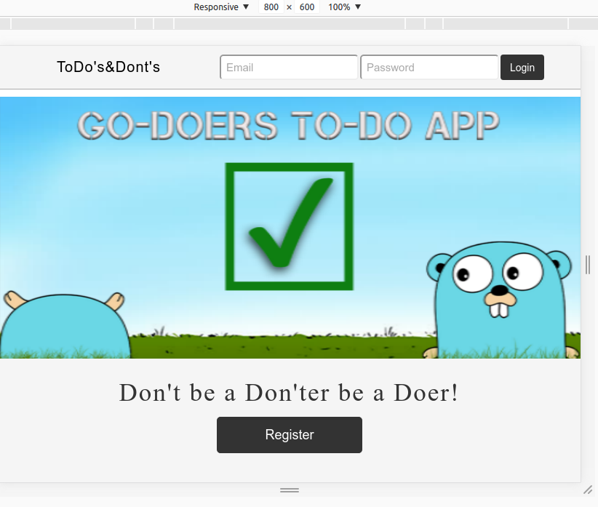
Above the fold design
Elements inside above the fold is always shown full height of the screen. Above the fold is achieved by setting the css height of html, body, and atf 100% occupying full height of screen.

Slide 3
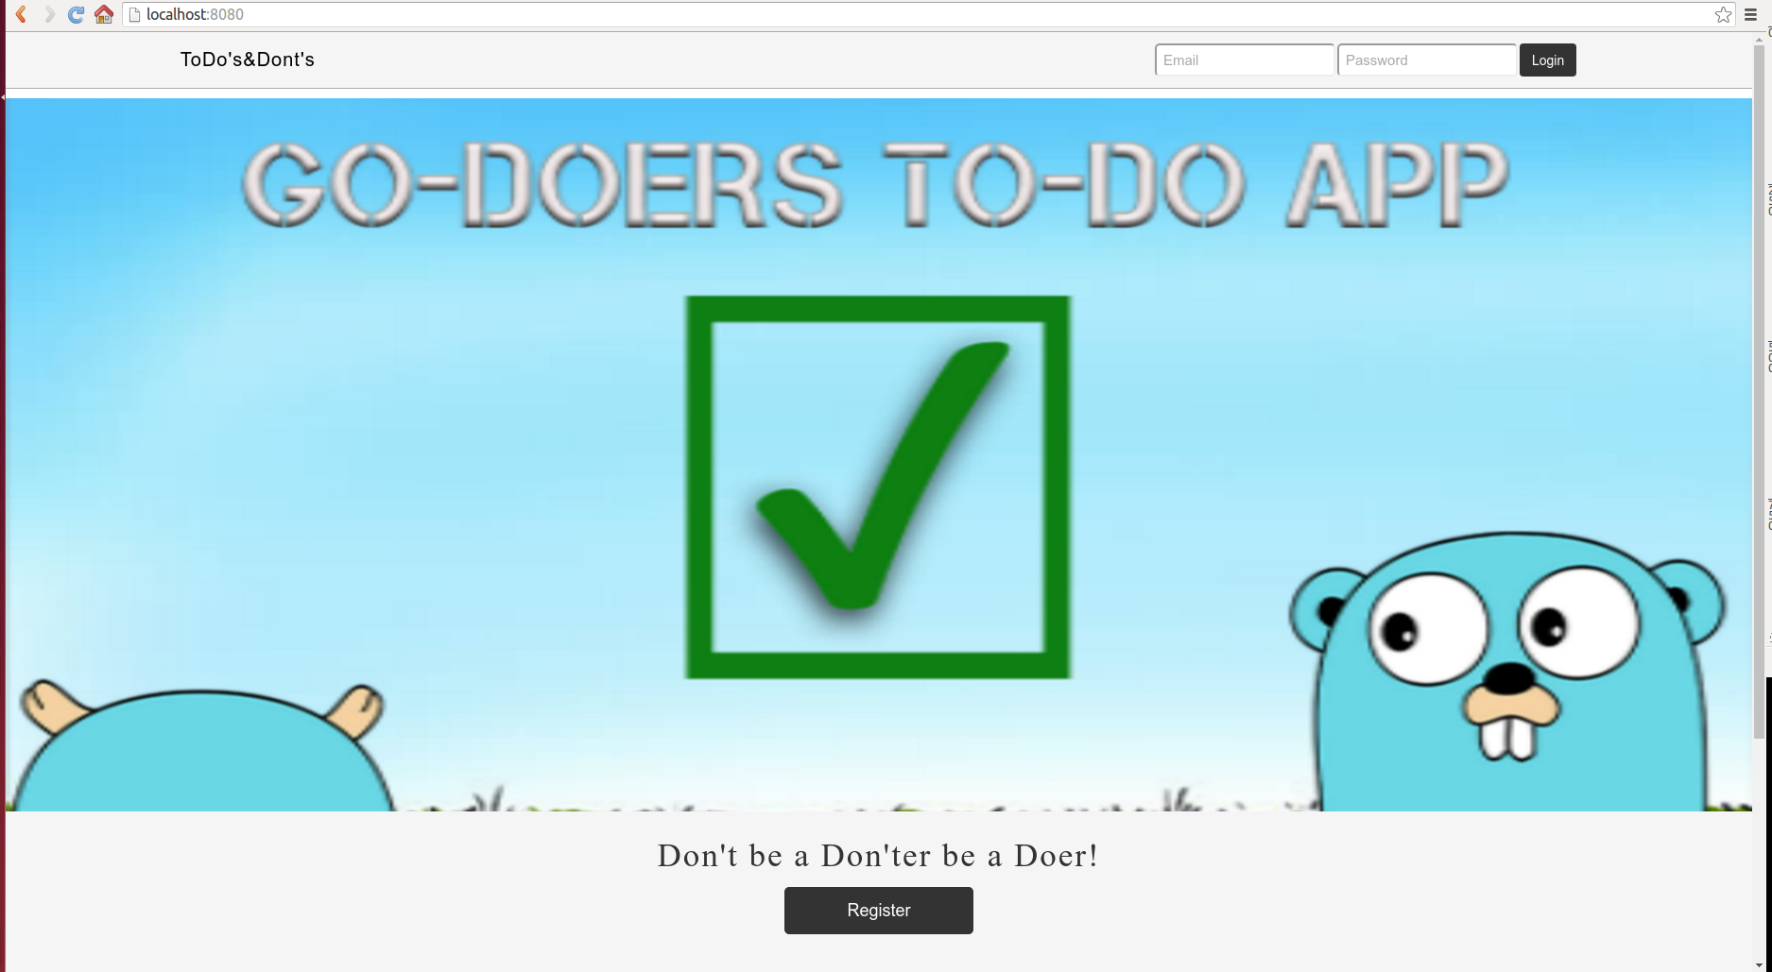
1920px x 1080px

Slide 4
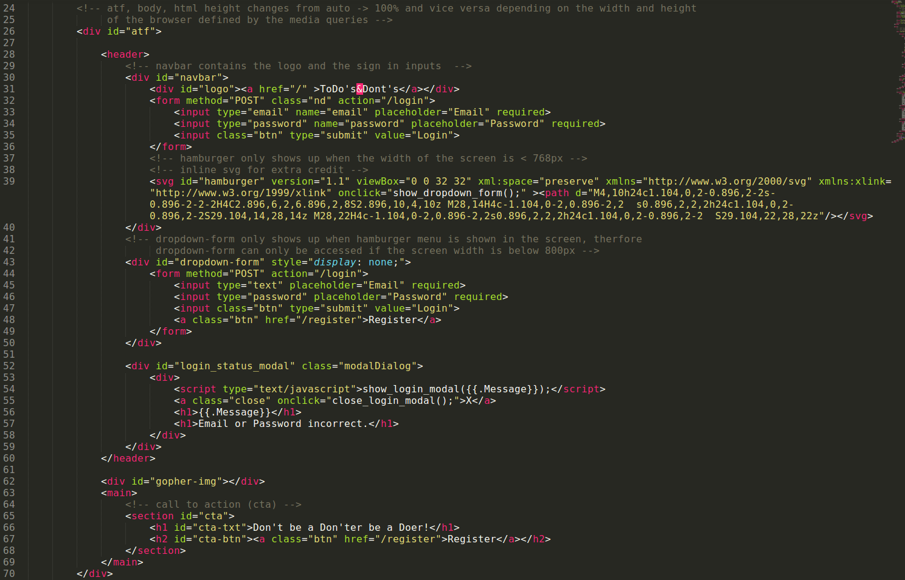
Above the fold

Slide 5
Flexbox
CSS3 Flexbox Concepts
A flex container is declared by setting the display property of an element to flex (rendered as a block)
Inside a flex container there is one or more flex items.
Note: Everything outside a flex container and inside a flex item is rendered as usual. Flexbox defines how flex items are laid out inside a flex container.
Flex items are positioned inside a flex container along a flex line. By default there is only one flex line per flex container.

Slide 6
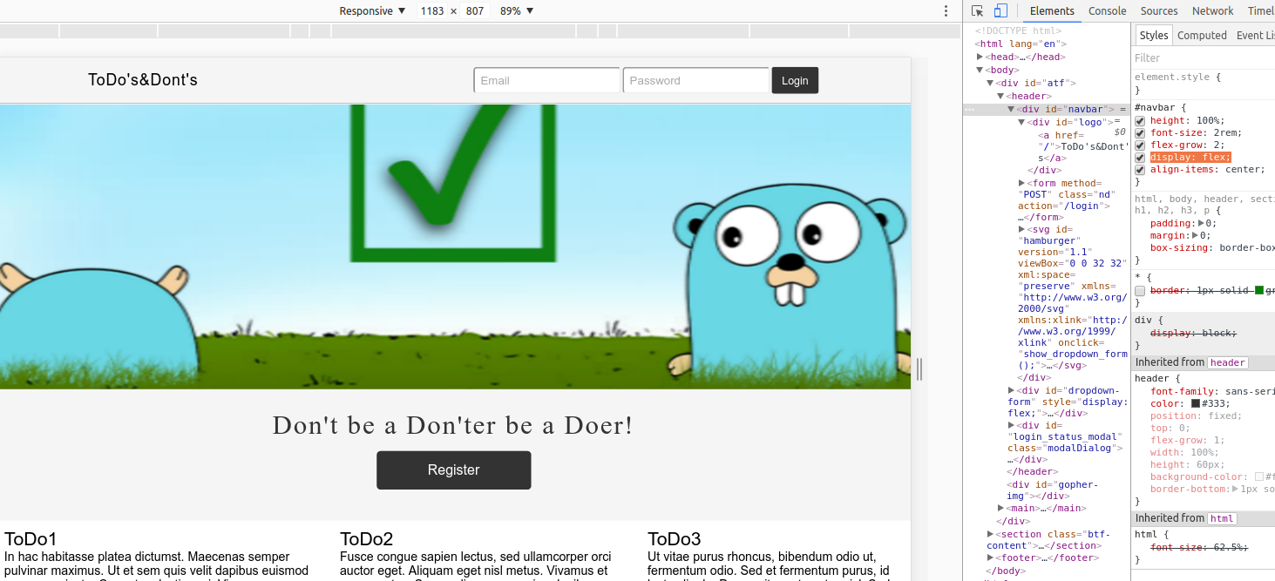
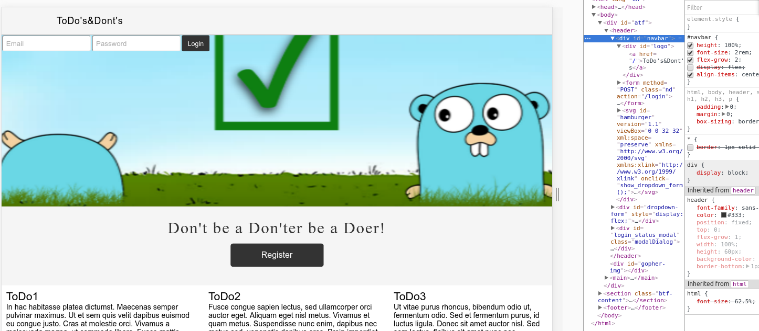
With flexbox on navbar
Without flexbox on navbar

Slide 7


Flex Grow
The flex-grow property specifies how much the item will grow relative to the rest of the flexible items inside the same container.
flex-grow: 1;
No flex-grow

Slide 8


Flex direction
specifies the direction of the flexible items inside the flex container. The default value of flex-direction is row (left-to-right, top-to-bottom).
No flex-direction set so default(row)
flex-direction: column; - If the writing system is horizontal, the flex items will be laid out vertically

Slide 9
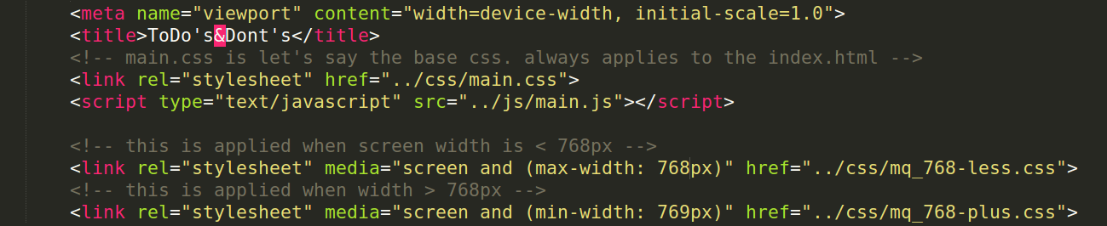
Media Queries
Width > 768px, main.css and mq_768-plus.css are applied
Width is <= 768px, main.css and mq_768-less.css are appied

Slide 10
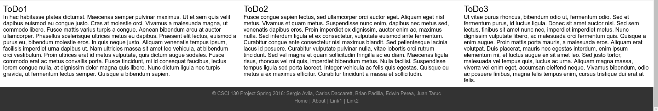
Below the fold
Some dummy content and on the footer is team member names.

